Slide 1



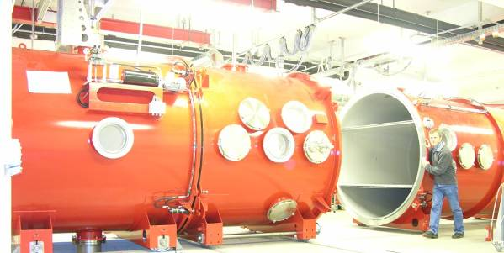
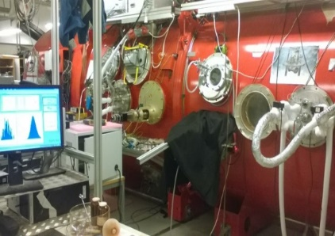
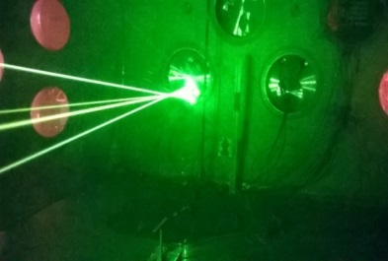
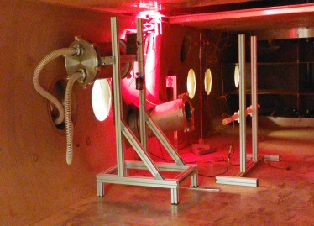
Laboratory study of dust resuspension mechanisms in the Martian Environment
Andebo Waza, Keld Rasmussen, Jens Jacob Iversen, and Jon Merrison
The EGU General Assembly 2022, Vienna, Austria, 23–27 May 2022

Slide 2

Objective
Knowledge of the physical condition that govern aeolian processes on Mars is very important to our understanding of the present environment of the planet as well as its geological history.
The main objective of this project is: to provide physical properties of airborne Martian dust particles based on the best possible Martian simulants and based on state-of-the-art laboratory simulations of relevant dust suspension mechanisms

Slide 3
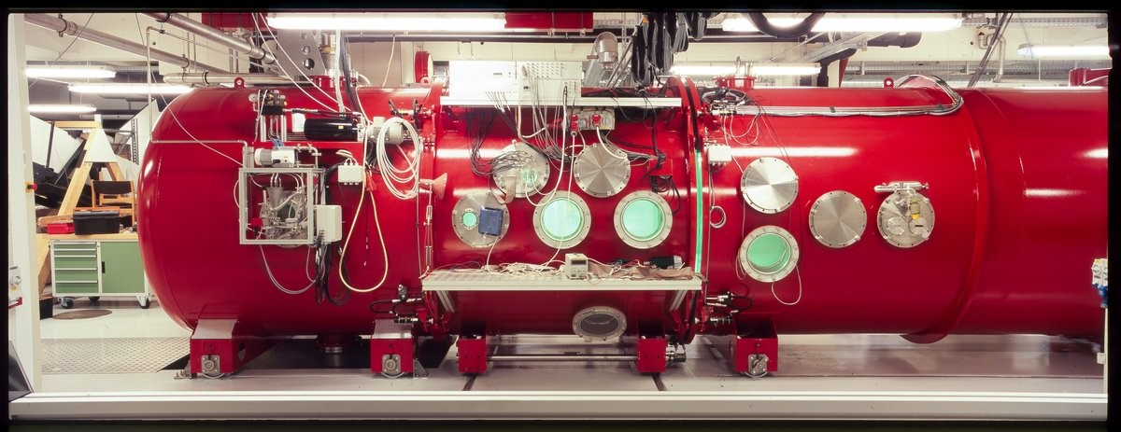
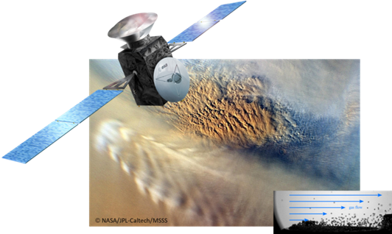
Design and operation of the experiment
The AU wind tunnel facility
The simulator consists of a 38m³ environmental (thermal-vacuum) chamber within which a re-circulating wind tunnel is housed

Slide 4

Digital microscopy and optical reflectance for dust removal estimation
Quantifying dust removal: By measuring the optical coverage (pixel intensity) by using webcam, dust removal has been quantified (…by determining some parameters from the optical measurement…)
Laser Doppler Velocimetry and optical opacity measurement for determining the concentration of dust particles
Three Mars Analogue dust
(Martian dust analogues from left to right: JSC-1, MMS-2 and MGS-1)

Slide 5
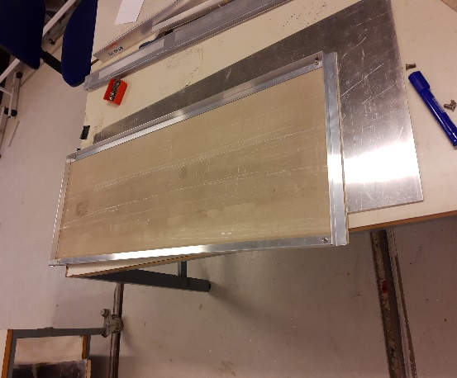
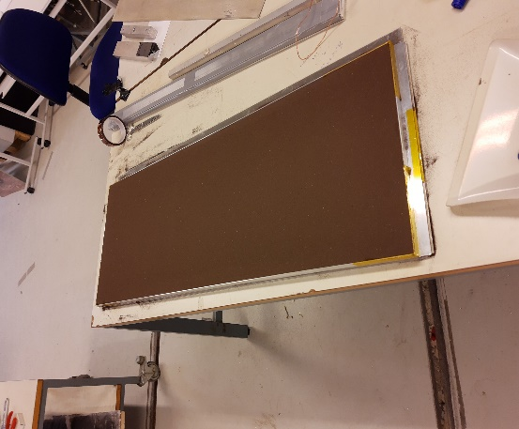
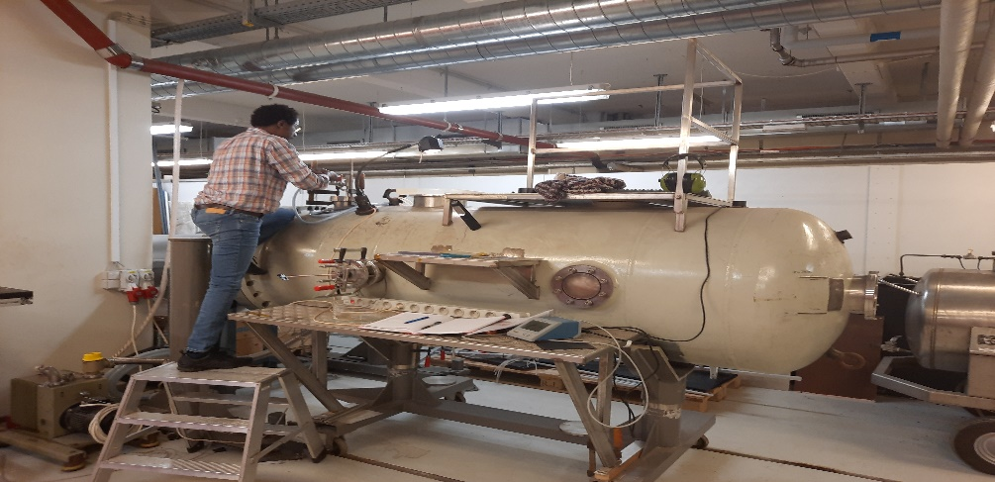
Schematic of dust resuspension experiments
1.Prepare Sand bed.
Glued bed (left) or loose sand (right)
2.Deposit dust from suspension in the smaller AWTSI chamber (at low wind speed)

Slide 6

3.Place the dust-covered sand bed into the larger AWTSII chamber for wind exposure and dust resuspension

Slide 7
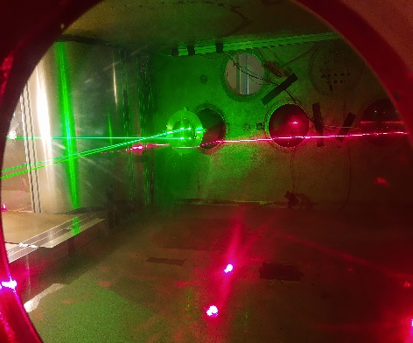
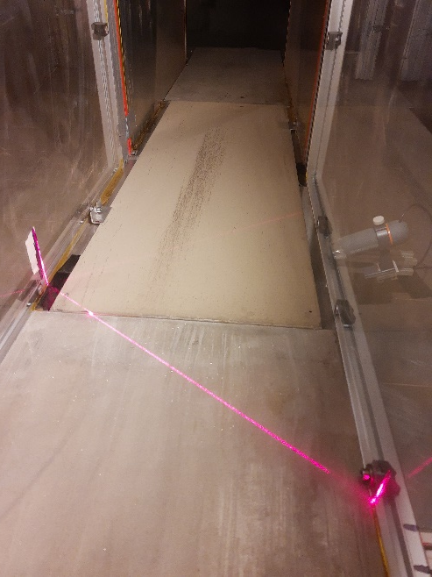
Downwind: study dust properties and settling velocity/rates
(using LDV and Opacity sensors)
Upwind: Resuspended the deposited dust and study removal rates / threshold
(using microscopes and a laser sheet)

Slide 8
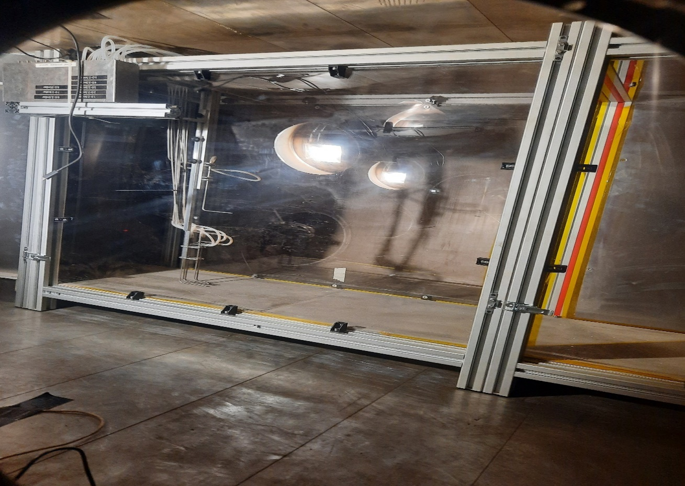
A Pitot tube is installed within the up-wind section of AWTSII
(for measuring the wind speed (friction velocity))

Slide 9
Calibration of friction velocity (U*) from Pitot tube measurements

Slide 10
Analysis and some of the preliminary results
Different Aeolian mechanisms of dust resuspension at low pressure (Martian condition)
Mass removal
Dust flux, Threshold

Slide 13
Preliminary results

Slide 14
Results so far?
From the first experiments, important advancements in our knowledge about different dust resuspension mechanisms have already been made
The threshold and flux of dust has been measured for the first time under Martian conditions using different Aeolian mechanisms: saltation-induced dust resuspension, direct wind driven dust resuspension, and abrasion-induced dust flux
          Direct Aeolian Dust flux (U*=2.1m/s) = 0.26 mg/m2/s
          Saltation induced Dust flux (U*=2.1-2.7m/s) = 74 mg/m2/s
          Abrasion (Saltation) dust flux (U*=2.7m/s) ~ 350 mg/m2/s
Next steps? The work continues with Mars analogue dusts…

Slide 15
Acknowledgements
This project has received funding from the European Union’s Horizon 2020 research and innovation programme under grant agreement No 101004052. These studies are part of an international EU supported research project called ROADMAP (ROle and impAct of Dust and clouds in the Martian AtmosPhere; https://roadmap.aeronomie.be/).
The laboratory is a member of Europlanet 2024 RI which has received funding from the European Union's Horizon 2020 research and innovation programme under grant agreement No 871149.

Slide 16
Thank you for your attention!
For questions: andebo.waza@phys.au.dk

