Slide 1
Variable flood wave shapes and their influence on dike safety
Teun van Woerkom (Utrecht University)
Mark van der Krogt
Marc Bierkens

Slide 2
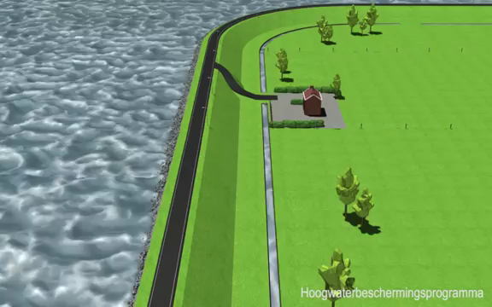
Dike slope stability

Slide 3
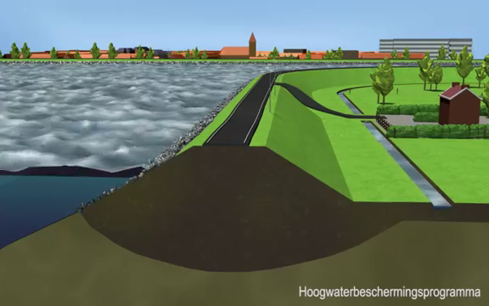
Sources of uncertainty

Slide 4
Sources of uncertainty
Material properties
Groundwater pressure heads
Cohesion?
Friction angle?
Unit weight?

Slide 5
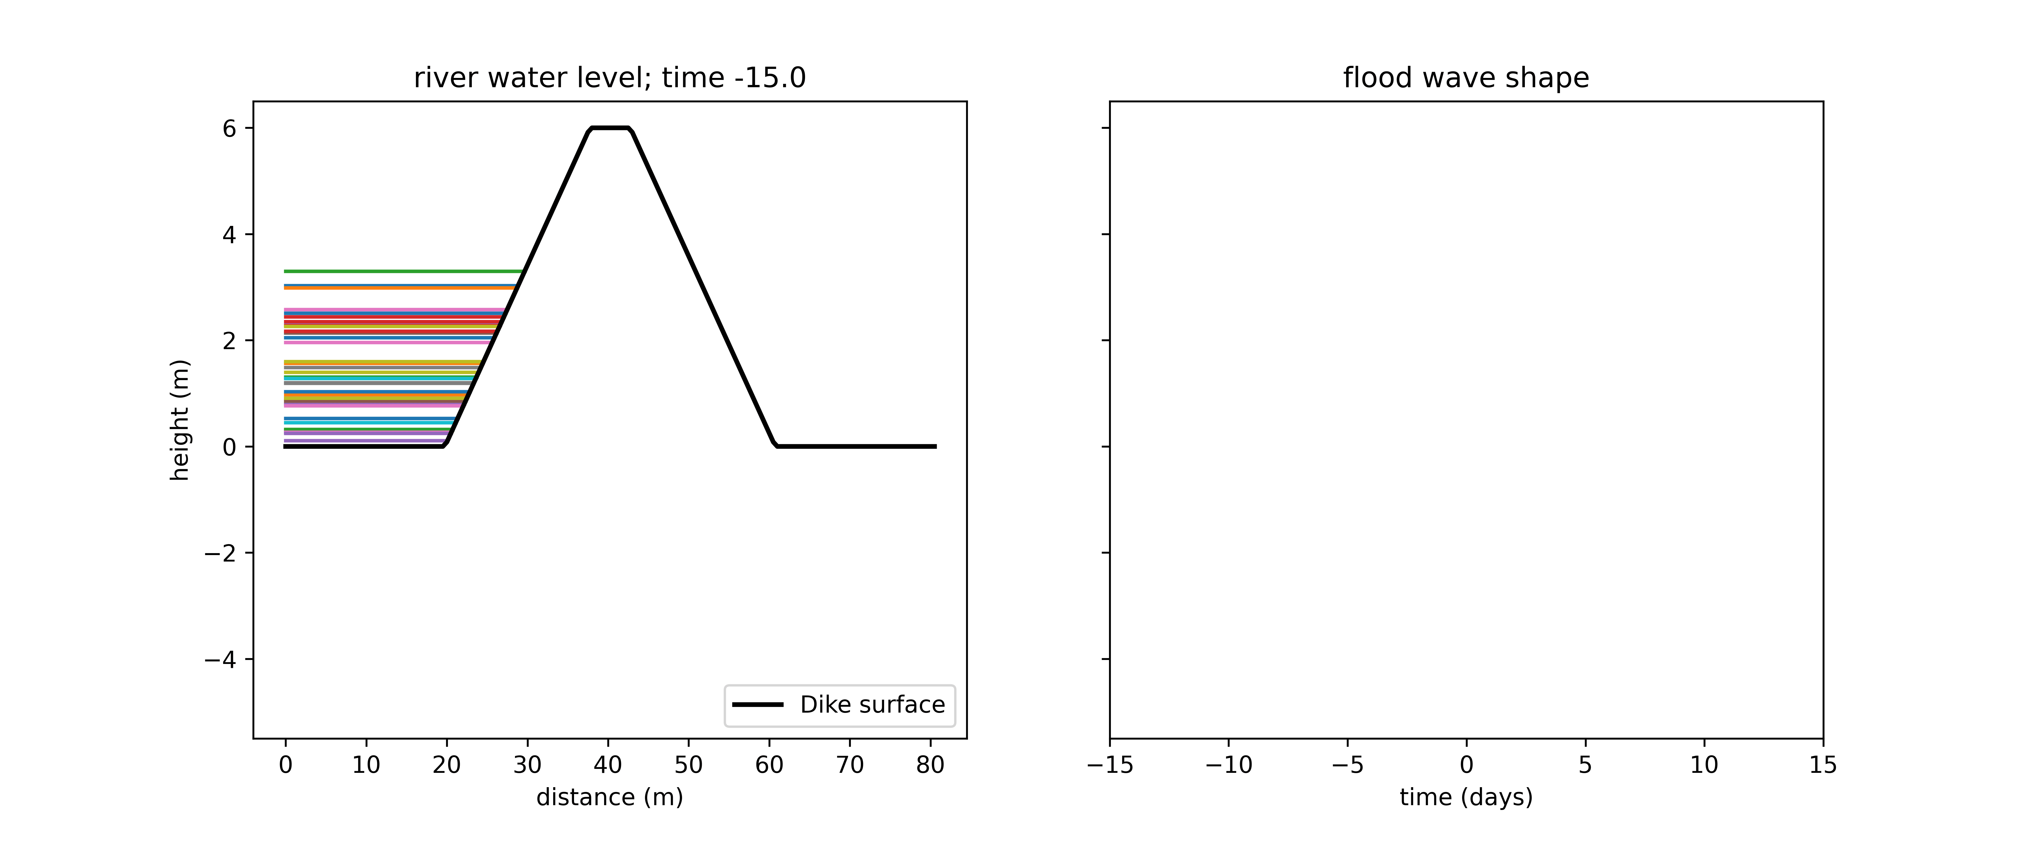
Incorporation of uncertainties for dike safety
Material properties influenced by material type
Groundwater levels influenced by flood wave shape
Groundwater model and stability model including uncertain material properties (Eurocode 7).
sand
clay

Slide 6
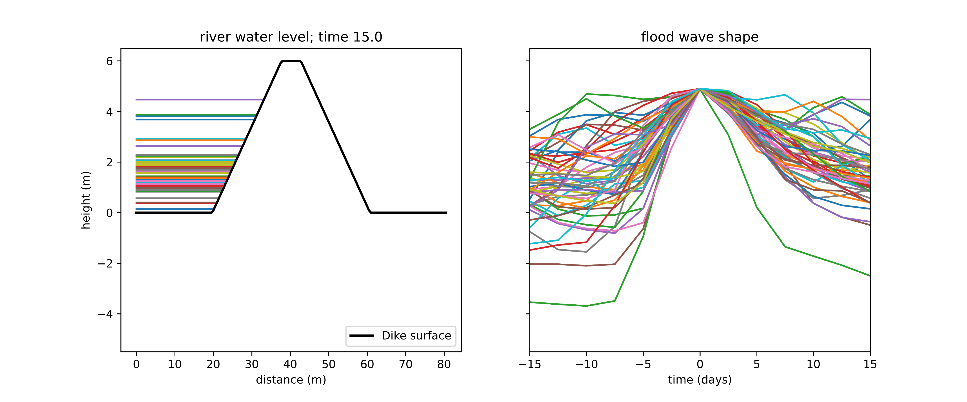
Research questions related to these uncertainties
How important is the variable flood wave shape?
What are the implications of doing a temporal risk analysis?
sand
clay

Slide 7
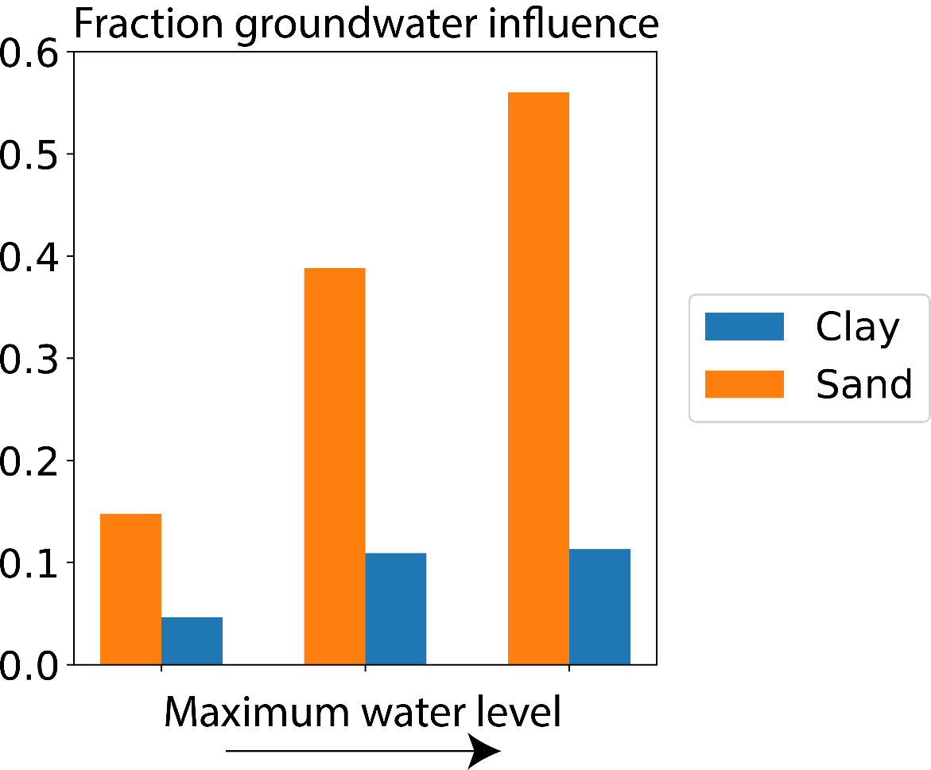
Relative groundwater importance
Influence groundwater uncertainty increases with increasing water level
Uncertainty of groundwater from variable flood wave shapes equally important as uncertainty in material properties

Slide 8
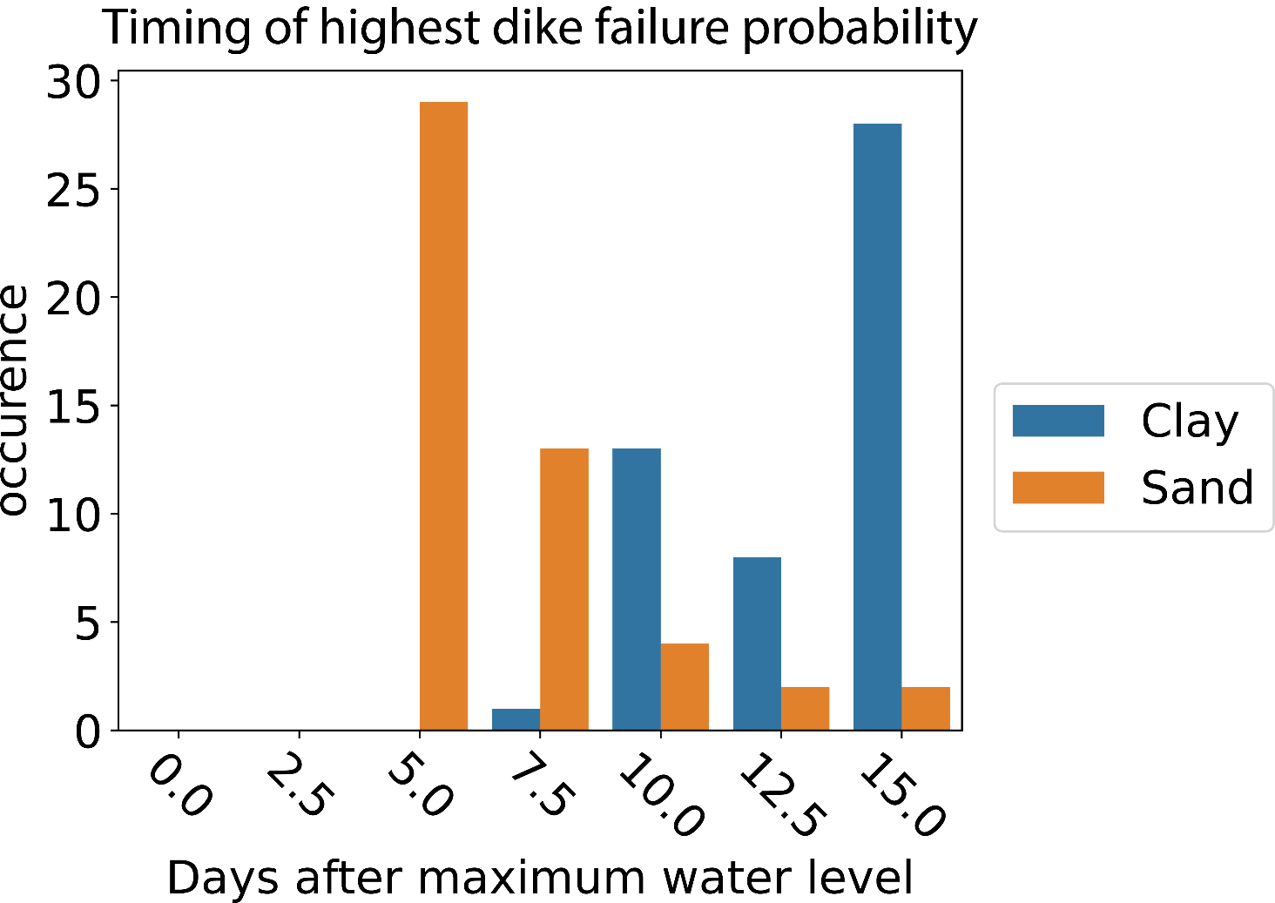
Temporal effects
Failure always happens after highest water level
As river water levels are already lower, there is a smaller chance of flooding

Slide 9
Conclusion
Pressure heads have a large influence on dike safety
Variable flood wave shapes result in variable pressure heads
Dike slope instability mostly occurs after peak water levels

Slide 10
What’s next?
Finishing this PhD at Utrecht University in September 2022
Applications on hazard risk management or groundwater problems are welcome!
Teun van Woerkom
t.a.a.vanwoerkom@uu.nl

