Slide 1
Downward COUNTERFACTUAL insights into weather extremes
Dr. Gordon Woo
23rd May 2022

Slide 2
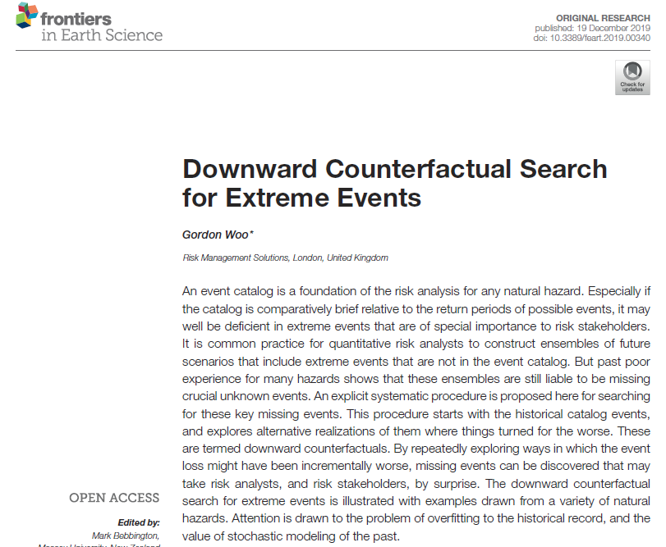
The vocabulary
of downward
counterfactuals
is ideal to describe
potential worse outcomes of historical events – such as might be associated with future climate change.

Slide 3
Scenario loss variability
Fortunate
historical
hazard
and loss
Small
Catastrophic
Outcome
bias may
set in.
Large

Slide 4
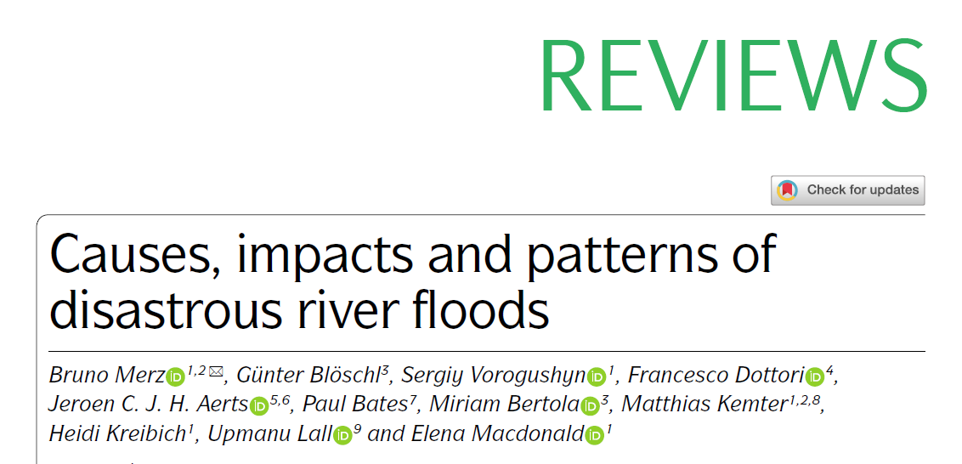
For instance, when exploring the possibility space of future floods, biases of wishful thinking should be avoided by purposefully constructing downward counterfactuals.
These scenarios can be constructed by starting from historical floods
and exploring alternative realizations in which things turn out worse.
Nature Reviews | Earth & Environment 2021

Slide 5
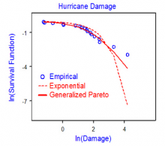
Statistical extreme value analysis
Statistical analysis of loss data
is very sensitive to the largest losses
in the historical database.
The duration of the historical database may be comparatively short, and the tail of the loss curve may include few major loss events.

Slide 6
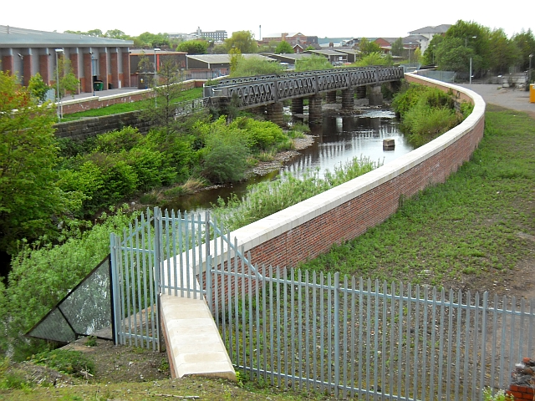
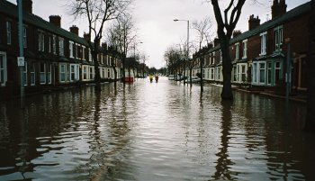
December 2015 Carlisle floods, UK
What was the chance
of rainfall causing the river
defences to be overtopped?
The Carlisle flood alleviation scheme was completed in 2010.

Slide 7
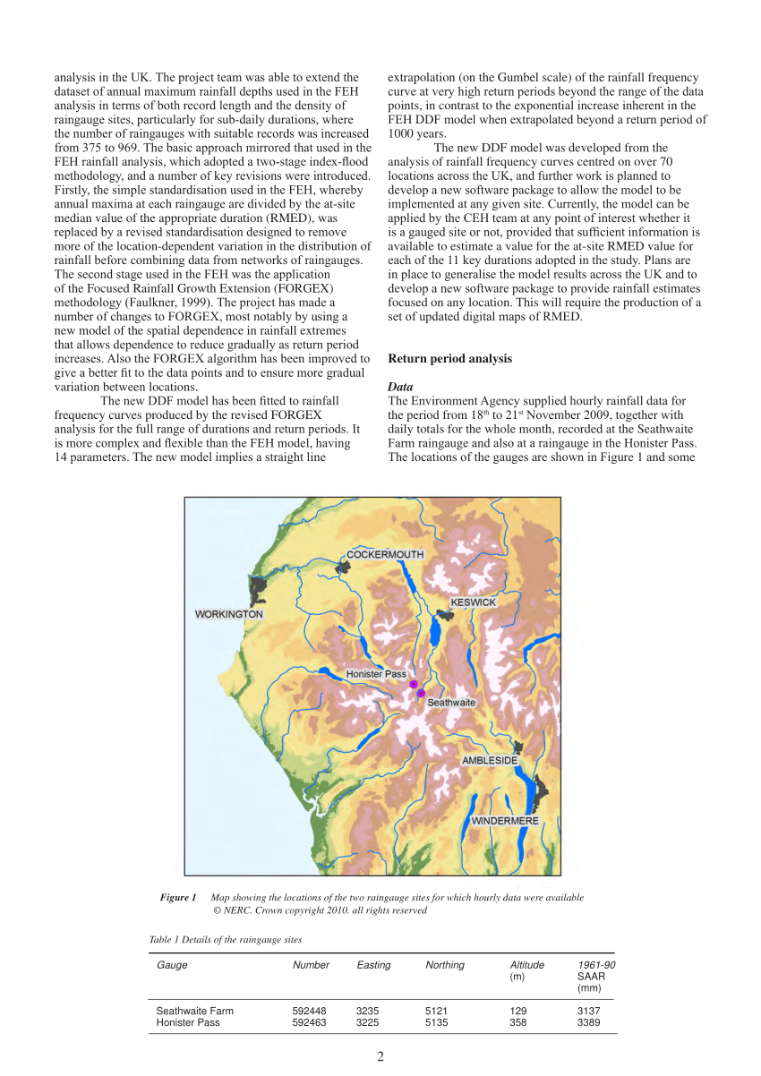
Reliability of extreme return periods
Flood Date | 24-hr Rainfall (mm) | Return Period (yrs)
20/11/09 | 301.4 | 400
05/12/15 | 341.4 | 1300
This extreme rainfall analysis was based on the comparatively brief time series of rainfall gauge measurements since 1970.
Honister Pass
In 2009, there was a moderate El Niňo.
But in 2015 there was a very strong El Niňo.
Stewart et al., 2010

Slide 8
Downward counterfactual thought experiment
Consider a historical system state S[0] that led to
a major economic loss of L.
Construct an alternative system state S[k] that would
have led to a major economic loss of L + k* Δ*L,
where Δ = 10% , and k = 1.
Repeat for ever increasing integer values of k = 1, 2,….n

Slide 9


