Slide 1
NOAA's Unified Forecast System Research to Operations (UFS-R2O) Project for accelerated transition of UFS based forecast applications into operations
Vijay Tallapragada*, Jim Kinter⁺, and Jeff Whitaker^
*Chief, Modeling & Data Assimilation Branch, NOAA/NWS/NCEP/EMC
⁺_{COLA, GMU;} ^_{NOAA/OAR/PSL}
AS1.1: EGU General Assembly 2022, Vienna, Austria, 23 May 2022, EGU22-3101

Slide 2
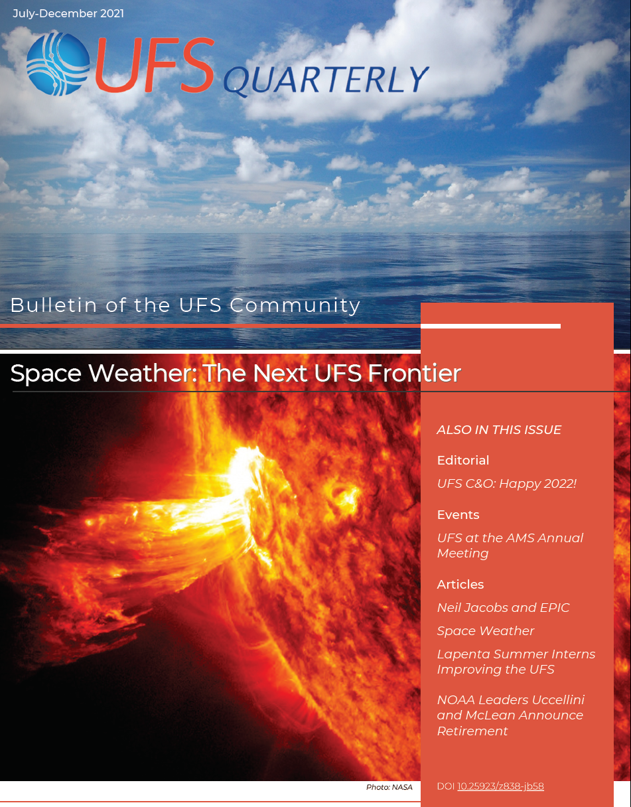

Unified Forecast System
Unified Forecast System: UFSCommunity.org
Unify research and operational forecast applications into streamlined code-base
Open-development, documented, community codes
Atmos. Dynamical core (FV3) - NASA-GEOS, NCAR
Ocean (MOM6) - NCAR, NASA-GEOS
Data assimilation (JCSDA) - many partners
Common Infrastructure based on MoA with NCAR
Public UFS model releases
Medium-Range global operational forecast system (2020)
Short-range regional development forecast system (2021)
Earth Prediction Innovation Center (EPIC) catalyzes the community strategy by making UFS more accessible and user-friendly

Slide 3
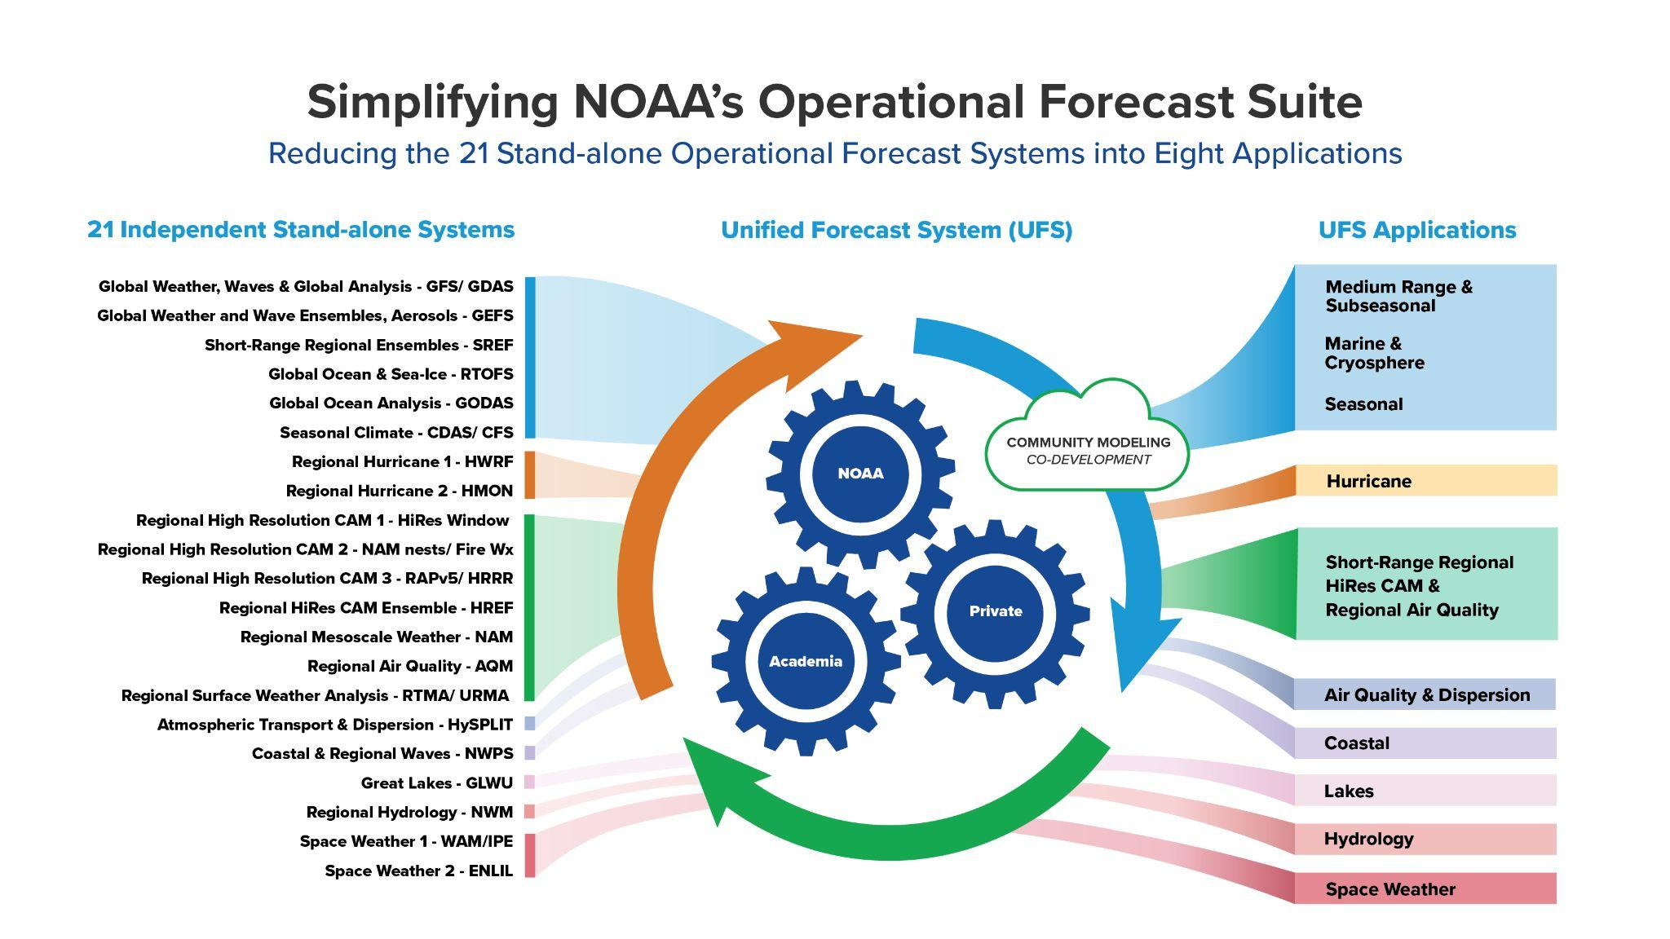
UFS in NOAA Operations

Slide 4
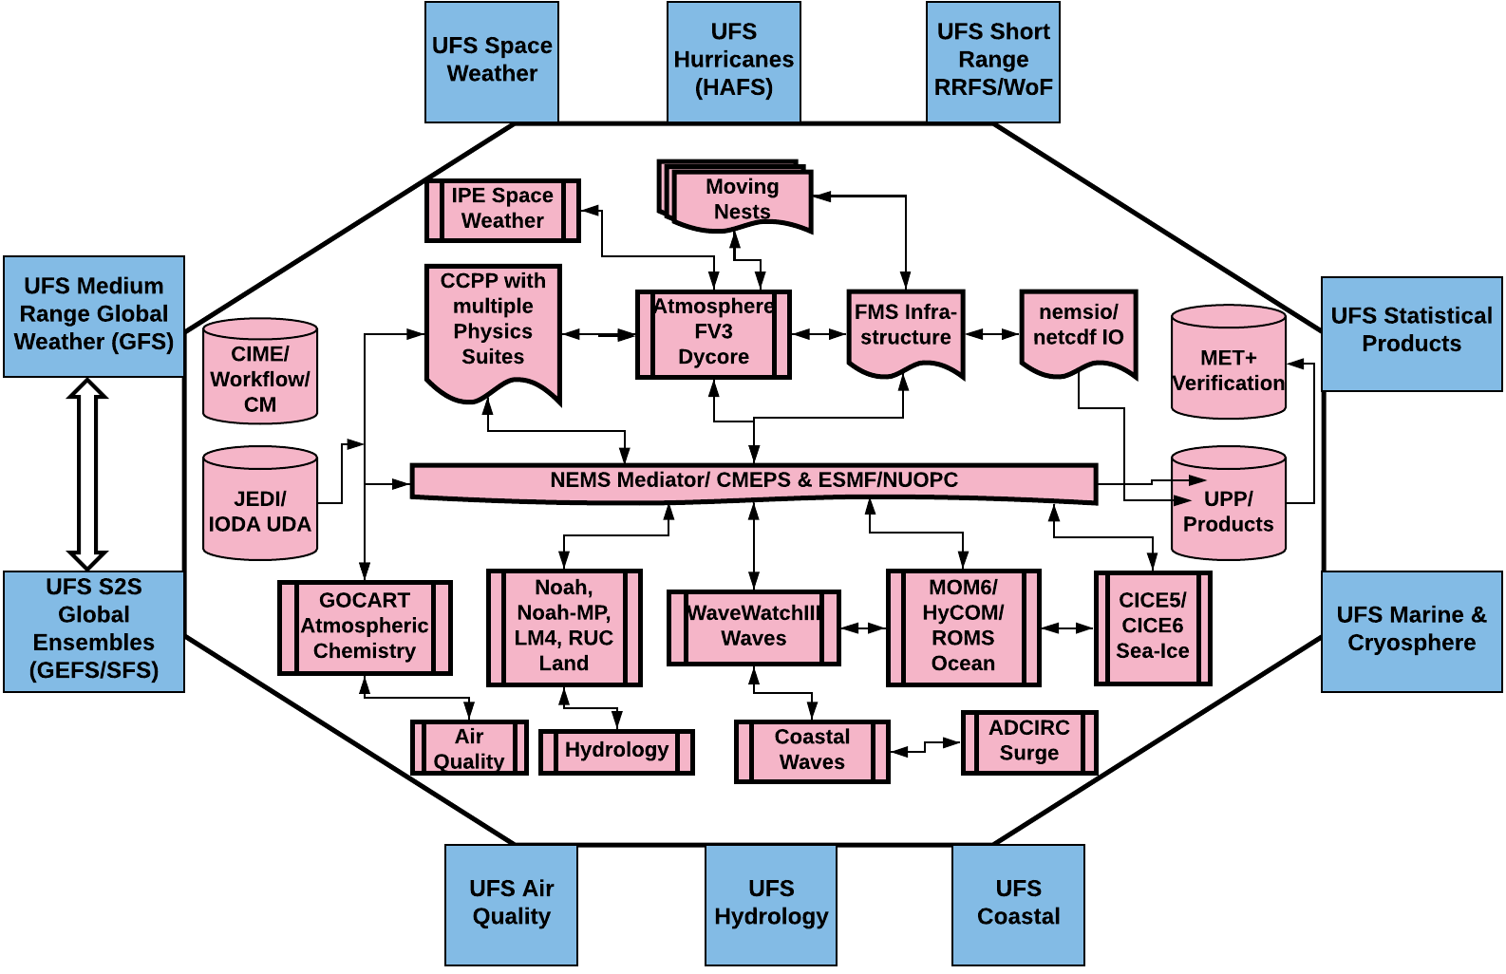

NPS Transitioning to UFS Applications
Conceptual UFS applications in production covering all NPS applications.
Components of UFS are configured to develop distinct applications while maintaining the dependencies between the applications and products

Slide 5
UFSR2O Project: A New Way of Doing Business!
An experiment to carry out R&D in a collaborative project within constraints imposed by operational imperatives and community research interests
Engagement within NOAA (NWS-OAR-NESDIS-NOS) and wider UFS community, with coordinated funding from both NWS & OAR.
Interested/engaged/willing participants from inside and outside NOAA under a single management framework
Project with a 5-year vision, first 2 years of deliverables defined.
Notes:
First, I think the most important thing about this project is that it really is an experiment testing a completely new way of conducting weather prediction research in NOAA. We are trying to see if we can do R&D in a collaborative way within the constraints of operations

Slide 6
The Wider UFS Context
EPIC
The UFS-R2O project is a subset of the UFS community that is funded by NOAA and focuses on the transfer of innovations into operations (lower part of the ”funnel”), but is engaged in some lower RL research to ensure the R2O pipeline is continuously fed.
Other lower readiness-level projects
UFS-R2O Project
UFS
Basic
Research
Other high readiness-level projects
Transition to Operations (EMC)
Operations
Operational forecast systems

Slide 7
Scientific Priorities
Motivated by forecast priorities collected from stakeholders/ testbeds and research priorities from the community
Reduce coupled model biases
Improve representation of key modes of variability (including MJO)
Optimally combine Earth system observations and model forecasts using an advanced data assimilation system to initialize coupled ensembles (land-ocean-sea ice-atmosphere-aerosols).
Develop a convection-allowing ensemble forecast capability for short-range prediction of severe weather, and hurricanes.
Improve quantification of model uncertainty in ensembles, especially near model component interfaces.

Slide 8
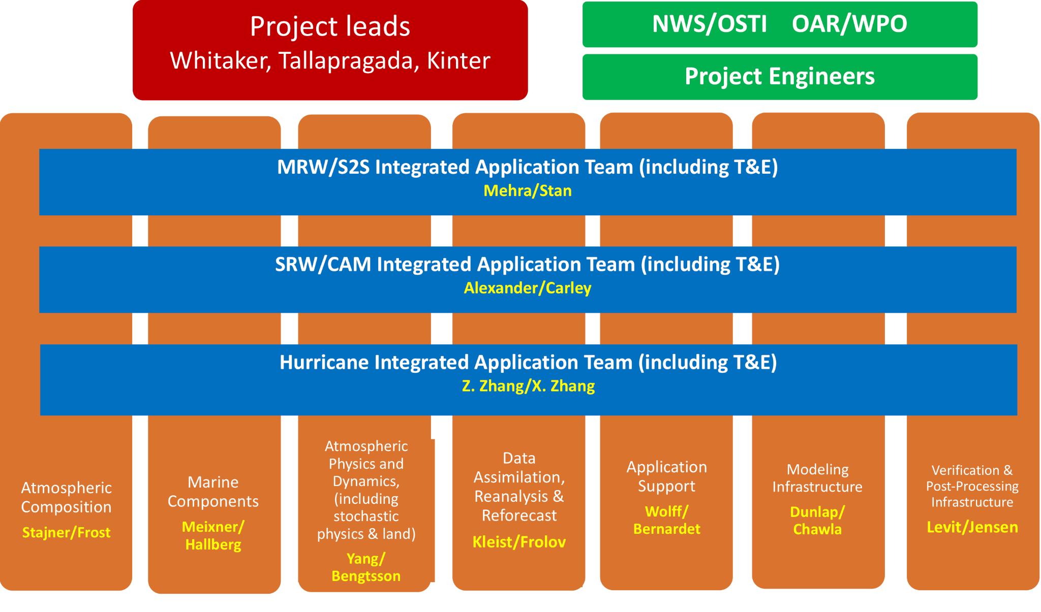
Project Structure
Notes:
“Sub-projects’ now “dev teams” that cross-cut all teams. App teams integrate the work done in “dev teams”, do T&E. New Hurricane App team replaces CCI app team. Better alignment with UFS working groups. Transition is taking place now.

Slide 9
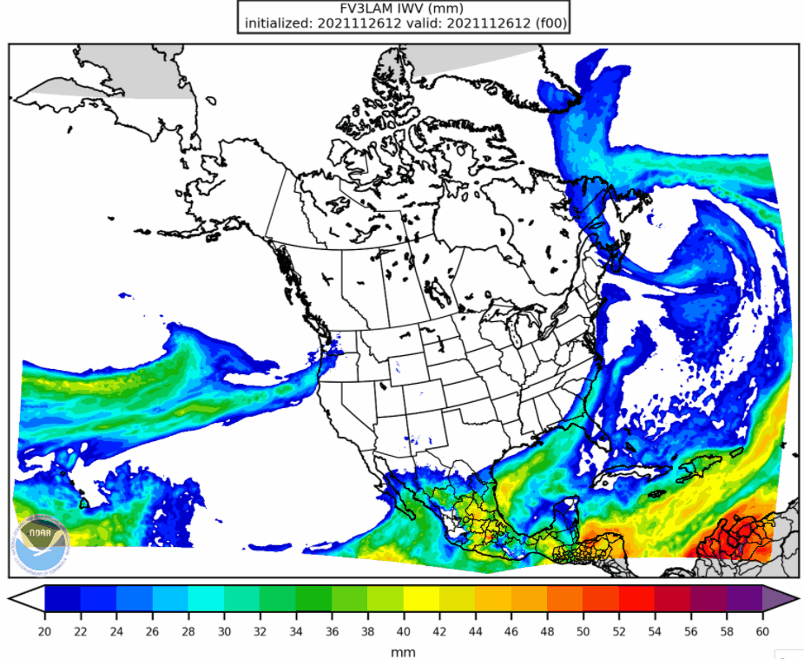
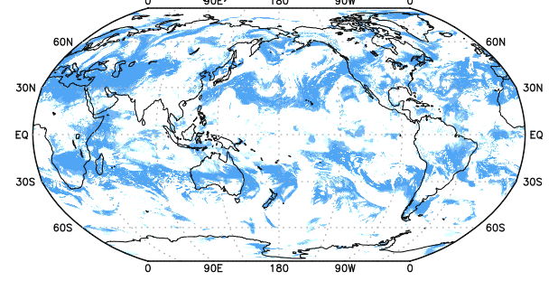
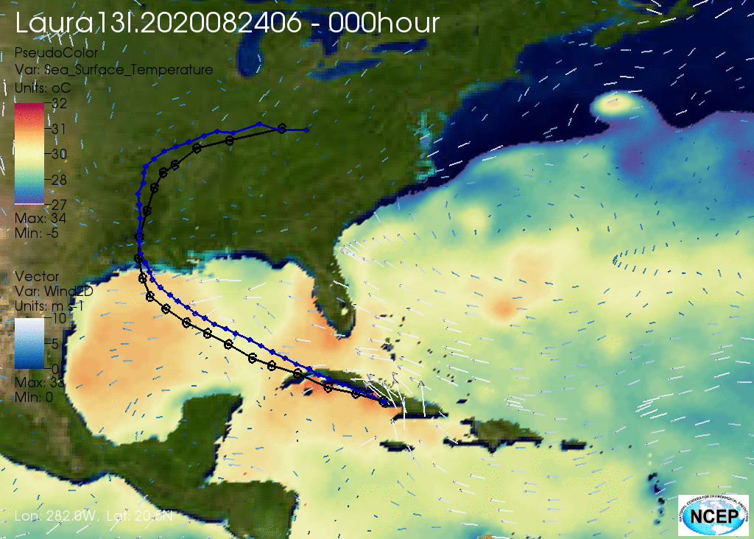

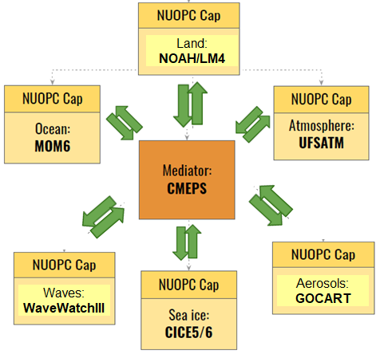
UFS-R2O Project Recent Accomplishments
Six-way coupled System for Medium Range, Sub-Seasonal and Seasonal Predictions
Rapid Refresh Forecast System (Cloud Resolving Short-Range Weather)
Hurricane Analysis and Forecast System (Cloud Resolving atmosphere-ocean-wave coupled system with storm following moving nests)

Slide 10
Concluding remarks
UFS-R2O Project is a major driving force for coordinating model development across multiple operational applications in collaboration with community partners
Making good progress towards developing a fully coupled earth system modeling with coupled data assimilation
Supporting accelerated development of MRW/S2S; SRW/CAM and Hurricane Applications
Some challenges still remain. Looking for expanding the collaborations across national, international, public, private and academic sectors
Thanks for your attention. Questions?

