Slide 1


Towards a calibration of the HYDRUS-1D model on a wheat crop in the semi-arid conditions of Haouz region
Aicha Moumni¹, Abderrahman Lahrouni¹
¹ Faculty of Sciences Semlalia, Cadi Ayyad University, Marrakesh, Morocco
ach.moumni@gmail.com

Slide 2
Introduction
Water is a vital element and plays an important role in all sectors, especially in agriculture;
Agriculture is the largest consumer of water in all regions of the world;
Due to the water shortage and poor management of limited water resources in semi-arid region, the improvement of irrigation efficiency became crucial.
In this context, the objective of this work is to estimate water content and evapotranspiration using the HYDRUS-1D model.

Slide 3
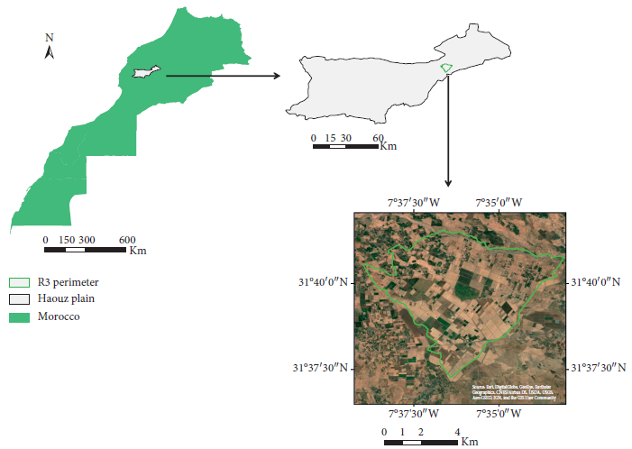
Materials and methods
Study area
Located in the haouz plain
An irrigated perimeter
Used mainly for cereal production
Mediterranean semi arid climate
Average precipetation of 250 mm per year

Slide 4
Materials and methods
Experimental data
Climatic data
Soil data
Temperature
Precipitation
Humidity of the air
Global radation
Experimental data
Soil moisture
Plant data
Water and energy flux
LAI
Canopy fraction Fc
NDVI
Temperature of vegetation
Data that concerns the local agricultural practice.

Slide 5
Materials and methods
Methodology
Hydrus-1D
model
Inverse method calibration
Manual calibration

Slide 6
Results and Discussion
Inverse method calibration
θs input | R² | θs ouput
0,38048 | 0,47418 | 0,51939
0,42804 | 0,48072 | 0,40161
0,4756 | 0,4688 | 0,55678
0,5232 | 0,47371 | 0,43352
0,57072 | 0,46381 | 0,45572
The inverse method, in the conditions of our experiment did not give satisfactory results
It is difficult to detect the source of error
to make an improvement.
We then proceeded to manual calibration

Slide 7
Results and Discussion
Manual calibration
+
The model overestimates soil moisture,
Underestimates actual evapotranspiration
1
2
The improvement could be made on root extraction or LAI, which could in principle improve the prediction accuracy of Soil moisture and ET

Slide 8
Conclusion and Perspectives
In the present work, the HYDRUS-1D model was tested, for the first time, over an area of Haouz plain in central Morocco.
Our objective was to investigate several methods for calibrating the HYDRUS-1D model. Several scenarios were analyzed for this purpose.
It was found that the best predictions are possible when the heterogeneity of the soil layers is taken into account.
The obtained results are not yet final. The model needs to be tested sufficiently over a wide spatio-temporal range.
The HYDRUS-1D model is widely used in different regions of the world and the extensive literature reports a good score on the consistency and robustness of the model.
Thus we are convinced that, overall, HYDRUS-1D seems to be an adequate model to estimate with acceptable accuracy the water content and the real ET under semi-arid conditions.
Therefore, it is also a promising tool for planning and decision support in the field of water and agro-environmental research.

Slide 9
References
Er-raki Salah, Estimation Des Besoins En Eau Des Cultures Dans La Region De Tensift AlHouaz: Modelisation, Expérimentation Et Télédétection. Thèse De Doctorat Nationale à l’université Cadi Ayyad-Marrakech, Maroc 2007 (p 30-34).
Hadria Rachid, Adaptation et spatialisation du modèle de cultures stics pour la gestion d’un périmètre céréalier irrigué en milieu semi –aride: Thèse De Doctorat Nationale à l’universite Cadi Ayyad-Marrakech, Maroc 2006 (p25-26, 39-40).
Šimůnek, and van Genuchten, Estimating unsaturated soil hydraulic properties from tension disc infiltrometer data by numerical inversion. Water Resour. Res. 9:2683–2696, 1996.
Šimůnek, Kodešová, Gribb, and van Genuchten, Estimating hysteresis in the soil water retention function from modified cone penetrometer test, Water Resour. Res., 35(5), 1329-1345, 1999.
Šimůnek. Šejna, Saito , Sakai, and van Genuchten, The HYDRUS-1D Software Package for Simulating the One-Dimensional Movement of Water, Heat, and Multiple Solutes in Variably-Saturated Media, CALIFORNIA 2012.

Slide 10
Thank you !

