Slide 1






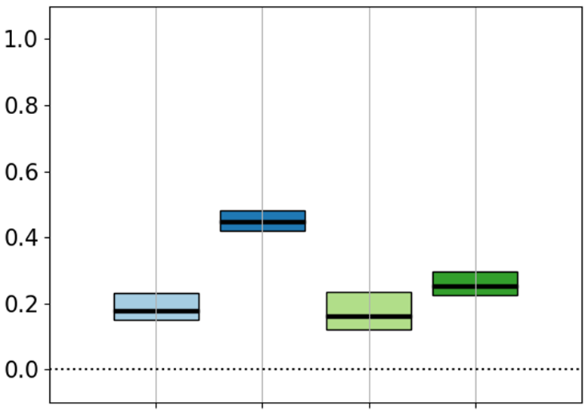







Linking the relative importance of input uncertainties of a flood risk model with basin characteristics
Sensitivity Index
latitude
longitude
Georgios Sarailidis¹, Francesca Pianosi¹, Thorsten Wagener²,
Rob Lamb^{4,5}, Kirsty Styles³, Stephen Hutchings³
Abstract:
OSPP contest:
1. Civil Engineering, University of Bristol, UK
2. Institute of Environmental Science and Geography, University of Potsdam, Germany
3. JBA Risk Management, UK
4. JBA Trust, UK
5. Lancaster Environment Centre, Lancaster University, UK
Grant No: EP/L016214/1

Slide 2
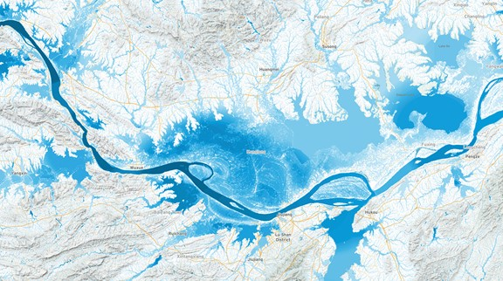

Past (catchment-scale) studies yield conflicting results as to which input uncertainties drive uncertainty in flood losses estimates
Flood Risk Modelling Chain:
Dominant Uncertainties:
Flood Events
Extreme Value Analysis
(Return Period of events)
Sampson et al., (2016)
Hazard Maps
Exposure Portfolio
Merz & Thieken (2009)
Inundation Modelling
Buildings Total Insured Value, locations
De Moel & Aerts (2011)
Apel et al., (2004)
Vulnerability Curves
Apel et al., (2008)
Scales of past studies:
< 100 km²
Winter et al. (2018)
Damage
> 100 km² & <1000 km²
Flood Depth
Saint-Geours et al., (2015)
> 1000 km²
Flood losses
(e.g. Average Annual Loss)
Notes:
Possible reasons for these conflicting results: studies use different methods and data
Or dominant uncertainties really change from place to place

Slide 3

We investigate dominant uncertainties in a larger domain that includes more variability of physical and socio-economic characteristics
Objectives:
Rhine River basin
Identify spatial patterns of dominant input factors
Link them (if possible?) to physical and other characteristics of places
Scales of past studies:
< 100 km²
> 100 km² & <1000 km²
> 1000 km²
Scale of new study:
> 100,000 km²

Slide 4
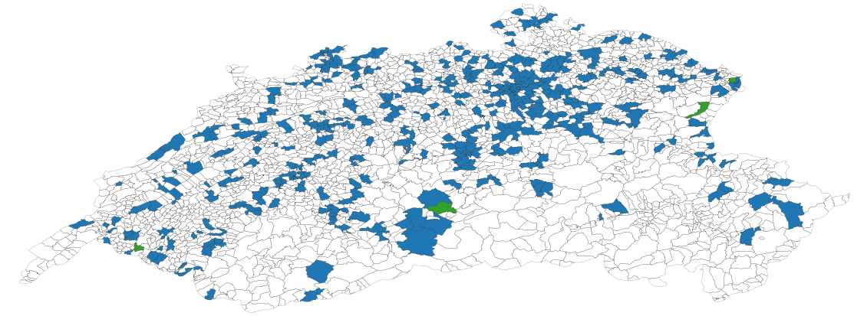
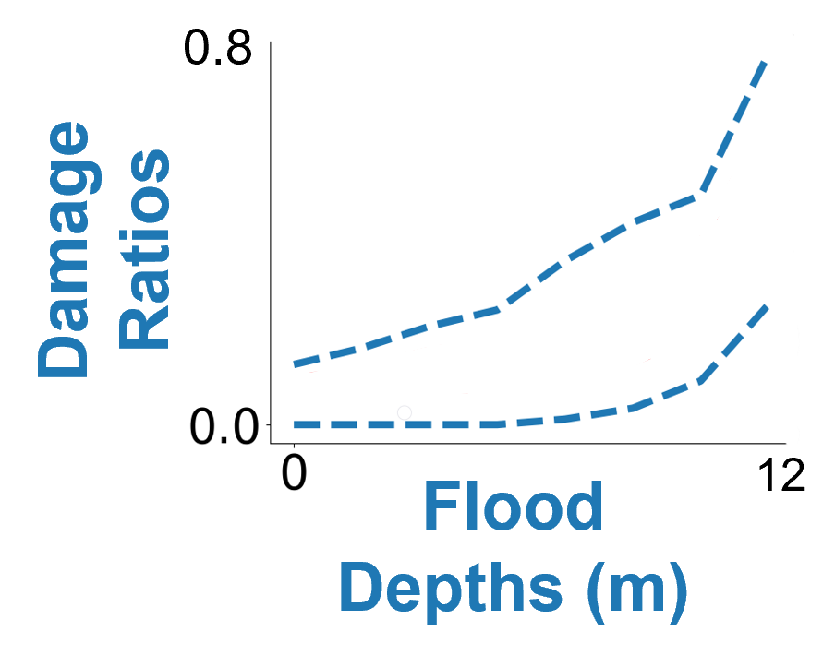
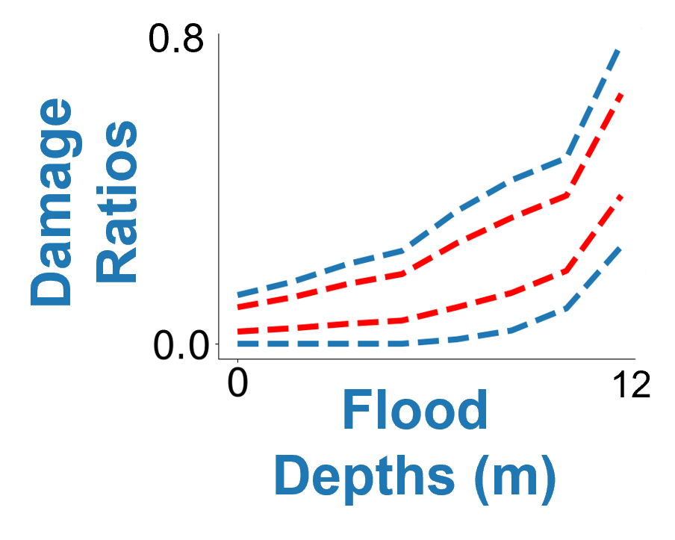
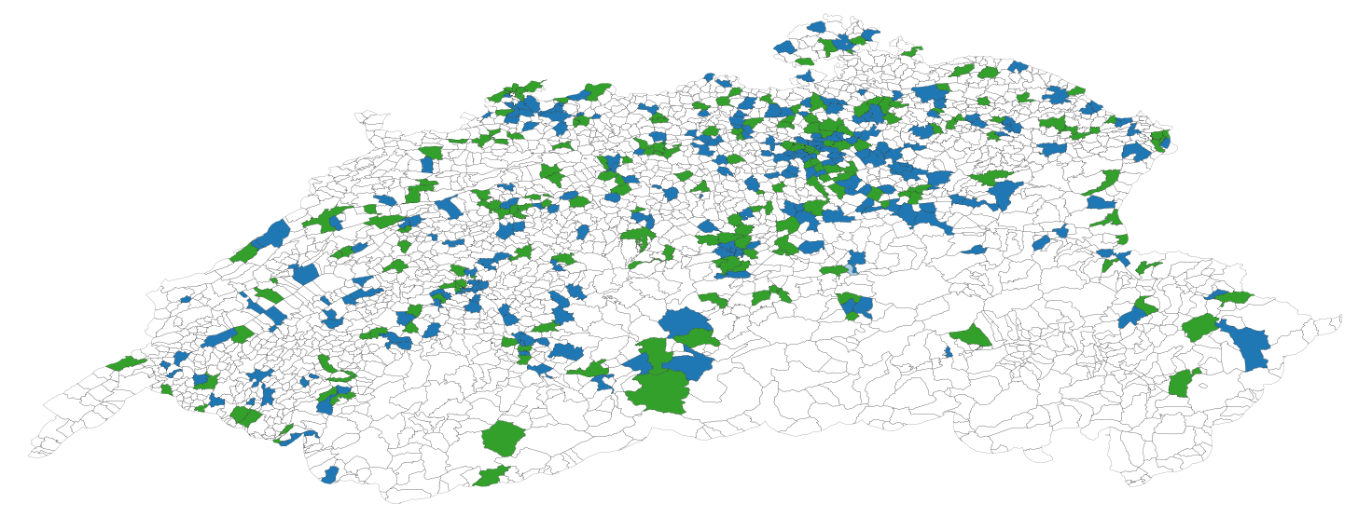
Preliminary results for Switzerland: Damage ratios uncertainty dominates unless its variability range is halved
Variability Ranges from Literature Review
Maps of Dominant uncertainties for Switzerland*
Total Insured Value
Damage Ratios
[55568, 112006] EUR
Flood
Events (RP)
Hazard Maps (RP)
50%
50%
default
default
-50%
-50%
*Cresta High Resolution Zones (postal code level), GFK data

Slide 5

Conclusions
We aim at identifying spatial patterns of dominant uncertainties using a flood risk model over a large and heterogeneous domain
We defined ranges of variability for hazard, vulnerability and exposure components from literature review
So far, we found damage assessment uncertainty to be dominant
Open questions
What is a meaningful way to represent input uncertainties?
What is a meaningful spatial resolution to best investigate the link between dominant uncertainties and physical & socio economic characteristics?
Thank you!
OSPP contest
Contact details:
Georgios Sarailidis
g.sarailidis@bristol.ac.uk
Grant No: EP/L016214/1
Abstract:

