Slide 1






Unraveling the landscape evolution of the Atacama Desert coast of Northern Chile through numerical models: the Pan de Azúcar National Park study case (~26°S).
Arróspide, C., Aguilar, G., Martinod, J., Rodríguez, M. P., and Regard, V.
ccamila.av@gmail.com

Slide 2
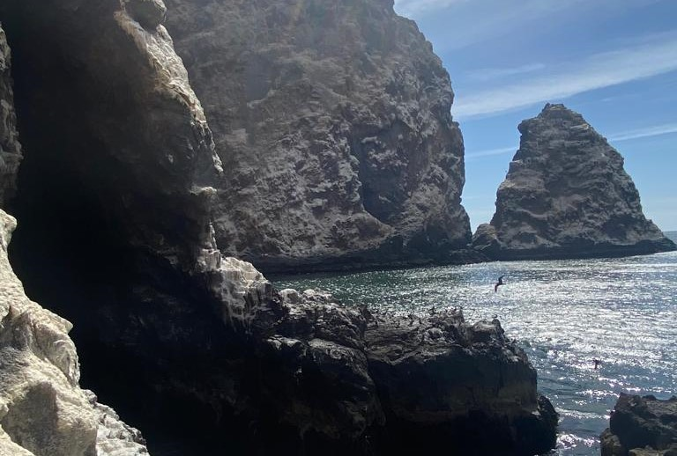
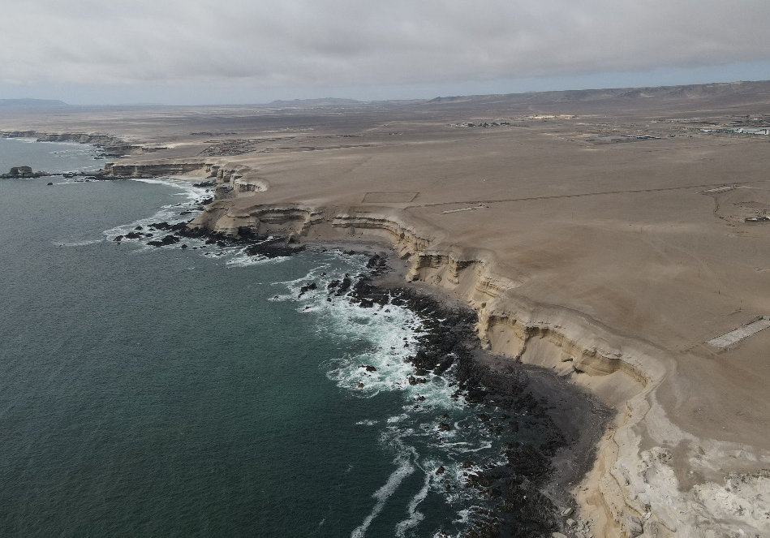
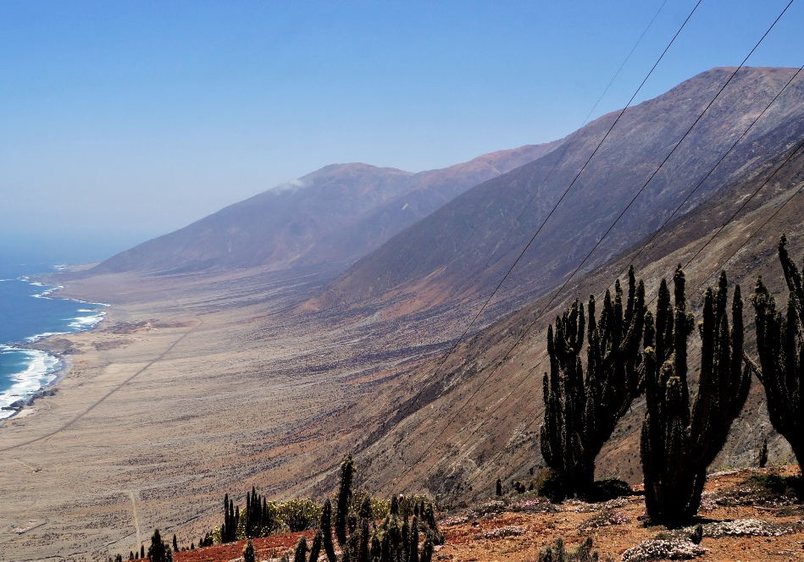
Active or “living” Cliff
Inactive or “dead” Cliff
Quebrada Vítor (~18.7°S)
Antofagasta (~23.5°S)
Paposo (~25°S)
Photo by A. Aránguiz
Photo by P. Rivera
Photo by Y. González
The Great Coastal Cliff of Northern Chile

Slide 3
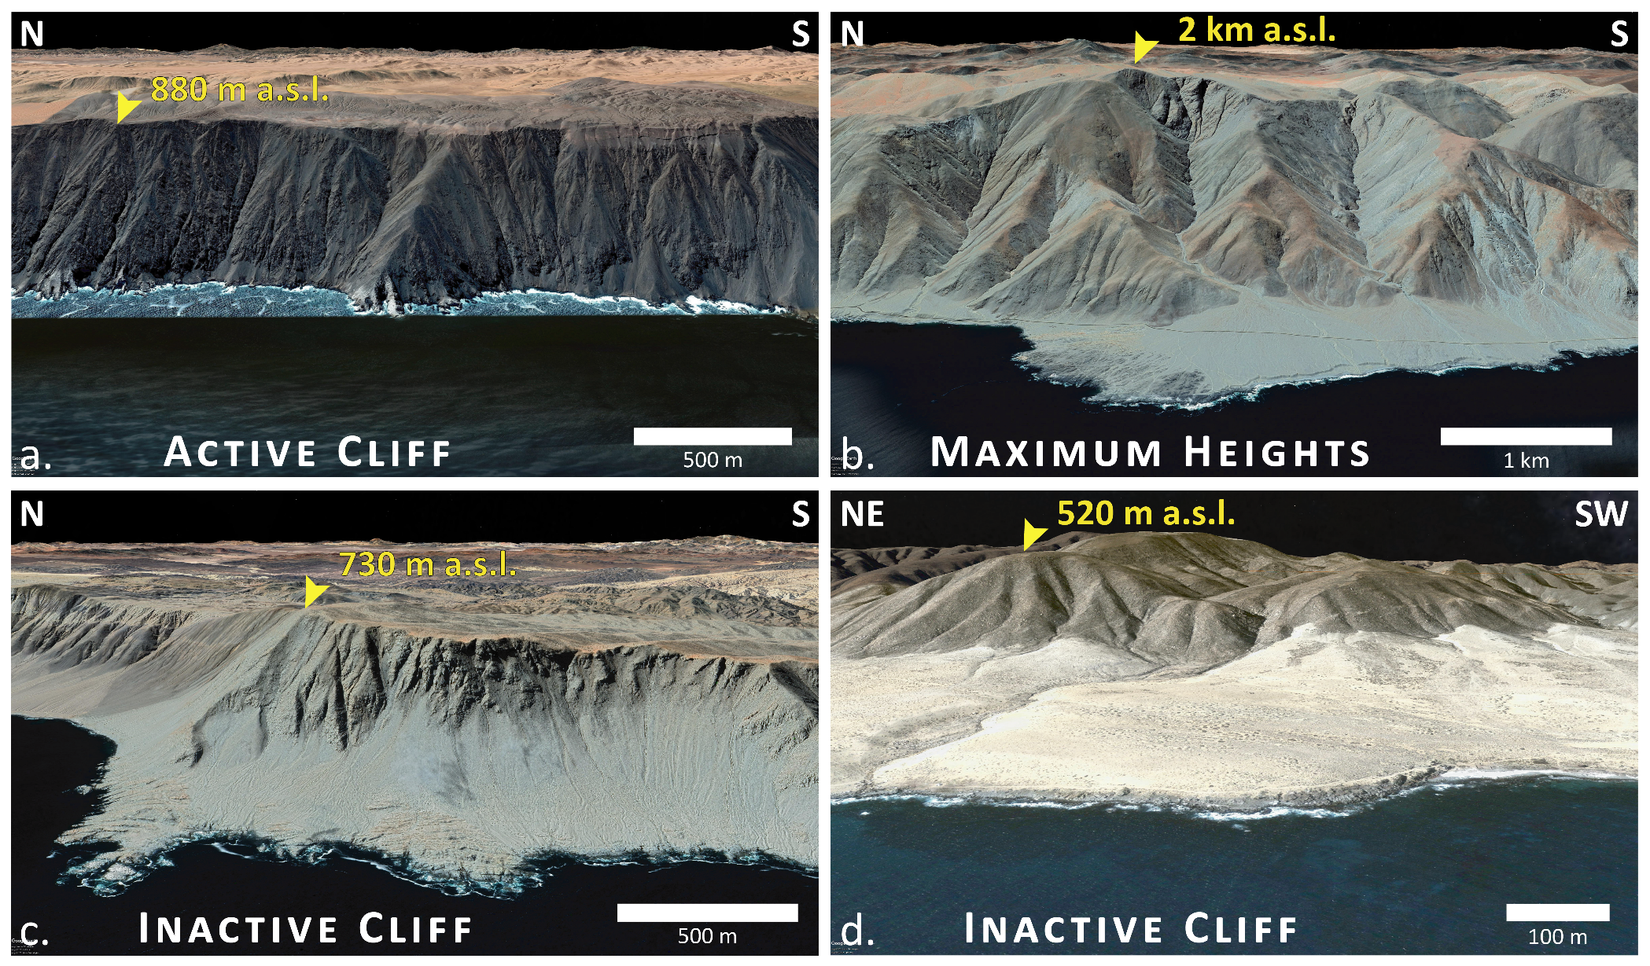
ALONGSHORE VARIATION BETWEEN ACTIVE AND INACTIVE CLIFFS
Arróspide et al. (in prep.)

Slide 4
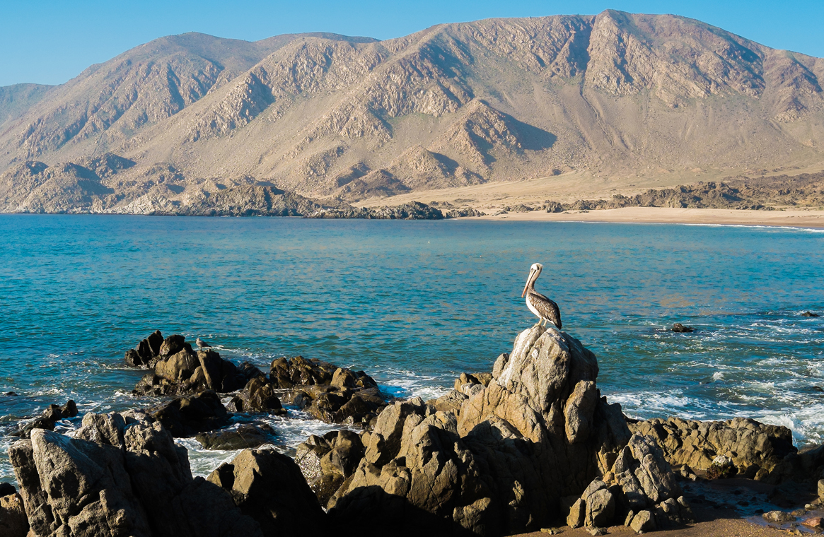
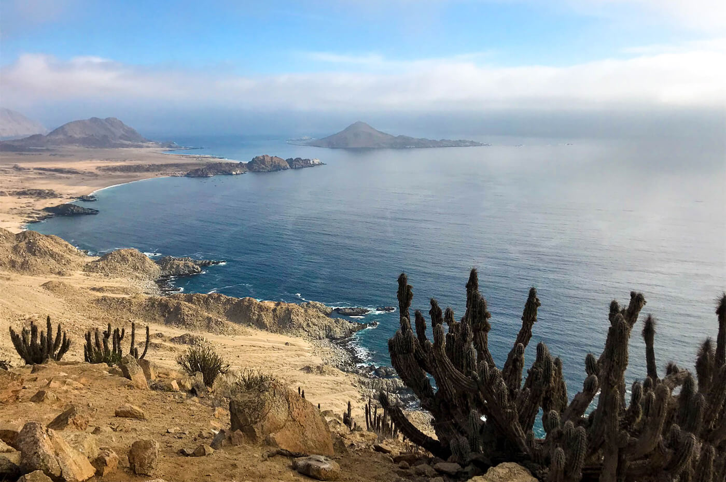
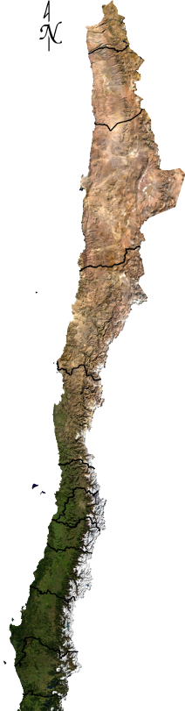

Pan de Azúcar National Park (~26°S)
CLIFF MORPHOLOGICAL VARIATIONS
EROSION
SLOPE; UPLIFT RATE; TIME

Slide 5
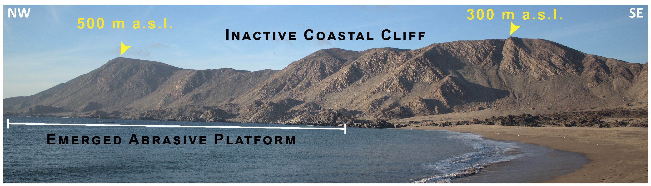
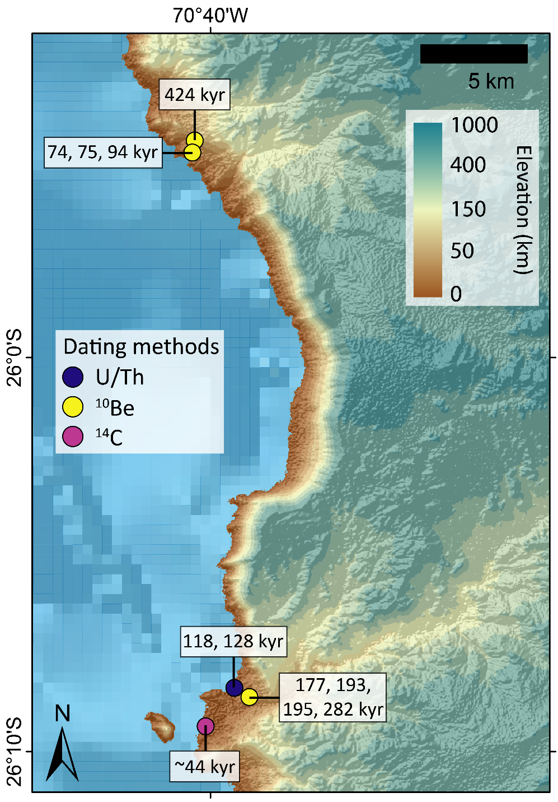
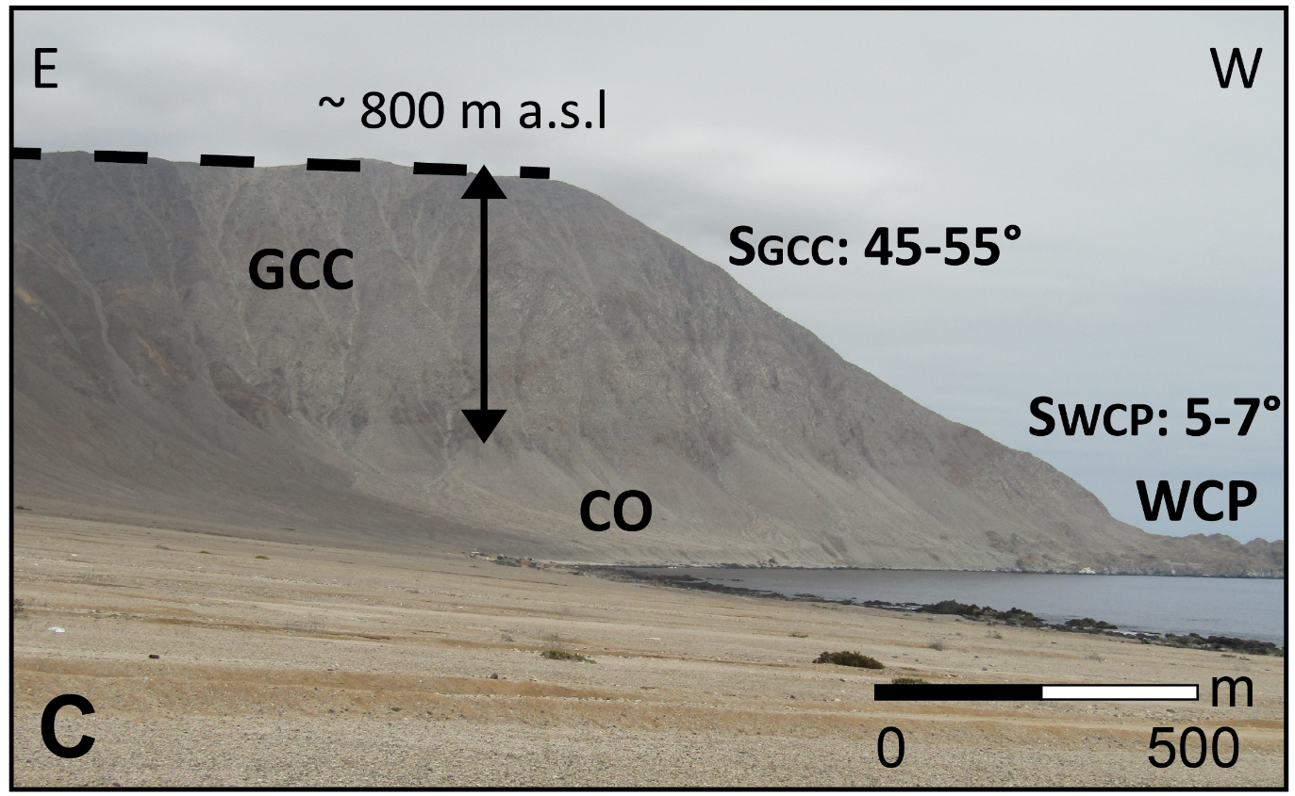
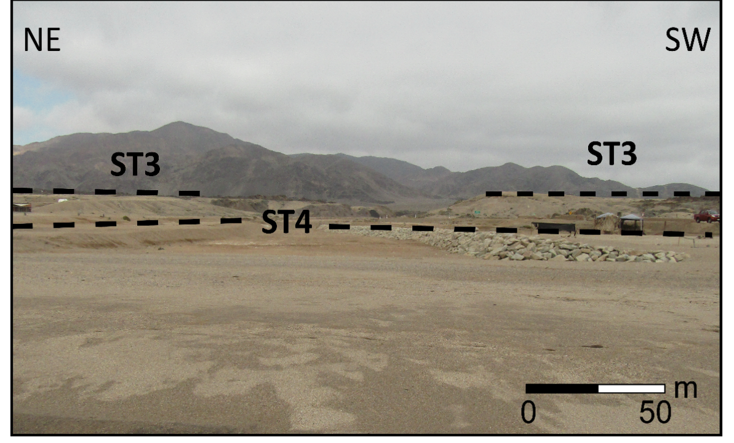
Cliff-dominated Areas
Martinod et al. (2016)
Terraces-dominated Areas
Arróspide et al. (in prep.)
Radtke, 19x89
Martinod et al. (2016)
Izquierdo et al. (2020)

Slide 6

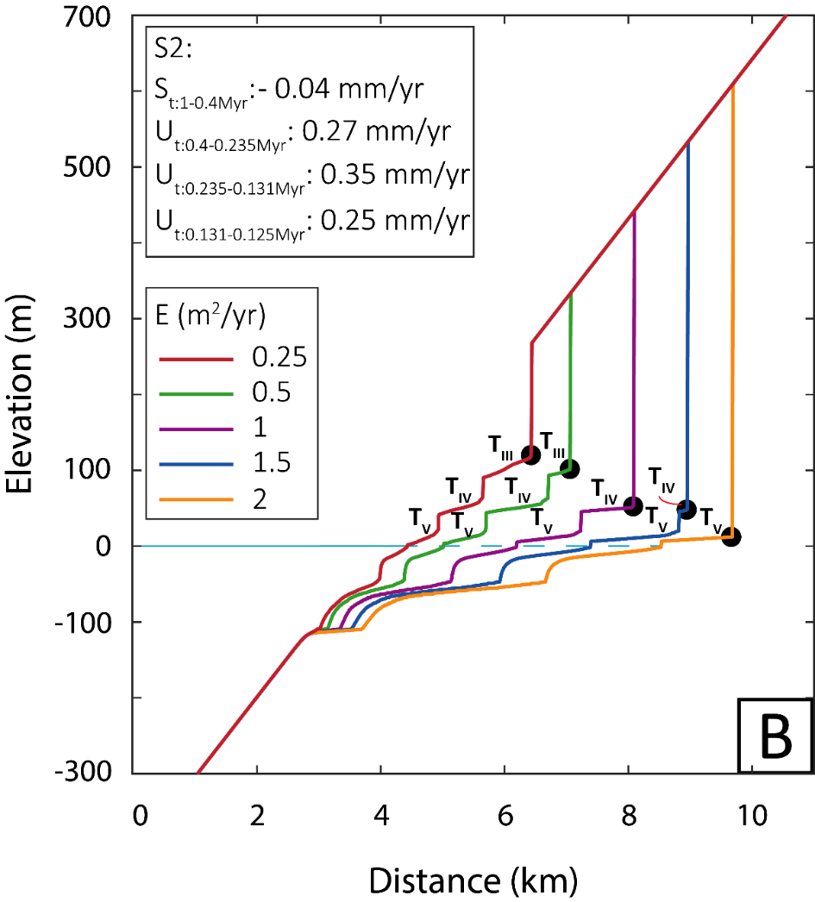
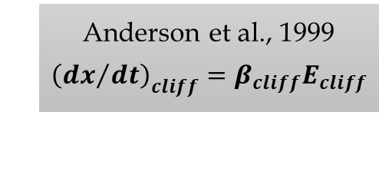
Exploratory model…
Anderson et al., 1999
$${{\left(dx\right.}/{\left.dt\right)}}_{cliff}=β_{cliff}E_{cliff}$$
Arróspide et al. (in prep.)
Local variations of EROSION may explain the development of contrasting morphologies, where:
- High erosion form areas dominated by a tall, inactive cliff.
- Low erosion form areas dominated by terraces with low cliff.
Notes:
Thus, as preliminary conclusions, we can say that local variations of erosion may develop for one side (1) areas dominated by a tall, inactive cliff that is located near the coast or out the sea and is separated from the coastline by just a single shore platform, and for the other, (2) areas dominated by terraces that leave behind the inactive cliff.

Slide 7
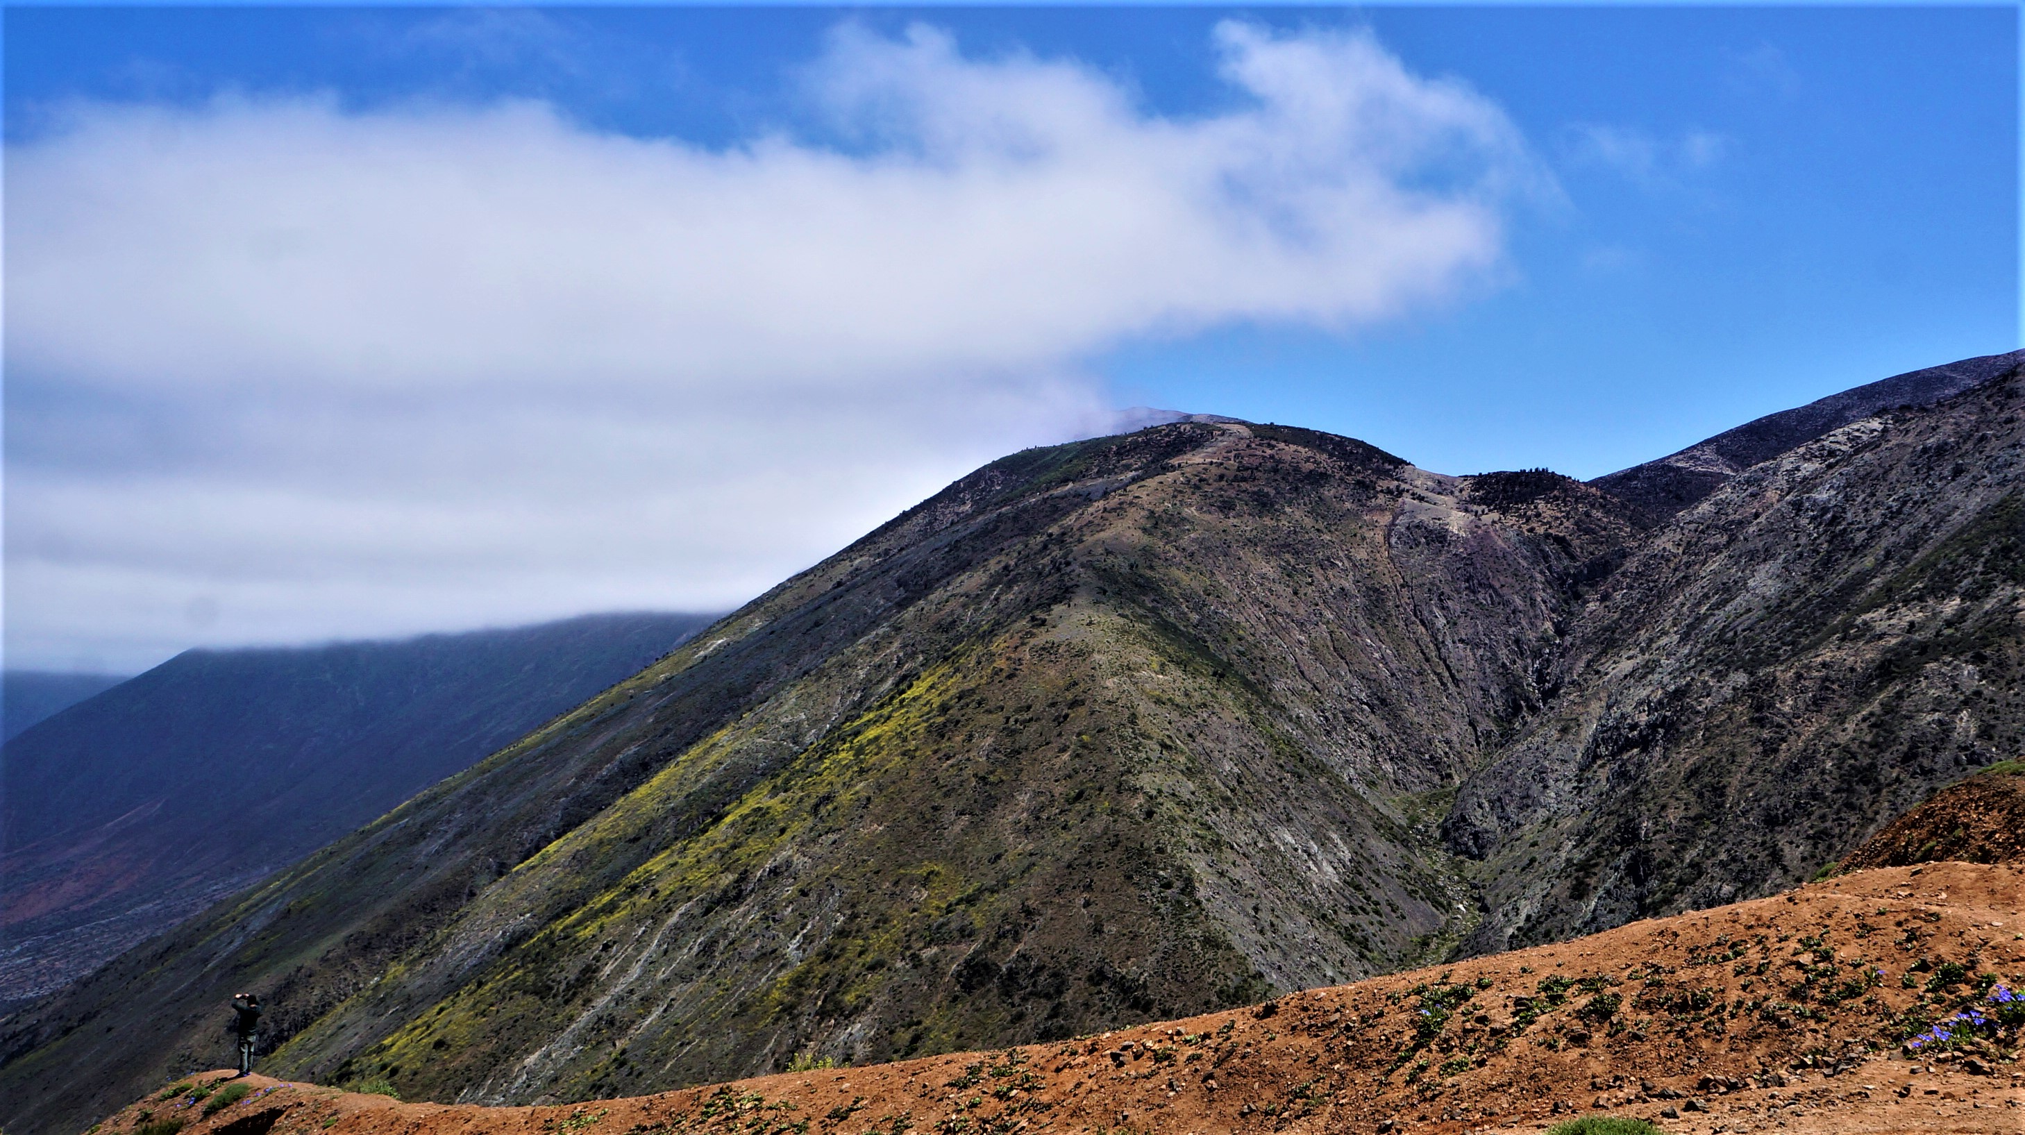
Thanks for your attention!

Slide 8
Unraveling the landscape evolution of the Atacama Desert coast of Northern Chile through numerical models: the Pan de Azúcar National Park study case (~26°S).
Arróspide, C., Aguilar, G., Martinod, J., Rodríguez, M. P., and Regard, V.
ccamila.av@gmail.com

