Slide 1
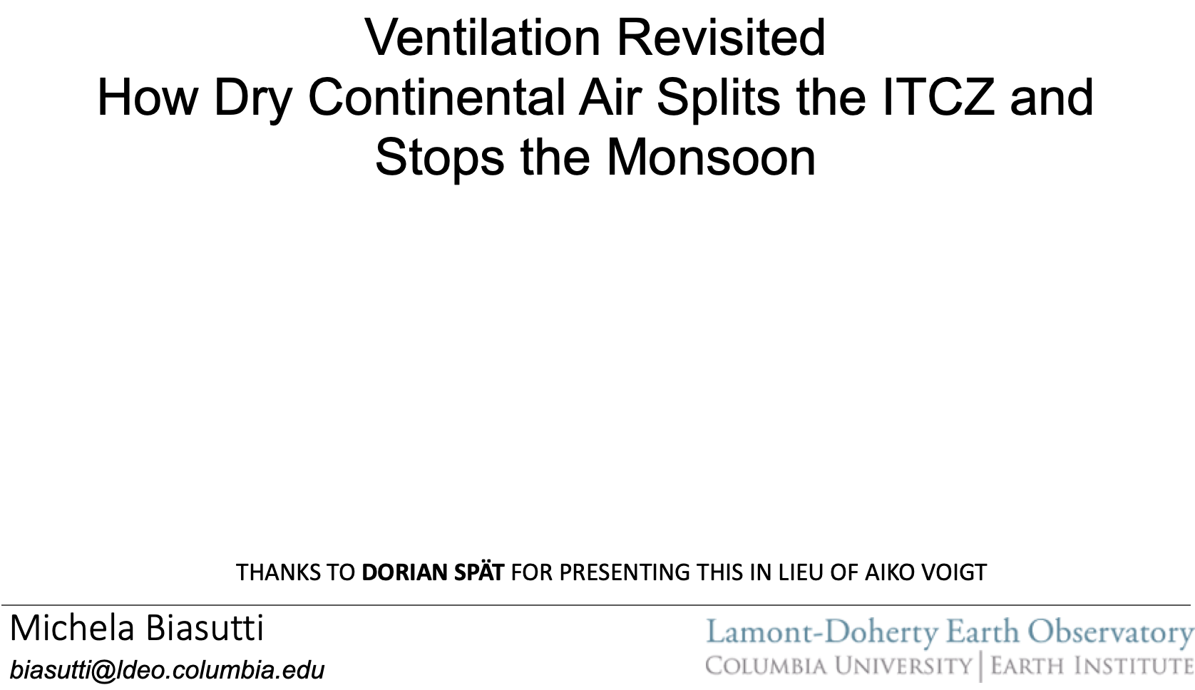
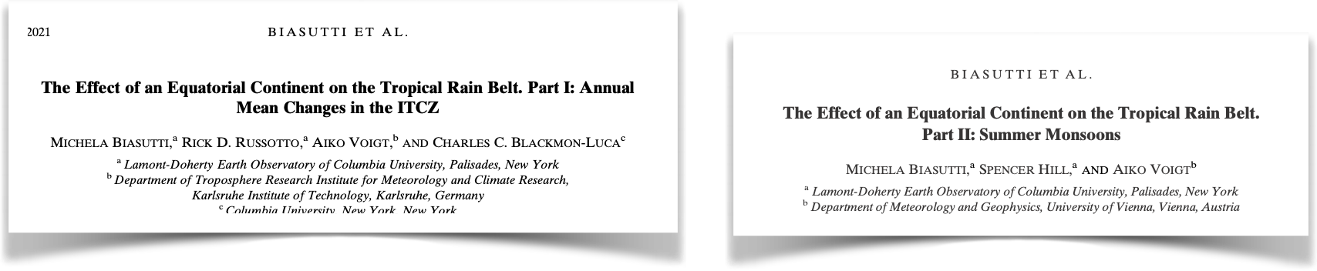


Ventilation revisited
how dry continental air splits the ITCZ and stops the monsoon
Aiko Voigt
Dorian Spät
Michela Biasutti

Slide 2
CMIP5 Atmospheric GCMs
Slab Ocean (30m)
Idealized oceanic northward heat transport
AQUAPLANET
TRACMIP SET-UP
Low heat capacity
Brighter than water
Resists evaporation
Does not transport heat
IDEALIZED EQUATORIAL CONTINENT

Slide 3
Cooling and drying in the winter portion of the continent is advected by the easterlies and initiates the cooling and drying downstream.
Wind-Evaporation-SST (WES) feedback near the equator
Cooling and drying over the ocean are maintained by a positive feedback with LW cooling
0 month (Jan)
2 months (Mar)
4 months (May)
Low-level convergence into the summer continent prevents warm and moist anomalies from spreading to the ocean.
The annual mean response is the rectification of the wintertime signal

Slide 4
A cold tongue without upwelling
The wintertime continent “ventilates” (cools and dries) the equatorial ocean, depressing rainfall in the ITCZ

Slide 5
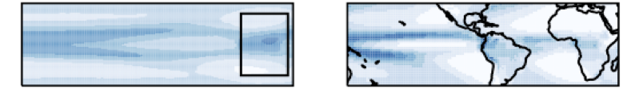
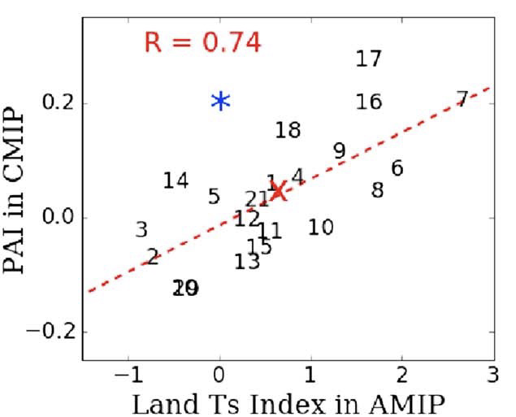

Why should we care? Implications for realistic GCMs
TRACMIP
CMIP6
This might help explain the relationship between continental biases and double ITCZ biases in CMIP models
Double ITCZ bias in CMIP
Temperature biases over land in AMIP

Slide 6
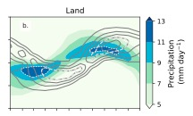
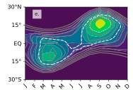
SEASONAL RESPONSE OVER LAND
the rainy season shift closer to the solstice
the monsoon remains in an ITCZ-like regime

Slide 7
The continental monsoon
Over the continent, rainfall is concentrated in summertime monsoons (as expected)
The extent of the monsoon is predominantly set by the low-level circulation advecting high MSE air to the east and low MSE air to the west

Slide 8
Ventilation of the western continent is mostly due to the anomalous flow in the boundary layer
Role of Boundary Layer
Role of Upper Level
Role of Anomalous V-wind

Slide 9
The continental monsoon
JJA Surface Temperature and Rainfall
Over the continent, rainfall is concentrated in summertime monsoons (as expected) with an East-West asymmetry (why?)
Ventilation by the Anomalous V-wind
The extent of the monsoon is predominantly set by the anomalous low-level circulation advecting high MSE air to the east and low MSE air to the west
Contrast this with Chou et al., 2001

Slide 10
Why should we care?
Implications for monsoon theory.
The horizontal scale of the dry/wet anomalies is not set externally by the mean wind. Circulation and rainfall anomalies are coupled.
Thus, predicting the monsoon extent requires knowing more than continental geometry, including the effects of all land characteristics.
Q: What land surface idealizations would produce subtropical rainfall over this Africa-like continent akin the Green Sahara?
Q: Would that be enough to trigger an angular momentum-conserving circulation?

Slide 11
Ventilation revisited
how dry continental air splits the ITCZ and stops the monsoon
Thank You!
Questions? Email biasutti@ldeo.columbia.edu

