Slide 1









Shallow conduit processes and sulfur release in the phreatomagmatic stages of the 1210-11 CE Younger Stampar eruption, Iceland
Jacqueline Grech Licari¹, William M. Moreland¹, Thorvaldur Thordarson¹, Bruce F. Houghton², Enikö Bali¹
¹University of Iceland, School of Engineering and Natural Sciences, Faculty of Earth Sciences, Reykjavík, Iceland
²Department of Earth Sciences, SOEST, University of Hawai’i at Manoa, Honolulu, HI 96822, USA
jgl3@hi.is
@GrechLicari
www.linkedin.com/in/jacqueline-grech-licari

Slide 2
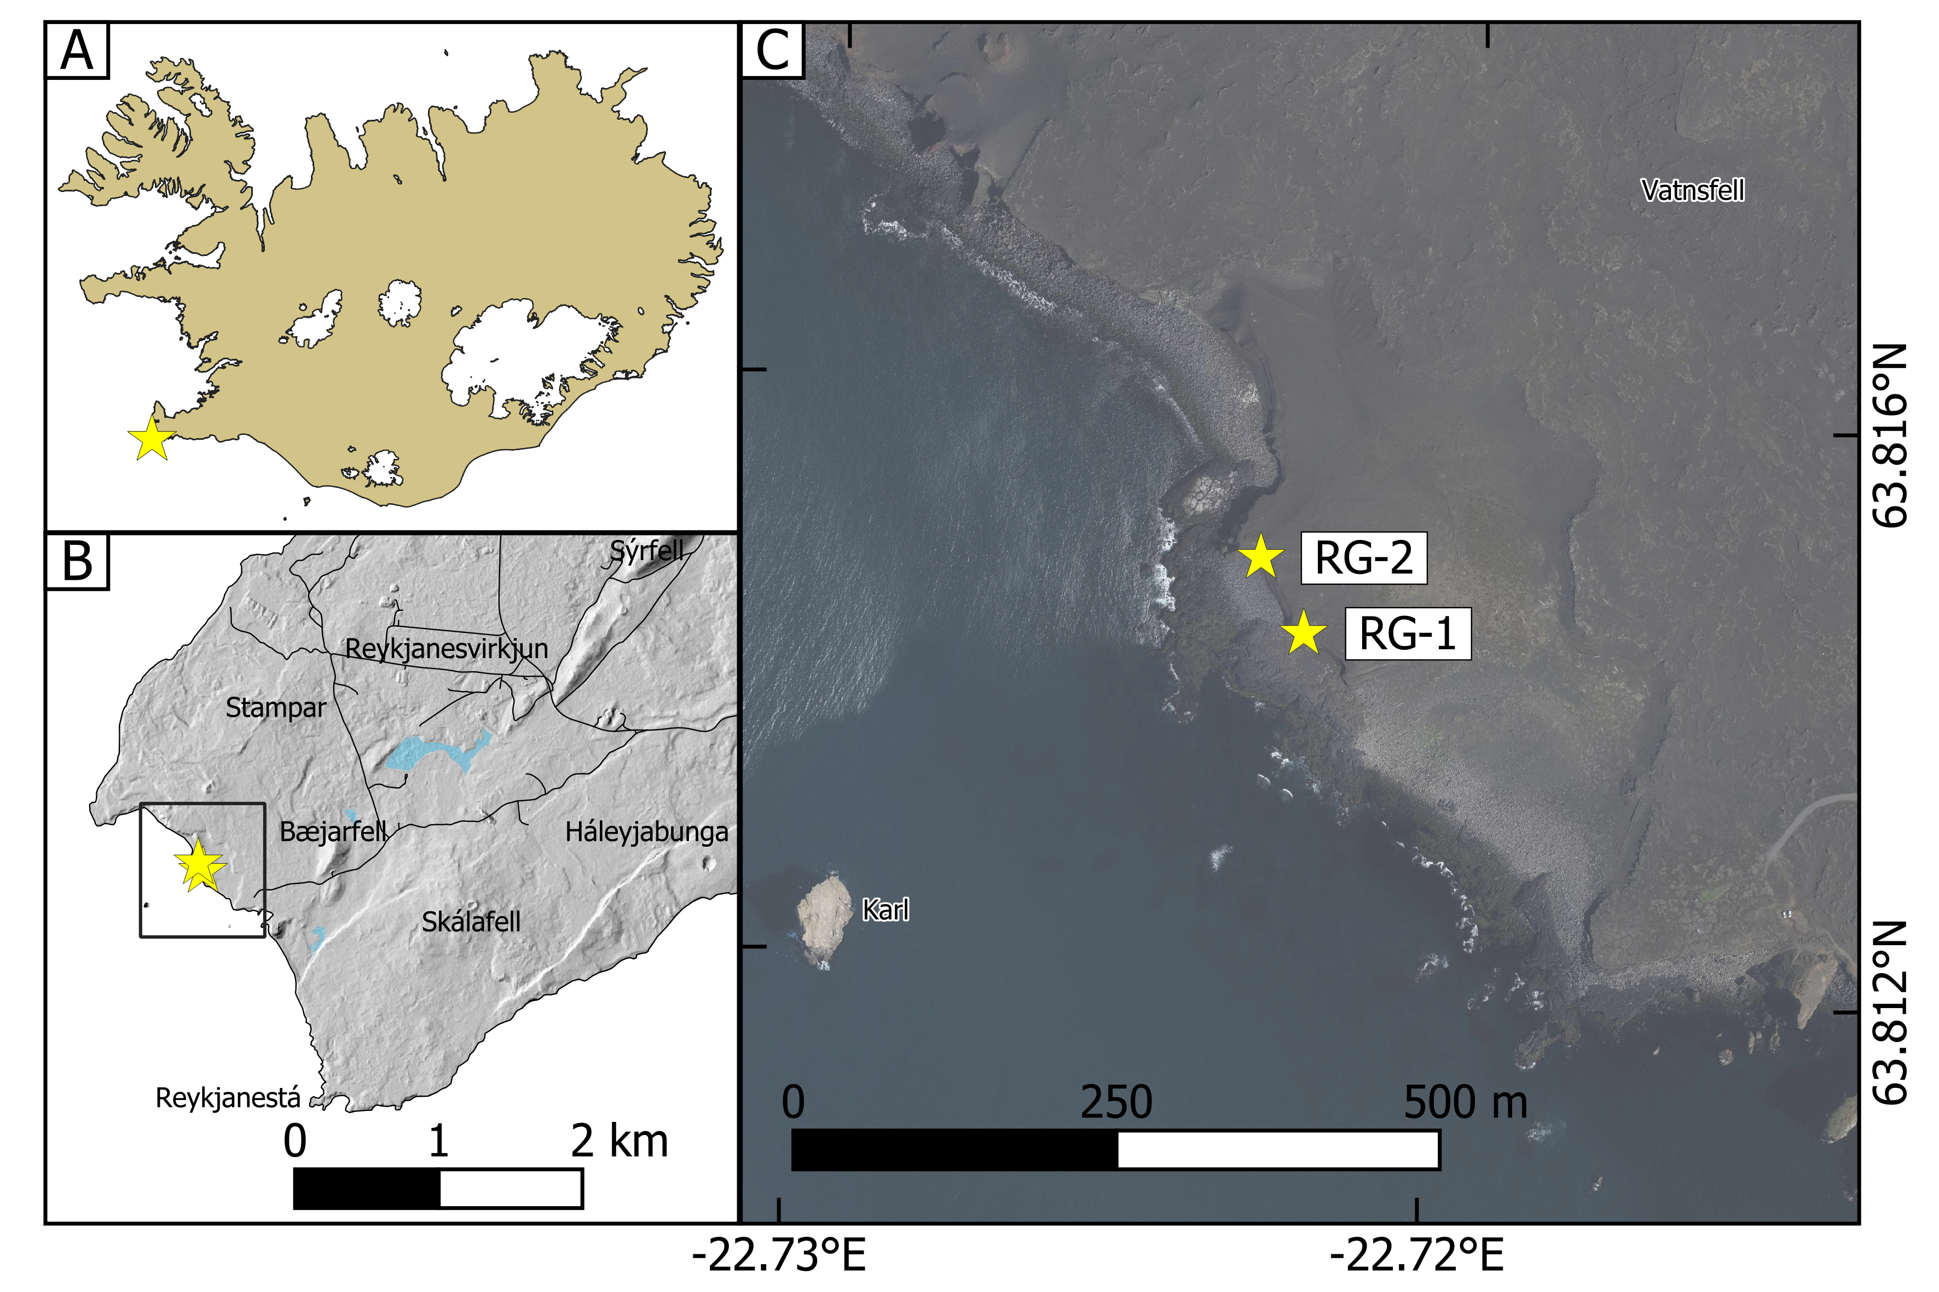
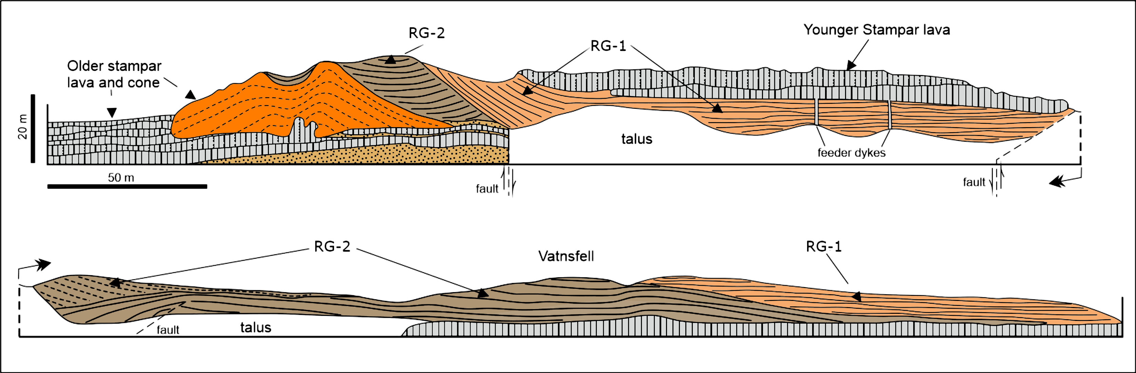
The 1210-11 CE Younger Stampar Eruption
The opening event of the 1210-40 CE Reykjanes Fires
Consisted of 3 stages:
  Surtseyan eruption that formed the Vatnsfellgígur tuff cone (RG-2 in Fig. 1 & Fig. 2)
  A second Surtseyan event ~500 m offshore that formed the larger Karlsgígur tuff cone (RG-1 in Fig. 1 & Fig. 2)
  Subaerial activity that formed the 4km-long Stampar spatter cone row and lava flow field¹
Fig. 1 Location of the two tuff cones, whereby RG-2 represents the older Vatnsfellsgígur tuff cone and RG-1 represents the younger Karlsgígur tuff cone (GIS data obtained courtesy of Landmælinger Íslands).
Fig. 2 Schematic cross-section of the two tuff cones produced by the 1210-11 CE Younger Stampar eruption during its two phreatomagmatic stages. The older tuff cone is labelled RG-2 and the younger one is RG-1 (modified from Sigurgeirsson 1995).
Notes:
The Younger Stampar eruption was the opening event of the Reykjanes Fires and took place at the southwestern tip of the Reykjanes Peninsula. This eruption consisted of 3 stages: a surtseyan event that formed the Vatnsfellsgígur tuff cone shown here as RG-2, a second Surtseyan event approximately 500 m offshore that formed the larger Karlsgígur tuff cone, which I shall refer to as RG-1, and subaerial activity that formed the 4km-long Stampar lava flow. The cones are tholeiitic basalt, with Mg content that ranges from 6.0 to 7.5 wt %.

Slide 3
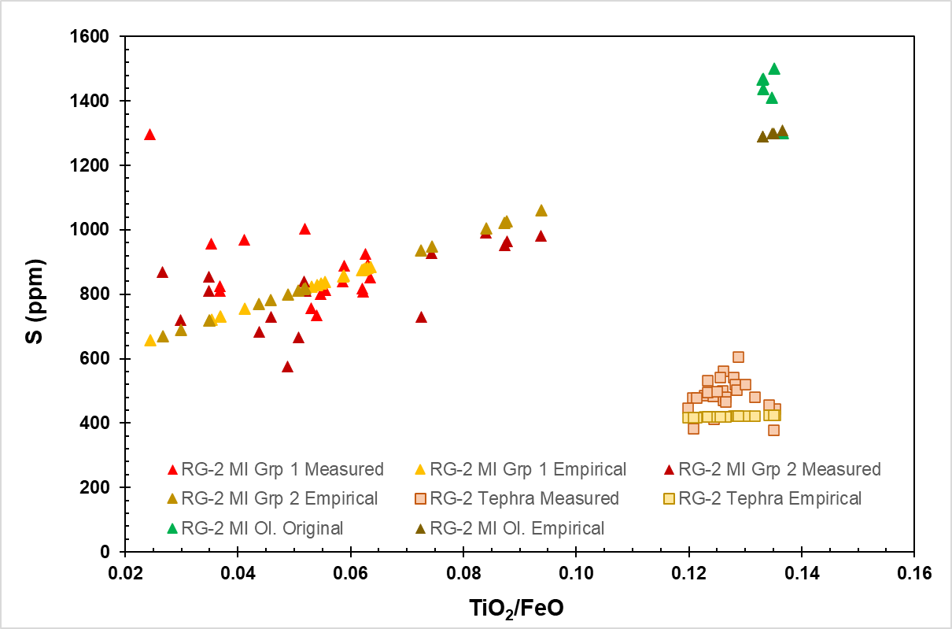
Volatile Content
Table 1 Combined sulfur (in ppm) and sulfur dioxide (in Tg) content in melt inclusions (MIs) and tephra from the two surtseyan stages of the Younger Stampar eruption versus sulfur content (in ppm) for the Fagradalsfjall eruption. # Data retrieved from Halldórsson et al. (Nature, accepted for publication)
 | Original (MI content) | Residual (Glass content) | Degassed | Degree of Degassing
Total S (in ppm) | 2860 ± 15 (1430 per stage) | 960 ± 15 | 1900 ± 15 | 66 %
Total SO₂ (in Tg) | 1.24 ± 0.013 | 0.08 ± 0.026 | 1.16 ± 0.034 | 32=
2021 Fagradalsfjall S (in ppm) # | 1120 | 175 | 945 | 84%
Table 2 Measured water content in melt inclusions and glass (wt %) for the two surtseyan events of 1210-11 CE eruption and for the 2021 Fagradalsfjall eruption.
 | Original H₂O ( wt%) | Residual H₂O ( wt%) | Degree of Degassing (%)
RG-2 (Older Cone) | 0.18 * | 0.06 ± 0.1 | 66 *
RG-1 (Younger Cone) | 0.50 * | 0.16 ± 0.02
Fagradalsfjall # | 0.22 ± 0.023 | 0.07 ± 0.01 | 68
Fig. 3 Empirical and measured values for sulfur content (in ppm) in three distinct chemical groups of MIs (in olivine and plagioclase) and glass from the older tuff cone of the 1210-11 eruption (i.e., RG-2)
# Data retrieved from Halldórsson et al. (Nature, accepted for publication)
* No direct measurement available. Value estimated or calculated.
Notes:
Three compositionally distinct groups of plagioclase and olivine-hosted melt inclusions were identified. As shown by the green triangles in this plot, only the Ti/Fe ratio of the olivine-hosted melt inclusions is comparable to that of the erupted tephra, which are shown as squares. Hence, these melt inclusions were the ones deemed representative of the erupted melt when measuring original volatile content. As seen in the top table, original sulfur contents of approximately 2860 ppm, and residual sulfur content in tephra of ca. 960 ppm indicate that roughly 1.16Tg of sulfur dioxide (SO2) were released into the atmosphere during these two stages of phreatomagmatic activity. This corresponds to approximately 66% degree of degassing at the vent. Conversely, groundmass glass measurements of Fagradalsfjall lavas suggest that the melt had lost 84% of its gas content. For many eruptions, approximately 18% of the original volatile mass is lost to the system via subsequent degassing in the lava field. So, when taking this into account, the degree of degassing at the vent for both eruptions is comparable, at ca. 65-70 % each. Assuming a similar degree of degassing for water as for sulfur, the original water content was estimated from the measured water content in glass as shown in the bottom table. The older cone hosted comparable water contents to those measured for the 2021 Fagradalsfjall eruption, whereas the younger and larger cone hosts higher original and residual water content at 0.5 wt% and 0.16 wt%, respectively.

Slide 4
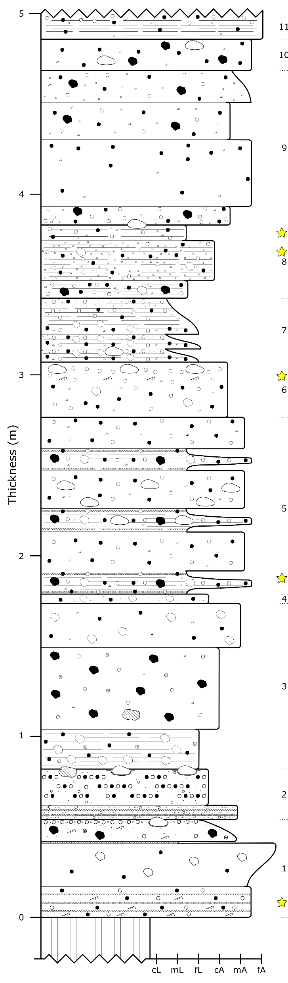
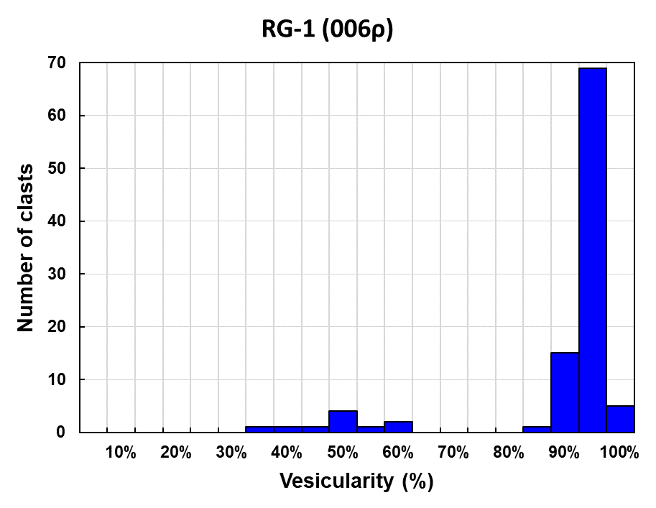
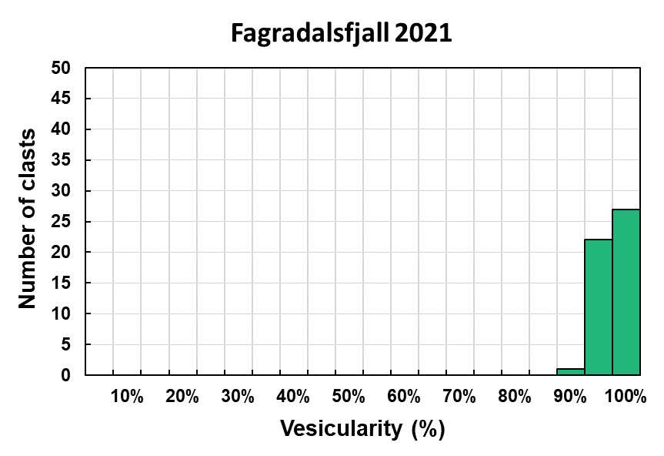
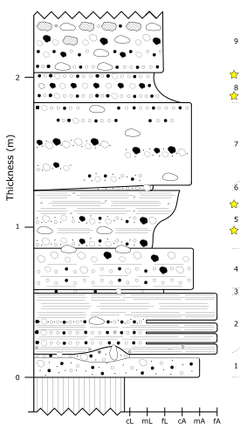
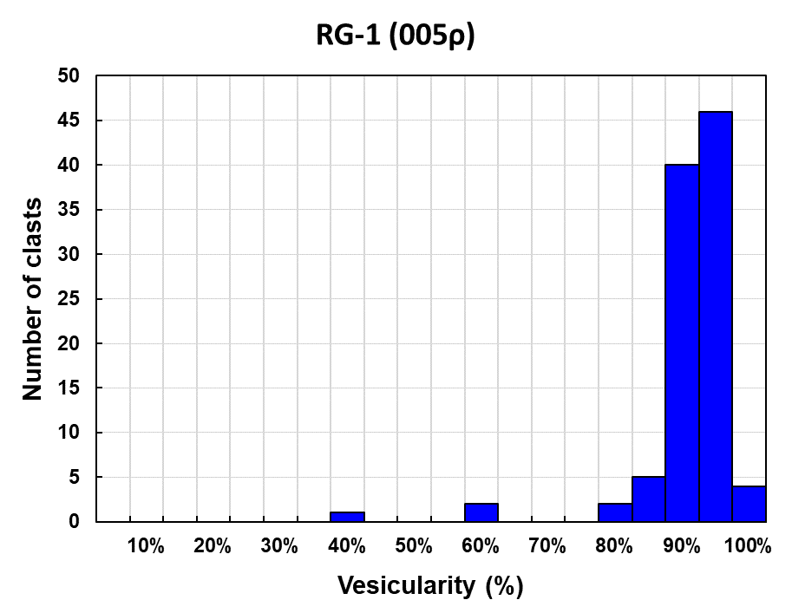
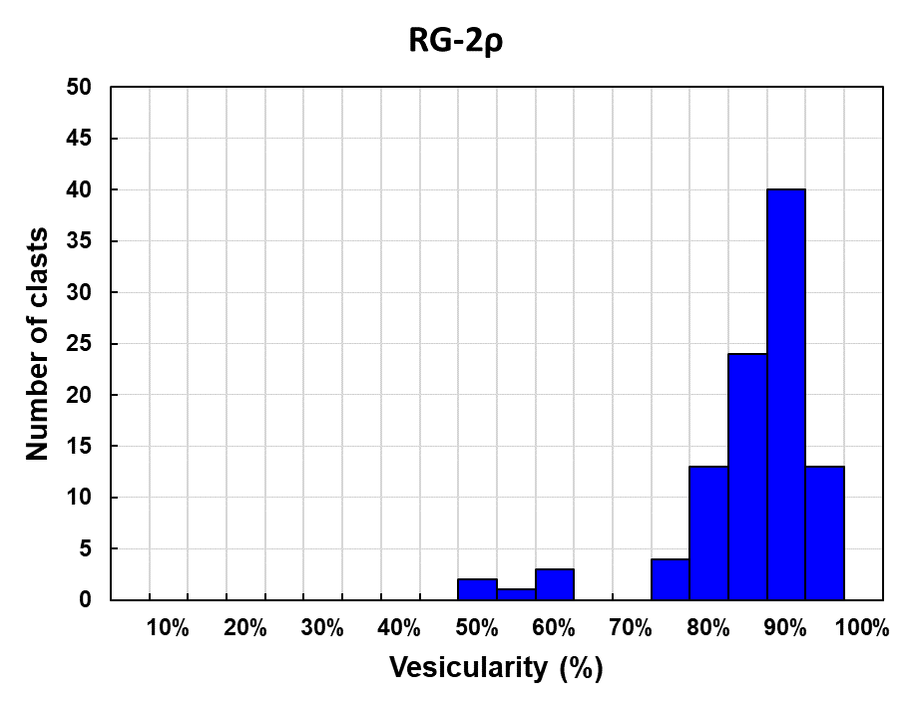
Density and Vesiculation Processes
Fig. 7 Vesicularity distribution plot for a lapilli layer in the 6th unit of the younger tuff cone.
Fig. 9 Vesicularity distribution plot for juvenile clasts taken from the Fagradalsfjall eruption (from unpublished data of the Volcanology Research Group at HÍ)
Number of vesicles per area (N_{A})
3.62E+0.1 mm⁻² – 7.77E+0.1 mm⁻²
Number of vesicles per volume (N^{V}_{m})
3.46E+0.3 mm⁻³ - 6.23E+0.3 mm⁻³
Fig. 4 Stratigraphic log for the younger Karlsgígur tuff cone
Fig. 6 Vesicularity distribution plot for a lapilli layer in the 5th unit of the younger tuff cone.
Fig. 8 Vesicularity distribution plot for a lapilli layer in the 8th unit of the older tuff cone.
Fig. 5 Stratigraphic log for the older Vatnsfellsgígur tuff cone
Notes:
Bulk vesicularity and micro-textural analyses were carried out on samples collected from lapilli layers within the 8th unit of a section within the older cone as shown on the right, and within the 5th and 6th units of a section within the younger one as shown on the left. All three samples, which are represented by blue histograms, produced similar bulk vesicularity distributions with a modal vesicularity of 90-95%. These distributions are similar to the 95-100% modal vesicularity shown in the green histogram, which represents the vesicularity distribution for the 2021 Fagradalsfjall eruption. The fact that both the phreatomagmatic stages of the Younger Stampar event and the explosive magmatic stages of the Fagradalsfjall eruption produced comparable degrees of vesiculation, indicates that both eruptions share the same driving mechanism for their explosivity, that is the expansion of magmatic gases. Thus, the presence of external water in the 1210 eruption must have played little to no role in the explosivity of its phreatomagmatic stages. This also agrees with values obtained via quantitative vesicle analysis, which you can see in the centre of the slide. The value to the right, known as the number density, is sensitive to bubble nucleation processes.
All samples are comparable – higher average vesicularity in Fagradalsfjall due to denser material falling within the lava field and impossible to sample.

Slide 5
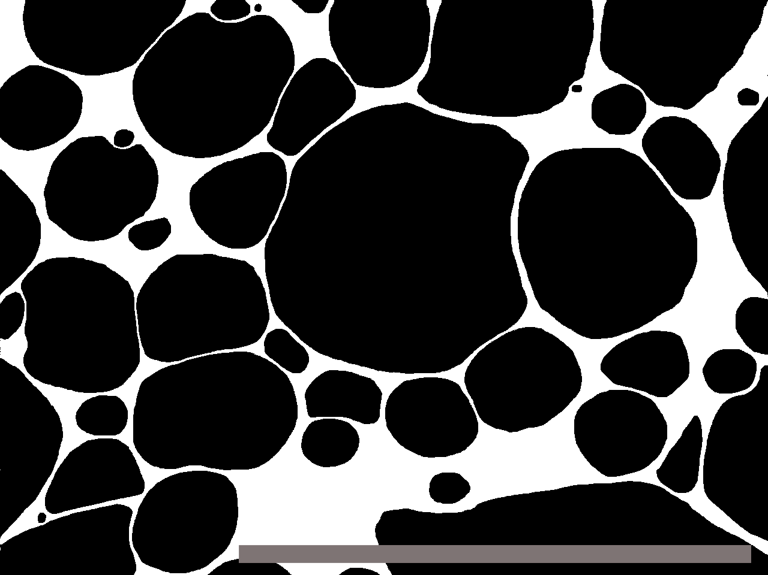
Interpretations and Conclusions
Number of vesicles per volume is comparable to “dry” magmatic eruptions from Kilauea Iki ², Stromboli ³ and episodes from Laki ⁴
Melt had fully degassed before dropping below glass transition zone:
  Bubble nucleation had already stopped before fragmentation
  Degree of degassing for dry 2021 eruption and phreatomagmatic stages of the 1210-11 CE one are comparable
Fig. 10 Back-scattered electron image (BSEI) of a juvenile clast of modal density from RG-1, captured at 250x magnification. Smallest bubbles (in black) do not have diameters smaller than 7-8 μm (shown by red circles). Scale bar represents 0.5 mm.
Explosivity was driven by the expansion of exsolved magmatic gases
Role of water likely late-stage and only generated re-fragmentation of already disrupting magma via quench granulation
Notes:
The range of bubble number densities for this eruption is comparable to magmatic explosive eruptions of relatively low intensity, such as Kilauea Iki and Stromboli. Qualitative observations further support this because the smallest bubble populations recorded in the analysed clasts did not have vesicles with diameters smaller than 7 or 8 micrometers, as can be seen in this image. However, during nucleation, vesicles do not exceed 1 micrometer in diameter. The absence of such small bubbles suggests that nucleation had stopped, and the melt had fully degassed, before dropping beneath the glass transition zone and fragmenting. This is also consistent with the comparable degree of degassing for the phreatomagmatic Younger Stampar versus the magmatic Fagradalsfjall eruptions.
Thus, this study thus concludes that the explosivity of the phreatomagmatic stages was driven by the expansion of exsolved magmatic gases and that external water only generated secondary fragmentation of already disrupting magma via quench granulation.

Slide 6
References
[1] Sigurgeirsson MÁ 1995. Yngra Stampagosið á Reykjanesi. Náttúrufræðingurinn 65 (3): 211-230
[2] Stovall WK, Houghton BF, Gonnermann H, et al (2011) Eruption dynamics of Hawaiian-style fountains: the case study of episode 1 of the Kīlauea Iki 1959 eruption. Bull Volcanol 73:511–529. doi: 10.1007/s00445-010-0426-z
[3] Lautze NC, Houghton BF (2008) Single explosions at Stromboli in 2002: Use of clast microtextures to map physical diversity across a fragmentation zone. J Volcanol Geotherm Res 170:262–268. doi: 10.1016/j.jvolgeores.2007.10.011
[4] Decker Z (2016) Episode 4 of the 1783-84 Laki eruption: conduit processes and eruption dynamics of phreatomagmatic phase 1. Masters dissertation, Faculty of Geoscience. University of Iceland.

Slide 7
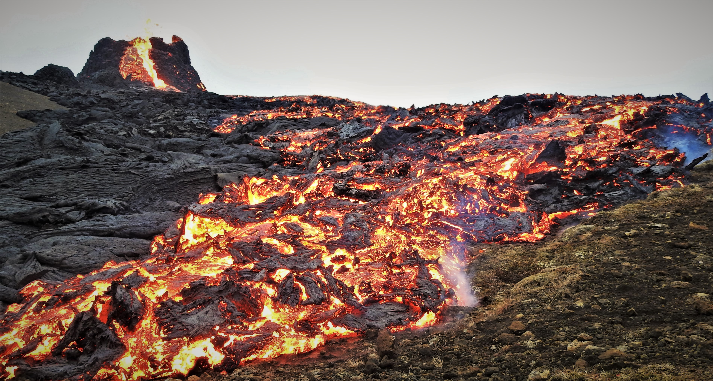


jgl3@hi.is
@GrechLicari
www.linkedin.com/in/jacqueline-grech-licari
Thank you! Any Questions?
The research work disclosed in this publication is partially funded by the
Endeavour Scholarship Scheme (Malta). Project part-financed by the European Social Fund -
Operational Programme II – European Structural and Investment Funds 2014-2020
“Investing in human capital to create more opportunities and promote the well-being of society”.

