Slide 1
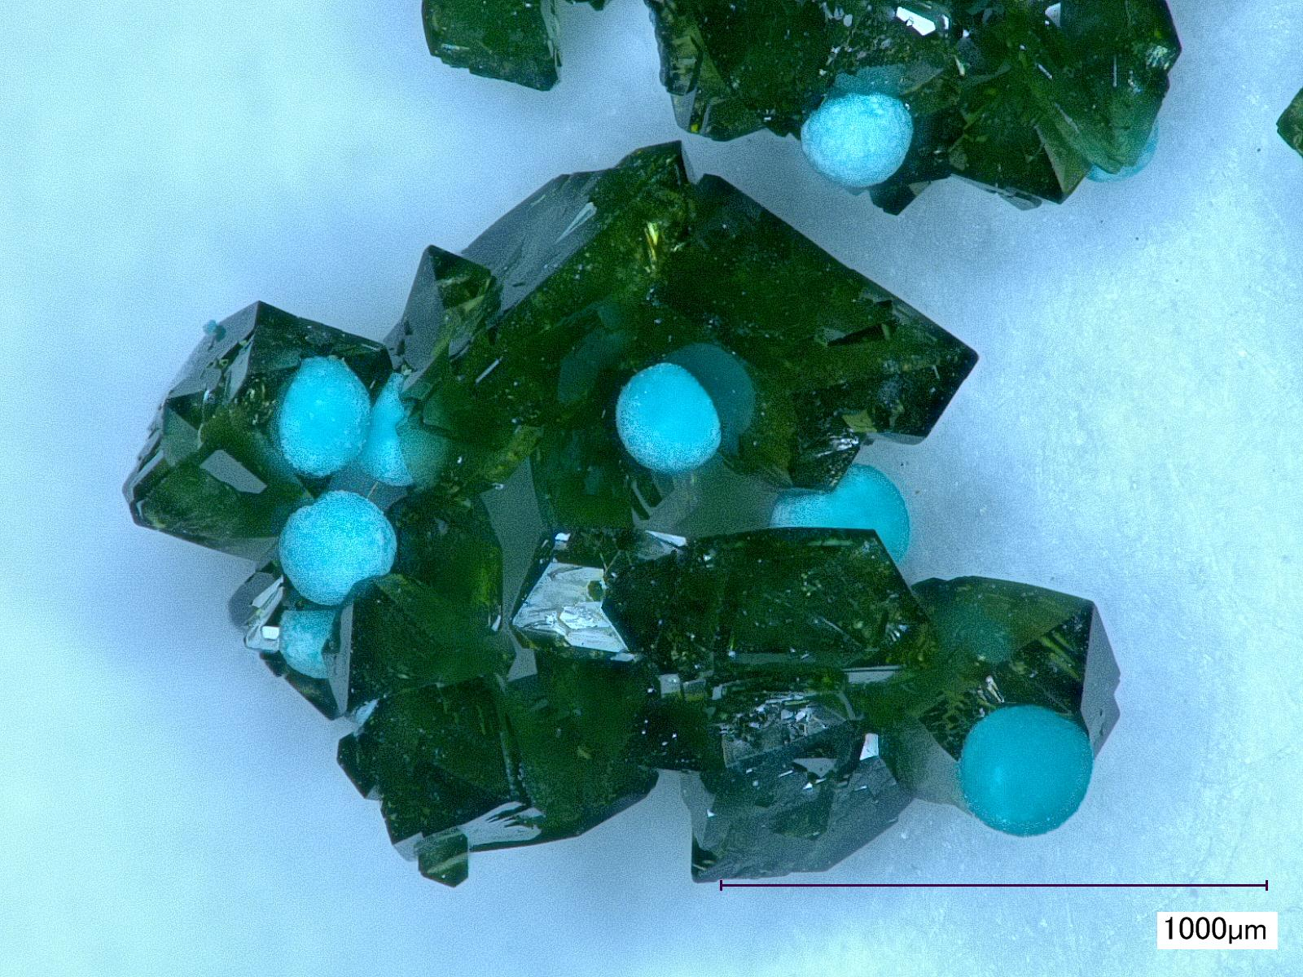
Thermodynamic analysis of the olivenite-libethenite solid solution
[Cu₂(AsO₄)(OH)-Cu₂(PO₄)(OH)]
Juraj Majzlan, Martin Števko, Alexandra Plumhoff, Edgar Dachs, and Artur Benisek

Slide 2
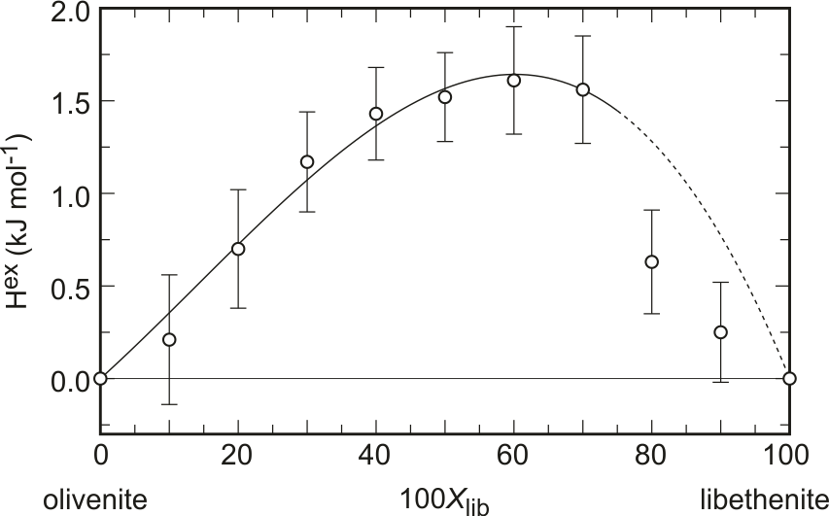
Enthalpies of mixing

Slide 3
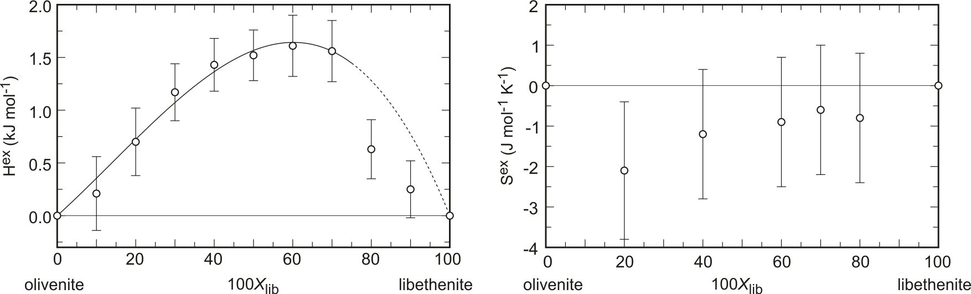
Enthalpies and entropies of mixing

Slide 4
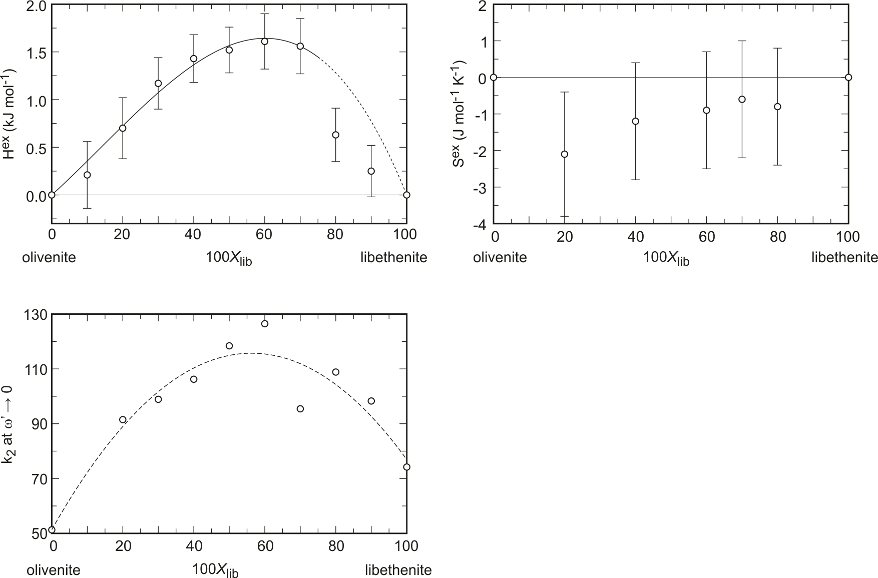
Enthalpies and entropies of mixing, autocorrelation analysis

Slide 5
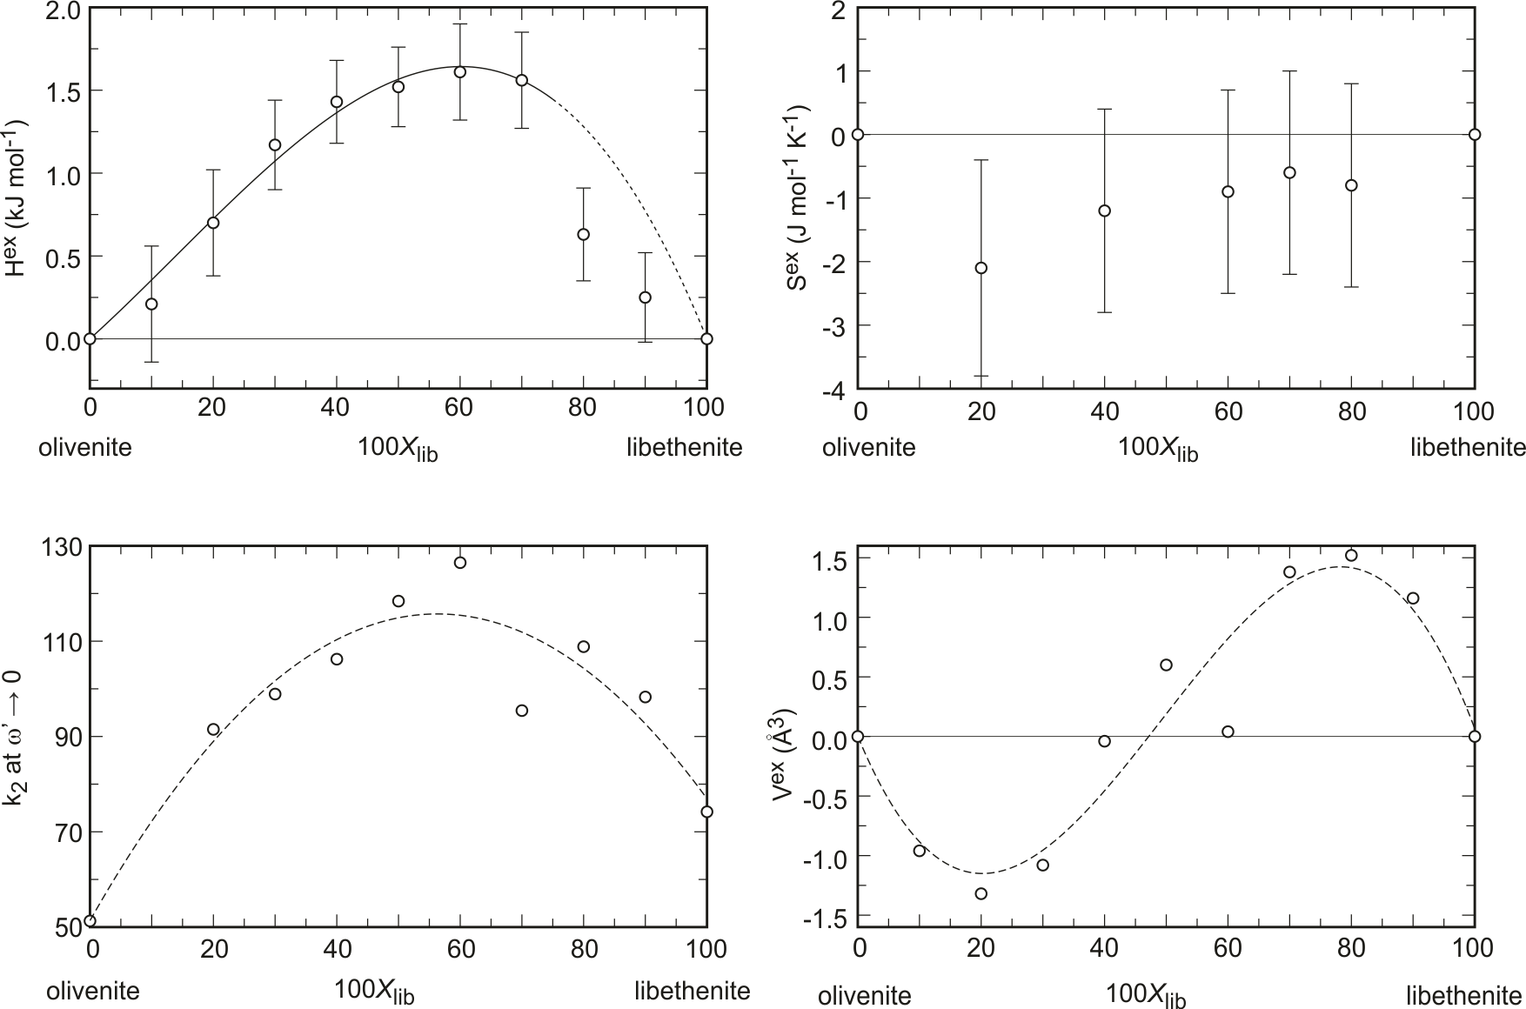
Enthalpies, entropies, volumes of mixing, autocorr. analysis

Slide 6
Answer: The phosphate concentration in secondary arsenate minerals is controlled by geochemistry, i.e., availability of the elements and their geochemical decoupling, not by thermodynamics

