Slide 1

Using AE based Machine Learning Approaches to Forecast Rupture during Rock Deformation Laboratory Experiments
Using ML to Forecast Ruptures via AE during Rock Deformation
Sergio Vinciguerra¹, Thomas King ² and Philip Benson ³
¹ Department of Earth Sciences, University of Turin, Turin, Italy;
² National Buried Infrastructure Facility, University of Birmingham, Birmingham, UK
³ Rock Mechanics Laboratory, School of Earth and Environmental Sciences, University of Portsmouth, Portsmouth, UK;

Slide 2
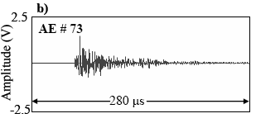
What’s an ACOUSTIC EMISSION (AE) and what can it tell us ?
Using ML to Forecast Ruptures via AE during Rock Deformation
Thompson et al. 2007
An acoustic emission corresponds to:
- the HF radiated acoustic waves emitted by a fast propagating crack
- average magnitudes Mw : -8 to -4, ie femto to nano earthquakes
- Corner frequency 1MHz ~ crack is only a few mm long (if Vr ~ Vrayleigh)
- Displacement ~ few tens of microns
An acoustic emission does not correspond necessarily to a macroscopic slip event, but rather to off fault micromechanical damage

Slide 3
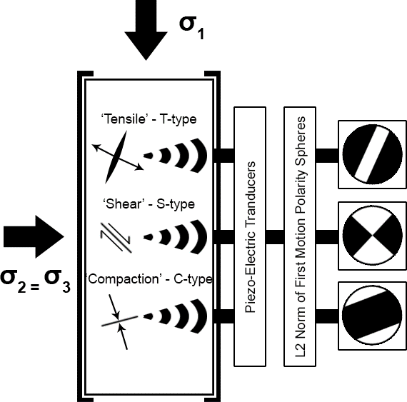
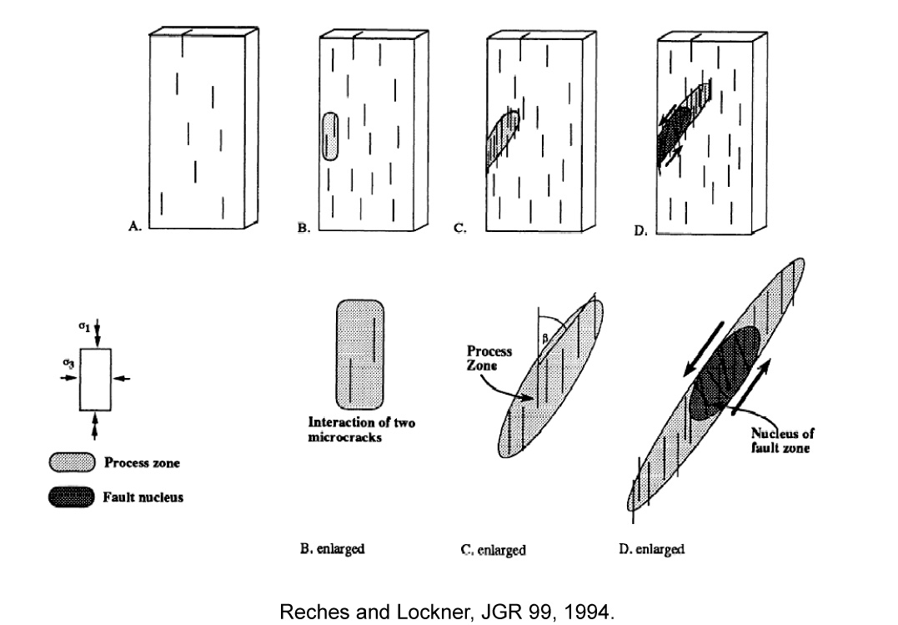
Motivation and aim
Using ML to Forecast Ruptures via AE during Rock Deformation
As crack damage nucleates, grows and coalesces into a fault zone, AE-derived properties suggest that strain localization is repeatable and forecastable. However, due to the inherent heterogeneity of rocks and the range of effective pressures, finding a full prediction of rupture mechanisms from AE analysis over different experimental conditions is still an open goal;
The objective of this work is to quantitatively classify phases of deformation/fracturing on physico-mechanical parameters and develop a model that functions over a range of confining pressures
We consider the AE rates, amplitudes and the derived source mechanisms to constraint the stress-strain regime and the seismic scattering and average velocity structure to define the evolving medium state over time as the most important attributes for the neural network model to learn.

Slide 4
Using ML to Forecast Ruptures via AE during Rock Deformation
Materials investigated
Alzo granite (AG) is typical of the white granites found in North-Western Italy. It is a medium-grained, plutonic rock comprising quartz, feldspar, and a high biotite content. Crystal sizes range between 2.5 and 6 mm for the biotite and 4–9 mm for the quartz and feldspars. Porosity values are characteristically low at less then 1%.
Darley Dale Sandstone (DDS) comes from a quarry in Derbyshire, UK is a brown-yellow, feldspathic sandstone with a modal composition of quartz (69%), feldspars (26%), clay (3%), and mica (2%). Grain sizes varying from 100 to 800 μm. Porosity of 13-14%
Experimental conditions
4x10cm samples; 12 AE sensors
Confining pressures = 5, 10, 20 and 40 MPa
Strain rate = 3.6mm/h
King et al., 2021

Slide 5
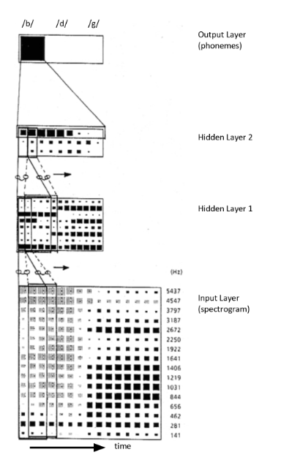
Networks Parametrisation and Analysis Method
Using ML to Forecast Ruptures via AE during Rock Deformation
Time delay neural networks (TDNNs) are automated signal classification techniques that are designed with the purpose of identifying patterns and trends in shift-invariant timeseries data without explicitly knowing the beginning or end of a signal;
Analogous to a 1D convolutional neural network (CNN), TDNNs are a form of recurrent neural network (RNN) that models the propagation characteristics of timeseries data;
By constructing models of the key elements of audio, or elastic vibrations in the case of seismology, they can already be used to recognise signal onsets in AE data (King et al., 2020).
As training parameters for the TDNN, we selected 5 key parameters 1) AE event rate, 2) AE amplitude, 3) AE source mechanism, 4) seismic scattering and 5) seismic velocity.
Discrete parameters are resampled onto a common timeseries and high-pass filtered to simplify the data for the modelling. These timeseries are then classified by the TDNN as variations in stress and strain (target parameters).

Slide 6
Mechanical data and AE time occurrence
Using ML to Forecast Ruptures via AE during Rock Deformation
King et al., 2021

Slide 7
Mechanism Percentages vs increasing Strain
Using ML to Forecast Ruptures via AE during Rock Deformation
1 - Single or multi-periodic fracturing related to initial patchiness of dilatant regions. Cycles begin as dominance of C- and S-type fracturing;
2 - Transitioning to bursts of T-type events and crack coalescence;
3 - Single/Multiple episodes of crack growth and dynamic failure.
4 – Low amplitude C and S-type prior to bursts of T-type events well represent foreschocks
King et al., 2021
Notes:
2- It can be explained by catacalstic pore collapse, driven by shear enhanced compaction, preceding widespread bifurcation.
3 – Single sequence for AG (rupture of a single dilatant zone), double sequence for DDS (growth cycle to first align fracture segments before a second cycle resulted in sample failure).

Slide 8
Velocity structure and Scattering vs. incremental strain
Using ML to Forecast Ruptures via AE during Rock Deformation
Vinciguerra et al., 2021
Key additional parameters for deformation vs. incremental strain:
Velocity structure is derived from the AE arrival time and hypocentral distance
Scattering ratio is the ratio of low frequency energy to high frequency content in the AE coda

Slide 9
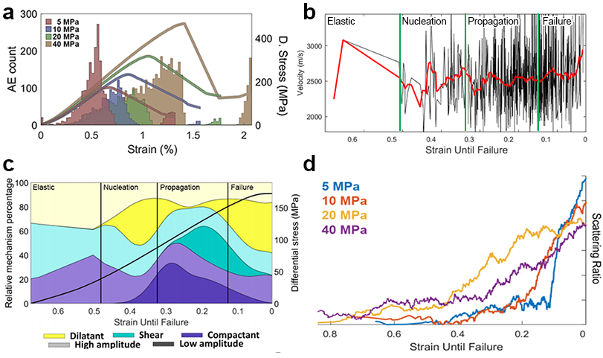
Using ML to Forecast Ruptures via AE during Rock Deformation
All input data for TDNN

Slide 10
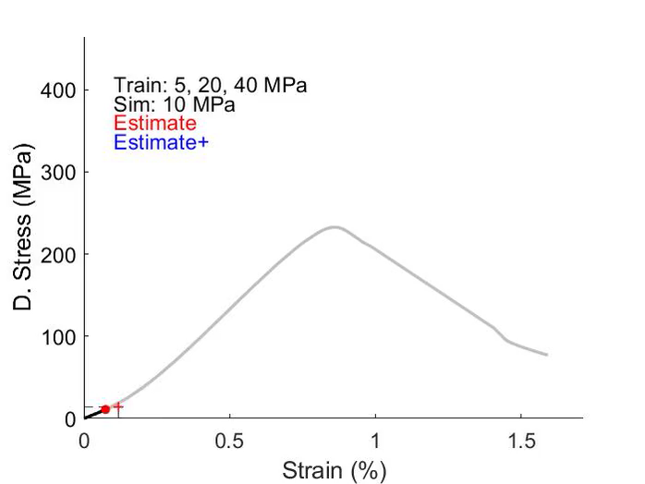
Forecasting dynamic failure
Using ML to Forecast Ruptures via AE during Rock Deformation
We train a model to classify the current phase of deformation
  E.g. 25%, 50% or 65% of ultimate compressive strength (UCS)
  From this we can forecast when 100% UCS will occur
10MPa simulation test on a model trained with data from 5, 20 and 40 MPa shows a good constraint;
Current objectives seek to identify what aspects of the training data that model is picking up on;
A basic TDDN looks for repeating trends in the training data to output deviations from a linear model
A good model is able to generalise the input patterns such that known data misfits are minimised and unknown data is accurately simulated;
Number of processing layers control the accuracy of the model
- Overfitting vs. underfitting. How to achieve generalisation?
Timesteps determine the classfying window
- Stress and strain variations are sensitive to different data cycles
Vinciguerra et al., 2021
Estimate: Moving average
Estimate+: MA for low standard deviations

Slide 11
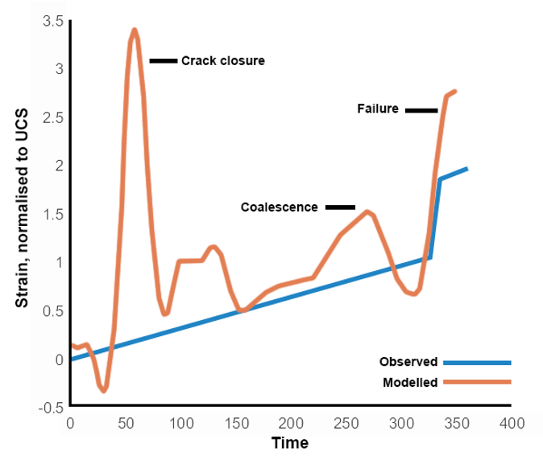
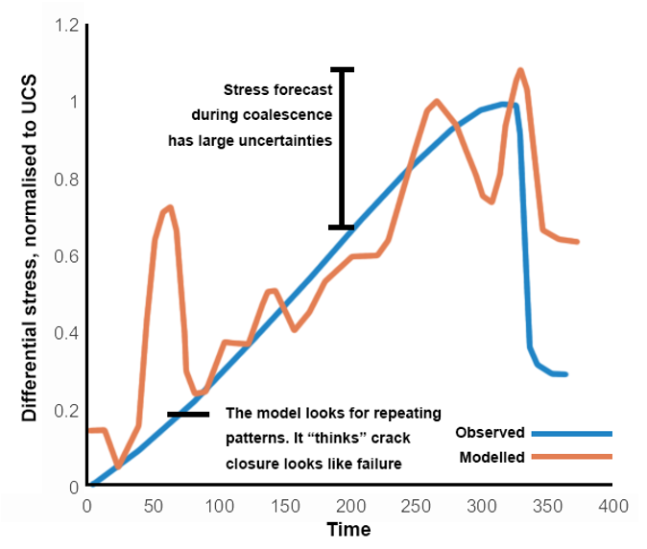
Our approach almost works, why is this?
Using ML to Forecast Ruptures via AE during Rock Deformation
Depending on model setup, the output can significantly vary but some trends are consistent
Critical points are consistent with key deformation phases reported in the literature
Our model still does not understand the magnitude of coalescence phases but recognises that there should be stress drops and strain increases
Next steps are to use these outputs to identify key physical variations that preceed deformation phases
  e.g. a drop in velocity coupled with an increase in scattering

Slide 12
Parameters importance
Multiple models are tested with a “leave one out” strategy to assess the relative importance of individual training parameters.
Misfits for target parameters of stress and strain are estimated as a percentage of Ultimate Compressive Strength (UCS).
It remains challenging to appropriately process discrete measurements into continuous timeseries for the model to learn.
Nonetheless, a clear observation is that different mechanical parameters are more suited to fitting either stress or strain models.
Furthermore, this suitability is time-varying and is likely dependent on the phase of deformation.

Slide 13
Conclusions
Using ML to Forecast Ruptures via AE during Rock Deformation
- We perform omission analysis to determine what are the most important parameters to use when training a neural network to predict dynamic failure in samples of Alzo Granite;
- Results are strongly dependent on the methods used to define the training parameters but several trends are clear;
- Event rate is intuitive and strongly influences predictions of stress;
- Fracturing mechanism trends do not have a strong relationship to either stress or strain. However, the significant burst of tensile events close to UCS is a clear indicator that failure is imminent to the model;
- Whilst AE velocity is suggestive of the type of deformation that is occurring, during crack closure (<30% UCS), velocities are better linked to stress variations. Whilst strain becomes a bigger influence during fracture growth (30 to 80% UCS).
- The next step of this study will be to determine if these variations are directly related to the mechanics of the fault zone or are simply an artifact of the processing.

