Slide 1
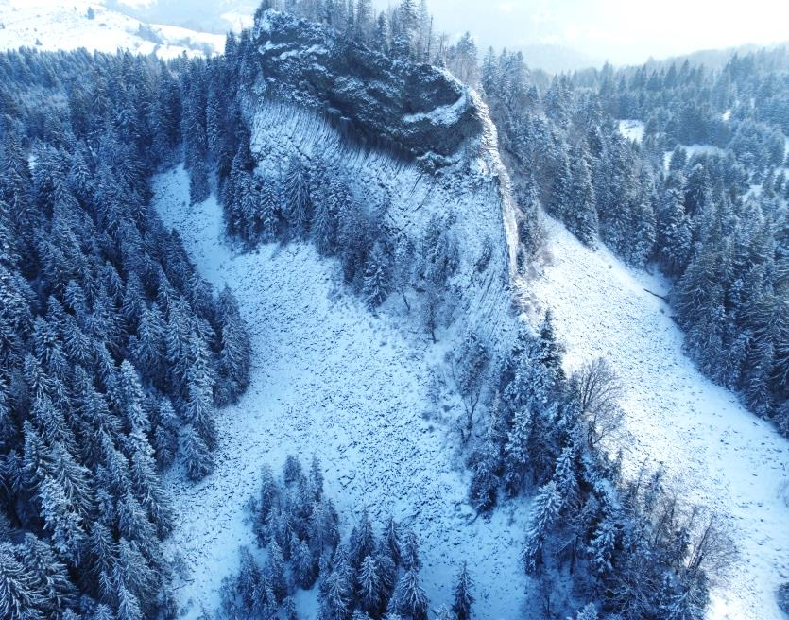


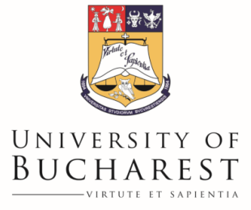

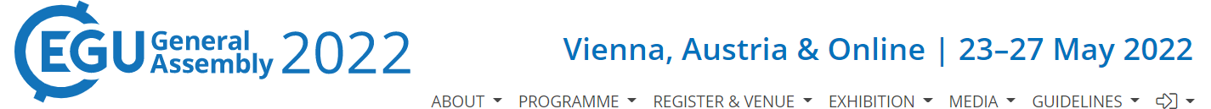
Core drilling in a low altitude permafrost site from temperate regions.
Case study: Detunata Goală, Romanian Carpathians
Răzvan Popescu¹, Alfred Vespremeanu-Stroe¹, Mirela Vasile², Sabina Calisevici¹, Ilie Andrian¹
¹Faculty of Geography, University of Bucharest, Romania
²University of Bucharest Research Institute, Bucharest, Romania
Research project: PN-III-P1-1.1-PD-2019-1275
Financed by Romanian Government (UEFISCDI)

Slide 2
Objectives:
Drilling and coring in the Detunata cold scree susceptible for low altitude permafrost presence;
Describe the stratigraphy with focus on:
  Debris thickness,
  Ice content;
Compare the results with geophysical data (electrical resistivity tomography - ERT and seismic refraction tomography - SRT);
Instalation of temperature sensors in the borehole for continuous monitoring of the underground thermal regime.

Slide 3
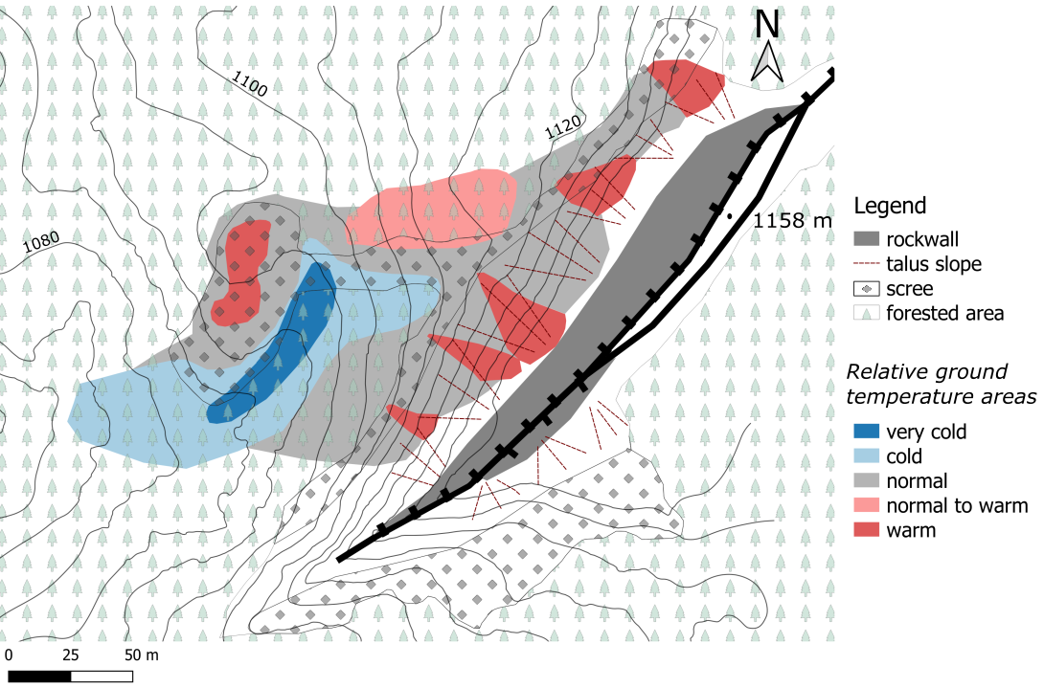
Study site
Basaltic andesite ridge with talus slope and probably rock glacier at the base;
Mean annual air temperature of 6-8°C;
Mean annual ground temperature is < 0 °C in the furrow caused by proven chimney effect;
Rock glacier lobe
Furrow
Thermal areas in early winter of 2020-2021 based on ground therma data

Slide 4
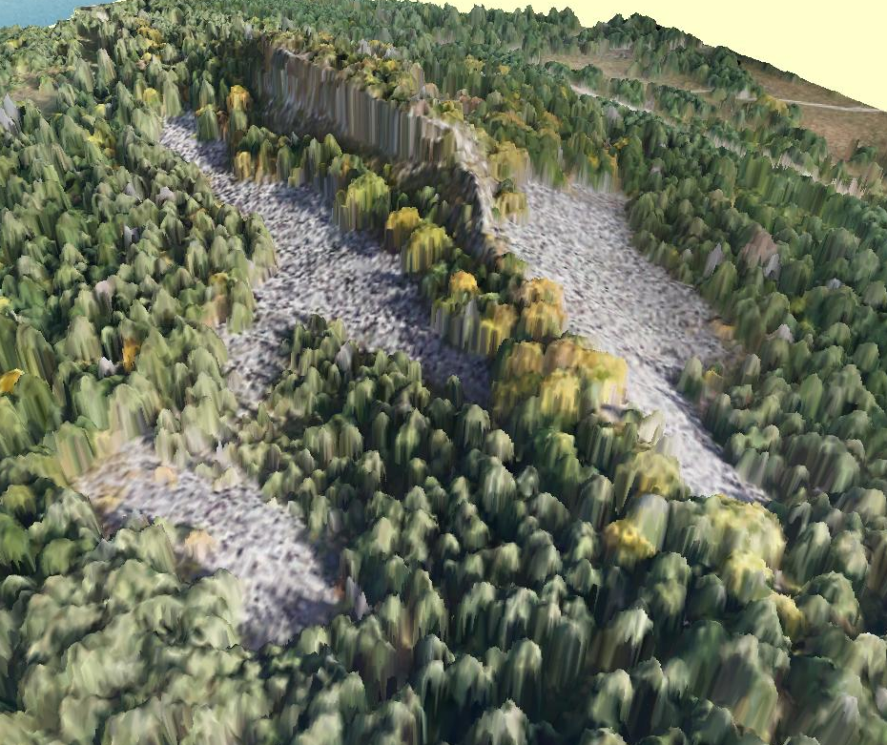
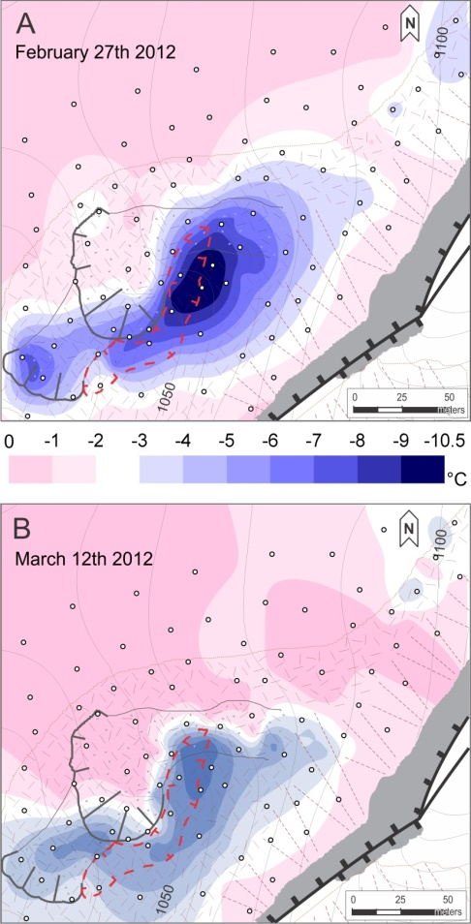
N
Coldest areas of the scree
Ortophoto on DEM of the Detunata cold scree
Temperature maps measured with BTS probe

Slide 5
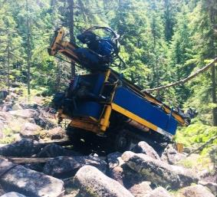
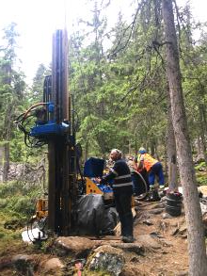
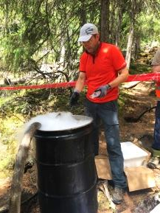
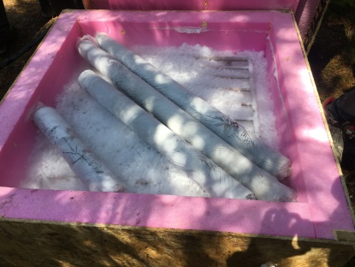
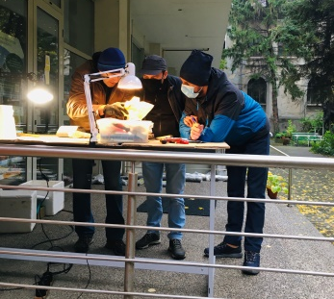
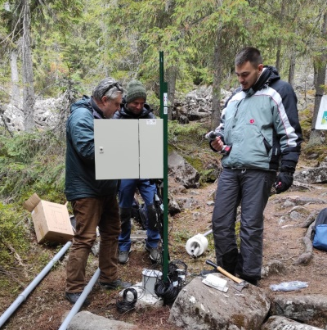
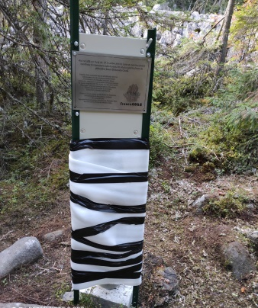
Methods
Drilling and coring using a rolatec RL 400 drilling machine using mix of cold air and water (close to 0 °C, 75-25% ratio) cooled by dry ice;
Storing the cores in refrigerator and describing the scree stratigraphy in cold environment;
Installation of temperature sensors (Hobo S-TMB 12-Bit Smart Sensor) connected to HOBO USB Micro Station Data Logger H21, installed at 16 depths between 0.2 and 15 m.

Slide 6
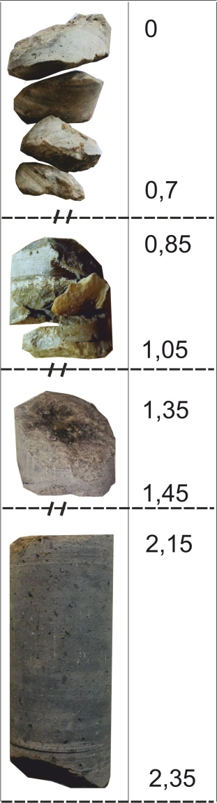
Depth (m)
Results
Internal structure of the debris deposits
0-1.05 m: only air was used for drilling and it was not possible to cool it more than 17 °C which resulted in destroing the air core bit and crushing and evacuating as dust almost all rocks;
1-2.35: mix of water close to 0 °C with air was used with a new air core bit. No tubes were used for coring. The first cylinder of 10 and 20 cm were recovered. Air between 1.65 and 1.85 m.

Slide 7
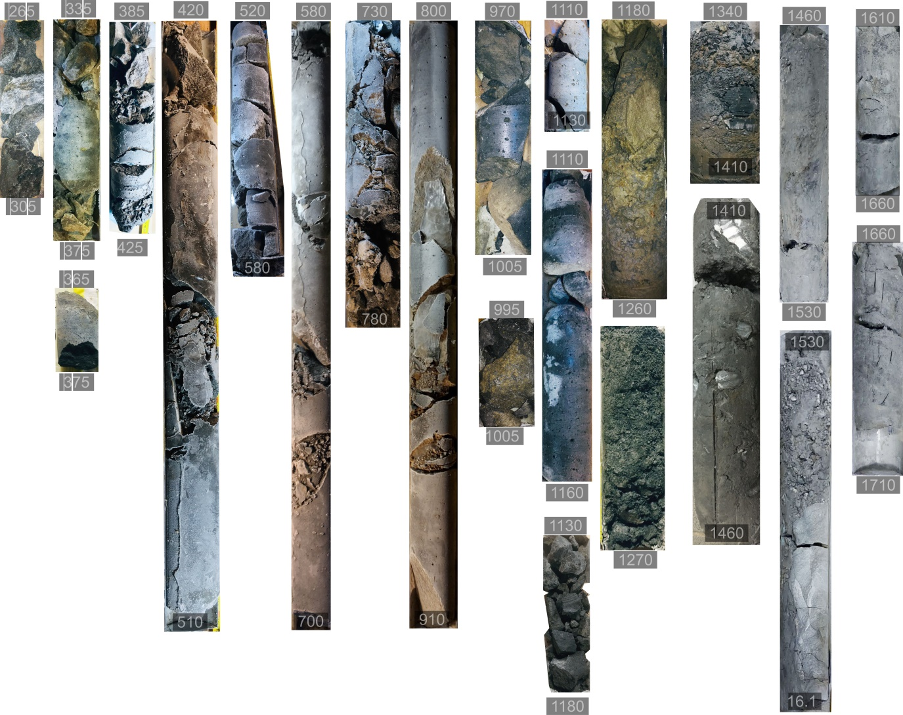
Depth (cm)
Transition between andesitic bazaltic talus and underlying marls at -12.4 m
Pure ice
Frozen sediments
Lowermost ice at -8.83 m
Not to scale

Slide 8
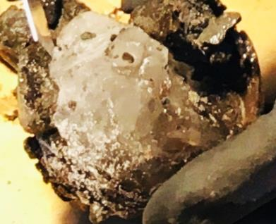
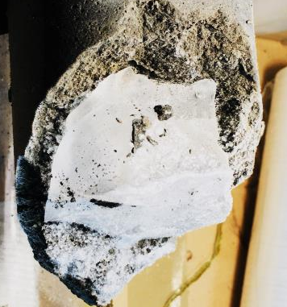
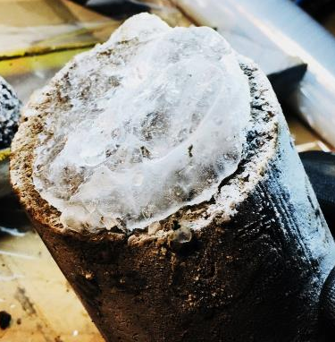
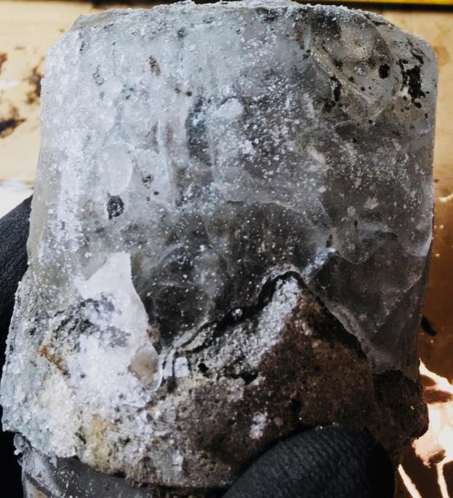
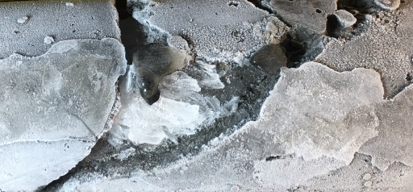
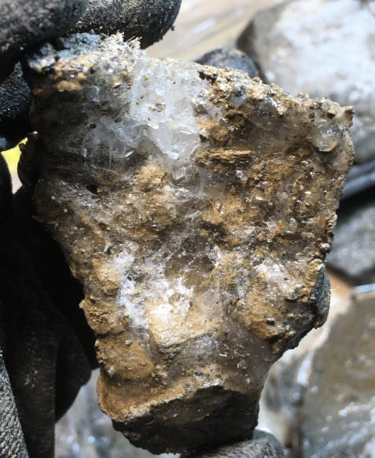
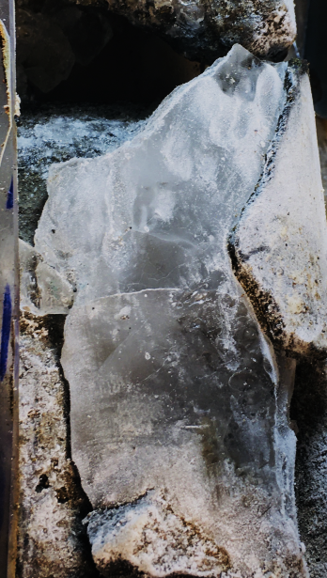
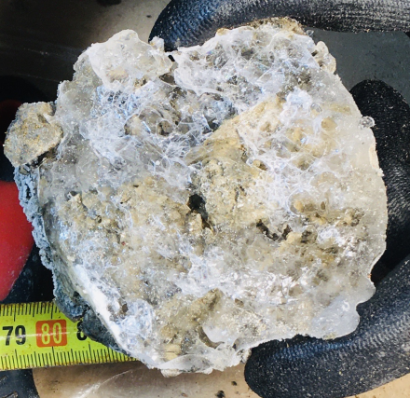
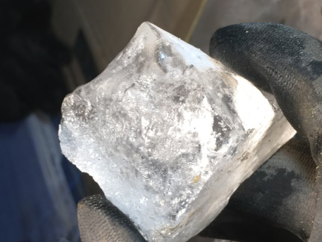
First ice layer at -3.2 m
Ice lens -4.6 m m.
Ice lens at -5.8 m
Ice lens of 5-7 cm at -5.15 m
Ice at 6.2 m
Ice-sediment mixture (ice cemented fine sediments) at 7.5 m
Ice at 8.6 m
Ice-sediment mixture (ice cemented fine sediments) at 8.83 cm – the lowermost ice

Slide 9
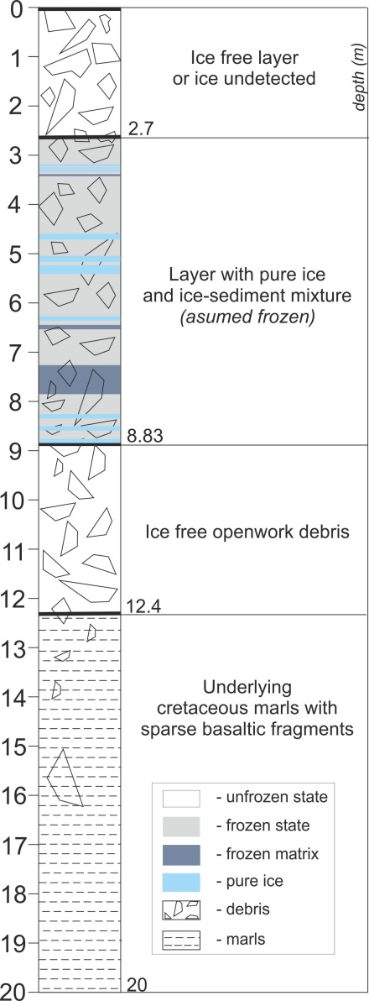
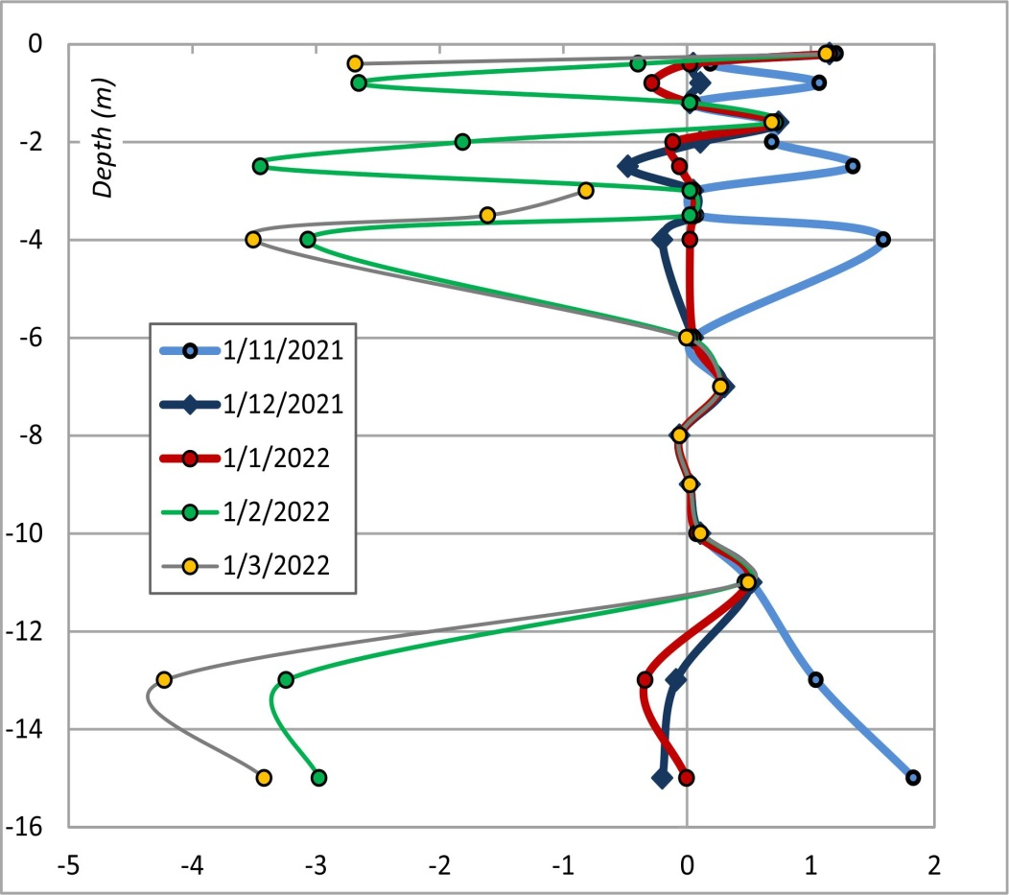
Temperature profiles
Wrong temperature data – unknown source of error
(needs to be checked)
?
Data is coherent between 7 and 11 m depth;
Continuously negative temperatures at -8 m during the 4 months.
?
---> Internal stratigraphy of the debris

Slide 10
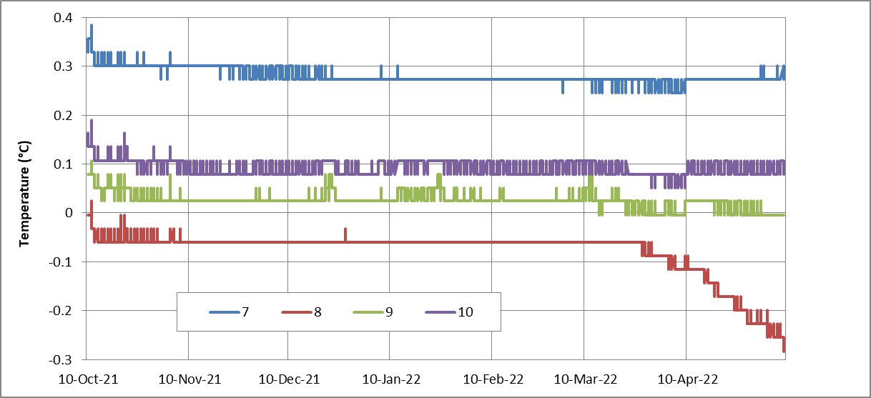
Temperature oscillations at 7, 8, 9 and 10 depths in the borehole between October 2021 and April 2022

Slide 11
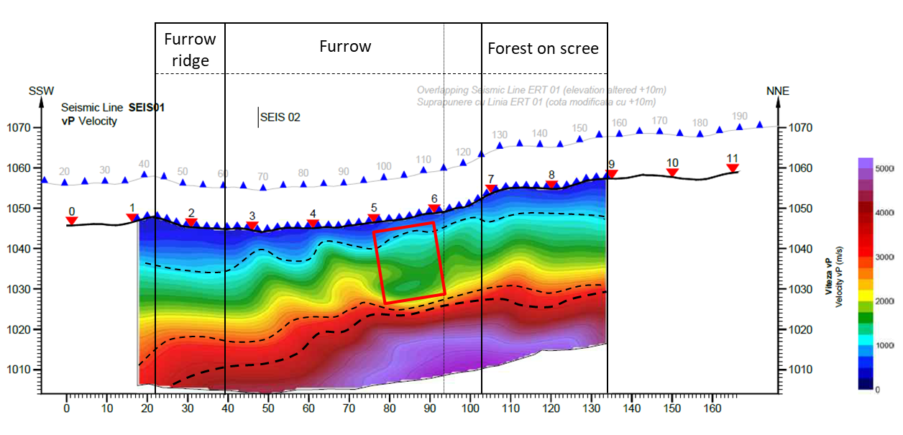
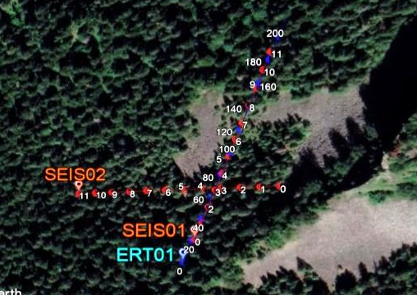
Comparison with geophysics
Seismic profile (SEIS01)
Low velocities (porous scree?) down to 20 m
Profile performed in 15 October. Data below 20 m depth are less reliable
Higher velocities layer closer to the surface
Scree stratigraphy in furrow (the maximum interest area)
SEIS-1 | Depths range (m) | Thickness range (m) | P wave velocity (m/s) | Interpretation
Layer 1 | 0 - 2.5 ( 9) | 2.5-9 | 0-900 | Openwork scree layer
Layer 2 | 2.5 (9) – 20 (30) | 16.5-24 | 900-2000 (3000) | Lower porosity talus?
Layer 3 | 20 (30) – 25 (36) | 1-10 | 3000-4000 | Transition to bedrock?
Layer 4 | 25 (36) – max depth |  | >4000 | Bedrock?
SRT indicated the improbable permafrost presence in the upper layer
The contact between debris and marls seem to correspond to the 1500-1700 m/s velocities with lower values for the talus and higher values for the marls. However, there is rather a continuous increase in velocities towards deeper layers and not a discontinuity

Slide 12
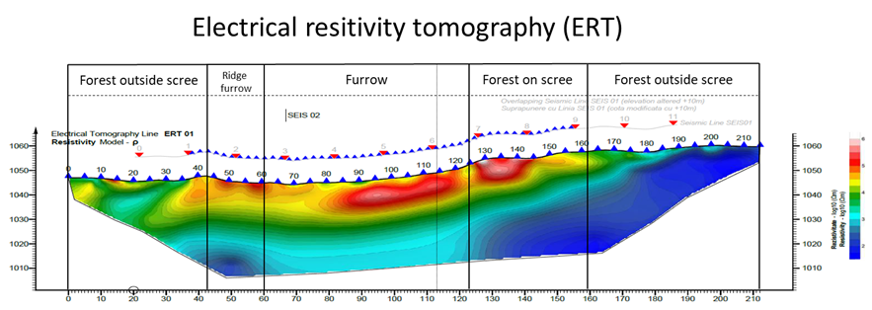

>17 kΩm
High resistivity cores
(50-560 kΩm) 10-13 m thick below 0 (3) m down to 13-14 m.
<1.7 kΩm
<1.7 kΩm
Higher velocities on SRT profile
Low velocities on SRT profile
Profile performed in 16 October 2020. RMS error: 10.6
The upper layer (0-14 m) has high to very high resistivity values (17-560 kΩm) in the furrow. However, 560 kΩm is rather an artifact and some 100 kΩm or 56 kΩm could be the value characterizing the cores.
A low resistivity layer (<1.7 kΩm) occurs below the furrow (>20-25 m) and at the surface in the forest area (northern part);
An intermediate layer with values of 5-10 kΩm between the two.
- The talus layer is indeed characterized by resistivity values >17 kΩm;
- Ice was probably absent on most of the layer at the date of the sounding (middle October) so the high values (50-100 kΩm) were caused by openwork debris.

Slide 13
Conclusions
Relatively thin debris layer (12.4 m) with low variability in grain size on top of cretaceous marls;
Poor ice content between 2.6 and 8.83 m even at the beginning of the warm season. Ice found under the form of pure ice lenses and frozen sediment matrix with various ice content;
> 3 m of ice free- and (most probably) unfrozen layer of debris below 8.83 m depth. Not all the talus deposit is affected by frost conditions;
Thermal monitoring system needs to be checked but the continuous negative temperatures at 8 m depth indicate a probability of a thin frozen layer (tens of cm) of perennially frozen ground. Above at 7 m and below at 9 m there is no (continuous) frost;
Transition between basaltic talus and marls correspond to P wave velocities of 1500-1700 m/s (SRT) and to resistivity values of 17 kΩm (ERT). However, ERT is more sensitive to discontinuities in comparison to SRT;
ERT cannot discriminate between porous talus and permafrost but SRT is better at this task.

Slide 14
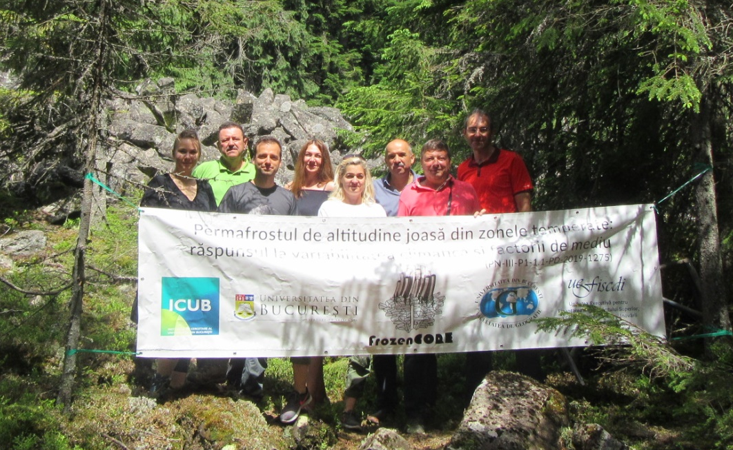
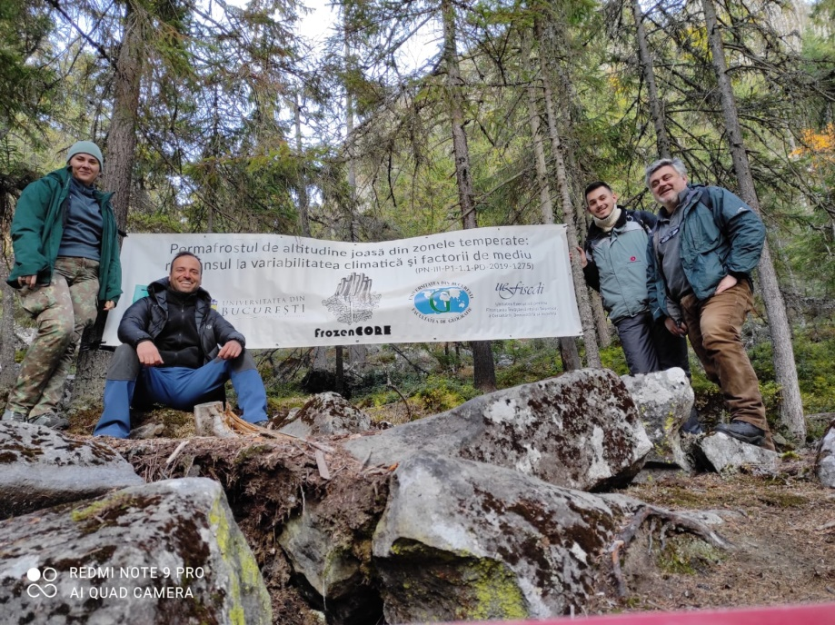

Thank you!
Acknowledgements:
Daniel Neagu
Agency of environmental protection (APM) Alba;
Management agency of protected natural areas (ANANP) Alba;
Bucium commune (Alba County) city hall.
Research project: PN-III-P1-1.1-PD-2019-1275
Financed by Romanian Government (UEFISCDI)
- www.frozencore.unibuc.ro
- https://www.facebook.com/Frozencore-100354808760241

