Slide 1
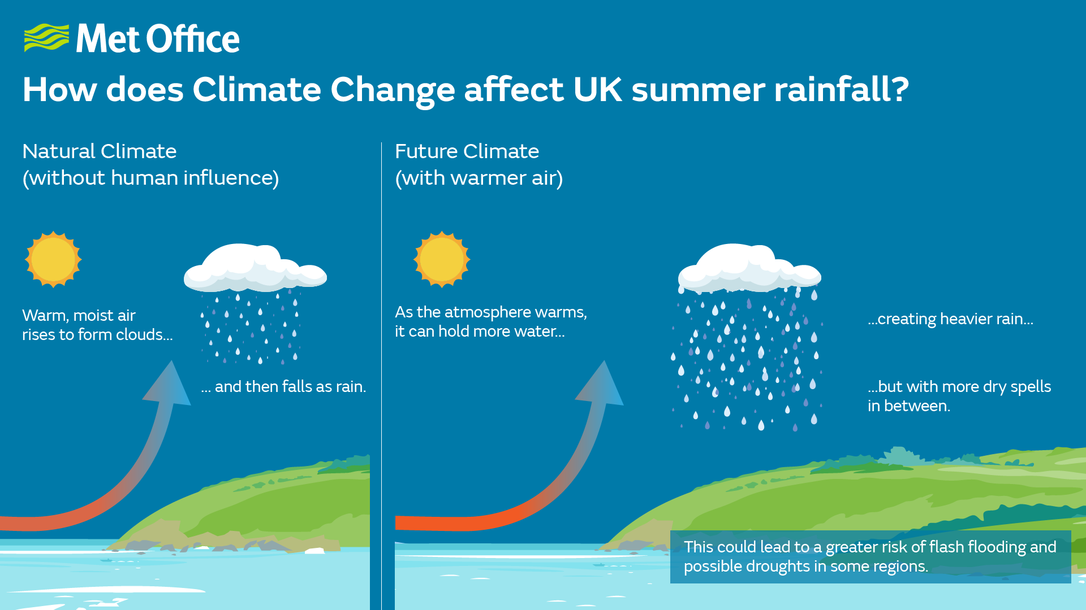
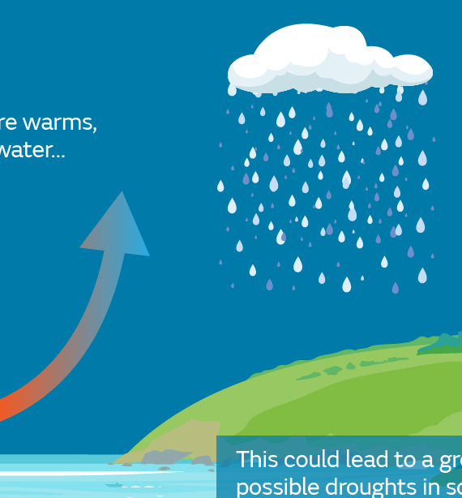
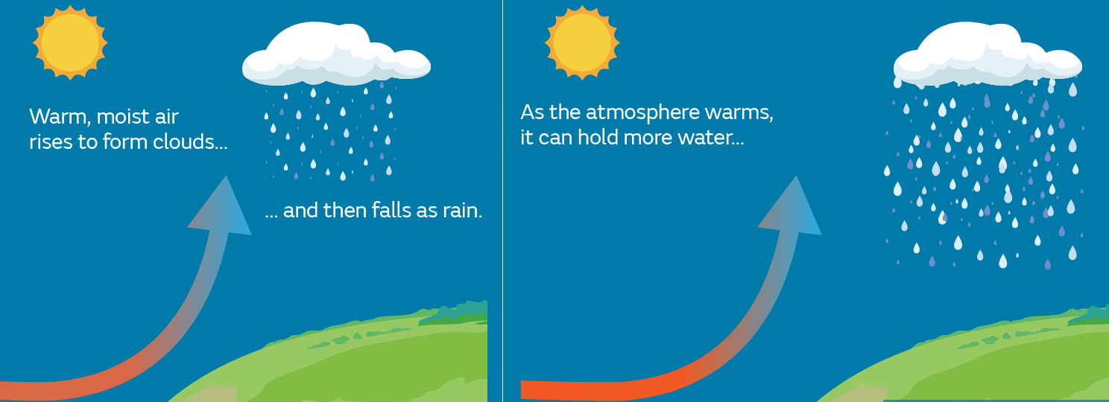


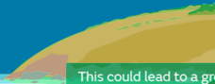




Warm, Moist air
rises to form clouds...
As the atmosphere warms,
it can hold more water...
Soil moisture is decreasing
Quantifying the impact of soil moisture dynamics and precipitation on UK future flood hazard under climate change using UKCP18
Youtong Rong, Paul Bates, Jeffrey Neal, Leanne Archer, Simbi Hatchard
youtong.rong@bristol.ac.uk
Abstract
download here:

Slide 2
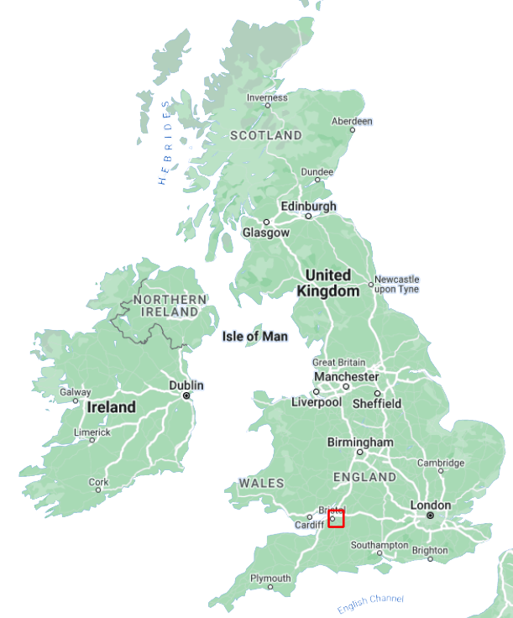
Motivation: How does climate change affect future UK flood?
Increasing precipitation VS Decreasing
observed surface runoff
Antecedent soil moisture modulate flood risk
Few studies have directly used output from
km-scale climate models in flood modelling
Few studies examine trends in the drivers of flooding
Taking Bristol as an example
Study Area
~ 746.5 km²
Complex transfer function
between precipitation and flooding

Slide 3
Method: a scenario-based UK future flood risk assessment using UKCP18
1
2
3
4
Initial Moisture + Precipitation - Infiltration – Drainage loss by sewer system = Flood Volume
1
2
12 climate scenarios, each
contains three period:
past (1980-2000)
present (2020-2040)
and future (2060-2080)
30098 rainfall events,
simulated with LISFLOOD-FP
4 return periods for drainage loss estimation
30m grid-based flood modelling
3
4

Slide 4
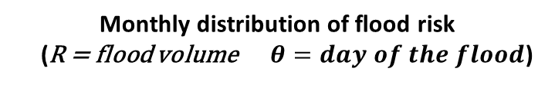
Results: Comparing the past and future monthly average flood volume (20year)
Apr
Mar
May
Feb
Flood volume
Jun
Jan
Soil moisture
Jul
Dec
Flood Volume
Difference
(Future-PAST)
Aug
Nov
Sep
Oct
Month over 20 years (1980-2000) and (2060-2080)
Monthly distribution of flood risk
(R = flood volume $θ=day of the flood$)
Small floods, responsible for filling our water supplies, are decreasing
Large flood events which pose a risk to life and infrastructure, are increasing.
Lag of extreme rainfall event under global warming
Thanks for your attention!

