Slide 1
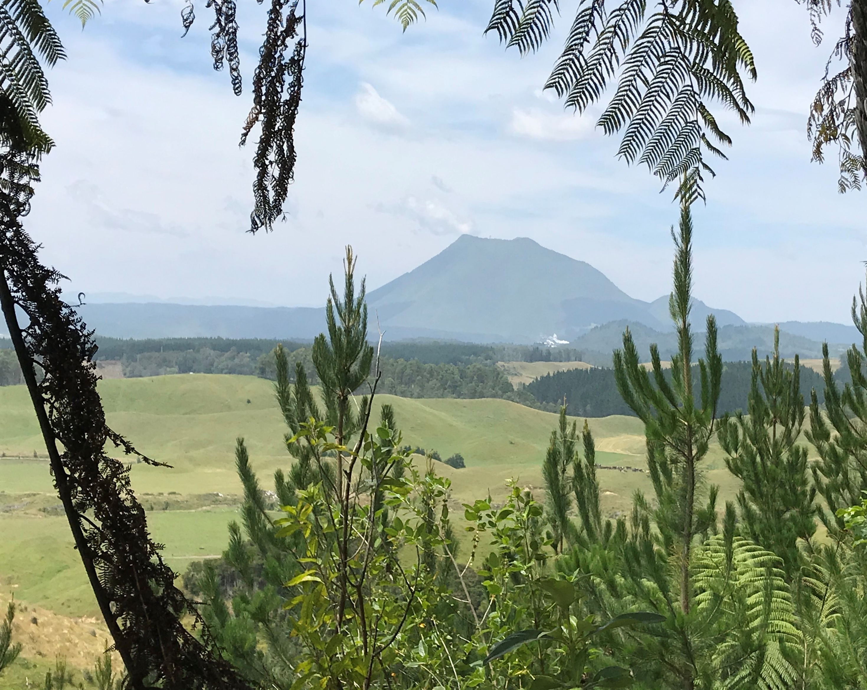

Origin of compositional variations of Taupo Volcanic Zone (TVZ) eruption products: crustal differentiation or subduction mélange diapirism?
Carlos R. Corella Santa Cruz; Georg F. Zellmer; Claudine H. Stirling; Susanne Straub; Malcolm Reid; Karoly Nemeth; Marco Brenna

Slide 2
Tonga-Kermadec-Hikurangi subduction zone
Tonga portion | Basaltic andesites + Andesites ± Dacites
Kermadec portion | Basalts, Basaltic andesites ± Dacites ± Rhyolites
Hikurangi portion (TVZ) | Rhyolitic volcanism > 95% Dacitic volcanism < 1% Andesitic volcanism < 3% Mafic volcanism < 1%
(Turner et al., 1997)
(Ewart et al., 1977)
(Ewart & Hawkesworth, 1987)
(Regelous et al., 1997)
(Cole, 1979)
Subduction of the c. 15 km thick Hikurangi Plateau
Crustal thickness from c. 15 to 30 km, Torlesse composite terrane, graywackes.
(Mortimer & Parkinson, 1996)
Hikurangi Plateau
(Salmon et al., 2011)
(Price et al., 2015)
(Modified after Schellart et al., 2006)
Notes:
Delete the 2700 km, don’t go into the isotopes. We are in the NZ arc, southernmost part of the TKH subduction zone that we have a continental arc… Talk about the compositions different (next slide)

Slide 3
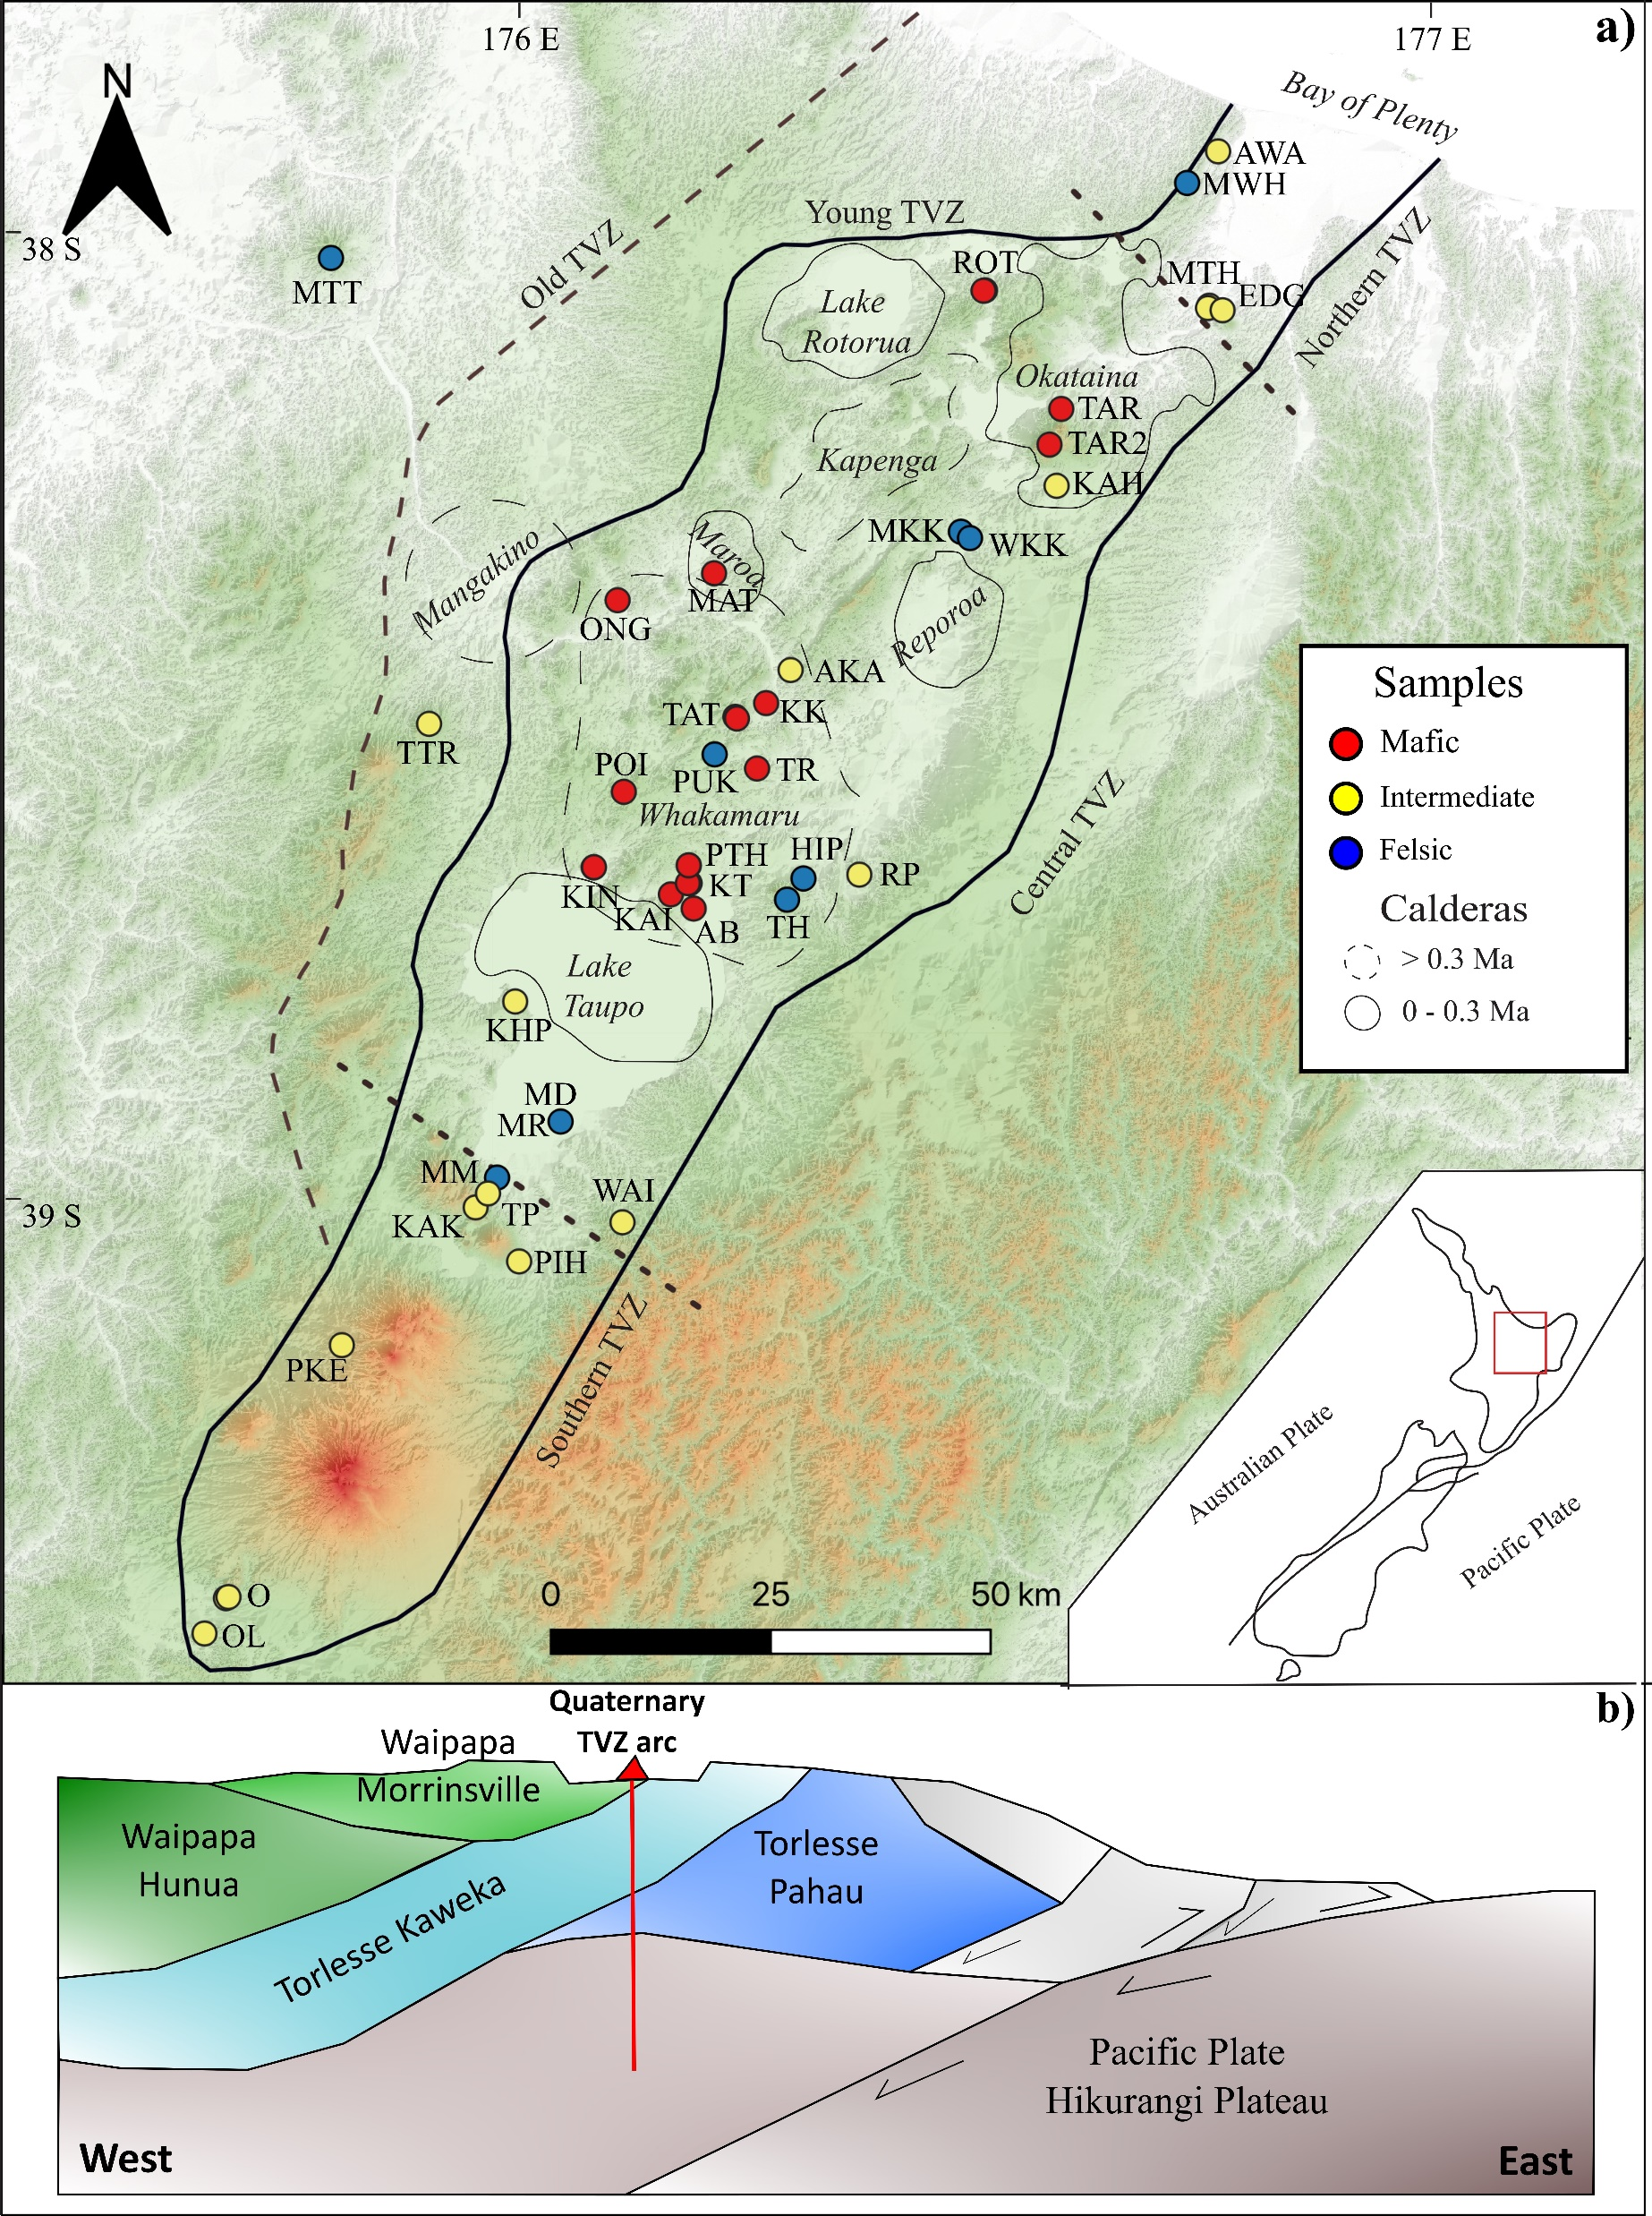
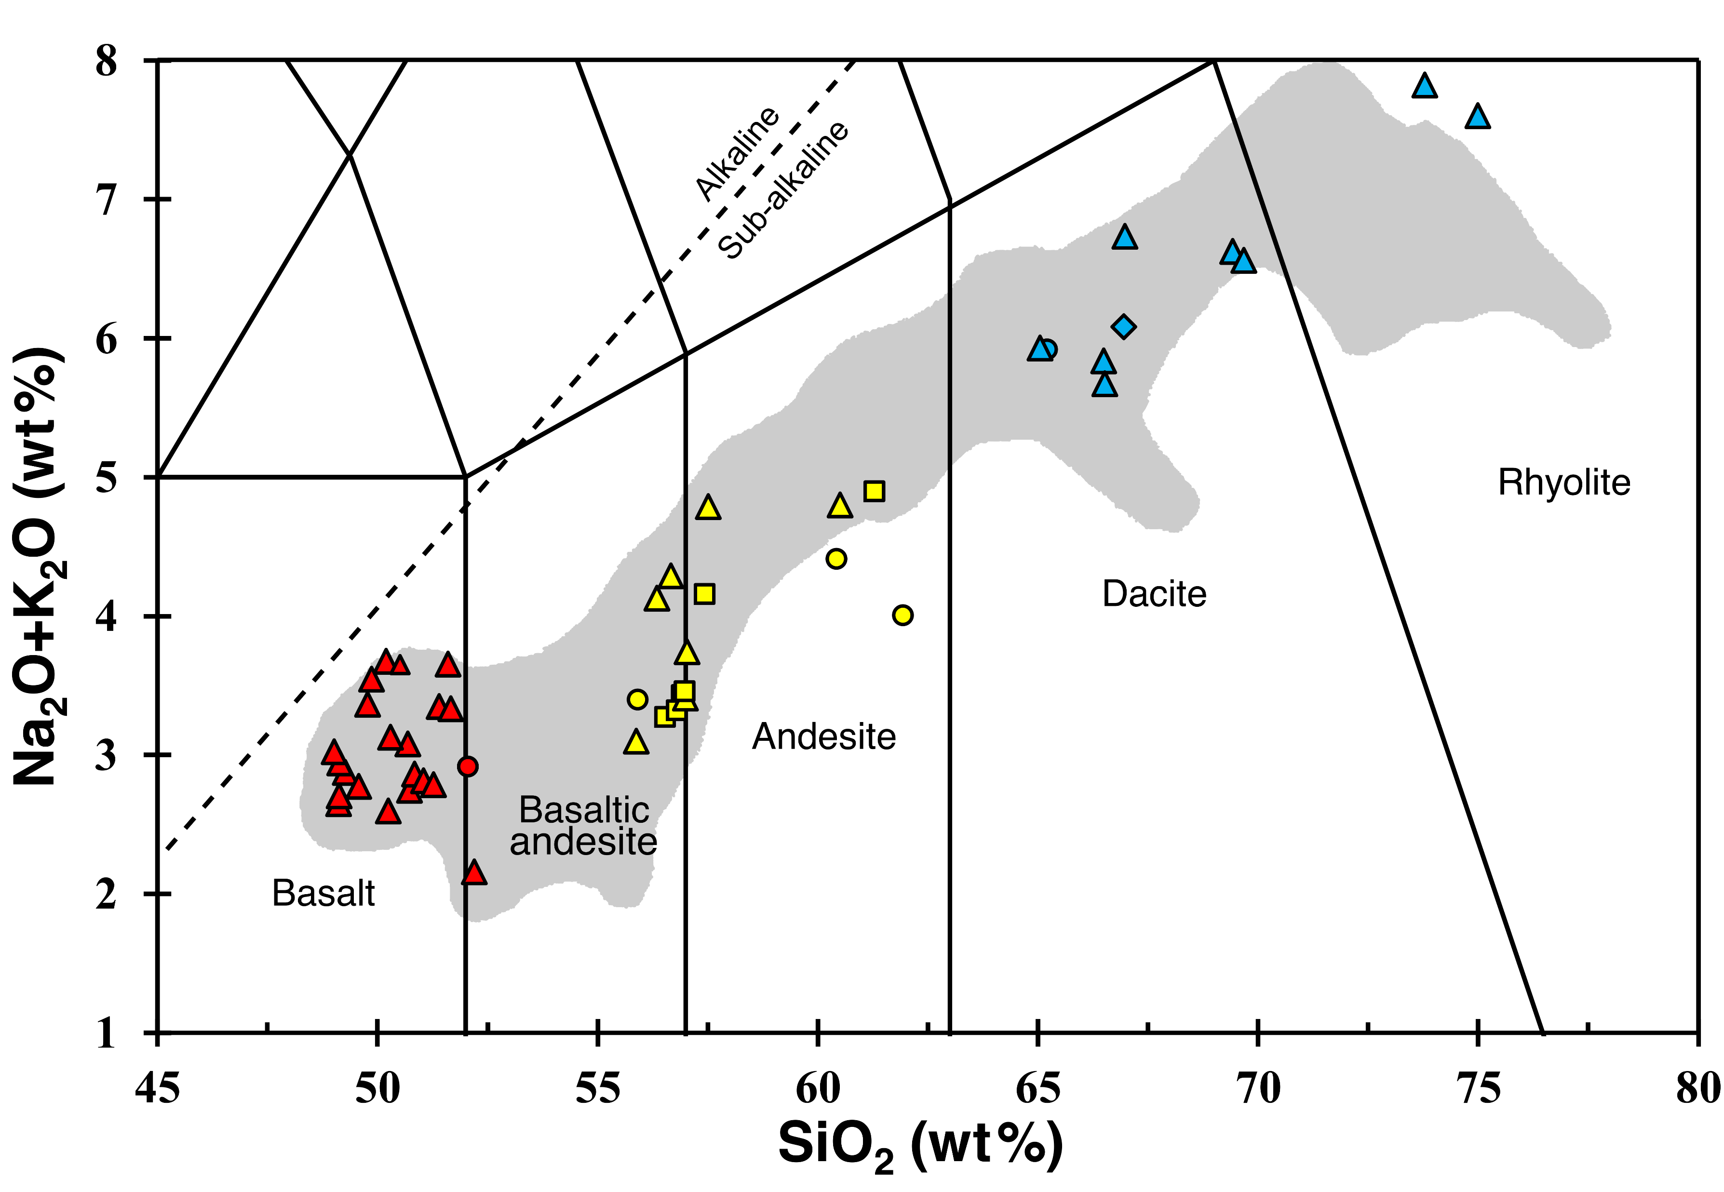
Is this compositional range generated by AFC in the thin crust?

Slide 4
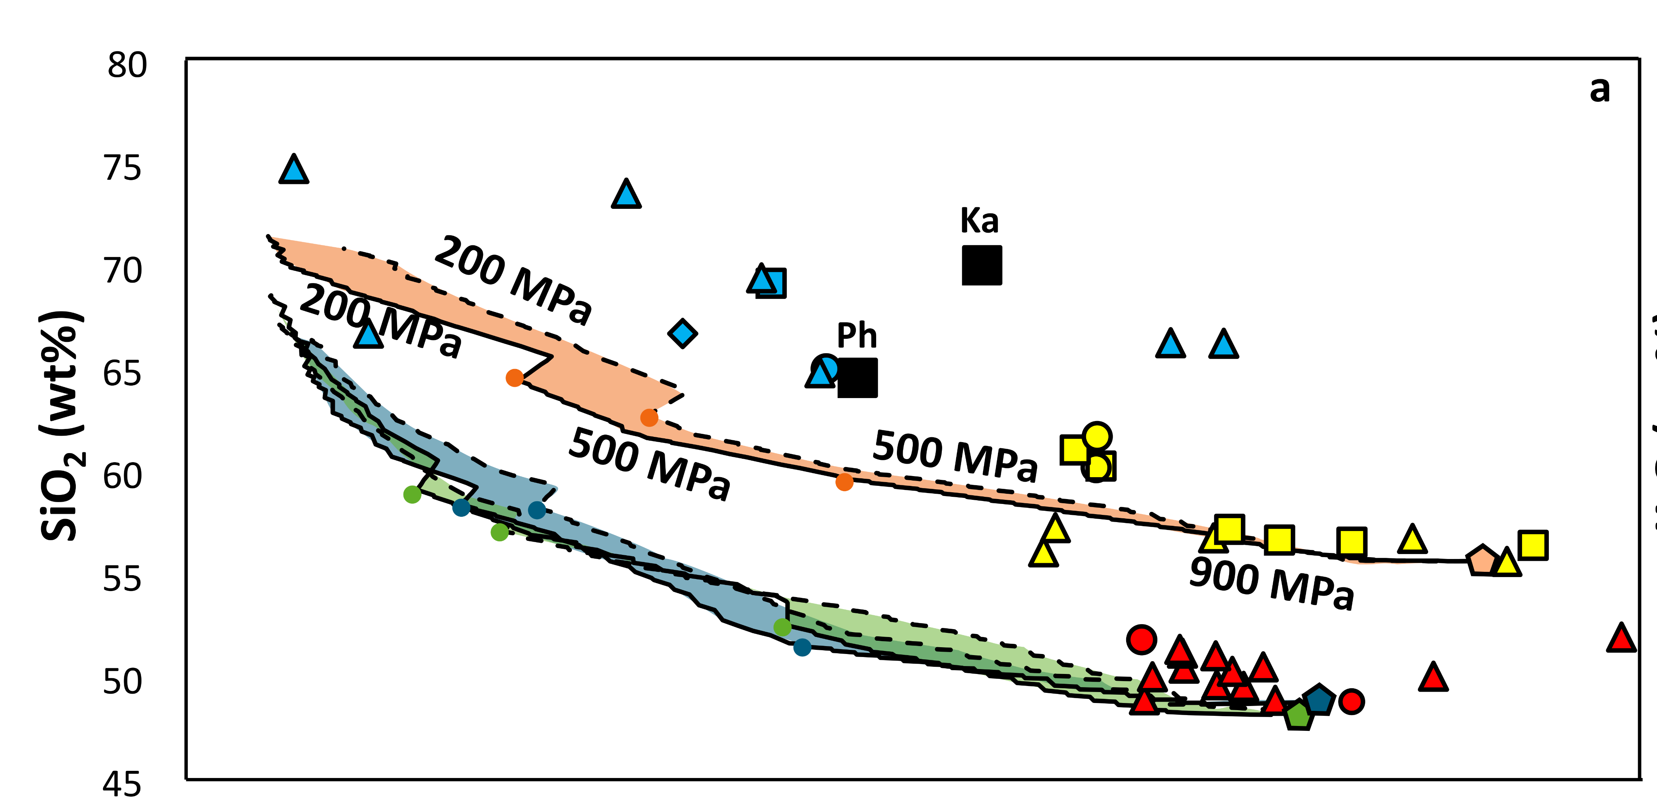
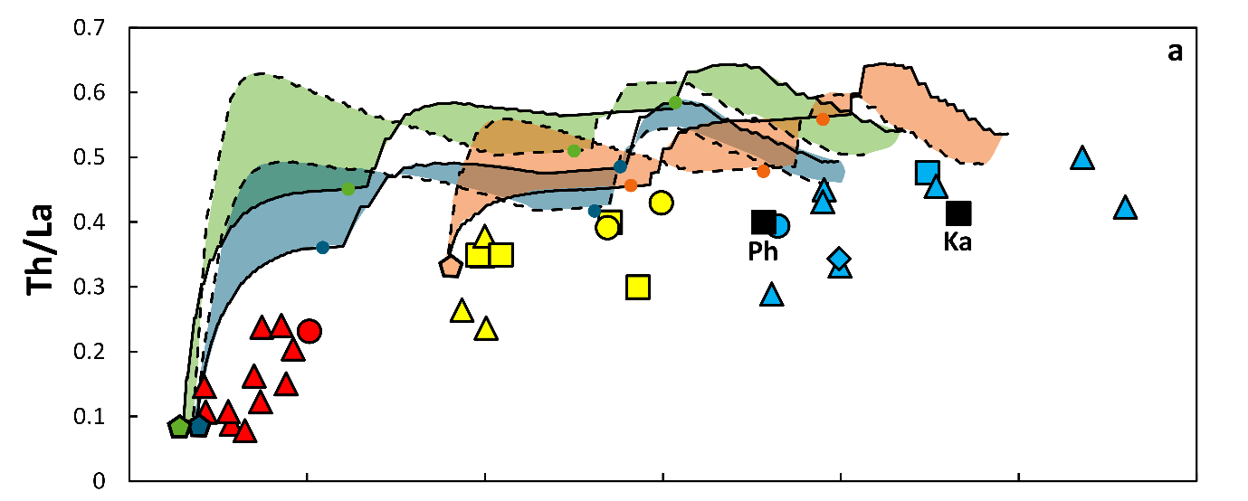
Three different starting compositions (Mafic and intermediate)
Two different pressure paths:
900-500-200MPa
500-200MPa
Two different wallrock compositions (Pahau and Kaweka subterranes)
Ph: Pahau subterrane
Ka: Kaweka subterrane

Slide 5
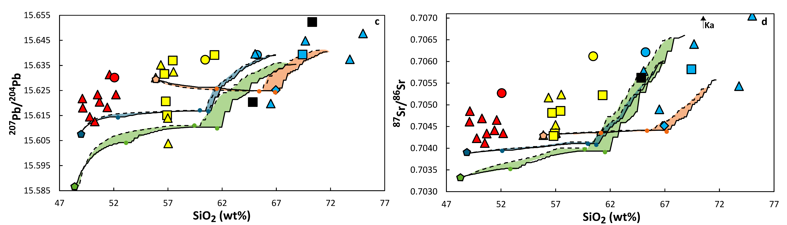
Sr and Pb isotopic ratios

Slide 6
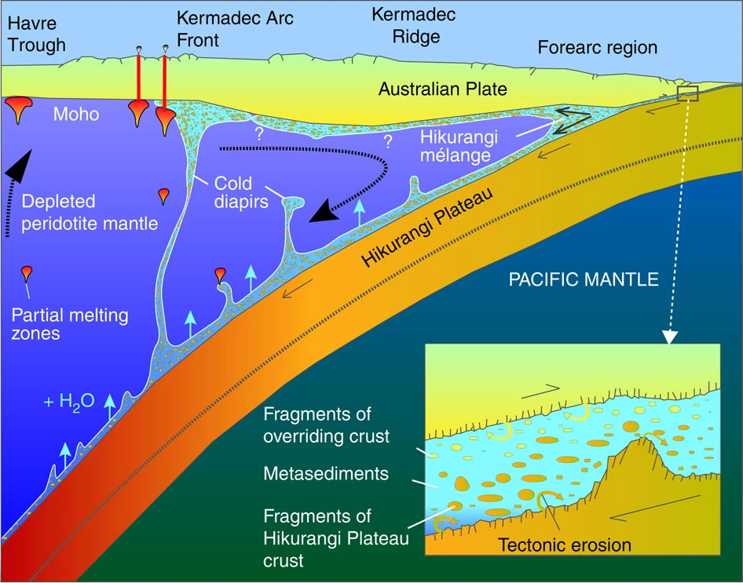
Hikurangi mélange diapirs with eroded material involved in the Kermadec Arc
Sr, Pb and Nd isotopic signatures
(Timm et al., 2014)
Subduction erosion in the Hikurangi margin
(Barker et al., 2009; Collot and Davy, 1998; Collot et al., 1996; Lewis et al., 1998, Pedley et al., 2010)

Slide 7
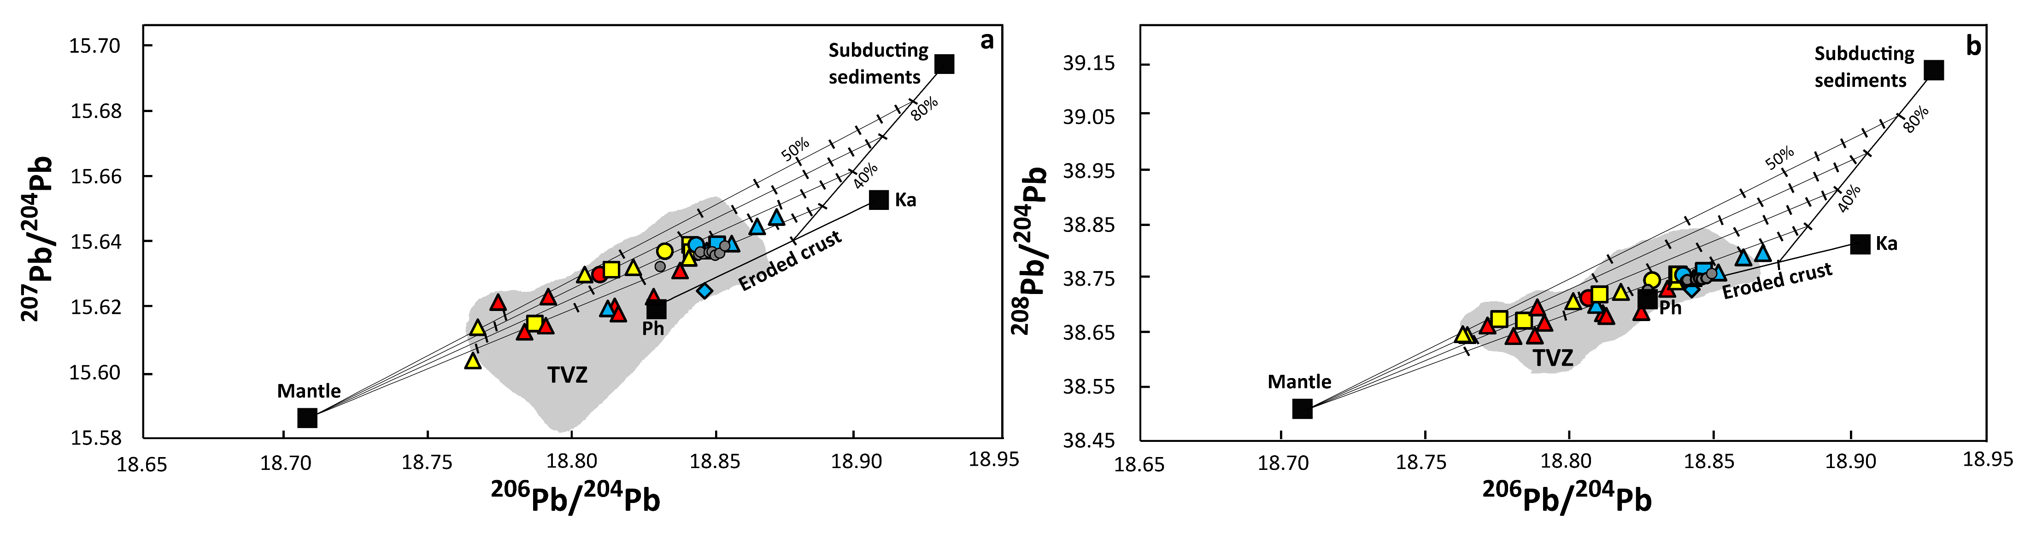

Slide 8
Conclusions
EC-AFC is unable to reproduce the compositional variation.
Inconsistent with the thin continental crust
Subduction erosion and mélange diapirs are a viable alternative model to mix crustal materials into the mafic mantle melts.
Thank you!

