Slide 1




Controlling dynamic splitting of Brazilian disc specimens using
Adelaide University Snapback Indirect Tensile test (AUSBIT)
Giang D. Nguyen, Rupesh Verma, Murat Karakus

Slide 2
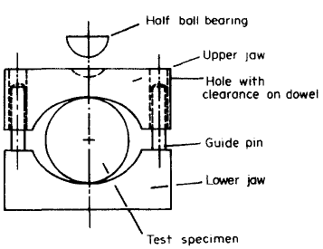
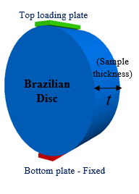
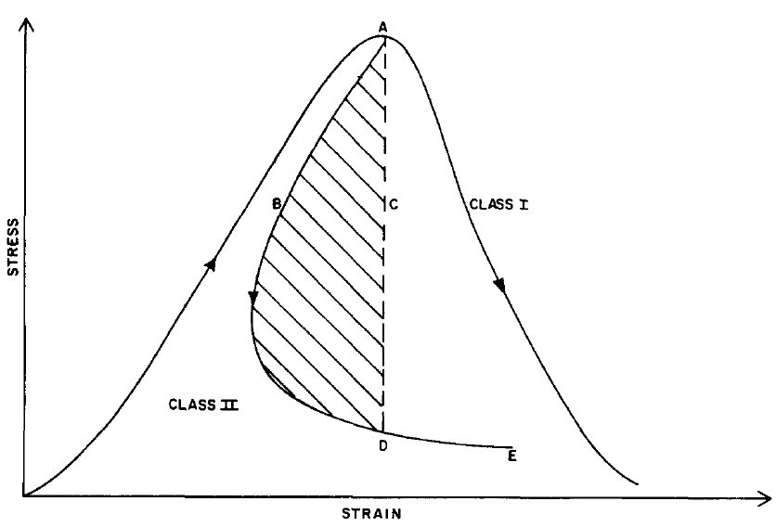

Brazilian disc testing
Load (kN)
Displacement (mm)
ISRM Standard
Snap-back (class II)
Brazilian disc testing
Popular: easy to prepare & set up; adopted in ISRM standard…
Very brittle behaviour observed: snap-back & dynamic behaviour
Storage energy at peak exceeds the dissipative capacity of a single centreline crack
2

Slide 3
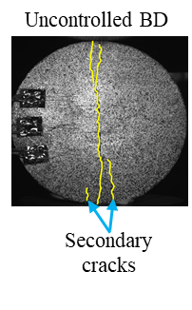
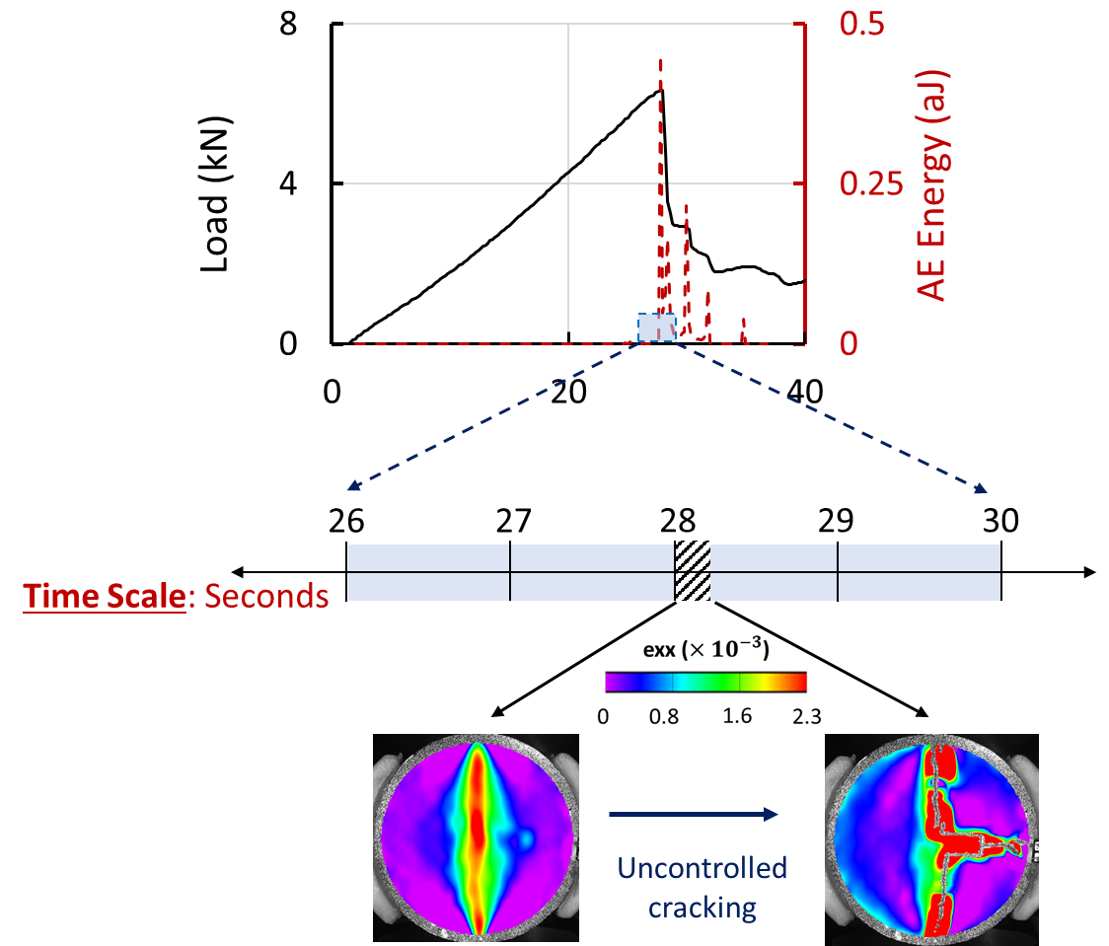
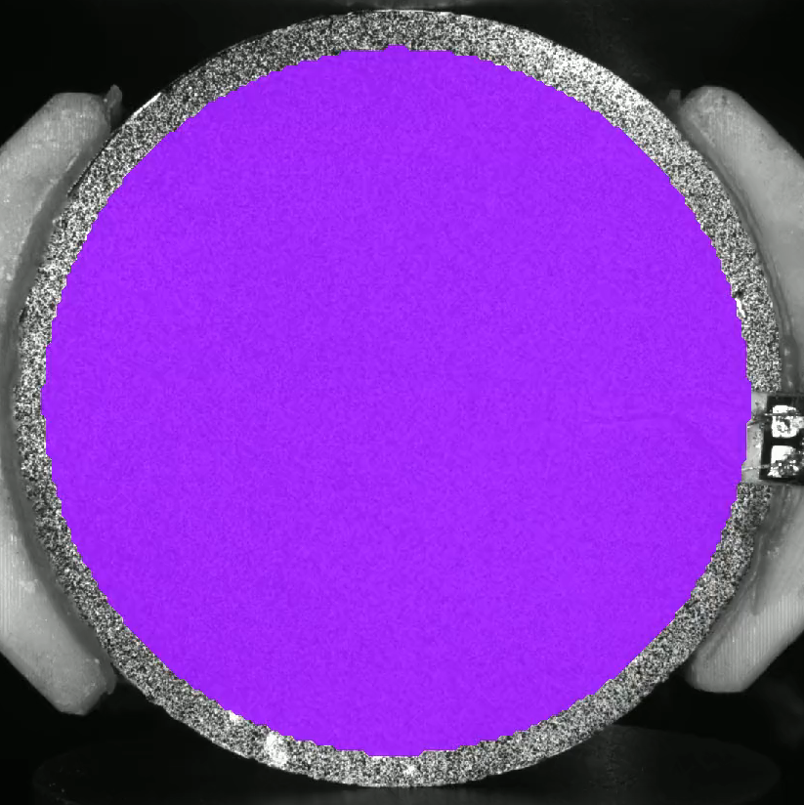
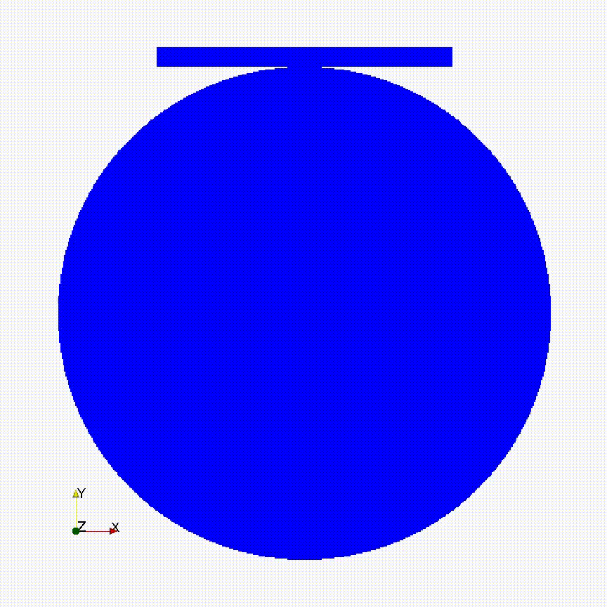
Brazilian disc testing: brittle & dynamic behaviour
Digital Image Correlation
150 Frames/second
Fracture in a split second – dynamic behaviour
Impossible to be captured and analysed using advanced image based instrumentation
How can we slow down the fracturing process?
3

Slide 4
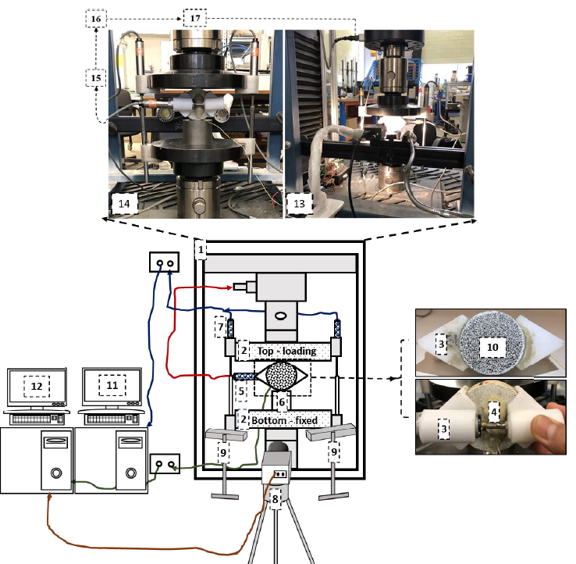
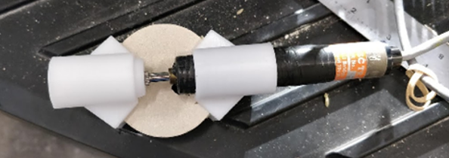
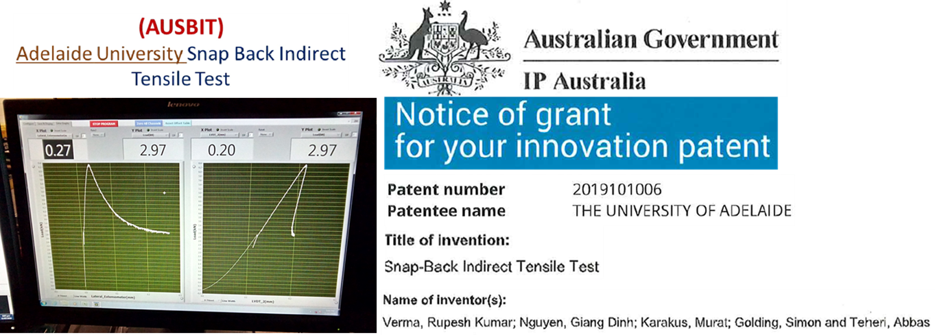
Slowing down fracturing process using AUSBIT
Lateral LVDT to provide feedback to load machine
Patented in Australia
Whole AUSBIT system
(Adelaide University Snap Back Indirect Tensile Test)
AUSBIT uses indirect displacement control based on lateral displacement
Very brittle behaviour with snap-back can be captured successfully
4

Slide 5
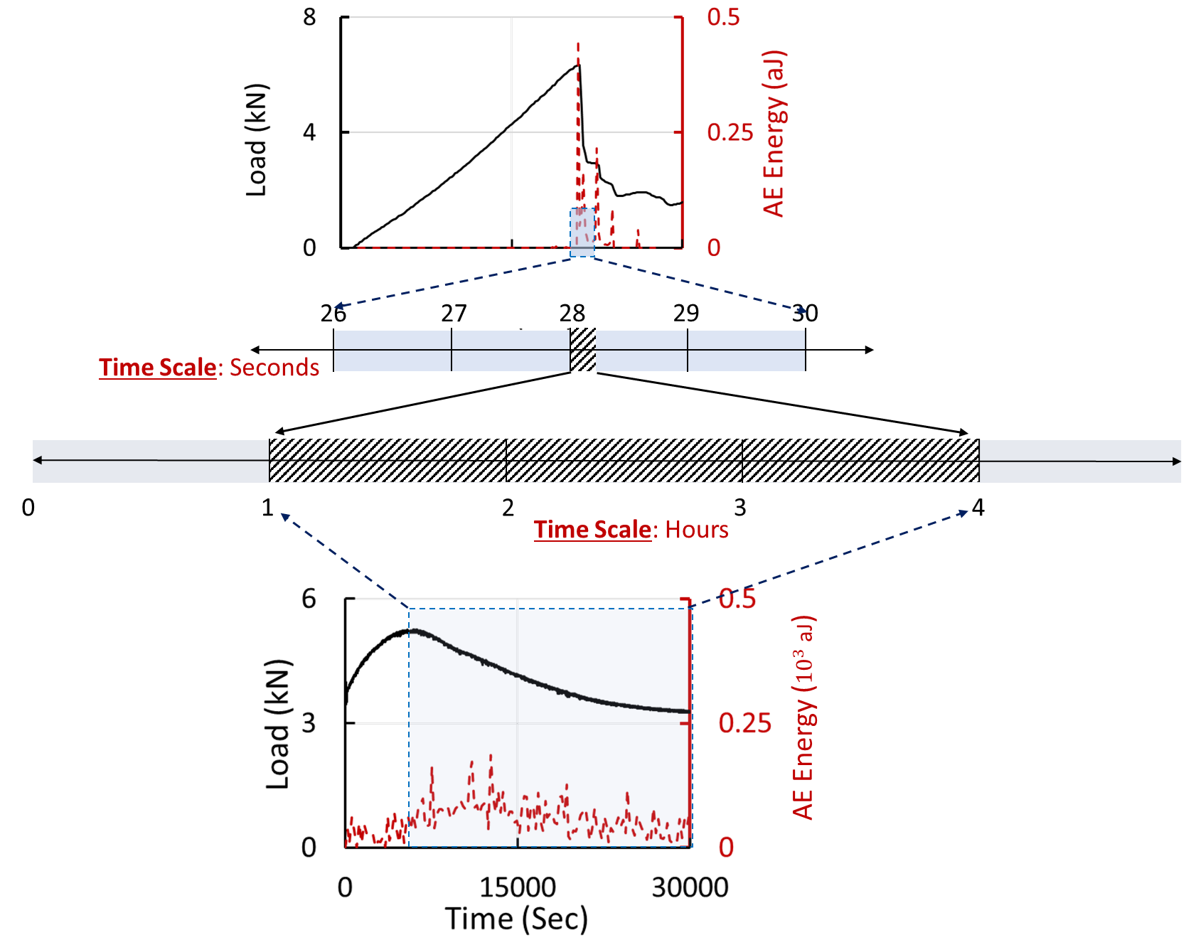
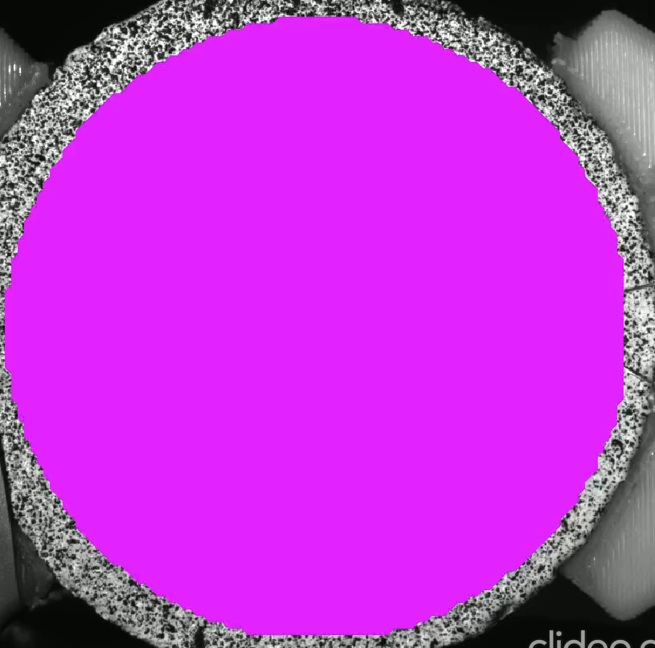
AUSBIT vs. conventional tests: much longer duration of fracturing
Conventional
AUSBIT
Hawkesbury Sandstone
Fracturing process with snap-back is over a few hours
This facilitates the use of advanced image-based instrumentation techniques
5

Slide 6
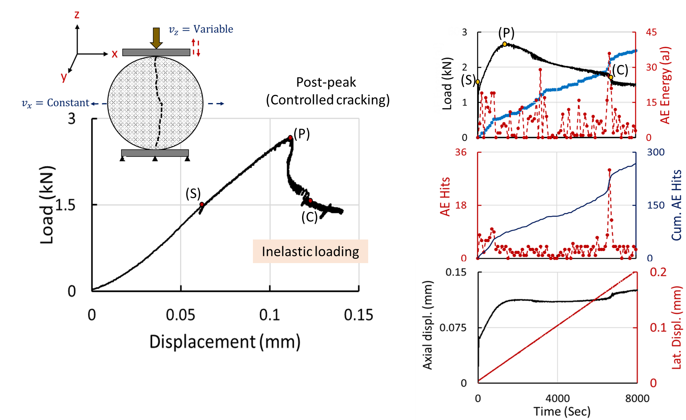
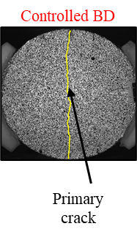
AUSBIT: proof that it actually works – true snap-back, not unloading
Acoustic Emission (AE) is used to detect inelastic activities
Significant AE activities recorded during snap-back
6

Slide 7
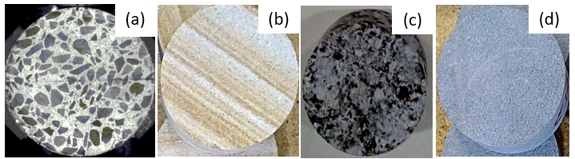
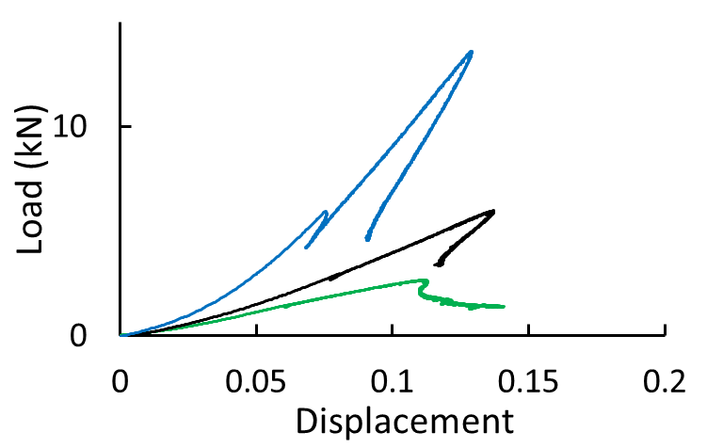
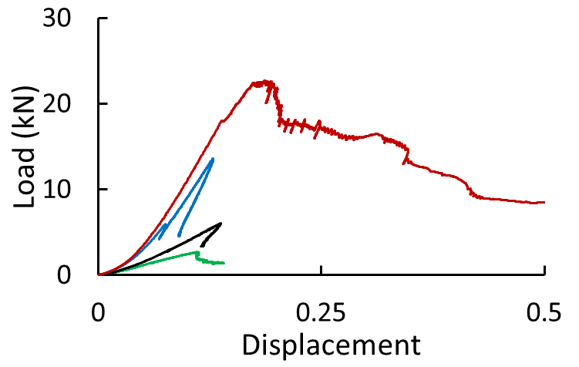
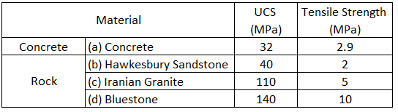
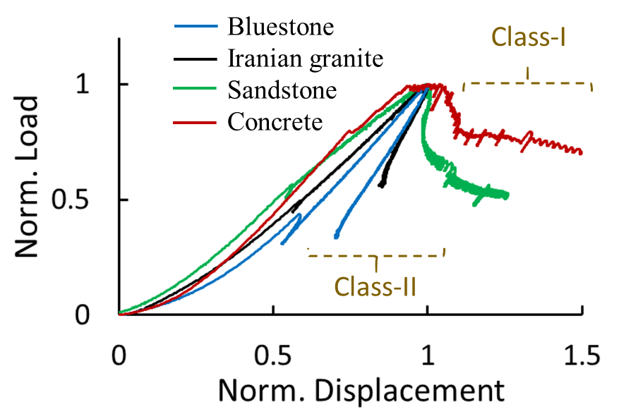
AUSBIT tests on different brittle materials
Bluestone
Iranian Granite
Concrete
Sandstone
Rocks
Load-vertical displacement curves
AUSBIT can capture snap-back in a range of brittle materials.
Both Class I and Class II responses can be captured.
Normalised Load-vertical displacement curves
7

Slide 8
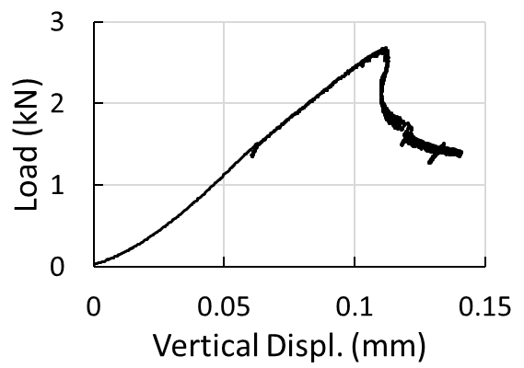
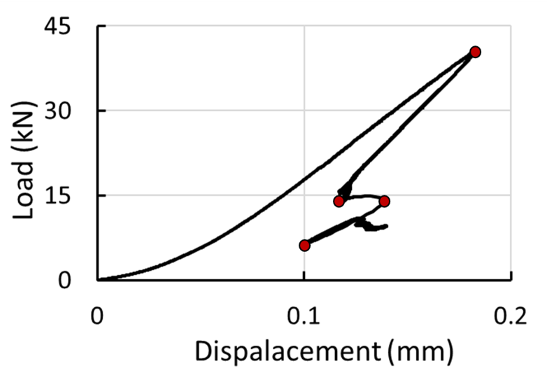
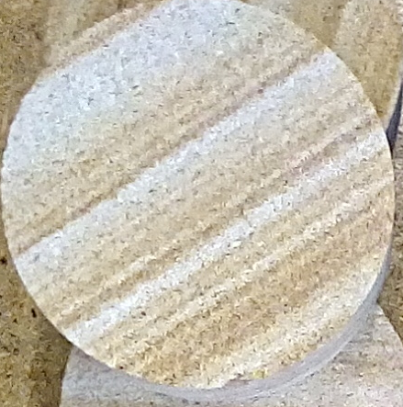
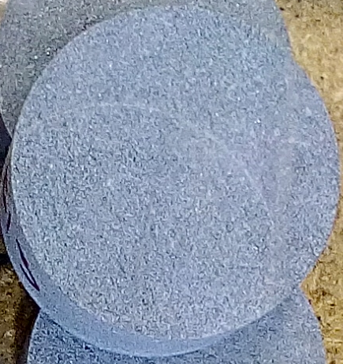
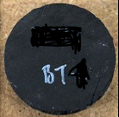
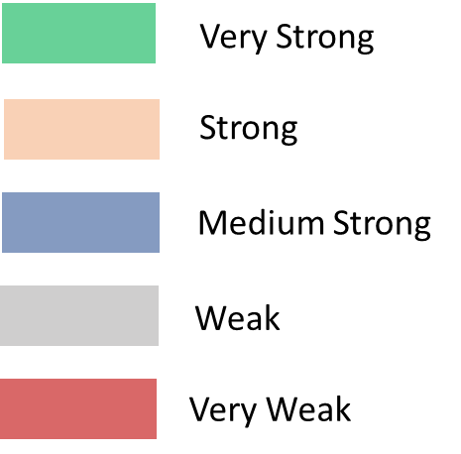
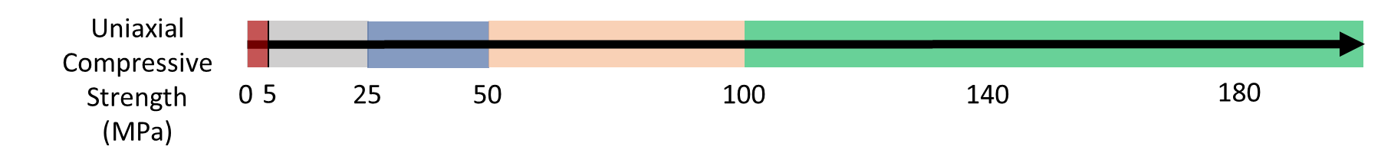
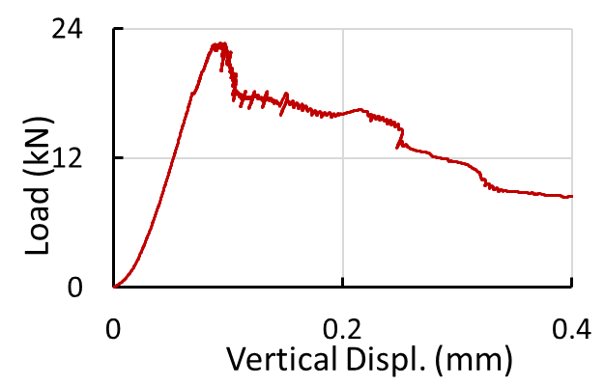
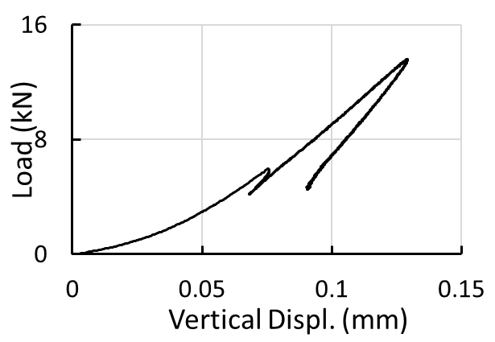
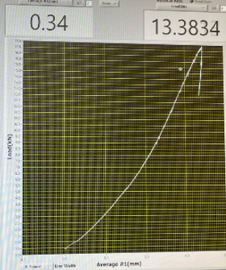
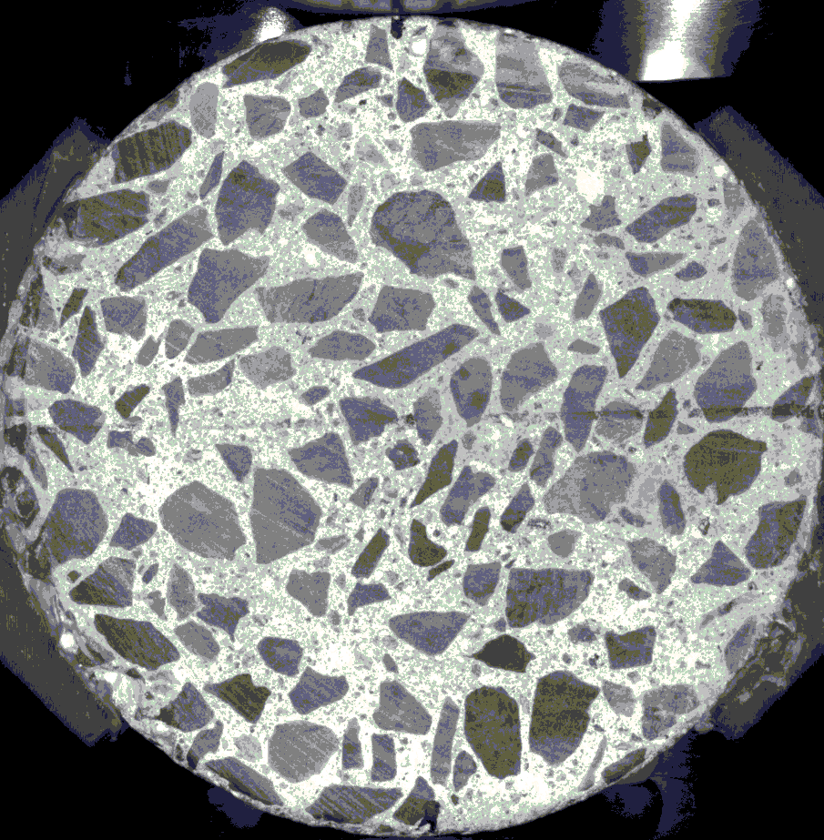
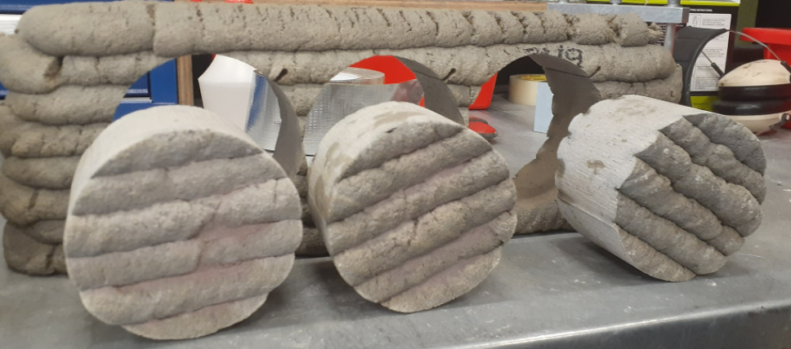
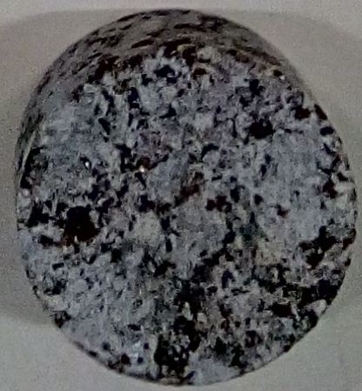



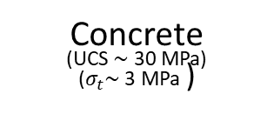



AUSBIT tests on different brittle materials
Sandstone
(UCS $\sim$ 50-60 MPa)
($σ_{t}\sim$ 2 MPa )
Bluestone
(UCS $\sim$ 140 MPa)
($σ_{t}\sim$ 10 MPa )
Coal
(UCS $\sim$ 17 MPa)
($σ_{t}\sim$ 0.9 MPa )
2018
2020
2018
Concrete
(UCS $\sim$ 30 MPa)
($σ_{t}\sim$ 3 MPa )
Iranian Granite
(UCS $\sim$ 110 MPa)
($σ_{t}\sim$ 5 MPa )
3D Printed Cement Paste
(Bedding Orientation $\sim {90}^{0}$)
Australian Granite
(UCS $\sim$ 180 MPa)
2018
2019
2021
AUSBIT: Applicable to a wide range of brittle materials
8

Slide 9
AUSBIT: Conclusions
Indirect displacement control must be used to capture snap-back (class-II behaviour). Our AUSBIT seems to be the first to use it for Brazilian disc testing
AUSBIT works well on a range of brittle materials.
It removes or at least minimises dynamic effects, prolongs the fracturing time, and facilitates the use of advanced image-based instrumentation techniques.
Thank you for your attention!!!

