Slide 1




for Earth and Climate Research
Place Louis Pasteur 3, b345
yue.zhou@uclouvain.be
High-resolution soil organic carbon mapping at the field scale in Southern Belgium (Wallonia)
Yue Zhou (yue.zhou@uclouvain.be)
Caroline Chartin, Kristof Van Oost, Bas van Wesemael

Slide 2

01
Introduction
CONTENTS
02
Methods and results
Conclusions and perspectives
03

Slide 3



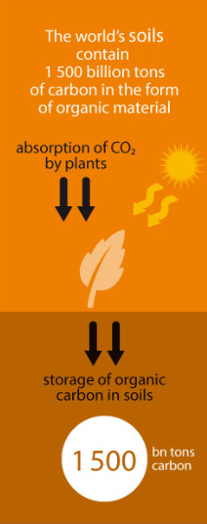
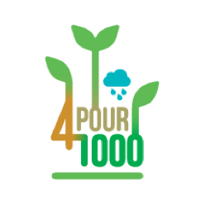
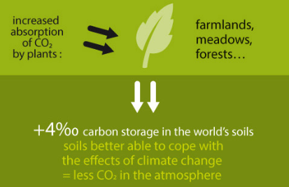
01 Introduction
Importance of Soil Organic Carbon (SOC)
Digital soil mapping (DSM) and SCORPAN model
Soils constitute the largest terrestrial carbon pool.
Soil organic matter is a main factor in aggregate stability, water retention and mineralization of nutrients.
statistical algorithm
Soil data
environmental covariates
Soil property maps
SOC(x) = f (s, c, o, r, p, a, n)
Soil
Organisms
Position
Climate
Parent material
Age
Relief
Including land cover and natural vegetation or fauna or human activity
Normalized difference vegetation index (NDVI)
Net primary productivity (NPP)
land use or vegetation types
Anthropogenic activities? (e.g. crop rotation, cover crops, tillage)

Slide 4
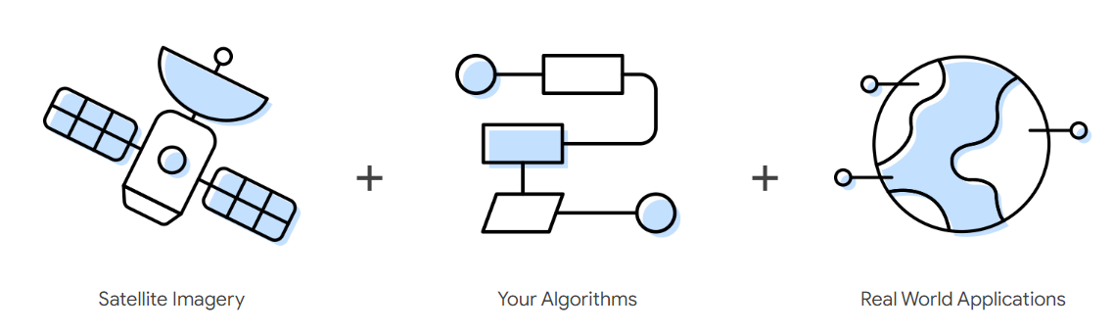
01 Introduction
GOALS:
Construct a new covariate (organic carbon input from the crops) to represent land management.
Use all covariates related to the Scorpan model to build a SOC model and create SOC maps with high-resolution remote sensing data.
Evaluate the covariates together with the scale at which they influence the SOC distribution.
(Google Earth Engine website)
Notes:
effects of differences in land use and/or management (including crop rotation and frequency of cover crops) between individual fields.

Slide 5
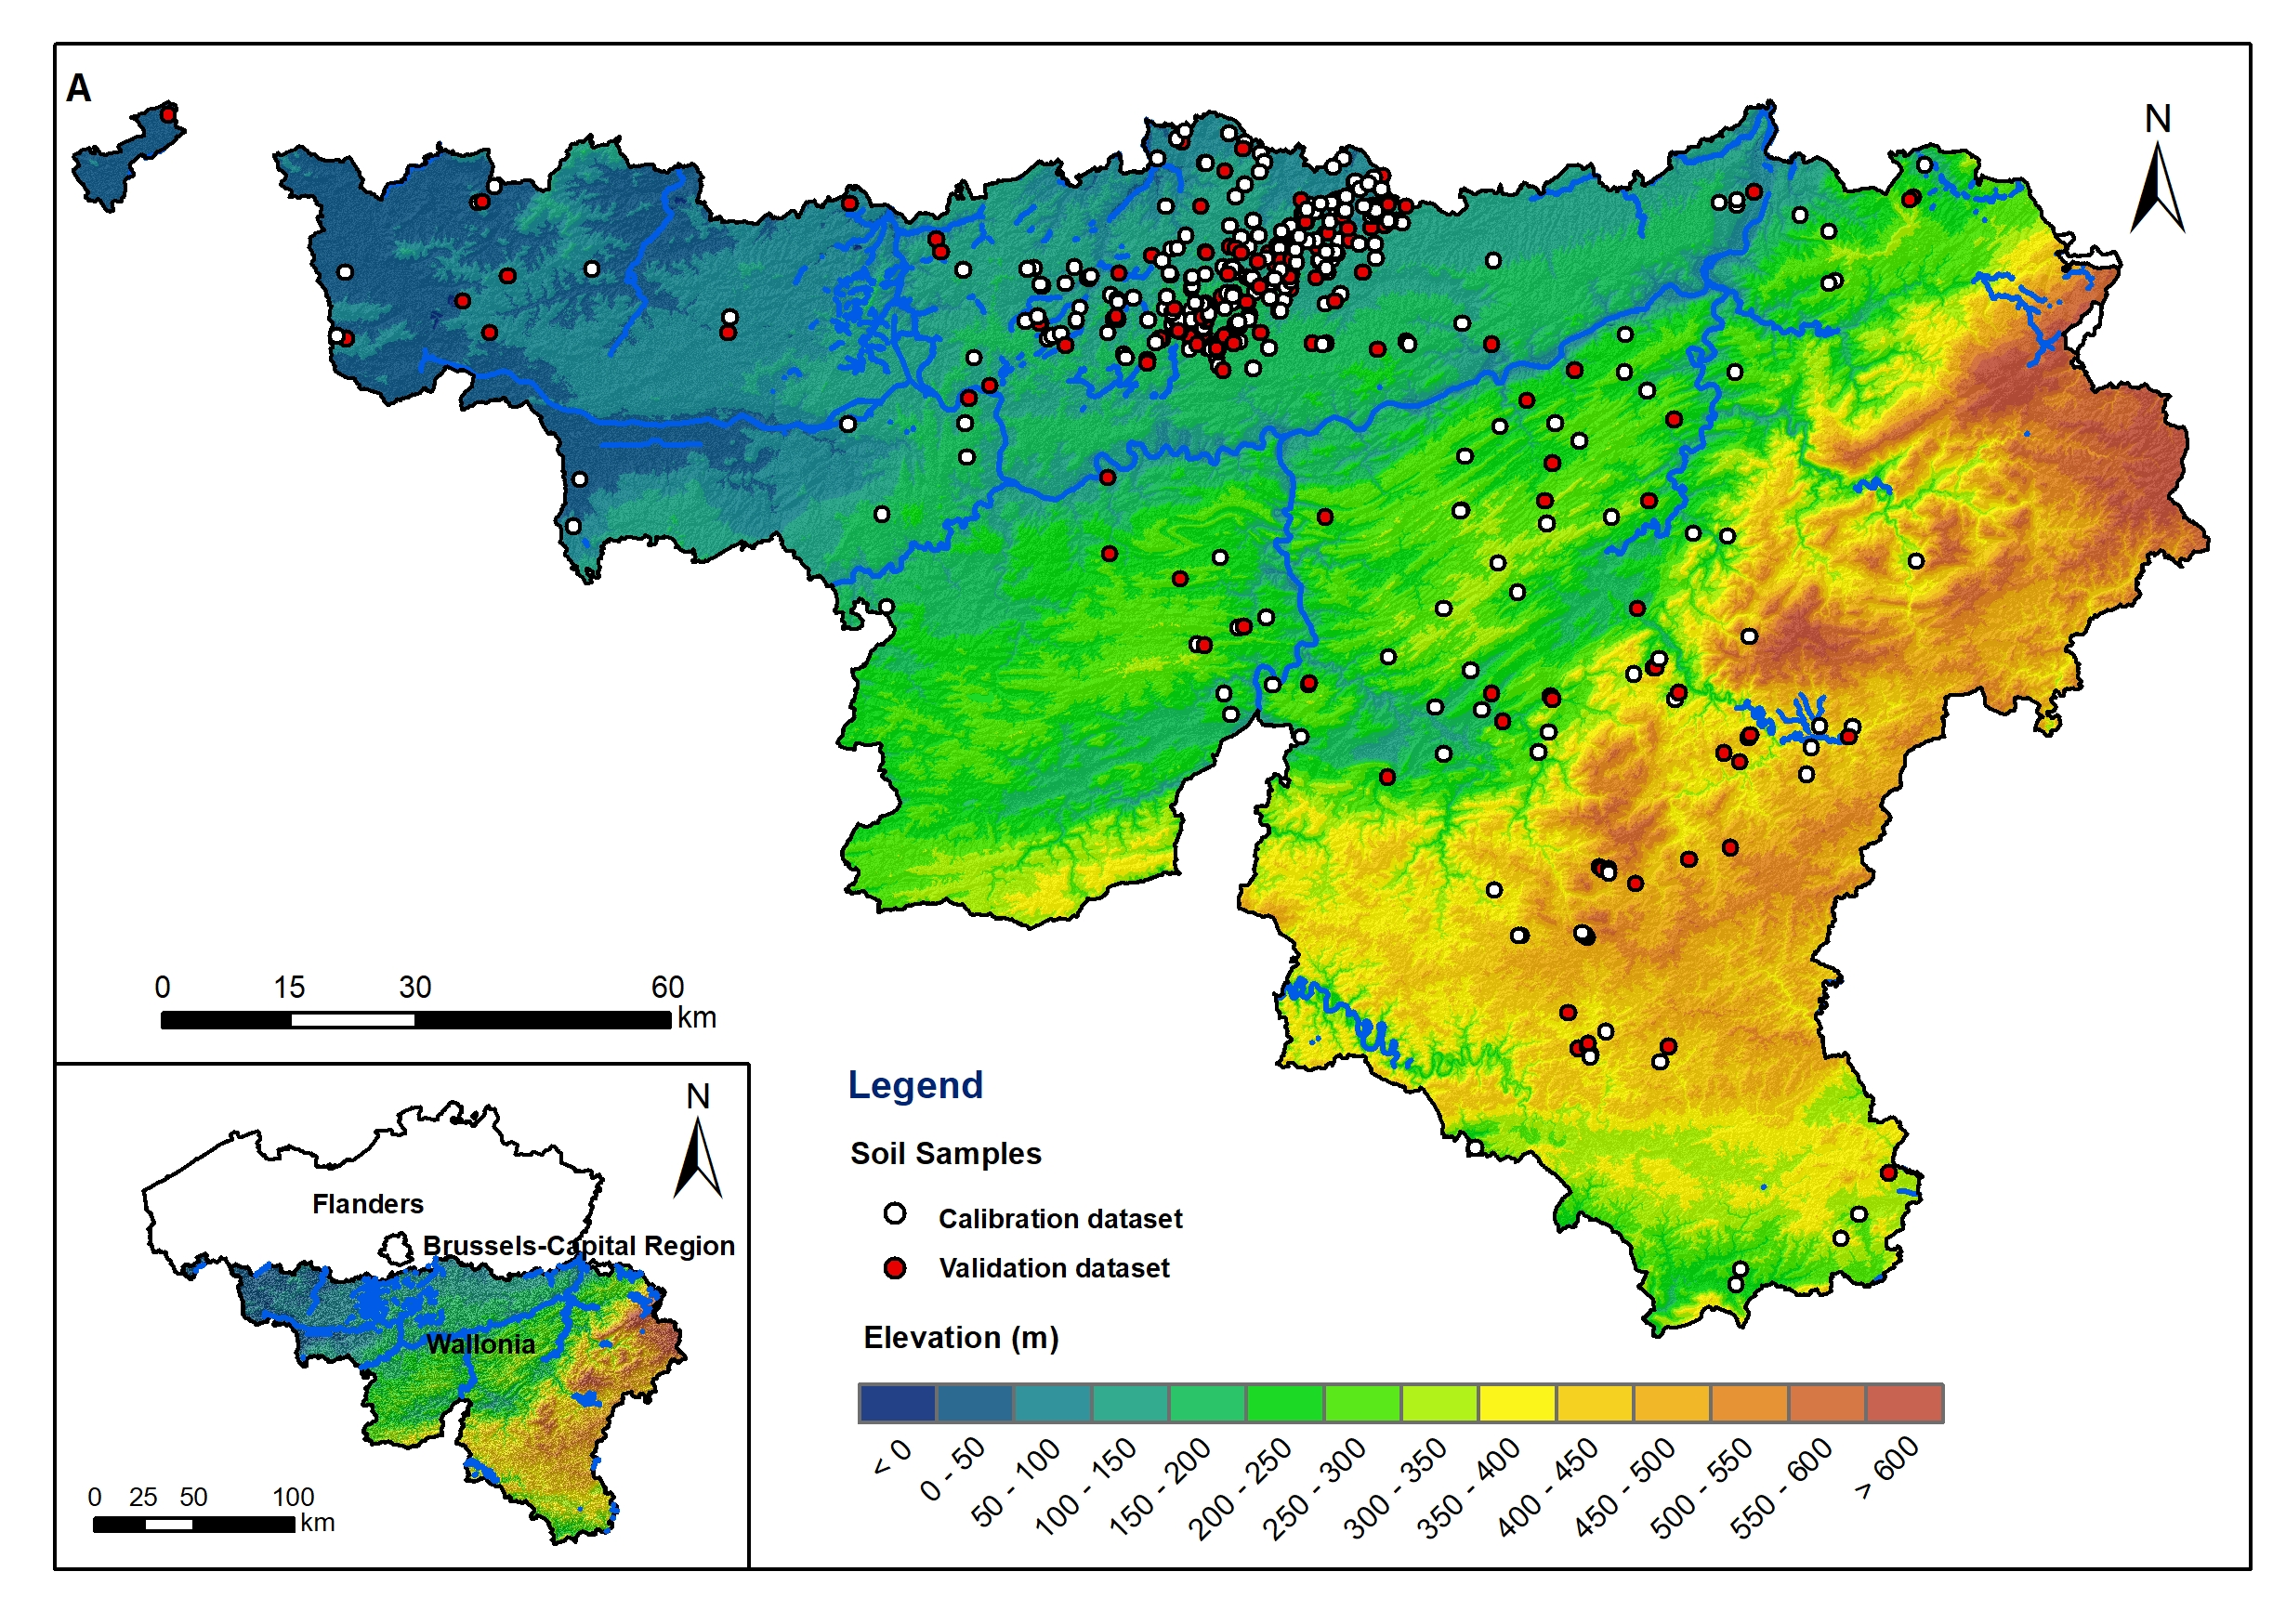
02 Methods and Results
Soil data
Goal 1
Goal 2
Wallon region: south of Belgium
Soil samples: 497
Colleted during 2015-2019
Conditioned Latin Hypercube Sampling
30% validation samples
Goal 3

Slide 6
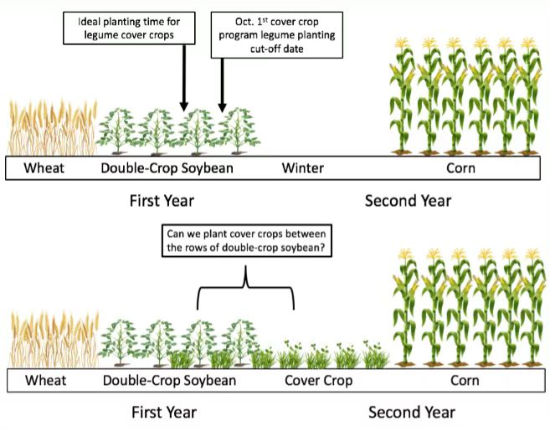
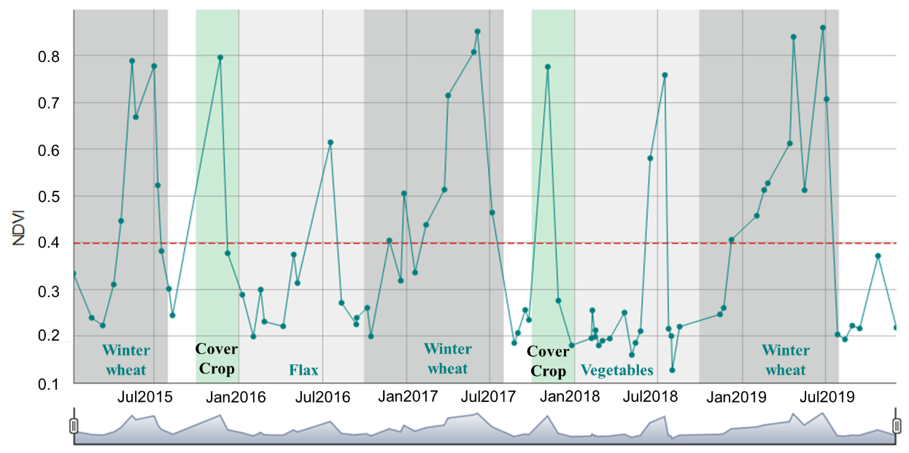
02 Methods and Results
Algorithm:
(Soil Service of Belgium & Ghent University, 2006)
Soil data
OC input to the soil = OC input from the crop residues (OC) * humification coefficient (HC)
Crop type | OC | HC
Grassland | 2.90 | 0.31
Winter barley | 2.24 | 0.31
Spring barley | 1.88 | 0.31
Winter wheat | 2.08 | 0.31
Spring wheat | 2.08 | 0.31
Maize grain | 3.20 | 0.31
Maize silage | 1.25 | 0.34
Cover crops | 1.46 | 0.31
Prepare the
covariates
One field
Wheat Soybean Wheat Cover crop Maize
(blog.umd.edu/agronomynews)
Data source:
Goal 2
Main crops: The website of the Walloon Region (https://geoportail.wallonie.be/)
Cover crops: Identify it based on NDVI time series data
Goal 3
Notes:
We considered the effective carbon input from the crops, contributing to the buildup of SOC, to be the product of the OC input and the humification coefficient.

Slide 7

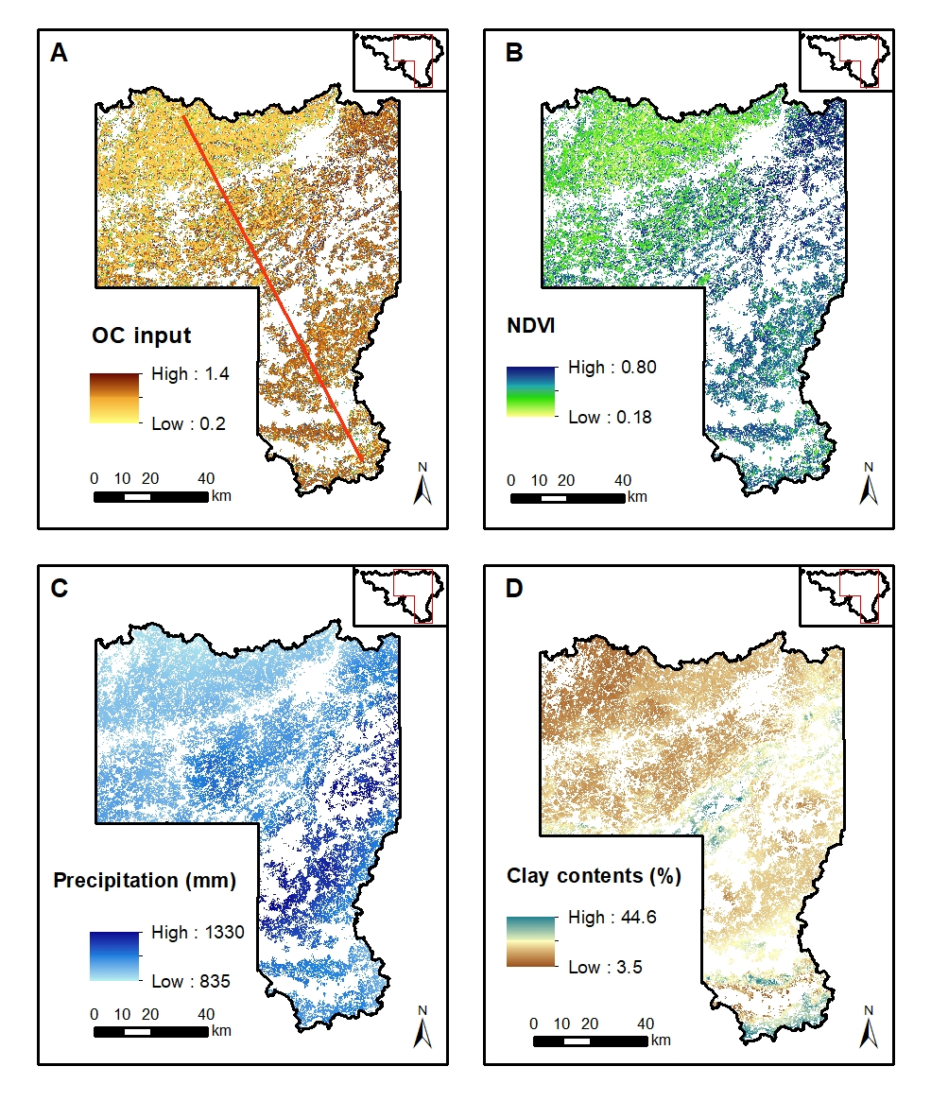
02 Methods and Results
Procedure
Soil data
Obtained NDVI data during 2015-2019 for 169,512 agricultural fields in Wallon region based on Google Earth Engine platform
Prepare the
covariates
Covariates map
Goal 2
Goal 3

Slide 8

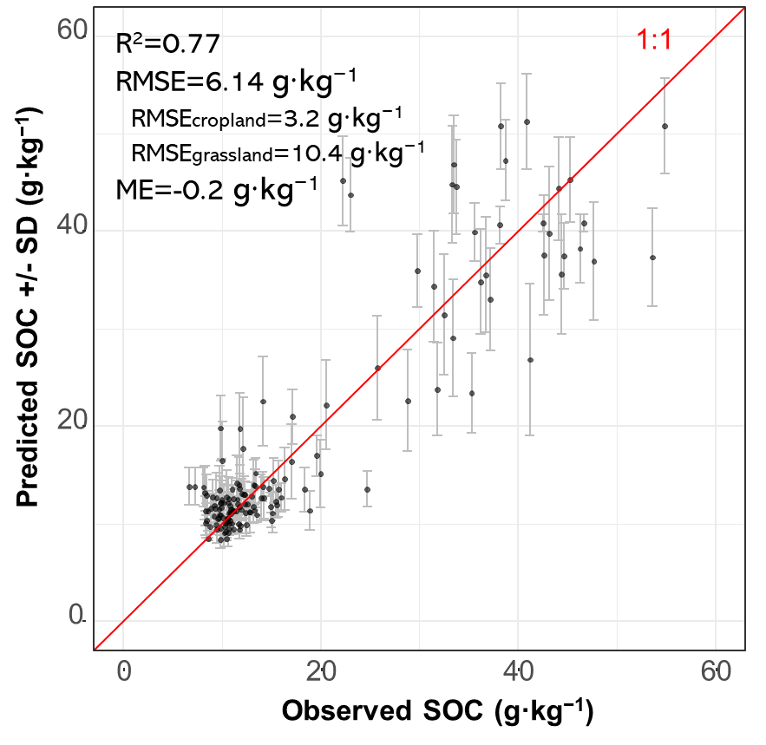
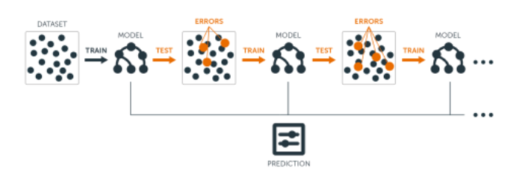
02 Methods and Results
Gradient Boosting Machine (GBM)
Model accuracy
Soil data
A highly flexible and powerful machine learning technique
Goal 1
Model Development
(UC Business Analytics R Programming Guide, 2018)
gbm R package
A grid search to iterate every combination of hyperparameter values
Goal 3
Hyperparameters | Names in gbm package | Values
Shrinkage | shrinkage | (0.01, 0.05, 0.1)
Depth of interaction | interaction.depth | (3, 5, 7)
fraction of bagging | bag.fraction | (0.6, 0.8, 1)
trees terminal nodes | n.minobsinnode | (6, 8, 10)
Our prediction (R² 0.77) outperformed previous models (R² range from 0.02 to 0.7) applied in similar regions or at the similar scale.

Slide 9
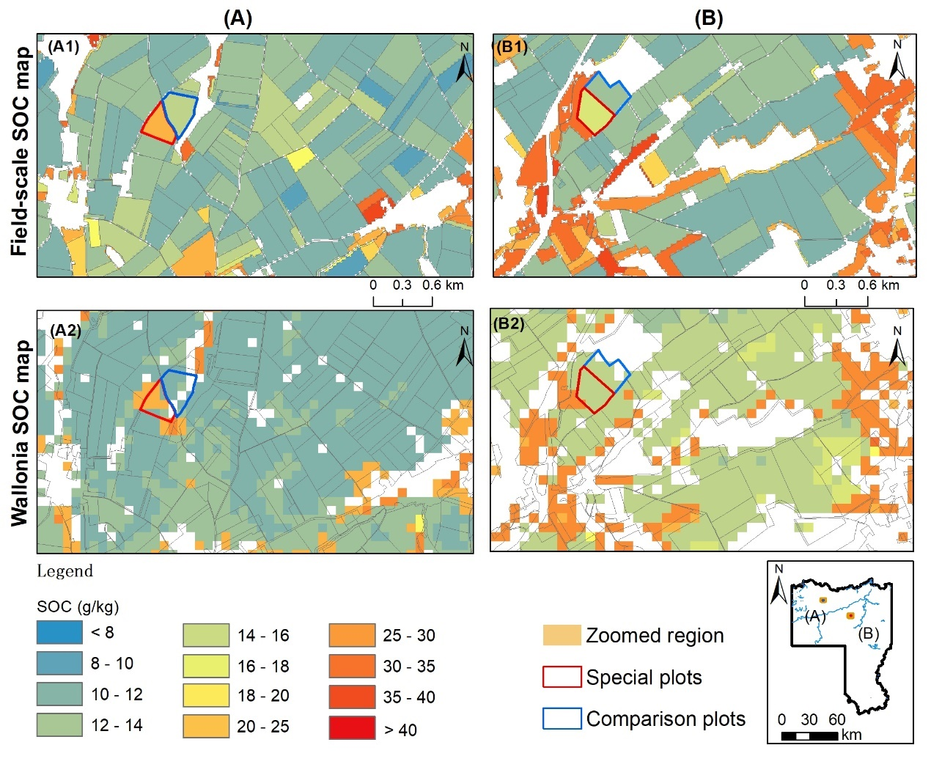
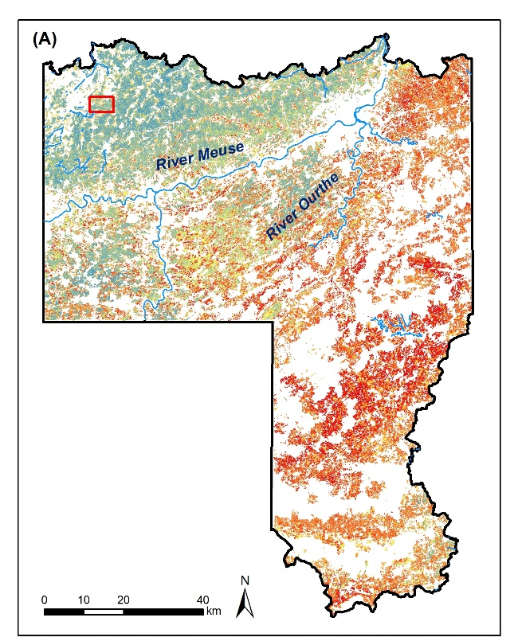
02 Methods and Results
Mapping SOC content at 30 m resolution
Soil data
Global distribution of SOC: increasing first and then decreasing from northwest to southeast, with a mean value of 28.4 g·kg⁻¹,
Goal 1
Model Development
Detailed SOC map : Compared our maps to published open-access SOC maps of the Walloon region, the distinction between fields is clearer in our map.
Goal 3

Slide 10
02 Methods and Results
Zoomed into the field scale
Soil data
Goal 1
Model Development
Crop types and total OC input (include Cover Crop (CC)) over a five-year period.
Goal 3
Zone | Type | 2015 | 2016 | 2017 | 2018 | 2019 | OC input (kg·C·m⁻²)
A | typical | Maize silage | Winter wheat | grassland | grassland | grassland | 3.77
 | Contrast | Potato | Winter wheat | Peas | Sugar beet | beans | 2.23
B | typical | Winter wheat (CC) | Flax | Winter wheat | Winter rapeseed | Winter wheat | 2.96
 | Contrast | Winter wheat | Potato | Winter wheat (CC) | Flax | Sugar beet | 2.70

Slide 11
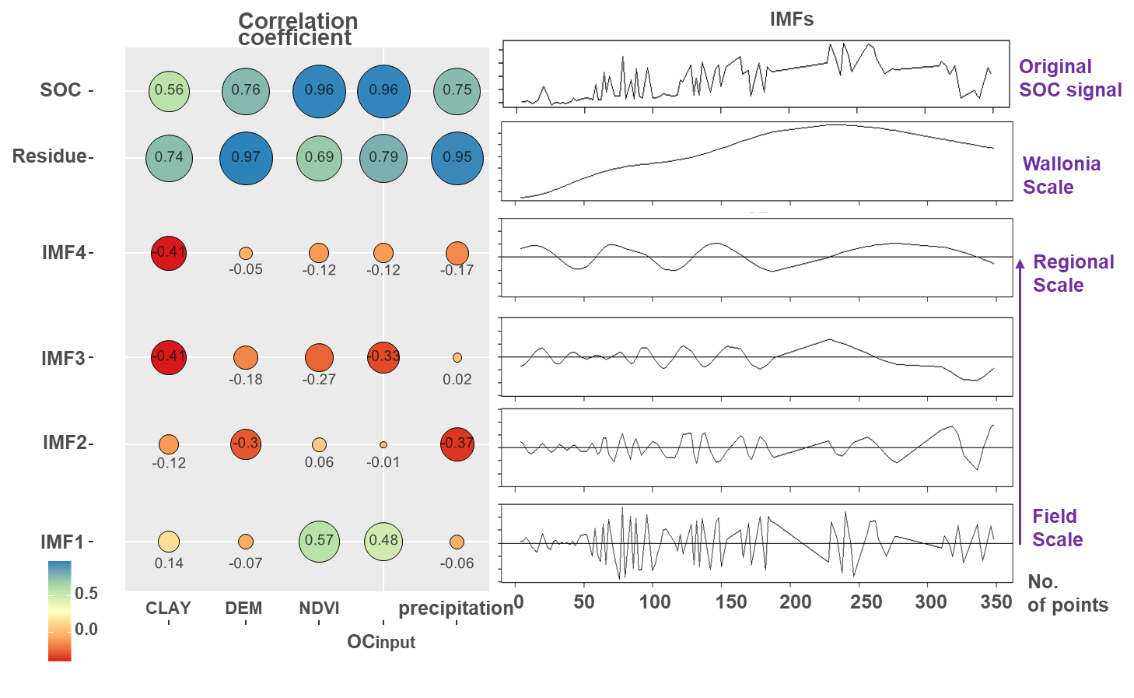
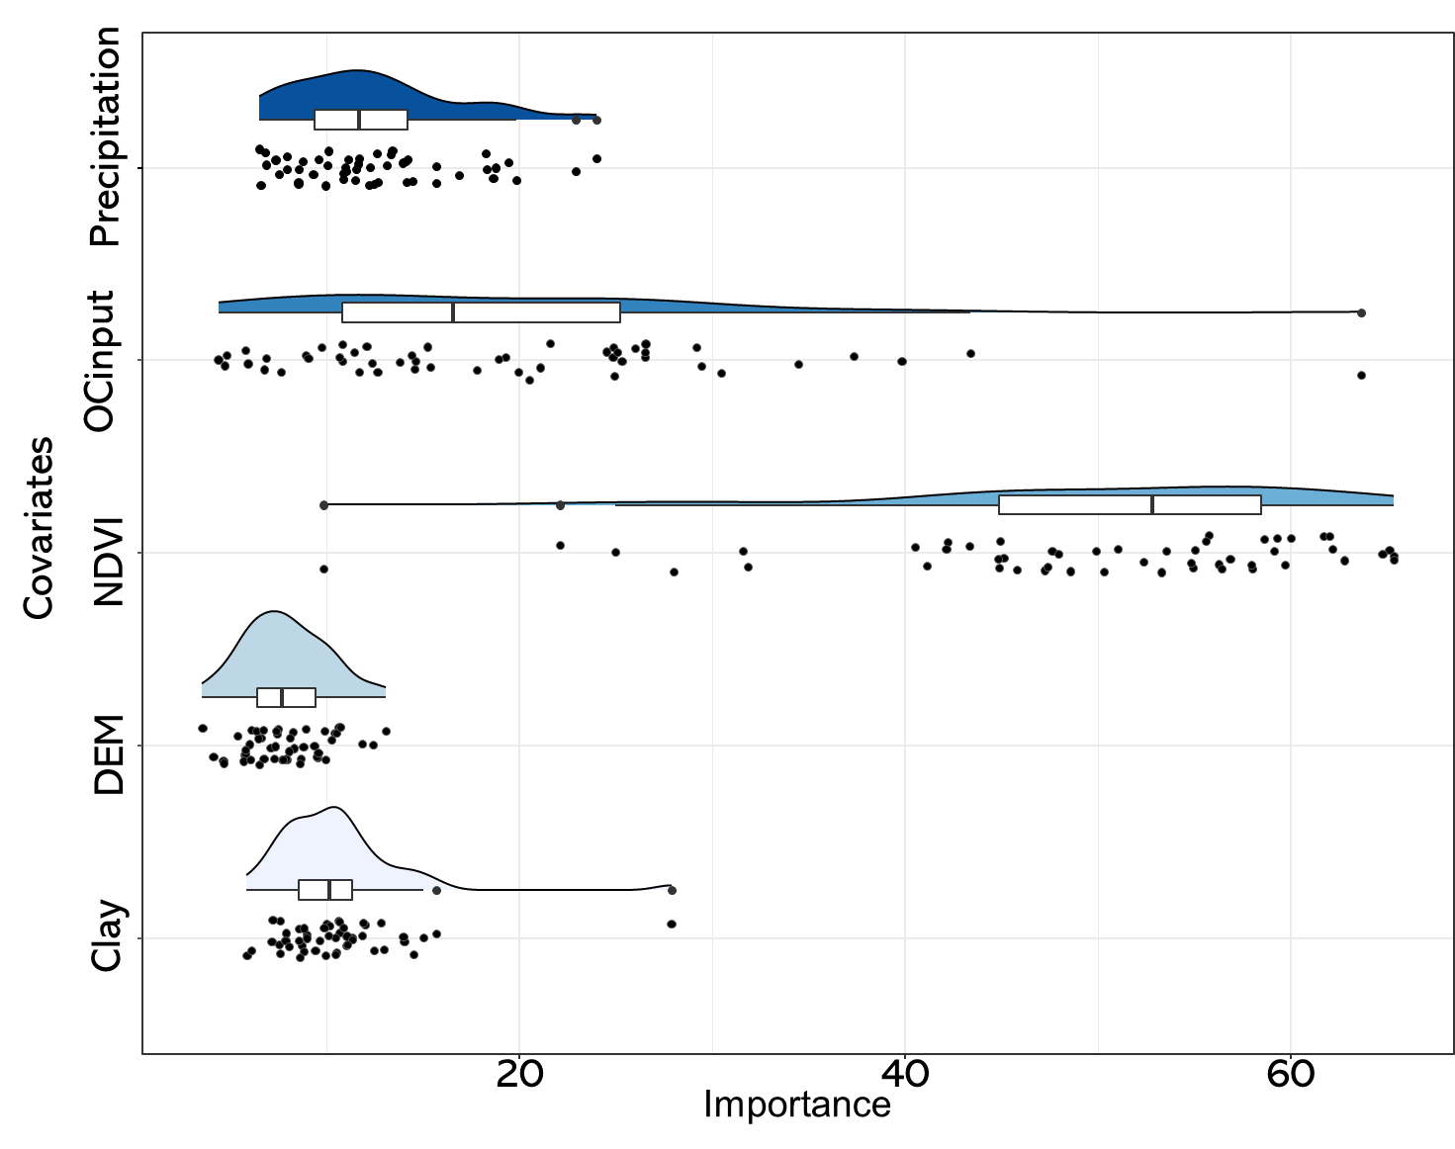
02 Methods and Results
Generate the relative importance of covariates during the modelling
Empirical mode decomposition (EMD) can reveal attribute variation at different spatial scales.
Soil data
Principle: The nonstationary and nonlinear signals are adaptively decomposed into intrinsic mode functions (IMFs) of different frequencies without setting of basic functions.
Goal 1
Shortcoming: The correlation between the covariates will reduce the reliability of importance.
Goal 2
Controlling factors of SOC pattern

Slide 12
03 Conclusions and perspectives
Limitations &
Future work
Conclusion
GBM model can explain 77% of the variance in the SOC contents for Wallonia
Farm-scale maps can provide more accurate SOC contents for each field, and document management practices.
Proper crop rotation, conversion to grassland and sowing of cover crops all contribute to organic carbon accumulation.
Climate, topography and soil texture factors shape the distribution of SOC contents across the Walloon region, the differences between fields are more likely to be generated by differences in organic carbon inputs from crop residues.
Proper sampling strategy, declustering of the data or spatial cross-validation should be explored further.
Try to identify tillage or no tillage at field-scale with satellite images.
Not all management practices (irrigations/fertilizer/livestock) have been considered.

Slide 13
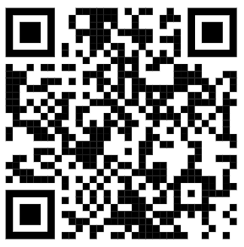



Thank you for the attention
More info:
yue.zhou@uclouvain.be
Earth and Life Institute
Place Louis Pasteur 3, b345
Acknowledgment

