Slide 1


The effects of stream water velocity, streambed celerity, and particle properties on microplastic deposition in streams
Verena Levy Sturm, Silvia Gobrecht, Roy Bernstein, and Shai Arnon
The Zuckerberg Institute for Water Research, Ben-Gurion University of the Negev, Israel

Slide 2
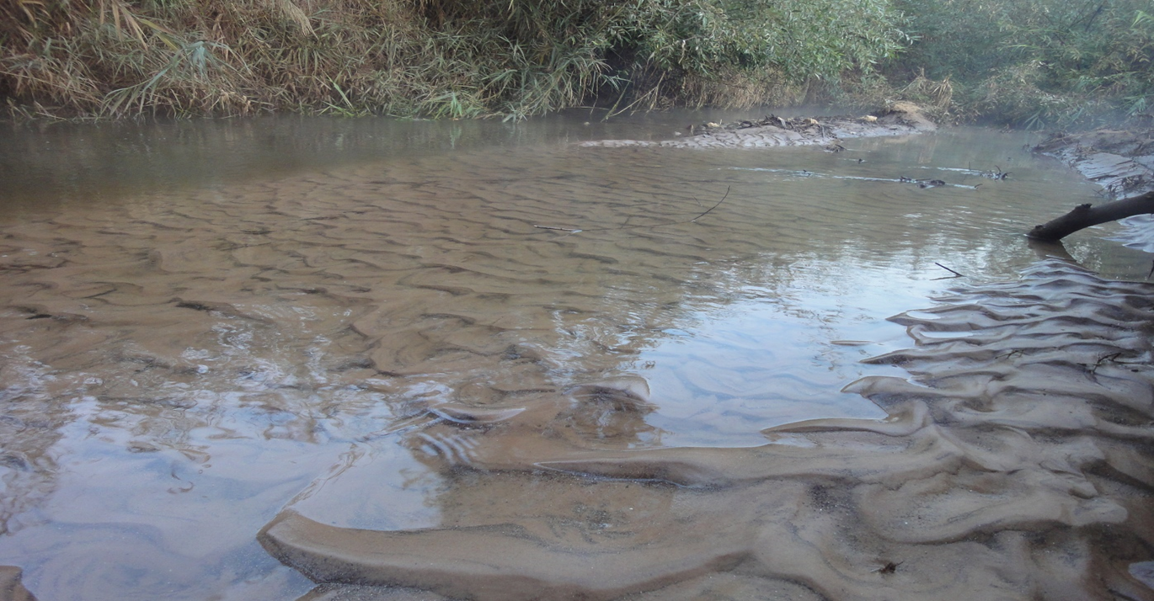
Bedforms
Our objective was to study the mechanism of particle deposition in moving bedforms

Slide 3
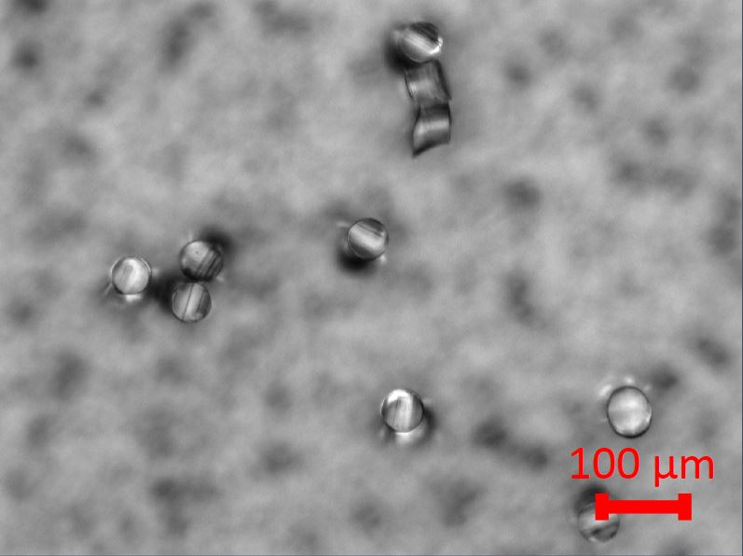
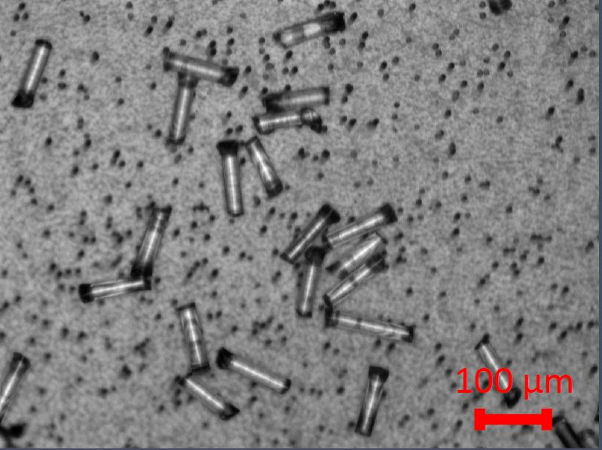
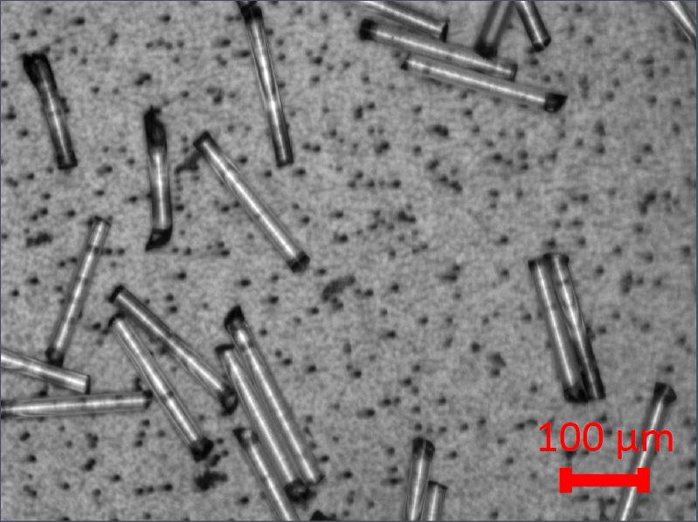
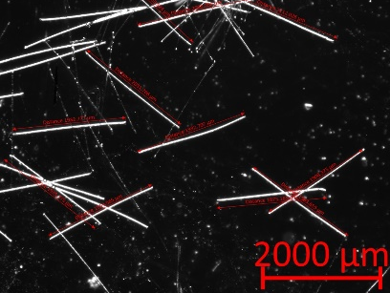
We use pre-prepared fibers-
PET, PP, PA
25 μm
100 μm
200 μm
2000 μm

Slide 4
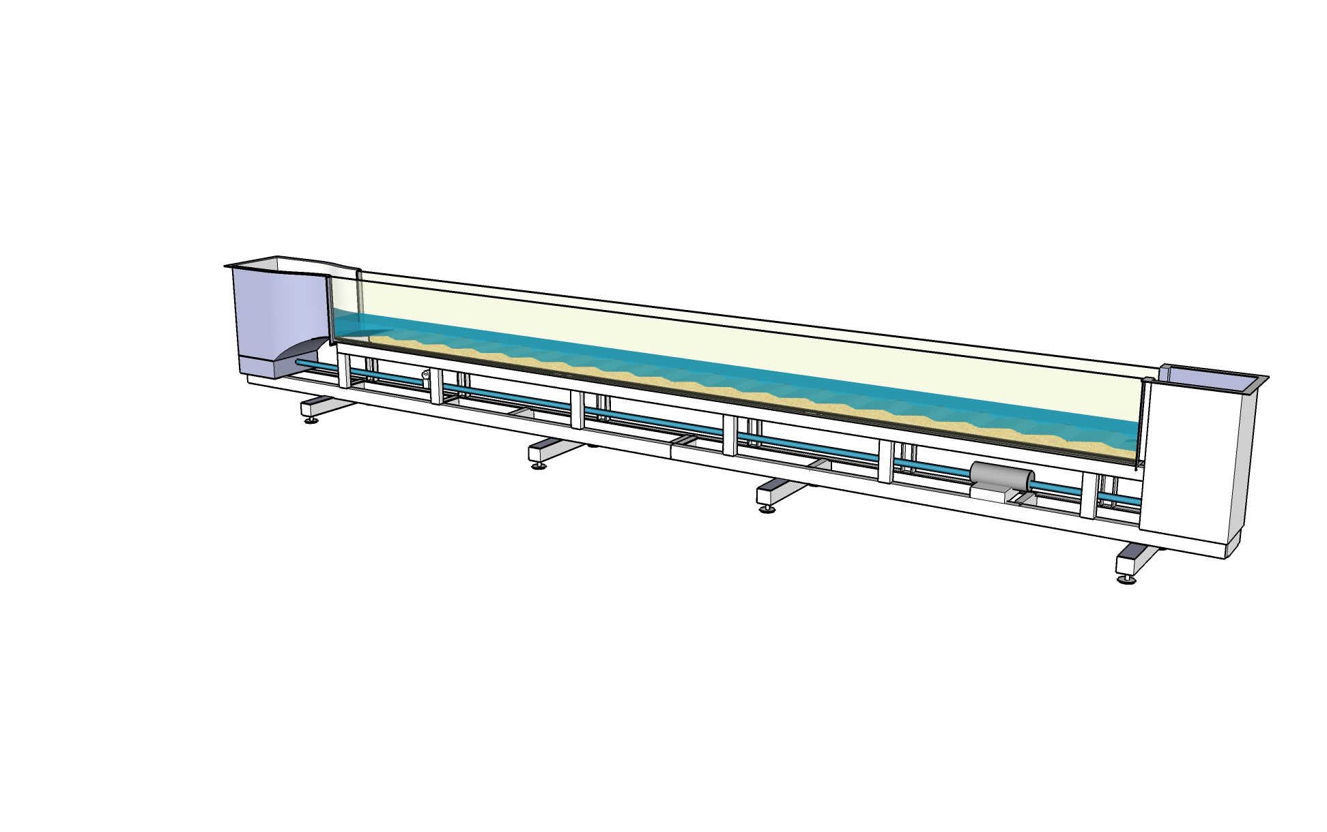
Flume Experiment
MP slug addition
Water
6 m
Sediment
Pump

Slide 5
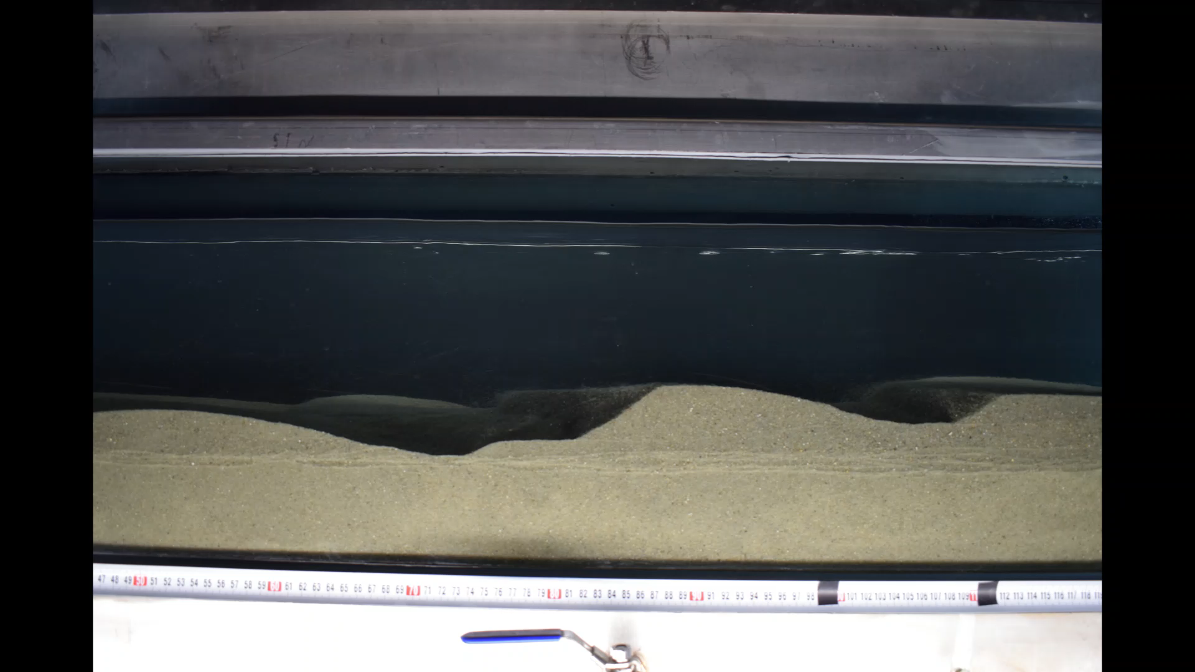
Bed Movement and Water Exchange
Velocity ~ 0.5 m/s
Celerity ~ 0.45 m/h
Flow
10 cm

Slide 6
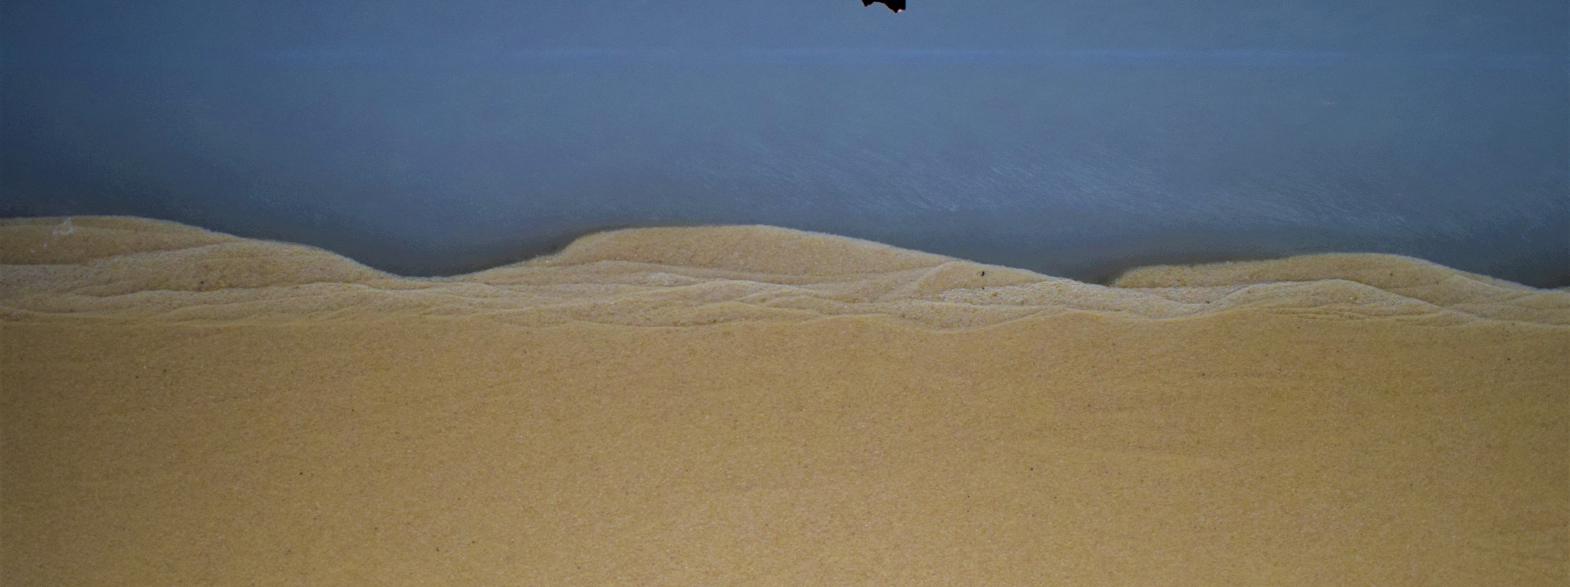
Clay Deposit Below the Moving Fraction of the Bed
10 cm
10 cm

Slide 7
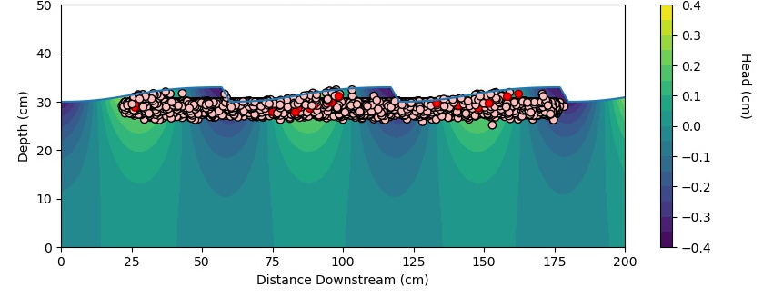
Particles Deposit Below the Moving Fraction of the Bed
Flow

Slide 8
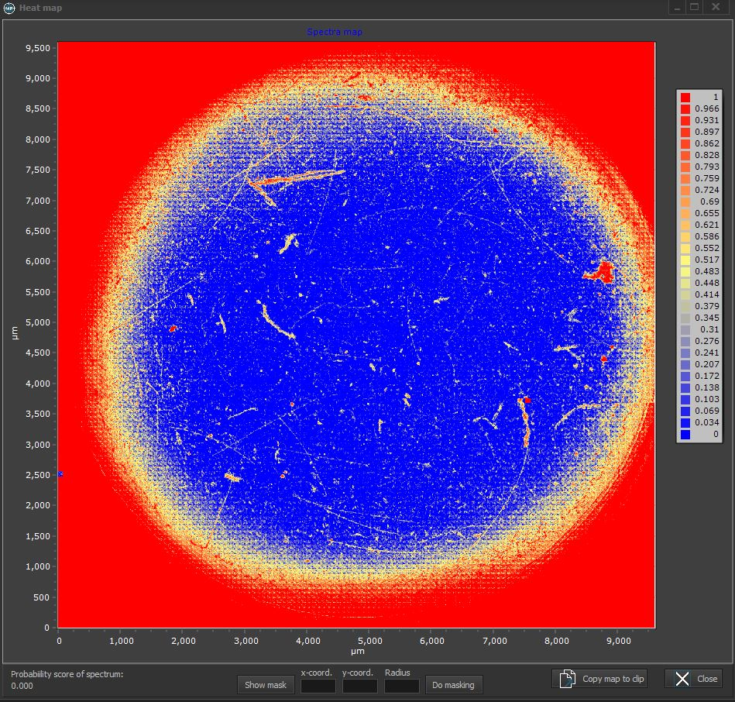
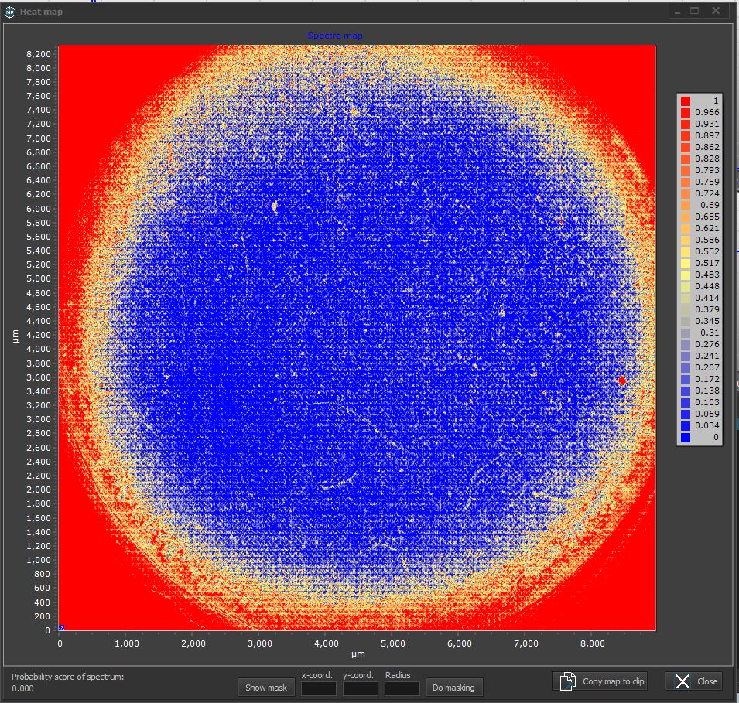
Time zero
Reduction of Particles in Streamwater
After 5 days

Slide 9
Summary
Our preliminary experimental and modeling results suggest that deposition of microplastic due to bed movement is a significant mechanism of burial.

Slide 10

Acknowledgment - Funding
Israel Science Foundation
ISF #647/21

