Slide 1

Distribution Characteristics of Auroral Kilometric Radiation in Earth’s Northern and Southern hemispheres based on Arase satellite and the Van Allen Probes
Jiawen Tang¹ , Fuliang Xiao^{1,2}, Sai Zhang^{1,2}, Qinghua Zhou^{1,2}, Si Liu¹, Yihua He¹, Qiwu Yang^{1,2}, Yoshiya Kasahara³, Yoshizumi Miyoshi⁴ , Atsushi Kumamoto⁵, Yosuke Nakamura⁶, Fuminori Tsuchiya⁵, Iku Shinohara⁶, Satoko Nakamura⁴
[1] {Changsha University of Science & Technology, School of Physics & Electronic Science, China}
[2] {Hunan Province Higher Education Key Laboratory of Modeling and Monitoring on the Near-Earth Electromagnetic Environments, Changsha University of Science and Technology, Changsha, China }
[3]Graduate School of Natural Science and Technology, Kanazawa University, Kakuma-machi, Kanazawa 920-1192, Japan
[4]Institute for Space-Earth Environmental Research, Nagoya University, Nagoya 464-8601, Japan
[5]Tohoku University, 6-3, Aoba, Aramaki, Aoba, Sendai 980-8578, Japan
[6]Institute of Space and Astronautical Science, Japan Aerospace Exploration Agency, JAXA, 3-1-1
Yoshinodai, Chuo-ku, Sagamihara, Kanagawa 252-5210, Japan
EGU 2022, Sharing Online ST2.8, 3288, Tue., 24 May 2022, 14:00-15:45

Slide 2
Outline
Introduction on Auroral Kilometric Radiation (AKR)
Observations of Arase satellite and Van Allen Probes
Statistical results
Summary

Slide 3
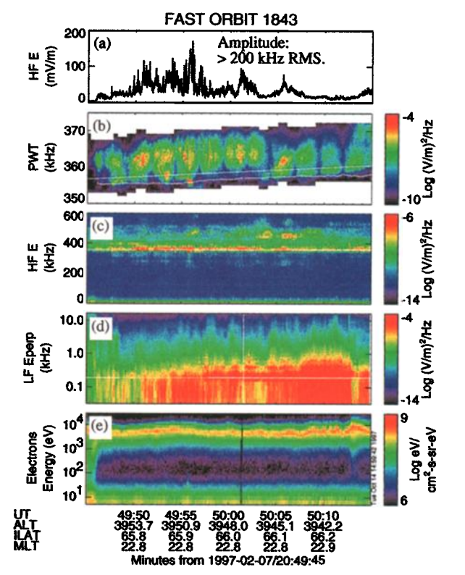
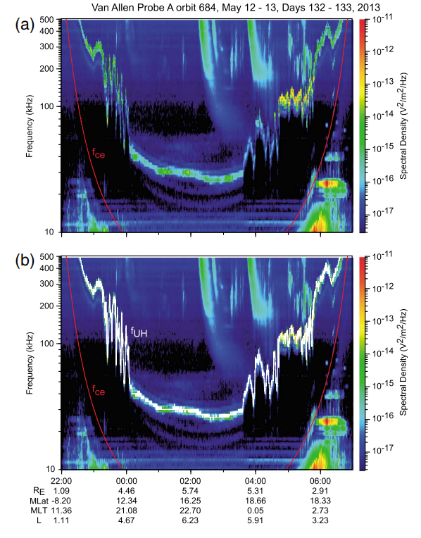
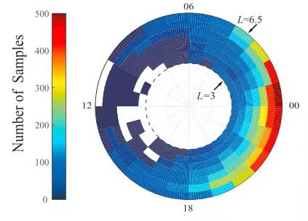
Introduction
figure 3. (Zhao et al., 2019)
figure 1. (Ergun et al., 1998)
figure 2. (Kurth et al., 2015)

Slide 4
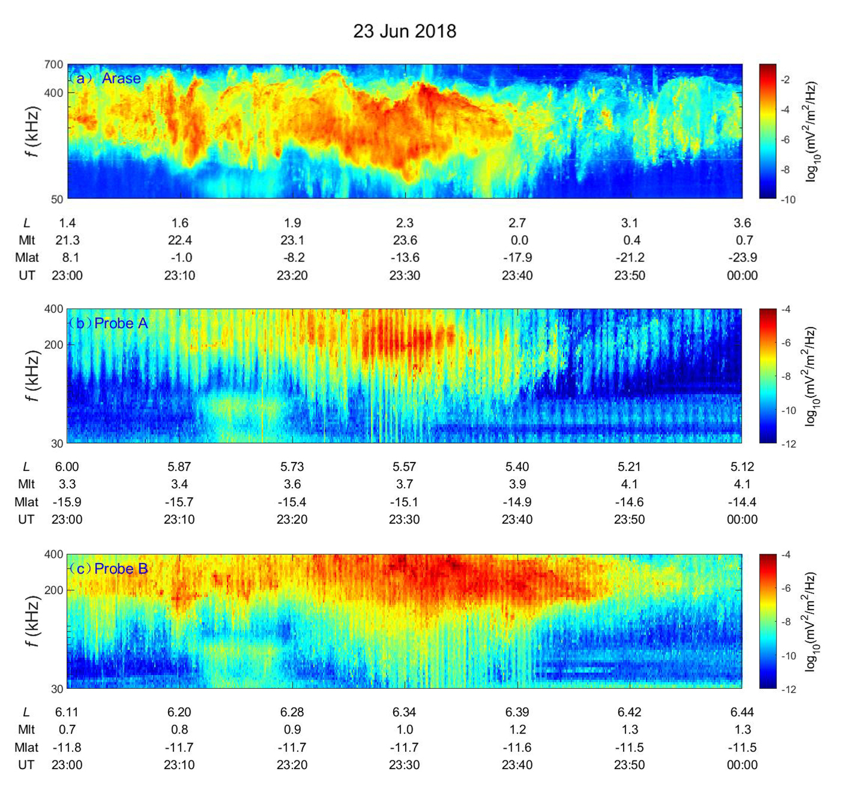
Observation
figure 4. Observations from the Arase satellite and Van Allen Probes on 23 Jun 2018. (a) The Arase satellite. (b) VAPa. (c) VAPb.

Slide 5
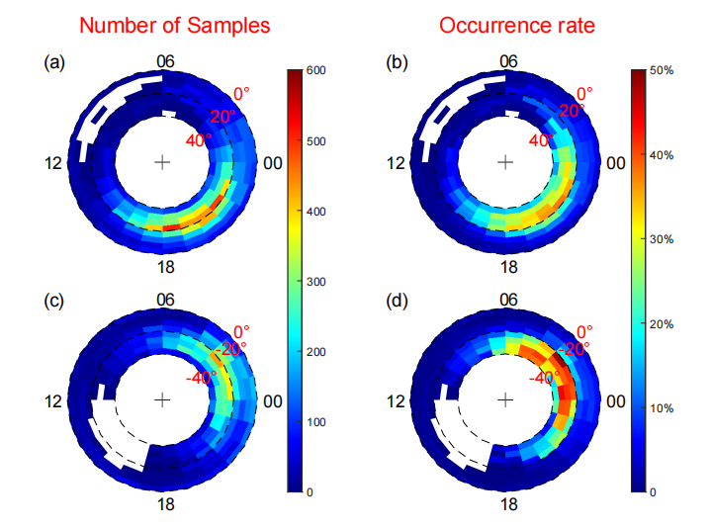
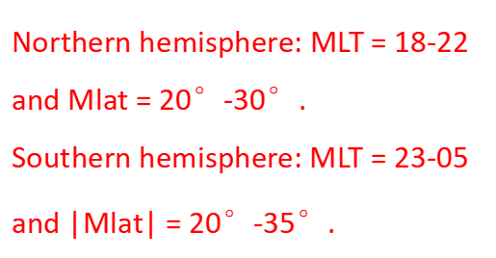
Results
Northern hemisphere: MLT = 18-22 and Mlat = 20°-30°.
Southern hemisphere: MLT = 23-05 and |Mlat$|$ = 20°-35°.
figure 5. (a) The number of AKR samples in the northern hemisphere as a function of MLT and λ. (b) The occurrence rate in the northern hemisphere. (c-d) The same as (a-b) except for the southern hemisphere.

Slide 6
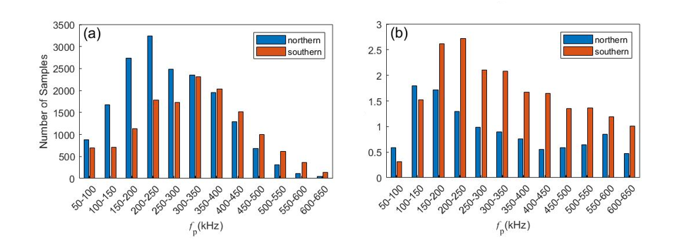
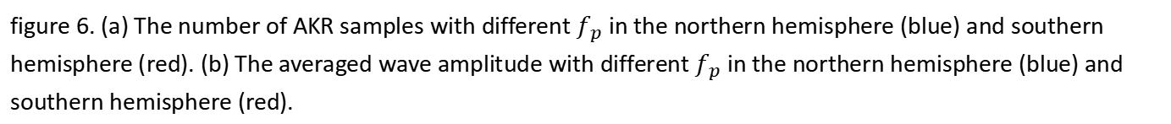
Results
figure 6. (a) The number of AKR samples with different $f_{p}$ in the northern hemisphere (blue) and southern hemisphere (red). (b) The averaged wave amplitude with different${ f}_{p}$ in the northern hemisphere (blue) and southern hemisphere (red).
Northern hemisphere: 62% wave samples in the frequency range of ≤ 300 kHz.
Southern hemisphere: 57% wave samples in the frequency range of > 300 kHz.
Wave amplitudes in lower frequencies (≤ 150 kHz) in the northern hemisphere are greater than those in the southern hemisphere. Wave amplitudes in higher frequency (> 150 kHz) in the northern hemisphere are smaller than those in the southern hemisphere.

Slide 7
Summary
Relatively high occurrence rates (> 20%) in the northern hemisphere occur on pre-midnight and in the southern hemisphere occur on after-midnight.
More wave samples in the northern (62%) or southern (57%) hemisphere can be observed in the low (≤ 300 kHz) or high (> 300 kHz) frequency range.
Wave amplitudes in lower frequencies (≤ 150 kHz) in the northern hemisphere are greater than those in the southern hemisphere. Wave amplitudes in higher frequency (> 150 kHz) in the northern hemisphere are smaller than those in the southern hemisphere.

Slide 8
Discussion
the propagation of AKR in the magnetosphere (the plasma density)
the source conditions (solar wind condition, IMF condition, field aligned current system or polar region plasma condition).

Slide 9
Contact Me
Jiawen Tang
Email：tang.lucy@foxmail.com
Thank you for paying attention !

