Slide 1
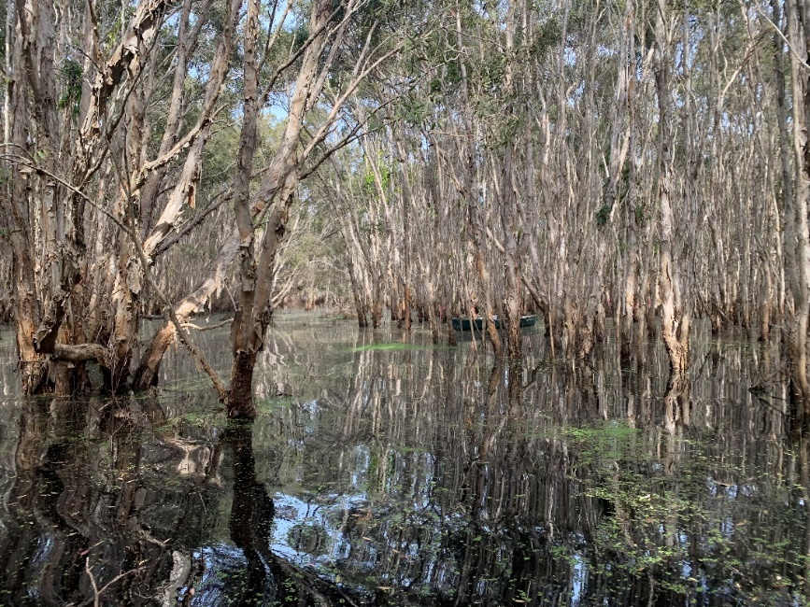
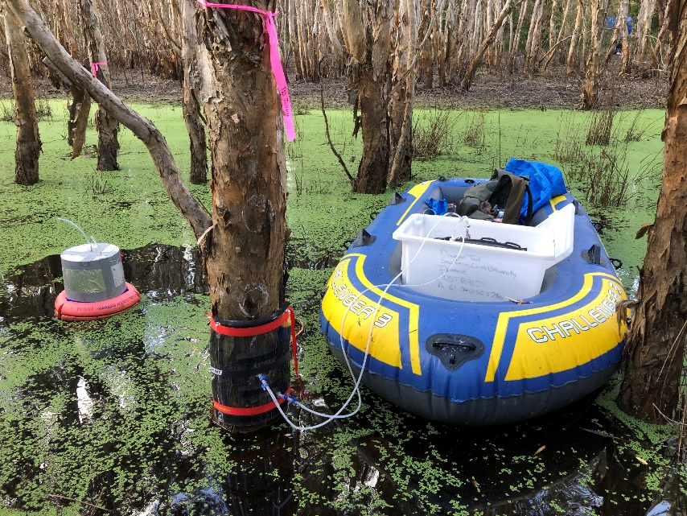
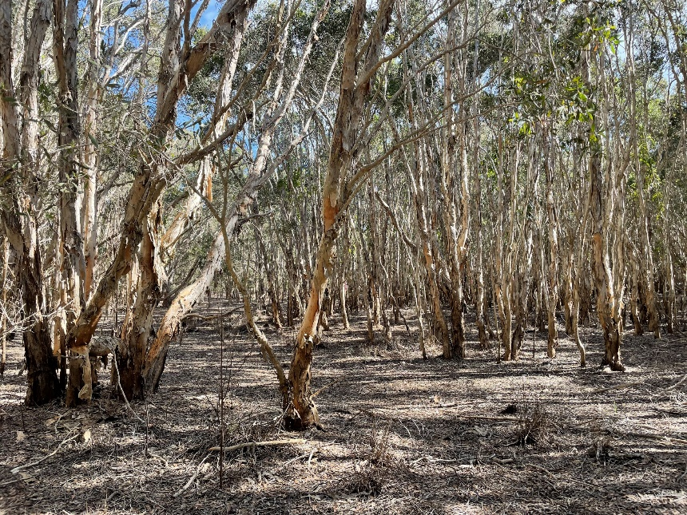




How important are annual tree stem methane emissions to the total wetland flux? A seasonal case study of subtropical lowland Melaleuca forest.
Luke Jeffrey¹, Charly Moras¹, Douglas Tait ¹, Mitch Call ¹, Dylan Laicher ¹,
James Sippo ¹, Sebastian Euler ¹, Scott Johnston ¹ & Damien Maher ¹.
¹ Faculty of Science and Engineering, Southern Cross University, Lismore Australia.
@Luke_Jeffrey

Slide 2
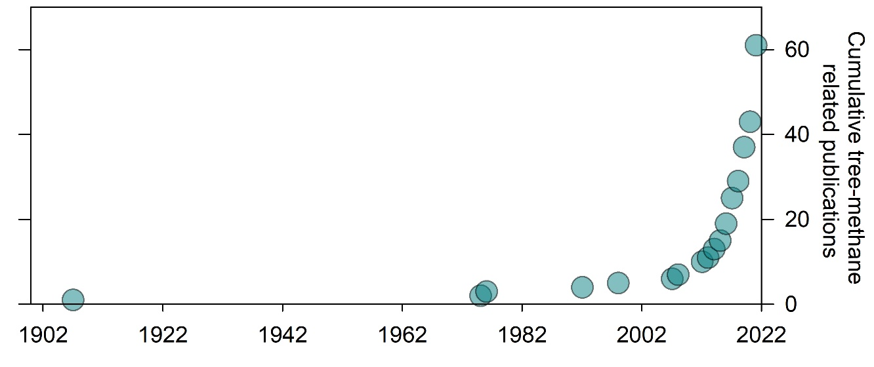
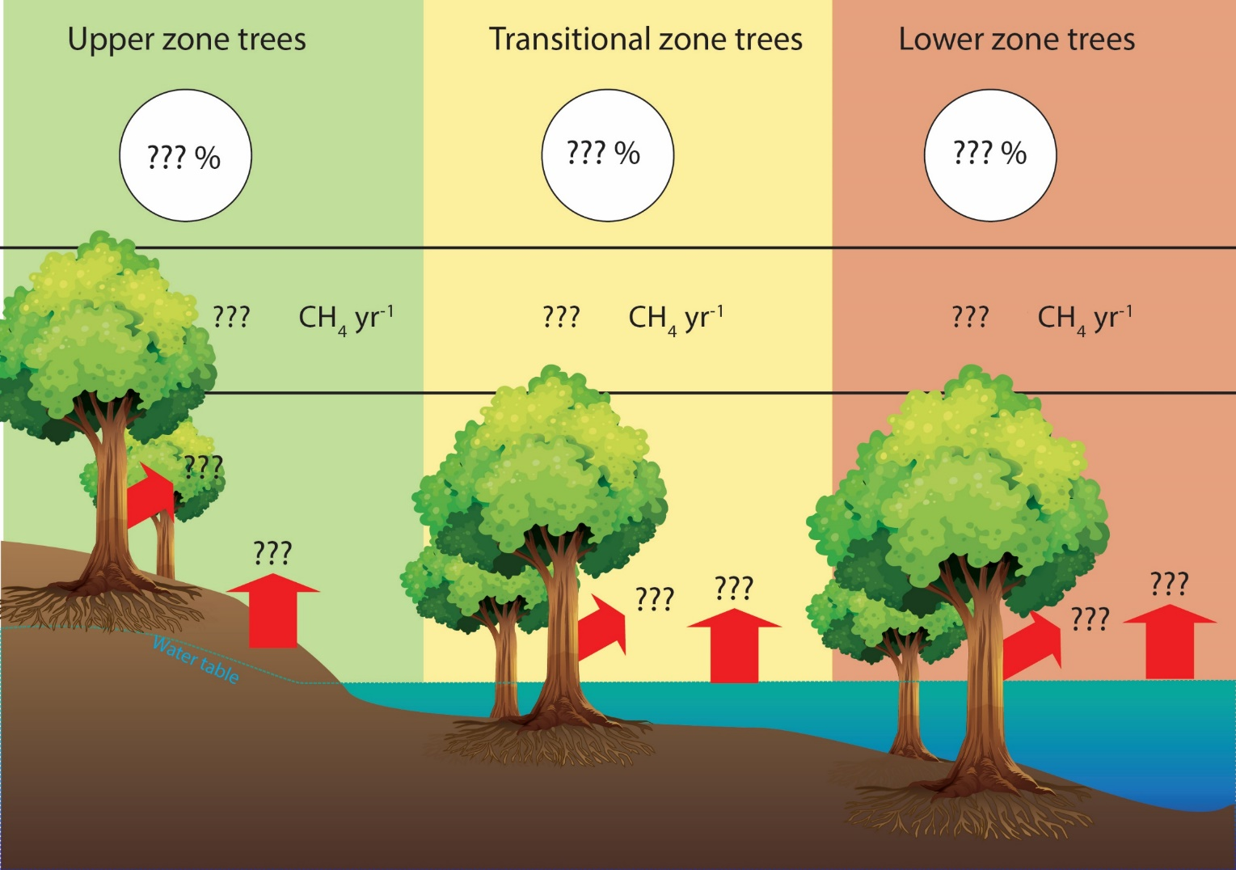
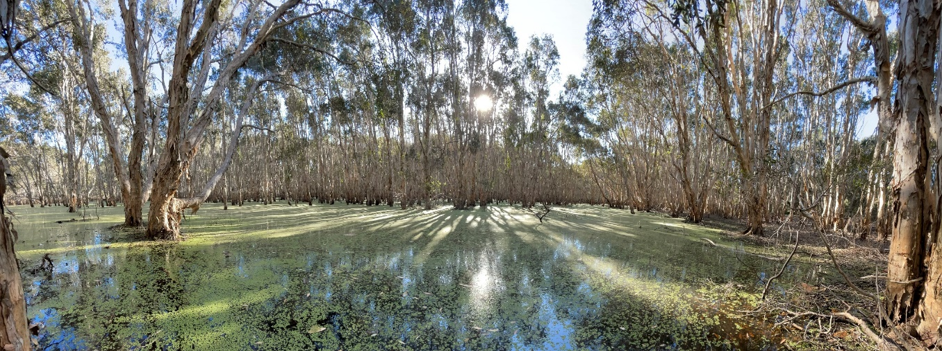
Background
#Treethane is a new research frontier¹
Wetland trees 10-50% CH₄ source²⁻⁵
Hydrological, seasonal, redox oscillations^{2,6}
Long term studies are scarce
Quantify annual tree stem CH₄ fluxes
Quantify soil / water CH₄ fluxes
Determine drivers
Constrain importance of tree CH₄ pathway.
Aim
¹Barba, J. et al. Methane emissions from tree stems: a new frontier in the global carbon cycle. New Phytologist 222, 18-28 (2019). ²Jeffrey, L. C., Maher, D. T., Tait, D. R., Euler, S. & Johnston, S. G. Tree stem methane emissions from subtropical lowland forest (Melaleuca quinquenervia) regulated by local and seasonal hydrology. Biogeochemistry 151, 273-290 (2020). ³Pangala, S. R. et al. Large emissions from floodplain trees close the Amazon methane budget. Nature 552, 230 (2017). ⁴Pangala, S. R., Moore, S., Hornibrook, E. R. & Gauci, V. Trees are major conduits for methane egress from tropical forested wetlands. New Phytologist 197, 524-531 (2013). ⁵Sjögersten, S. et al. Methane emissions from tree stems in neotropical peatlands. New Phytologist 225, 769-781, doi.org/10.1111/nph.16178 (2020). ⁶Pitz, S. L., Megonigal, J. P., Chang, C. H., & Szlavecz, K. (2018). Methane fluxes from tree stems and soils along a habitat gradient. Biogeochemistry, 137(3), 307-320.

Slide 3
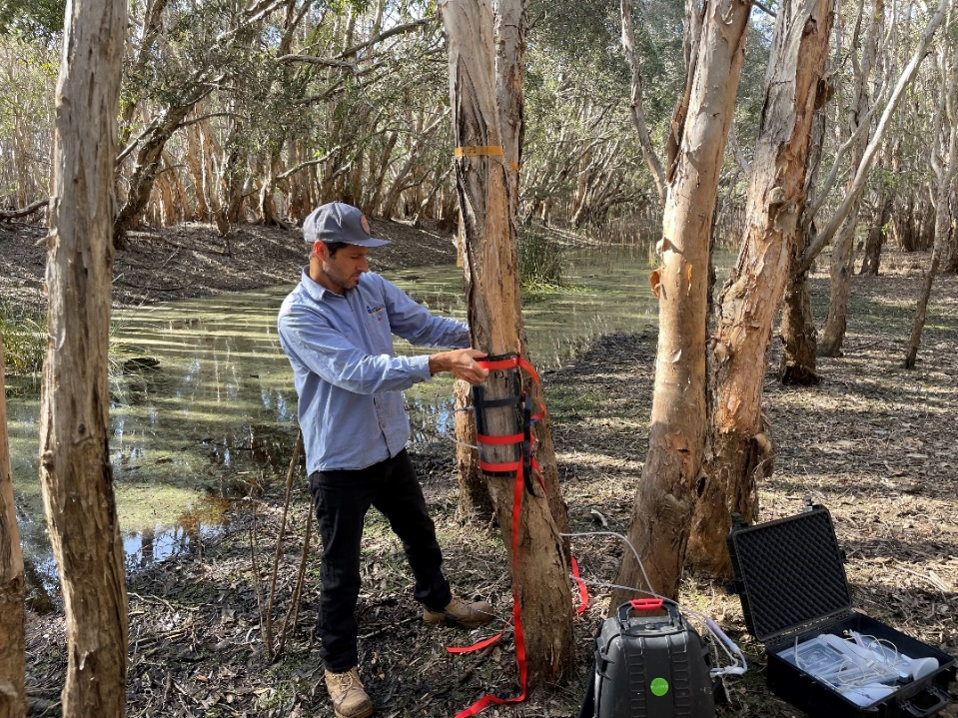
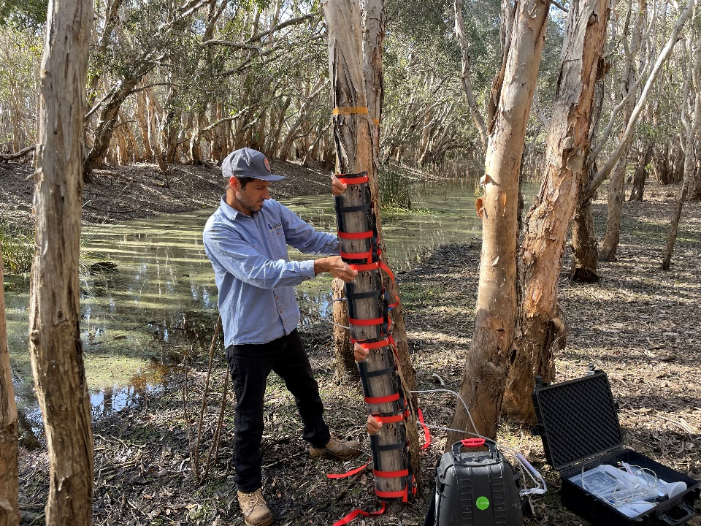
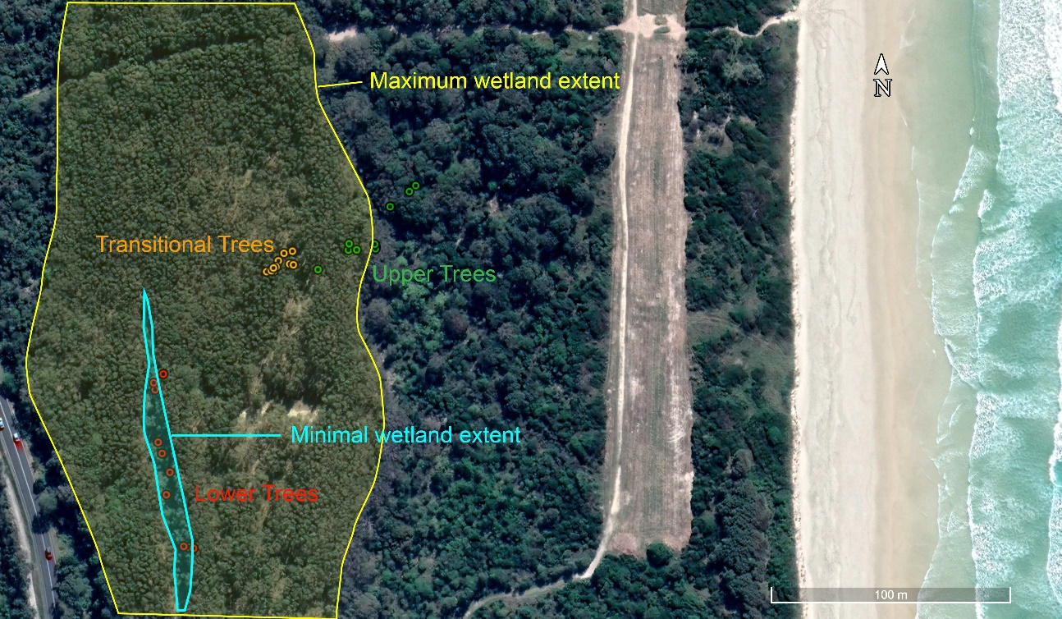
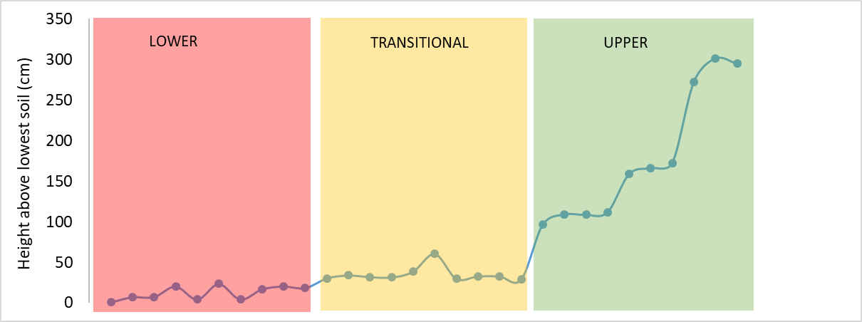
Methods
Topo-hydro-gradient (L,T,U)
30 mature trees – 10 per zone
Stem CH₄ fluxes from four heights (10, 40, 70, 110 cm)⁶
30 Soil/ Aquatic CH₄ fluxes
WT depth, PAR, Elevations, Forest density
Surface/porewater [CH₄], pH, EC, DO%, Redox, Temp, VWC%
4-6 weekly campaigns over 1 year (WIP)
⁶Siegenthaler, A., Welch, B., Pangala, S. R., Peacock, M. & Gauci, V. Technical Note: Semi-rigid chambers for methane gas flux measurements on tree stems. Biogeosciences 13, 1197-1207, doi:10.5194/bg-13-1197-2016 (2016).

Slide 4
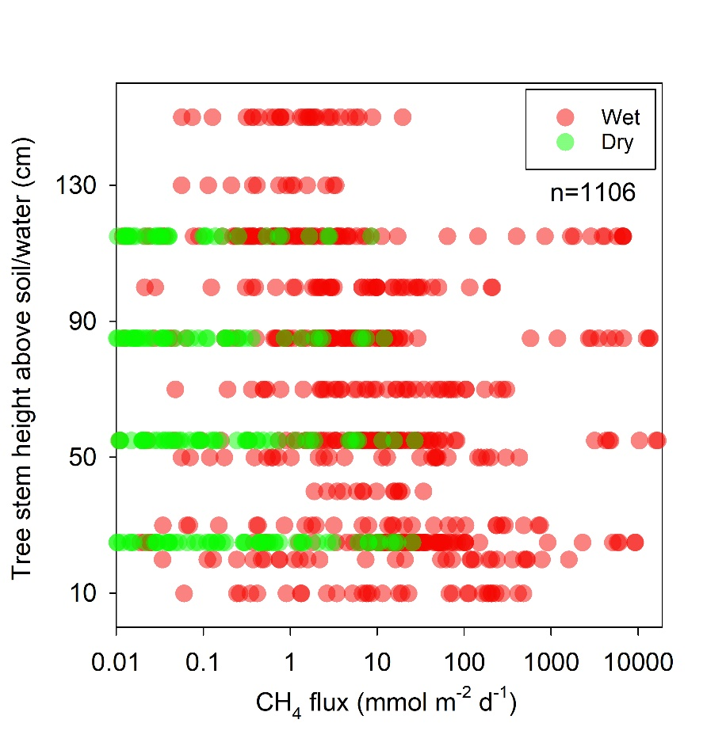
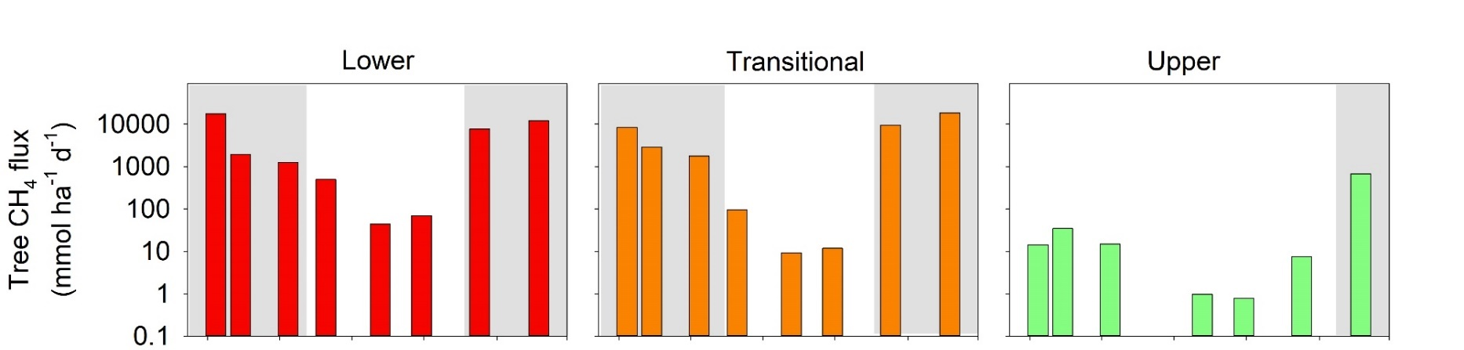
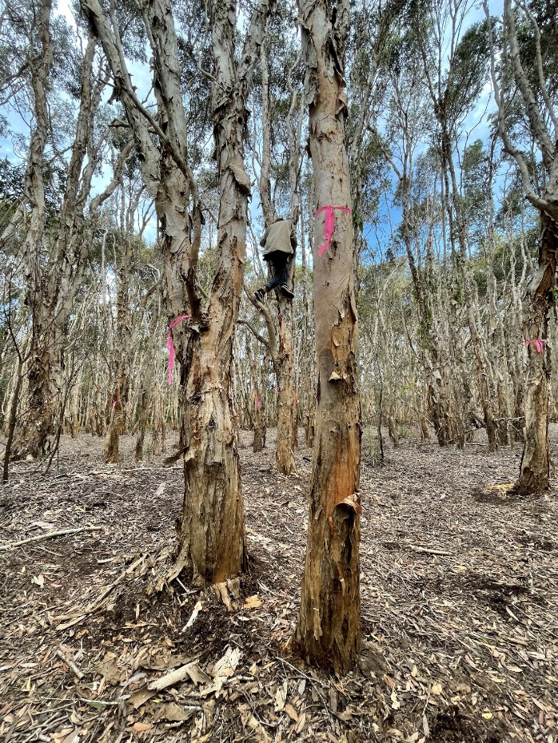
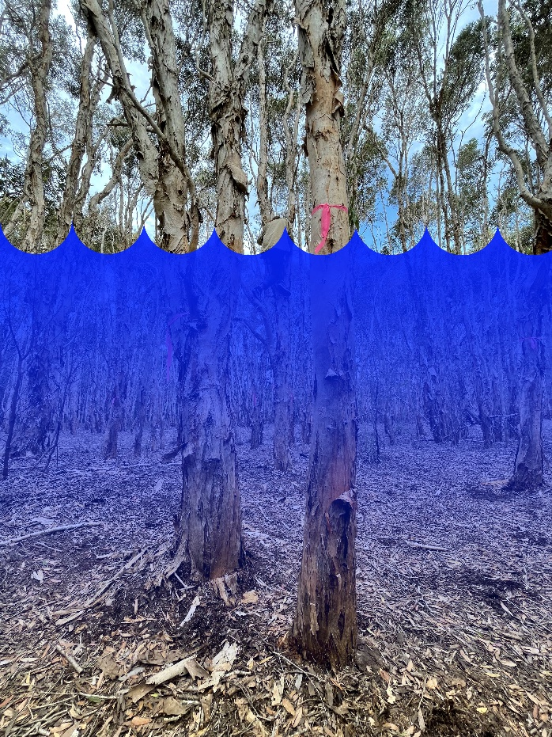
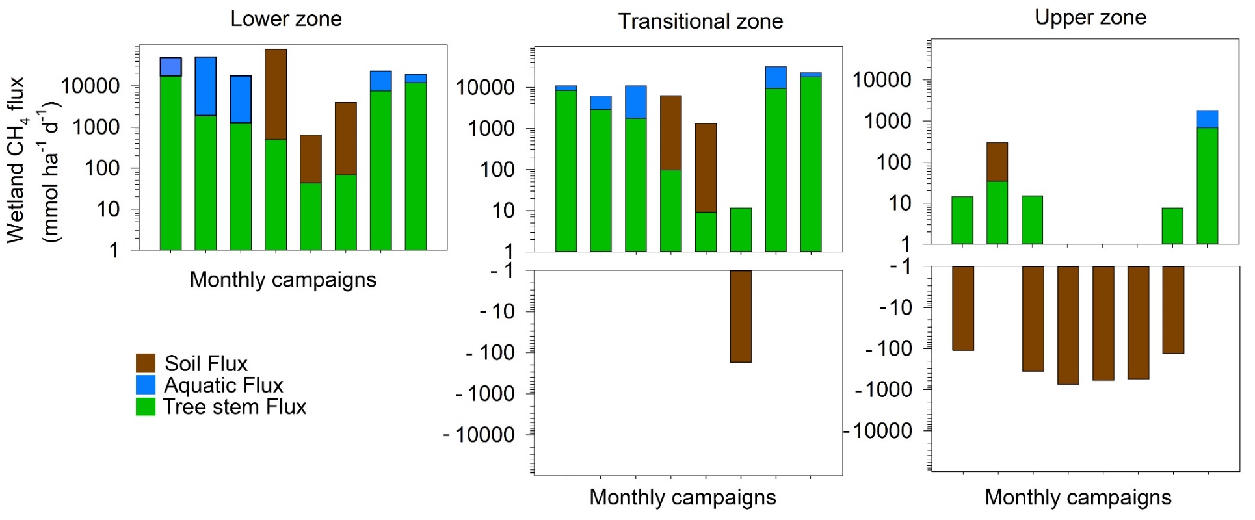
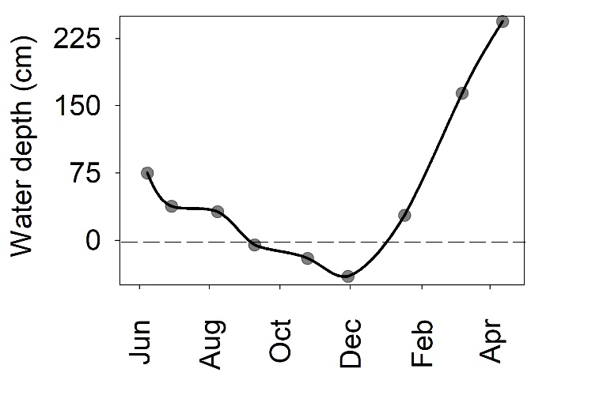
Results
Dynamic water table
Huge stem CH₄ flux variability
Seasonal trends
WT height

Slide 5
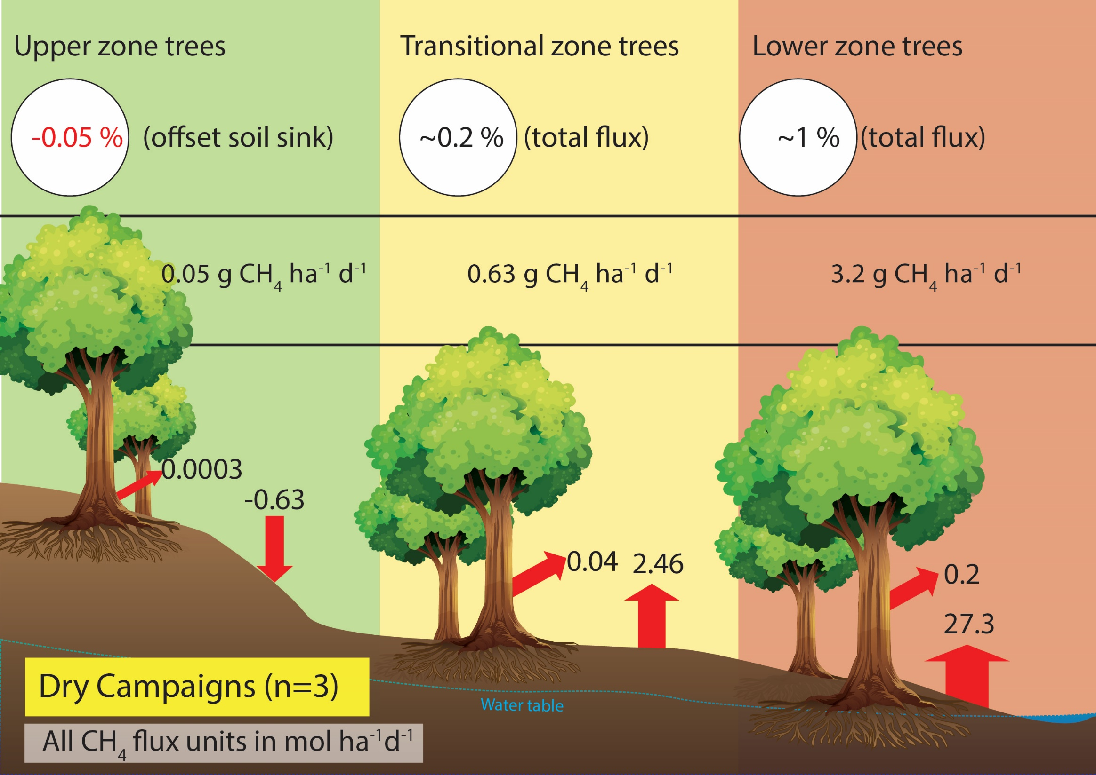
Results

Slide 6
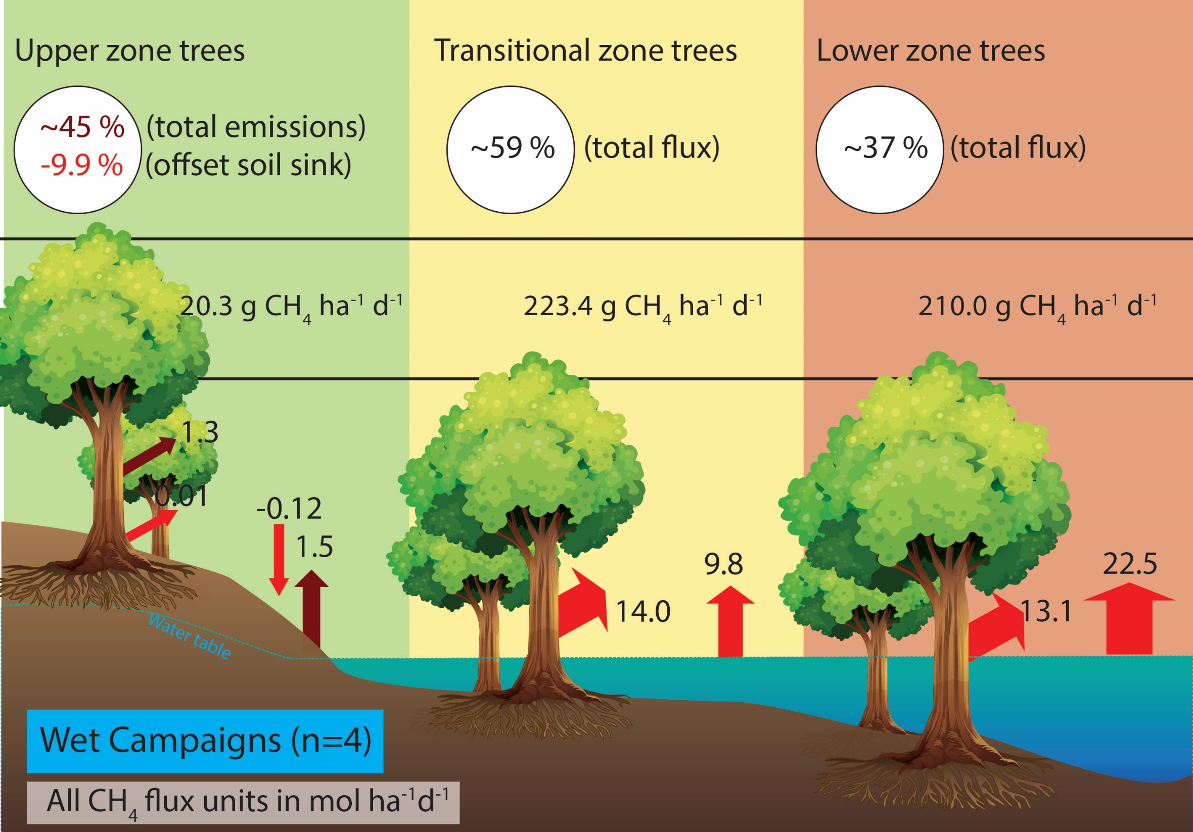
Results

Slide 7
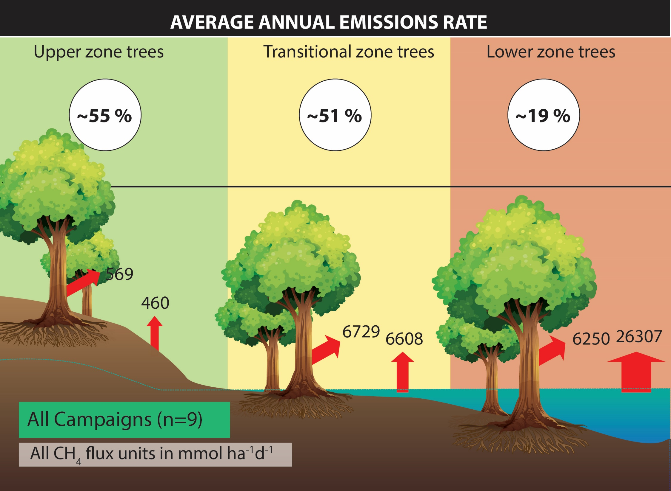
Results

Slide 8
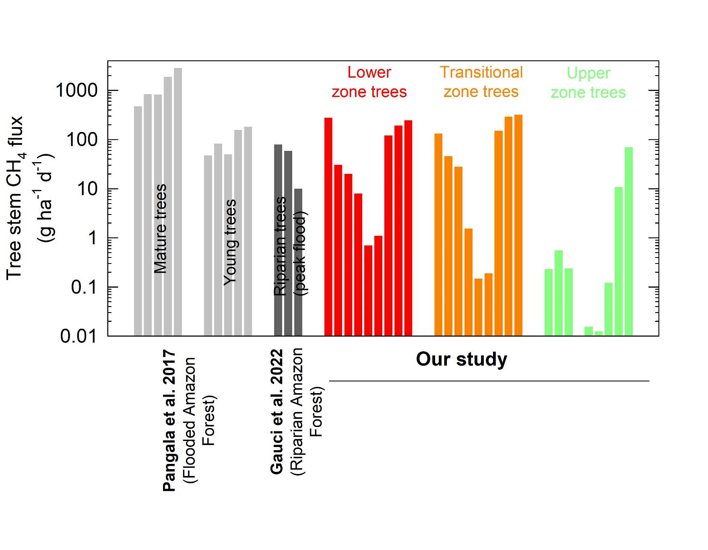
Summary
Wetland trees are significant (20-50% annual emission)
Trends with WT height
Rates in range of Amazon studies
Upper tree stem beyond 130cm?
Ebullition? Night time? Oxidation?
Rain/Wind?
Scaling…
Drivers?
Inundation
Caveats/ Next

Slide 9
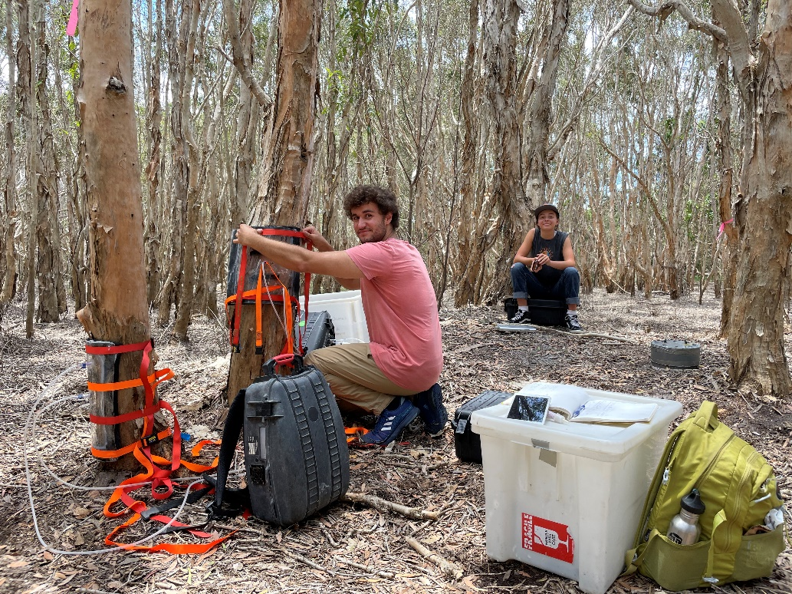
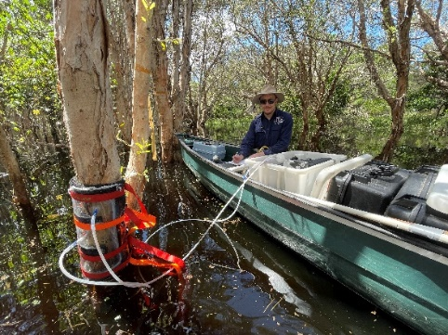
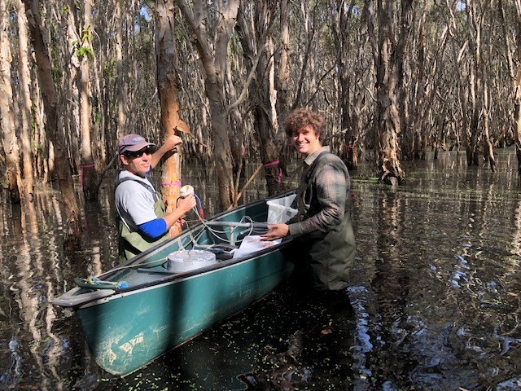



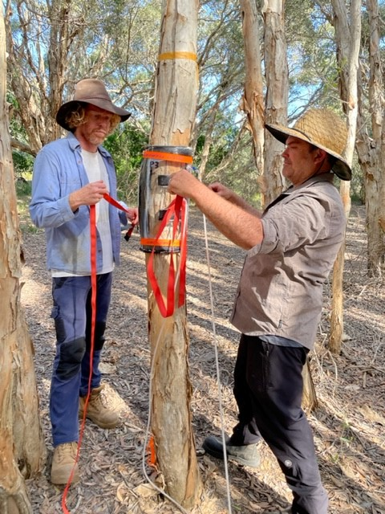
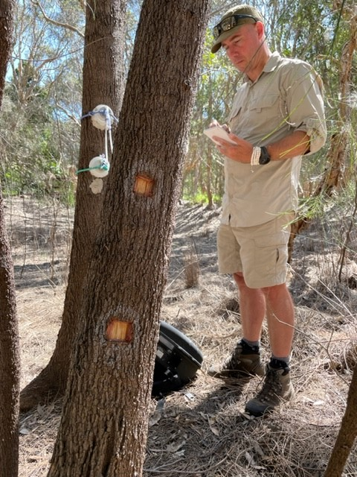
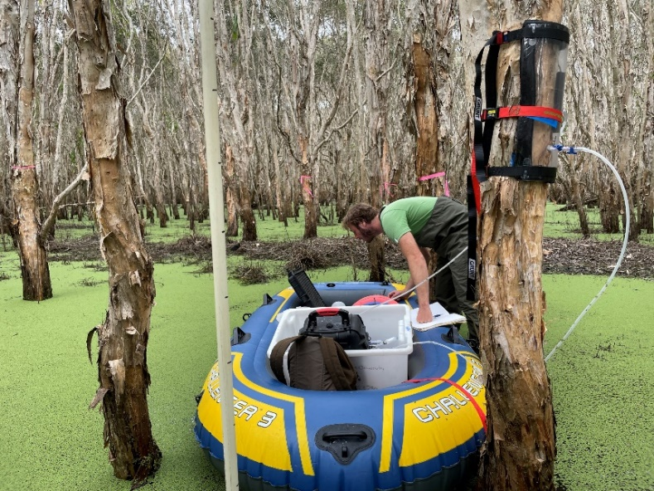

Thank you!

Slide 10
