Slide 1


Zhang Jun
Institute of Mountain Hazards and Environment, CAS
Chengdu, China
2022.5.26

Slide 2
Contents
Curriculum Vitae
Research Work
Main Achievements

Slide 3

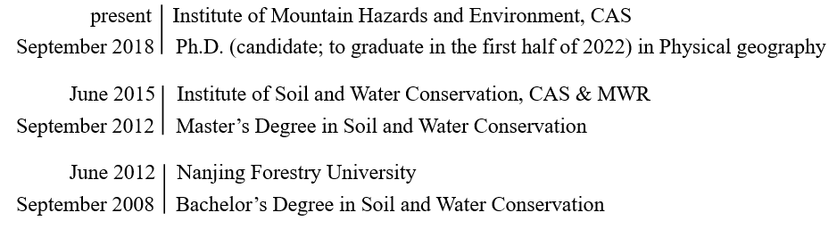
Jun Zhang
Institute of Mountain Hazards and Environment, CAS
Key Laboratory of Mountain Hazards and Earth Surface Process
Professor：Yong Li
Place of Birth：Shanxi
Date of Birth: 1992-09
Mobile Phone：17311360521
E-mail：zhangjun0266@imde.ac.cn
Business Address: No. 9, Block 4, Renminnan Road Chengdu 610041, P.R. China
Education

Slide 4
Research field
Characters and processes of vegetation covered slopes; soil grain research; slope instability; spatial distribution of soil water; debris-flow series analysis
Social Work
Reviewer of SCI Journals, Catena, Geoderma, Journal of Hydrology
Professional members
The American Association of Geographers, AAG, member Ecological Society of China, member
Translations
Play with geometry, Author, (Serbia) Mirjana Radovanovic, Jun Zhang, Hunan Science & Technology Press, 2019.5.
Mama’s Last Hug, Author, (Netherlands) Frans de Waal, Translator, Jun Zhang
Maths Olympiad, Author, Terry Chew Translator, Jun Zhang

Slide 5
Contents
Curriculum Vitae
Research Work
Main Achievements

Slide 6
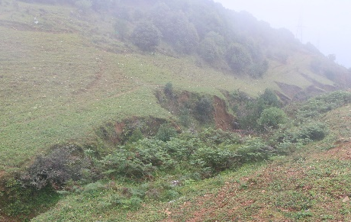
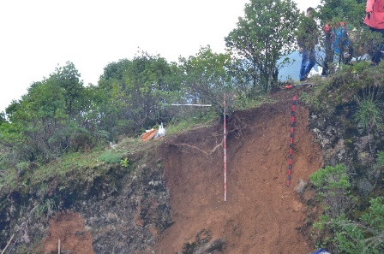
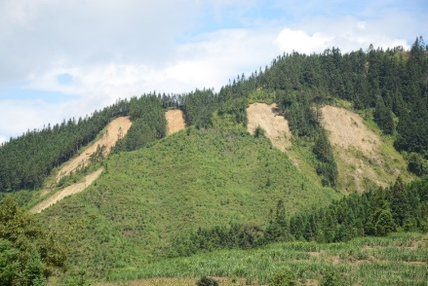
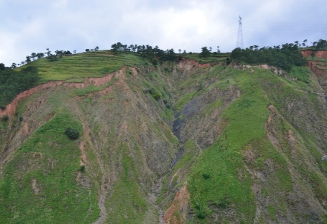
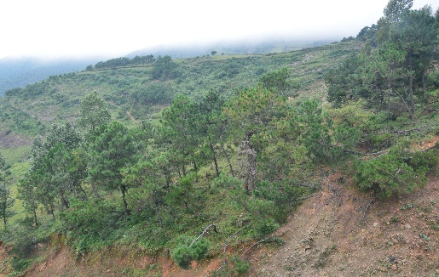
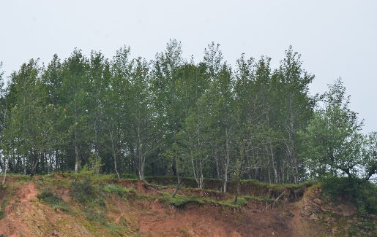
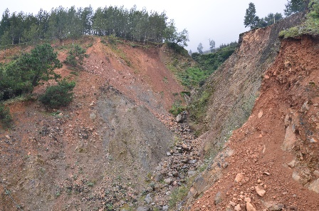
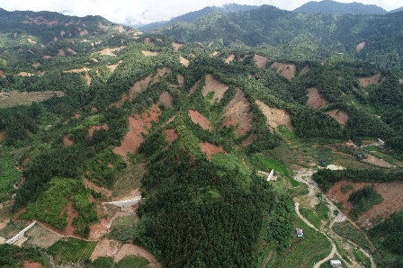
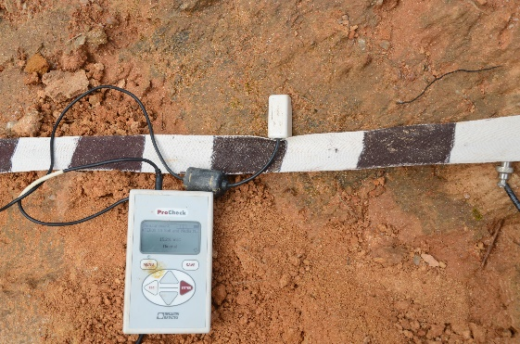
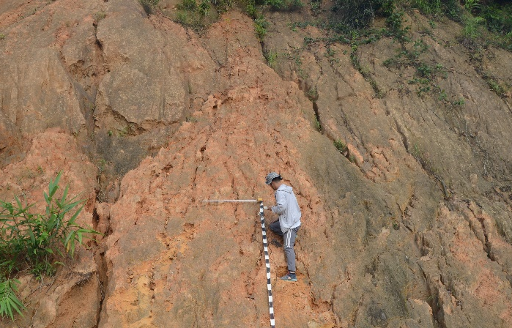
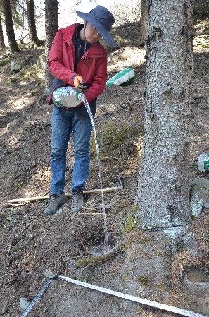
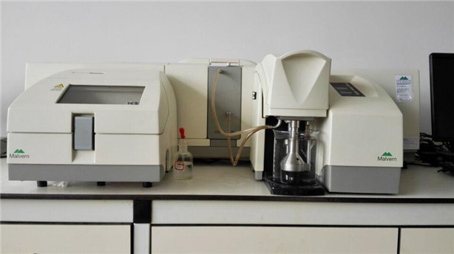
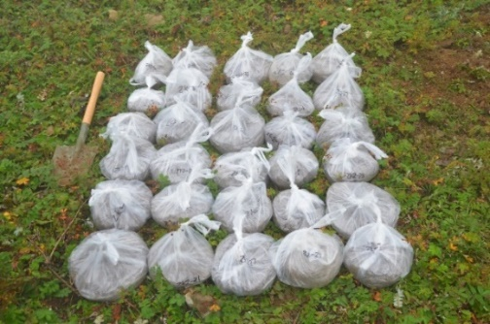
Field Work
Vegetation covered soils
Slope instability phenomenon
grass
shrub
Coniferous
Broad-leaf
Soil moisture measurement
Soil sample handling

Slide 7
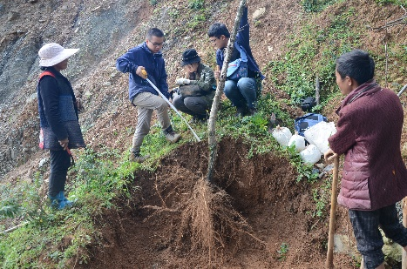
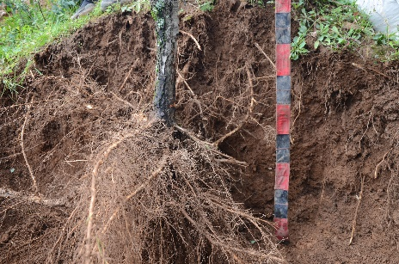
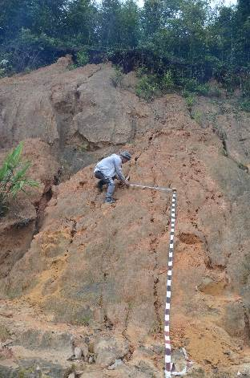
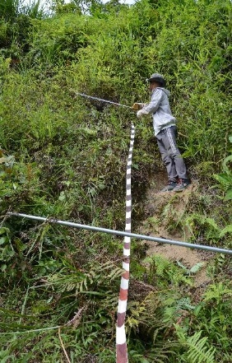
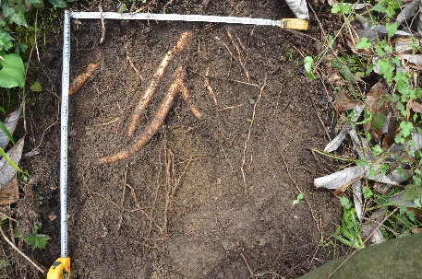
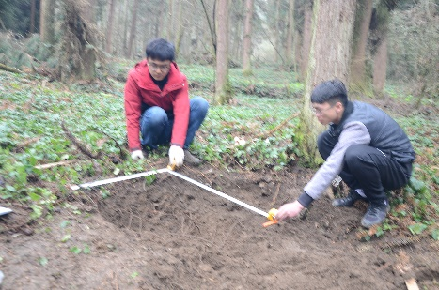
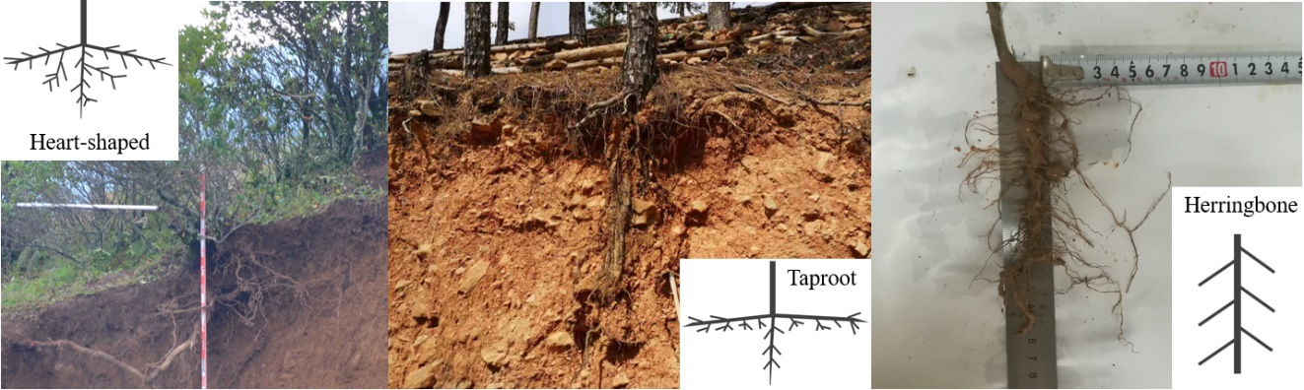
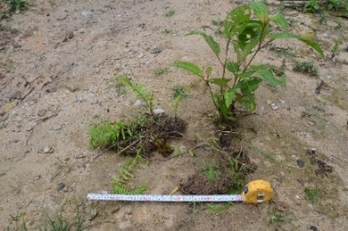
Field Work
Root system investigation
Soils of different kinds
Bare slope
Grass slope
Root soil
Three root system types, heart-shaped, taproot and herringbone.

Slide 8
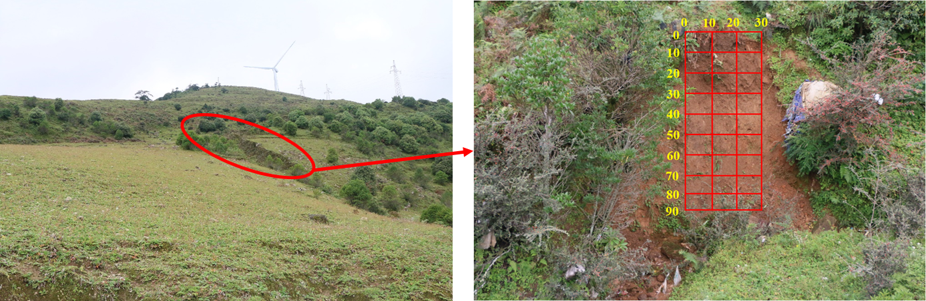
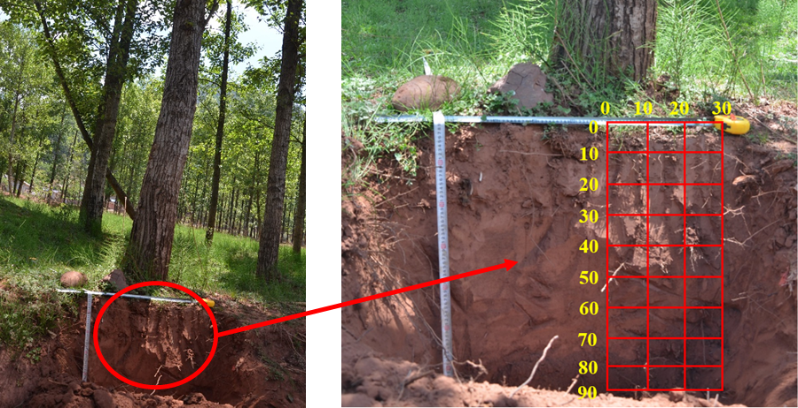
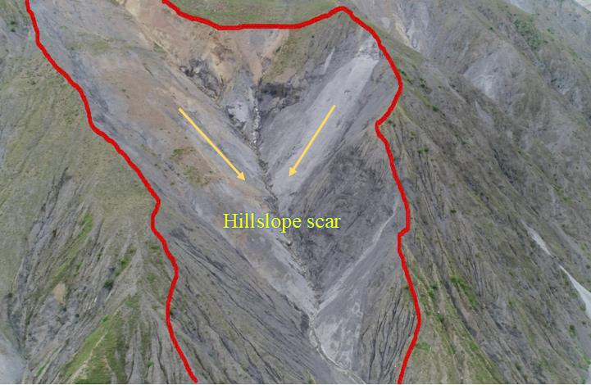
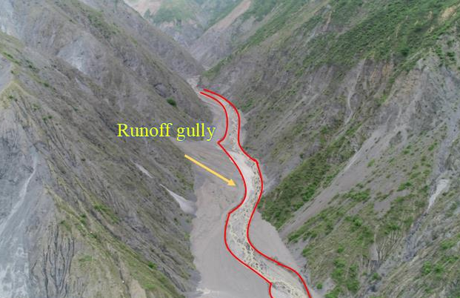
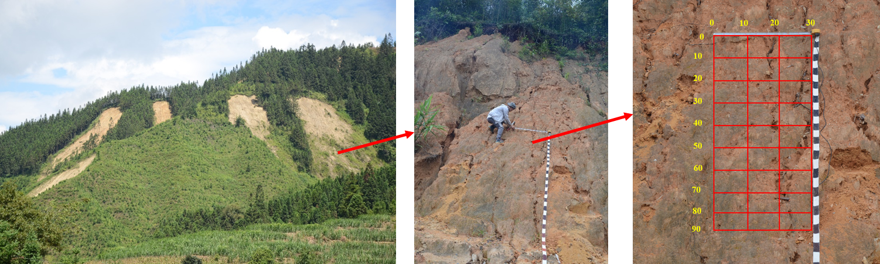
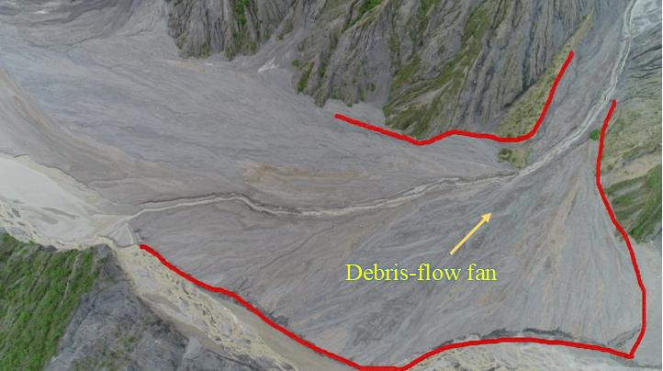
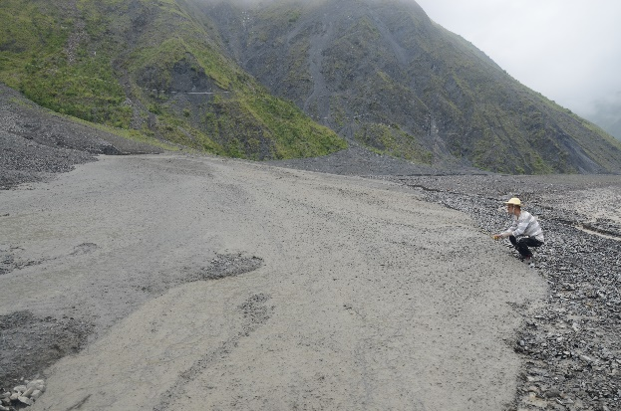
Field Work
Debris flow initiation and transportation
Soil grain spatial distribution in the root-zone and along slope surface
Panorama photo of debris-flow gully
Duozhao Gully
Menqian Gully
Source
Gully
Fan
Surge

Slide 9
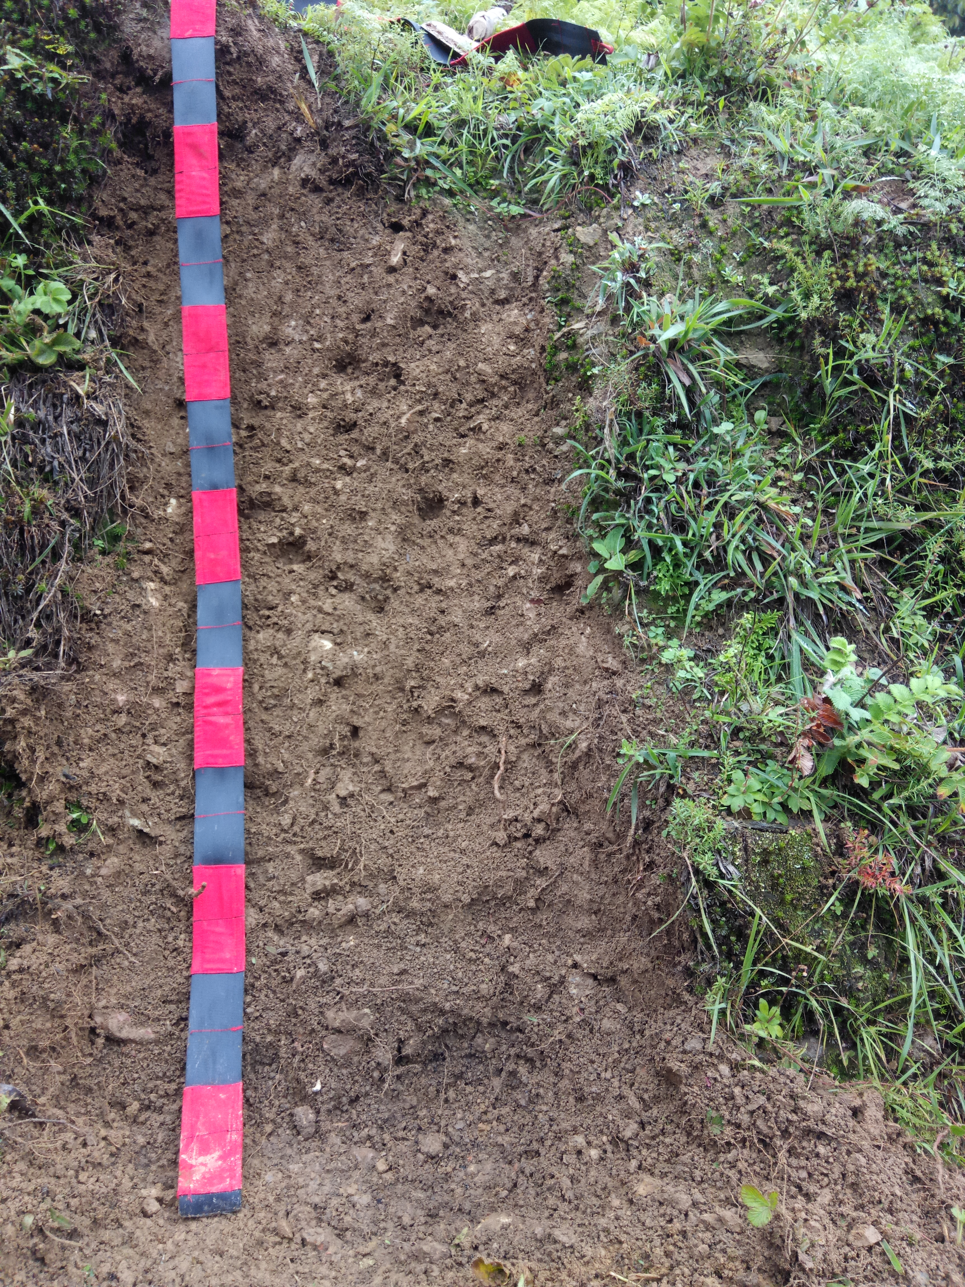
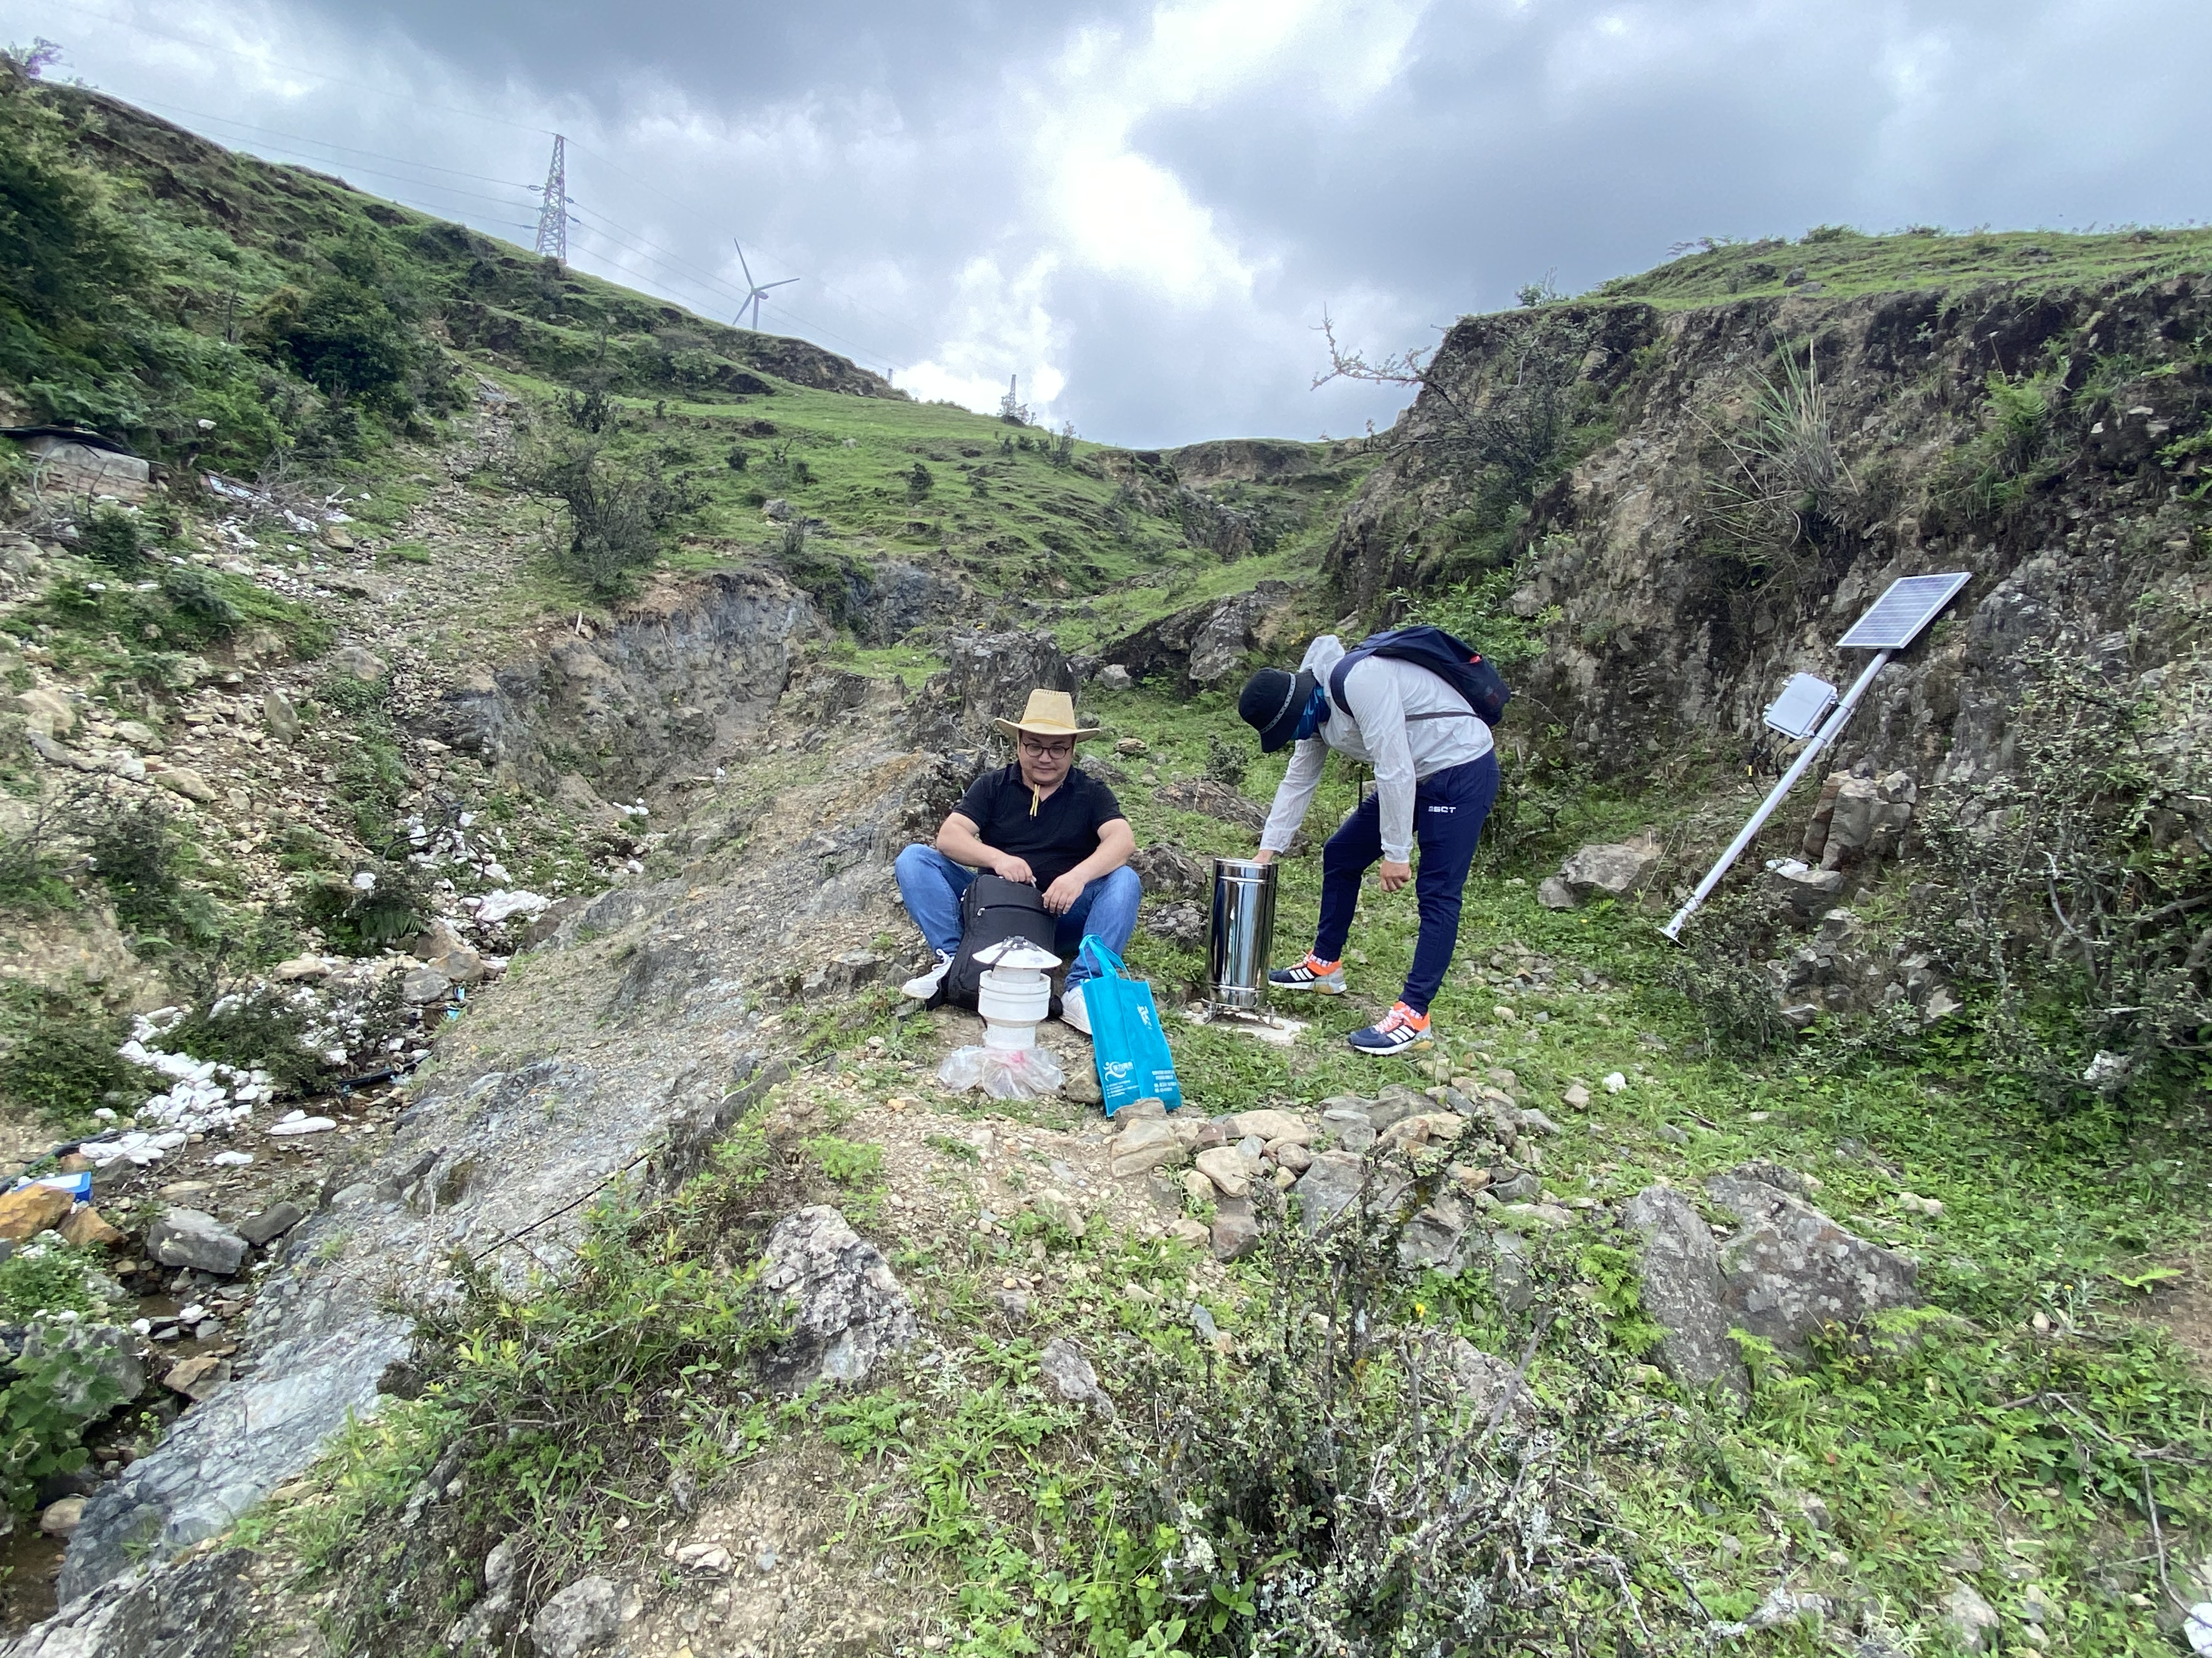
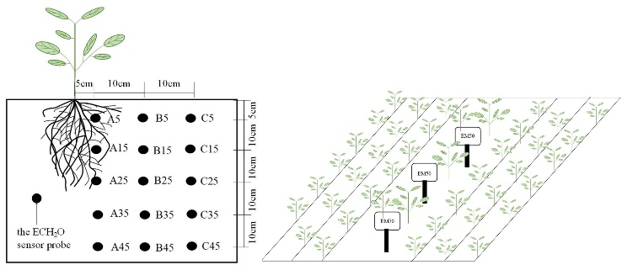
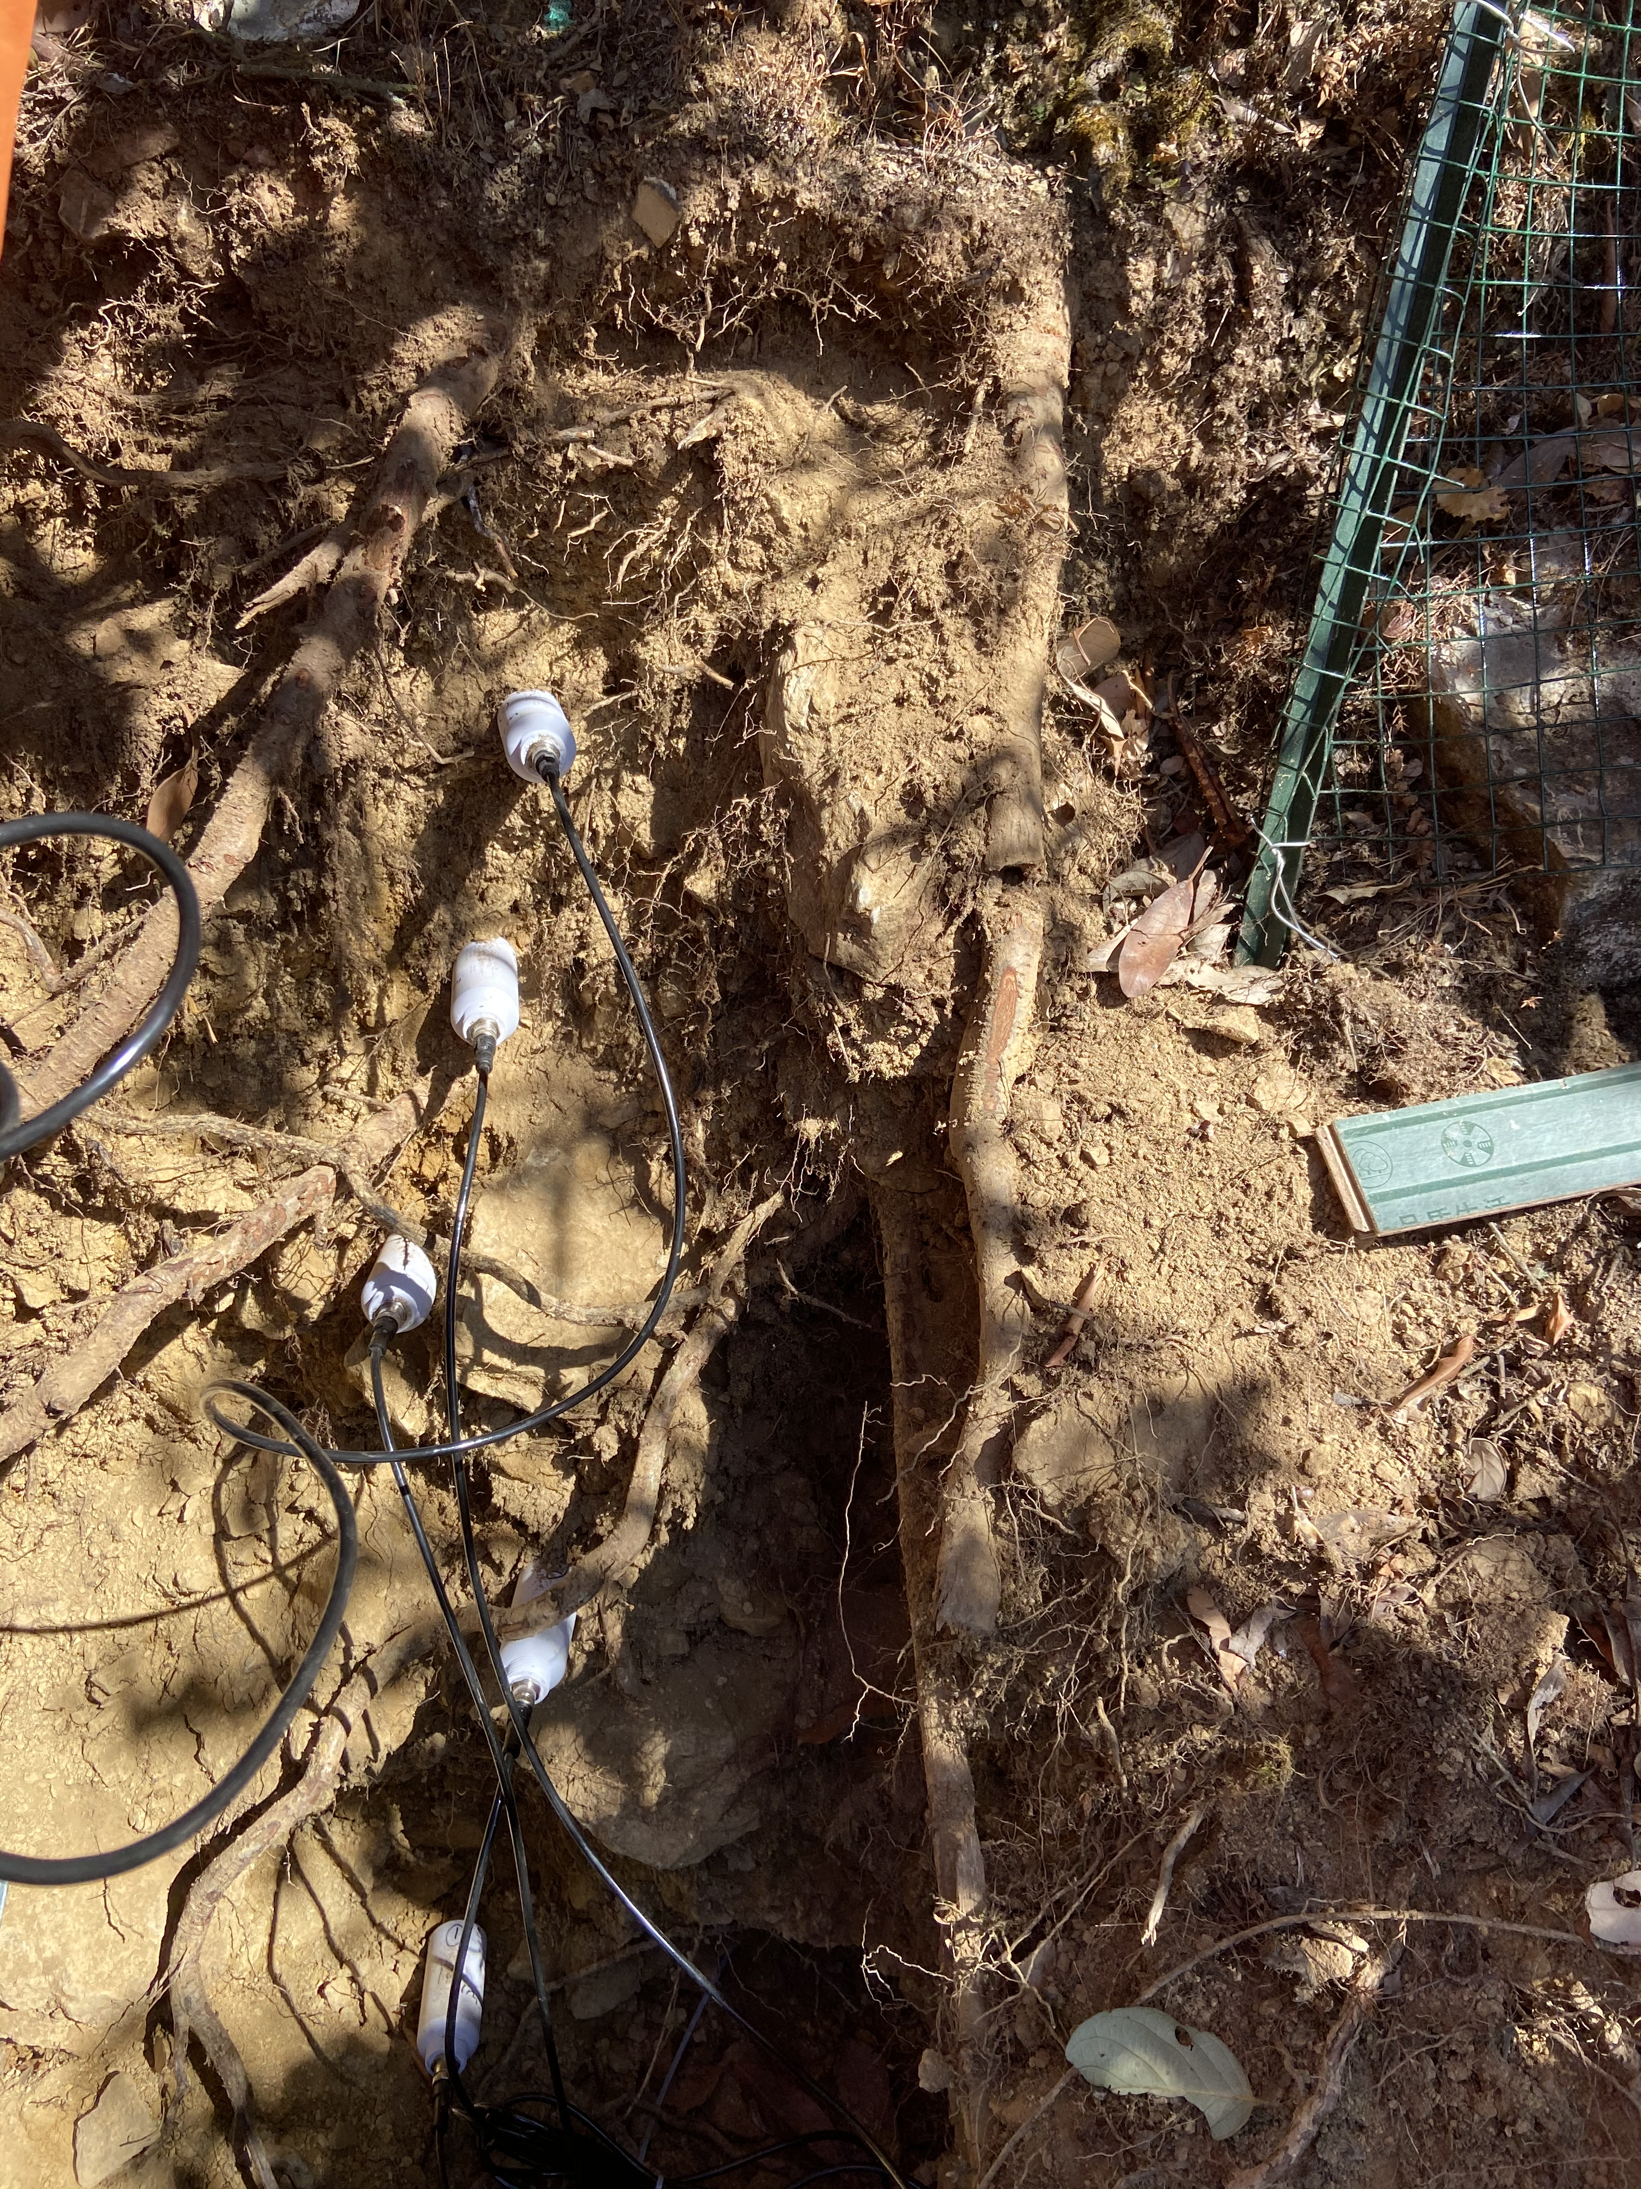
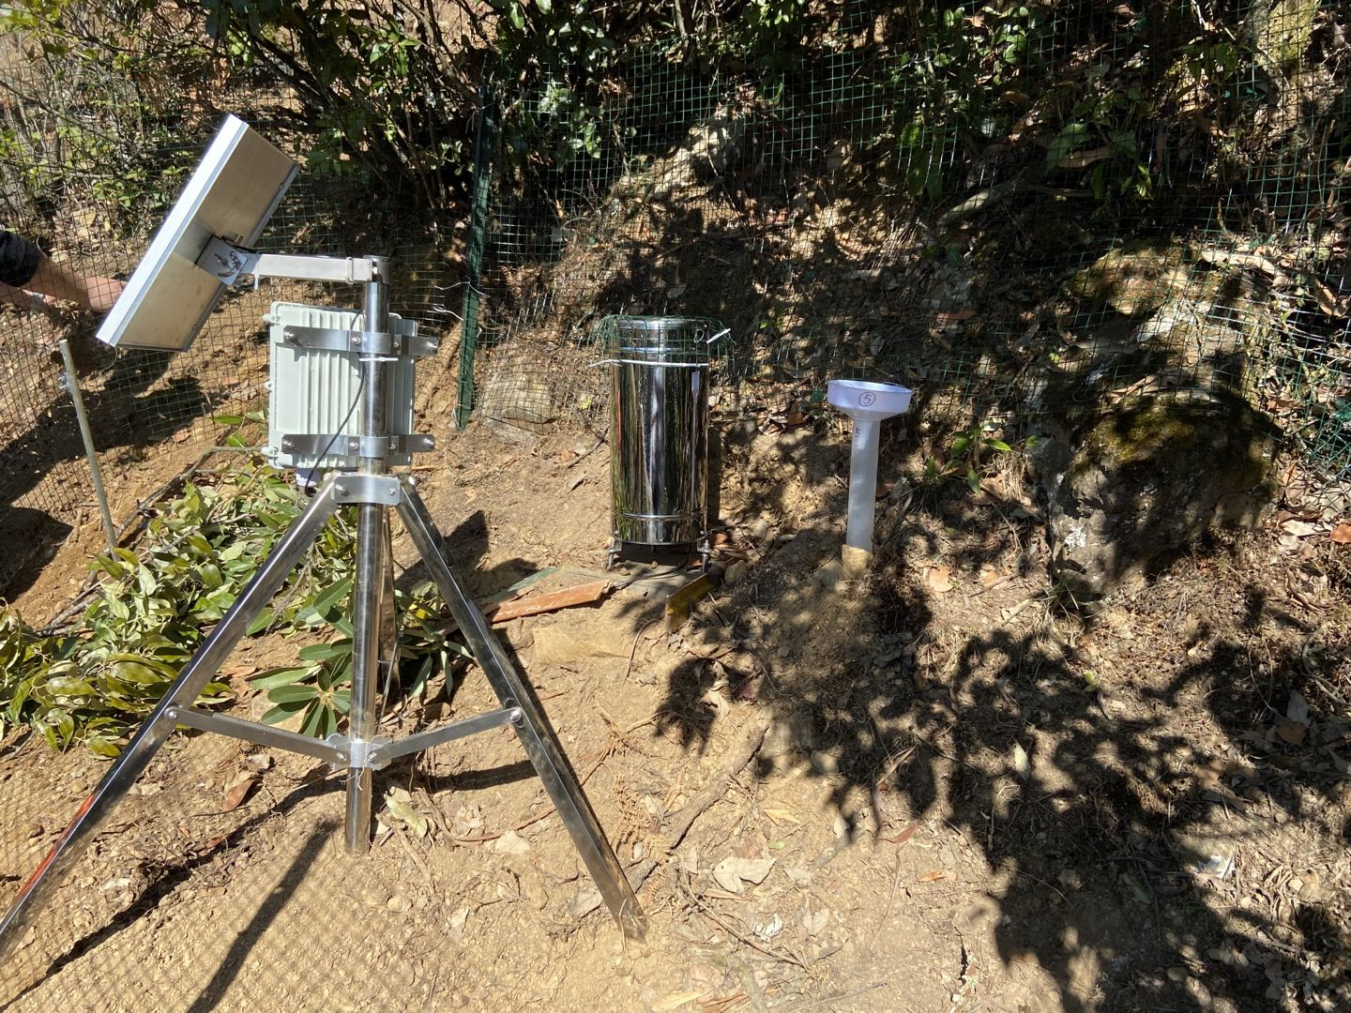
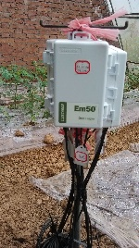
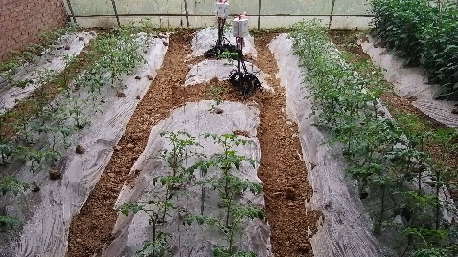
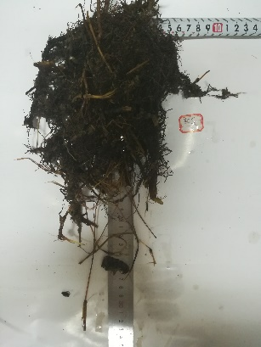
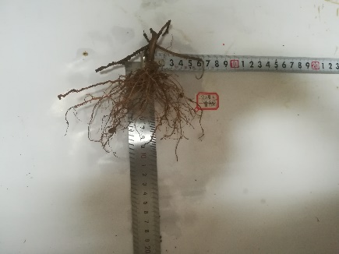
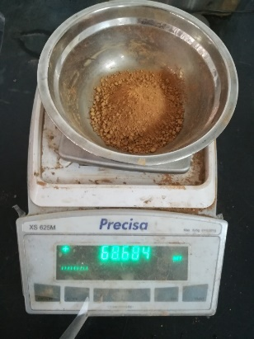
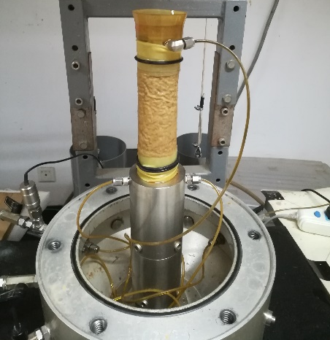
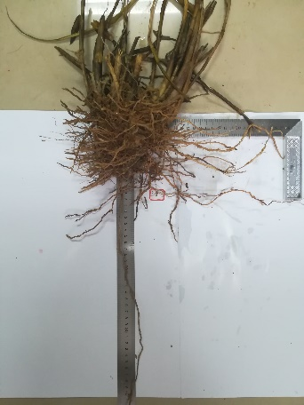
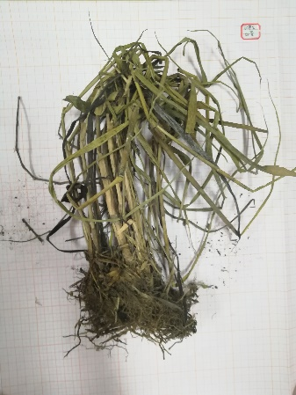
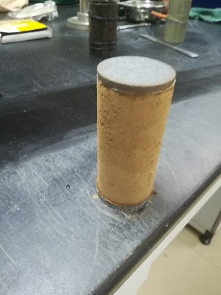
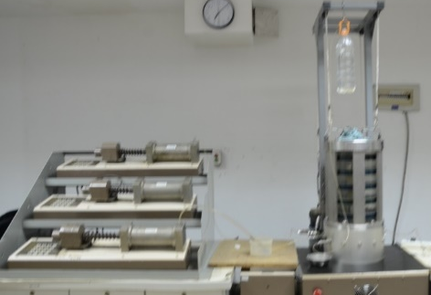
Experiment design
Soil moisture information collection
Soil moisture measurement in the root-zone
Root system handling
penetration test

Slide 10
Contents
Curriculum Vitae
Research Work
Main Achievements

Slide 11
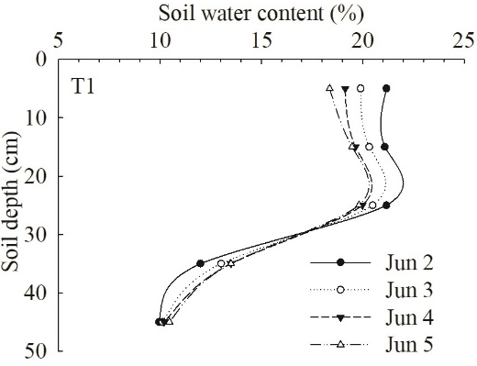
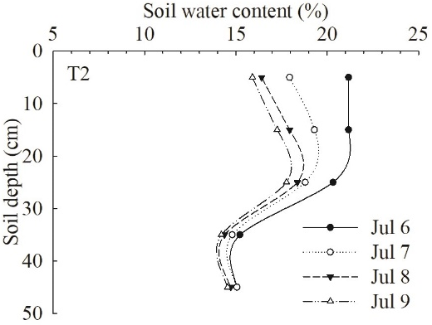
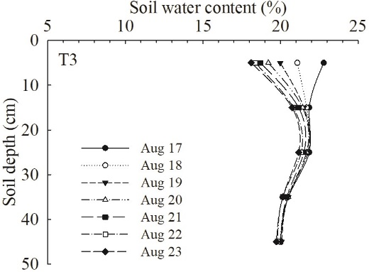
1. Root-zone soil moisture research
② Soil moisture time series
① Spatial distribution of root-zone soil moisture
In the three growth stage, high (H),medium(M) and low(L) soil moisture sub-area exist
Soil moisture time series in different locations in the root zone possess different variation range, memory or persistence character.
③ Soil water penetration in the root zone
During each irrigation cycle, with time passing by, routes of soil water varied.
Zhang, J. , Li, Y. , Yang, T. , Liu, D. , & Jiang, N. (2021). Spatiotemporal variation of moisture in rooted-soil. Catena, 200, 105144.

Slide 12
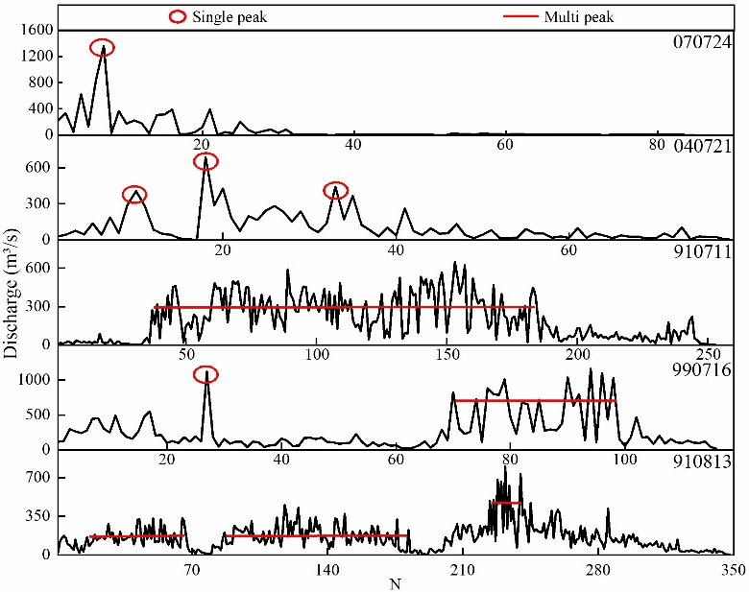
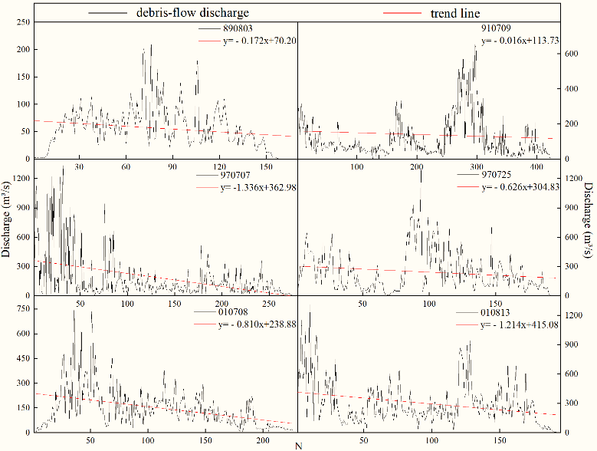
3. Spatio-temporal character of debris-flow surge sequence
① Precipitation and corresponding debris-flow surges
② Debris-flow modes and tendency
Debris-flow patterns reflect rainfall patterns
Mode：single-peak, several single peaks, multi-peak, single multi-peak, peak groups
Tendency: downward
③ Persistence and memory character of debris-flow surges
Hurst exponent(H)
H>0.5，persistence or long-time memory
Zhang, J. , Li Y, Guo X, Yang T, Liu D andYu B (2021) Temporal Characteristicsof Debris Flow Surges.Front. Earth Sci. 9:660655.

Slide 13
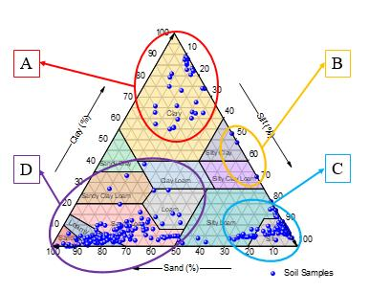







4. Soil grain description methods
② Grain-size distribution curve, special sizes (d₁₀, d₃₀, d₆₀)
④ The GSD formula
① Traditional method——USDA triangle
P(D) = CD^{−μ}exp(−D/D_{c})
Where P(D) is the percentage of grains >D(mm) ，C, μ and D_{c} are parameters, which can be received by fitting this equation to the grain size data. The μ exponent represent the finning samples, D_{c} increase with the grain size range.
③ 土壤分类系统
A:clay B：silty clay and silty clay loam
C：silty loam and silt
D：sand, loamy sand, sandy loam and loam
The μ-C relationship, soil groups identified by GSD parameters.
Texture information of soils from various areas
Canadian System of Soil Classification, CSSC
United States Department of Agriculture, USDA
International Society of Soil Science, ISSS
American Association of State Highway Officials, AASHO
American Society for Testing and Materials, ASTM
Zhang, J. , Li, Y. , Scaling laws in soil. Geoderma. (revision complete)
GSD for soils from various areas, weibull distribution for the grain compositions of soils.

Slide 14

Thanks for your attention!

