Slide 1




CT scan of a small-scale fault network: 3D fault geometries and their interpretation
Presenting: Inbar Vaknin
Under the supervision of Prof. Andy Nicol

Slide 2

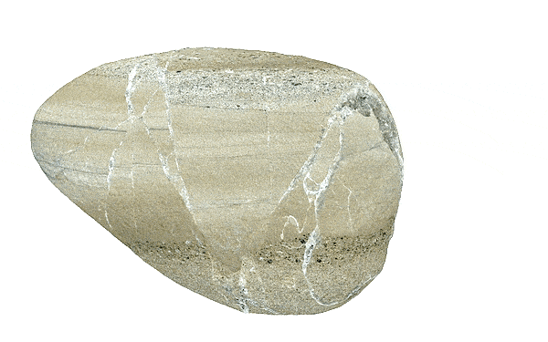
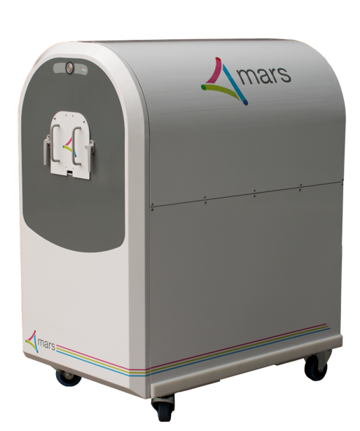



Rock and Machine
Rock & Machine
Scan Results
Analyses
Displacement Measurements
Permeability
Key Points
2cm
Rock sample
Interbedded Sand/silt stone of Mt. Messenger form., Taranaki, NZ
Extensional faulting region
Calcite secondary deposition in faults
Sample size 10 x 8 x 3 cm
mars scanner
Simultaneous multi energy bins scans
Resolution 50-200 µm, 80 µm here
Sample size up to 125 mm diameter x 450 mm

Slide 3
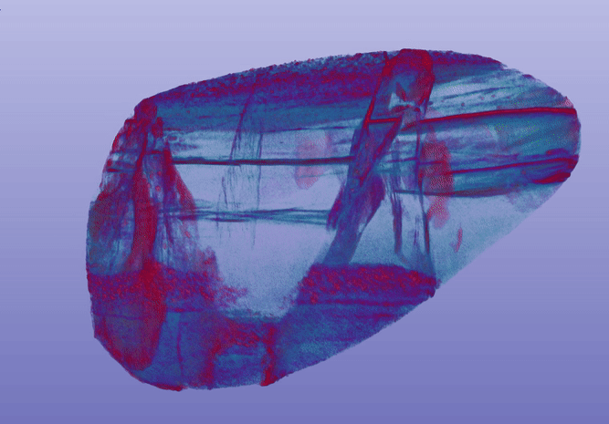
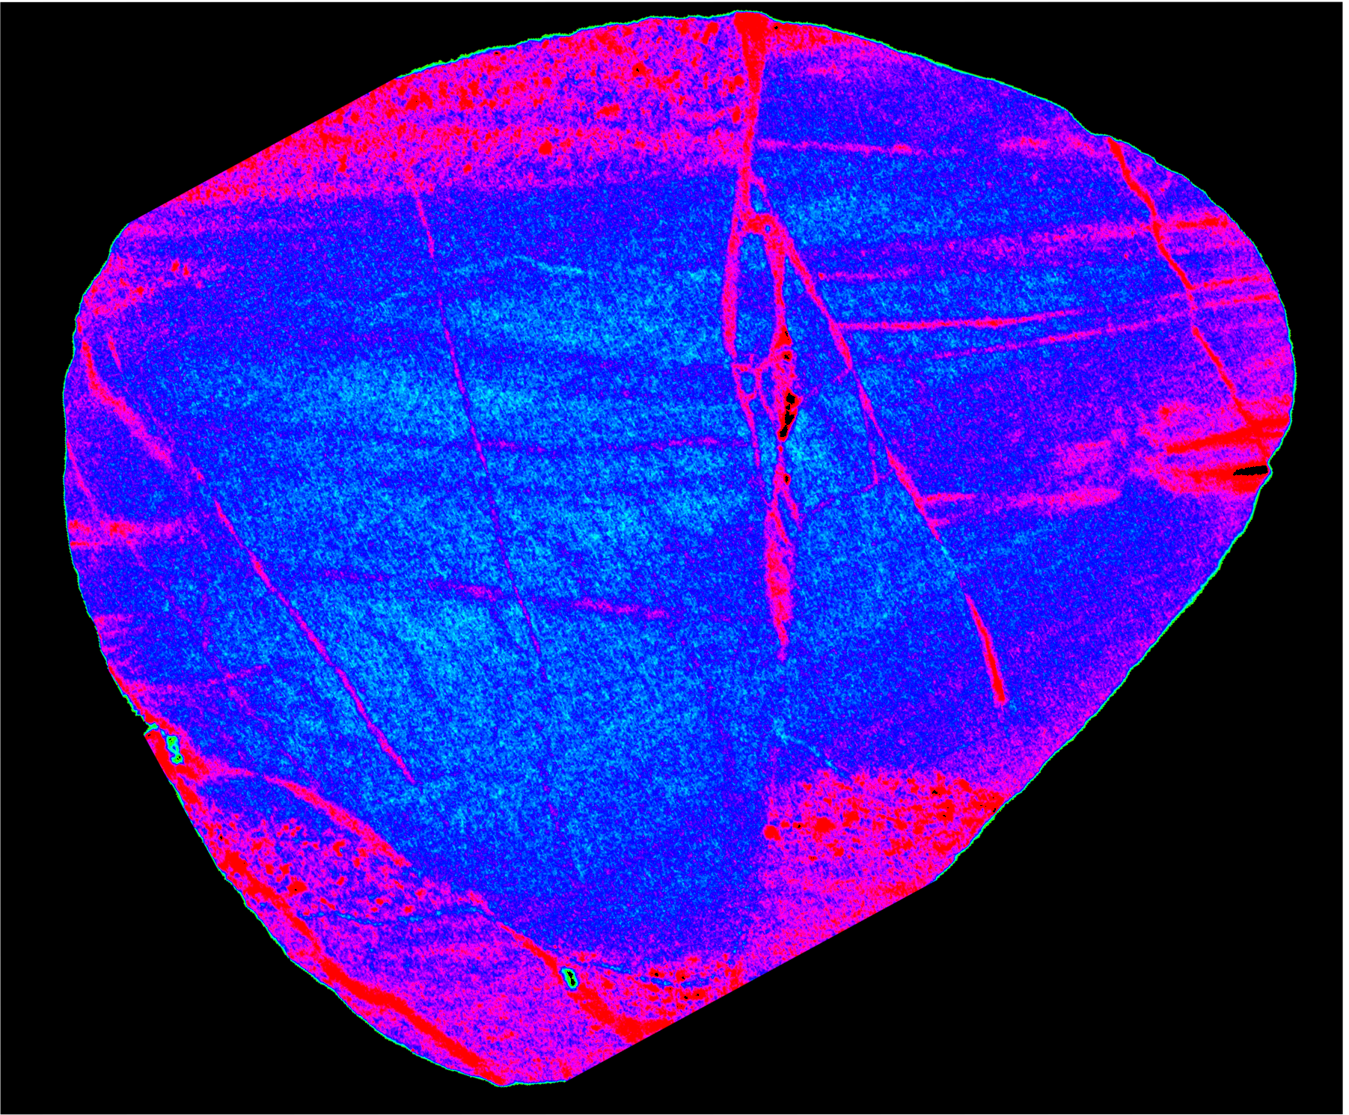
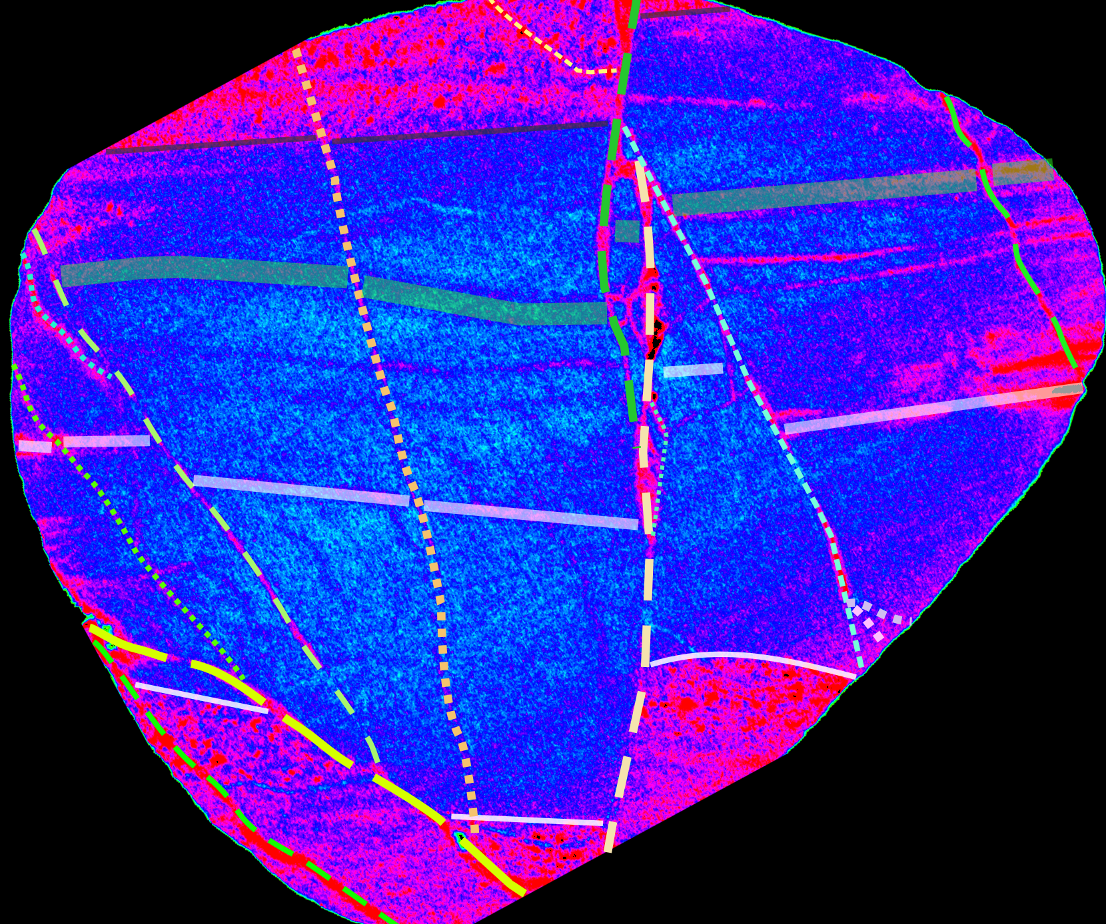
Scan Results and Interpretation
Rock & Machine
Scan Results
Analyses
Displacement Measurements
Permeability
Key Points
Interpreted in total: 17 Fault planes , 4 horizons

Slide 4
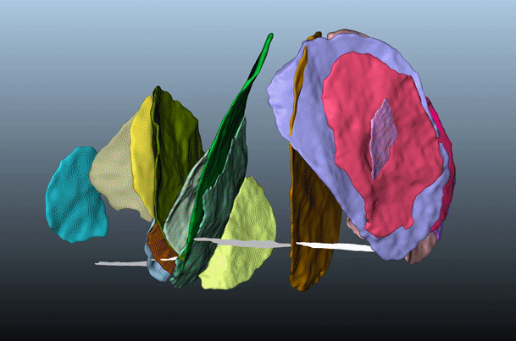
Scan Results and Interpretation
Rock & Machine
Scan Results
Analyses
Displacement Measurements
Permeability
Key Points
Interpreted in total: 17 Fault planes , 4 horizons

Slide 5
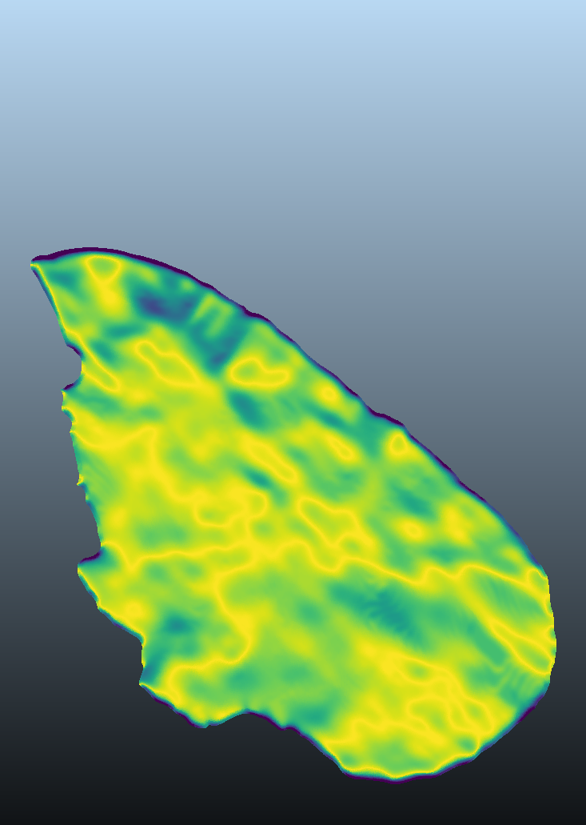
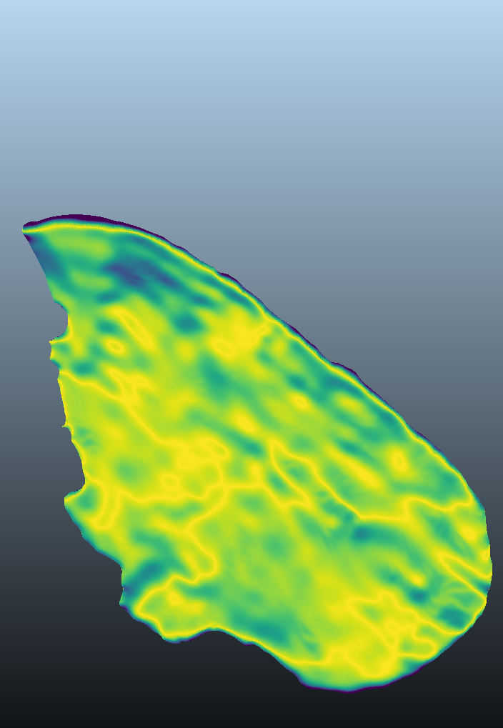
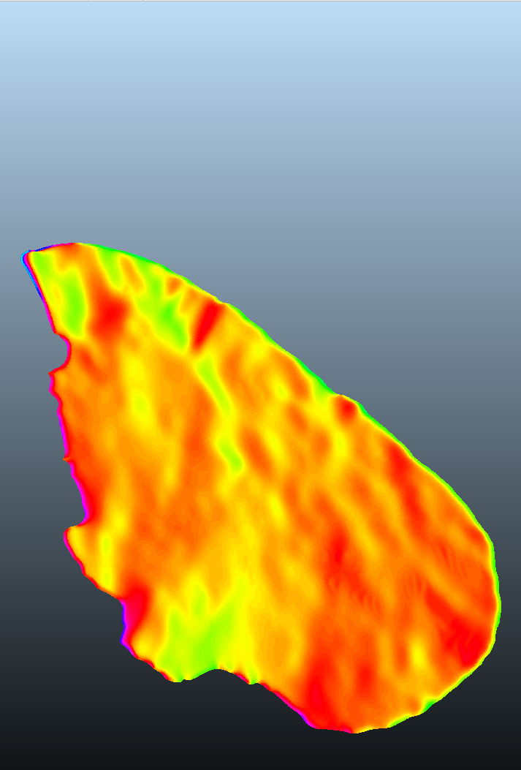
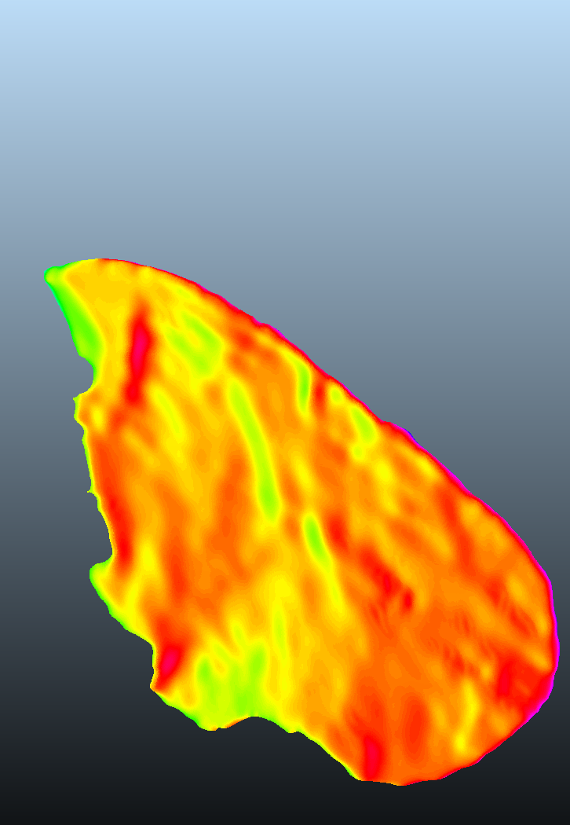
Analyses
Rock & Machine
Scan Results
Dip [angle]
Dip-direction
Analyses
0 50 75 90
0 90 180 270
Displacement Measurements
Permeability
Key Points
FW
HW
FW
HW
2 cm

Slide 6
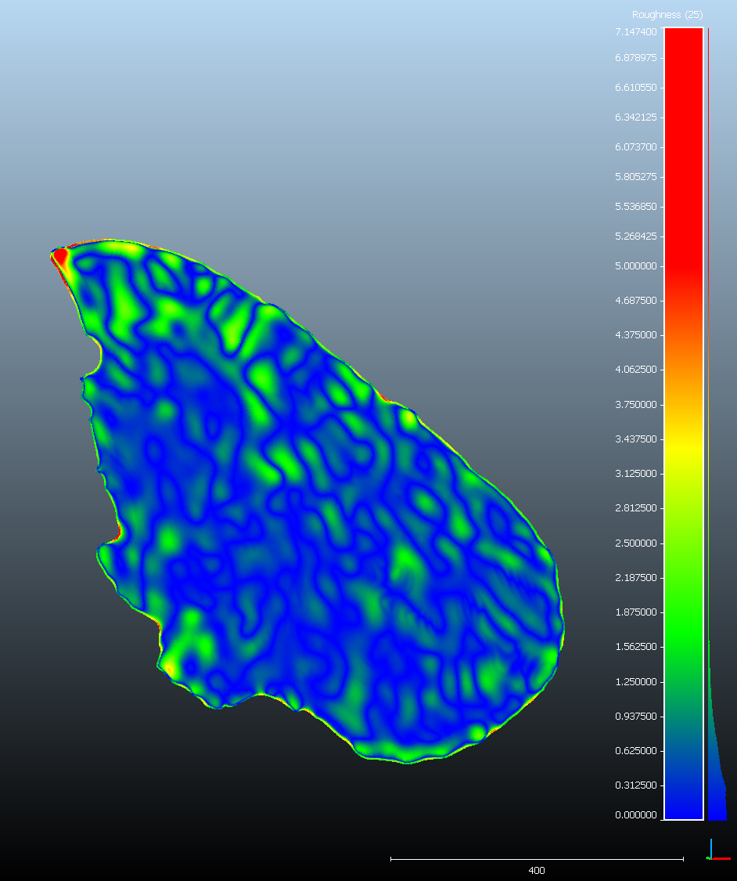
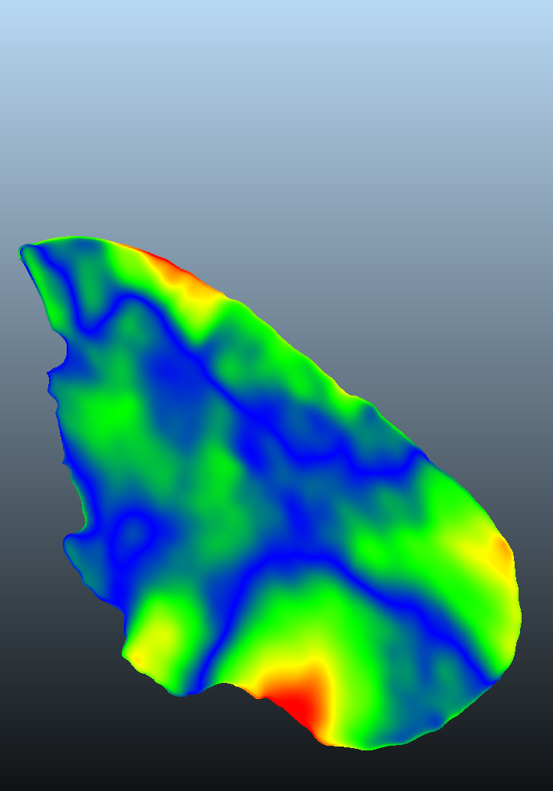
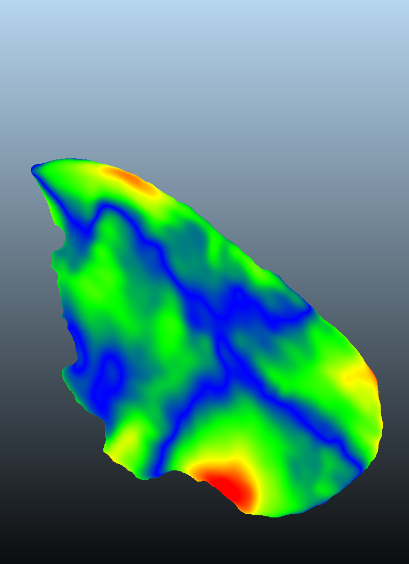
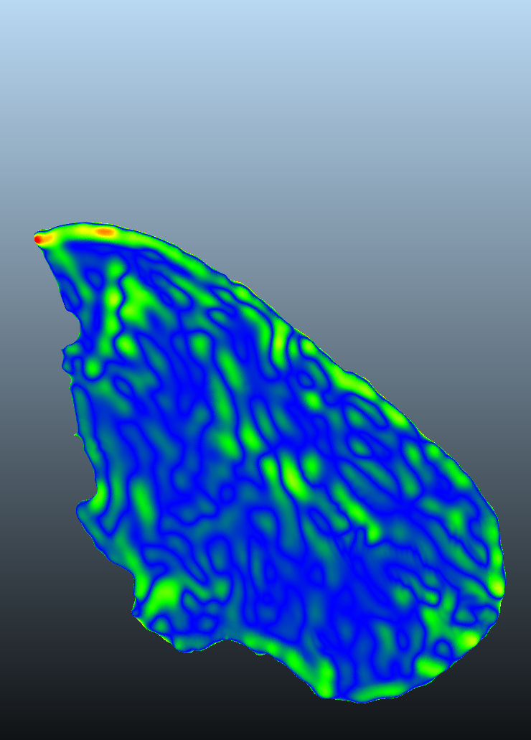
Analyses
Rock & Machine
Scan Results
Surface Variation [mm]
Roughness [mm]
Analyses
0 10 20 30 40
0 0.1 0.3 0.5 0.7
Displacement Measurements
Permeability
Key Points
FW
HW
FW
HW
2 cm

Slide 7
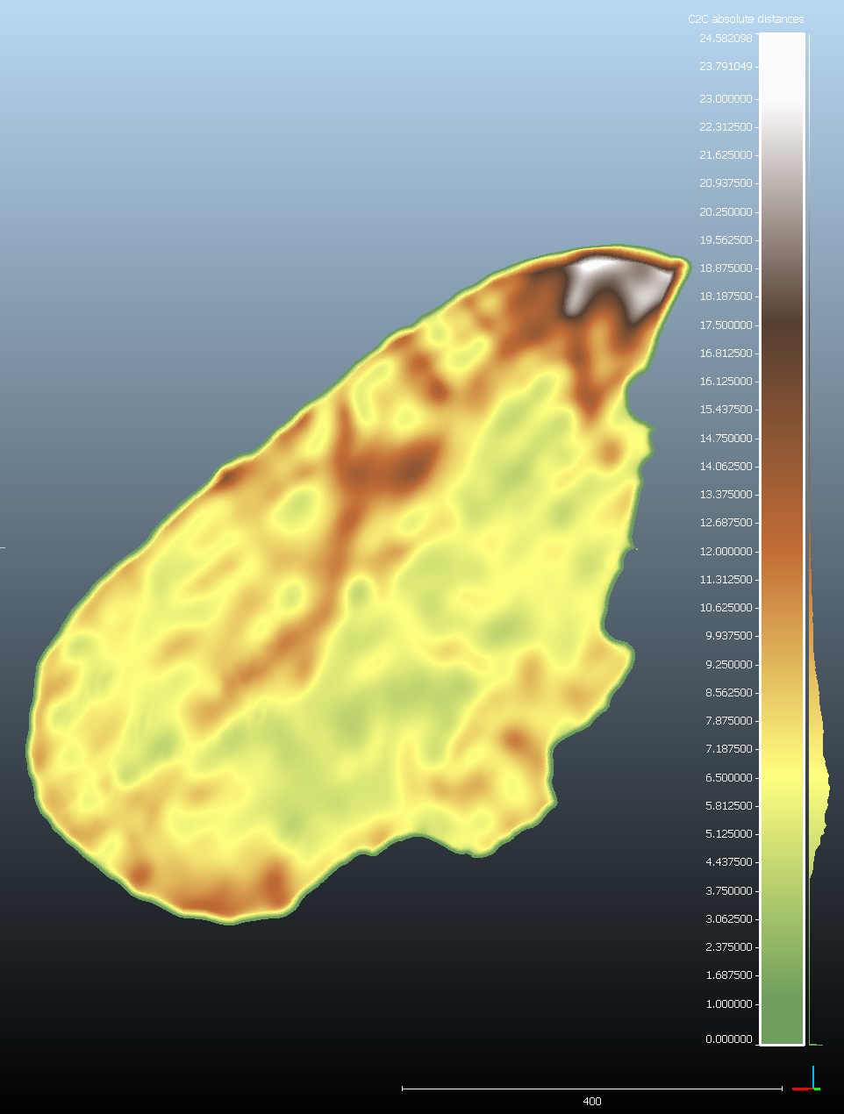

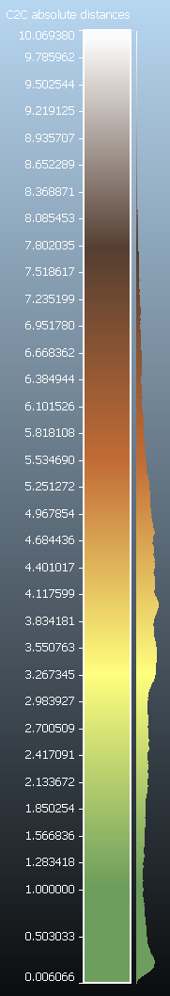
Analyses
Rock & Machine
Thickness [mm]
Scan Results
Dip angle
Dip direction
Analyses
0 50 75 90
0 90 180 270
Displacement Measurements
Permeability
Key Points
FW
HW
FW
HW
Surface Variation [mm]
Roughness [mm]
0 10 20 30 40
0 0.1 0.3 0.5 0.7
1 cm
FW
HW
FW
HW
0 0.5 1

Slide 8
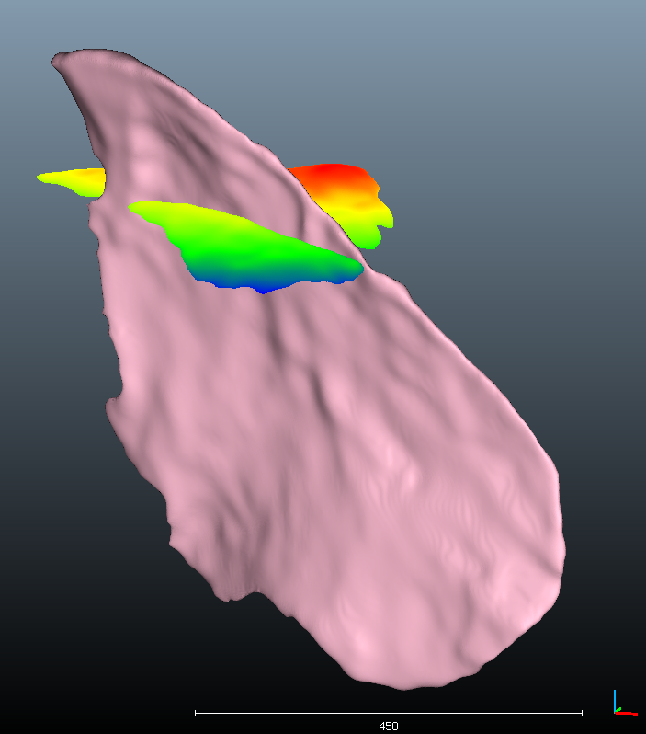
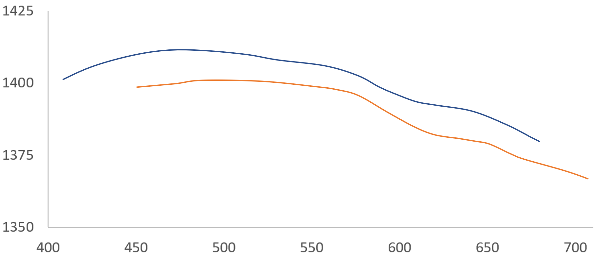
Displacement Measurements
Rock & Machine
Scan Results
Elevation profile of Horizon 4
Analyses
1430
North South
Displacement Measurements
Elevation
Permeability
Elevation
Horizon 4
1340
Key Points
310 Fault trend 110
Distance
* Distance and elevation in local coordinate system 1=100 µm
Intersection line with other fault
Fault C
Oblique displacement
1 mm vertical + 1 mm horizontal
South wall going down and South East
N
4.5 cm

Slide 9
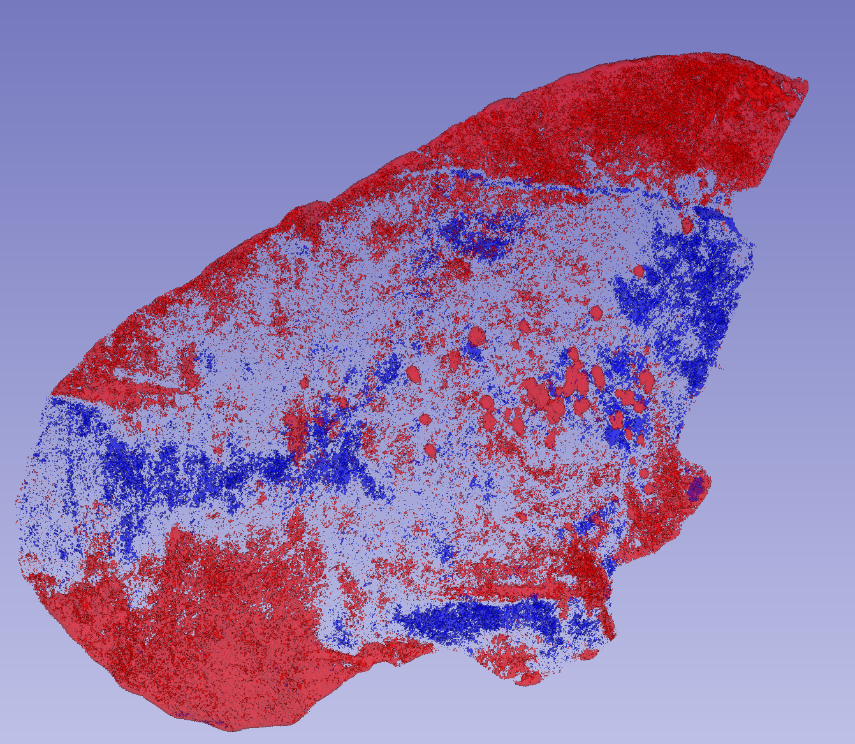
Permeability
Rock & Machine
High density voxels (>2.5 g/cc) – Calcite filled
Low density voxels (<1.7 g/cc) – Breccia filled
Scan Results
Analyses
Displacement direction
Displacement Measurements
Intersecting fault
Intersecting fault
Permeability
Key Points
Horizon 4
Horizon 3
1 cm
Horizon 2
0 0.5 1
1 cm

Slide 10
Key Points
Rock & Machine
Mapping fault structures using x-ray CT can be successful – when host rock and fault rock have different density
Data and Analyses:
Fault thickness variations – (lenses segments etc.)
Fault surface roughness footwall vs. hangingwall comparison
Displacement distribution on the fault plane
Influence of lithology changes
Influence of fault-fault interactions
How the above influence permeability
What’s next?
Larger samples
Multiphase scans (fluids and rock)
Scan Results
Analyses
Displacement Measurements
Permeability
Key Points

