Slide 1


EGU22-3334
Application of Simulation-Optimization modeling to suggest optimal hybrid in-situ flushing for nitrate attenuation
Suh-Ho Lee, In-Woo Park, Seong-Sun Lee, Kang-Kun Lee*
Seoul National University
Abstract code

Slide 2
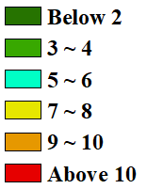
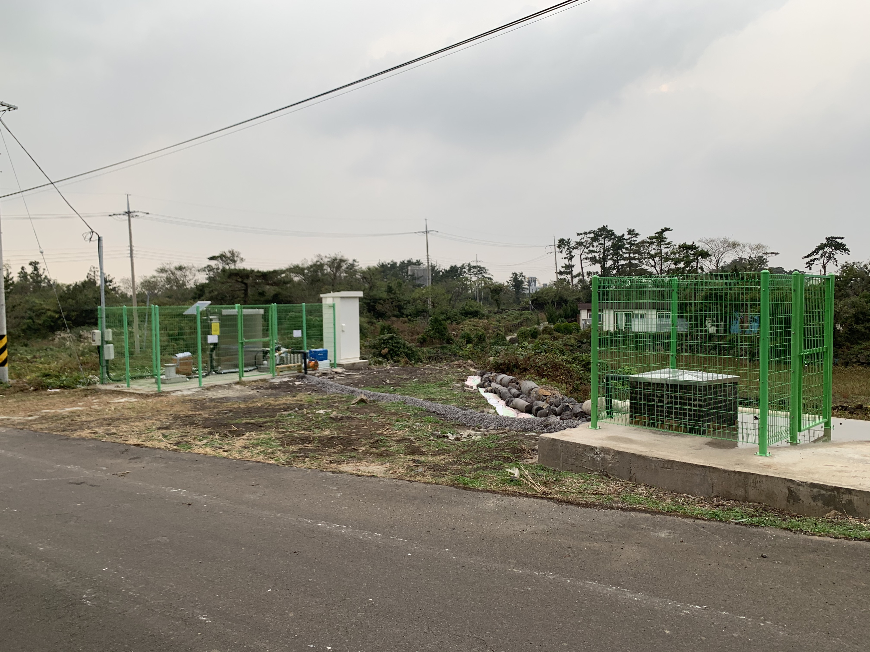
introduction
Groundwater is contaminated by nitrate in western Jeju area (Hallim) due to livestock manure.
In-situ technology (i.e. bioremediation) is widely used method in nitrate remediation (Aesoy et al., 1998; Haugen et al., 2002; Carey et al., 2014)
Hard to apply in-situ remediation technology due to higher permeability
Optimal new remediation strategy is necessary → Hybrid in-situ flushing
NO₃-N (mg/L)
Jeju
Hallim
Figure. Concentration distribution of nitrate-nitrogen in the study area at 2020.
Figure. Location of the study area
Figure. Study area where performed field test

Slide 3
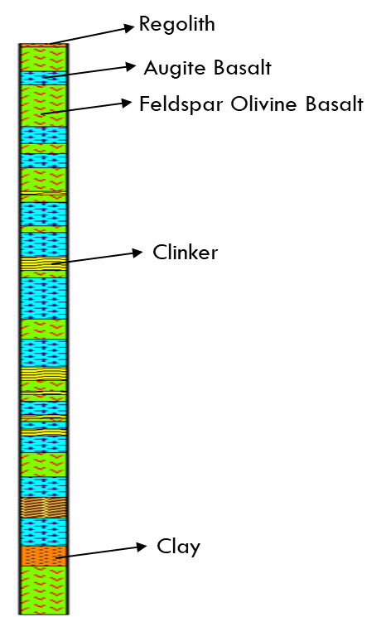
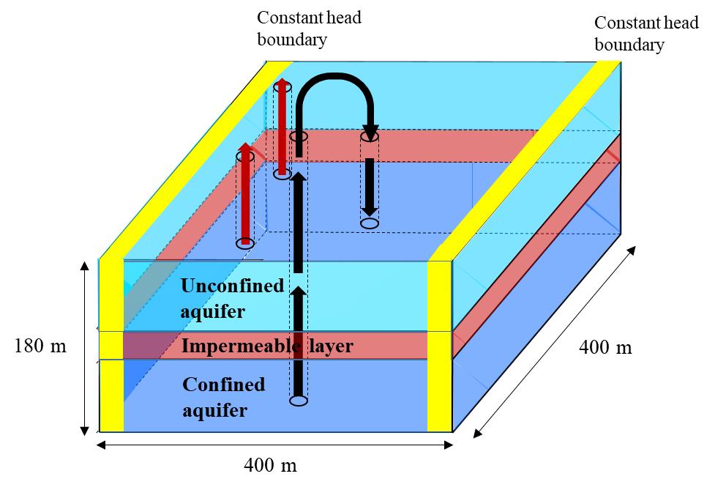
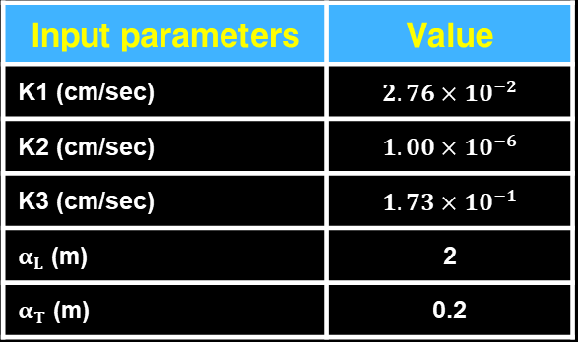
Methodology – Simulation model
MODLFOW(Harbaugh, 2005) is applied to simulate groundwater flow model
MT3D (Zheng, 1990) is applied to simulate nitrate transport
3 layers model
1 fixed injection well + 1 fixed pumping well & 2 unfixed pumping well
Parameters are obtained by hydraulic test
Table. Input parameters for simulation model
Input parameters | Value
K1 (cm/sec) | $$2.76×{10}^{−2}$$
K2 (cm/sec) | $$1.00×{10}^{−6}$$
K3 (cm/sec) | $$1.73×{10}^{−1}$$
$α_{L}$ (m) | 2
$α_{T}$ (m) | 0.2
Figure. Conceptual model domain of simulation model. Yellow area indicates constant head boundary and black arrow indicates the process of pumping and injection of uncontaminated groundwater and red arrow indicates the process of pumping contaminated groundwater.
Figure. Drilling log at the study area

Slide 4
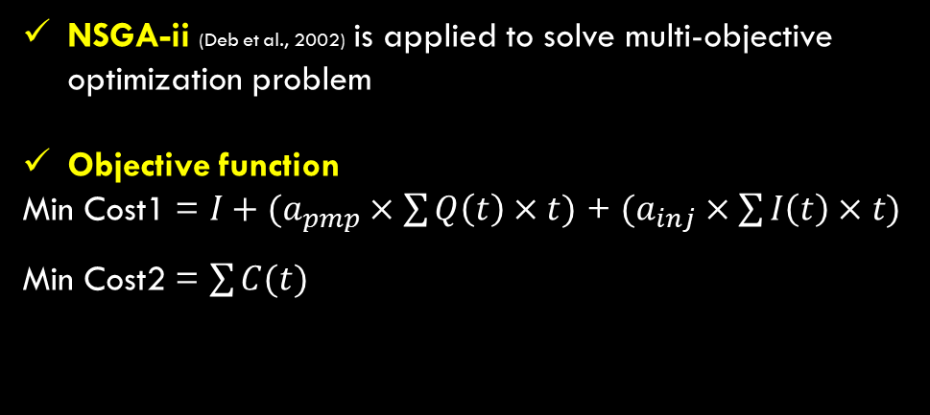
Methodology – optimization model
Calculate initial flow and transport model
Using MODFLOW-2005 and MT3D-USGS
NSGA-ii (Deb et al., 2002) is applied to solve multi-objective optimization problem
Objective function
Min Cost1 = $I+(a_{pmp}×\sum{Q\left(t\right)×t)}$ + $(a_{inj}×\sum{I\left(t\right)×t)}$
Min Cost2 = $\sum{C(t)}$
Evaluate fitness of objective function
Multi objective function
GA operation
Evaluate fitness of objective function
I (KRW): Installation of pumping well cost
a_{pmp} (KRW/m³): Operation of pumping well cost
a_{inj} (KRW/m³): Operation of injection well cost
Q(t) (m³/day): Pumping rate at specific time
I(t) (m³/day): Injection rate at specific time
t (day): Time for remediation
C(t) (mg/l): Concentration at an observation points at a specific time
Combine parent and child populations
Ranking + Sorting
Rank population by non-dominated sorting and select populations
Maximum pumping and injection rate: 2000 m³/day
Generate first solution front
Pareto optimal front
Select dominated solutions at next generation
Generate pareto front
Is Generation
< Max Generation ?
Stop
Figure. Flowchart of NSGA-ii couple with groundwater model

Slide 5
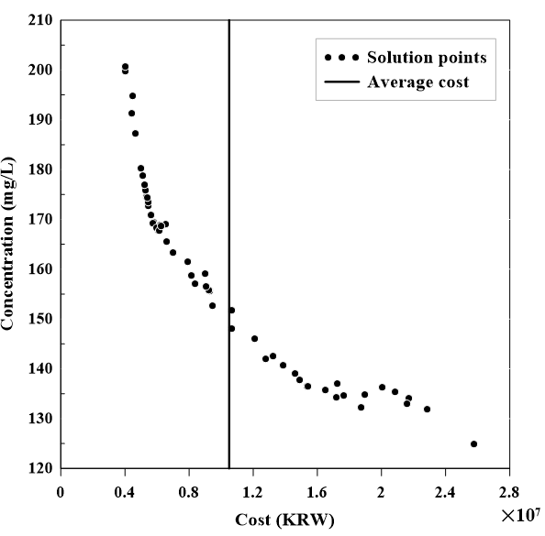
Result and discussion – optimization result
Pareto optimal front shows trade-off relationship between cost and concentration
Solution diversity is maintained after evolution
Select 3 cases for simulation
- Case A: Minimum cost for remediation
- Case B: Average cost for remediation
Case C: Maximum cost for remediation
→ Identify remediation effect by applying hybrid in-situ flushing
Figure. Pareto optimal front of NSGA-ii at final generation. Black solid line indicates the mean cost of whole solution points.

Slide 6
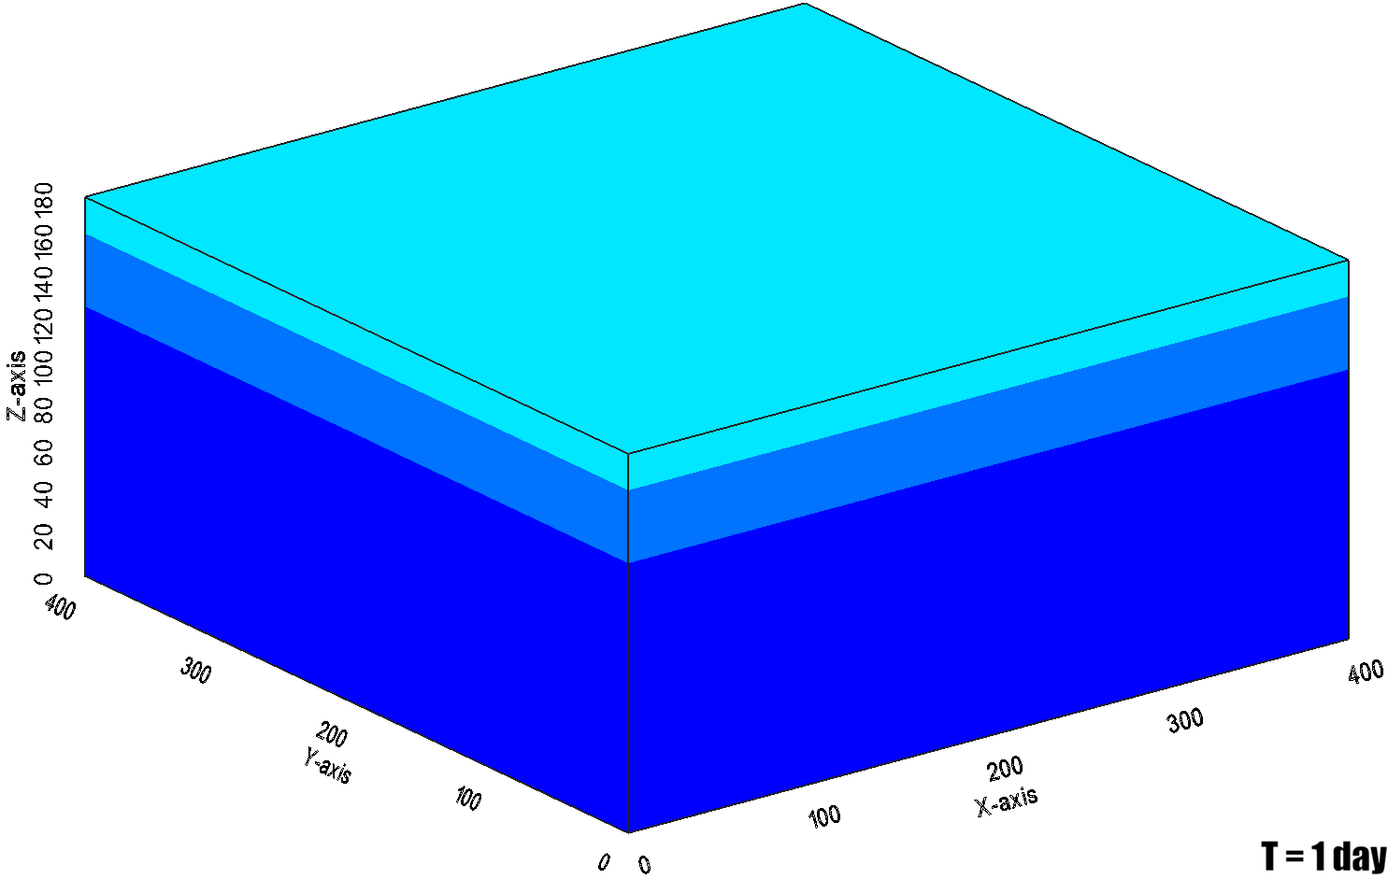
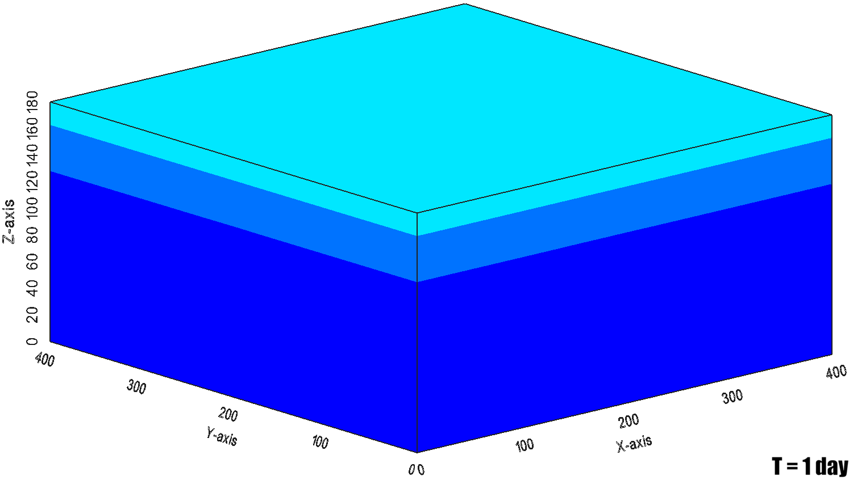
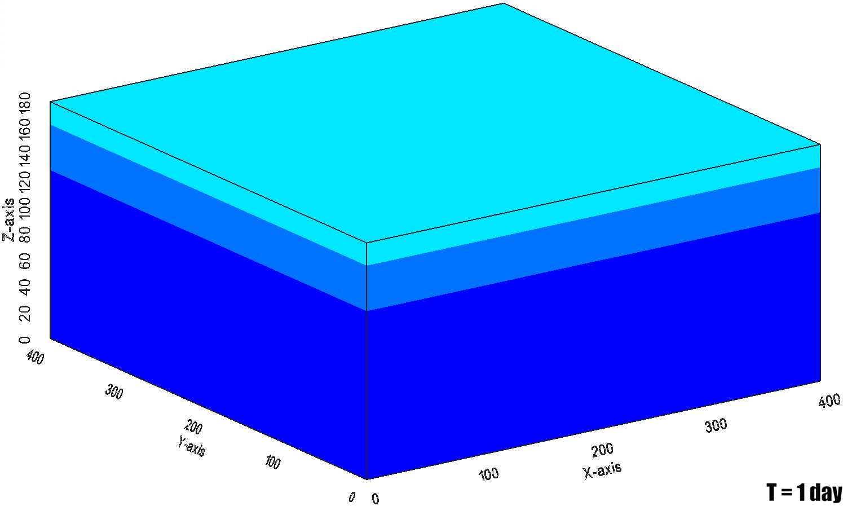

Result and discussion – simulation result
(a)
(b)
(c)
NO₃ (mg/L)
X
X
□
X
X
□
X
□
X
X
X
X
X
●
●
●
●
●
●
●
●
●
X
X: Injection well
X: Pumping well
●: Observation points
□: Contaminated area
Figure. Best results of NSGA-ii subject to (a) minimum cost (b) mean cost (c) maximum cost; Nitrate concentration distribution in layer 1. Red cross dot indicates the location of injection well and black cross dot indicates optimal location of pumping well after optimization. Black dot indicates observation points and black box indicates contaminated area.
When flushing is operating, diluted plume is formed.
Pump-and-treat prevents that part of remained contaminants flown out.
Too many options that make combination of optimal well locations

Slide 7
Take home message
Flushing contributed to make diluted nitrate plume.
Pump-and-treat could reduce remained nitrate concentration.
Hybrid in-situ flushing is available for nitrate remediation.
NSGA-ii performs well to solve multi-objective optimization problem related to nitrate remediation.
Performance criteria should be applied
NSGA-ii is proper method to suggest optimal remediation design.

Slide 8
THANK YOU!
Acknowledgement: This work was supported by Korea Environment Industry & Technology Institute(KEITI) through "Activation of remediation technologies by application of multiple tracing techniques for remediation of groundwater in fractured rocks" funded by Korea Ministry of Environment (MOE) (Grant number:20210024800002/1485017890) and Korea Environment Industry & Technology Institute(KEITI) through the Demand Responsive Water Supply Service Program (RE20191097) funded by the Korea Ministry of Environment (MOE).

