Slide 1









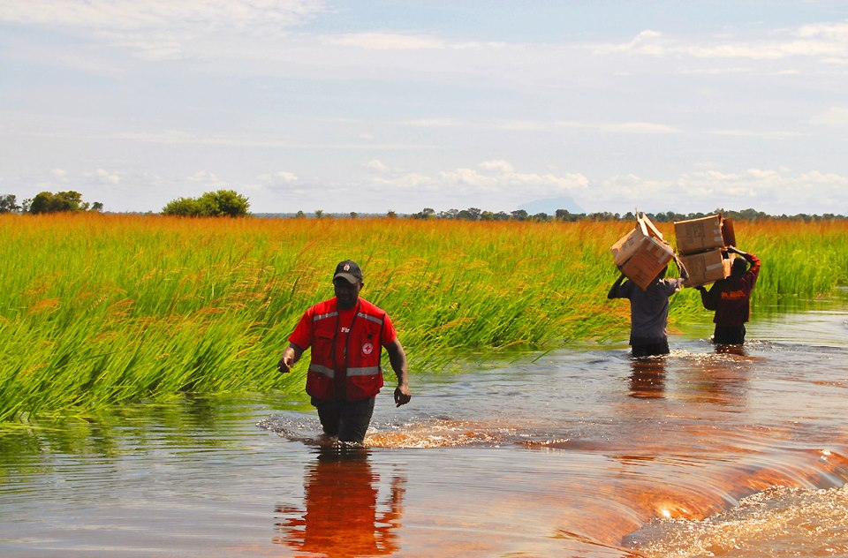




Comparative Suitability of the Global Flood Awareness System and a Catchment-based Model to Simulate Floods in Uganda
Douglas Mulangwa ^{1,2}, Andrea Ficchì ^{3,4}, Philip M. Nyenje ¹, Jotham Sempewo ¹, Linda Speight ^{4,9}, Hannah Cloke ^{4,5,6}, Shaun Harrigan ⁷, Benon T. Zaake ², Liz Stephens^{4,8}
¹ Makerere University, College of Engineering Design Art and Technology, Department of Civil and Environmental engineering, Uganda; ² Department of Water Resources Monitoring and Assessment, Directorate of Water Resources Management, Ministry of Water and Environment, Uganda; ³ Department of Electronics, Information and Bioengineering, Politecnico di Milano, Italy; ⁴ Department of Geography and Environmental Science, University of Reading, Reading, UK; ⁵ Department of Meteorology, University of Reading, Reading RG6 6BB, UK ;⁶ Department of Earth Sciences, Uppsala University, Uppsala, Sweden; ⁷ European Centre for Medium-Range Weather Forecasts, ECMWF, Reading, UK; ⁸ Red Cross Red Crescent Climate Centre, The Hague, 2521 CV Netherlands; ⁹ School of Geography and the Environmental, University of Oxford, Oxford, UK
@Mul_Douglas1
www.reading.ac.uk/fathum
@liz_stephens
@andrea_ficchi

Slide 2
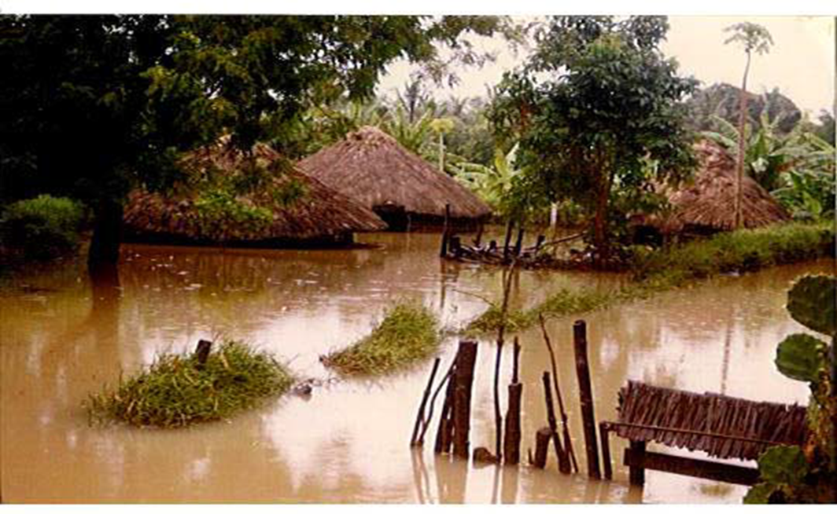
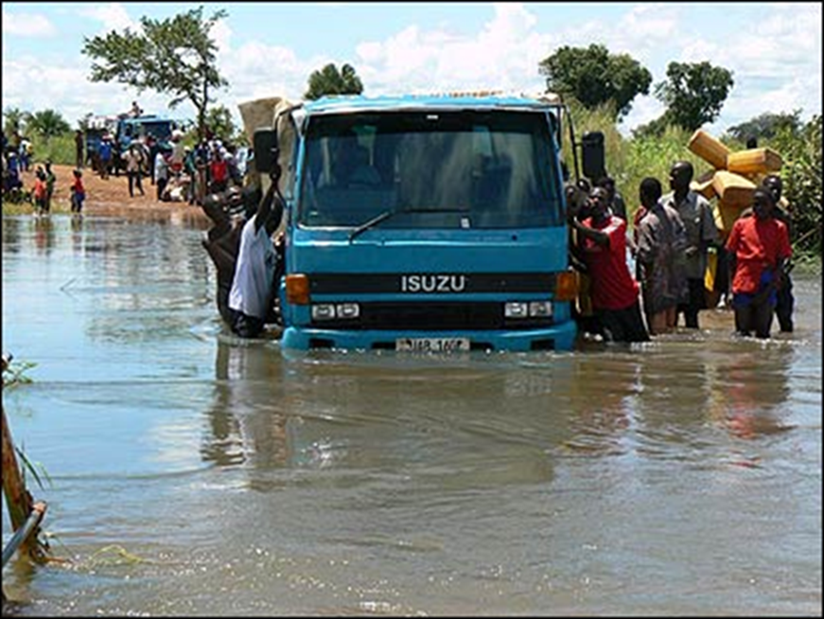
MOTIVATION AND OBJECTIVES
Floods are the 2nd deadliest type of disaster, causing 24% of deaths due to disasters globally in 2018 (EM-DAT, 2019)
WMO proposed flood forecasting as a valuable tool in the strategy of ‘living with floods’ (WMO, 2010)
Uganda Red Cross Society (URCS) piloted Forecast-based Financing (FbF) in NE Uganda in 2013-2018 (Coughlan De Perez et al., 2016).
Limitation: lack of validated flood forecasting information for Uganda.
Objectives
This study therefore aimed at assessing the suitability of two different systems that would be readily available for flood forecasting in Uganda:
  a global freely-available flood forecasting system, the Global Flood Awareness System - GloFAS (Copernicus EMS), already operational at the global scale (www.globalfloods.eu);
  a catchment-based model (GR4J) that can be a free and easy-to-implement alternative at the local scale.
Flood forecasts from GloFAS are being used, alongside in-country knowledge and data, for example by the Uganda Red Cross Society. How do these forecasts perform compared to other possible systems?

Slide 3
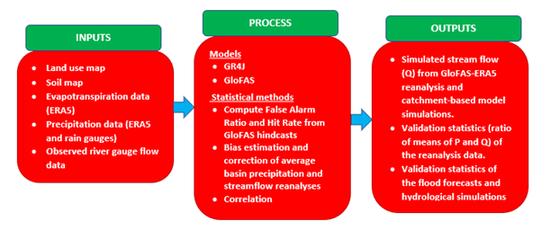
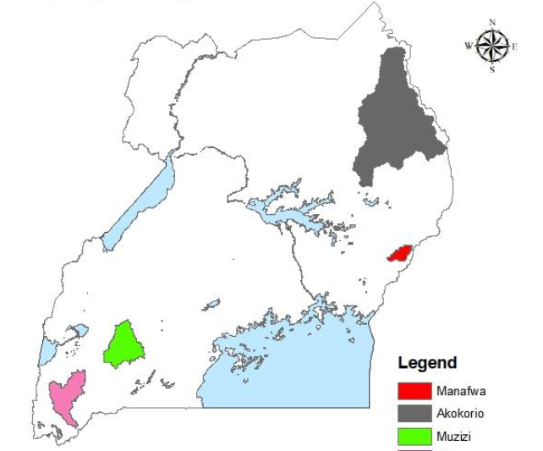
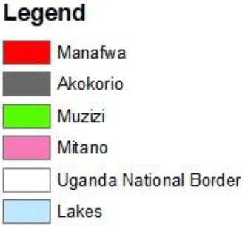
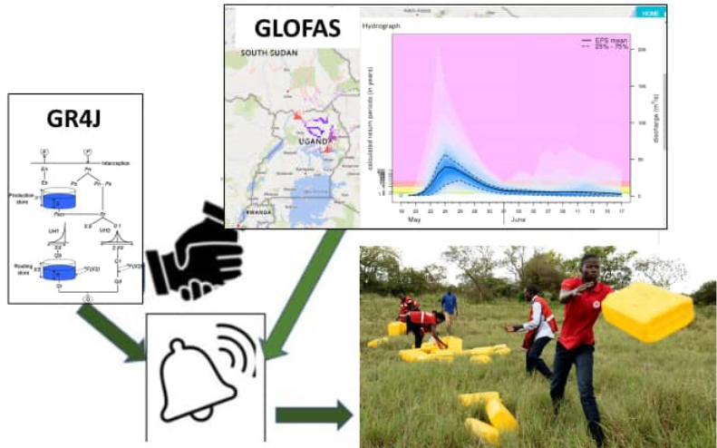
Methods and Data
Study Area
4 catchments selected
Areas from 500 km² (Manafwa) to 13’000 km² (Akokorio)
Daily observed river flow (DWRM, Uganda)

Slide 4
GloFAS-3.1 REFORECASTS AND THRESHOLDS
Reforecasts
GloFAS- v3.1 30-day reforecasts (ECMWF, 2021) are produced from the twice-weekly 11-member ensemble ECMWF ENS reforecasts and complemented by past real-time forecasts from 51-member ECMWF Ensemble from January 2018
We use 11 ensemble members along the whole period for sake of consistency
21-year long period, 1999-2019 (GloFAS- v3.1 30-day reforecasts)
Reference for forecast evaluation
As reference, we use daily river flow observations (Qobs) at river gauges in Uganda
Flood thresholds
We focused on a 90th or 95th percentile flood threshold, as for higher thresholds the number of events/warnings would not be sufficient (especially with obs.)
For both reforecasts and reference (obs) the thresholds are calculated based on the correspondent dataset (choice that is coherent with climatology-based warnings as in GloFAS)

Slide 5
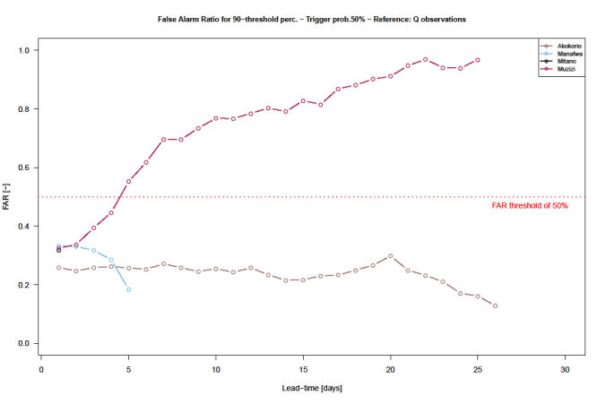
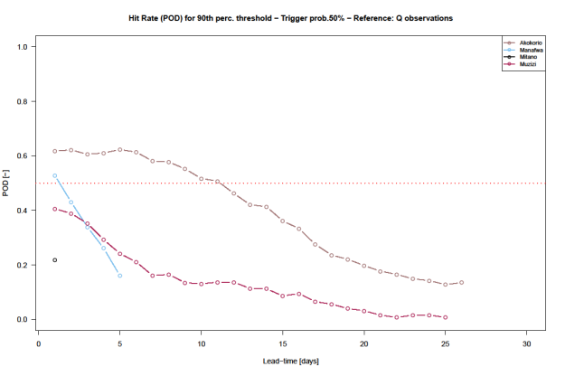
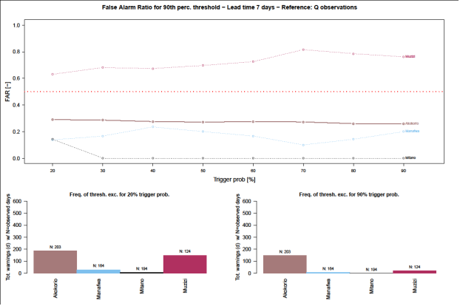
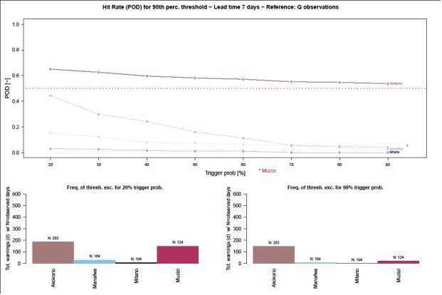
Results and Analysis: FAR & POD
GloFAS Flood Forecast Verification
POD with lead-time at 50%trigger Probability
FAR with lead-time at 50%trigger Probability
FAR with trigger probability at 7-d lead-time
POD with trigger prob at 7-d lead-time
‘Acceptable’ skill for URCS: FAR<0.5; POD >0.5
More skilful stations up to 5-d lead time (Muzizi shows increasing FAR & Akokorio decreasing POD)
Low sensitivity to trigger probability (low ENS. spread)
Trigger probability of 60%, and 5-day lead time found appropriate (high skill at most stations)

Slide 6
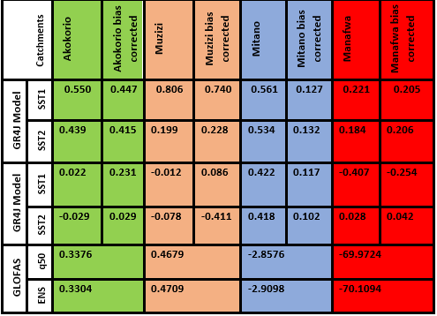
Comparison of KGE for GLOFAS (at 1-day lead-time) and GR4J
Kling Gupta Efficiency (KGE) [GloFAS vs. Observations]
Lead time (days) | KGE value for Akokorio Catchment (A = 12646 km ²) |  | KGE value for Manafwa Catchment (A= 462 km²) |  | KGE value for Muzizi Catchment (A= 2223 km²) |  | KGE value for Mitano Catchment (A= 2102 km²)
 | ENS q50 | ENS mean | ENS q50 | ENS mean | ENS q50 | ENS mean | ENS q50 | ENS mean
1 | 0.3376 | 0.3304 | -69.9724 | -70.1094 | 0.4679 | 0.4709 | -2.8576 | -2.9098
3 | 0.3296 | 0.3001 | -63.9340 | -64.3238 | 0.4156 | 0.4379 | -1.7166 | -1.8011
5 | 0.3302 | 0.2847 | -57.4559 | -57.7125 | 0.3842 | 0.4161 | -1.2520 | -1.3434
7 | 0.4012 | 0.3348 | -53.3641 | -53.6398 | 0.3513 | 0.3772 | -0.9780 | -1.0694
10 | 0.4941 | 0.4434 | -49.0576 | -49.4511 | 0.2882 | 0.3049 | -0.6859 | -0.7853
15 | 0.4311 | 0.5092 | -43.7930 | -44.2584 | 0.2519 | 0.2645 | -0.3538 | -0.4411
GR4J gives better KGE on average over the 4 basins (in both calibration / validation), especially for the smaller basins
GloFAS performs better for the two biggest basins (Akokorio and Muzizi, > 2200 km2) than the smaller (Manafwa and Mitano)
Higher performance for Akokorio than Manafwa (as expected from catchment areas)
GloFAS performance for Manafwa is worse than the mean benchmark flow

Slide 7
CONCLUSIONS AND FURTHER WORK
Global forecasts can provide an interim solution for Countries like Uganda with gaps in local forecasts, providing relatively good results especially for larger catchments (e.g. > 2000 km2)
For Uganda, a simple catchment-based model (like GR4J) appears to be a promising option
Further work:
Setting up and running GR4J (& possibly alternative catchment-based models) in forecasting mode with extended-range meteorological forecasts as done in GloFAS, given the good potential of GR4J highlighted in this work in simulation mode
Comparing the model performance of GloFAS 3.1 and GR4J over a larger sample of catchments
Improving the GR4J model calibration, especially for the catchments with lower performance (probably linked with calibration/validation sampling strategy and data gaps issues)
Analysing the discrepancies between traditional general scores (as the KGE) vs. other more specific flood event-based scores (e.g., FAR, POD, flood timing and magnitude errors)

Slide 8

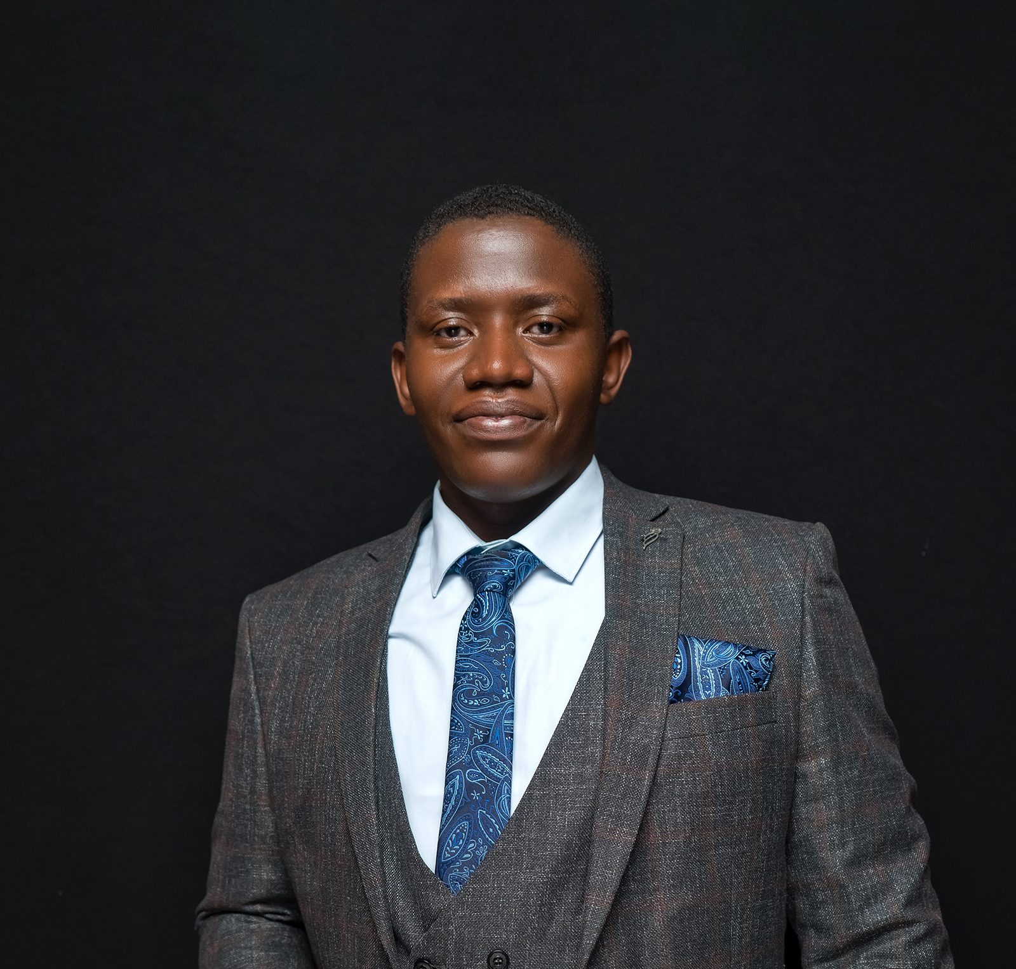
Thank you FOR YOUR ATTENTION
Contact: muldouglas99@gmail.com
@Mul_Douglas1
@liz_stephens
@andrea_ficchi

