Slide 1










Re–Os geochemistry of altered dacitic rock at Site U1527, IODP Expedition 376: Implications for the Re cycle in intraoceanic arcs
EGU General Assembly 2022 (Tue, 24 May)
SSP1.2; EGU22-3372
Mizuki Ishida ª, Tatsuo Nozaki ^{b,c,d,e}, Yutaro Takaya ^{a,f,b}, Junichiro Ohta ^{c,e}, Qing Chang ^{g}, Jun-Ichi Kimura ^{g}, Kentaro Nakamura ^{a,e}, Yasuhiro Kato ^{c,a,e,b}
a, c
b, g
e
d
Link to the abstract info:
Funding
f
1

Slide 2
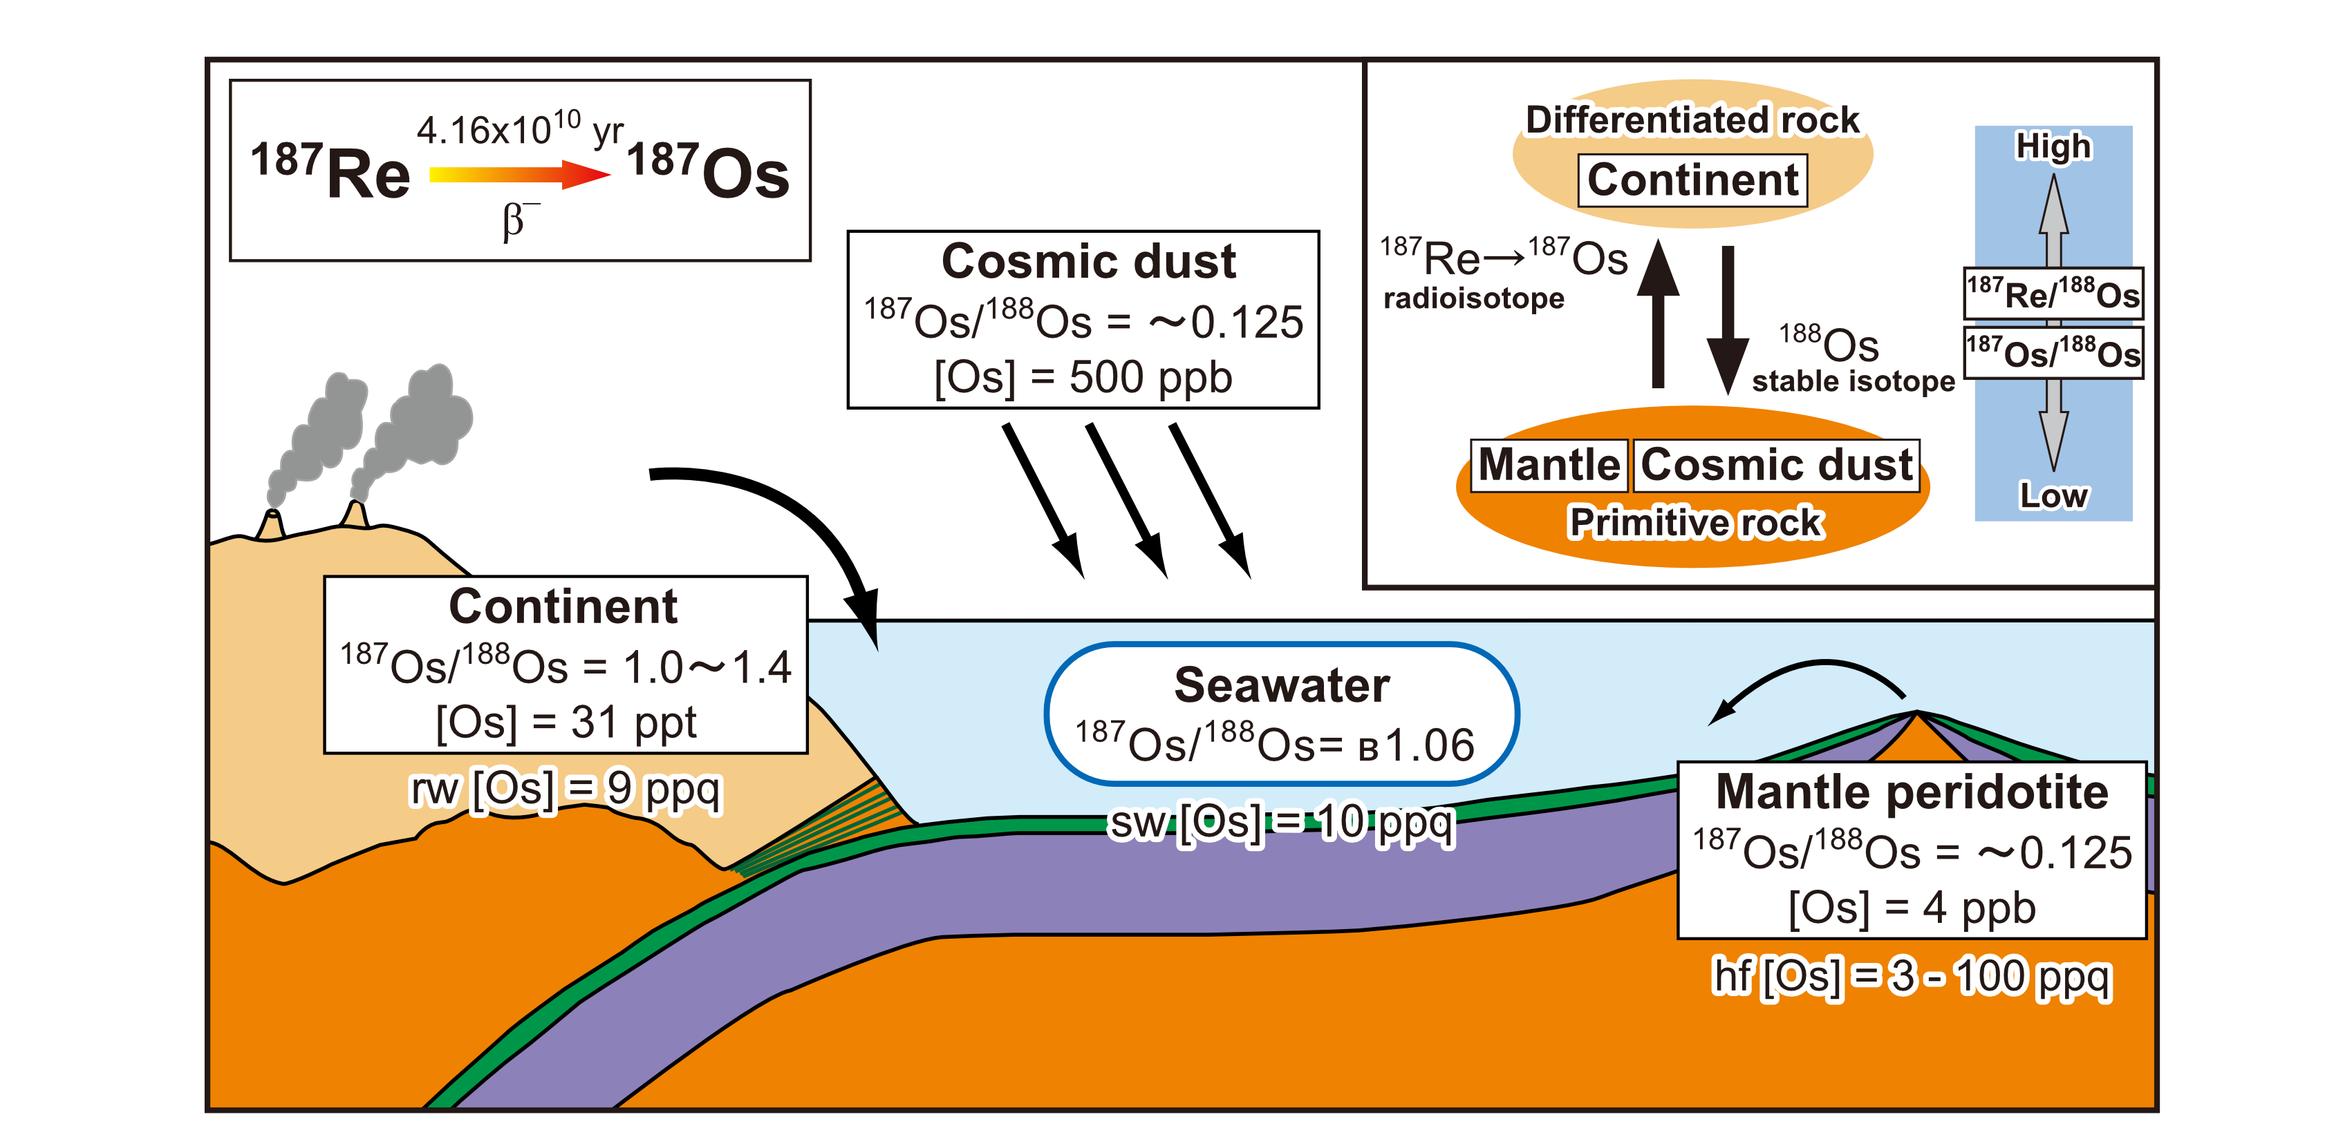
Background
Subseafloor hydrothermal alteration is an important process controlling the elemental cycle on the Earth, since it …
Modifies the composition of the crust
Determine the composition of the hydrothermal fluid released into seawater
Because the Os isotopic ratio (¹⁸⁷Os/¹⁸⁸Os) differs between modern seawater and hydrothermal fluid, the Re–Os isotopic system is potentially a sensitive tracer of subseafloor fluid-rock interaction.
(Peucker-Ehrenbrink and Ravizza, 2000)

Slide 3
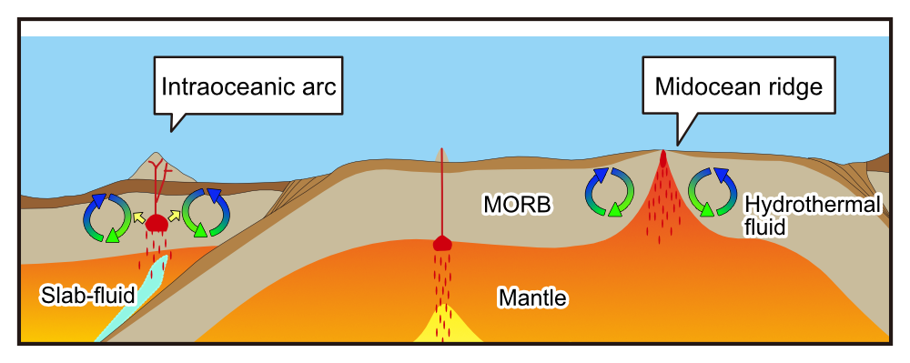
Background
Previous studies have examined the effect of alteration on the Re–Os budget in MORB, which is mainly associated with alteration processes at midocean ridges.
ODP Site 735 (Blusztajn et al., 2000)
ODP Site 504 (Peucker-Ehrenbrink et al., 2003)
DSDP Sites 417/418 (Peucker-Ehrenbrink et al., 2003)
ODP Site 801 (Reisberg et al., 2008)
Little is known about the behavior of Re and Os during hydrothermal alteration in an intraoceanic arc setting.
Notes:
, which host magmas and hydrothermal systems fundamentally different from that of mid-ocean ridges

Slide 4
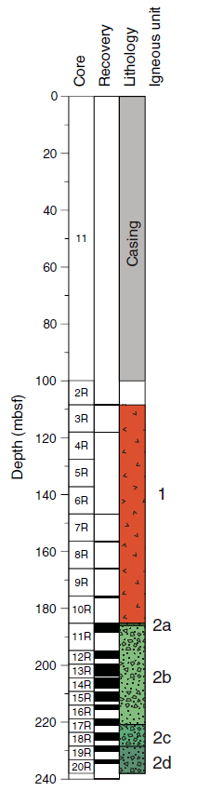
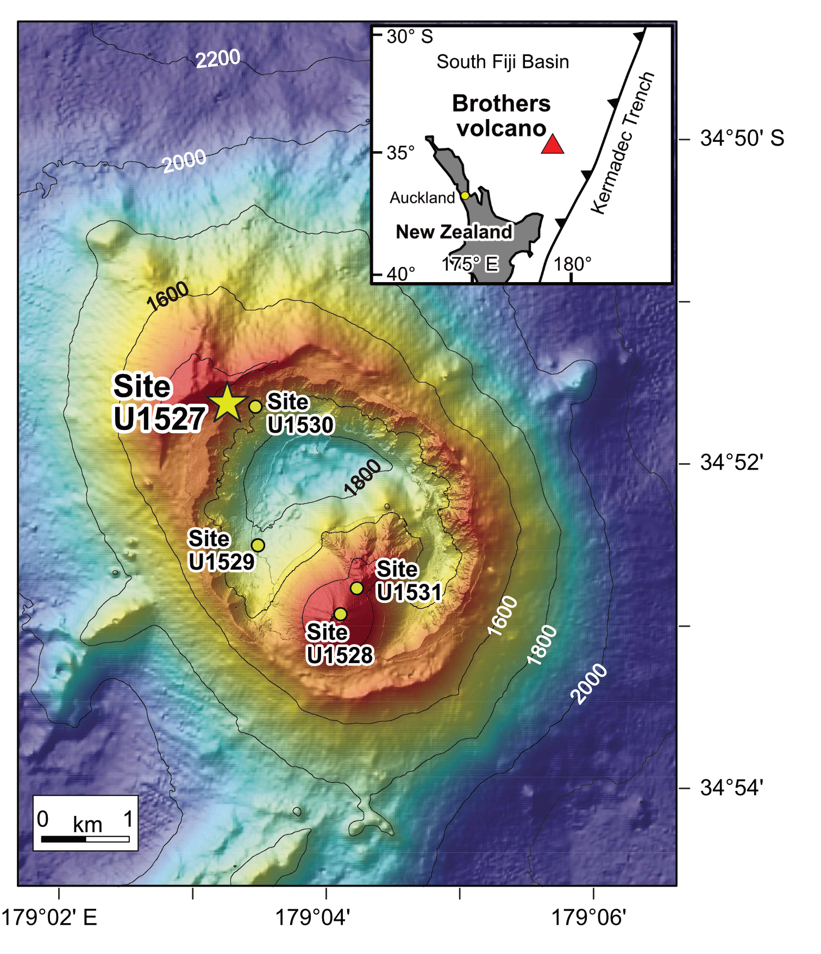
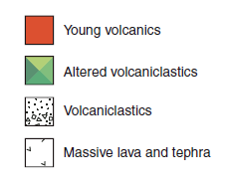
Materials & Methods
Core samples from the Brothers volcano in the Kermadec arc, drilled during IODP Exp. 376 in 2018, can be used to investigate this matter.
We provide a depth profile of Re–Os geochemistry at Site U1527, located on the NW caldera rim of the Brothers.
Hydrothermally altered volcaniclastic rocks (Unit 2) of Hole U1527C were analyzed for bulk chemical composition and Re–Os isotopes.
(de Ronde et al., 2019)

Slide 5



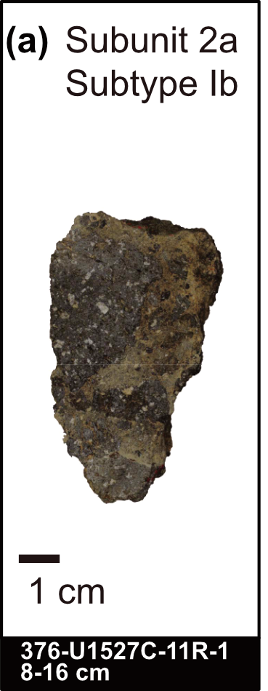
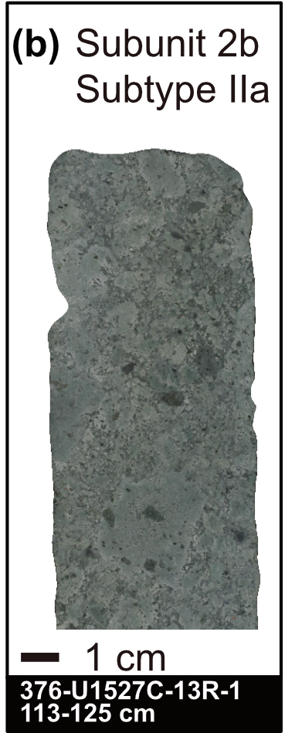
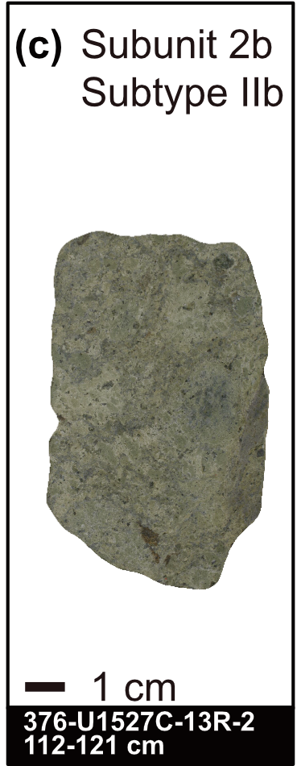
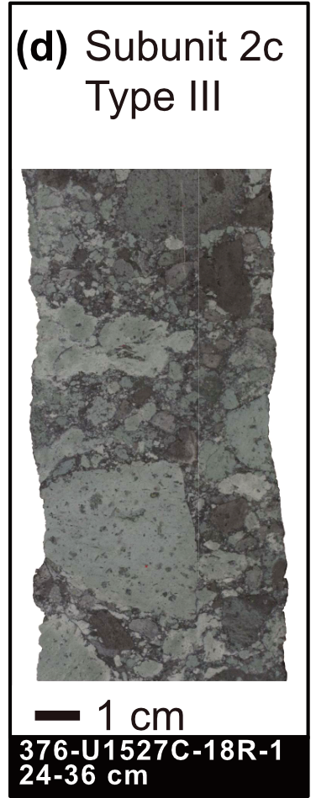
Alteration at the Hole U1527C
(de Ronde et al., 2019)
Type I: Low-T (<150 °C)
Type II: higher-T
Type III: High-T (>200 °C)
Ia:
Ib:
IIa:
IIb:
goethite + opal + mordenite ± illite ± smectite ± quartz
chlorite + quartz + illite + smectite ± mordenite
chlorite + quartz + goethite ± illite ± smectite ± mordenite
quartz + chlorite + pyrite ± illite (No smectite)
mostly fresh
(Symbols)
Overprinting by oxidative seawater ingress
Overprinting by oxidative seawater ingress
Subtype Ia
(Not analyzed)

Slide 6
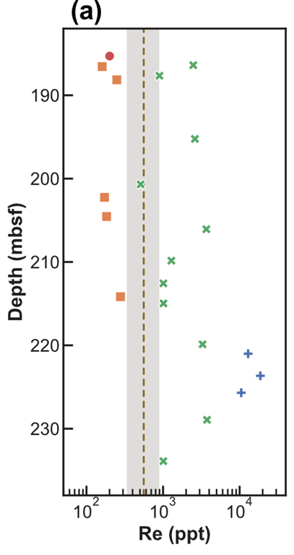
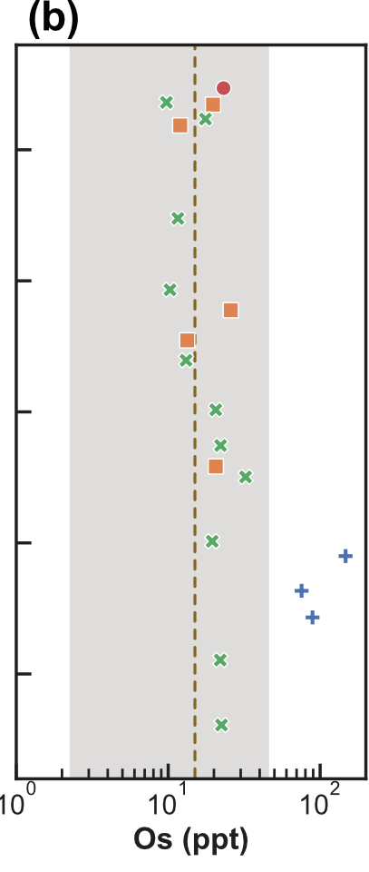
Re-Os concentrations
Re released by LT alteration
Re sequestered by HT alteration
High-temperature alteration processes have generally resulted in Re enrichment.
The Re host may be pyrite, a high Re/Os mineral
Part of Re was released into the ocean by later oxidative weathering (Ib and IIb).
Pyrite -> Goethite?
Os mobility resulting from alteration was limited compared to Re.
Range of
fresh dacite
(Fresh dacite values are from Turner et al., 2009)

Slide 7
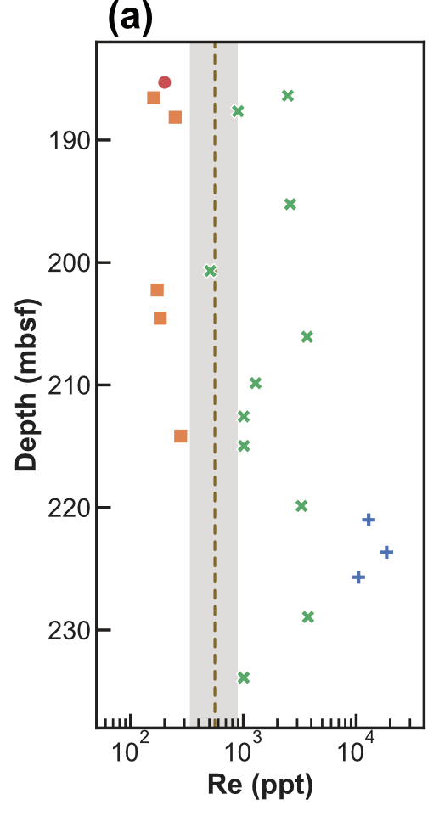
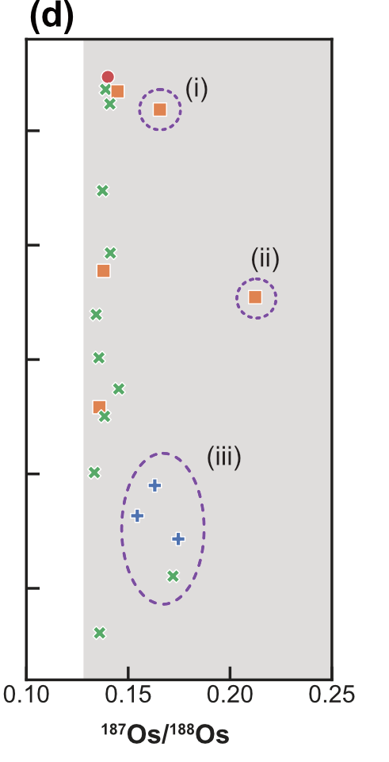
Sources of the enriched Re
Magmatic
Seawater
Lack of correlation between Re and ¹⁸⁷Os/¹⁸⁸Os suggests dominantly magmatic origin of the enriched Re
Samples with slightly more radiogenic ¹⁸⁷Os/¹⁸⁸Os may have incorporated some seawater Re and Os
Range of
fresh dacite
(Fresh dacite values are from Turner et al., 2009)

Slide 8
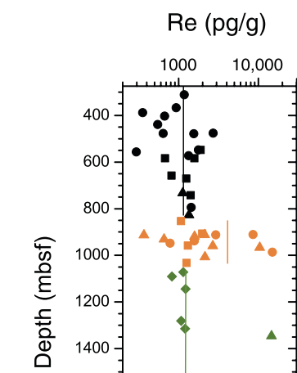
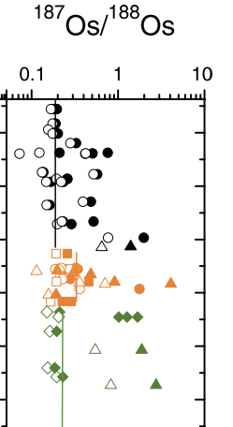
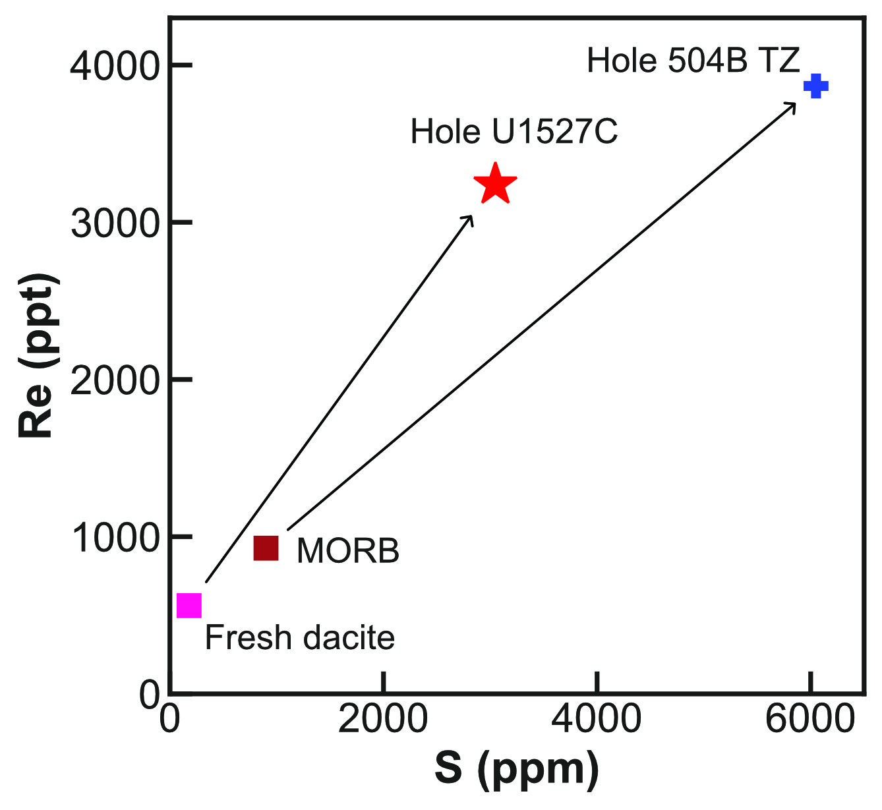
Comparison with altered MORB
Primary features of high-temperature subseafloor alteration near the mid-ocean ridge is preserved in the Transition Zone (TZ) of ODP Hole 504B.
The enriched Re in Hole 504B TZ is likely to have derived from seawater, consistent with the elevated ¹⁸⁷Os/¹⁸⁸Os
Enhanced Re uptake in Hole U1527C compared to Hole 504B
(Data sources: Peucker-Ehrenbrink et al., 2003; Bach et al., 2003; Hauri and Hart, 1997; de Ronde et al., 2019; Turner et al., 2009; Haase et al., 2006)
Transition zone (TZ)
(Peucker-Ehrenbrink et al., 2003)

Slide 9
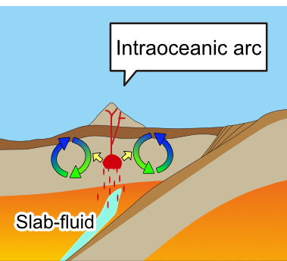
Implications
Primary arc magmas are thought to have higher Re concentrations than MORB related to the addition of Re from subducting slabs.
Substantial fraction of Re is likely to have lost by shallow degassing, but the fate of degassed Re remains unclear.
（Bennett et al., 2000; Lassiter, 2003; Sun et al., 2003a; Sun et al., 2003b; MacKenzie and Canil, 2006; Tessalina et al., 2008）
The degassed Re from intraoceanic arc magmas may be partly stored in high-temperature hydrothermal alteration zones.
The stored magmatic Re may be slowly delivered to the ocean via low-temperature hydrothermal alteration.
Future research should provide more information about the detailed role of hydrothermal alteration in the Re cycle in arc settings.

Slide 10
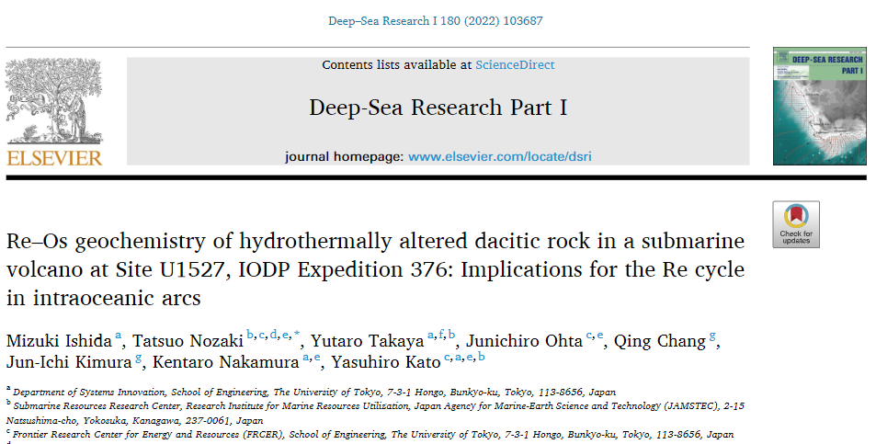


Thank you very much!
VOTE ME!
Further details of this study:
Ishida, M. et al. (2022). Deep Sea Research Part I: Oceanographic Research Papers, 180, 103687.
https://doi.org/10.1016/j.dsr.2021.103687
Find me at:
Personal HP:
https://mizuki-ishida.webflow.io/

