Slide 1




Integrated Multiscale Urban Flood Modeling with Drainage Pipe System
L. Dasallas, H. An and S. Lee
Chungnam National University, Korea
KWater Research Institute, Korea
Korea Environment Institute

Slide 2
Outline
Research background
Supplementing research gaps
Methodology
Model input data
Urban flood event
Results and discussion
Summary and conclusion

Slide 3
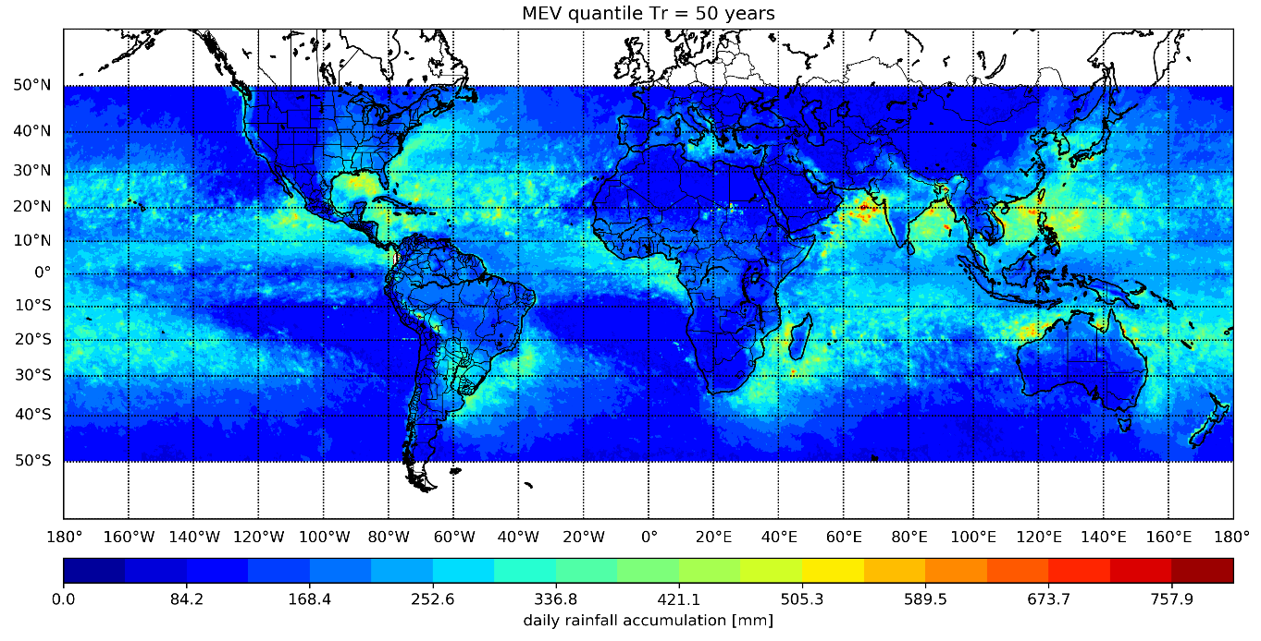
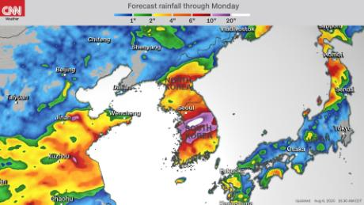

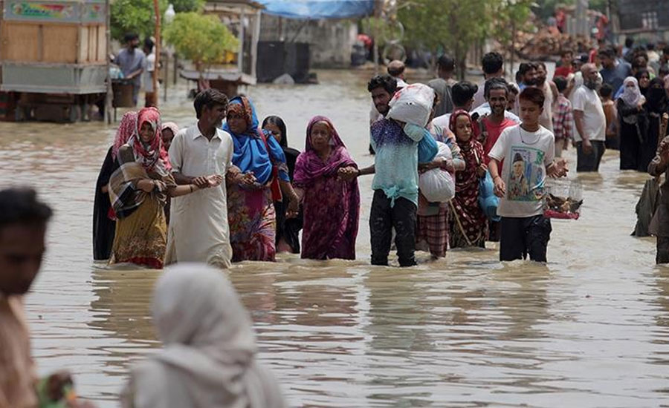
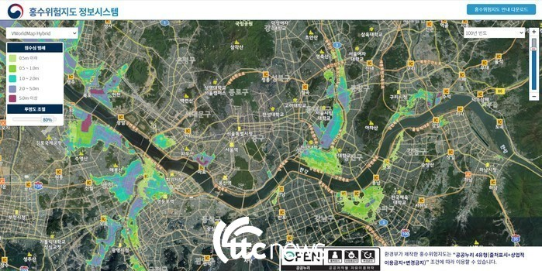
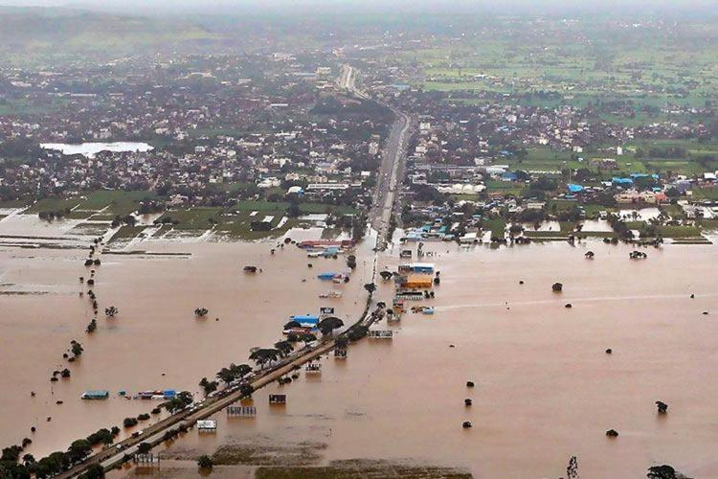
Why is FLOOD MODELING important?
Susceptibility to rainfall events
Flood susceptibility
Flood preparation and mitigation
4

Slide 4
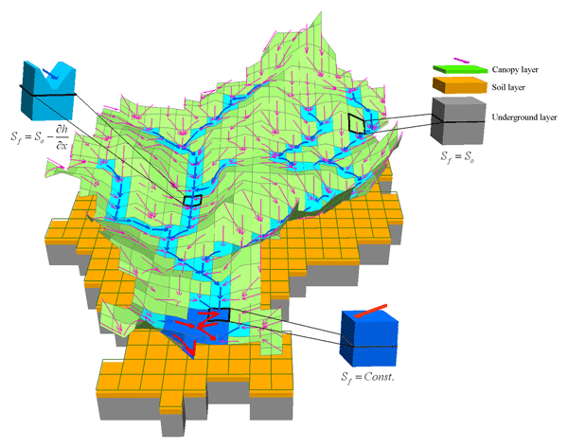
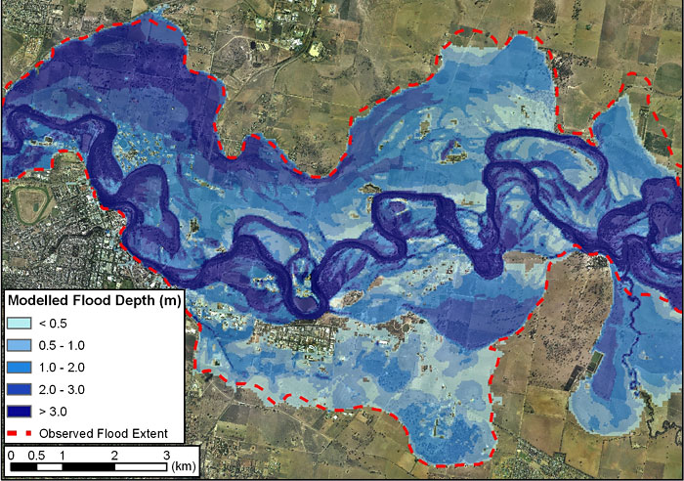
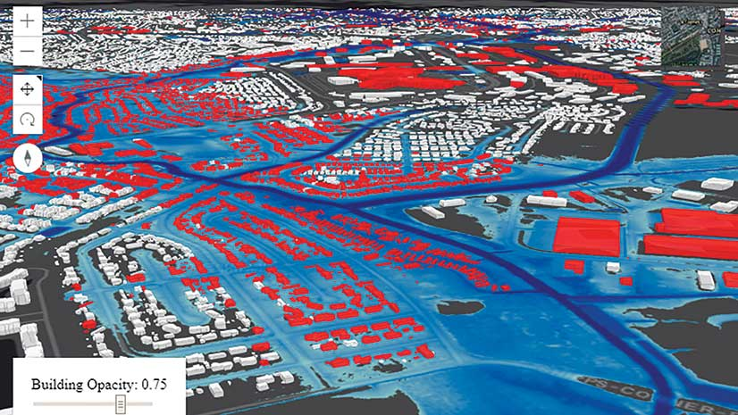
FLOOD MODELING TECHNIQUES
Spatial Extent
Watershed
~1,000,000,000 m²
Dimensionality
Mathematical complexity
Kinematic
Inundation
<50,000,000 m²
Inertial
Diffusive
Dynamic
Sewer pipe cell grid
<100 m²
Coupled
5

Slide 5
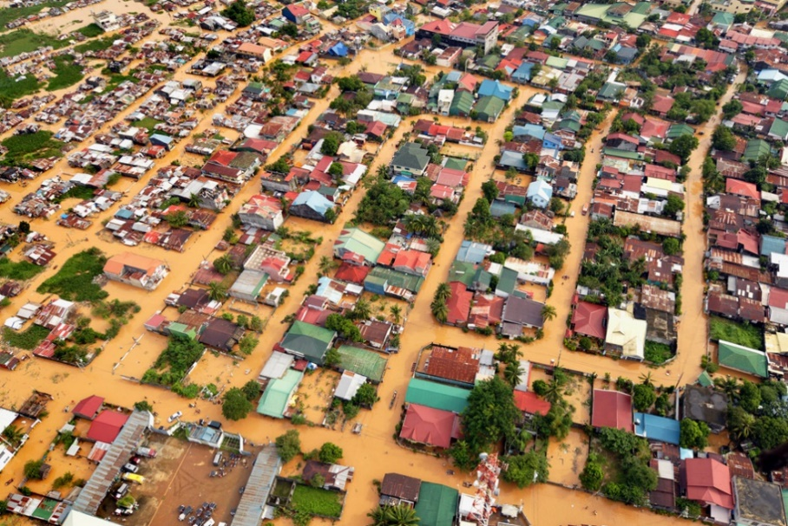
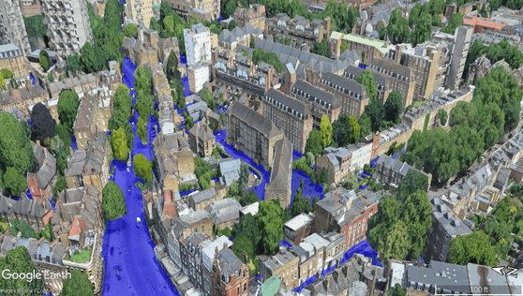
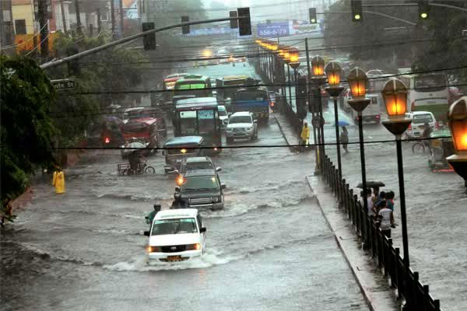
Urban flood modeling
Inundation modeling | Urban flood modeling
2D overland flow | More complex dynamics (building, artificial barriers)
Soil type based infiltration | More impervious surfaces, more runoff
 | Integration of surface and sewer pipe system
Generalized DEM | Requires higher resolution DEM
Scale (~50km²) | Scale (<100m²)
 | More densely populated areas
6

Slide 6
RESEARCH GAPS
Flood modeling:
Separate computations of large scale runoff, urban domain-scale inundation and sewer pipe interaction
Long simulation time for high-resolution data
Incompatibility and complexity in integration
Issues for developing countries:
Limited availability of adequate resolution elevation data
Lack of systematized drainage network data
Scarce researches on flood modeling/mitigation
7

Slide 7
Methodology outline
DTM
DSM
Road network
Rainfall data
Watershed DEM
Urban sub-catchment modified DEM
Rainfall-runoff and inundation
MULTI-SCALE FLOOD MODELING
Urban flood extent and depth
Validation: 2009 Rainfall event
Manhole
Sewer pipe
Storm drain
Model application: 2020 Rainfall event
Drainage network
SEWER PIPE MODELING
Surface and subsurface interaction
Urban flood analysis
Research conclusion
11

Slide 8
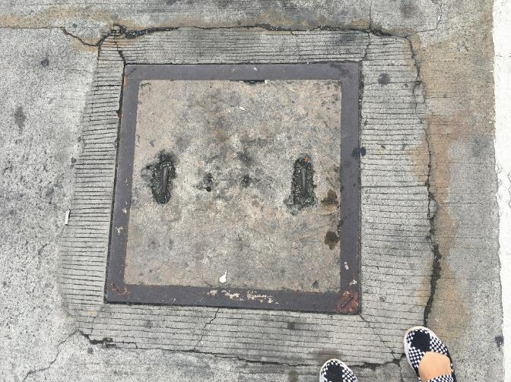
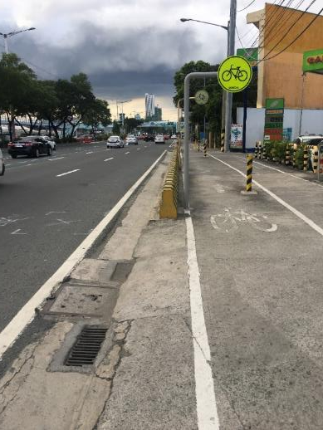
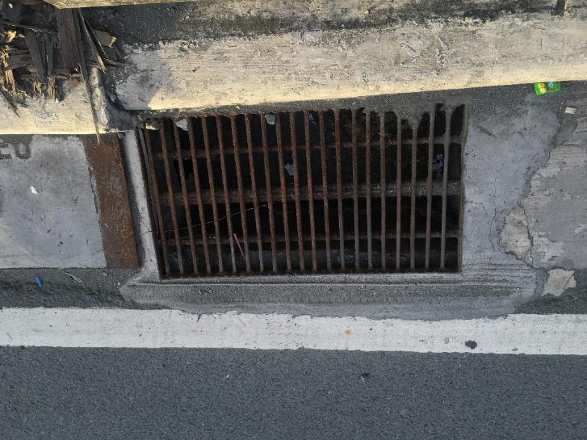
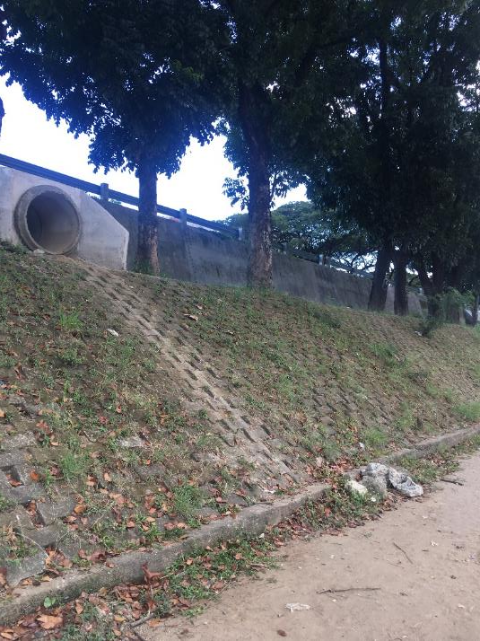
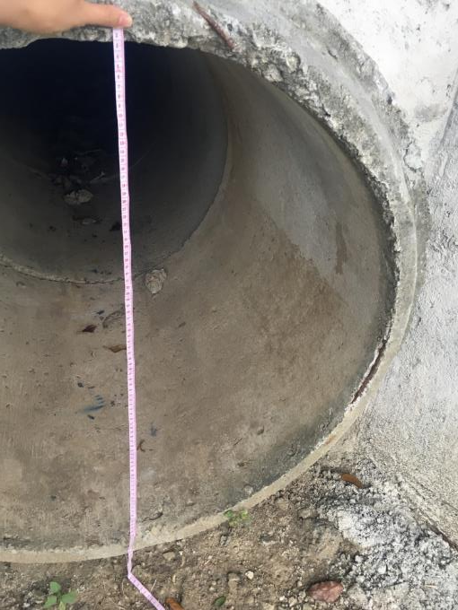
manhole
Constructing synthetic sewer network using GIS
Sewer pipe data (293)
ID Length Shape Slope Manning coefficient Diameter Upstream manhole Downstream manhole
Manhole data (333)
ID Location in x and y-coordinates Bottom elevation Shape diameter
Drainbox data (1866)
ID Area Face perimeter Bottom elevation Depth Location in x and y-coordinates Smaller width of storm drain cover Tube diameter between drainbox and pipe Connecting pipe
Storm drain
pipe
23

Slide 9
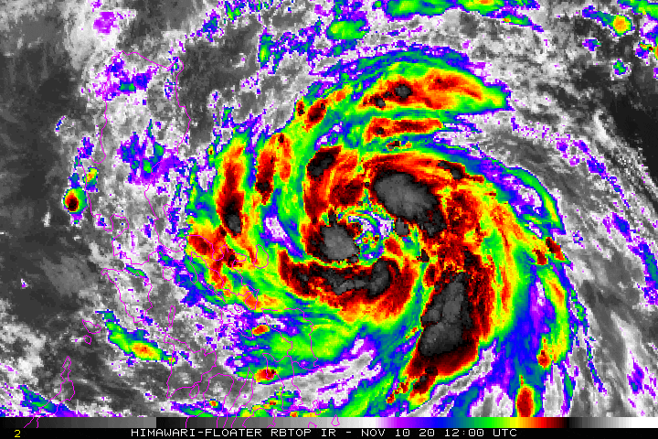
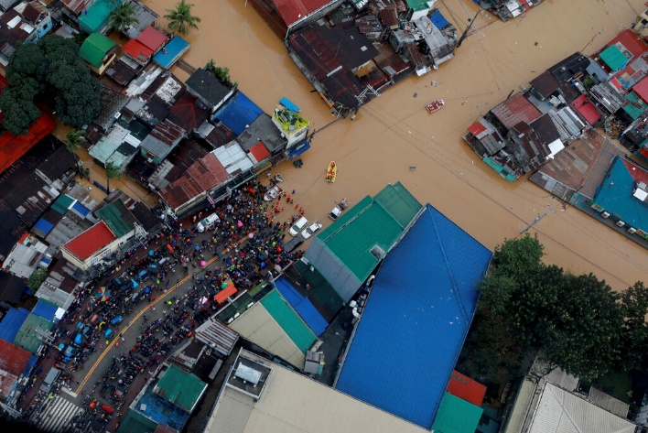
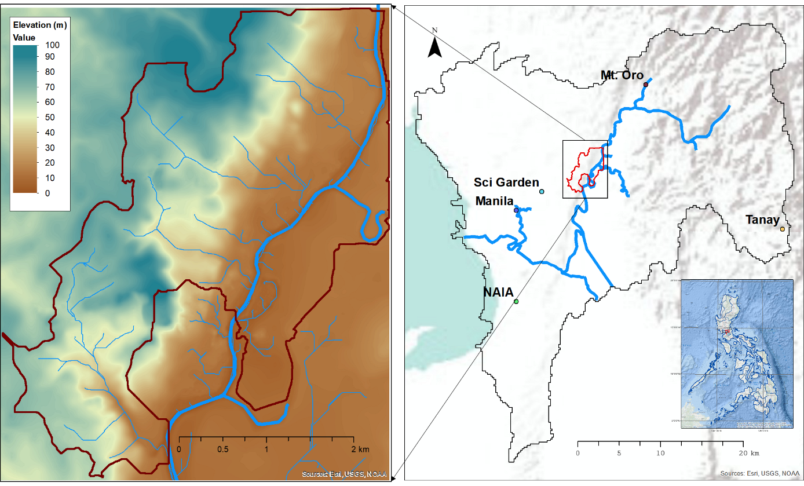
Urban flood events
Vamco 2020
26

Slide 10
Results and Discussions

Slide 11
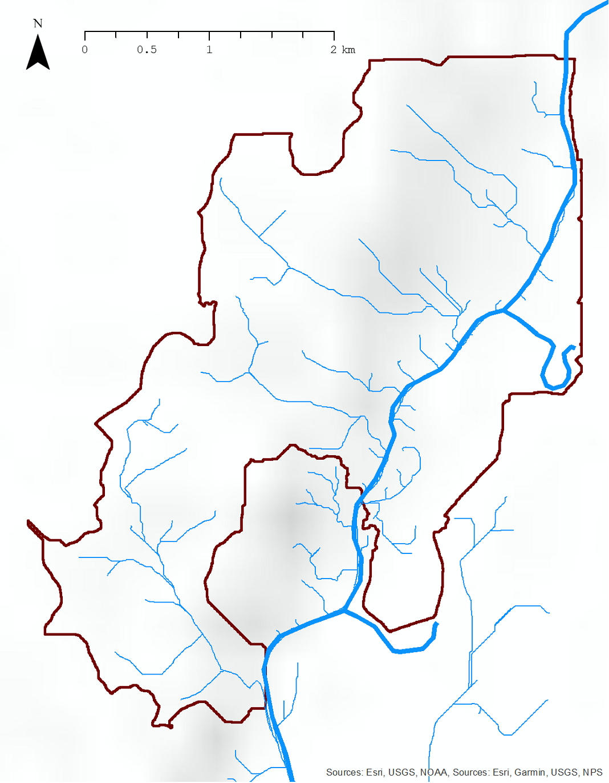
SYNTHETIC SEWER SYSTEM
Stream channel
Synthetic sewer system:
1st order
Synthetic sewer system:
2nd order
39

Slide 12
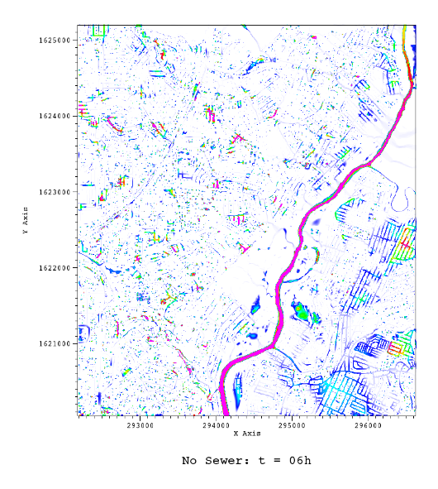
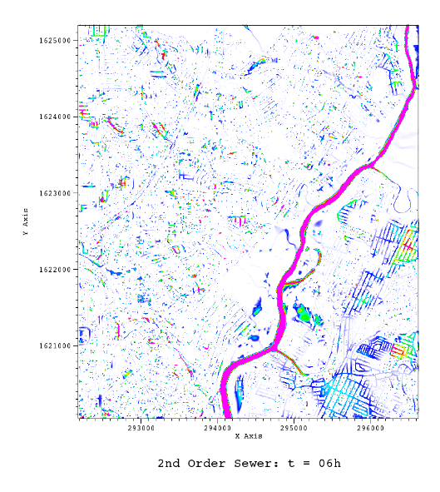
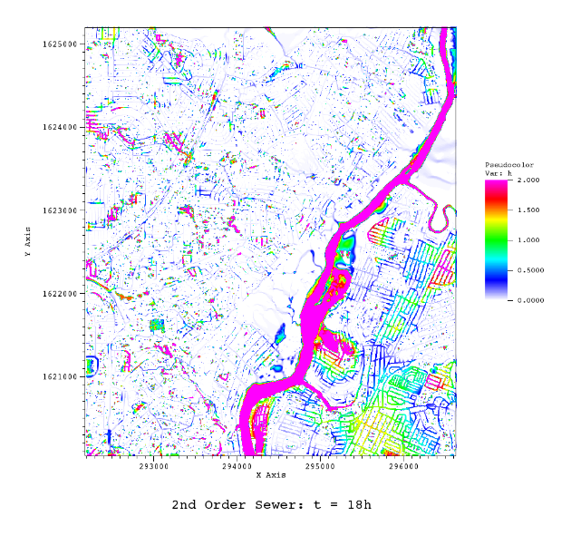
SIMULATION RESULTS: FLOOD DEPTH (M)
40

Slide 13
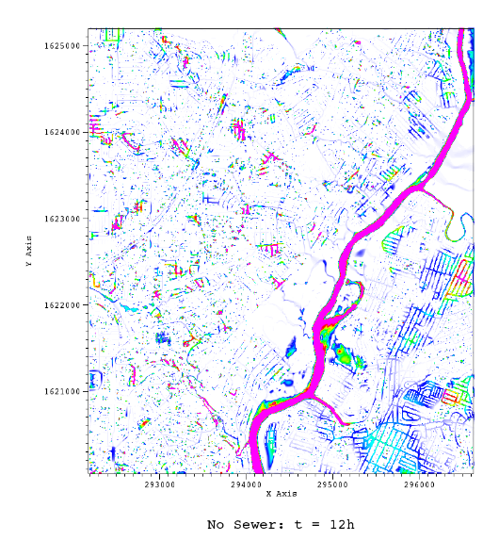
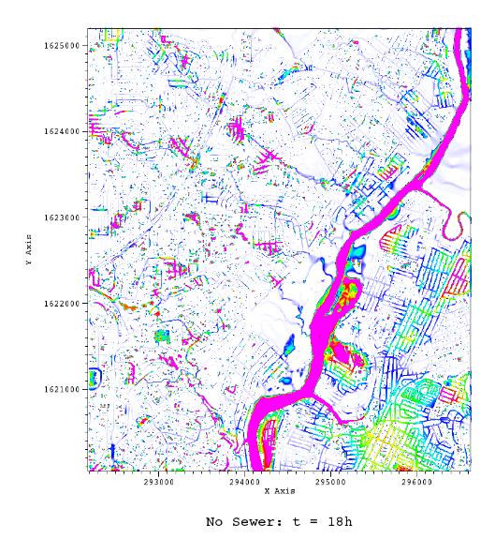
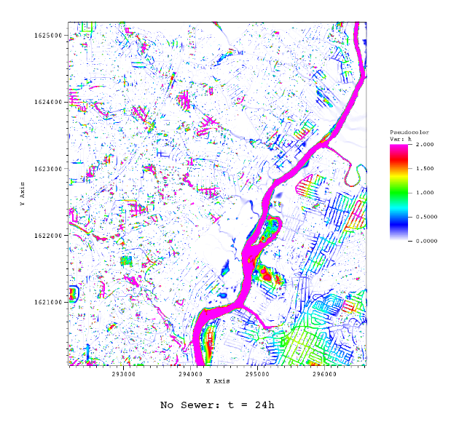
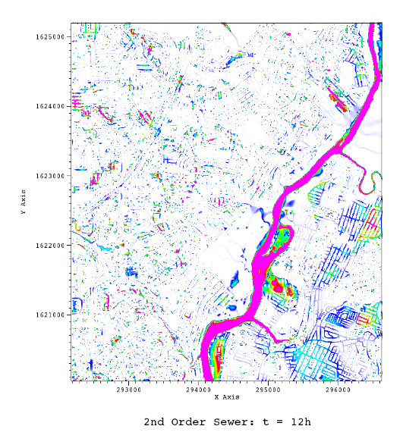
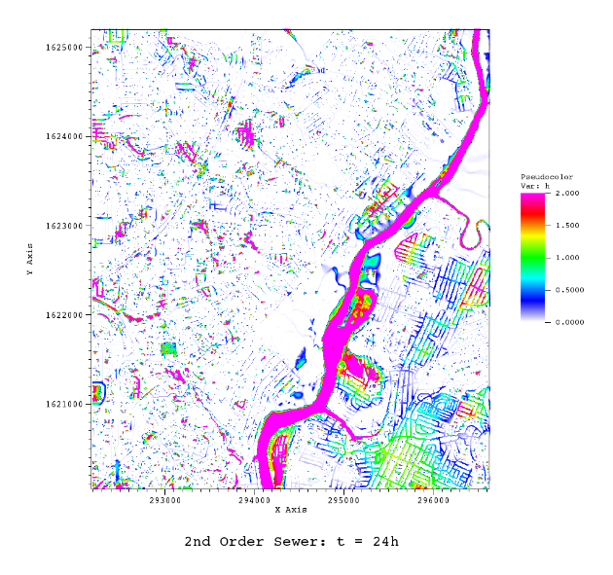
SIMULATION RESULTS: FLOOD DEPTH (M)
41

Slide 14
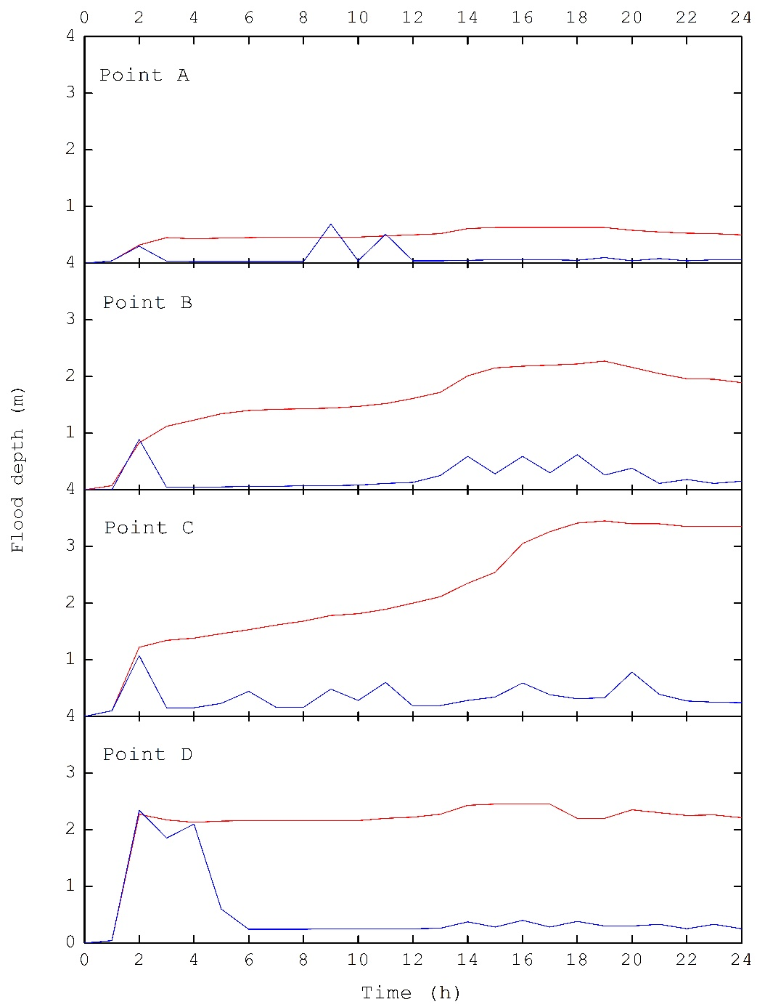
Flood depth comparison: Case 1 and Case 2
Case 1: No sewer
Case 2: Sewer
A
D
C
B
42

Slide 15
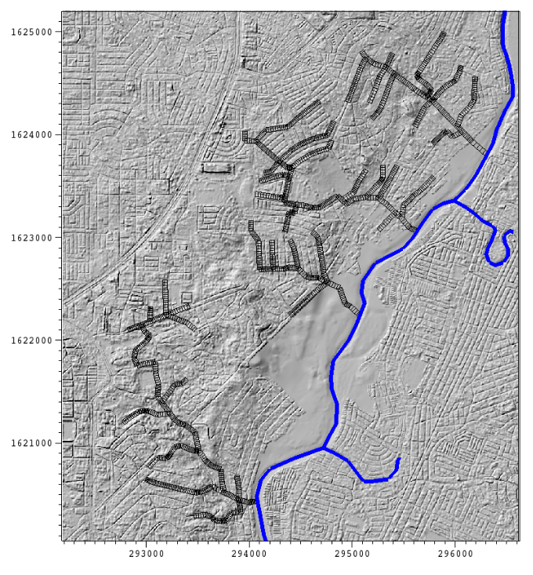
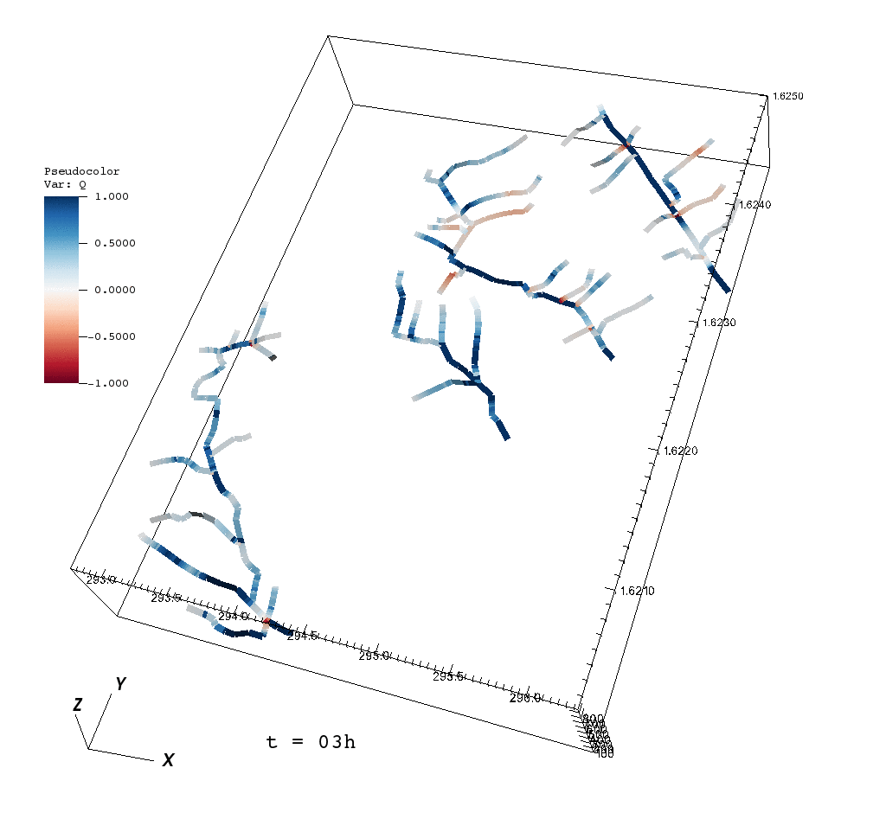

Sewer pipe flow
Pipe flow Q (m³/s)
Predominant flow is observed within the principal pipe
Weakened/backflows are observed in:
  Chokepoint pipe junctions
  Pipes with lesser steep slope
  Upstream connecting pipe is perpendicular to the receiving pipe
44

Slide 16
5. Comparison of sewer and no-sewer simulation
Change in water level (Tumana Station)
Tumana station
Case 1: No sewer flood simulation
Case 2: 2nd order sewer-integrated flood simulation
Observed increase in simulated water level and flood extent on surrounding flood plain with integration of sewer flow
26

Slide 17
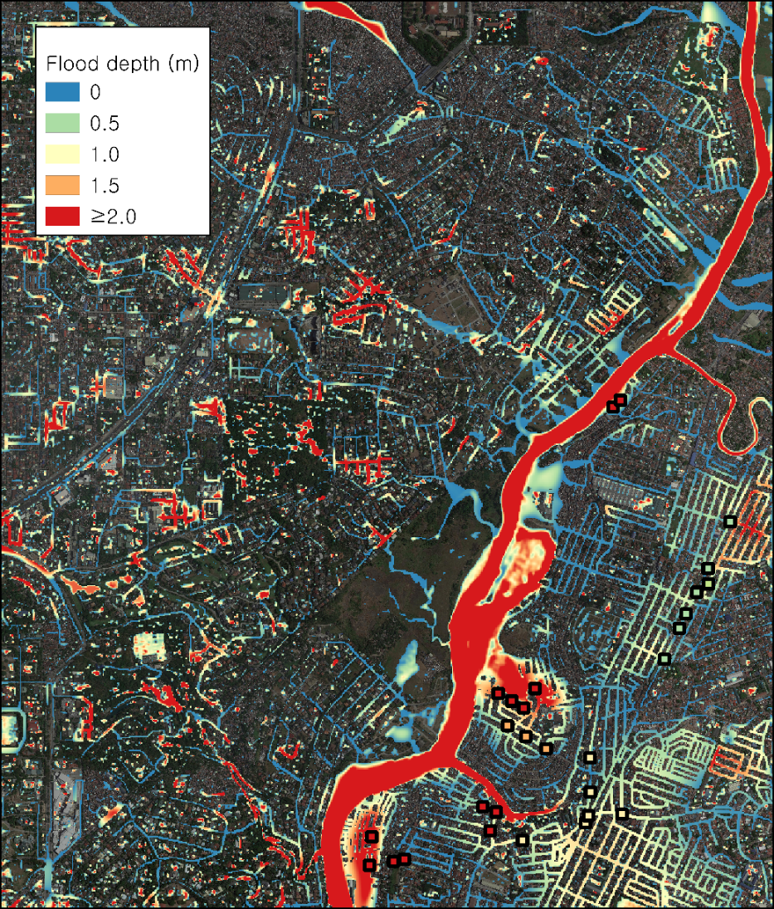
Flood validation
2020 Case event
 | District |  | Street | Maximum height | Peak | Flood time | Image
1 | Bench | Tumana | Pipino, Mais | tuhod sa 2nd floor
2 |  | Tanong | Manggahan st | dibdib |  |  | Image 1
3 | Paula | Tanong | Providence village, Anne st. | 20 ft | 10-11am |  | Image 2
4 |  | Malanday | Malaya st | 2nd floor | 6am
5 |  | Tumana | Dona Petra | 2nd floor |  |  | Image 3
6 |  | Conception Uno | Shoe avenue | gutter deep | 10:30 AM
7 |  | Conception Uno | Libis | balikat
8 |  | San roque | Midtown subd, dragon st | dibdib
9 |  | Malanday | Purok 4 | bewang second floor
10 |  | Malanday | Bouganvilla | bubong |  |  | Image 4
11 |  | Tumana | Bagong Farmers 1 | step 1 from 2nd floor
12 | Robert | Dela Pena | Flores st | leeg | noon |  | Image 7
13 |  |  | Providence, Austin St | bewang second floor
14 |  |  | Providence | bewang second floor
15 |  | Calumpang | Roxas st | bewang | noon
16 | Gema | Sto nino | sto nino highschool, agriculture st | bewang
17 | Airam | San roque | Munding ave, ignacio st, dela paz highway | dibdib
18 |  | Sto. Nino | Pla pla st. | 1 step to 2nd floor
19 |  | Tanong | Providence | 5m | 4am
20 | Emelita | TAnong | Tuazonville, Road 3 and road 4 | tuhod
21 | Ultimo | Tanong | Lopez jaena | lampas tuhod
22 | Luciano | San roque | New Marikina subd, flamingo, eagle, paralle, bacolod st. | dibdib
23 | Luciano |  | lark st | 5ft | 12nn
24 | Judea | Parang | Kaolin st. Calcite st | 2 ft
25 | Shiela | Malanday | Purok 7, Dahlia st | 2nd floor
26 |  | Barangka |  | lubog ang 1st floor | 7am |  | Image 5
27 | Johnardie | Tumana | singkamas | lampas 2nd floor | 10-11am
28 | Janina | Conception Uno | Libis, jp rizal | dibdib. Lampas tao | 10-11am | subside 3-4pm | Image 6
29 | Elsa | Tumana | Ampalaya | 2nd floor
30 | Janice | San Roque | eagle st, new marikina | 4ft
45

Slide 18
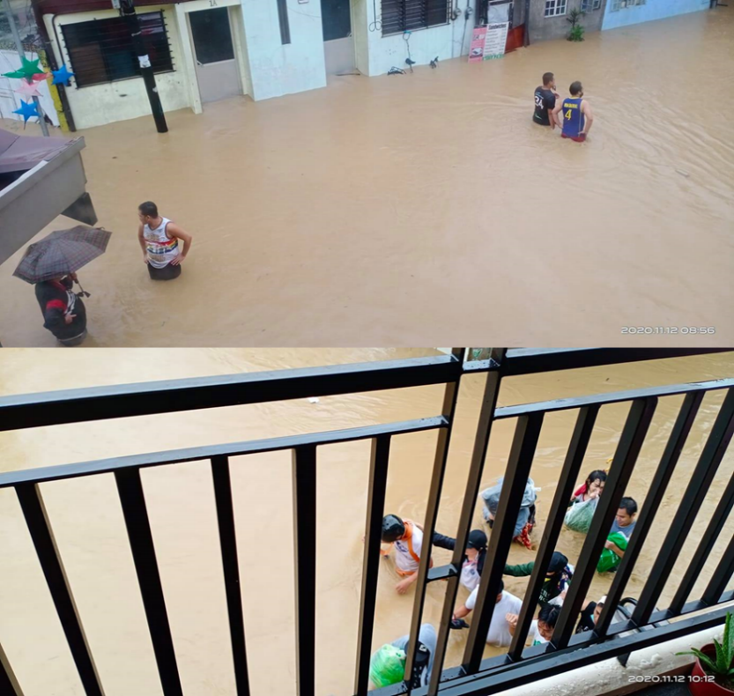
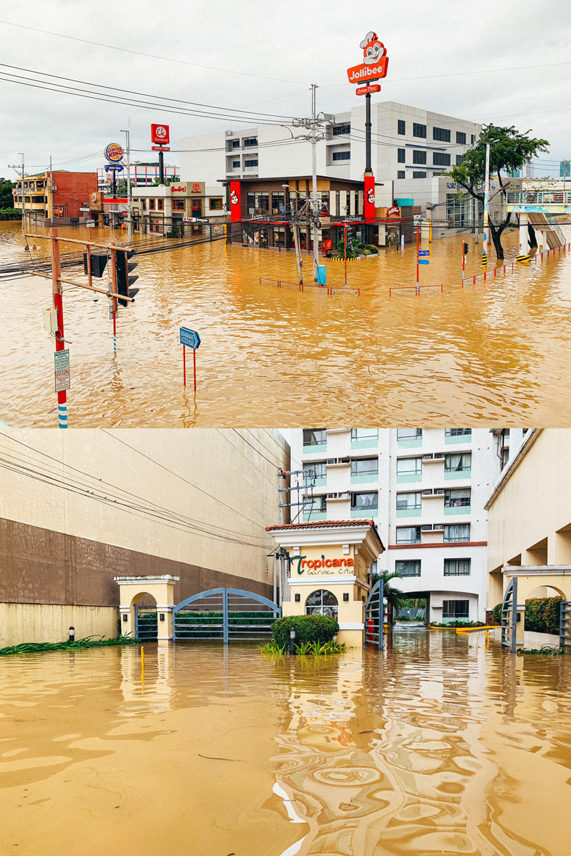
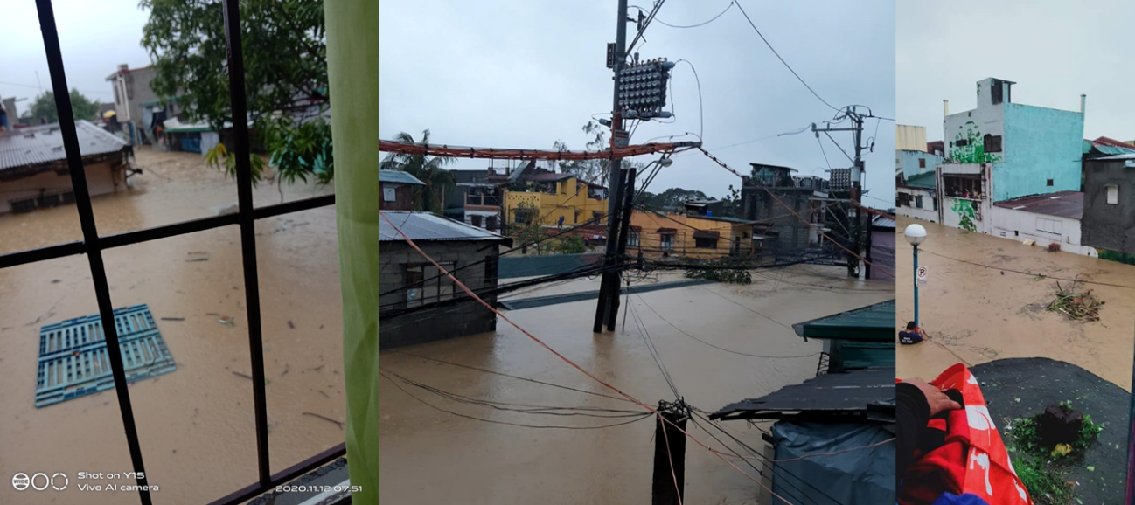
Flood validation
2020 Case event
~0.5m flood depth
~1.0m flood depth
>2.0m flood depth
46

Slide 19
Sewer pipe model: Analysis summary
Model can simulate recession of flood in surfaces connected to the sewer pipes
Increase in river extent is observed when applying sewer simulation
Surcharge is expected for bottleneck pipes, slope with smaller values and when upstream pipe is perpendicular to the receiving pipe
Accuracy of flood is sensitive to small changes in DEM
51

Slide 20
Limitations/recommendations for future studies
Applicable for short-term urban flood events
Lack of information for detailed river cross section area
Information on upstream dam and levee
Detailed survey of sewer network
Higher order synthetic system simulation
Recommendation in reducing flood vulnerability of the study domain
River widening/desilting
Construction of:
  River levees
  Outlets with gateways
  Pump stations
Increasing pipe diameter for bottle neck areas
Recommendation for well-designed sewer system
52

Slide 21
Thank you for listening.
Contact:
Lea Dasallas, PhD
Chungnam National University, Korea
lea.dasallas@o.cnu.ac.kr

