Slide 1
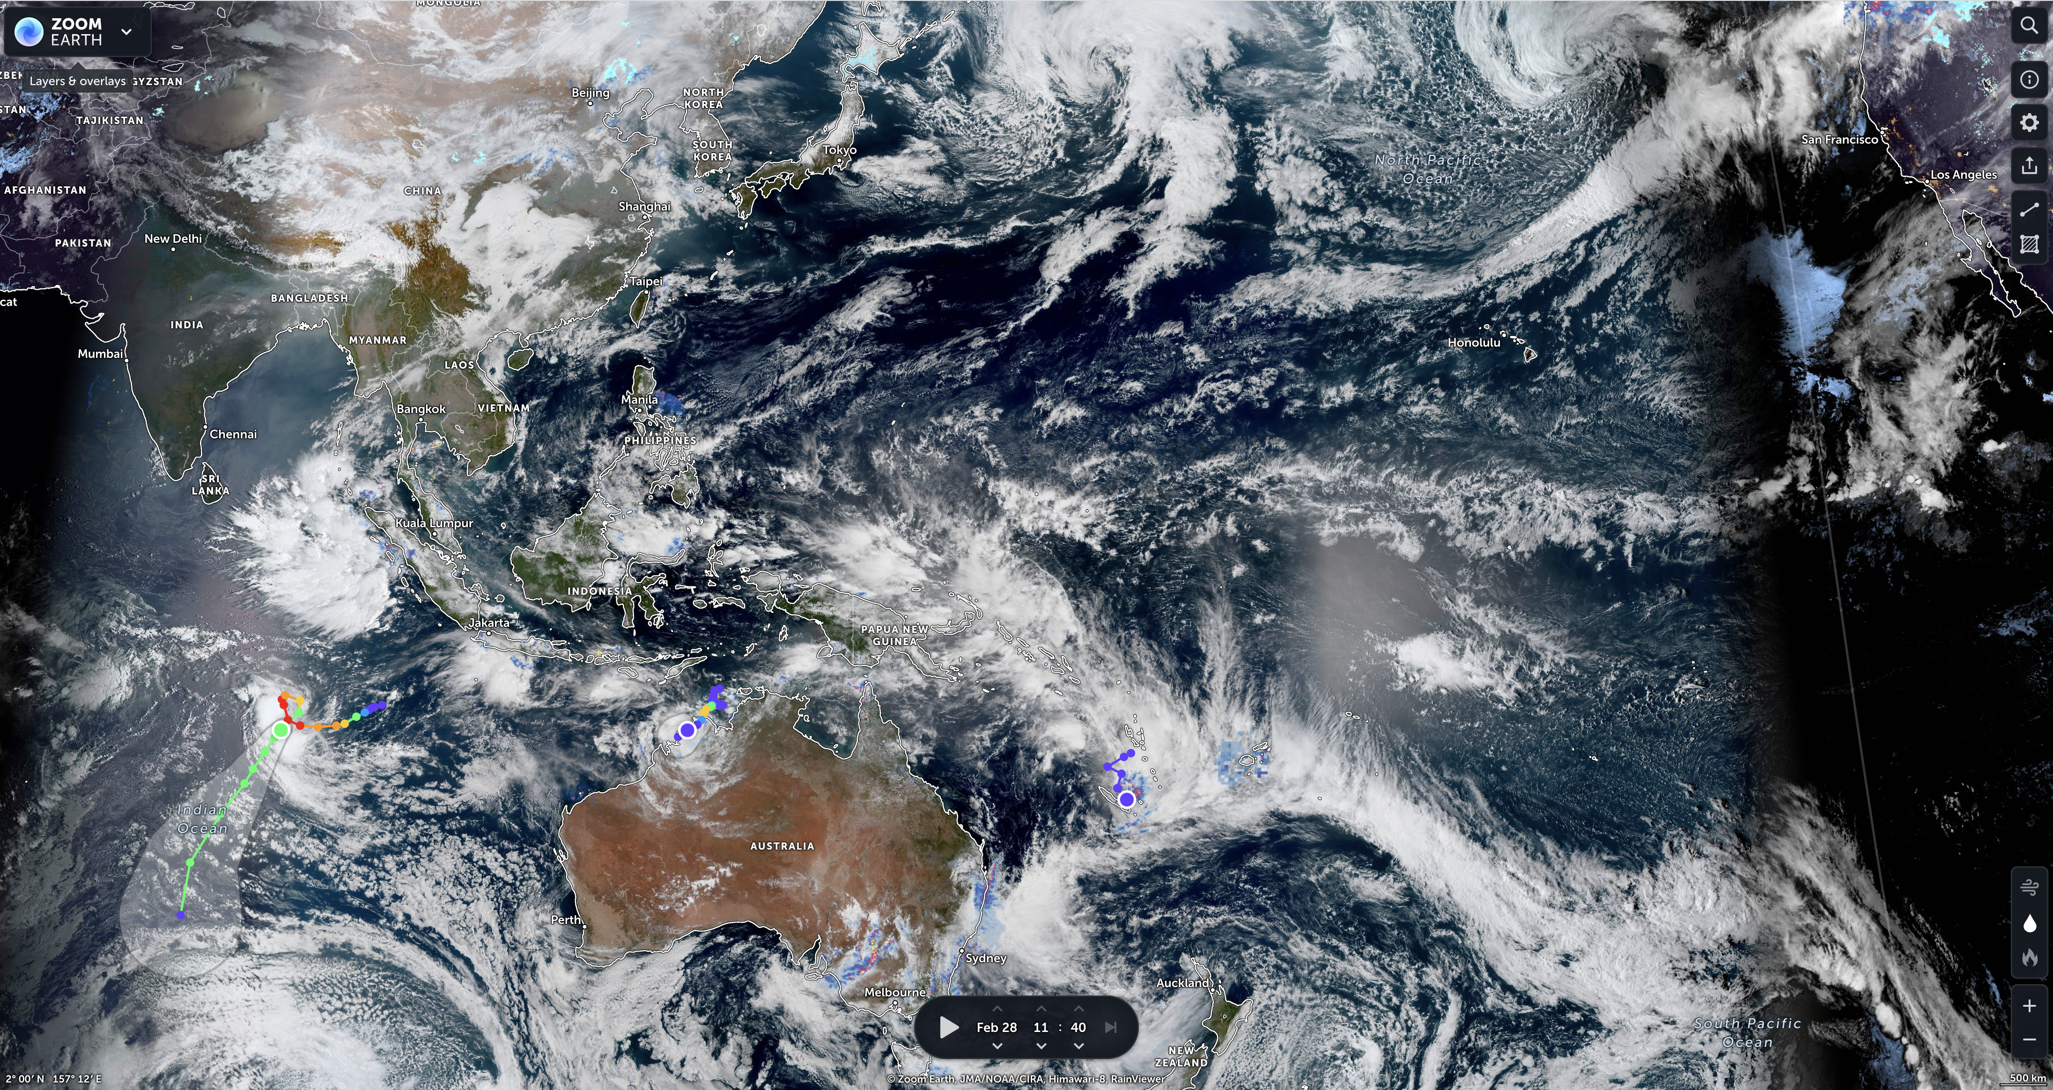


Indian Ocean influence on the ENSO-Indian summer monsoon teleconnection is mostly apparent
Tamás Bódai
EGU22 session OS1.9
Understanding the Indian Ocean’s past, present and future role in climate variability and predictability
Vienna, 26 May 2022
Notes:
https://zoom.earth/#view=2,157.2,4z/date=2022-02-28,11:40,+9
Developed from IBS_YSF_2022_Bodai_01.pptx, stripping off the rest.

Slide 2
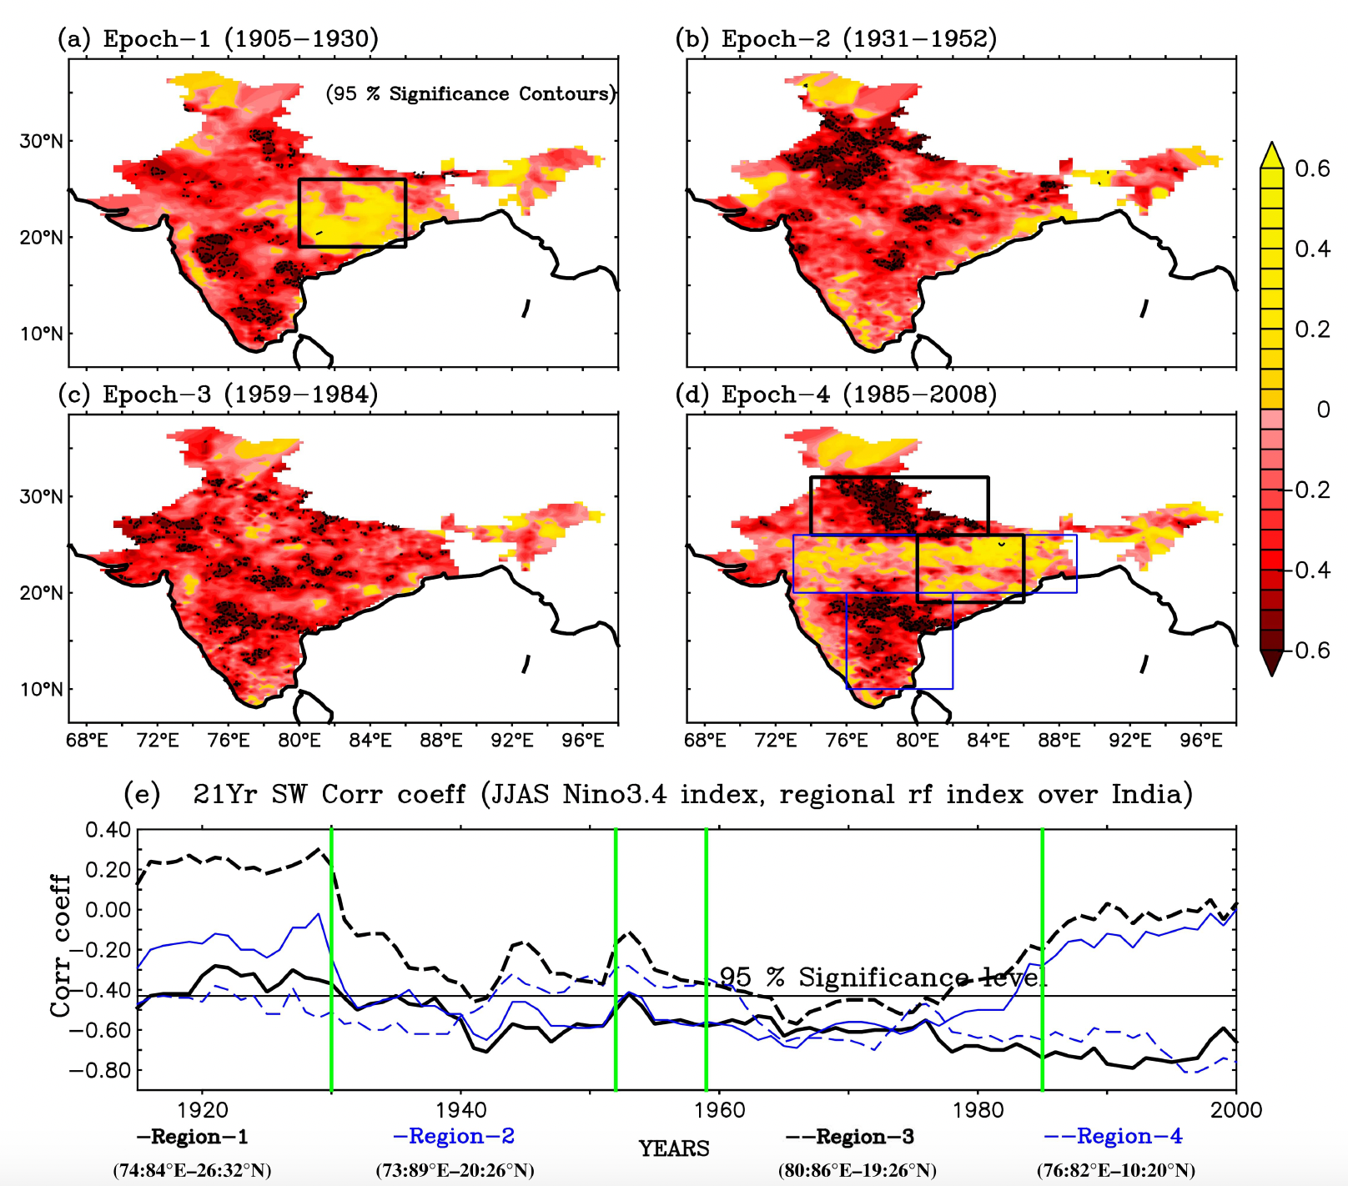


Consider the variability of the “apparent” ENSO-ISM teleconnection as a moving $τ$-window correlation coefficient (cc) $r_{τ}\left(N,M(x)\right)$ (Mahendra et al. Int J Climatol 2021)
Consistency of observations with the null-hypothesis, H0: $M(x)=aN+ ξ$ (Yun & Timmermann, GRL, 2018: YT18) – detectability of any “decadal influence”
Apparent influence specifically of the Indian Ocean (IO) as a cc (in CESM2)
Causality: Does the IO really influence the ENSO-ISM teleconnection? – No!

Slide 3
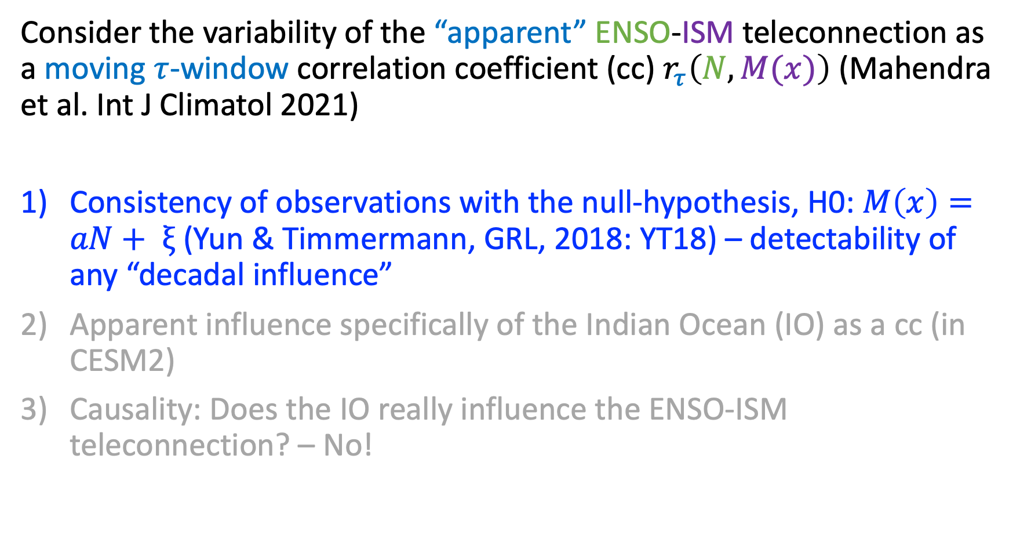
Consider the variability of the “apparent” ENSO-ISM teleconnection as a moving $τ$-window correlation coefficient (cc) $r_{τ}\left(N,M(x)\right)$ (Mahendra et al. Int J Climatol 2021)
Consistency of observations with the null-hypothesis, H0: $M\left(x\right)=aN+ ξ$ (Yun & Timmermann, GRL, 2018: YT18) – detectability of any “decadal influence”
Apparent influence specifically of the Indian Ocean (IO) as a cc (in CESM2)
Causality: Does the IO really influence the ENSO-ISM teleconnection? – No!

Slide 4
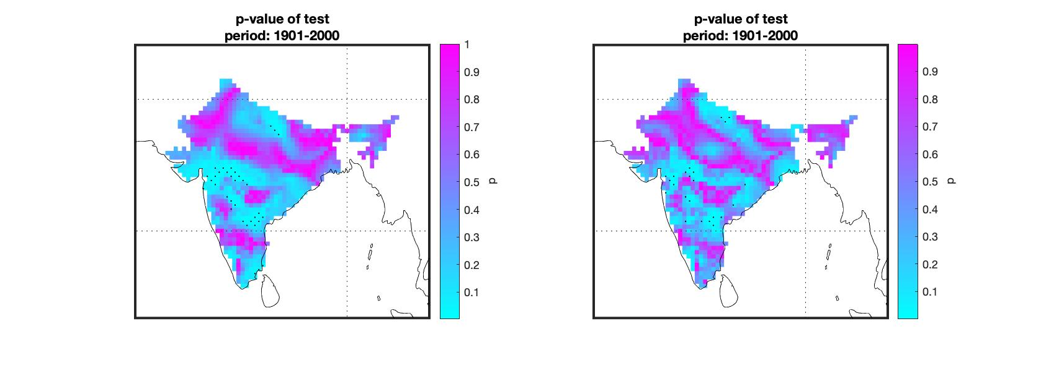
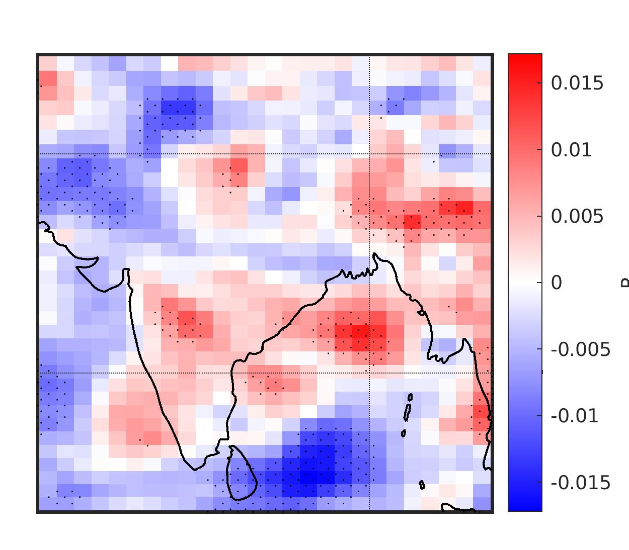
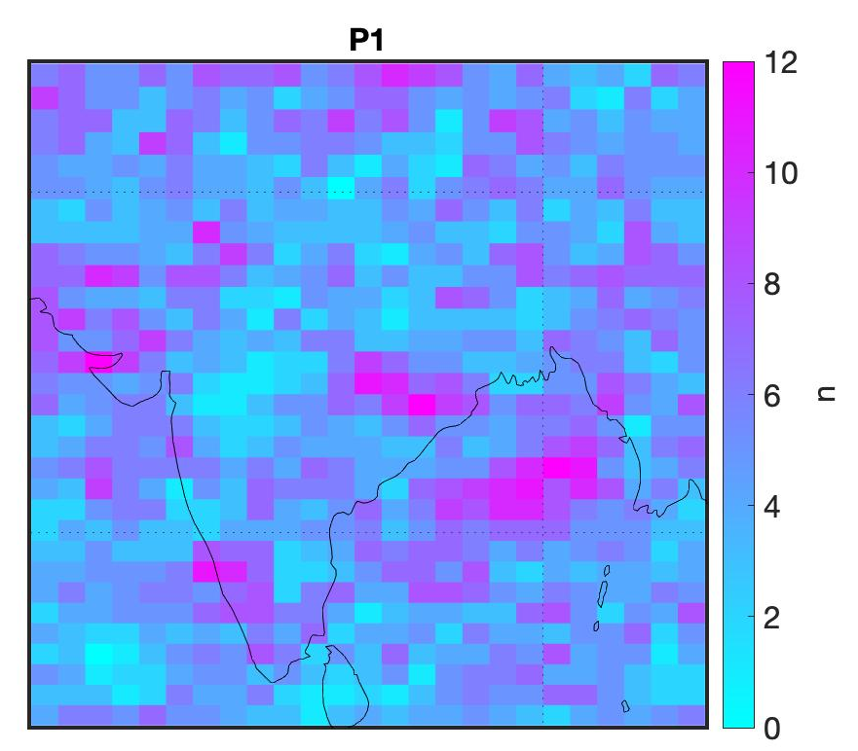
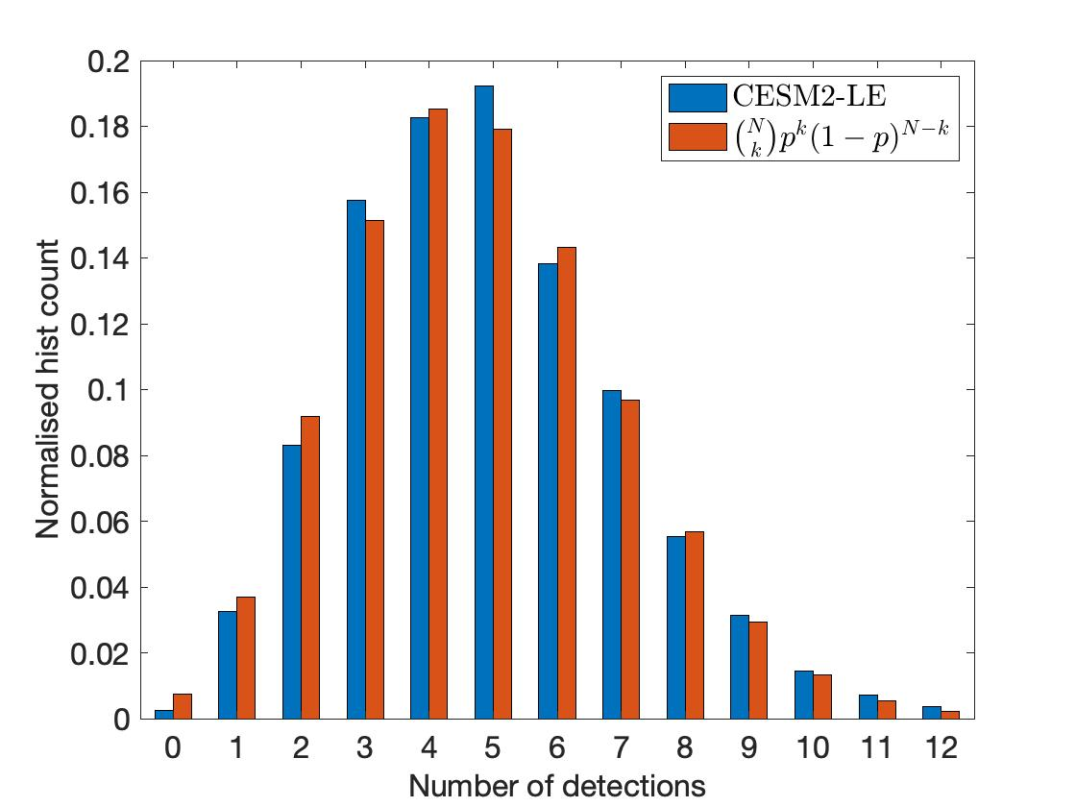
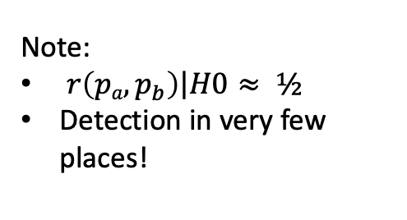

YT18a
YT18b
CESM2-LE
Observation:
Nino3 from ERSSTv5
Precip’: CRUPREv4.03
Test statistics:
YT18a:
YT18b:
Note:
$\left.r\left(pa,p_{b}\right)\right|H0≈ ½$
Detection in very few places!
$σ_{0}:σ(z_{τ})$ under H0
→ Let’s look at ensemble model data!
Model: CESM2-LE (N = 100)
Use YT18a.
CONCLUSION: Detections by YT18a,b are mostly false
Distribution under H0
k
k
However…
k
Notes:
Fig. 1 from ENSO_IM_PDO_IOD_influence_05.pdf
detectability_03_mean_dtrended_1901_2000.jpg

Slide 5
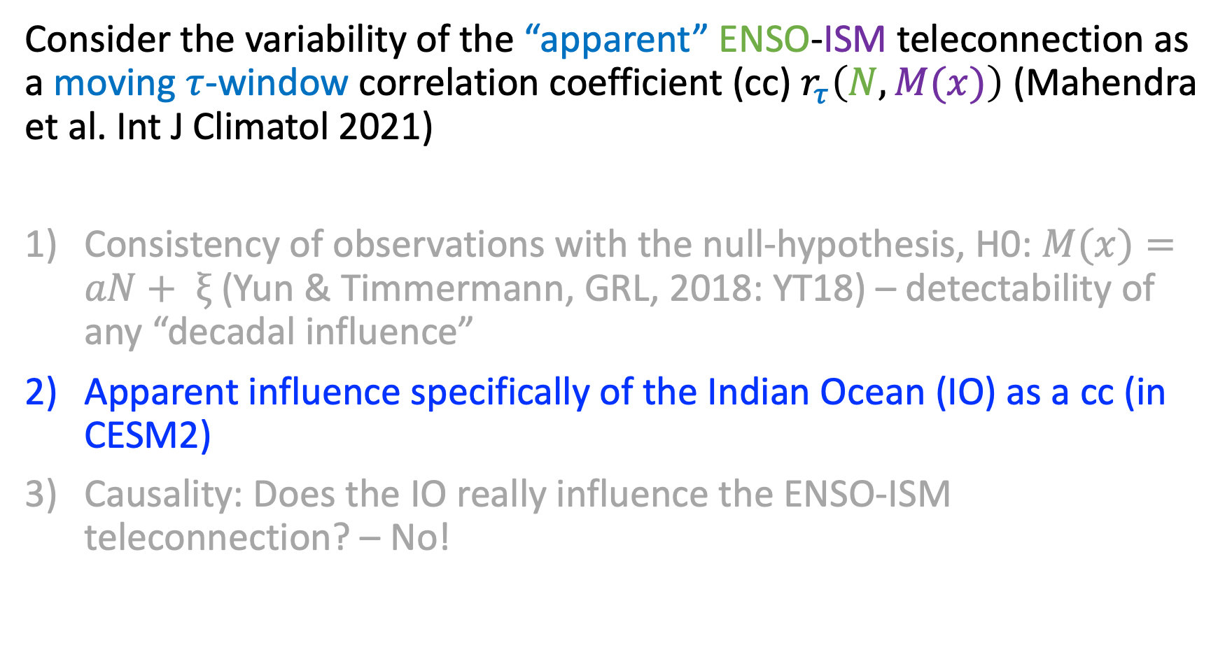
Consider the variability of the “apparent” ENSO-ISM teleconnection as a moving $τ$-window correlation coefficient (cc) $r_{τ}\left(N,M(x)\right)$ (Mahendra et al. Int J Climatol 2021)
Consistency of observations with the null-hypothesis, H0: $M(x)=aN+ ξ$ (Yun & Timmermann, GRL, 2018: YT18) – detectability of any “decadal influence”
Apparent influence specifically of the Indian Ocean (IO) as a cc (in CESM2)
Causality: Does the IO really influence the ENSO-ISM teleconnection? – No!

Slide 6
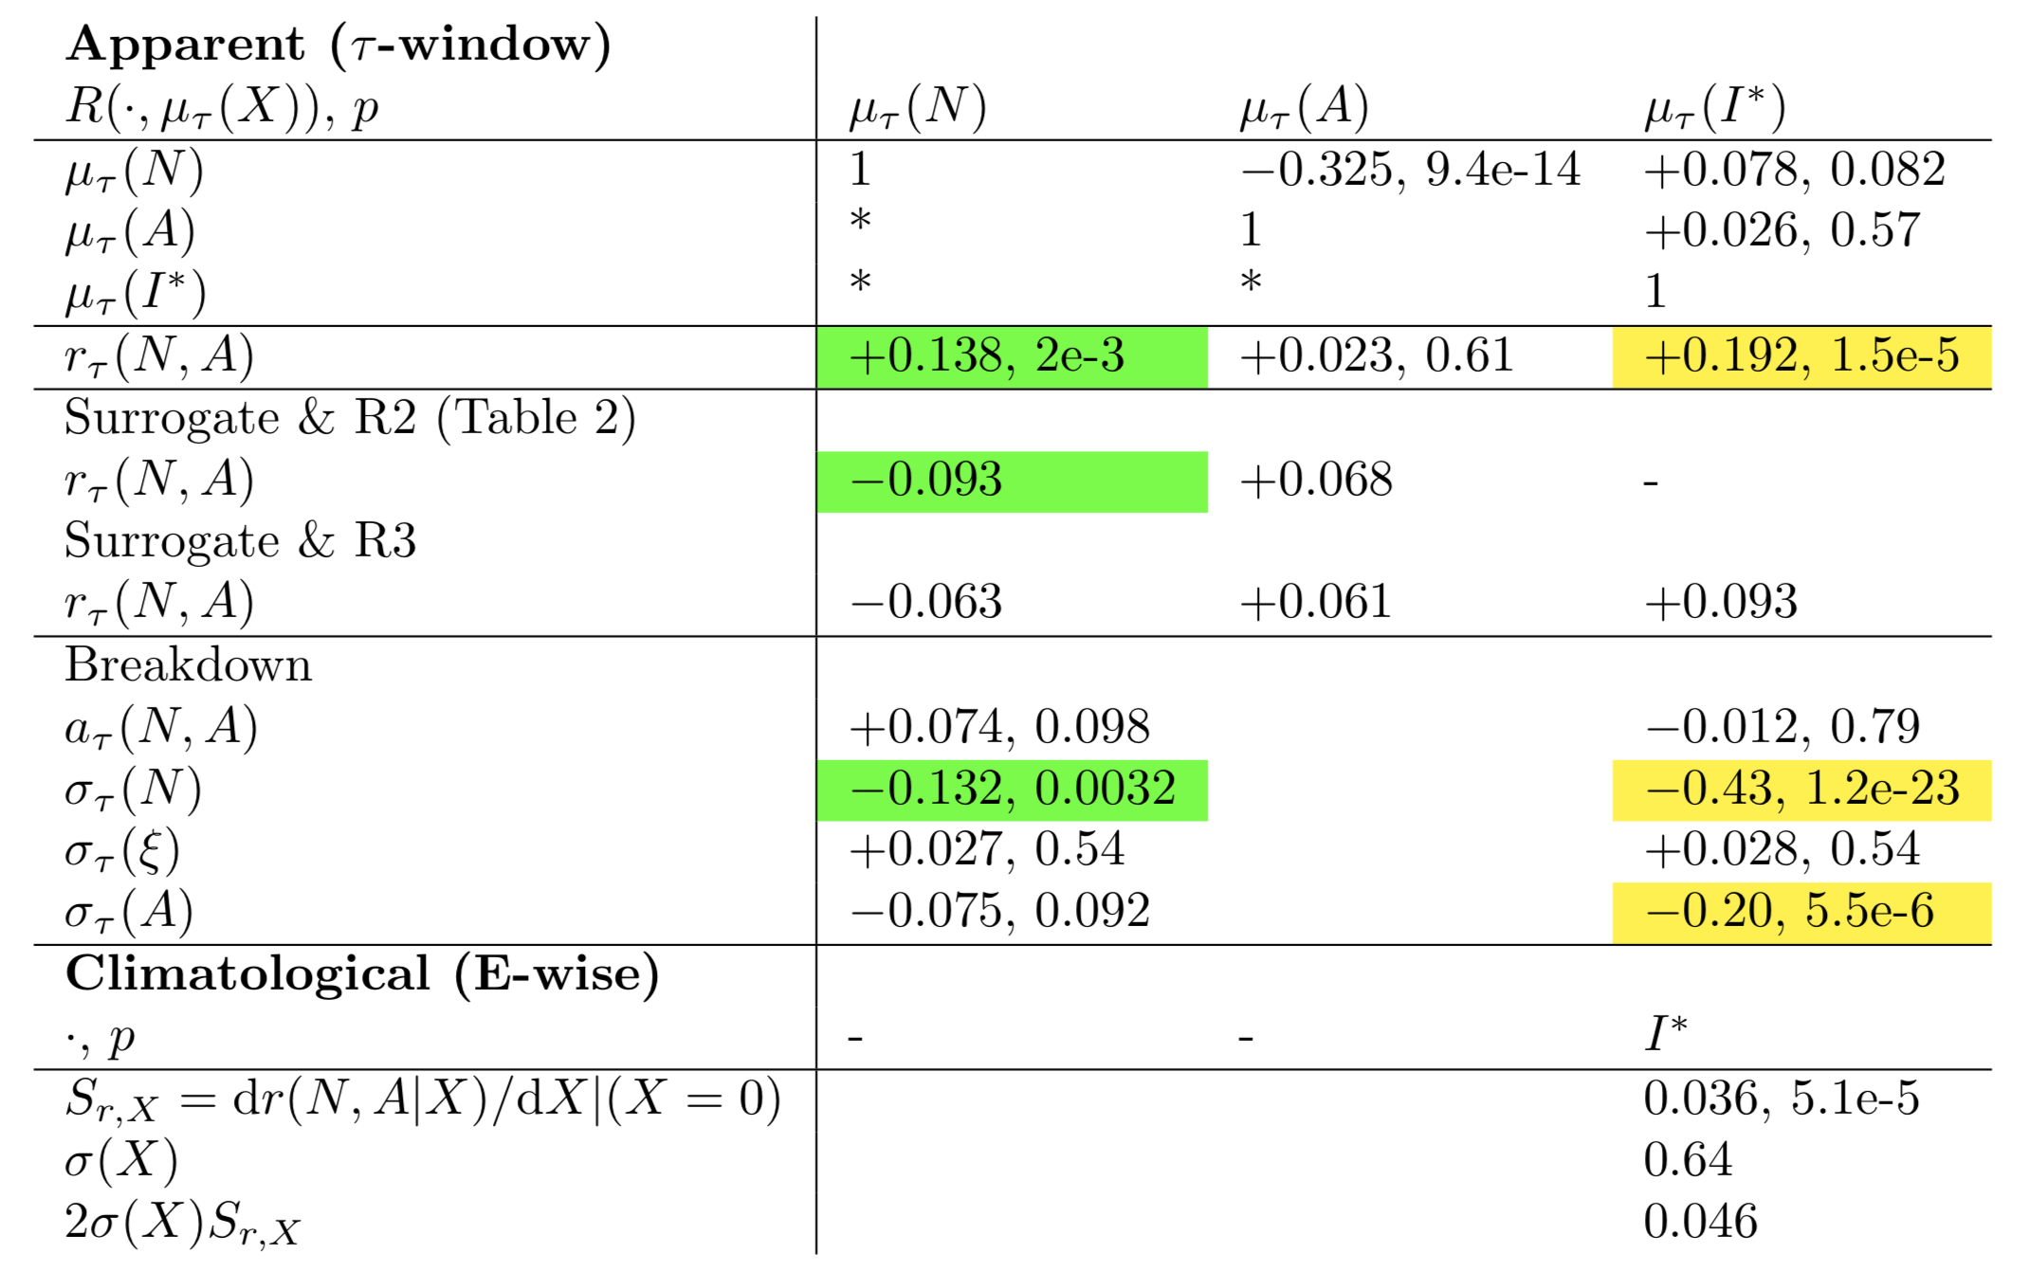
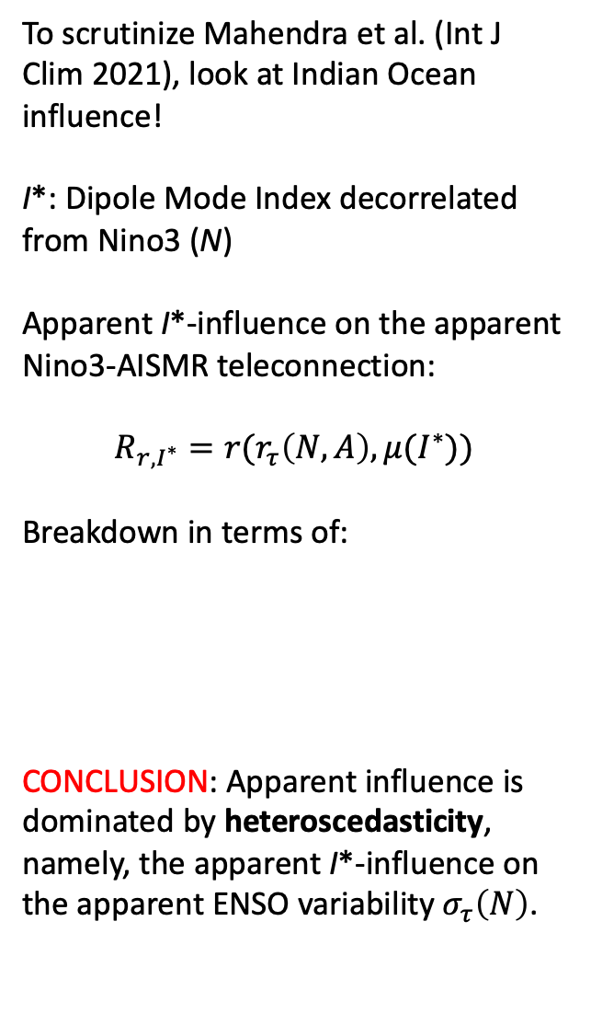
To scrutinize Mahendra et al. (Int J Clim 2021), look at Indian Ocean influence!
I*: Dipole Mode Index decorrelated from Nino3 (N)
Apparent I*-influence on the apparent Nino3-AISMR teleconnection:
$$R_{r,I^{∗}}=r(r_{τ}\left(N,A\right),μ(I^{∗}))$$
Breakdown in terms of:
CONCLUSION: Apparent influence is dominated by heteroscedasticity, namely, the apparent I*-influence on the apparent ENSO variability${ σ}_{τ}\left(N\right)$.
Influencing “native” and “foreign” factors
Nonlinearity
Heteroscedasticity

Slide 7
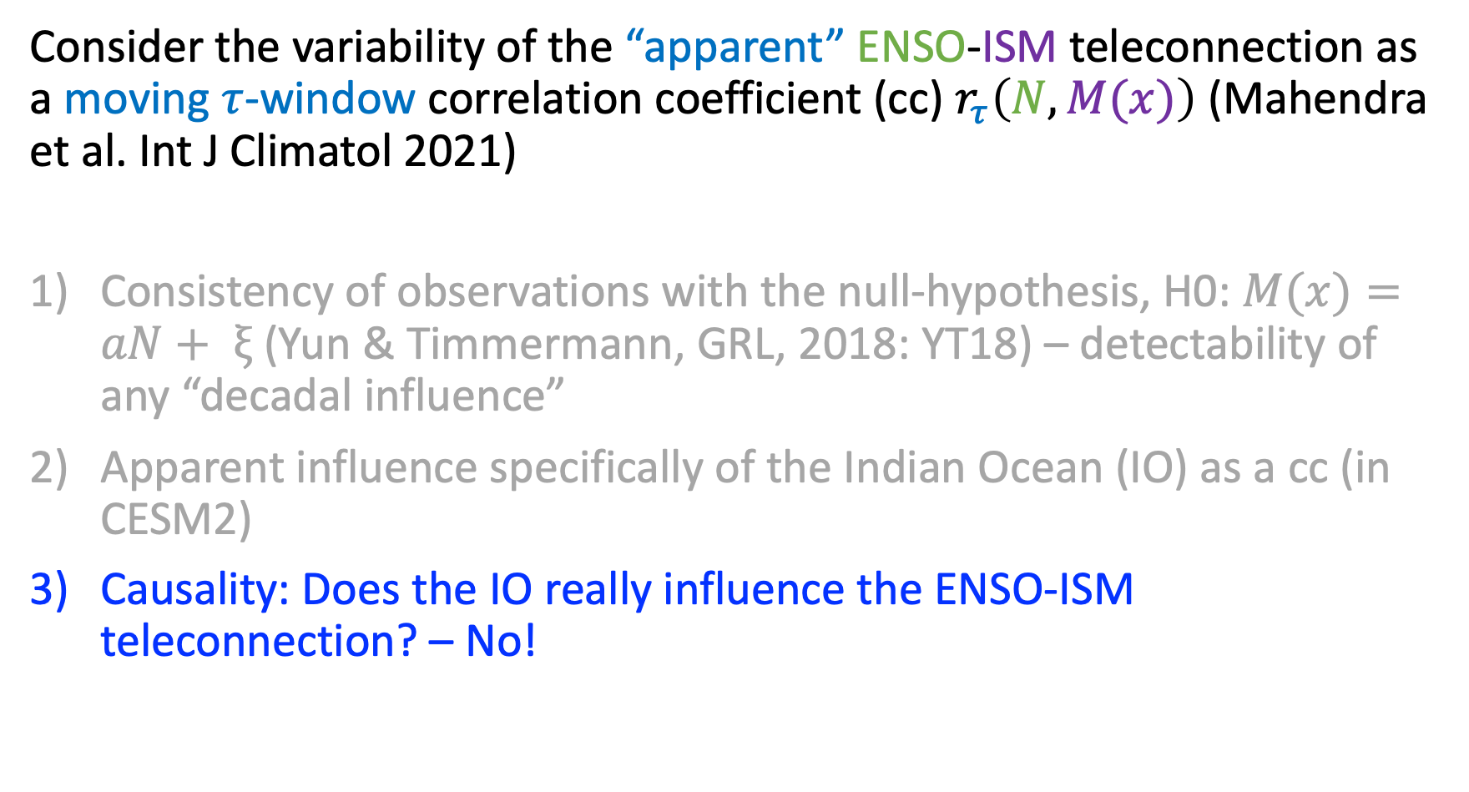
Consider the variability of the “apparent” ENSO-ISM teleconnection as a moving $τ$-window correlation coefficient (cc) $r_{τ}\left(N,M(x)\right)$ (Mahendra et al. Int J Climatol 2021)
Consistency of observations with the null-hypothesis, H0: $M(x)=aN+ ξ$ (Yun & Timmermann, GRL, 2018: YT18) – detectability of any “decadal influence”
Apparent influence specifically of the Indian Ocean (IO) as a cc (in CESM2)
Causality: Does the IO really influence the ENSO-ISM teleconnection? – No!

Slide 8
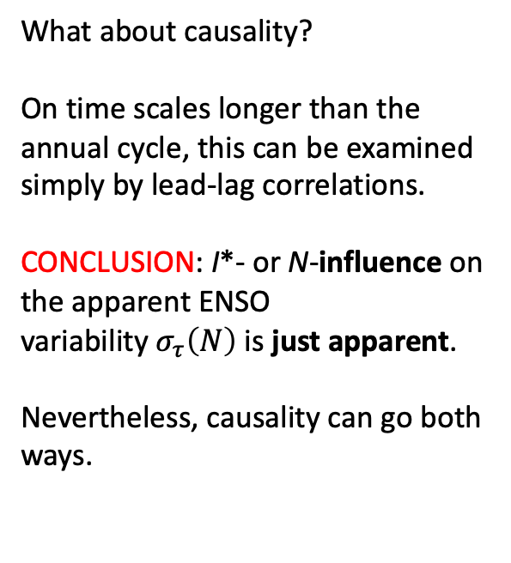
What about causality?
On time scales longer than the annual cycle, this can be examined simply by lead-lag correlations.
CONCLUSION: I*- or N-influence on the apparent ENSO variability${ σ}_{τ}\left(N\right)$ is just apparent.
Nevertheless, causality can go both ways.
“Foreign” I*-influence
Dominant
Subdominant
“Native” N-influence
Dominant

Slide 9
Spatial view on 2) and 3)

Slide 10
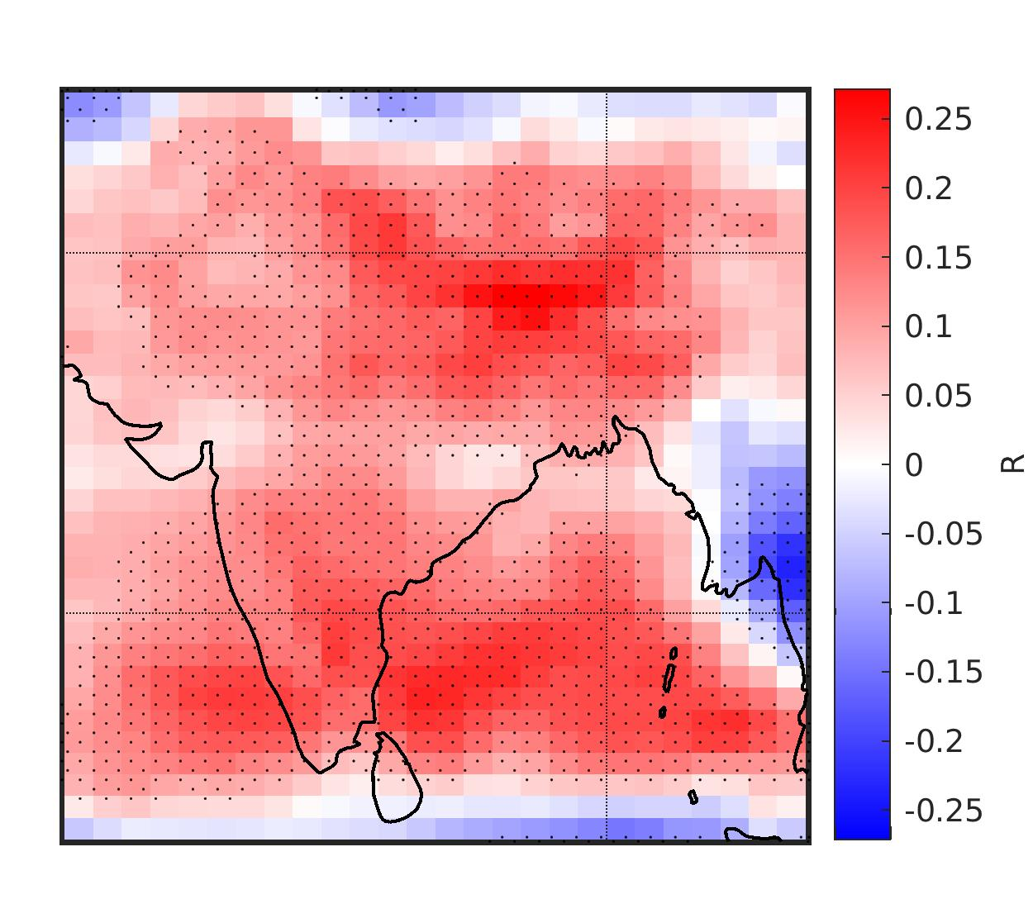
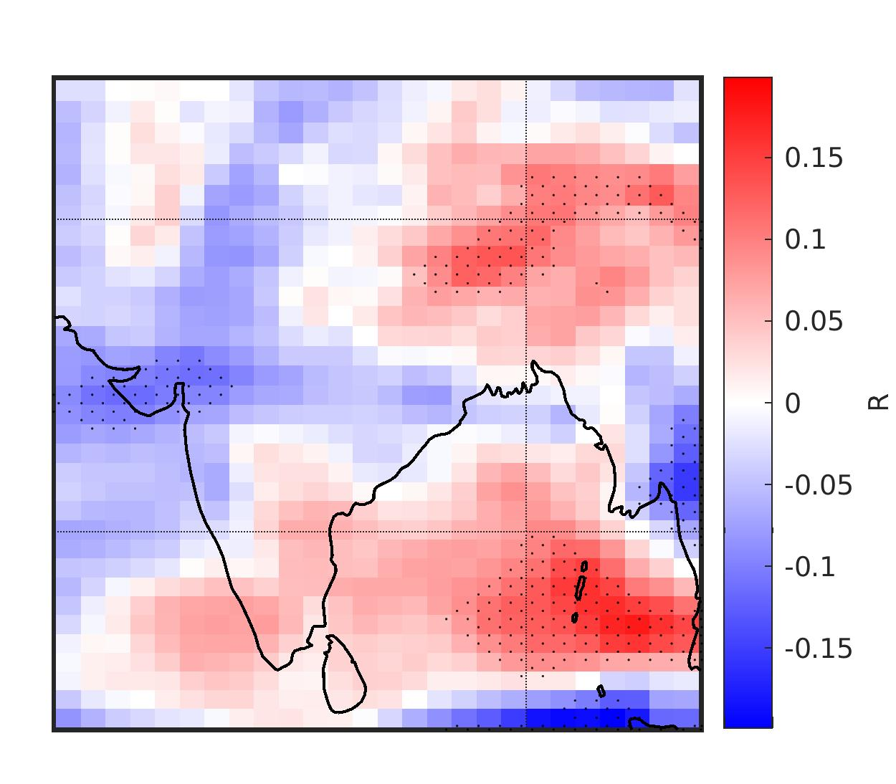
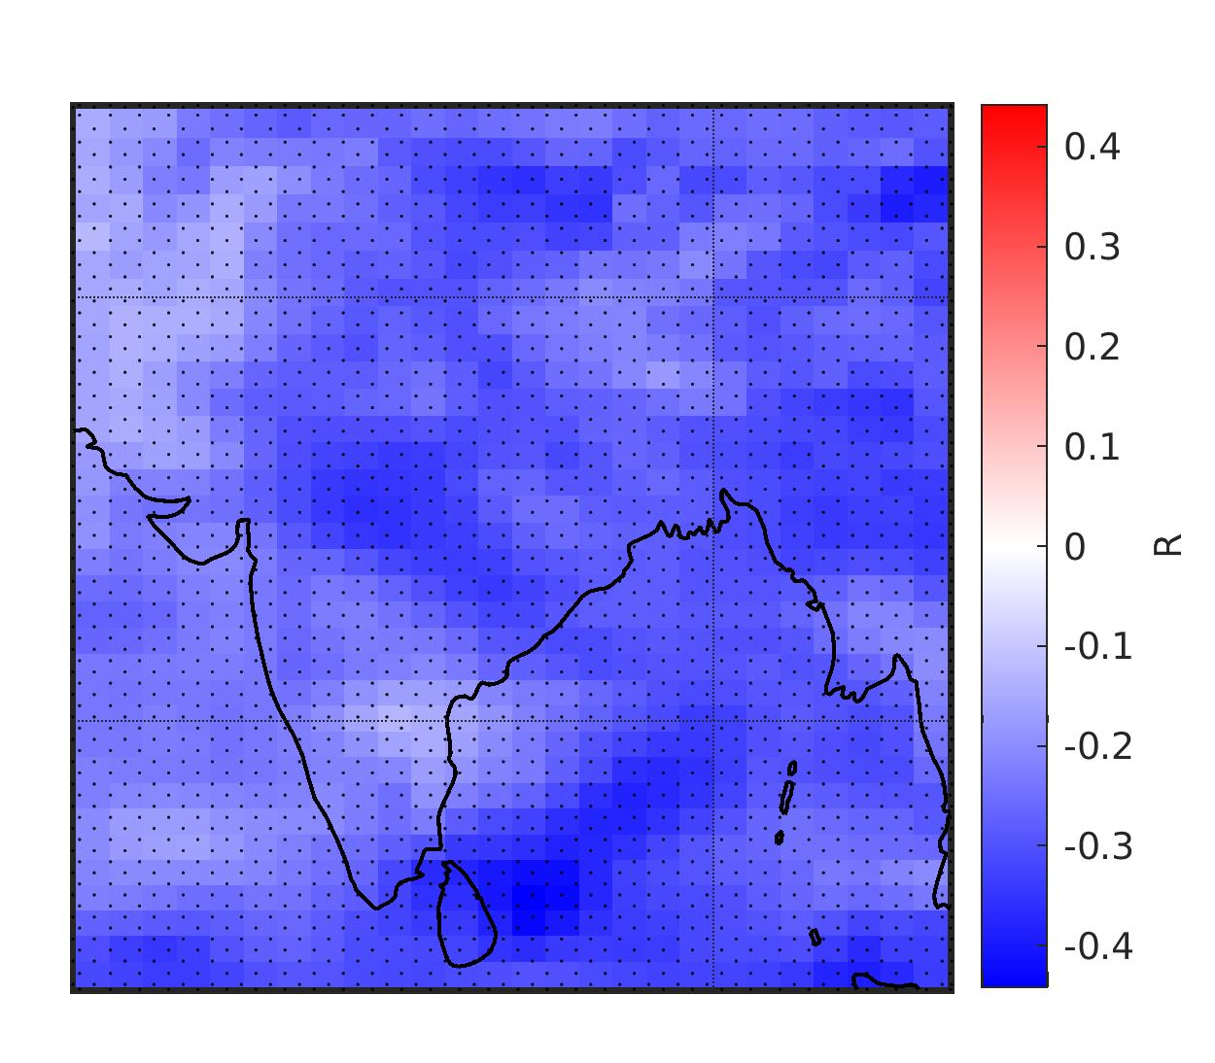
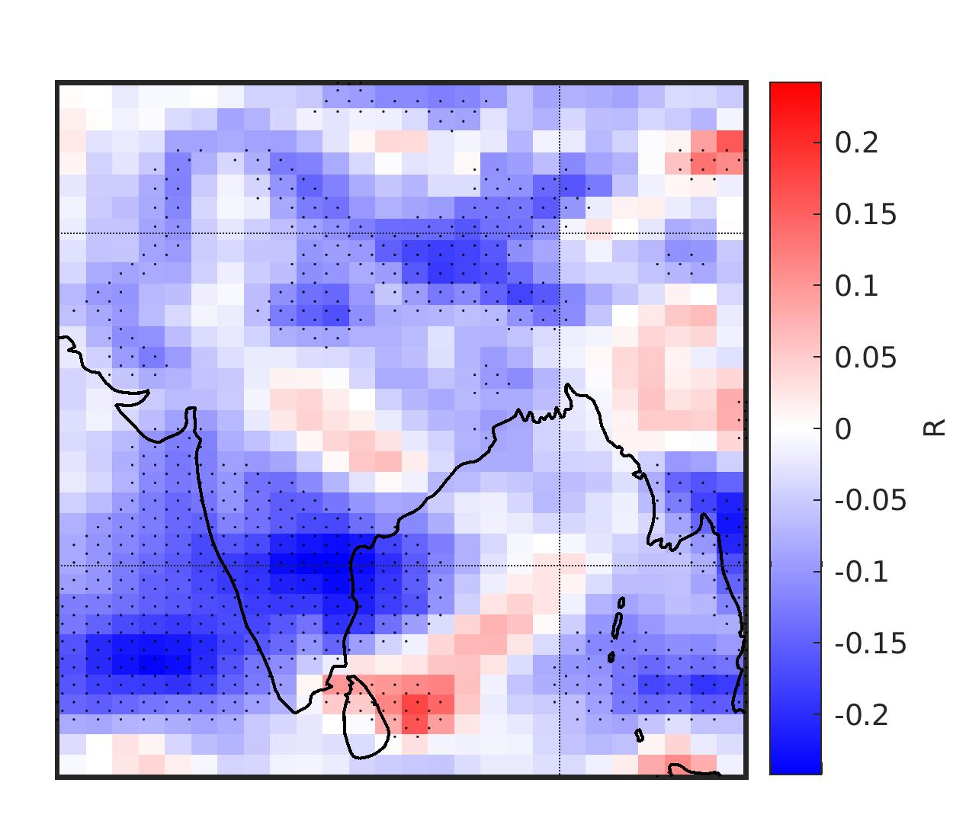
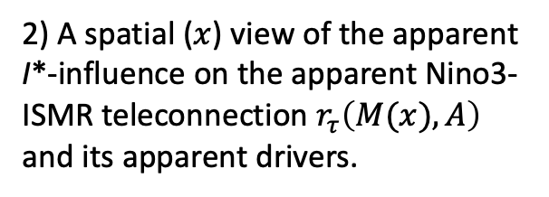
2) A spatial ($x$) view of the apparent I*-influence on the apparent Nino3-ISMR teleconnection $r_{τ}\left(M(x),A\right)$ and its apparent drivers.
Notes:
Part of Fig. 3 of ENSO_IM_PDO_IOD_influence_05.pdf

Slide 11
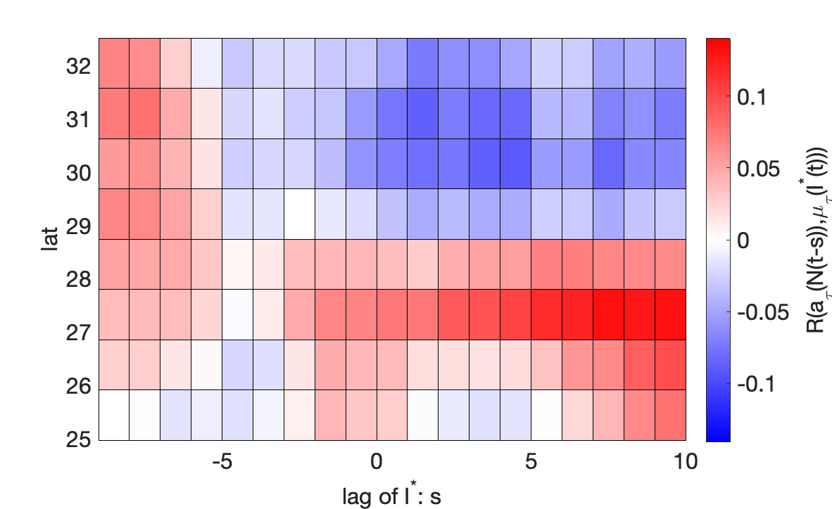
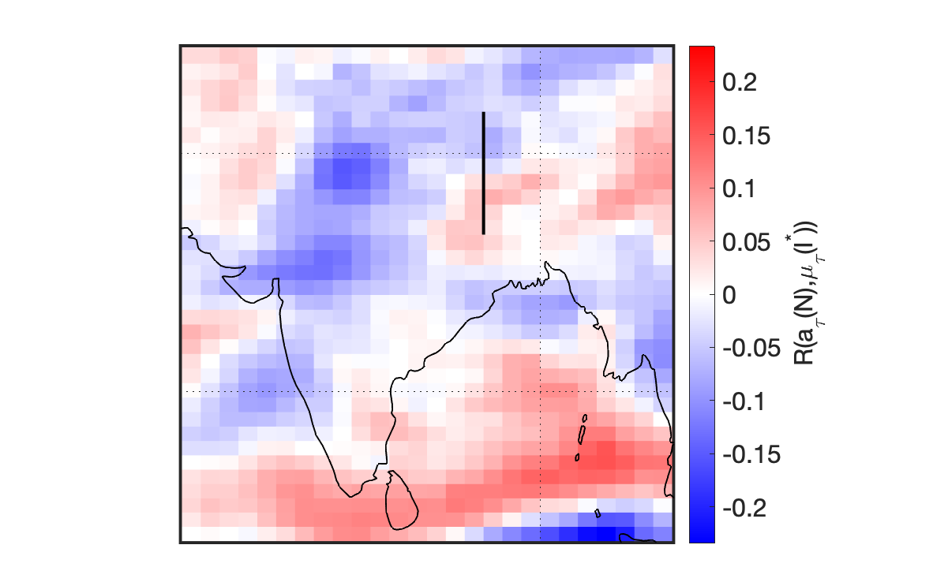
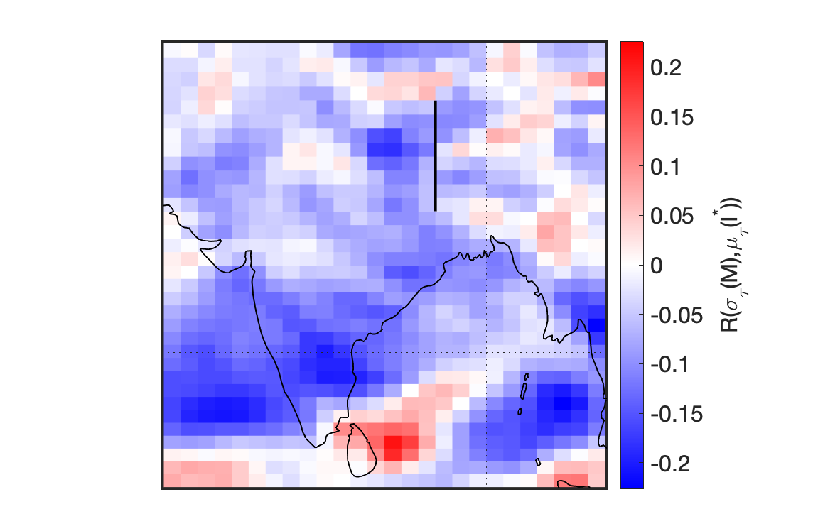
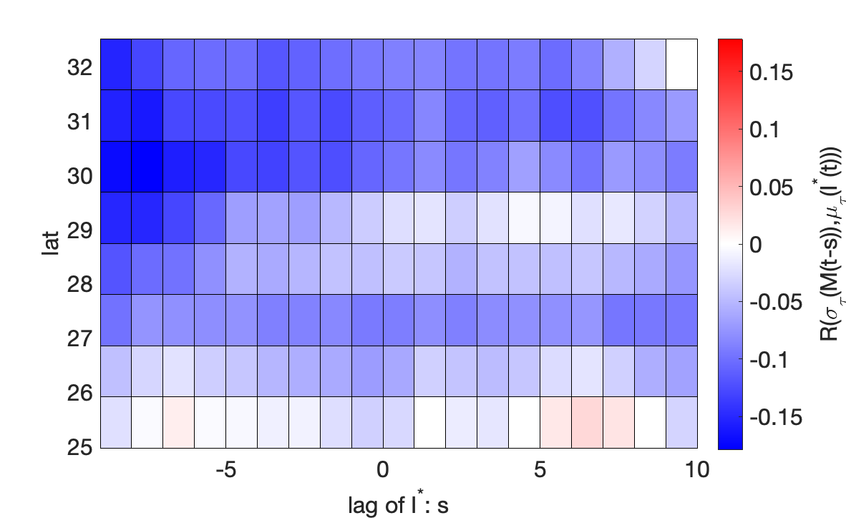
3) Causality? The dominance of one factor is not the case everywhere.
Notes:
Part of Fig. 4 of ENSO_IM_PDO_IOD_influence_05.pdf

