Slide 1
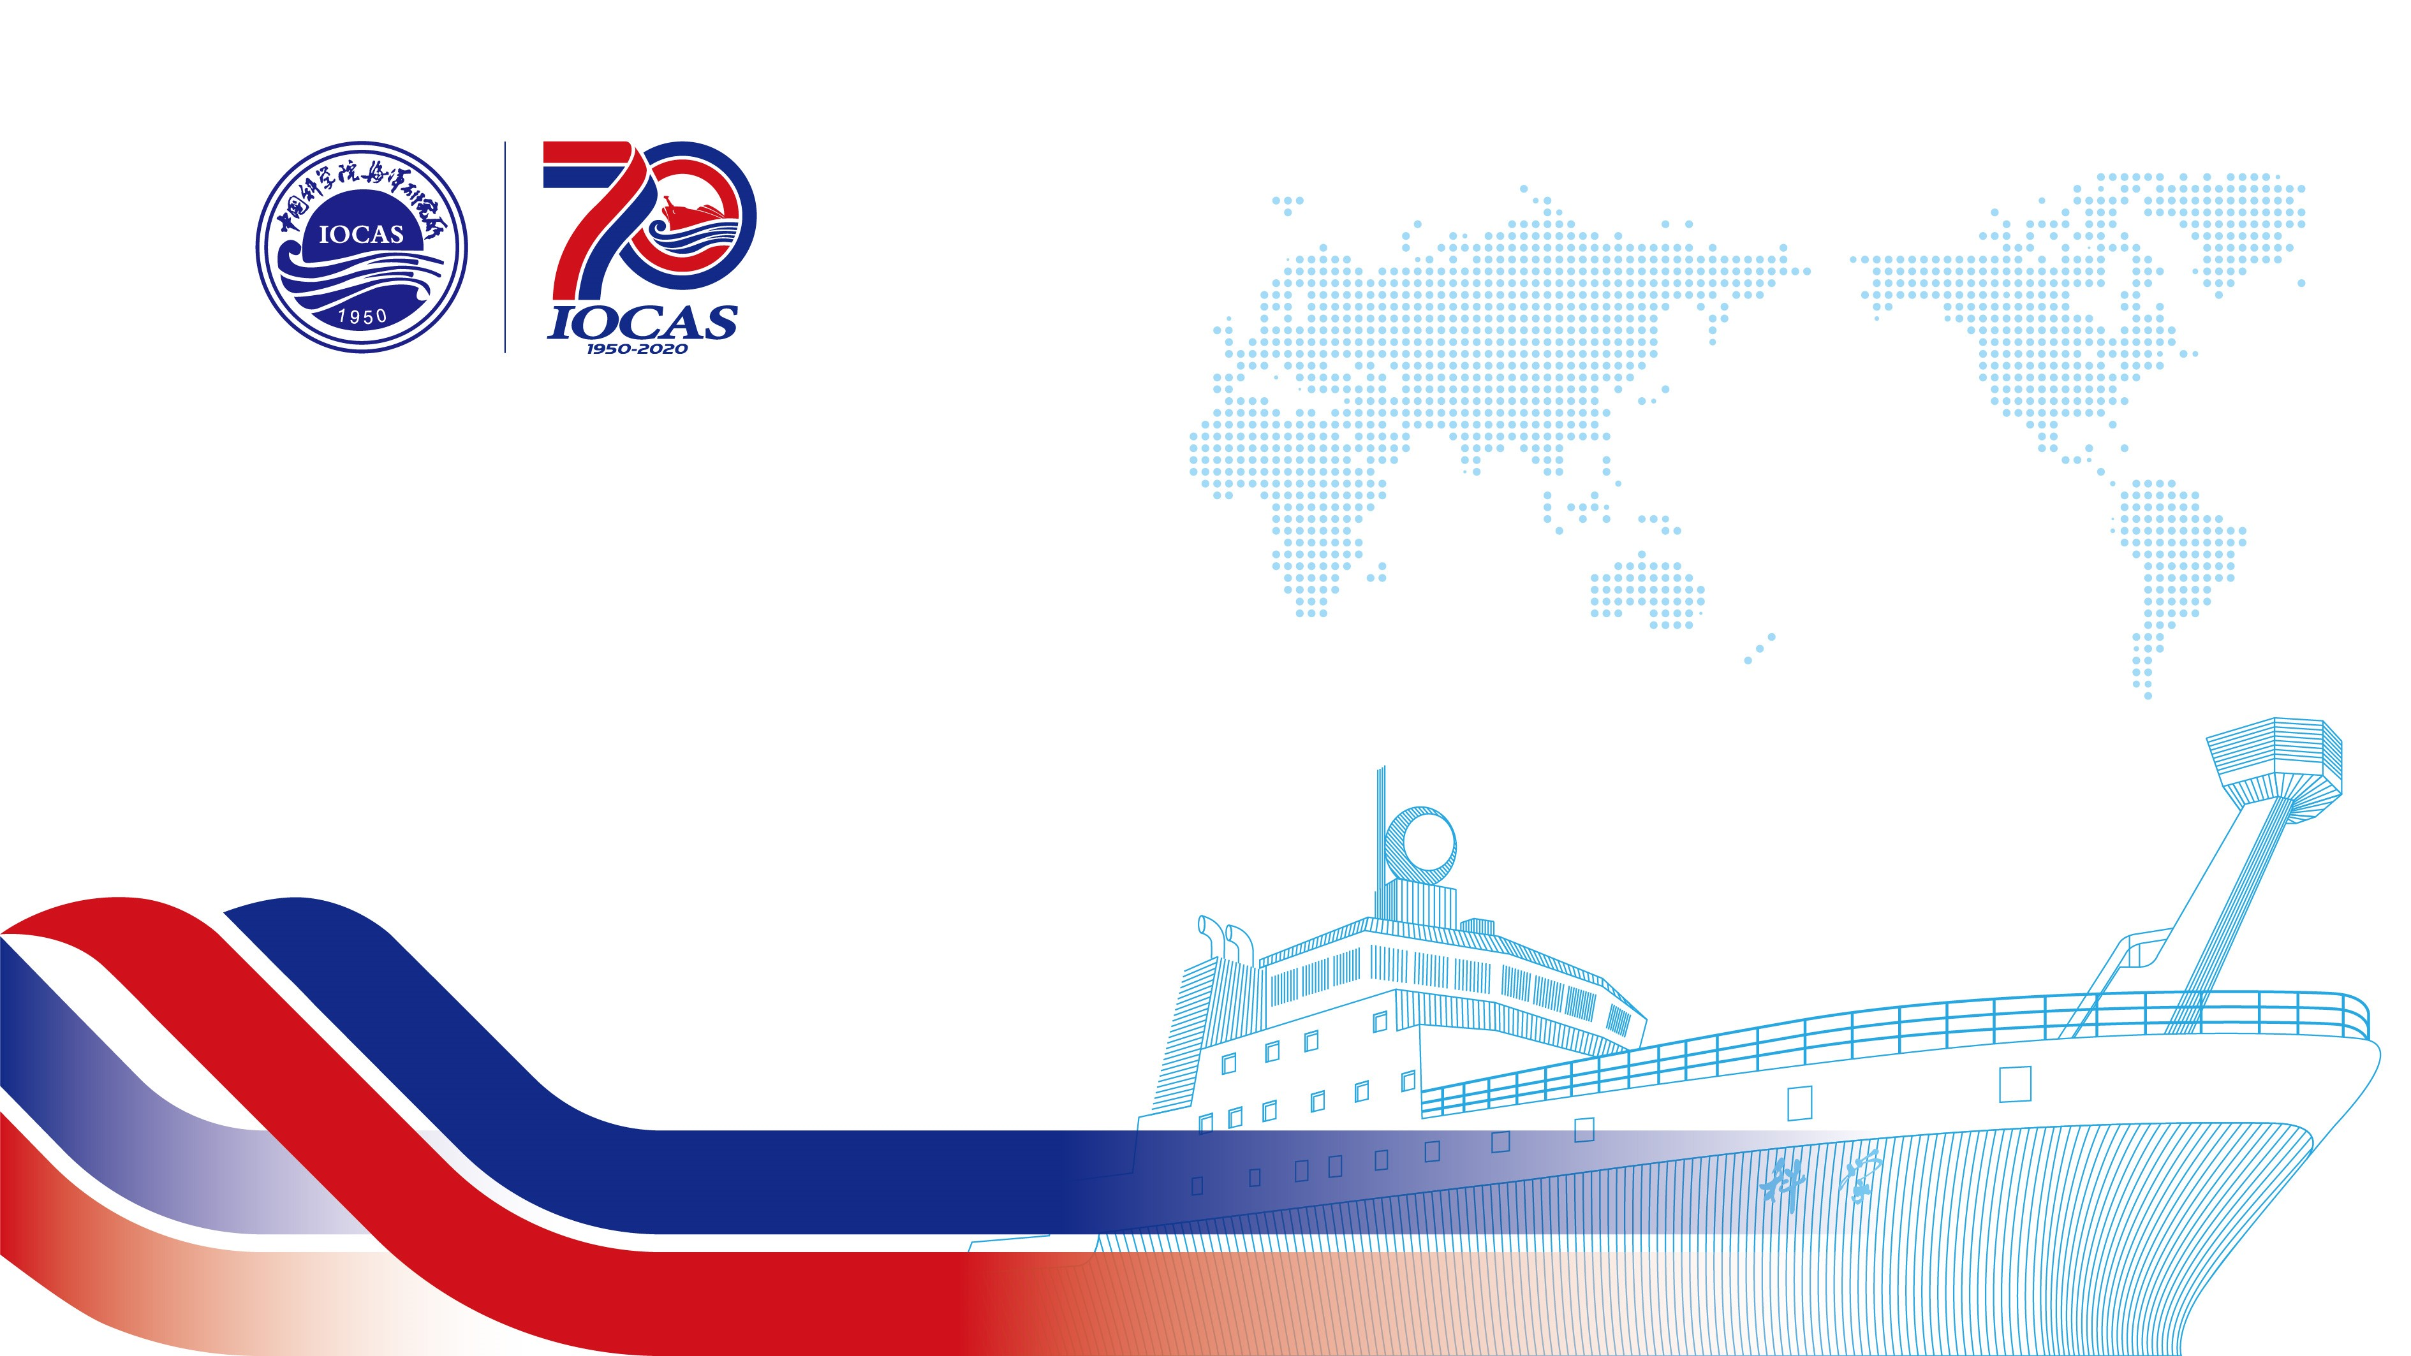


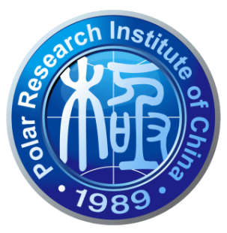
中国极地研究中心
Polar Research Institute of China
Geographical inhomogeneity and temporal variability of
mixing properties and driving mechanism in the Arctic Ocean
Jia You, Zhenhua Xu, Qun Li, Robin Robertson, Baoshu Yin
Institute of Oceanology, Chinese Academy of Sciences, Qingdao, China
Polar Research Institute of China, Shanghai, China
China-Asean College of Marine Science, Xiamen University Malaysia, Sepang, Malaysia

Slide 2
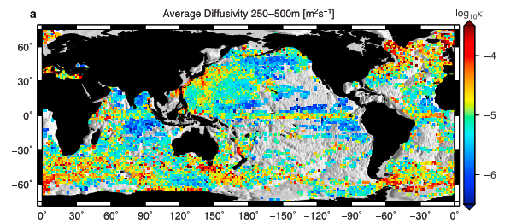
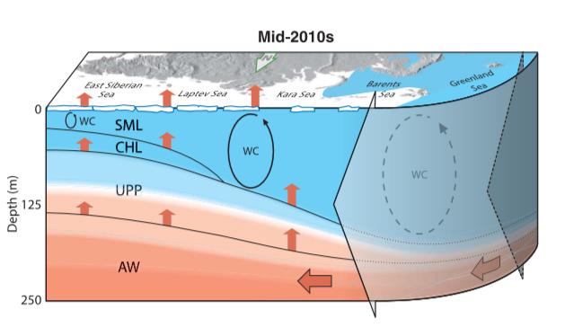
Introduction
An lacked area in the global pattern of ocean mixing in the Arctic Ocean.
A lot of heat reserved in the Atlantic water will release upward by ocean mixing.
Whalen et al., 2012, GRL, global mixing pattern
Polyakov et al., 2017, Changes of water layer in Eurasian Basin in Mid-2010s

Slide 3
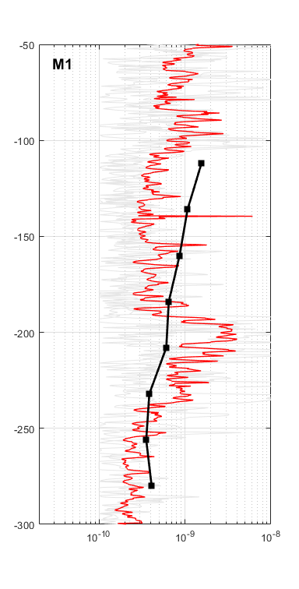
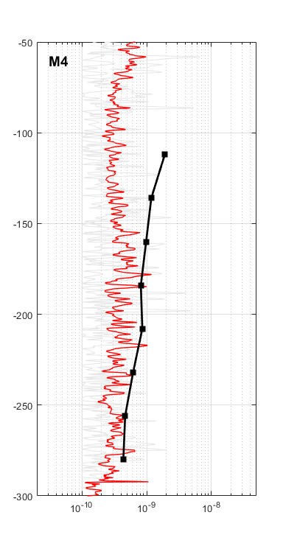
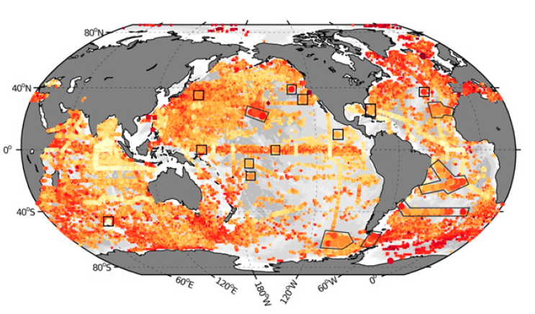
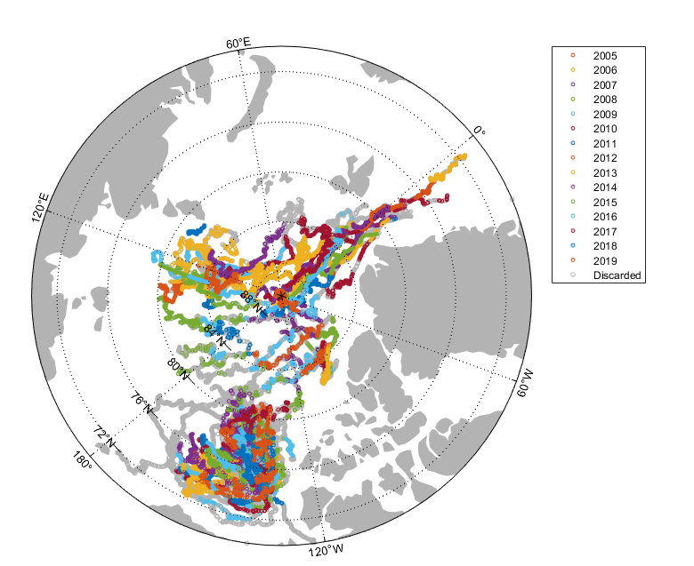
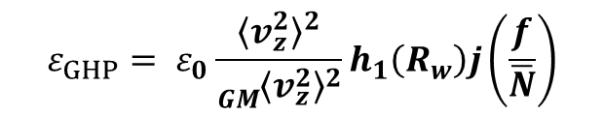
Method and Data
Fine scale parameterization method—GHP
This method first proposed by Gregg (1989) based on the GM spectrum.
ARGO dataset is scarce in the Arctic Ocean, and the global pattern is incomplete.
ITP (Ice-Tethered Profiler) have a good temporal and spatial coverage
$$ε_{GHP}= ε_{0}\frac{{〈v_{z}^{2}〉}^{2}}{{{}_{GM}^{1}{〈v_{z}^{2}〉}}^{2}}h_{1}\left(R_{w}\right)j\left(\frac{f}{\overline{N}}\right)$$
Comparison between fine-scale parameterziaton and direct observation
In this work, we firstly compared our result from this method and direct turbulence measurements, proved the reliability of this method in the Arctic Ocean.
Waterhouse et al., 2014, Global ocean mixing
You et al., 2021, locations of ITPs dataset

Slide 4
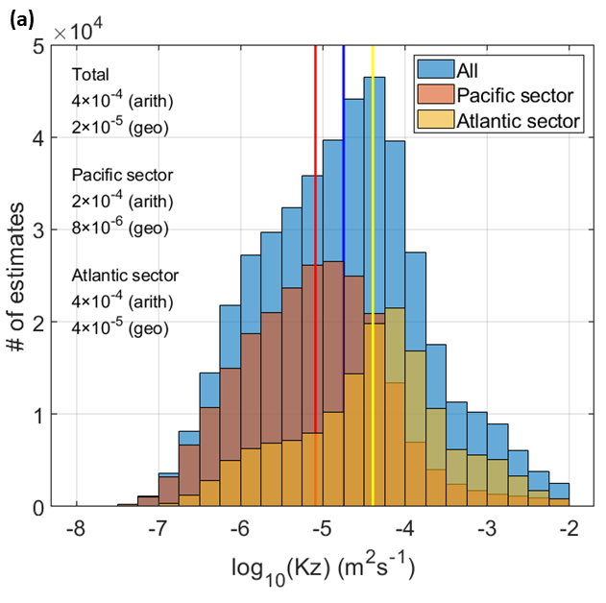
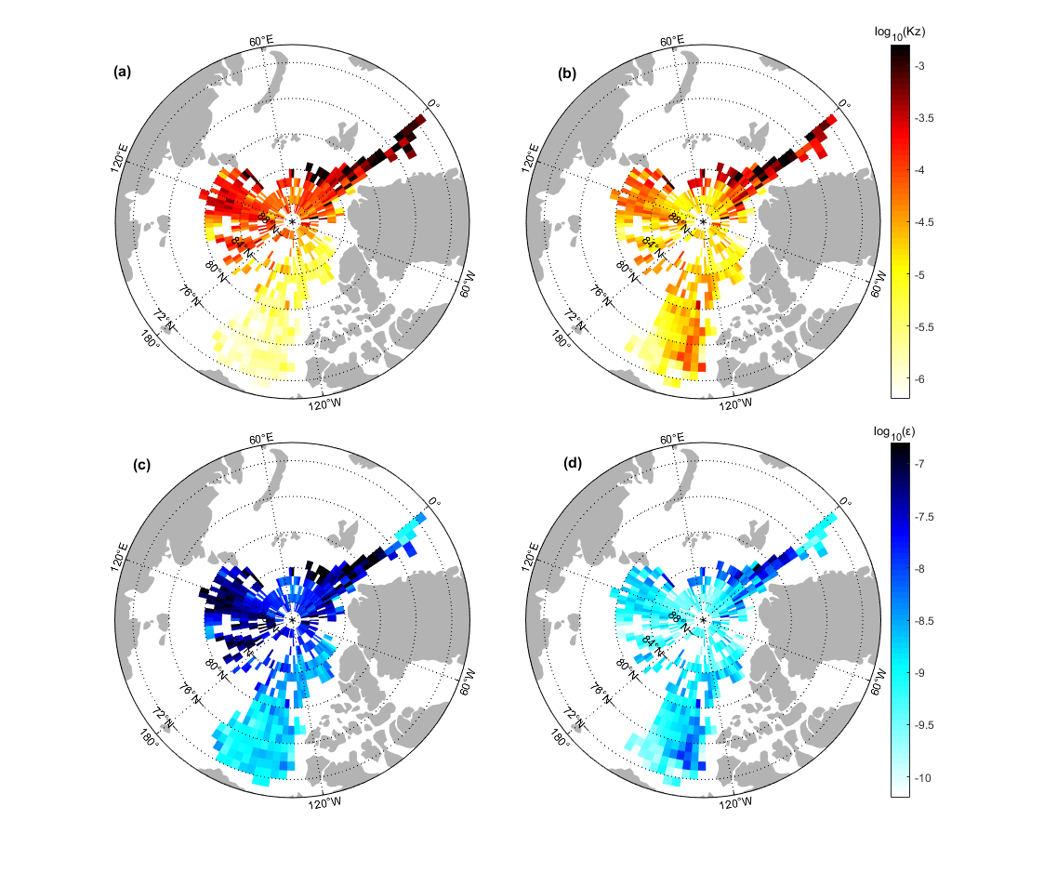
Spatial distribution of Arctic Ocean Mixing
Diapycnal diffusivity
Dissipation rate
Eurasian
Basin
Canada Basin
Mixing is strong in the Eurasian basin of the eastern Arctic, and weak in the Canada basin of the western Arctic.
On average, the diffusivity in Canada Basin is smaller a half order of magnitude than that in Eurasian Basin.

Slide 5
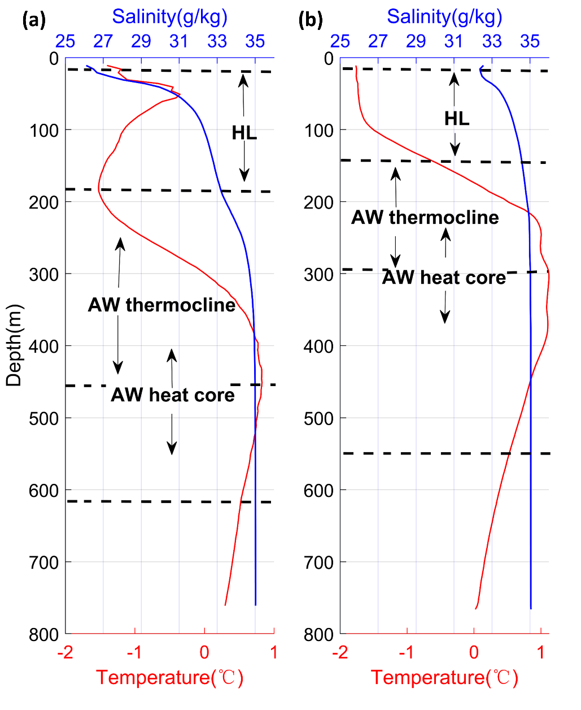
Difference between two side of Arctic
Vertical heat flux
Eurasian
Basin
Canada Basin
The heat flux is also strong in the Eurasian basin and weak in the Canada basin.
Eurasian basin: thinner Halocline and shallower Atlantic Water, indicating the heat from Atlantic Water will easier to transport upward in the Eurasian basin.
Canada Basin
Eurasian Basin

Slide 6
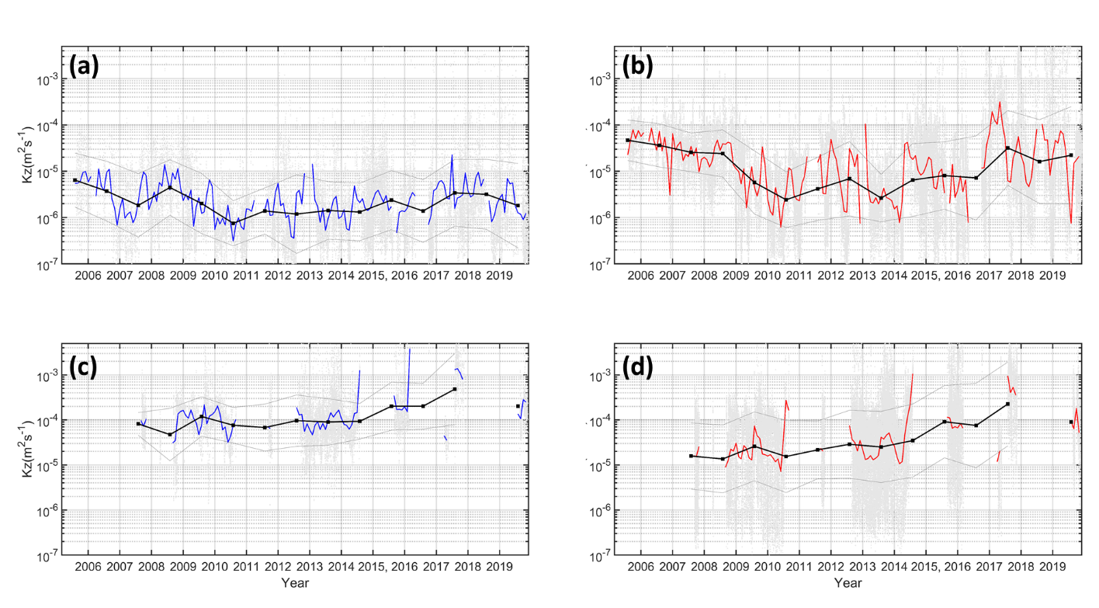
Temporal variability of Arctic Ocean Mixing
Halocline
Atlantic Water
Canada Basin
Canada Basin
Eurasian Basin
Eurasian Basin
In Canada basin, the mixing in the Atlantic Water Layer continue to weakened until 2011, then it was maintained at about 10^{-5.5}. After 2014, the mixing gradually enhanced.
In the Eurasian Basin, mixing is gradually increased, and enhanced by an order of magnitude during a decade.

Slide 7
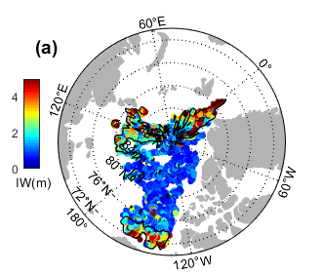
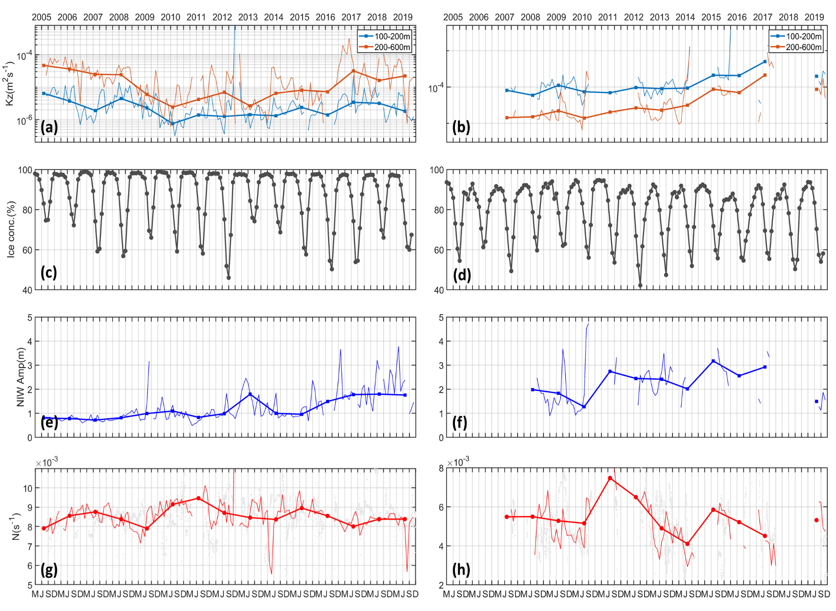
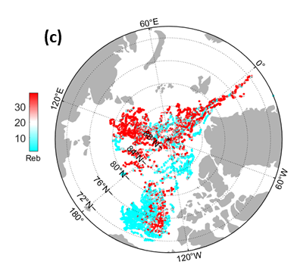
Internal wave enhance the ocean mixing
Canada Basin
Eurasian Basin
Diffusivity
Amplitude of NIW
Near-inertial Wave Amplitude
stratification
← Reynolds number < 20, turbulence is suppressed
Dimensionless Reynolds number

Slide 8
Summary
The averaged diffusivity in Canada Basin is smaller a half order of magnitude than that in Eurasian Basin.
In Eurasian Basin, the vertical heat flux is stronger and the heat is easier to transport upward to surface.
In the Eurasian Basin, the turbulent mixing was enhanced by the increased internal waves, but in the Canada Basin the mixing is always suppressed by strong stratification.

