Slide 1

Implementation of soil moisture data into landslide rainfall thresholds: two case studies in Italy and Norway
Distefano P.^{1*}, Piciullo L.², Peres D.J.¹, Scandura P.¹, Cancelliere A¹.
¹University of Catania
²Norwegian Geotechnical Institute, NGI
* pierpaolo.distefano@phd.unict.it

Slide 2
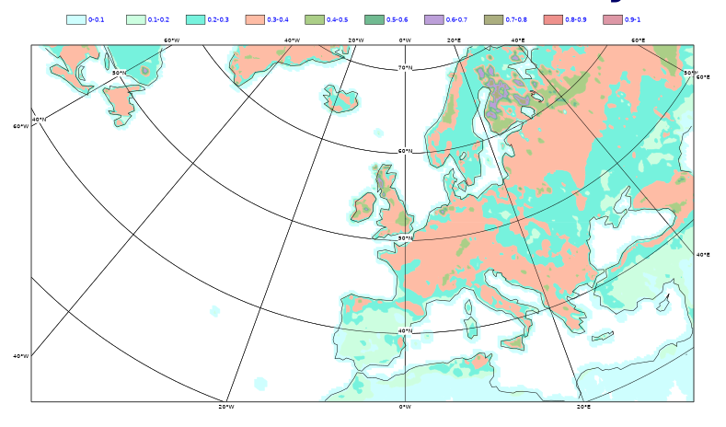
Aim of the study
Implement soil moisture data for landslide forecasting, moving from a purely empirical to a semi-physically-based model.
Consider the possibility of using soil moisture data from the ERA5-land database, for different study areas.
Evaluate the performance of the determined thresholds.
Volumetric soil water
layer 1 (ERA5-land)

Slide 3
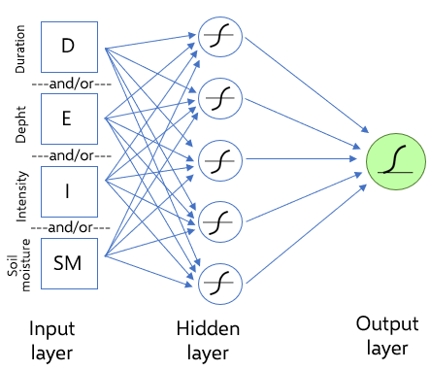
Methodology of the study
Reconstruction of triggering and non-triggering precipitations using the algorithm proposed by Melillo et al. (2018), and thresholds determination (Peres & Cancelliere, 2021)
Comparison between soil moisture data recorded in situ and those provided by the ERA5-Land database, through graphical and statistical comparisons
Precipitation and soil moisture data were used as input data of a neural network, specially trained for pattern recognition through which thresholds performance was evaluated (Distefano et al., 2022)

Slide 4
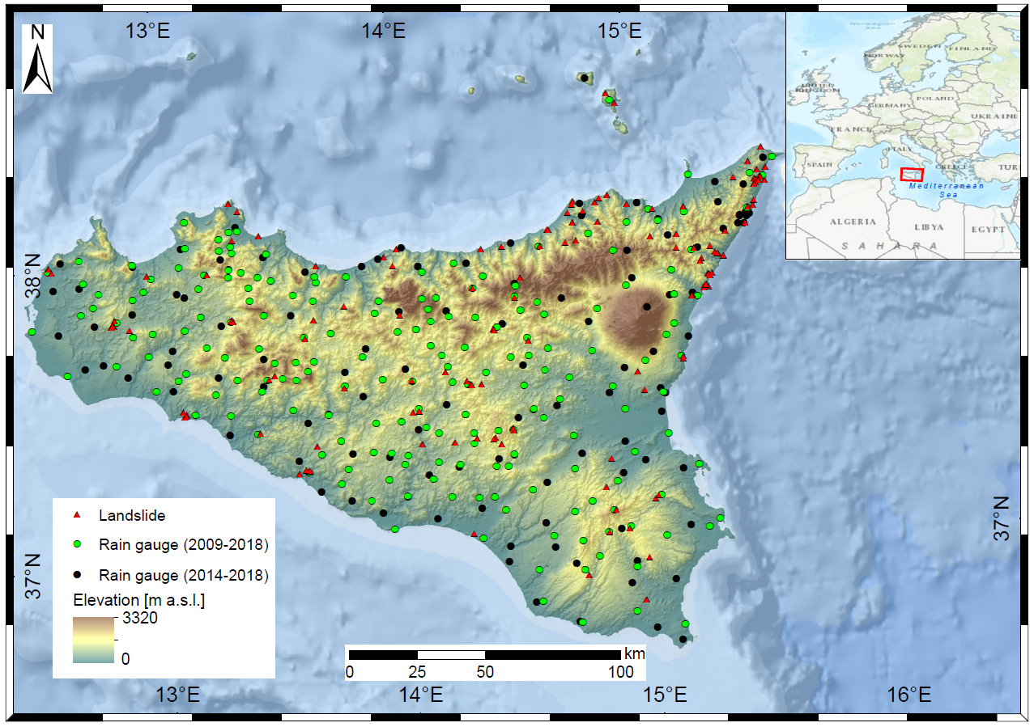
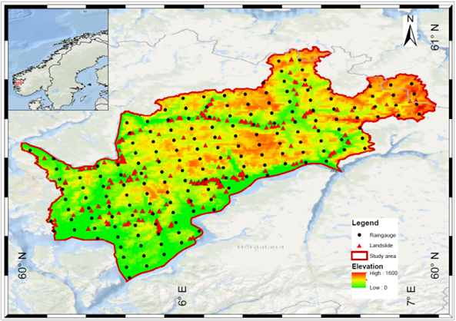
Rainfall – Landslide Data
Study area: Sicily (southern Italy);
Rainfall data: 306 rain-gauges were used for processing in 2009÷2018 time frame, hourly scale provided by OdA, SIAS, DRPC;
Landslides data: “FraneItalia” database (Calvello & Pecoraro, 2018).
Study area: 5 basins east of Bergen.
Rainfall data: 175 raingauges time frame 2000÷2021 time daily scale from a raster database provided by seNorge.
Landslides data: NVE database.

Slide 5
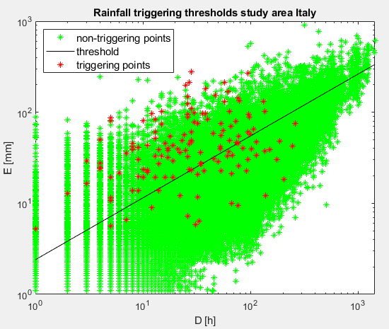
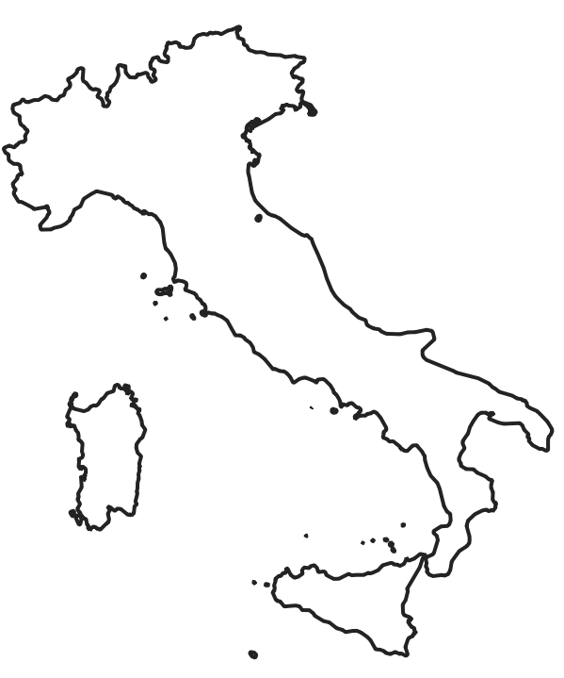
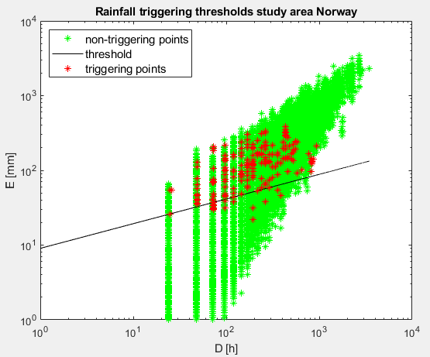
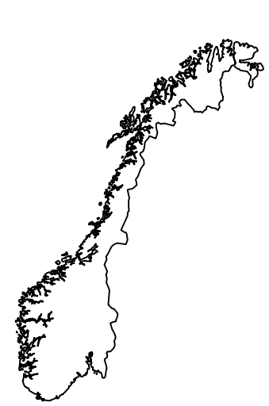

Rainfall triggering thresholds
The thresholds presented take into account both triggering and non-triggering events using a procedure that maximizes the True Skill Statistic (Peres & Cancelliere, 2021).
$$TSS=\frac{True positive}{True positive −False negative}−\frac{False Positive}{True Negative −False Positive}=0.5$$
E = 2,4*D^{0,68}
E = 9,05*D^{0,33}

Slide 6

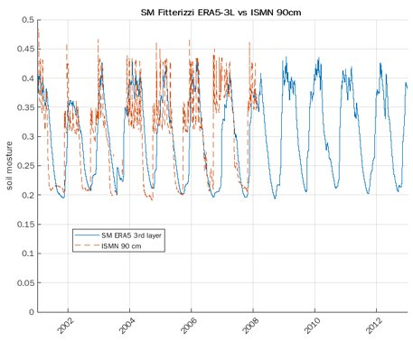
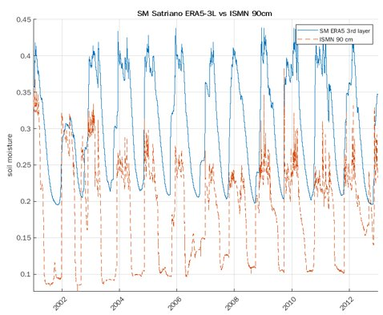
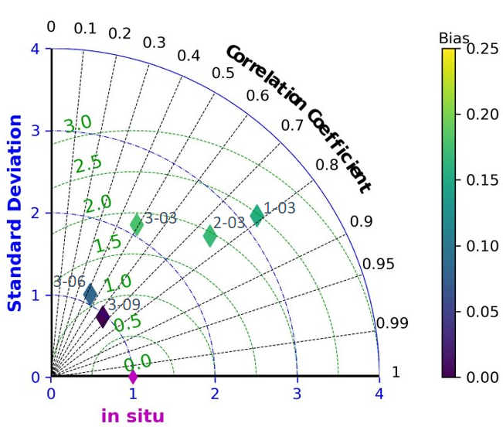
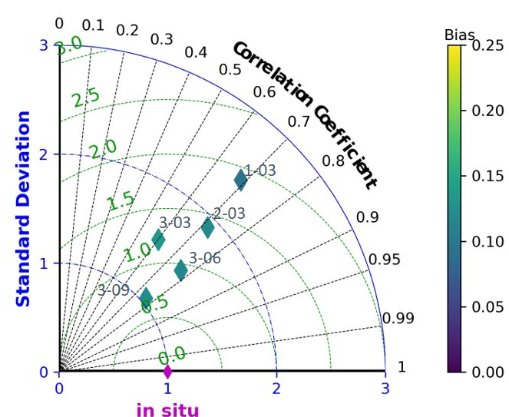
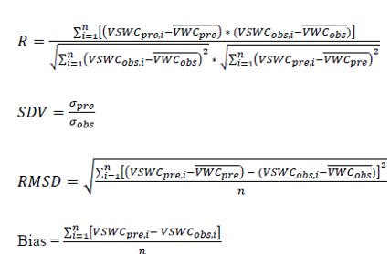
Soil moisture data comparison
Soil moisture data, for comparisons, comes from five different stations in Calabria region, the nearest for position and climate because no monitoring station are available for Sicily.
Fitterizzi
station
Satriano
station

Slide 7
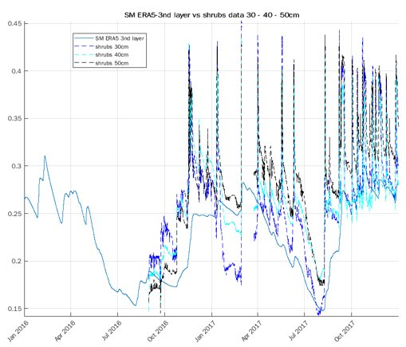
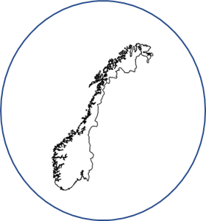
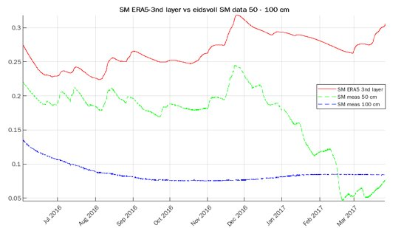
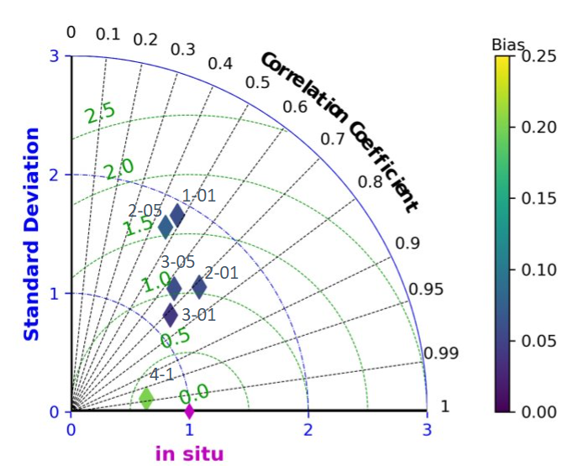
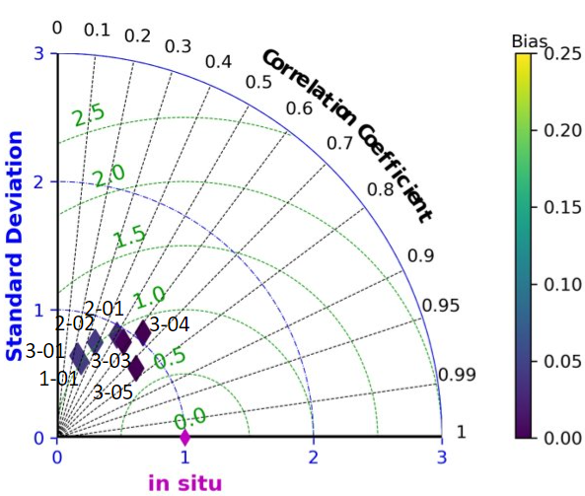
Soil moisture data comparison
Soil moisture data comes from two different stations in Eidsvoll, managed from NGI, and along Hobøl river (Krzeminska, D., Catena 2019).
Eidsvoll
station
Hobøl
station

Slide 8
Results
Input data:
Rainfall characteristics of triggering and non-triggering event (duration D, cumulated rainfall E, intensity I);
Soil moisture data from 3rd layer (Sm3L) of ERA5 at the start (in) and at the end (fin) of triggering and non triggering event.
TSS = 0.5, performance of power law threshold

Slide 9
Conclusions
Aim of the presented study is to seek a correlation between precipitation characteristics, soil moisture and landslide triggering.
Based on preliminary results, the comparisons between the measured values ​​and the ERA5 values, it is noted that the trend is similar but there are differences in the measured values (bias ~0.10 in best case).
As shown, the implementation of soil moisture data, in both case studies can improve the performance of rainfall triggering thresholds. Better results are obtained for the Sicily region where TSS values ​​are greater than 0.7

