Slide 1


Characterization of a fractured rock mass using Geological Strength Index (GSI): A Discrete Fracture Network (DFN) and Machine learning (ML) approach
EGU22-3456
Presented by
Jaspreet Singh
Ph.D. Scholar
Department of Earth Sciences
Indian Institute of Technology Roorkee, India

Slide 2

Contents
EGU22-3456
Introduction
Preliminary data analysis using photogrammetry
Discrete fracture network development
Estimation of Geological strength Index
Conclusions
References

Slide 3
Introduction
EGU22-3456
Rock mass pose wide heterogeneity due to presence of structural discontinuities in it.
Geological Strength Index (GSI) is simple and commonly adopted method having broad applicability in rock engineering (Hoek and Brown, 2019).
The traditional approaches are limited to 2D exposers for mapping purposes, but block formation or joint intersection is a 3D parameter (Miyoshi et al., 2018).
The remote sensing techniques render the data with high precession potential not accessible with conventional methods.
The stochastic DFNs generated based upon the statistical distribution of the input parameters can represent the natural fracture system in 3D (Elmo, 2010).
A machine learning based python GUI tool was developed to find GSI from block volume and joint condition parameter and to systematically digitizing the standard GSI chart.

Slide 4
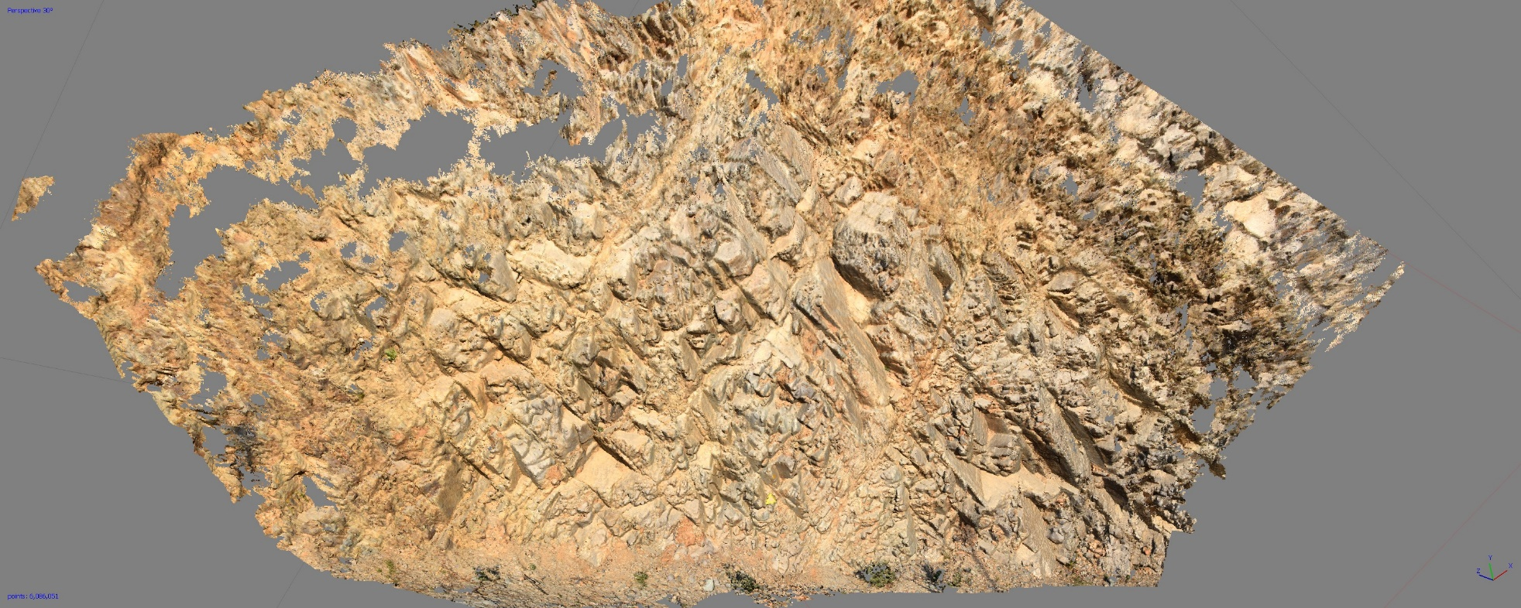
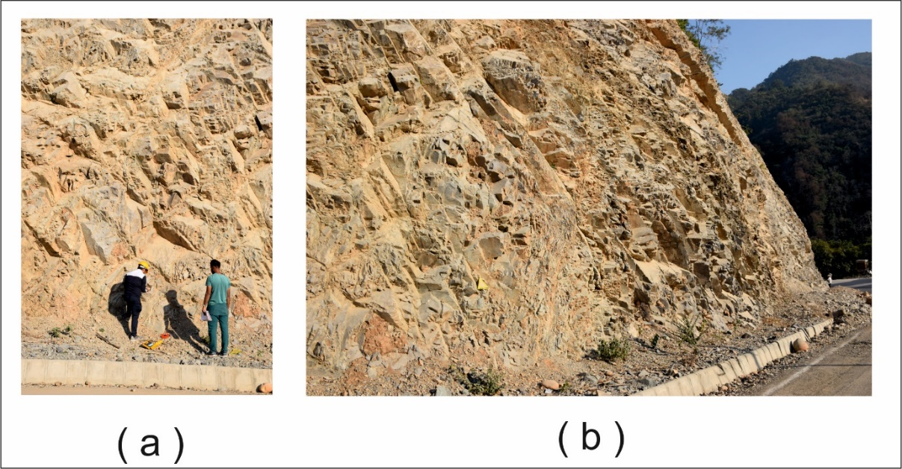
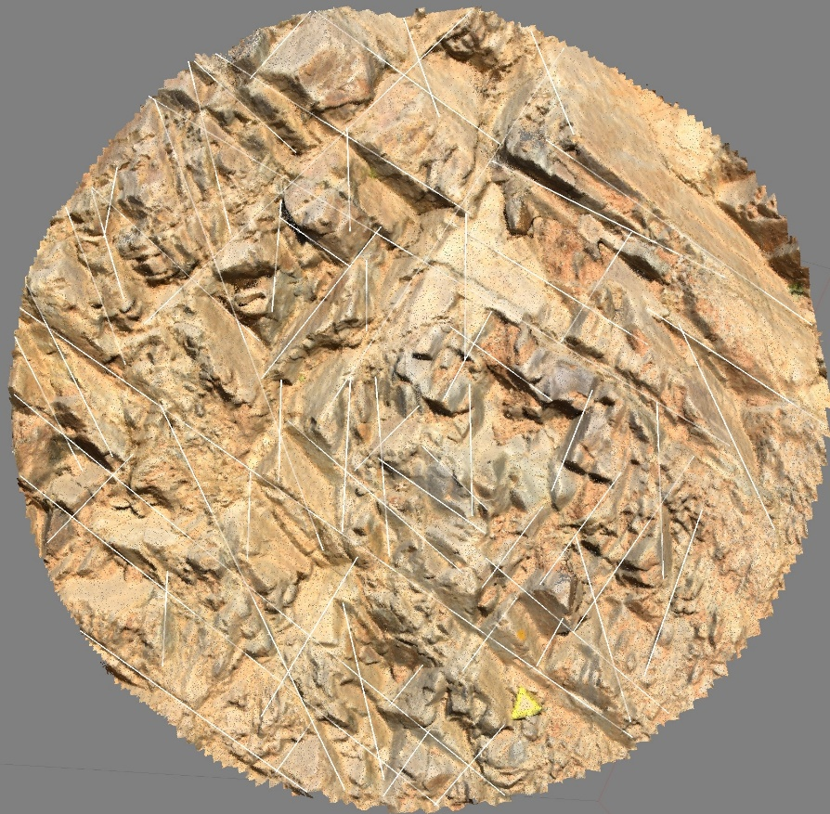
Preliminary data analysis using photogrammetry
EGU22-3456
Photogrammetry is a way of obtaining reliable information about physical objects by acquiring multiple overlapping photographs.
Fig. 1 Two field photographs of the outcrop along NH-07 Uttarakhand, India
Fig. 1 Point cloud developed using photogrammetry of a slope

Slide 5
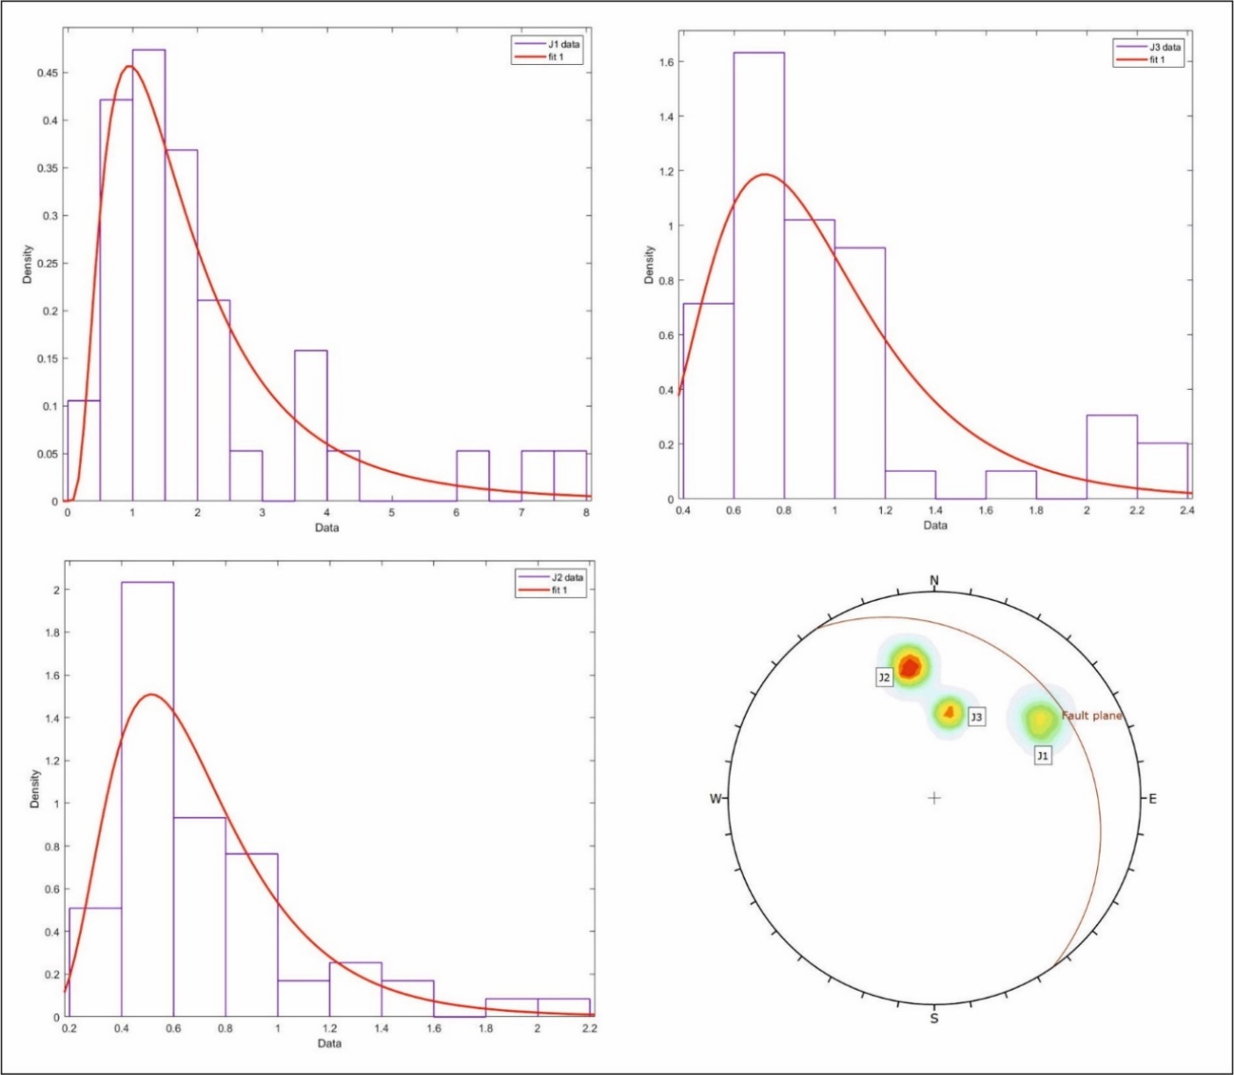
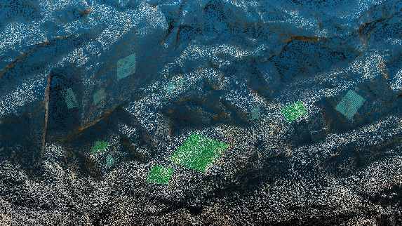
Extraction of joint data
EGU22-3456
Fig. 3 Zoomed image depicting planes fitted in different joint sets to find the orientation;
Fig. 2 Joint traces of all the three joint sets following log-normal distribution

Slide 6
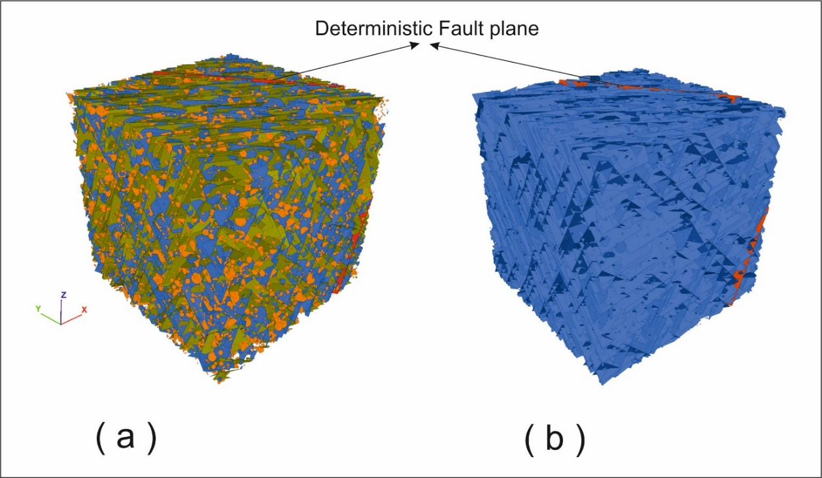
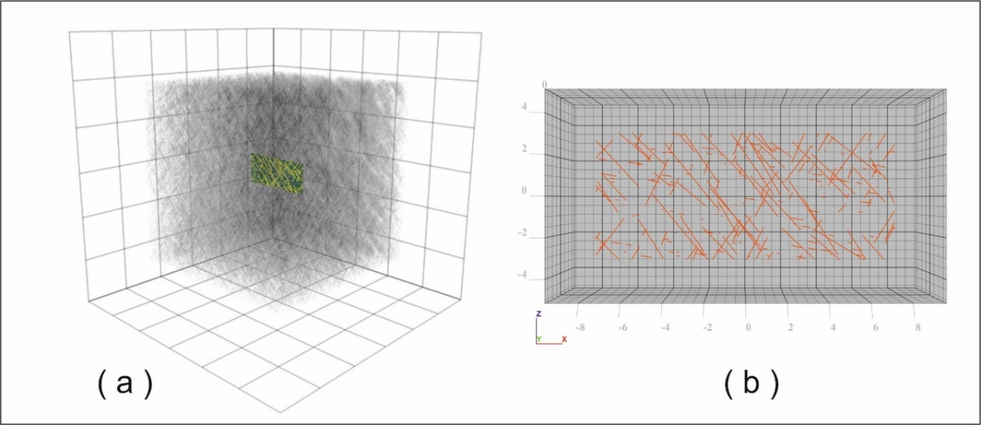
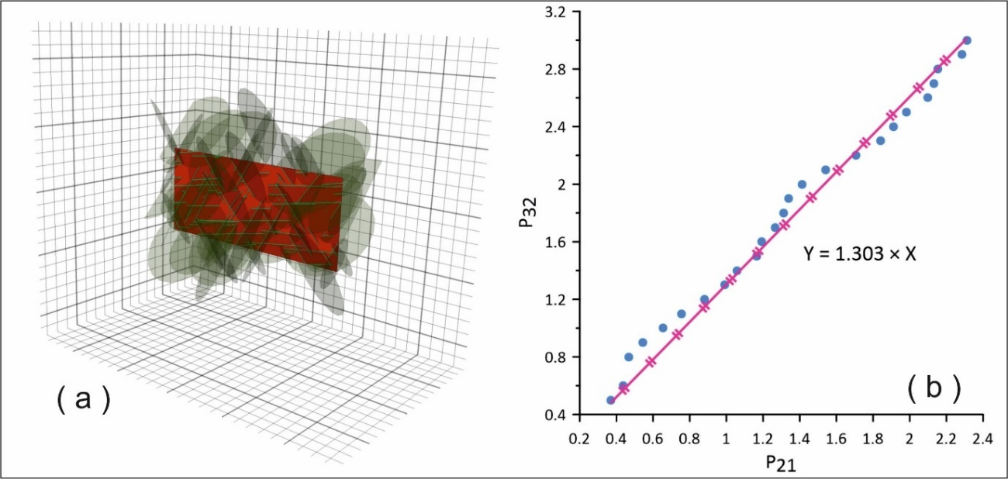
DFN generation
EGU22-3456
The DFN approach is a modeling methodology that uses statistical methods by creating a series of fractures that describe the rock mass fracture system
Fig. 4 A generated DFN and its intersection with the slope face (disaggregate approach); b Fracture traces of all the three joint sets generated using DFN
Fig. 5 Fracture trace length along with fractures intersecting the slope face (aggregate approach); b Straight line relation between P₃₂ and P₂₁
Disaggregate approach showing three different fractures coloured in blue, green, and orange
Aggregate approach, considers all sets as a one.

Slide 7
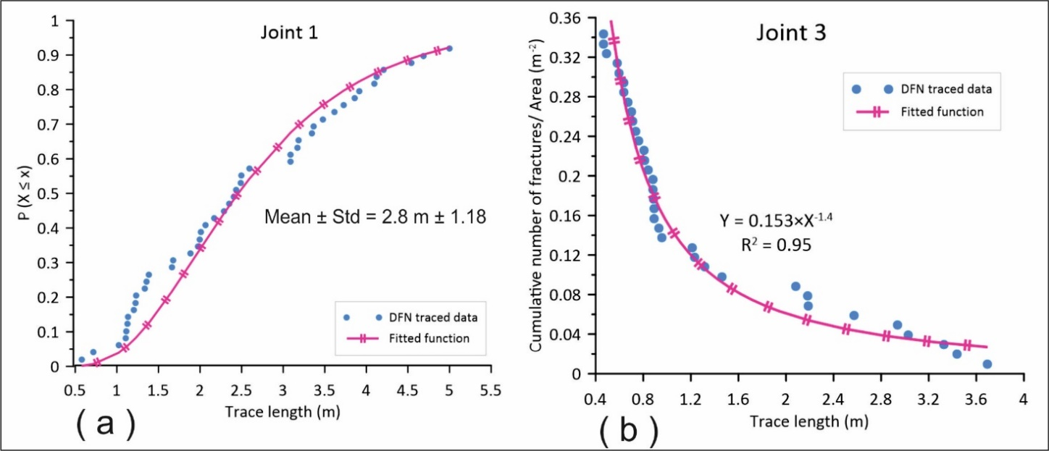
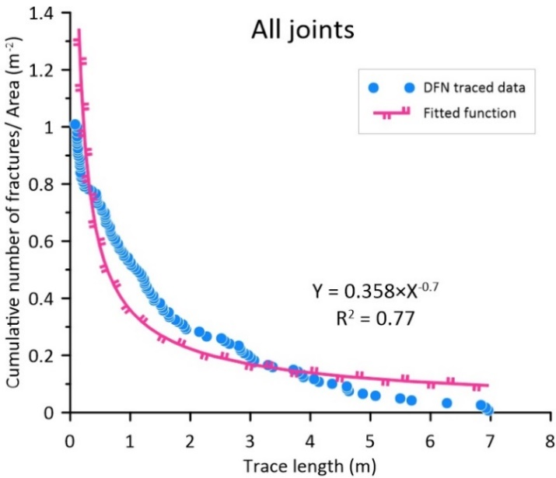
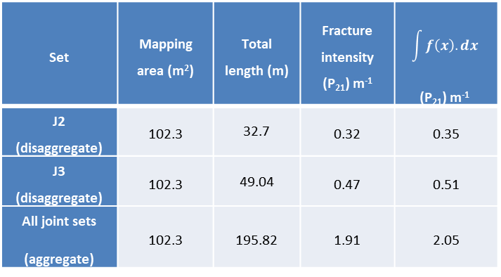
EGU22-3456
( c )
Fig. 6 Cumulative trace length distribution curves for the fracture traces mapped using generated DFN. a Joint 1; b Joint 3 ; c All joints
Set | Mapping area (m²) | Total length (m) | Fracture intensity (P₂₁) m⁻¹ | $$\int{f\left(x\right).dx}$$ (P₂₁) m⁻¹
J2 (disaggregate) | 102.3 | 32.7 | 0.32 | 0.35
J3 (disaggregate) | 102.3 | 49.04 | 0.47 | 0.51
All joint sets (aggregate) | 102.3 | 195.82 | 1.91 | 2.05
Table 1 Field (point cloud) mapped fracture intensity data and P₂₁ estimated from best fit function assigned to DFN generated trace lengths

Slide 8
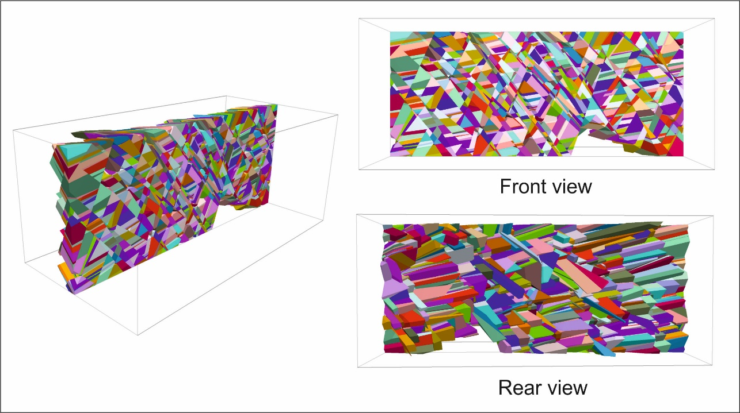
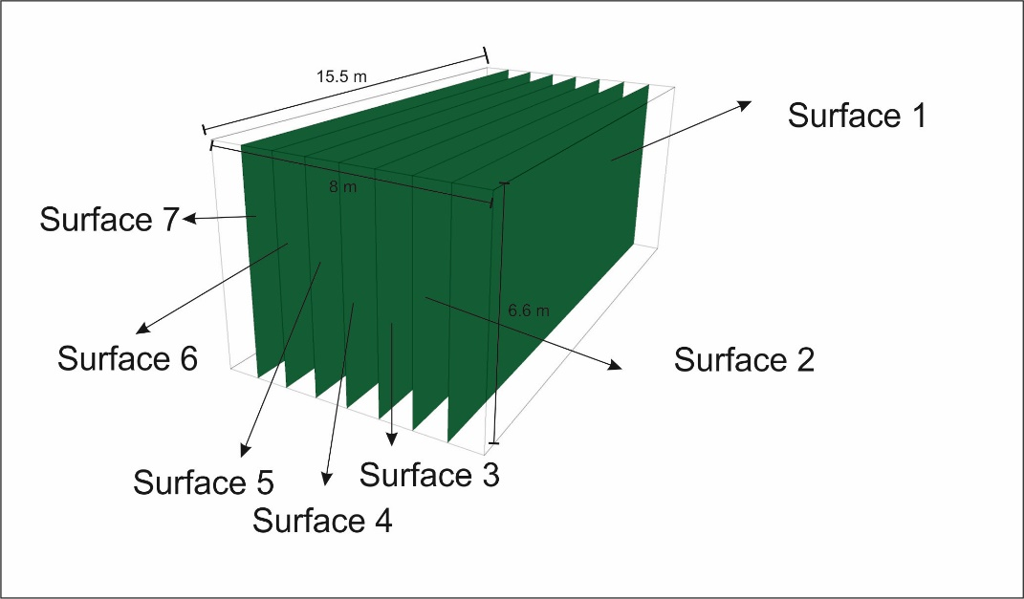
Estimation of GSI
EGU22-3456
The generated DFNs for the rock mass using both aggregate and disaggregate approaches were used to find the parameters (i.e., block volume) to estimate the GSI using method proposed by Cai et al. (2004).
Multiple vertical sampling surfaces for block analysis
Fig. 7 Blocks formed by the intersection of slope face and fractures imported from DFN (disaggregate approach)

Slide 9
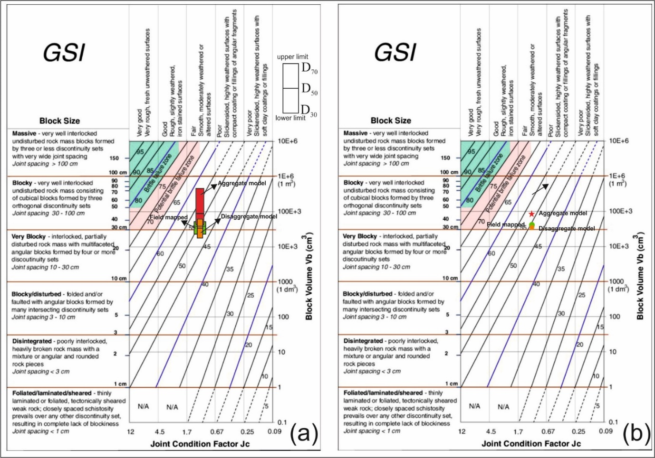
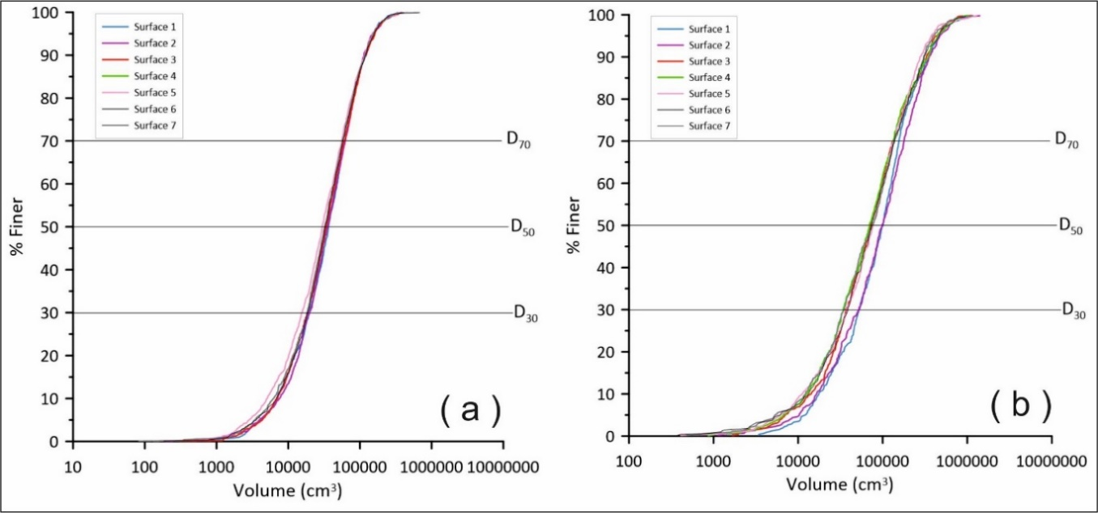
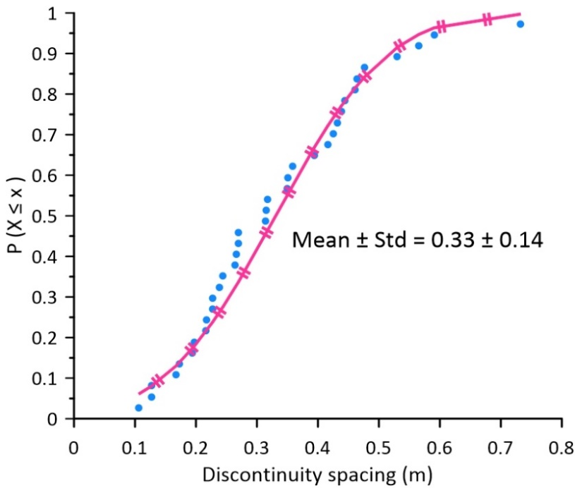
EGU22-3456
$JC=\frac{J_{w}∗J_{s}}{J_{a}}=1.125$
Fig. 8 Particle size distribution (PSD) of block volume for the blocks formed by intersecting each sampling plane. a Disaggregate DFN; b Aggregate DFN
Fig. 9 CDF of discontinuity spacing found using scanline survey following the normal distribution

Slide 10
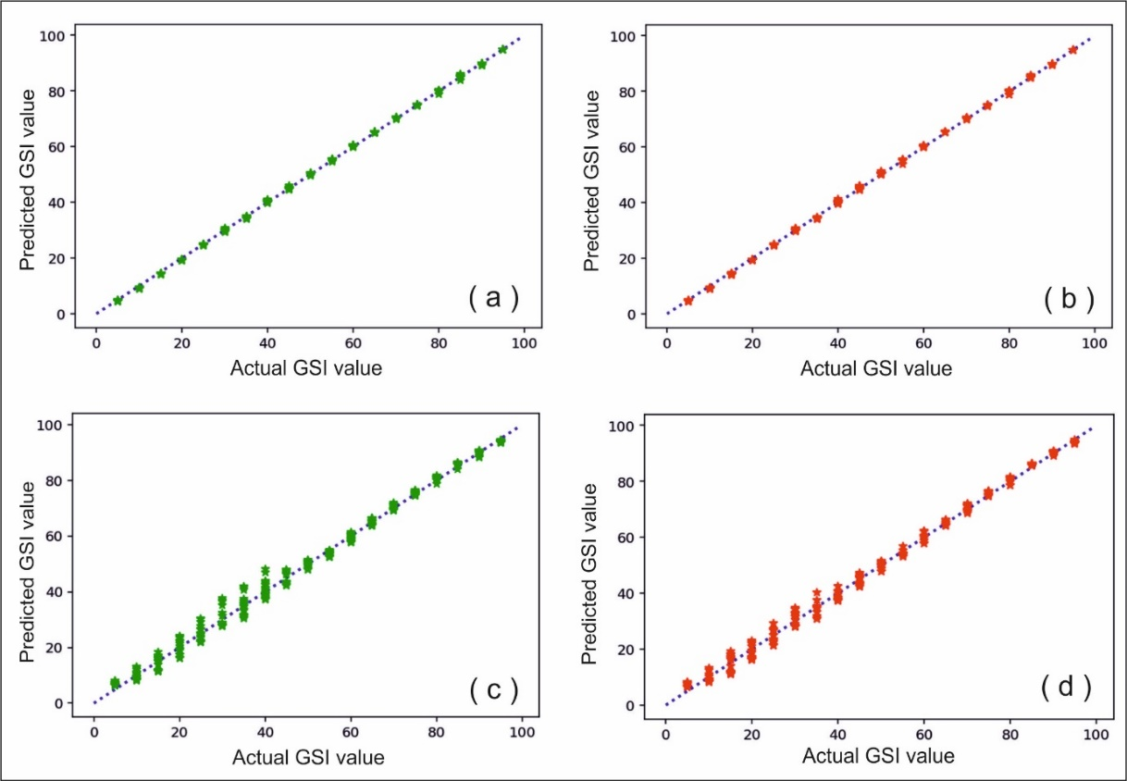
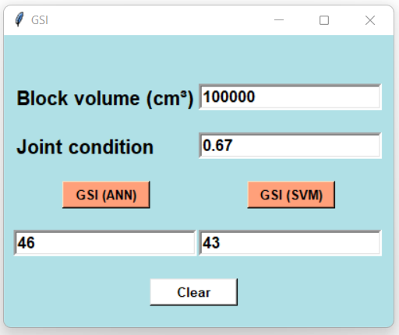
Prediction of GSI using Machine learning
EGU22-3456
Fig. 11 Screenshot of python-based GUI tool with estimated GSI value from the given parameters
Fig. 10 Actual GSI vs. ML predicted GSI plots. a ANN training data set; b ANN testing data set; c SVM training data set; d SVM testing data set
 | Chart (approx.) | ANN | SVM
Disaggregate | 49 | 48.74 | 48.54
Aggregate | 52 | 50.85 | 50.43
2. Field mapped | 49 | N/A | N/A
Table 2 GSI estimated with different technique. Note: Case 1: V_{b} is estimated from D₅₀ volume, Case 2: Field-based technique

Slide 11
Conclusion
EGU22-3456
Traditional methods are based upon field estimation and empirical equations.
The formation of blocks is genuinely a 3d parameters.
Development of stochastic DFN can help to cope with the uncertainty of the rock mass.
The developed numerical modeling techniques can be implemented for assessment of the rock mass in support of traditional methods.

Slide 12
References
EGU22-3456
Cai. M., Kaiser, P.K., Uno, H., Tasaka, Y., Minami, M., 2004. Estimation of rock mass deformation modulus and strength of jointed hard rock masses using the GSI system. Int. J. Rock. Mech. Min. Sci. 41(1),3-19.
Elmo, D., Stead, D., 2010. An Integrated Numerical Modelling–Discrete Fracture Network Approach Applied to the Characterisation of Rock Mass Strength of Naturally Fractured Pillars. Rock. Mech. Rock. Eng. 43,3–19
Hoek, E., Brown, E.T., 2019. The Hoek-Brown Failure criterion and GSI. J. Rock. Mech. Geotechnol. Eng. 11, 445–463.
Miyoshi, T., Elmo, D., Rogers, S., 2018. Influence of data analysis when exploiting DFN model representation in the application of rock mass classification systems. J Rock Mech Geotech Eng 10(6): 1046-1062.

Slide 13


