Slide 1

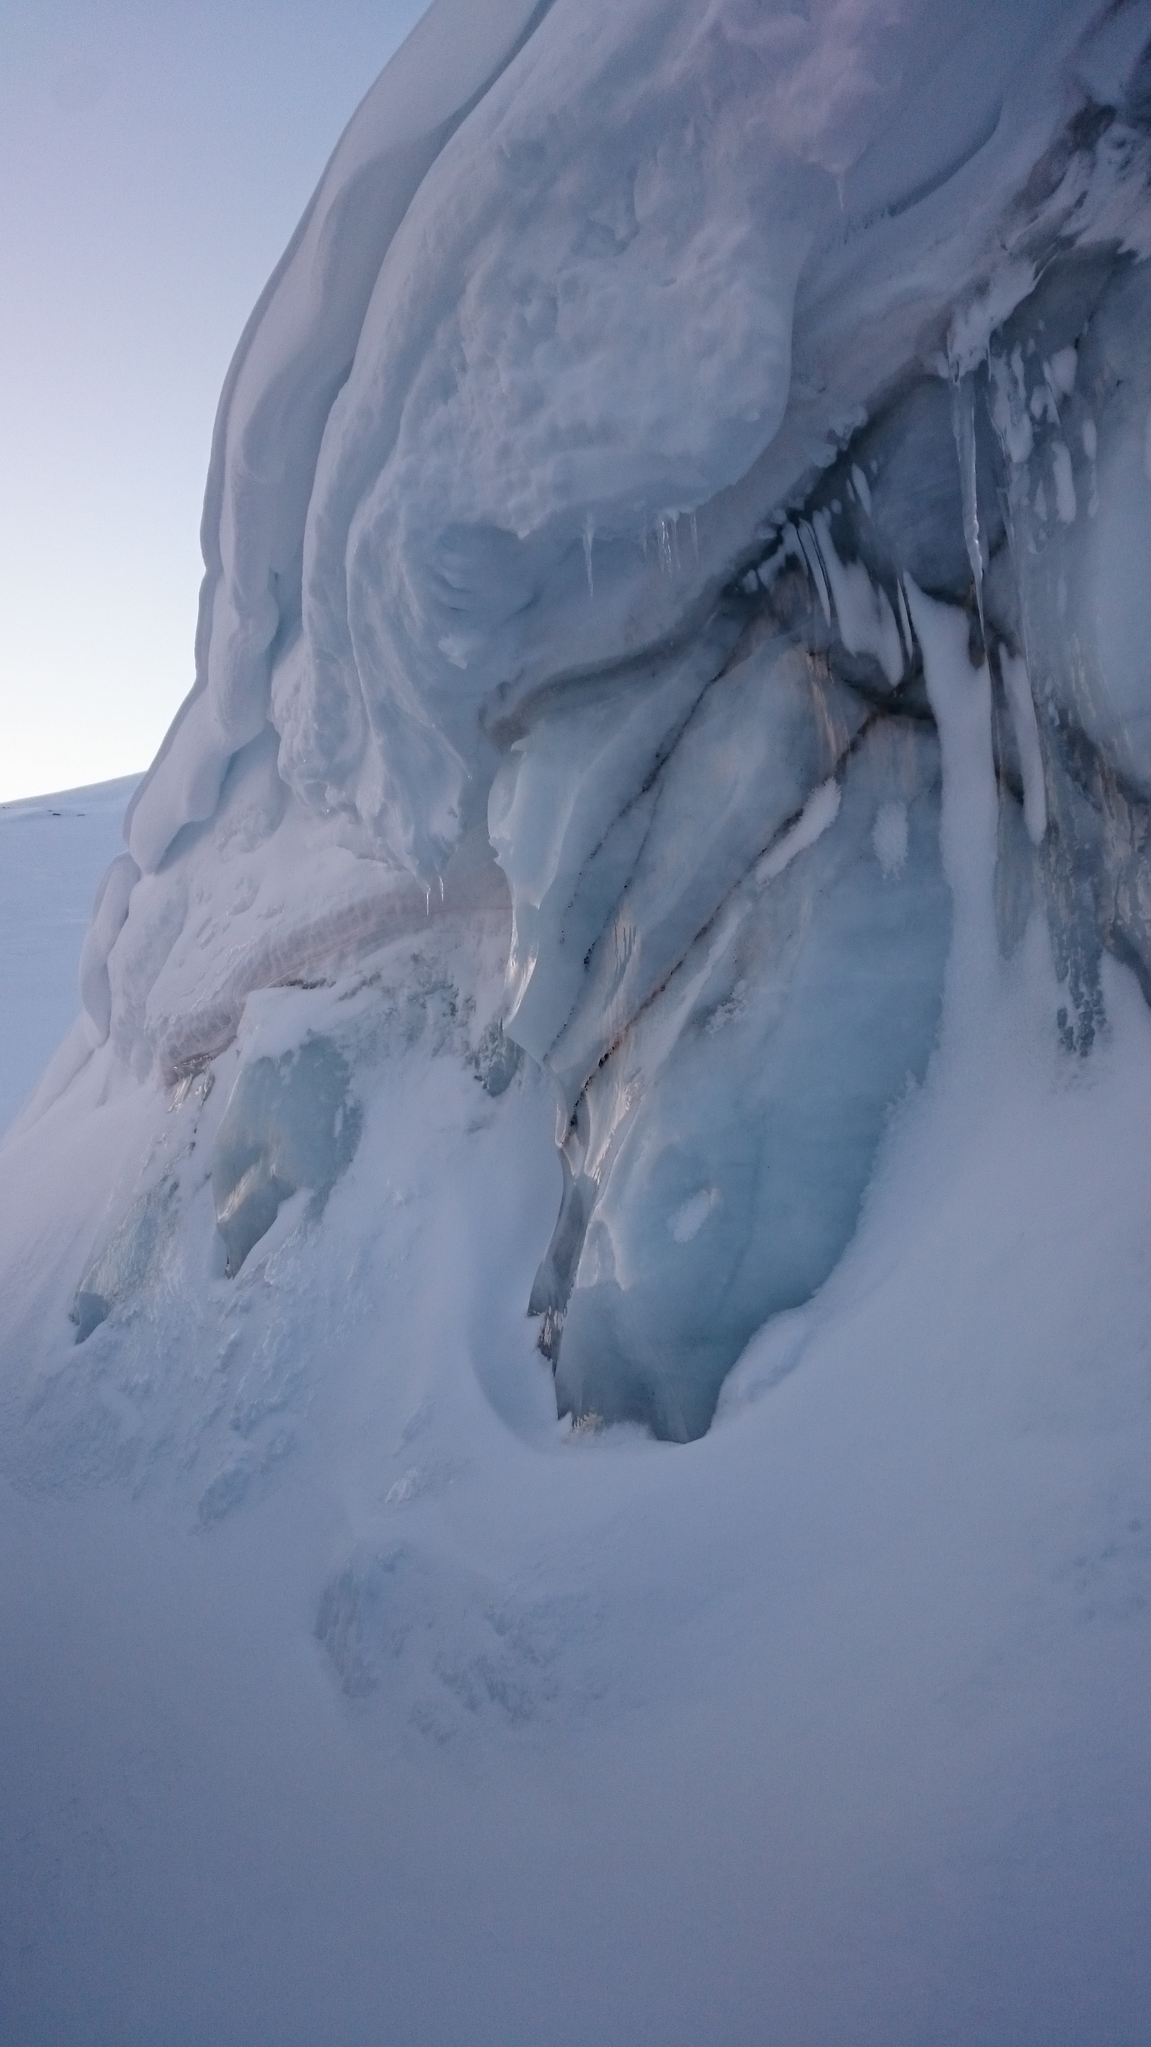


Insights from 3D Firn Microstructure into Near-Surface Snow Melt Conditions
Dorothea Elisabeth Moser
with Johannes Freitag & Elizabeth R. Thomas
Notes:
Le’s start with a question: Who of you has seen melt-affected ice core chemistry and didn’t publish on that record because Who of you drilled and ice core which turned out to be melt affected? (think of alpine community too).

Slide 2
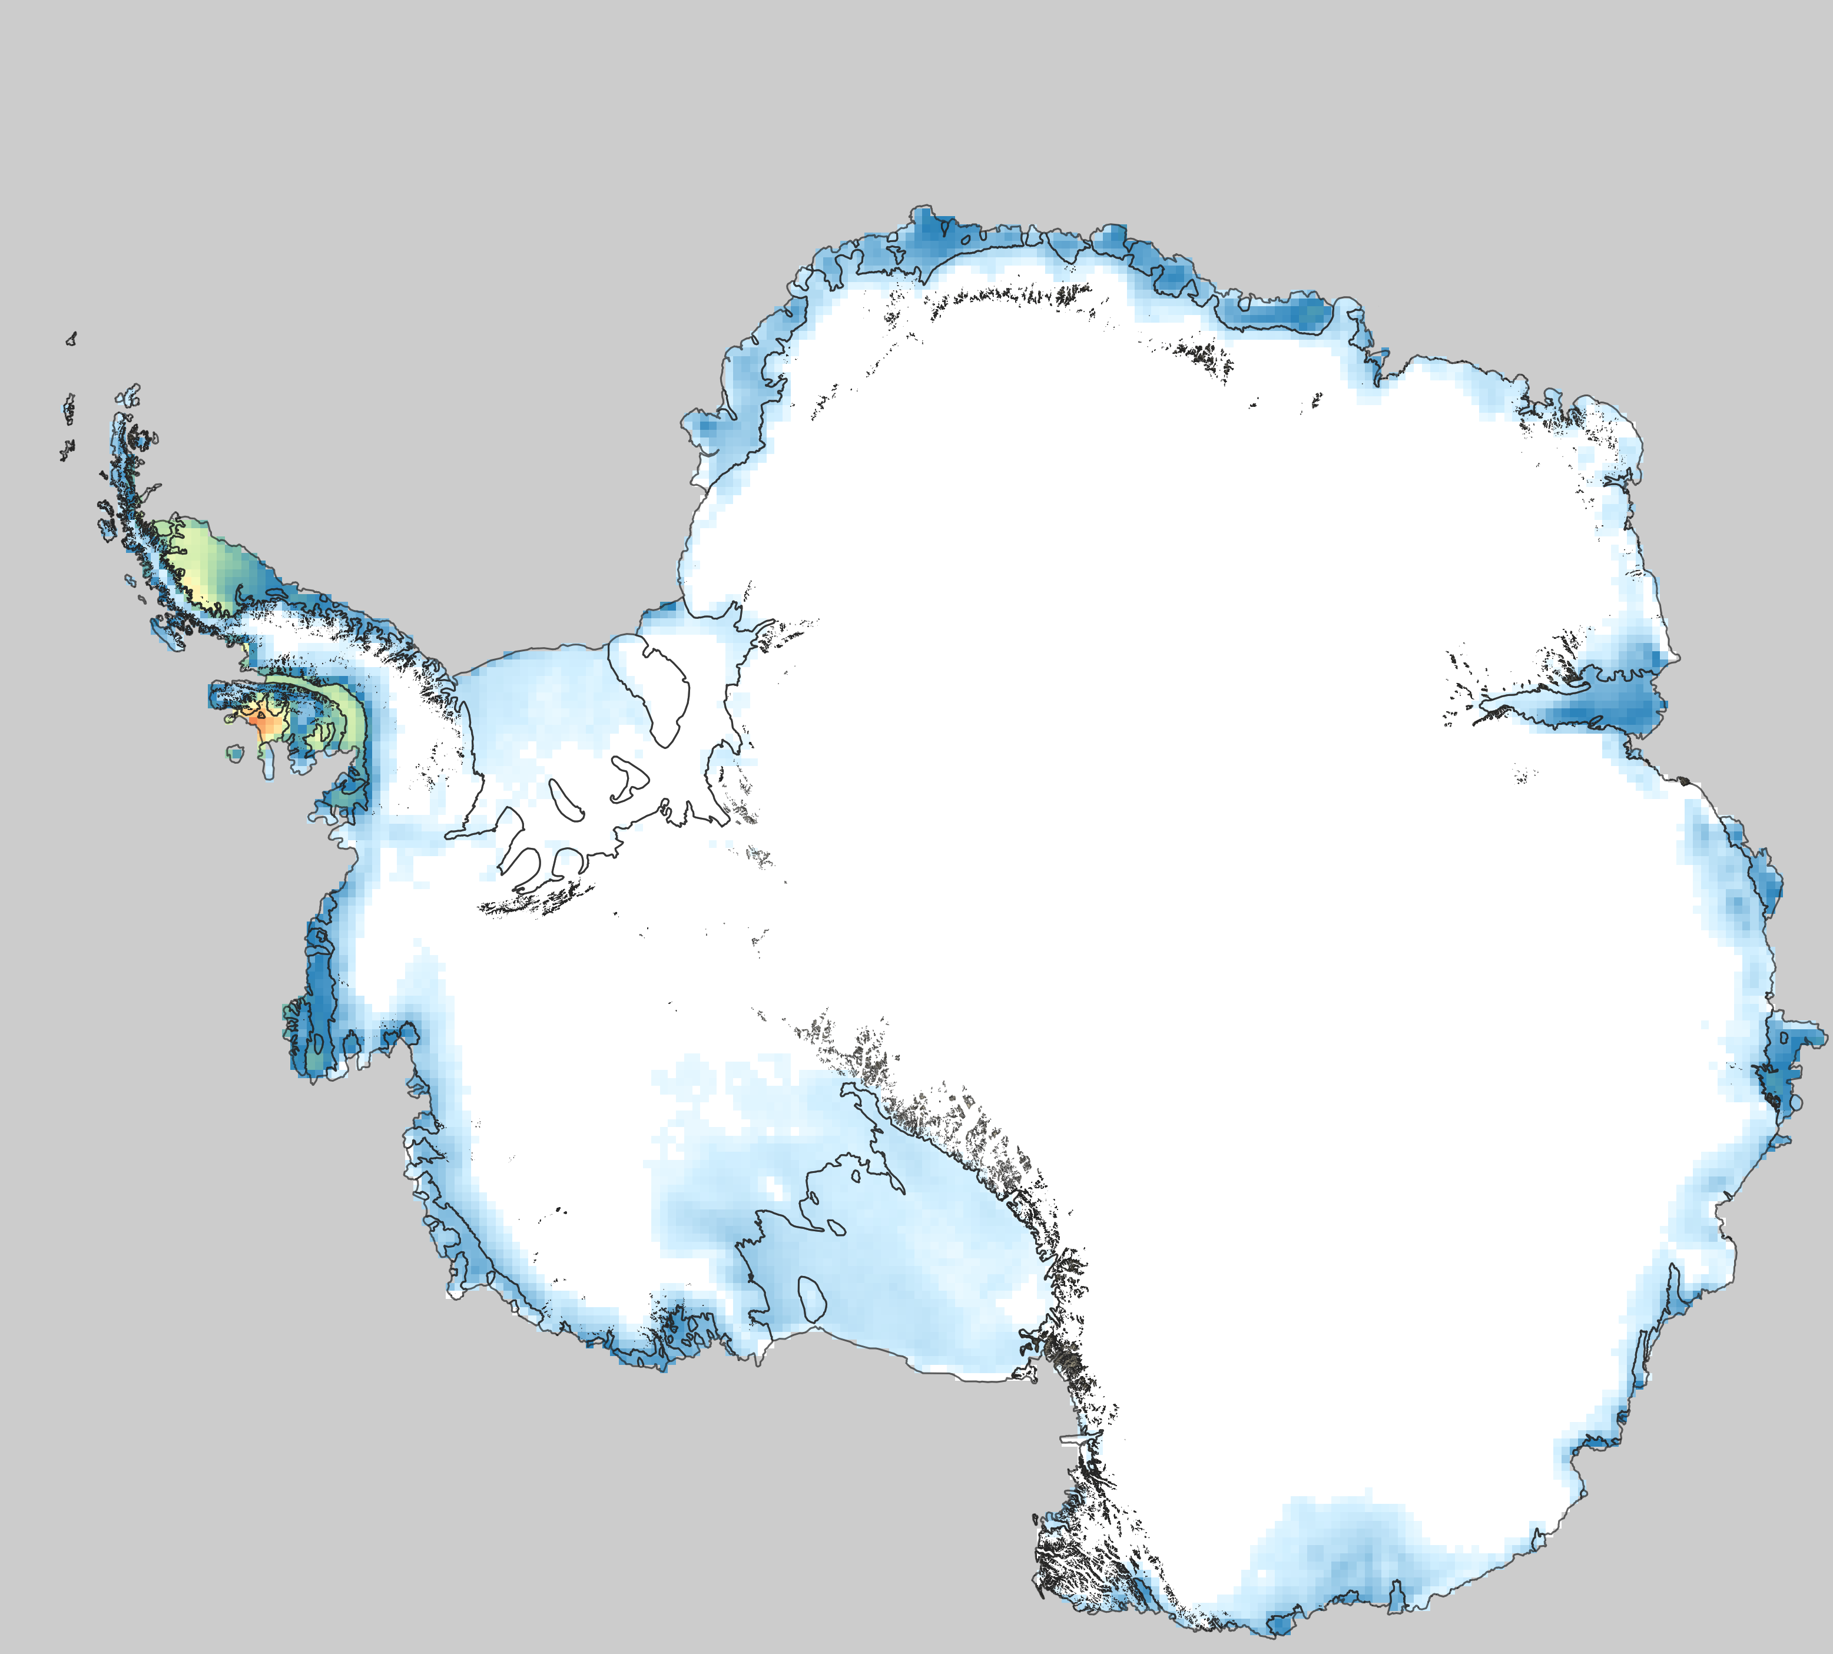
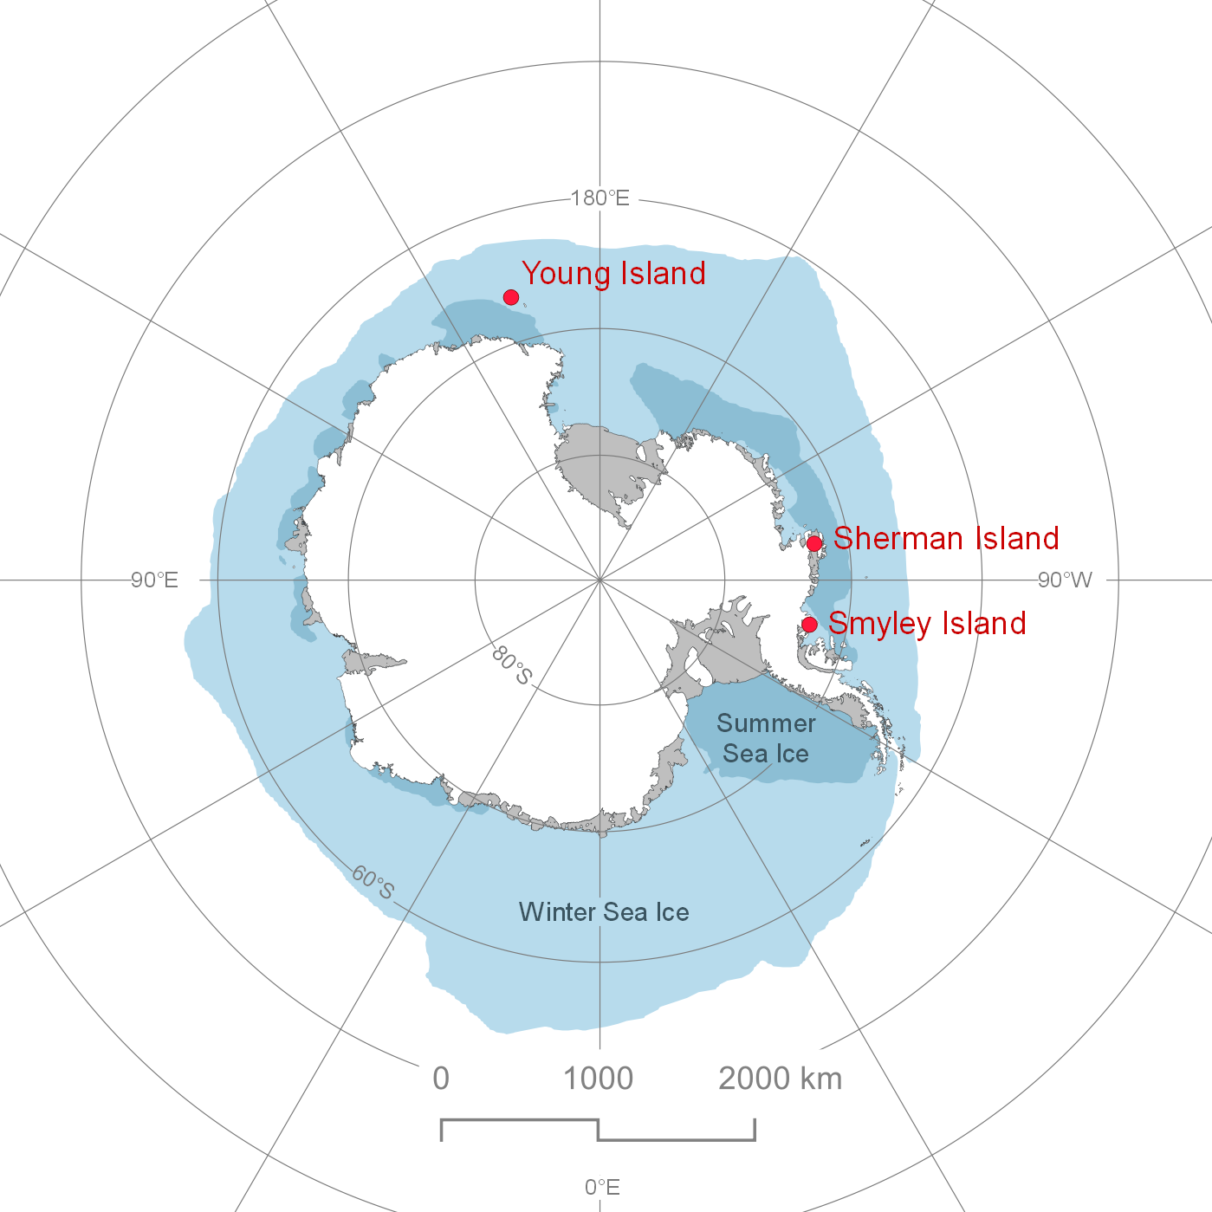
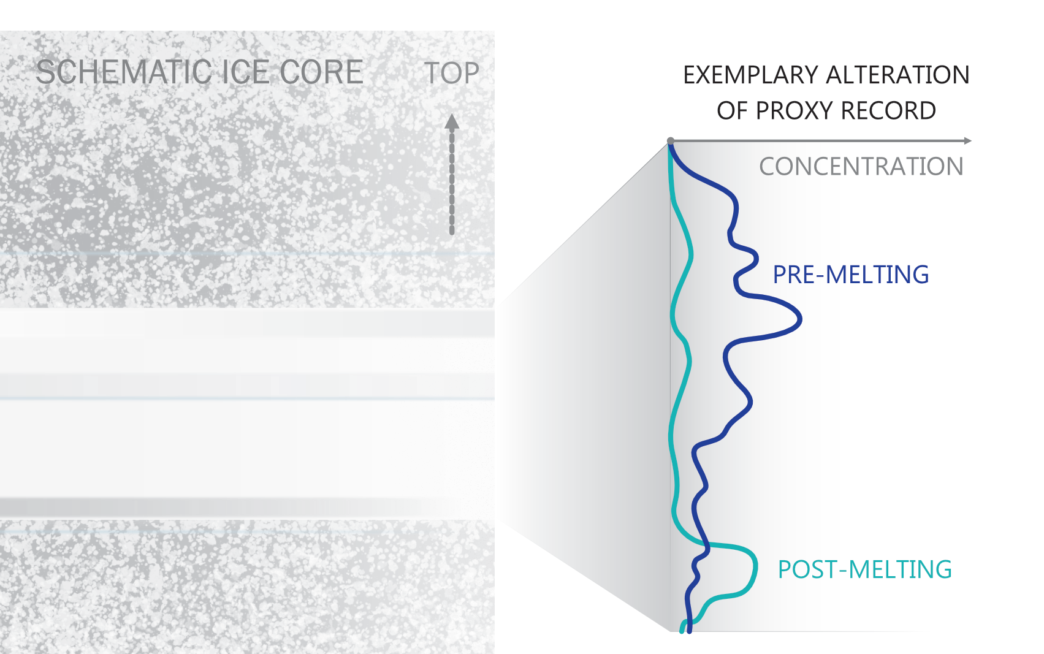
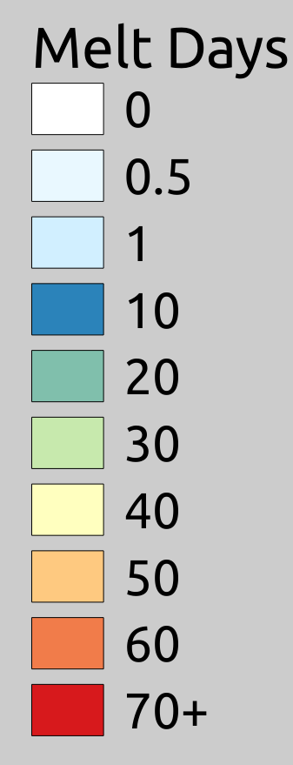
Melting & refreezing increasingly affects coastal ice core sites, and it alters the preservation of chemical proxy records.
Average Annual Melt Days
1989–2019
NSIDC (2021)
Notes:
Sites are more and more affected. Sub-Antarctic, Karte NSIDC where is melting happening Greenland http://nsidc.org/greenland-today/
First show map of Greenland melting, then antarctica melt days, let issue scheme appear to say that this is an issue for climate reconstruction, then point out study sites, and what our specific aims are.

Slide 3

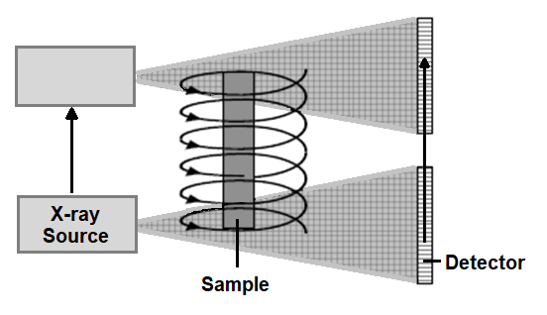
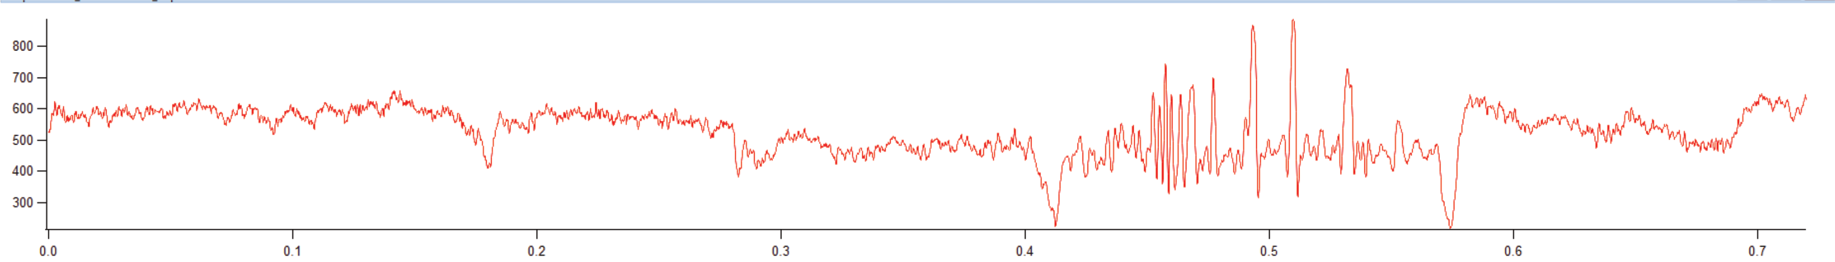
We use core-scale microfocus X-ray computer tomography to reveal 3D firn microstructures at 120 µm resolution.
Density (kg m⁻³)
800 -
700 -
600 -
500 -
400 -
300 -
Freitag & Kipfstuhl (2014)
3D density of a 72-cm firn section
from Smyley Island
Notes:
Structural assessment to understand the physical characteristics of our archive. Background, on which all ou chemical data will be projected. But maybe it is already more than just a background?

Slide 4
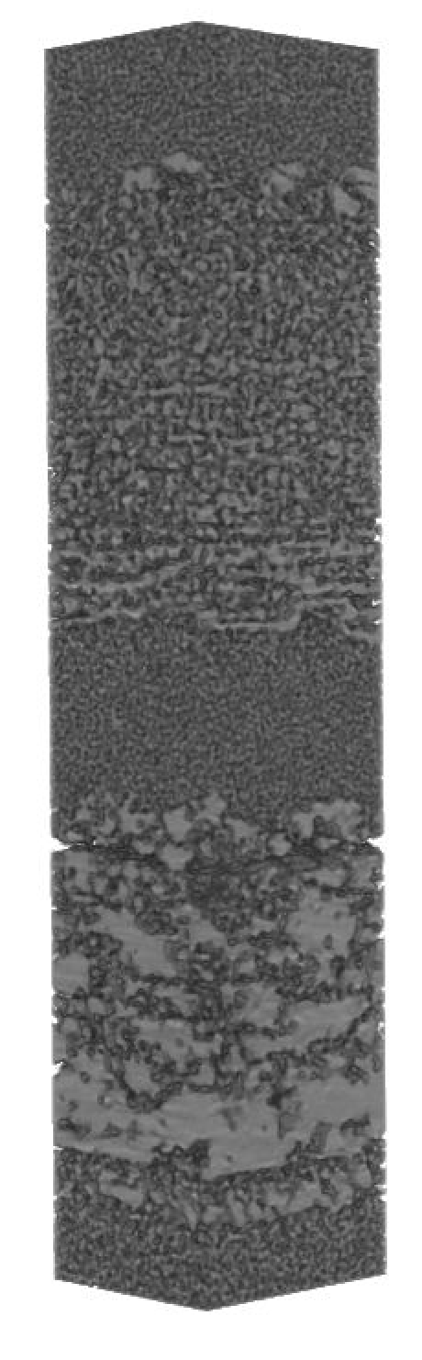
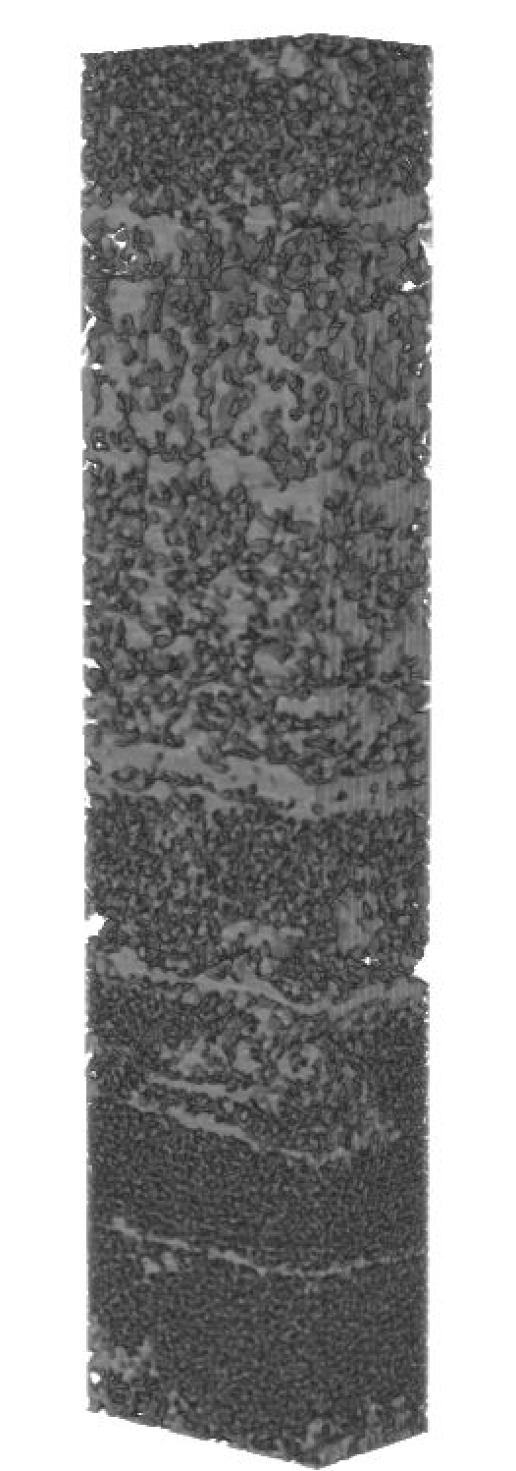
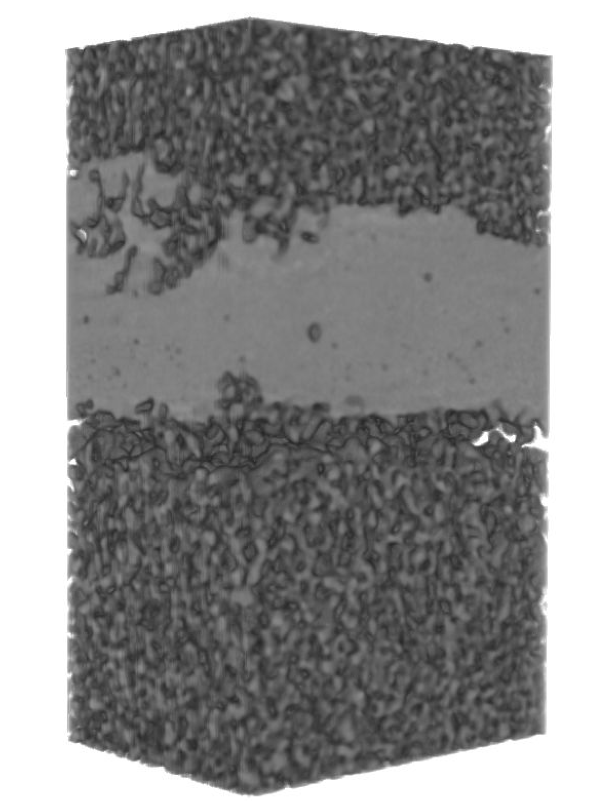
Melt features in ice cores are structurally heterogeneous – among sites, within profiles and internally.
distinct layer
~12 mm thick
~6.8 mm
wet coarsening
~48 mm
Young Island
~1.4 mm
Sherman Island

Slide 5
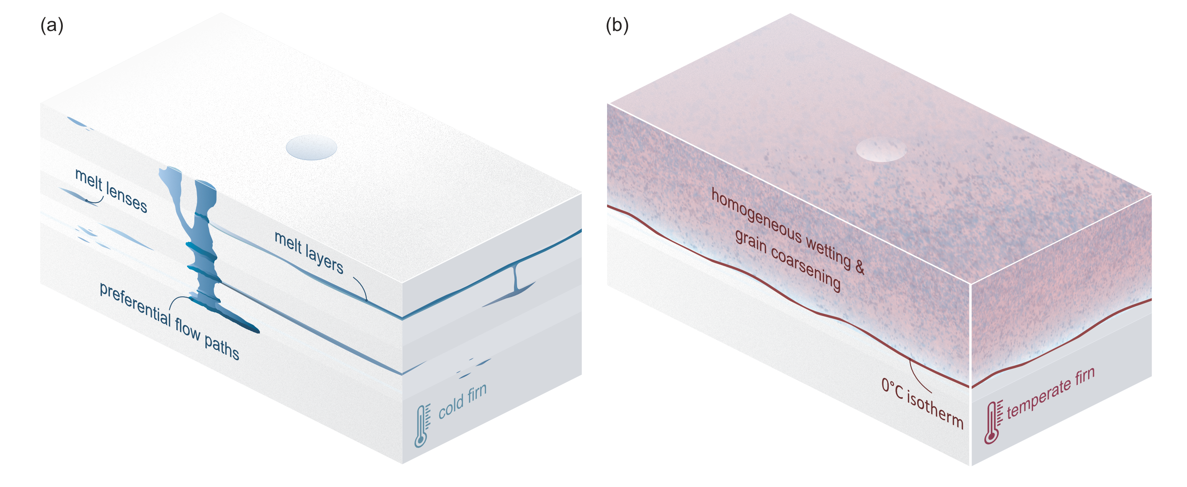
The microstructure of melt features contains environmental information & can help to understand their altered chemistry.
Ice core drilling site

Slide 6



Melt features bear not only limitations but also potential for ice core proxy development.
Dorothea Elisabeth Moser
moser@bas.ac.uk
HeartMeltingIce
Notes:
Le’s start with a question: Who of you has seen melt-affected ice core chemistry and didn’t publish on that record because Who of you drilled and ice core which turned out to be melt affected? (think of alpine community too).

