Slide 1


Multi-scale observations and evolution of the magnetopause Kelvin-Helmholtz waves during southward IMF
Kevin Alexander Blasl¹, Takuma Nakamura¹, et al.²
¹ Space Research Institute, Austrian Academy of Sciences, Graz, Austria
² Collaborators from companion papers (see references)

Slide 2
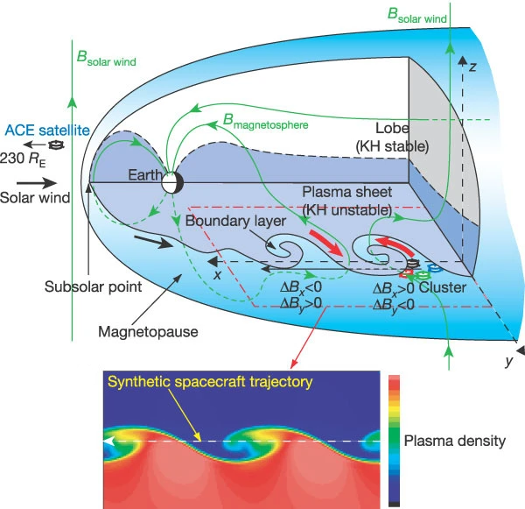
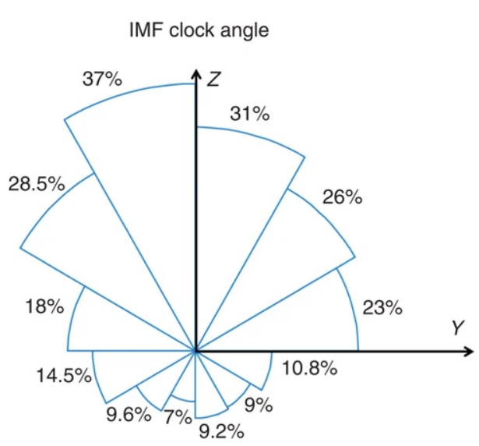
Kelvin-Helmholtz instability
MHD-scale velocity shear instability
Sinusoidal waves at low latitudes developing into vortices along the flanks
Plasma transport across the magnetopause
Much more frequently observed during northward IMF
Irregular and temporally intermittent during southward IMF (Hwang et al., 2011)
(Kavosi & Raeder, THEMIS, 2015)
(Hasegawa et al., 2004)

Slide 3
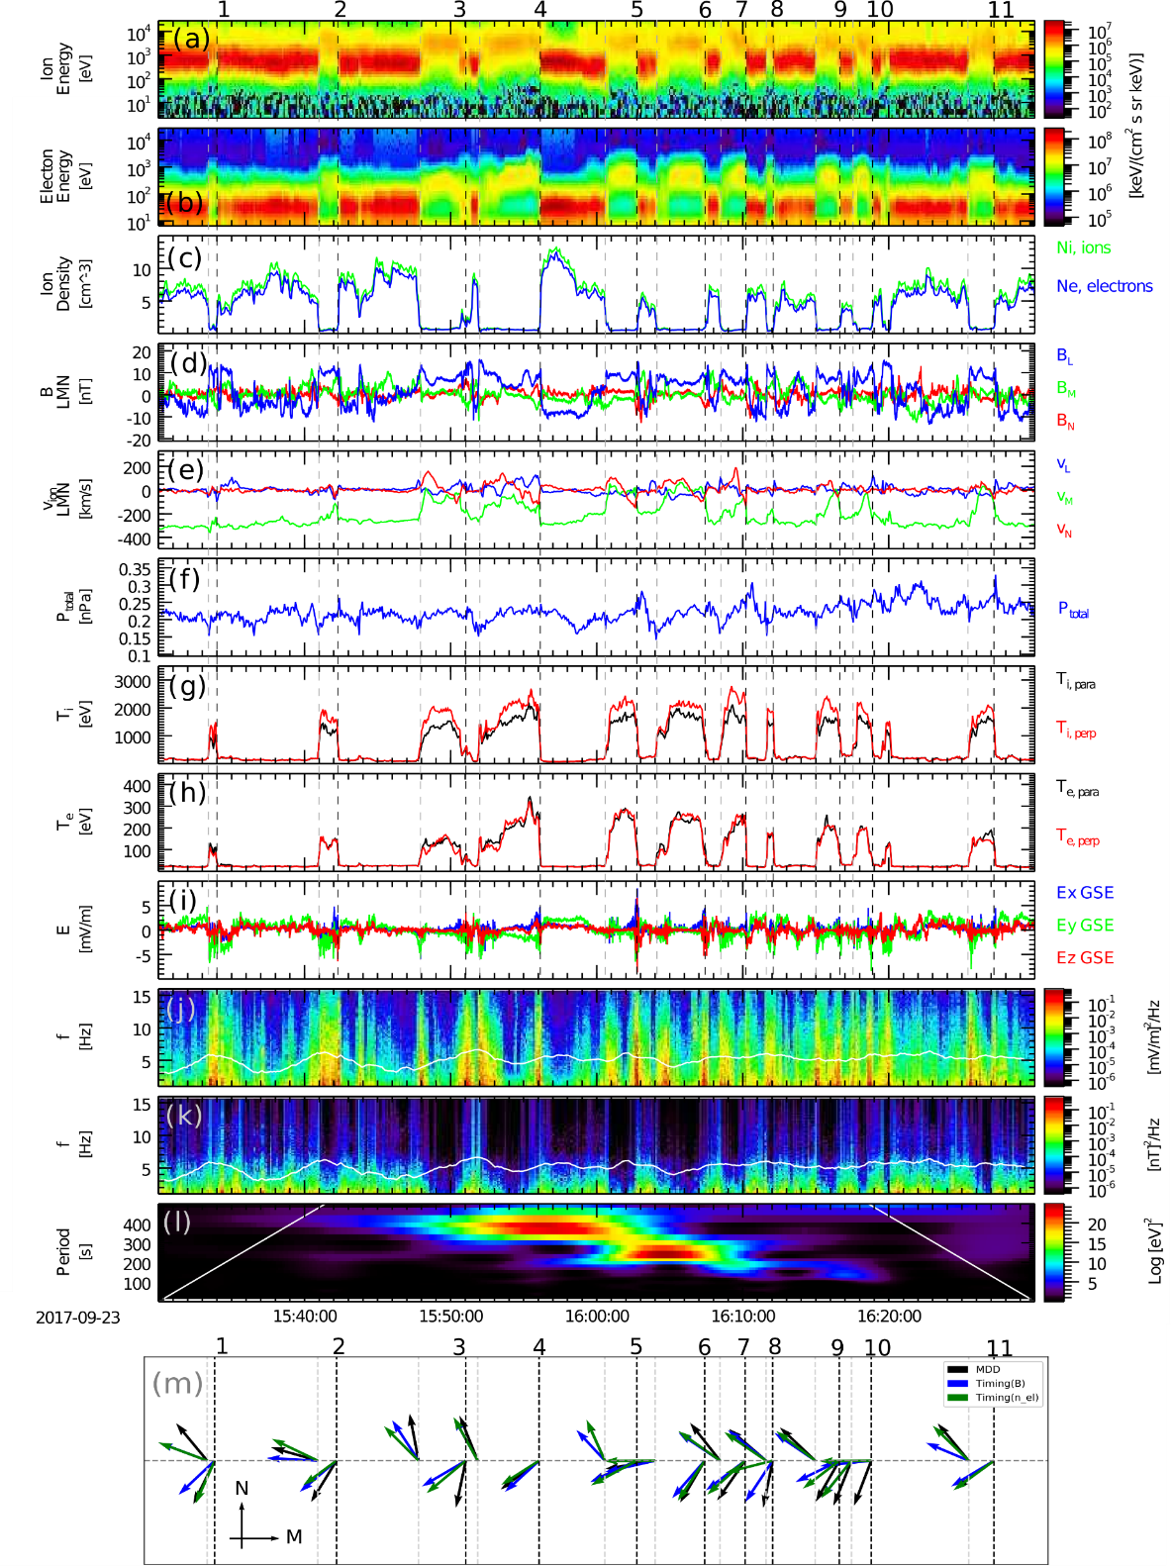
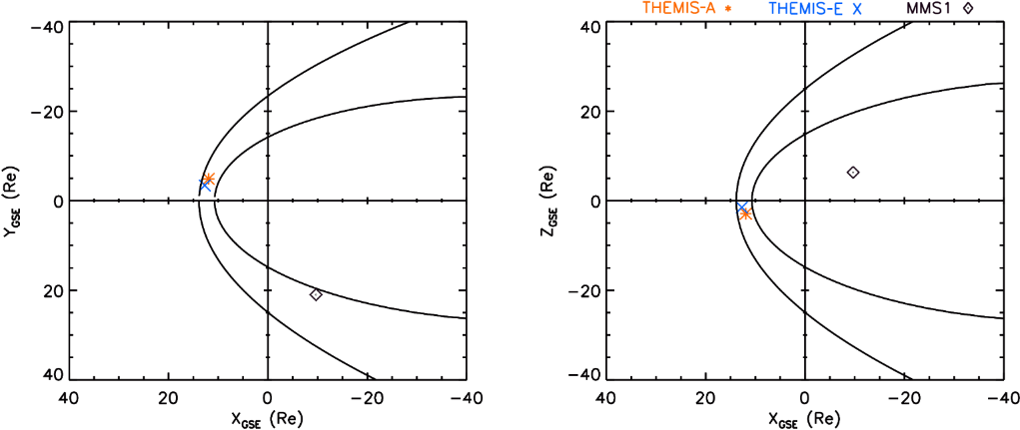
MMS event - September 23, 2017
(Blasl et al., 2022)
First MMS observations of KHI during southward IMF to study multi-scale physics
Multiple magnetopause crossings at duskside (x, y, z)_{GSE} ≈ (-10, 21, 6) R_{E}
Non-ideal signatures and strong wave power
L
(Blasl et al., 2022)
M
M
N

Slide 4
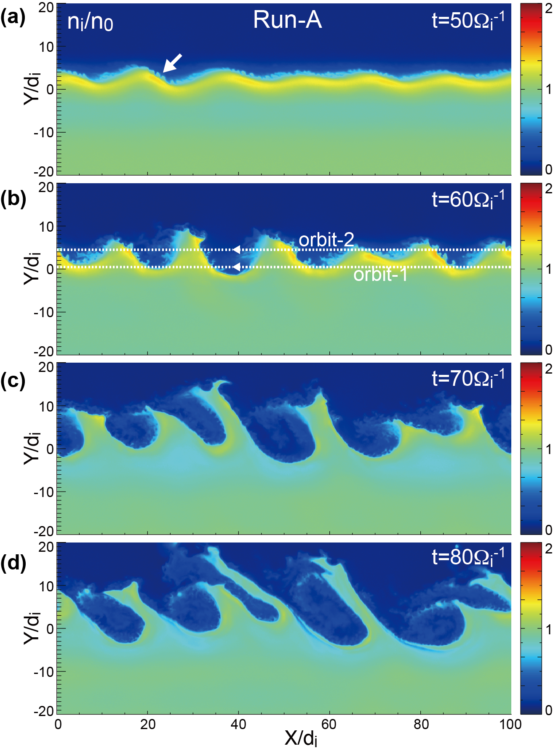
Simulation results
Fully-kinetic 2D & 3D PIC simulations under realistic parameters of MMS event
Confirmed KHI onset and evolution
Suggested secondary instabilities:
LHDI: diffuse boundary layers and plasma mixing
RTI: Vortex arms grow nearly perpendicular to magnetopause boundary
RTI leads to irregular structures and can easily reduce observational probability
(Nakamura et al., 2022)

Slide 5
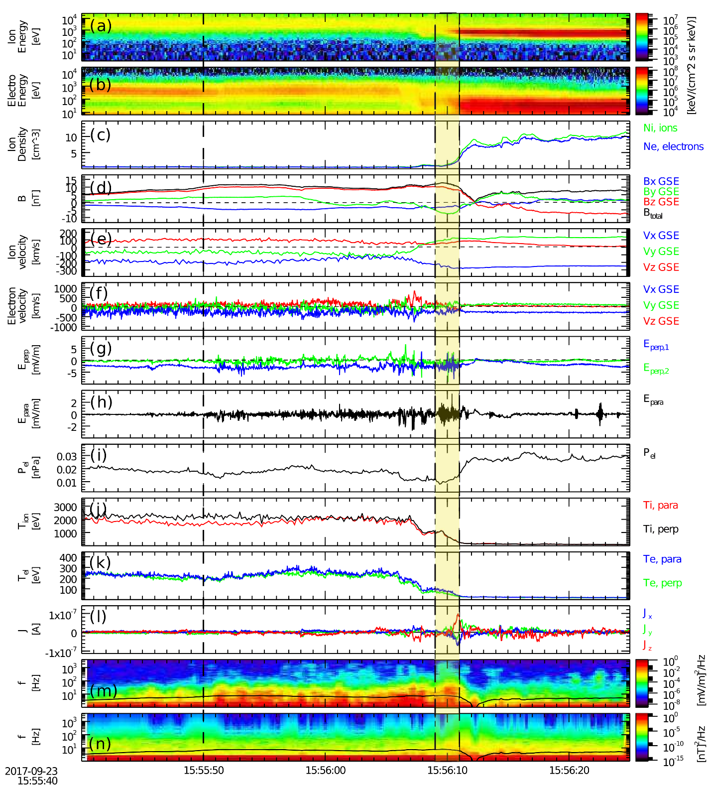
(Blasl et al., 2022)
LHDI
Enhanced wave activity in the electric field:
around f_{LHD}
perpendicular to B
electrostatic waves
Preferentially at trailing edges
Reach rather deep into low-density side of the boundary layer
Plasma mixing across the boundary and diffuse boundary layer
f_{LHD}

Slide 6
Summary & Outlook
First observation of the KHI during southward IMF from MMS data
Simultaneous study of MHD-scale KHI and kinetic scale effects during southward IMF
Signatures for occurrence of Lower Hybrid Drift Instability at the edges of the KH waves/vortices
Possibility of further multi-scale studies and energy conversion processes

Slide 7
Acknowledgements
For the simulations employed in this work, we acknowledge PRACE for awarding us access to MareNostrum at Barcelona Supercomputing Center (BSC), Spain.
References
Multi-scale observations of the magnetopause Kelvin–Helmholtz waves during southward IMF
K. A. Blasl, T. K. M. Nakamura, F. Plaschke, R. Nakamura, H. Hasegawa, J. E. Stawarz, Yi-Hsin Liu, S. Peery, J. C. Holmes, M. Hosner, D. Schmid, O. W. Roberts, M. Volwerk
Multi-scale evolution of Kelvin–Helmholtz waves at the Earth's magnetopause during southward IMF periods
T. K. M. Nakamura, K. A. Blasl, H. Hasegawa, T. Umeda, Yi-Hsin Liu, S. Peery, F. Plaschke, R. Nakamura, J. C. Holmes, J. E. Stawarz, W. D. Nystrom
Diffusive Plasma Transport by the Magnetopause Kelvin-Helmholtz Instability During Southward IMF
T. K. M. Nakamura, K. A. Blasl, Yi-Hsin Liu, S. A. Peery

