Slide 1



SESSION HS8.2.4
Field, modeling, and laboratory approaches for the assessment of hydrogeological and engineering problems in karst - Characterization, mapping and simulation of karst features
The neglected role of karst features in rock mass characterization and stability assessment
L. Loiotine ^{1,2}, G.F. Andriani ², M-H. Derron ¹, M. Jaboyedoff ¹, P. Lollino ³, M. Parise ²
1 University of Lausanne, Institute of Earth Sciences, 1015 Lausanne, Switzerland
2 Department of Earth and Environmental Sciences, University of Bari Aldo Moro, 70125 Bari, Italy
3 CNR – IRPI, Istituto di Ricerca Protezione Idrogeologica, Bari, Italy
Corresponding author: lidia.loiotine@uniba.it

Slide 2



The neglected role of karst features in rock mass characterization and stability assessment
INTRODUCTION
Stability analyses in karst settings coexist with a significant uncertainty related to difficulties in modelling karst features (voids, conduits or caves) which can strongly influence the mechanical behavior and the water flow in rock masses.
Most of the rock mass classification systems do not directly take into account the presence of karst structures.
Although Remote Sensing techniques are being used to support geostructural and geomechanical surveys, the interpretation of the Digital Outcrop Models (DOMs) is challenging, especially if Discontinuity Sets (DSs) affect the rock mass:
  irregular surfaces resulting from surface and subsurface karst features are difficult to classify into DSs even using the most-advanced algorithms. This occurs even more heavily in the case of weathered soft rocks, such as calcarenites.
With this study, we demonstrate that karst features can seriously affect rock mass stability and that they must be taken into account when dealing with the most advanced stability analysis methods.
EGU General Assembly 2022

Slide 3
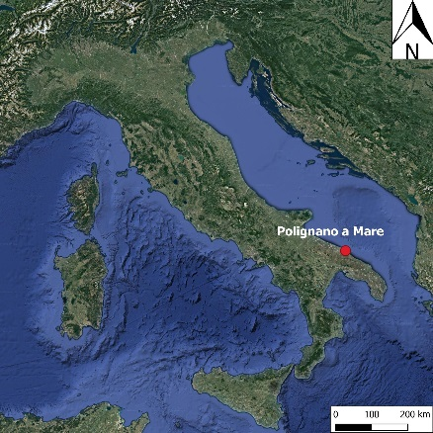
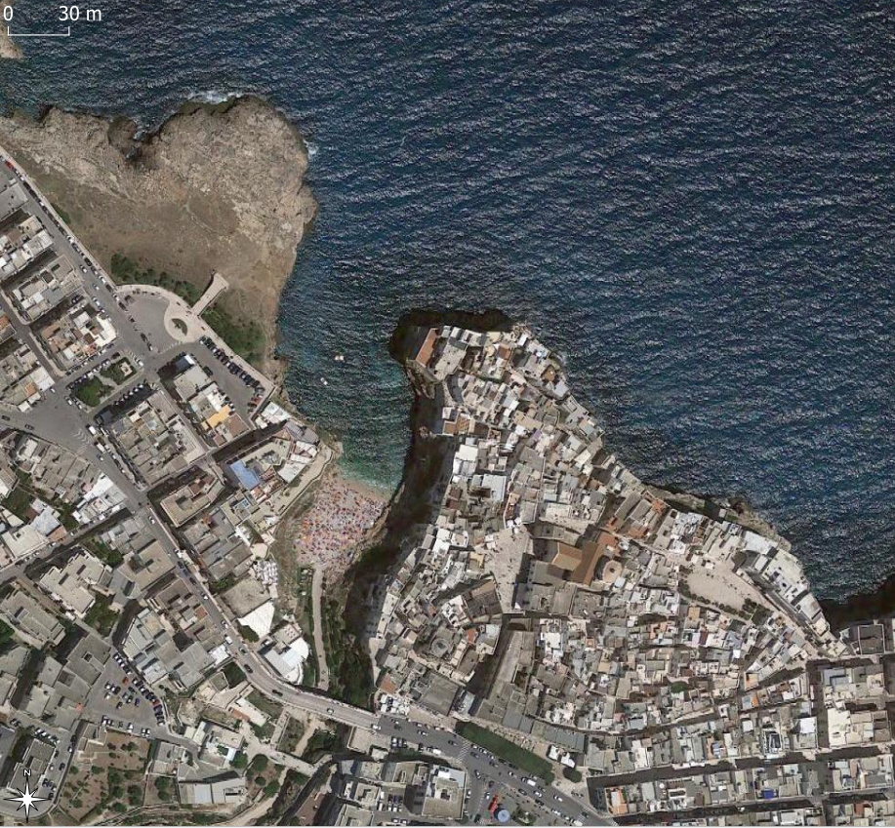
The neglected role of karst features in rock mass characterization and stability assessment
CASE STUDY
Location: Lama Monachile site (Polignano a Mare, Italy)
20-m high cliff made up of Cretaceous limestones (Calcare di Bari Formation) unconformably overlain by Pleistocene transgressive calcarenites (Calcarenite di Gravina Formation).
Pocket beach at the base of the cliff attracting many tourists throughout the year.
Sub-vertical joints and thin-to-medium bedded layers whose intersections determine the formation of potential unstable blocks with variable volumes.
Notches and karst caves formed due to wave erosion and dissolution at the interface between fresh groundwater and sea water.
Mechanical, chemical and biological processes contribute to degradation of the rock mass.
EGU General Assembly 2022

Slide 4
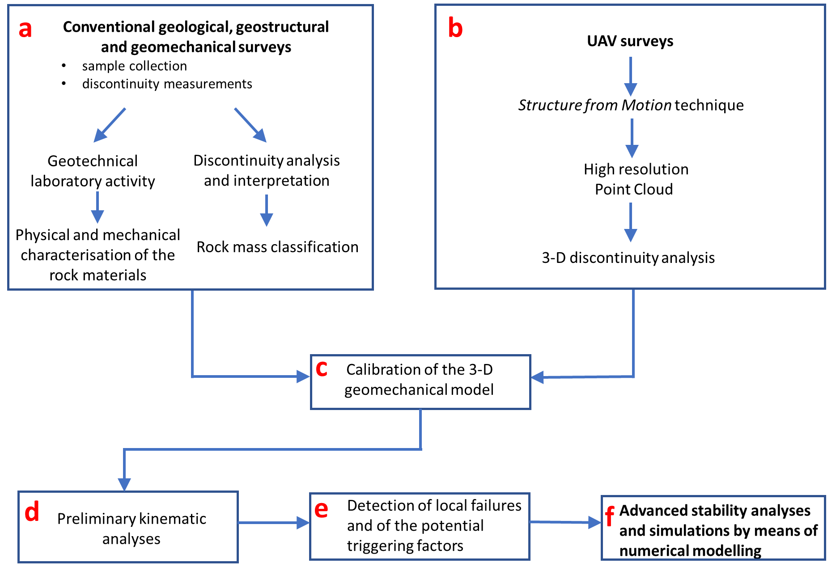
The neglected role of karst features in rock mass characterization and stability assessment
RESEARCH APPROACH
EGU General Assembly 2022

Slide 5
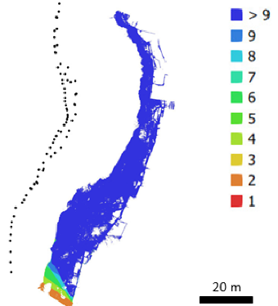
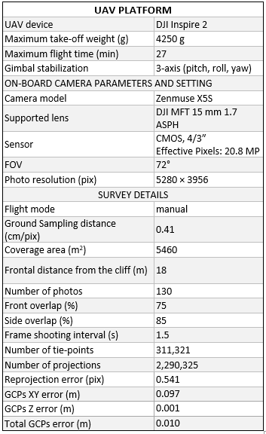
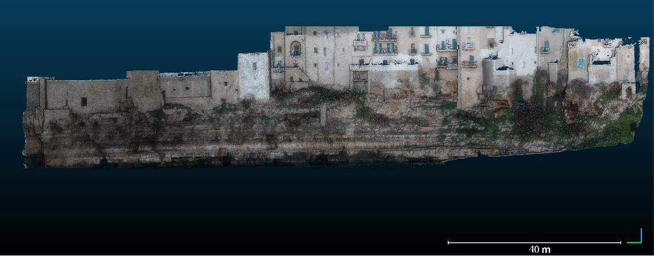
The neglected role of karst features in rock mass characterization and stability assessment
Camera locations
STRUCTURE FROM MOTION
1. UAV survey
2. Processing
3. Results
Image inspection, importation, and conversion of the coordinates into the WGS84/33 N metric coordinate system.
Insertion of Ground Control Points to roughly georeference the SfM model.
High-accuracy camera alignment by means of sparse bundle adjustment algorithm. High-quality depth maps calculation and generation of the dense point clouds.
Refinement of the dense point cloud by means of subsampling and direct segmentation.
Fine registration by means of ICP algorithm using Terrestrial Laser Scanning point cloud as reference.
Final point cloud of Lama Monachile site:
29,922,815 points
mean surface density = 3377 points/m²
EGU General Assembly 2022

Slide 6
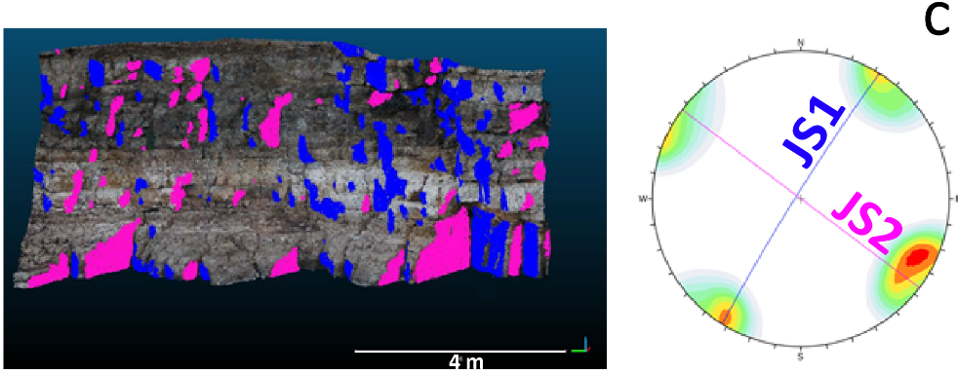
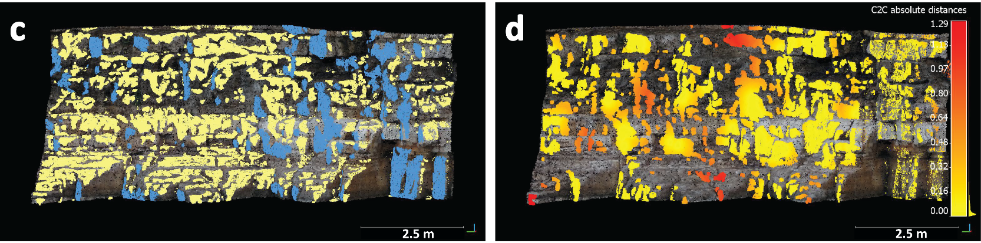

The neglected role of karst features in rock mass characterization and stability assessment
SEMI-AUTOMATIC EXTRACTION of the DSs from the POINT CLOUD
Coltop 3D on the UAV point cloud
JS1 extracted with Discontinuity Set Extractor
a
Validation on the field
b
(c) Some points of the topography (in yellow) were not separated from JS1 (blue) by DSE and interfered with the estimation of the JS1 dip direction.
(d) Differences in JS1 between the point clouds from Coltop3D and DSE: red areas correspond to points belonging to the topography that were considered by the DSE for the extraction of JS1.
The irregular surfaces produced by carbonate dissolution, further enhanced by weathering, caused an incorrect classification of the DSs by means of the more automated technique (DSE).
EGU General Assembly 2022

Slide 7
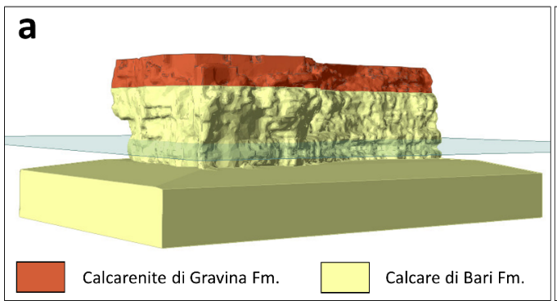
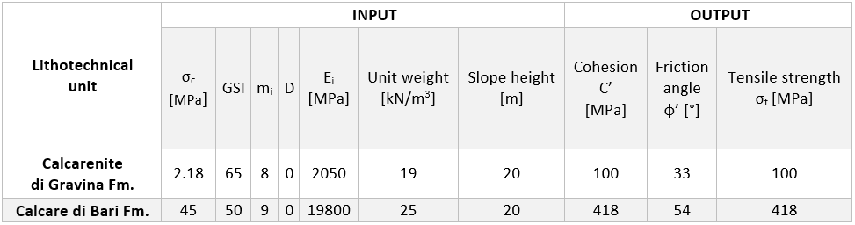

The neglected role of karst features in rock mass characterization and stability assessment
3-D STABILITY ANALYSIS BY MEANS OF FINITE ELEMENT METHOD
→ CONTINUUM-BASED APPROACH (RS3 SOFTWARE - Rocscience)
MODEL SET-UP
Geometric model: a high-resolution DOM was used to generate a very fine mesh (average element size = 35 cm) to take into account the large-scale karst structures.
Water conditions, load and restraints: assigned through a chronological multi-stage procedure according to the site conditions.
Geomechanical model
Lithotechnical characterization: the equivalent Mohr-Coulomb parameters of the rock mass were evaluated through the linearization of the generalized Hoek-Brown failure criterion using the GSI values defined for the lithotechnical units, according to the site conditions.
Mesh + water + loads + restraints
EGU General Assembly 2022

Slide 8
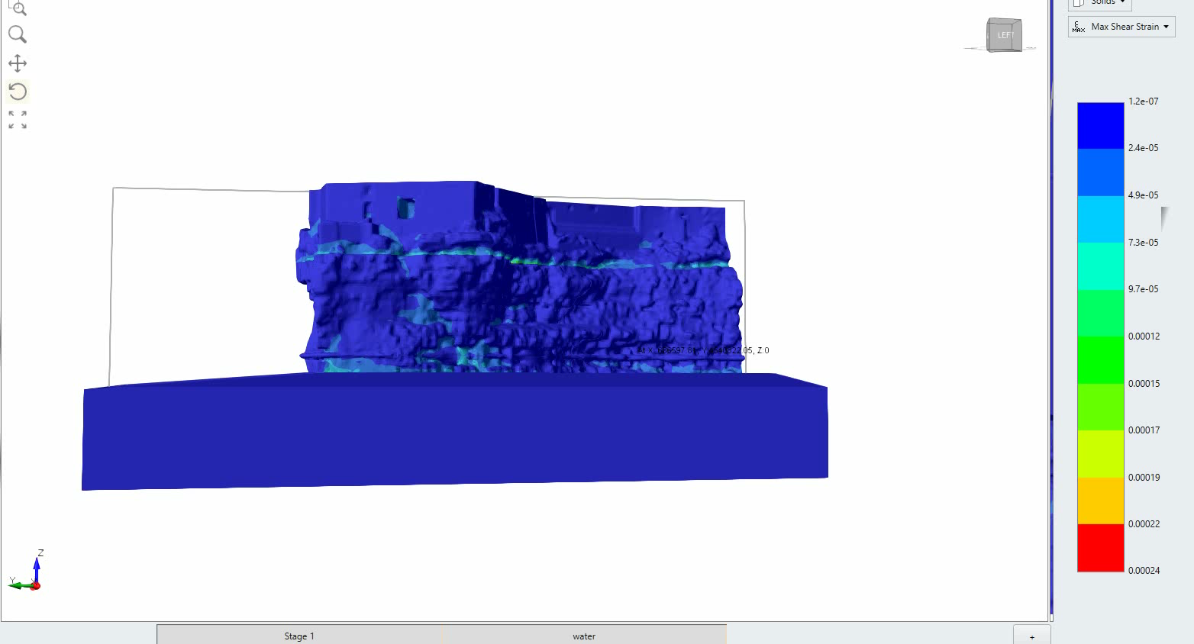
The neglected role of karst features in rock mass characterization and stability assessment
3-D STABILITY ANALYSIS BY MEANS OF FINITE ELEMENT METHOD
→ CONTINUUM-BASED APPROACH (RS3 SOFTWARE - Rocscience)
min
RESULTS
Although in the current conditions the examined slope is stable, the results illustrate that the maximum shear strain is localized in correspondence of the karst features (e.g. caves and voids) and at the sea level.
By applying the Shear Strength Reduction method, it was found out that weathering processes can cause the same structures to be under yield and lead to localized failures.
Maximum shear strain
max
EGU General Assembly 2022

Slide 9
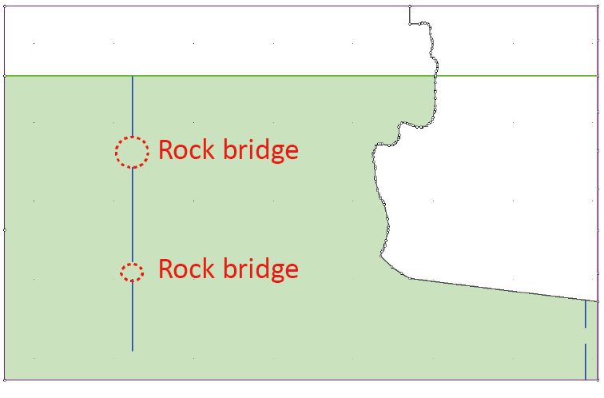
The neglected role of karst features in rock mass characterization and stability assessment
2-D STABILITY ANALYSIS BY MEANS OF FINITE ELEMENT METHOD
→ RS2 SOFTWARE - Rocscience
Implementation of the DSs by combining the data derived from point cloud inspection and conventional geostructural and geomechanical field surveys.
Generation of the DSs orientation, spacing, trace length and persistence by means of Discrete Fracture Network techniques.
The strength properties of the discontinuities (classified as non-persistent) were assigned proportionally to the percentage of rock bridges.
Calcare di Bari Fm.
DS | Type | Mean Dip dir. ° | Mean dip ° | Spacing (m) | Persistence (m) | Trace length (m)
JS1 | Joint | 122 | 88 | 0.12-1.00 | 0.22 | 0.22
JS2 | Joint | 33 | 84 | 0.08-0.30 | 1.99 | 0.55
S0 | Bedding | 224 | 5 | 0.05-1 | >20 | -
= intact rock
= intact rock
EGU General Assembly 2022

Slide 10
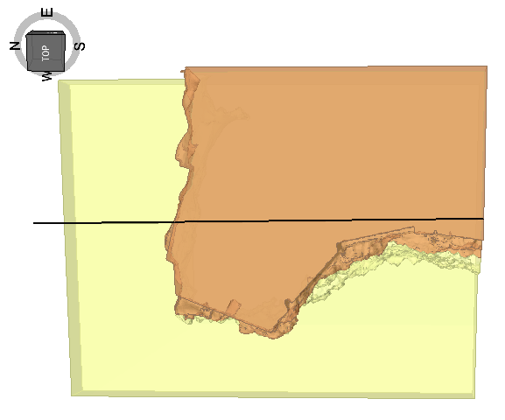
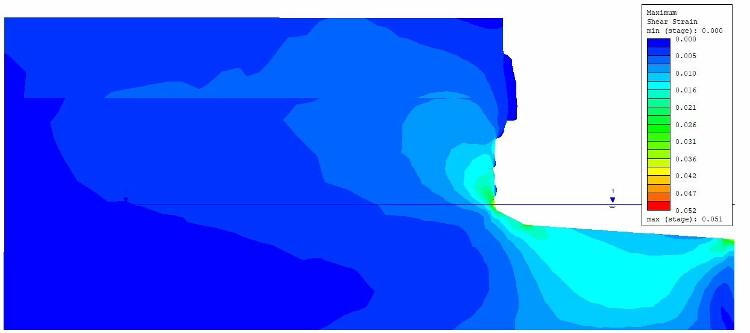
The neglected role of karst features in rock mass characterization and stability assessment
2-D STABILITY ANALYSIS BY MEANS OF FINITE ELEMENT METHOD
→ CONTINUUM-BASED APPROACH
A’
A
RESULTS
Maximum shear strain
Current conditions: the rock mass is stable, but the maximum shear strain is located at the sea level.
Shear Strength Reduction method: weathering processes and karst structures (e.g. caves) interact to produce localized failures.
Karst cave
Sea level
A
A’
EGU General Assembly 2022

Slide 11
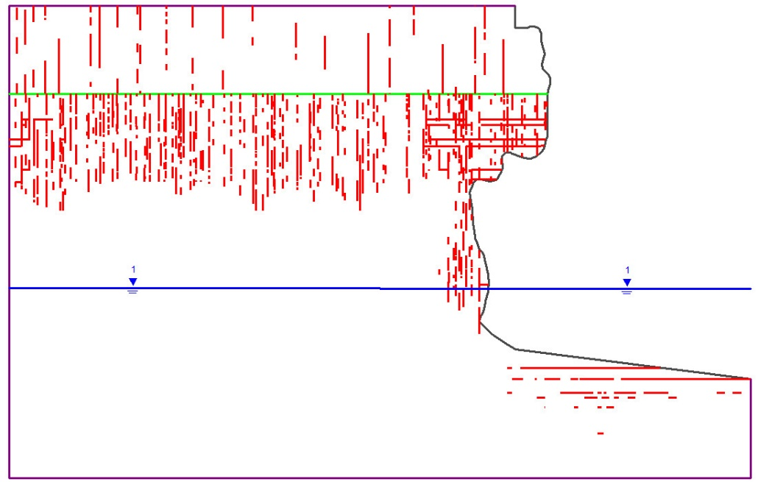
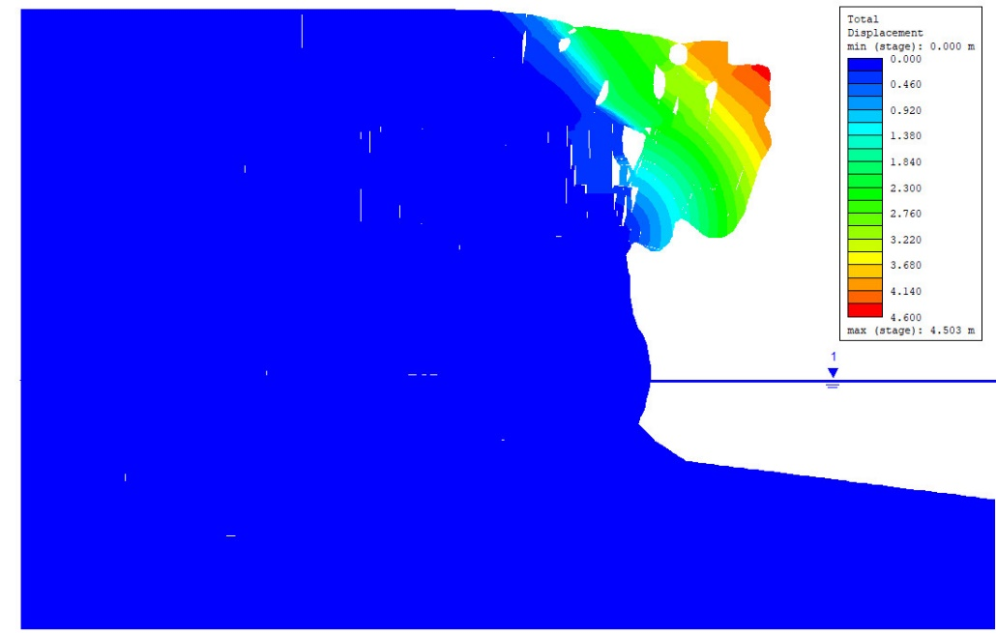
The neglected role of karst features in rock mass characterization and stability assessment
2-D STABILITY ANALYSIS BY MEANS OF FINITE ELEMENT METHOD
→ DISCONTINUUM-BASED APPROACH
RESULTS
When the DSs are implemented, localized failures occur (using the SSR method) by means of sliding and toppling of blocks formed by the intersection of yielded joints.
Yielded joints
Total displacements with deformation contours
Deformations are exaggerated for visualization purposes
EGU General Assembly 2022

Slide 12
The neglected role of karst features in rock mass characterization and stability assessment
FINDINGS
The results of the numerical simulations, which are in agreement with field observations, show that:
Karst features, which tend to be neglected during the modelling of numerical stability analyses, can significantly modify the slope morphology and produce localized shear zones which, in turn, can cause failures and drive their kinematics.
In coastal settings, the interaction of karst and marine erosion can increase the pervasiveness and aperture of the discontinuity systems, thus reducing the rock bridges over time and favoring instability processes.
With this study, we demonstrate that karst processes, which are often disregarded in the most used rock mass classification systems and when modeling numerical stability analysis, must be taken into account to achieve realistic stability assessments and plan appropriate intervention and mitigation measures.
EGU General Assembly 2022

