Slide 1
MeteoInfo: An open-source GIS, scientific computation and visualization platform
Institute of Artificial Intelligence for Meteorology,
Chinese Academy of Meteorological Science
Yaqiang Wang
May 2022

Slide 2
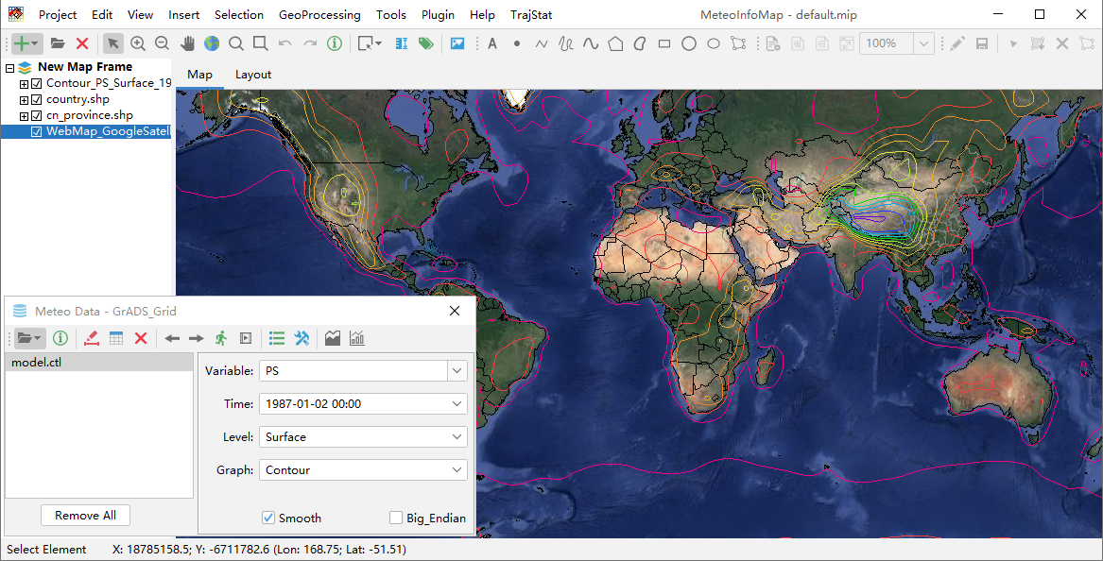
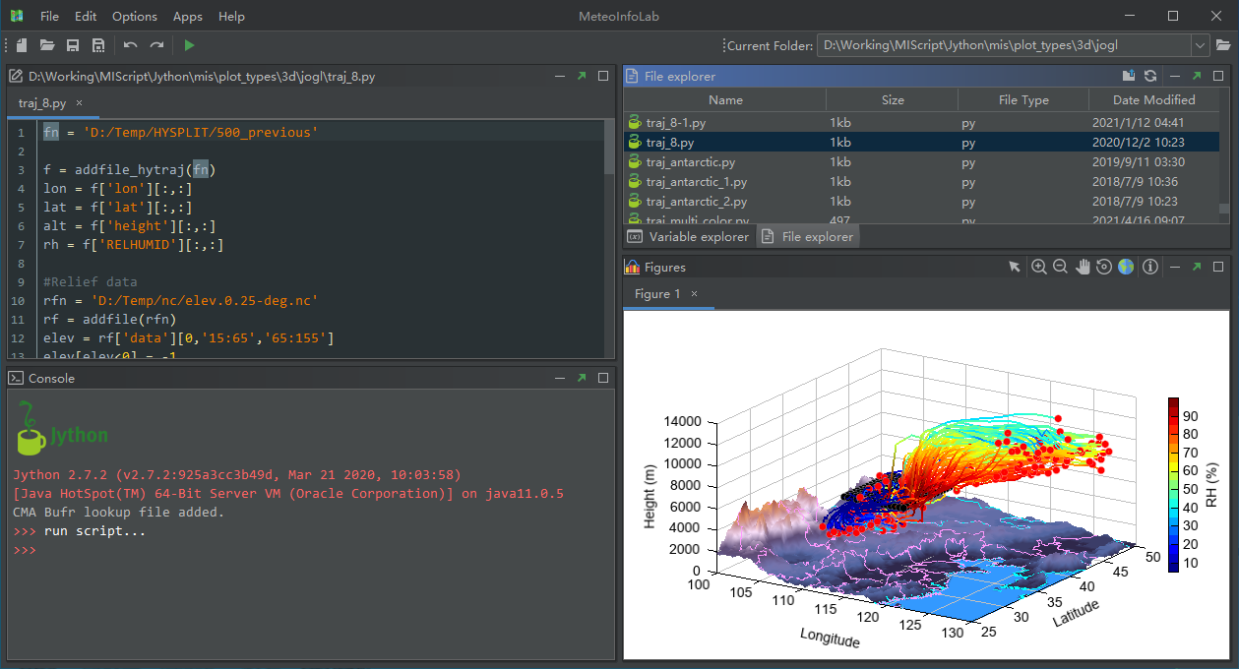
MeteoInfo: MeteoInfoMap + MeteoInfoLab
An intergrated framework both for GIS application and scientific computation environment – especially for meteorological community.
(Wang et al., 2014, Meteo. Appl.
Wang 2019, JORS)
GIS functions
netCDF, GRIB, HDF, ARL …
Script (Jython)
Multi-dimensional array computation
2D, 3D visualization
Plugin, secondary development
Open source
Cross platform (Java)

Slide 3
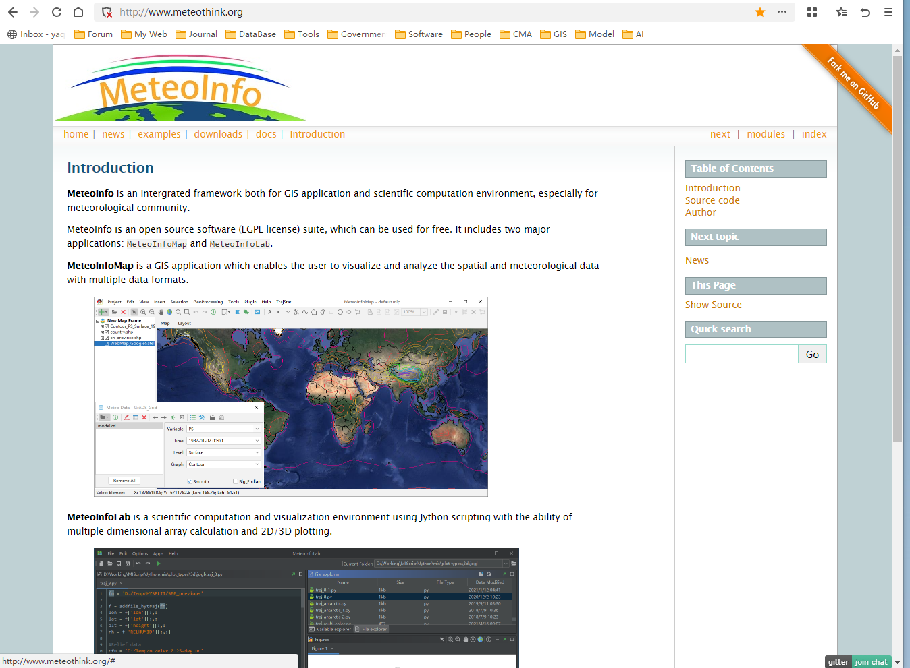
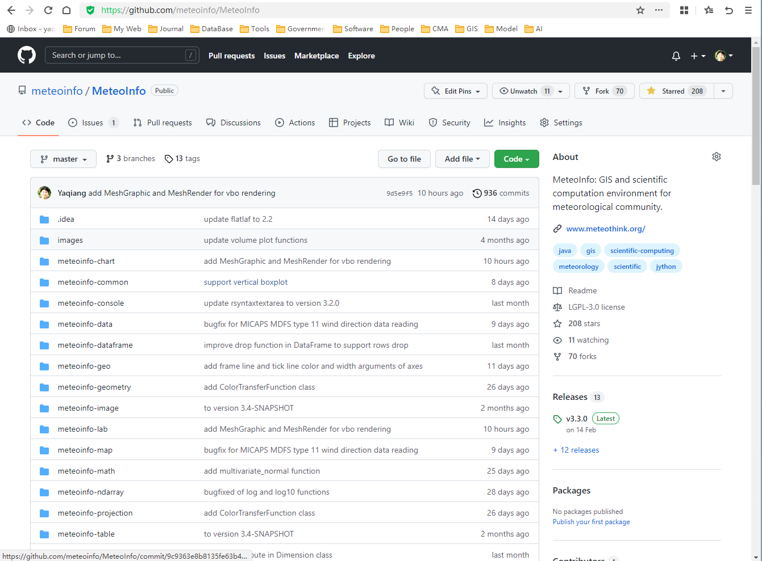
MeteoInfo website
Free and open source
Website：http://www.meteothink.org
Source code: https://github.com/meteoinfo

Slide 4
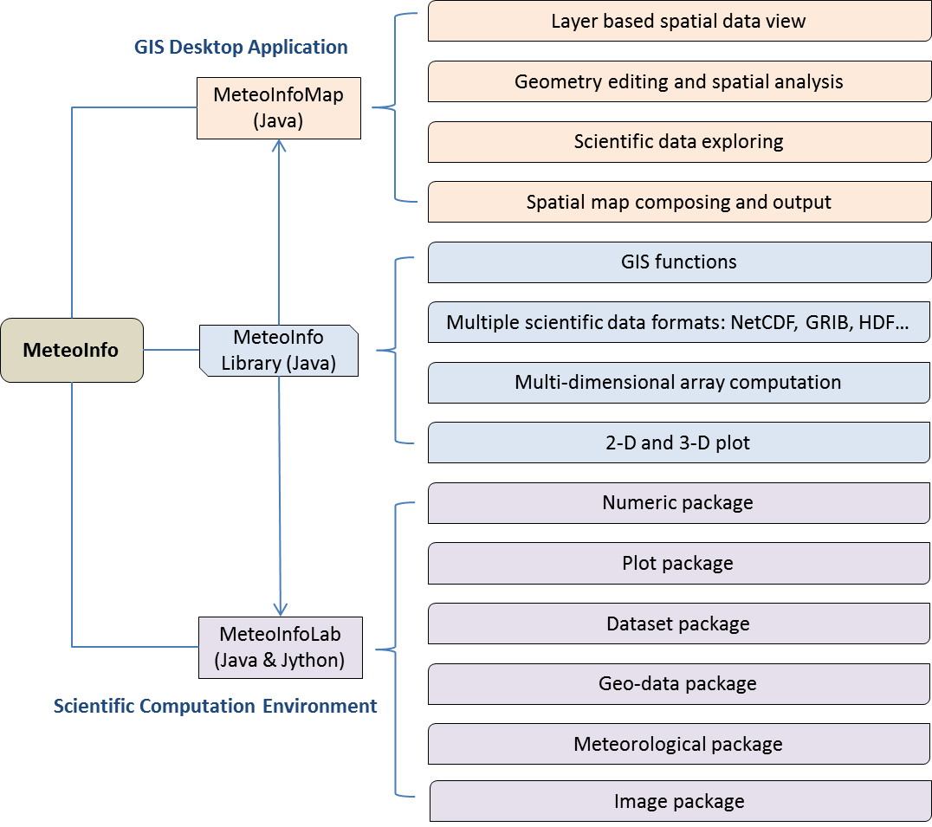
Framework of the MeteoInfo software and its main functions

Slide 5
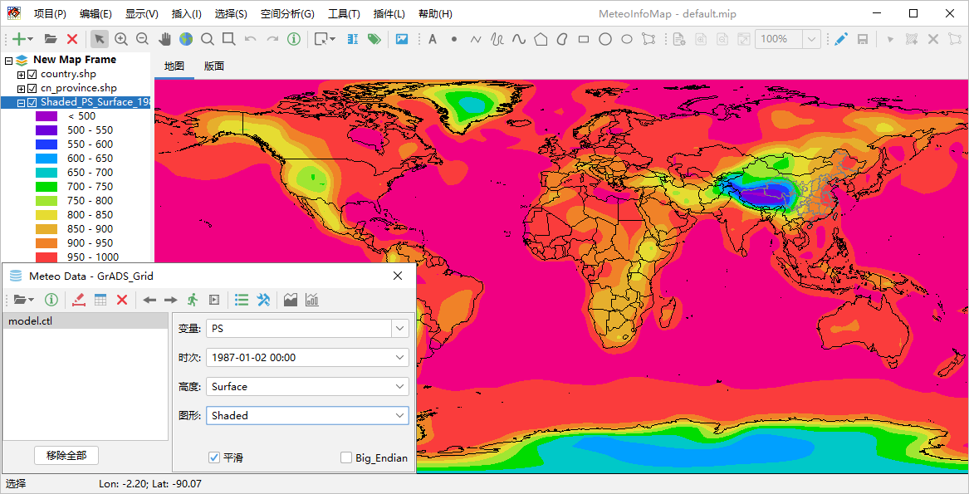
MeteoInfoMap GUI for geoscience data exploration

Slide 6
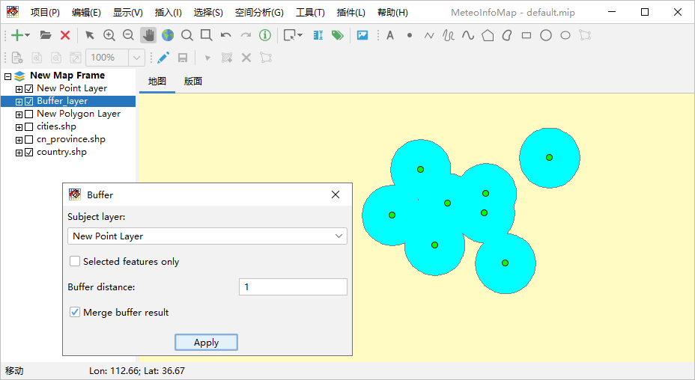
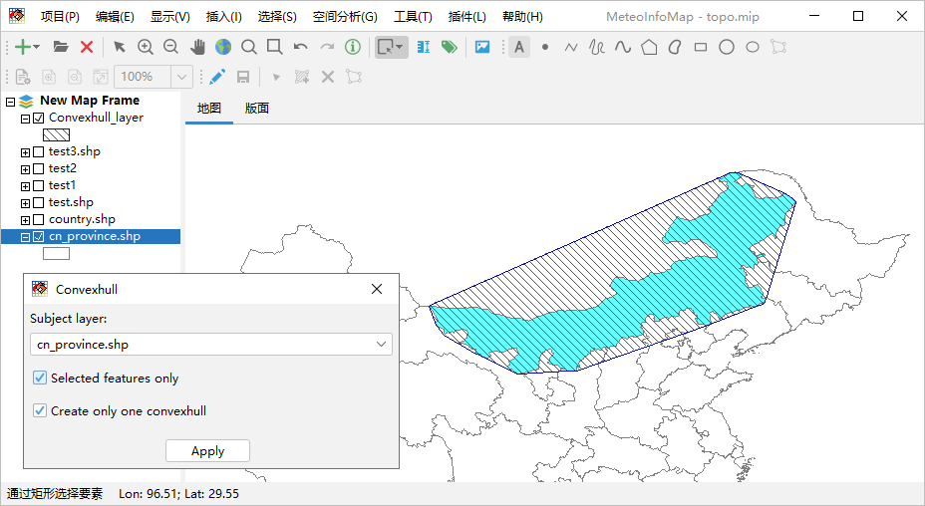
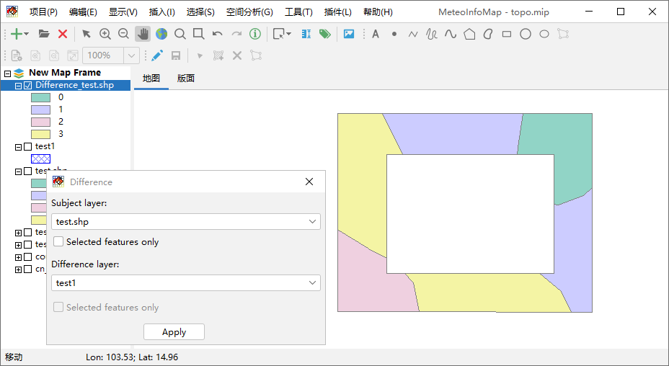
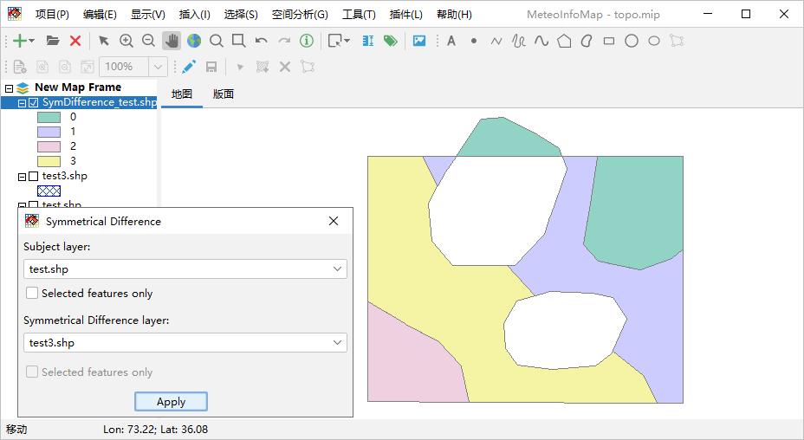
MeteoInfoMap – Spatial analysis functions

Slide 7
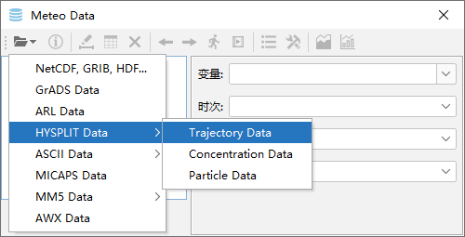
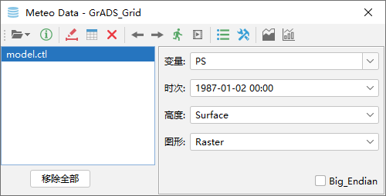
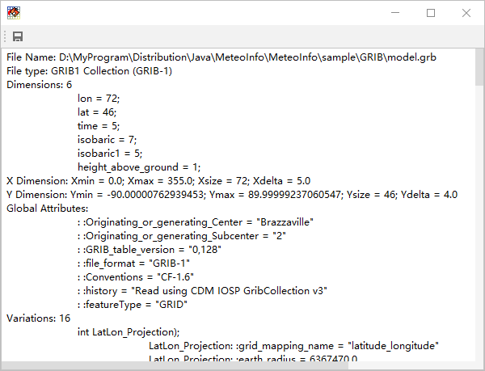
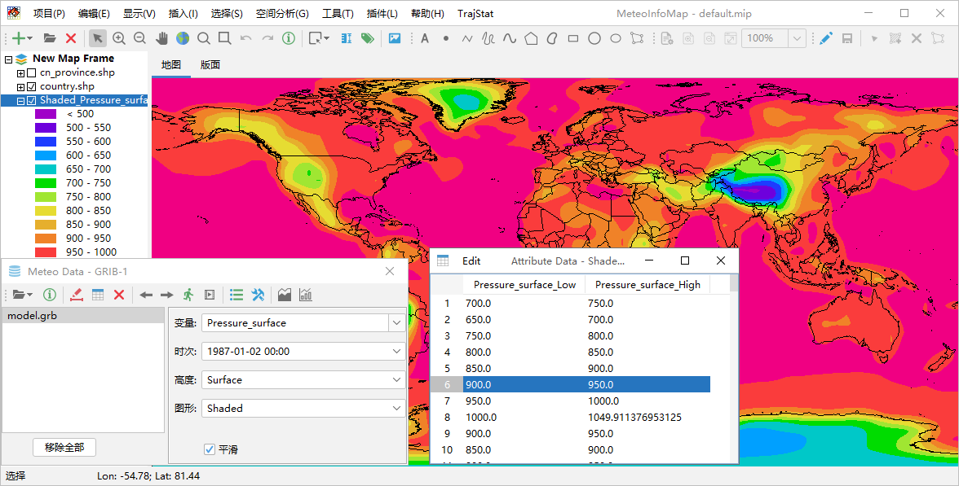
MeteoInfoMap – Read and plot meteorological data

Slide 8
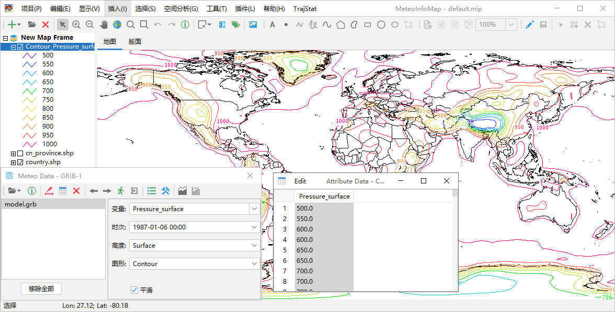
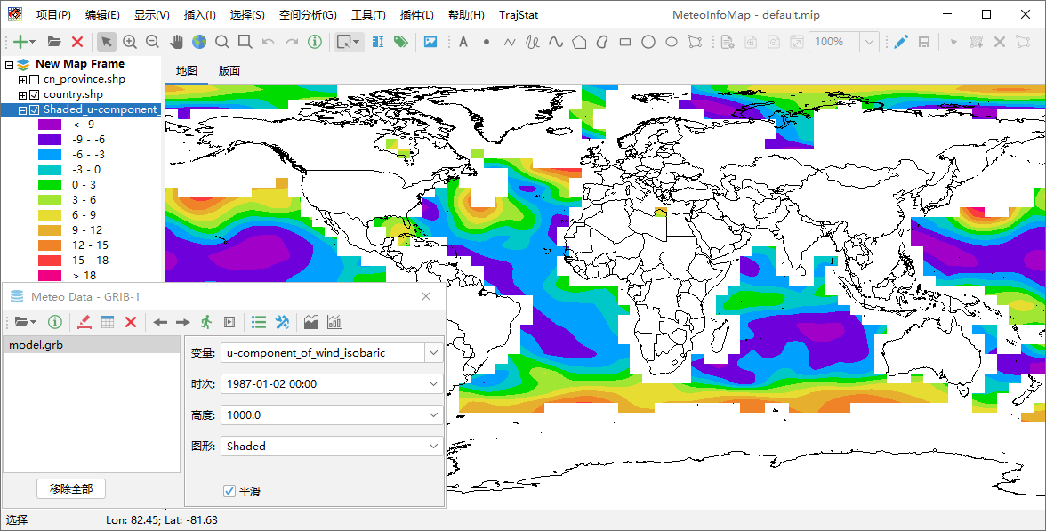
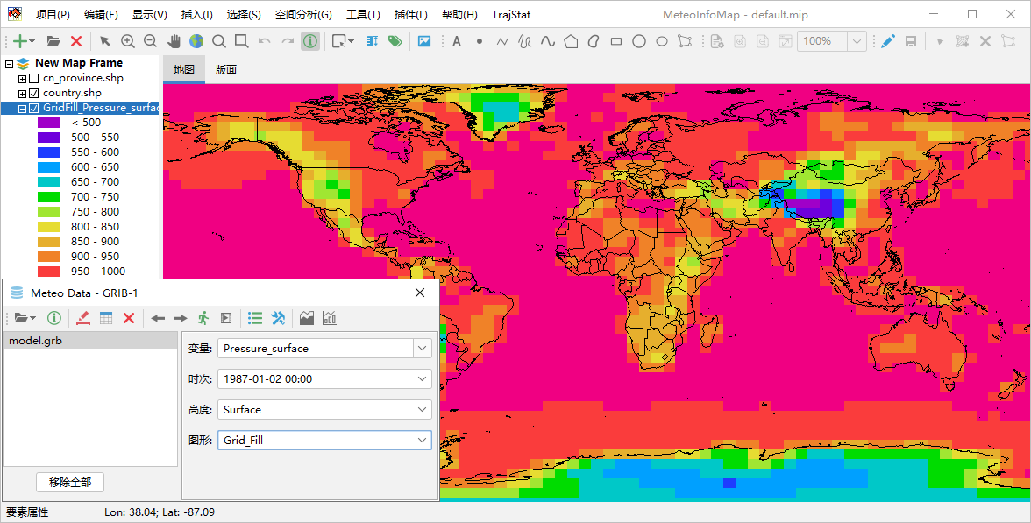
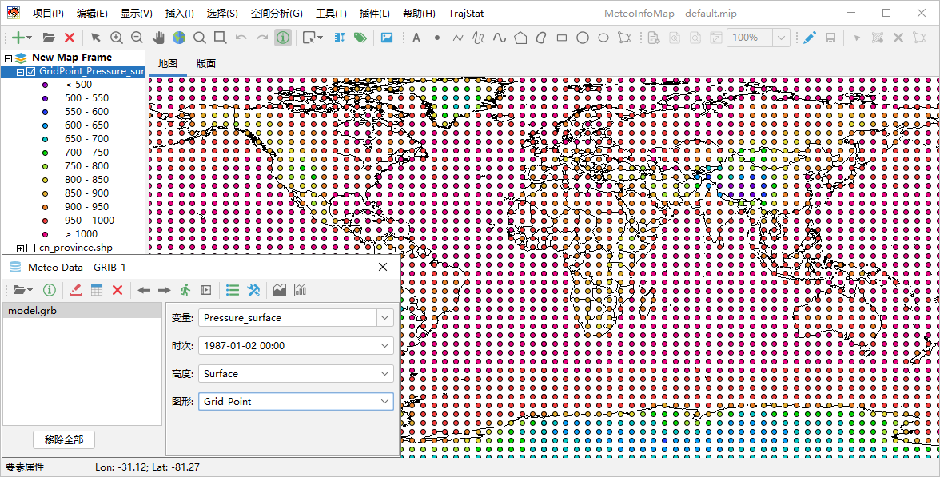
MeteoInfoMap – Grid data to GIS layers

Slide 9
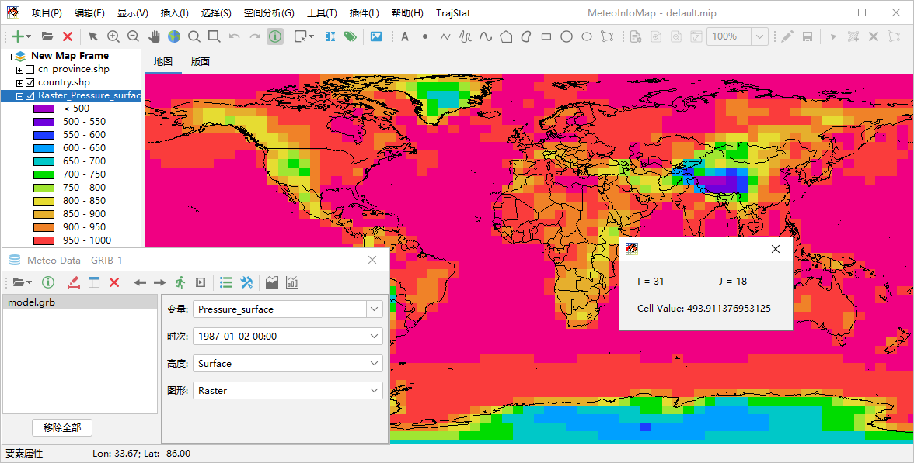
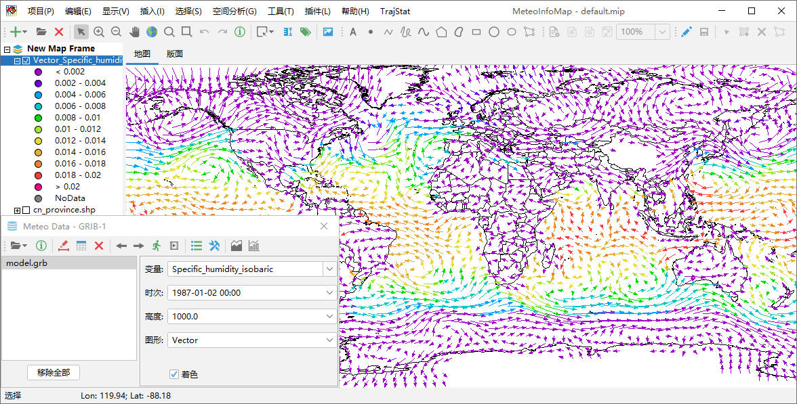
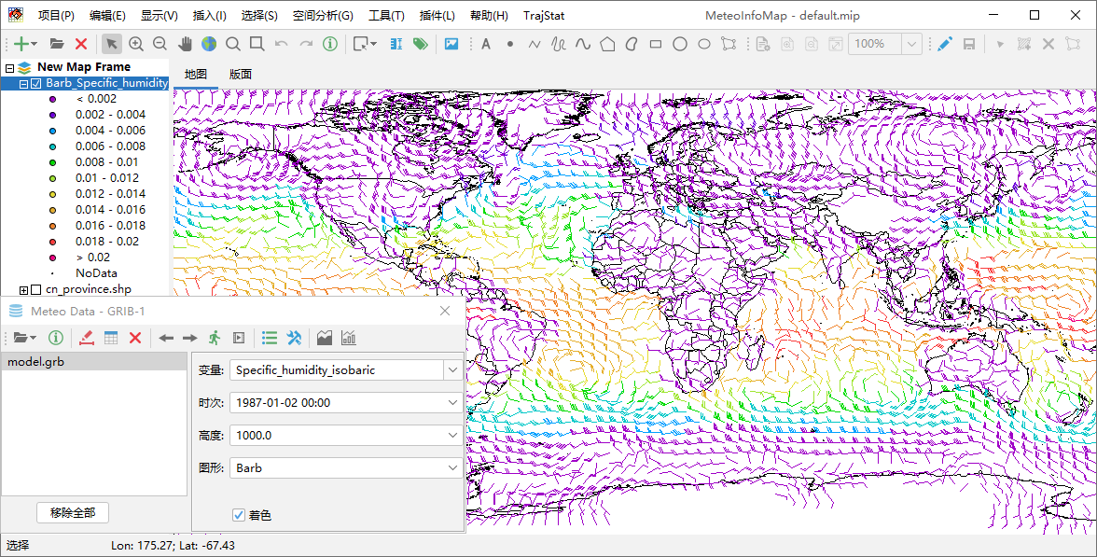
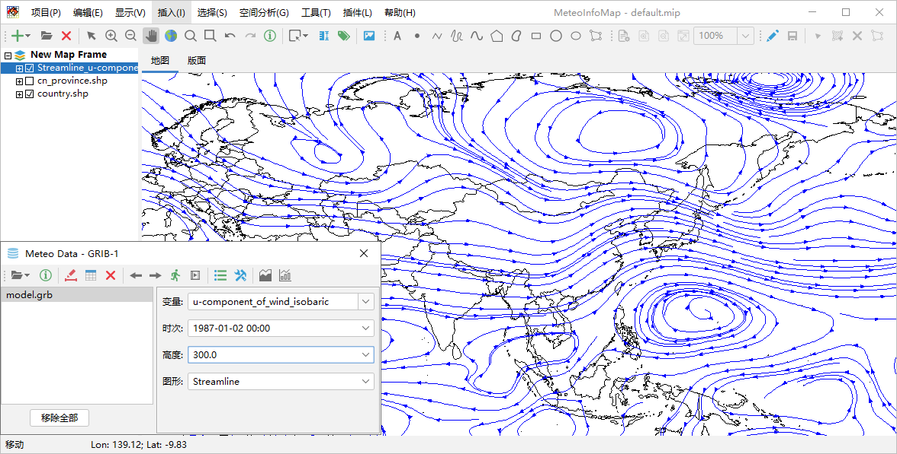
MeteoInfoMap – Grid data to GIS layers

Slide 10
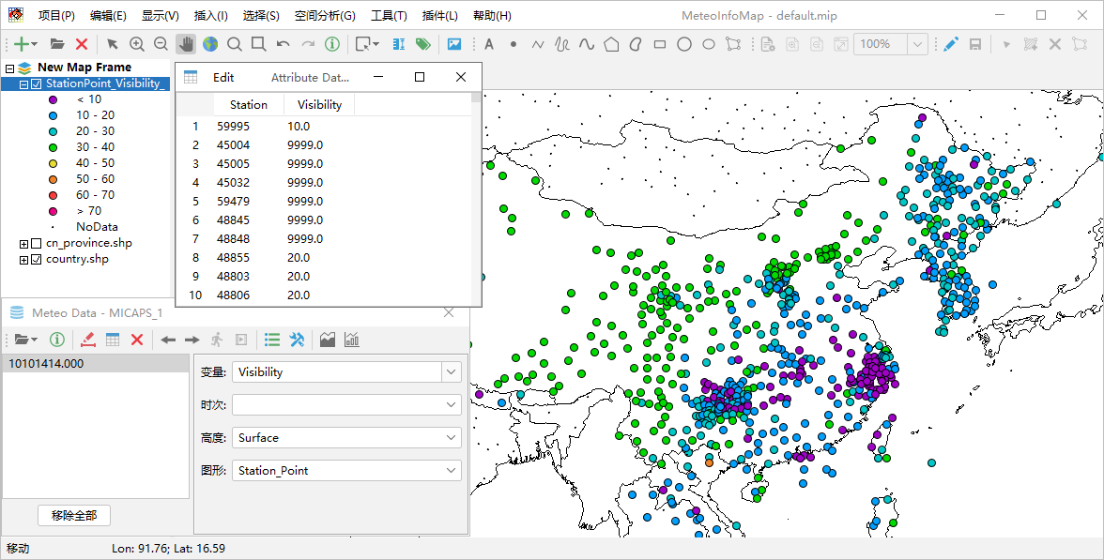
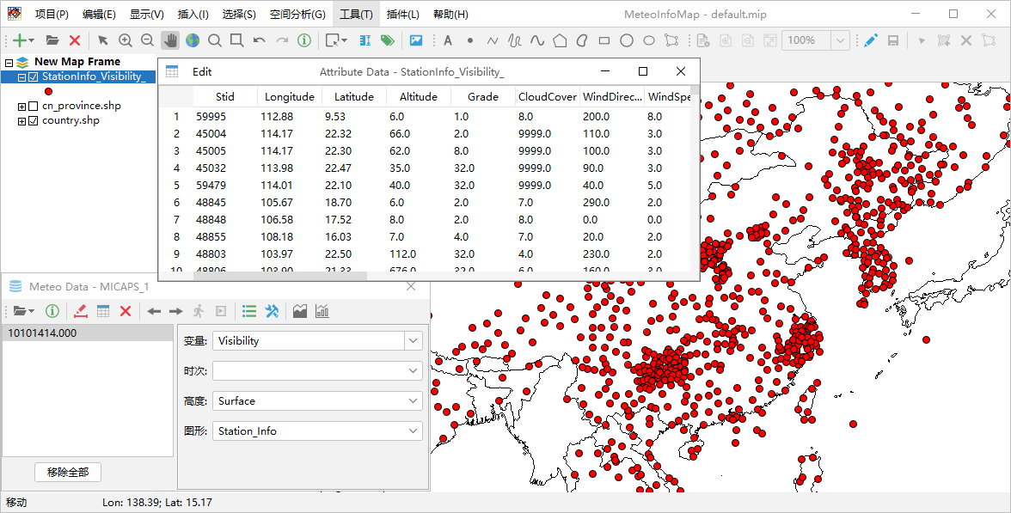
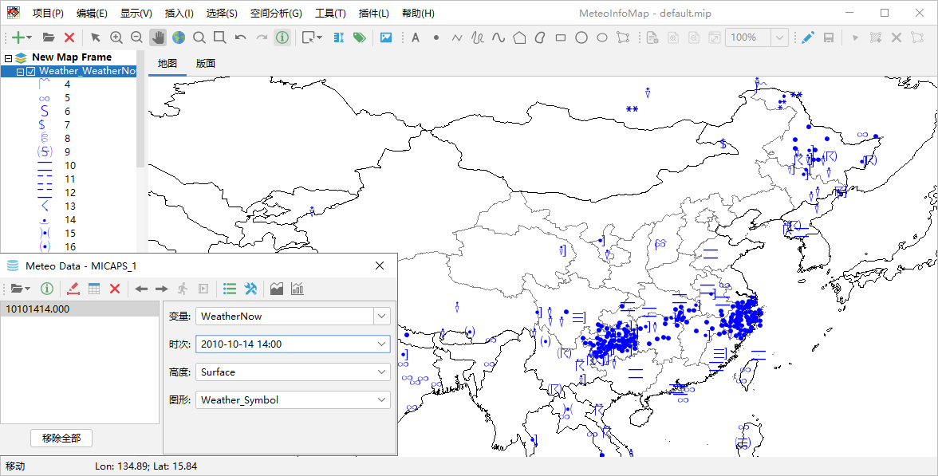
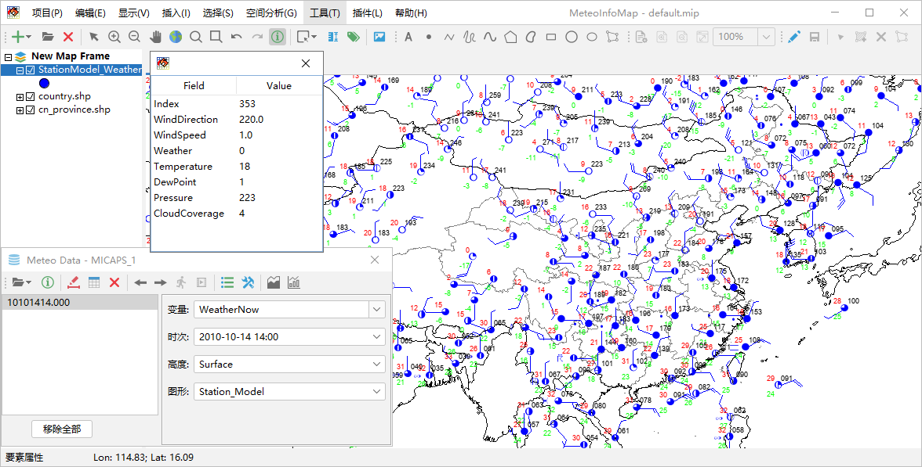
MeteoInfoMap – Station data to GIS layers

Slide 11
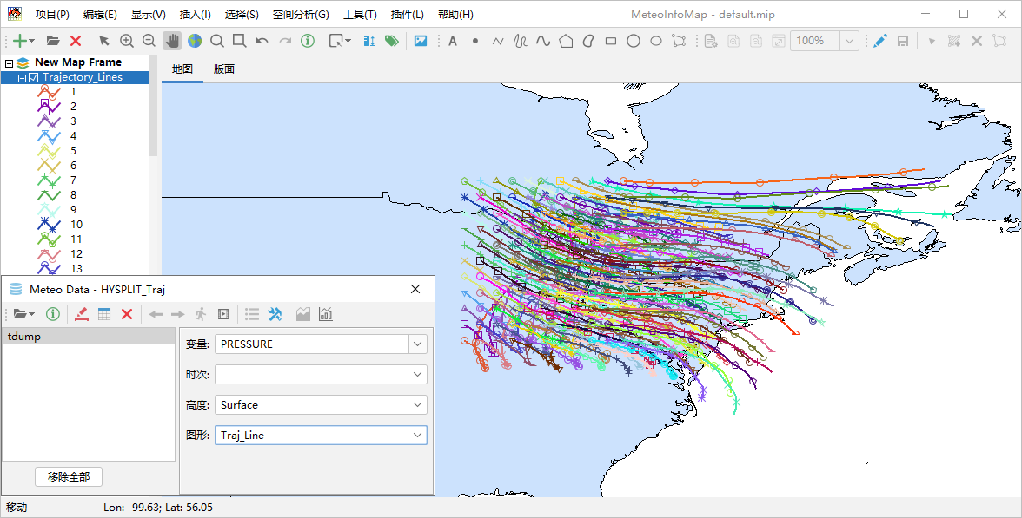
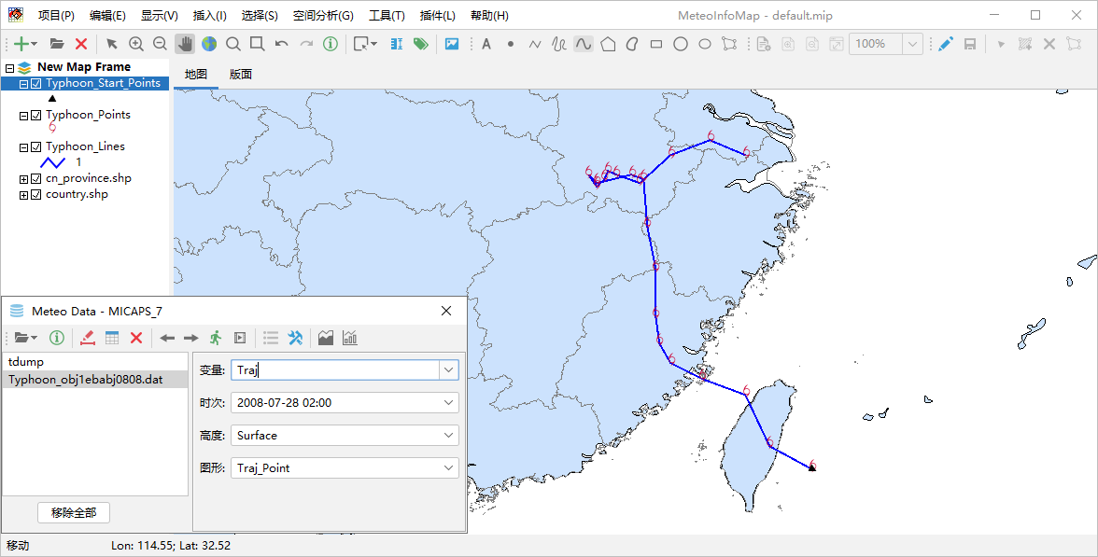
MeteoInfoMap – Trajectory data to GIS layers

Slide 12
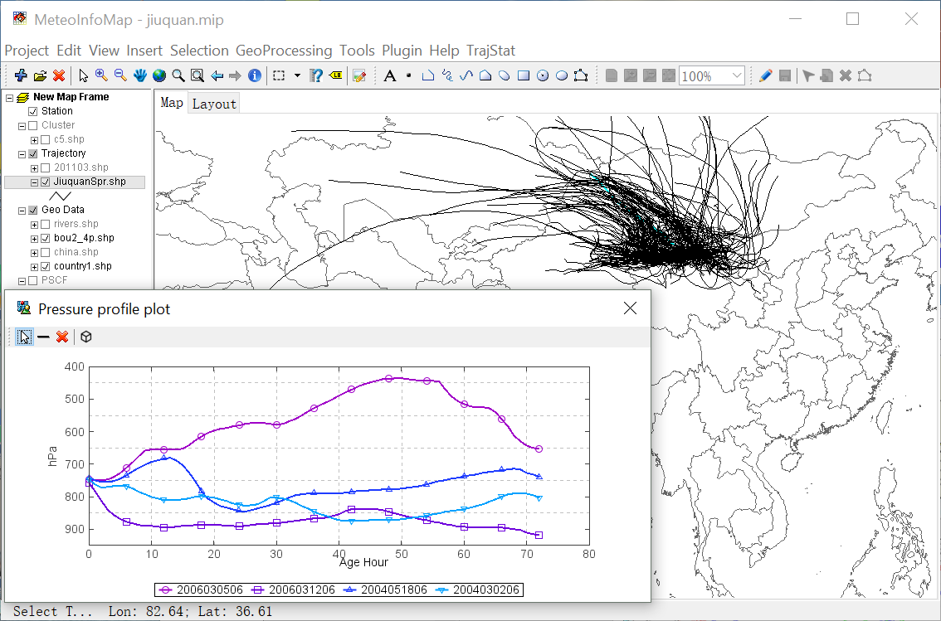
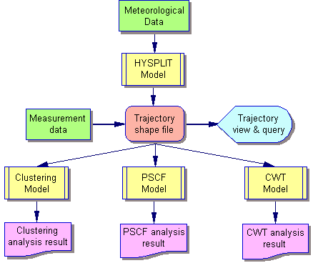
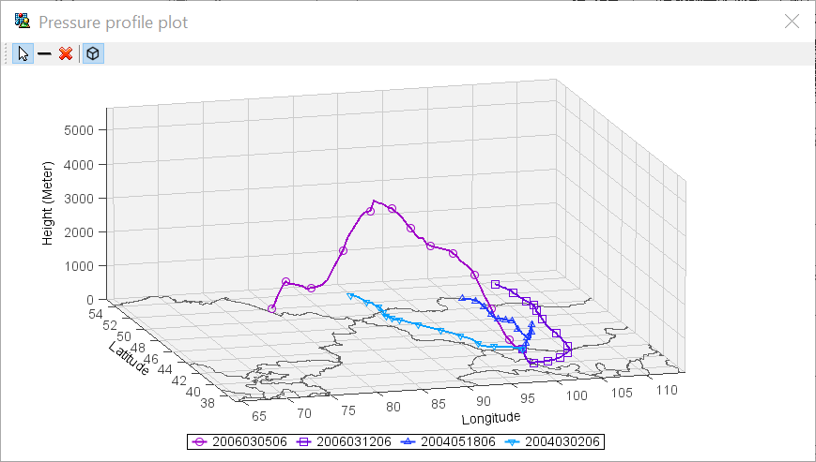
MeteoInfoMap plugin example - TrajStat
Wang et al., 2009, EMS

Slide 13
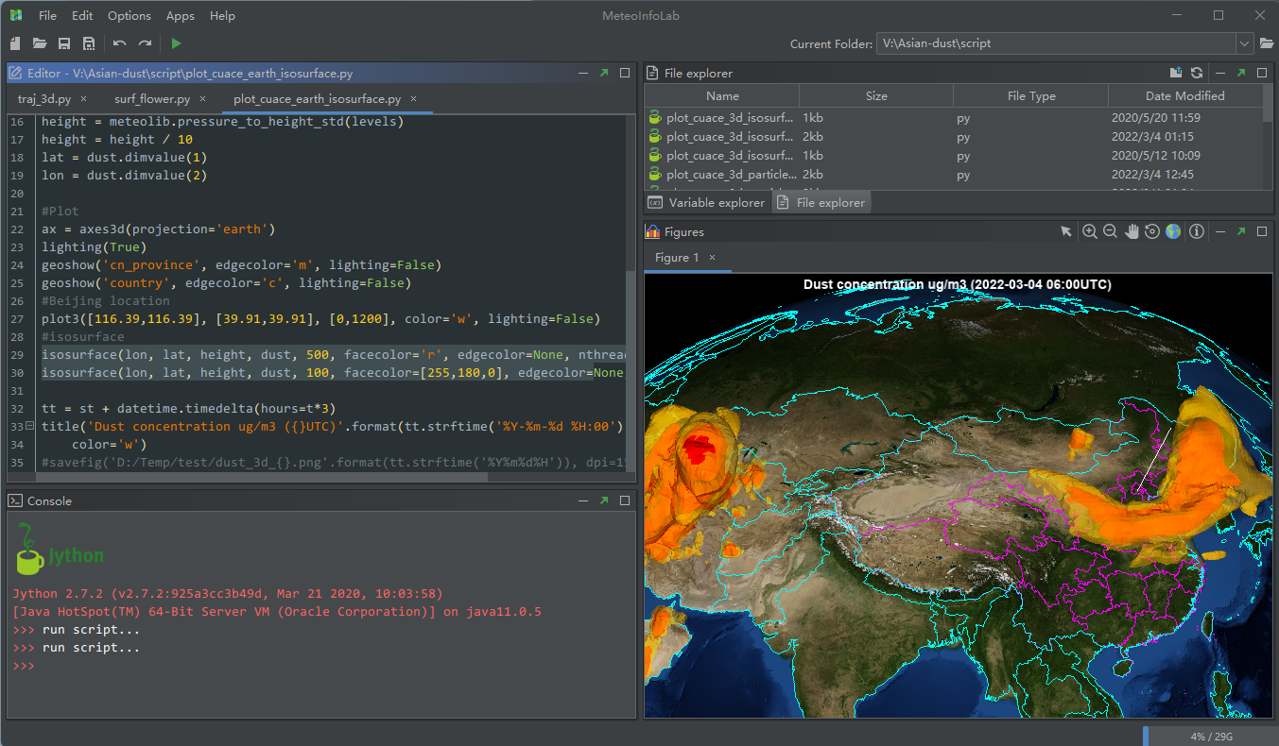
MeteoInfoLab GUI as a scientific computation environment

Slide 14
MeteoInfoLab Jython packages
Jython is a Java implementation of Python that combines expressive power with clarity.
Has similar functions with Python scientific computation environment.
Python: Numpy+Matplotlib+
Pandas+Cartpy+Netcdf4+…

Slide 15
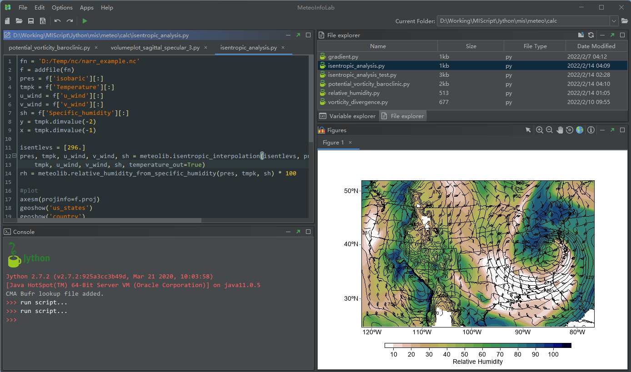
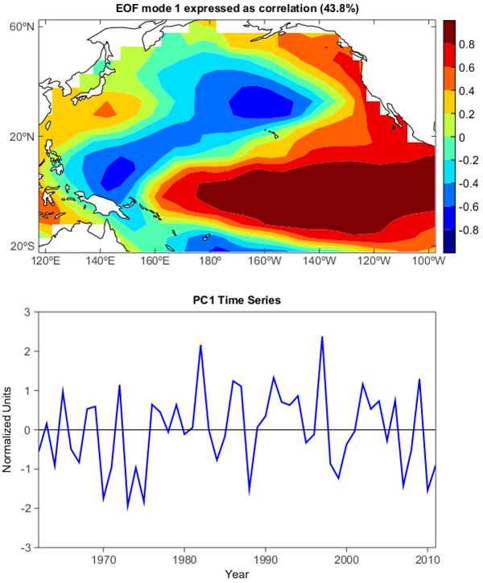
MeteoInfoLab – Meteorological data analysis examples

Slide 16
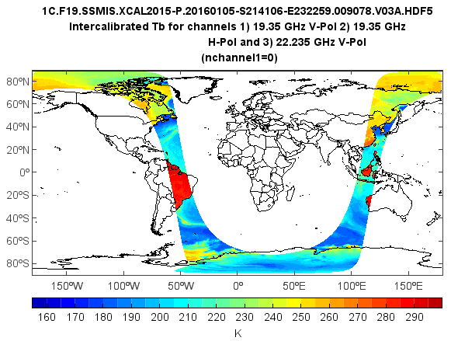
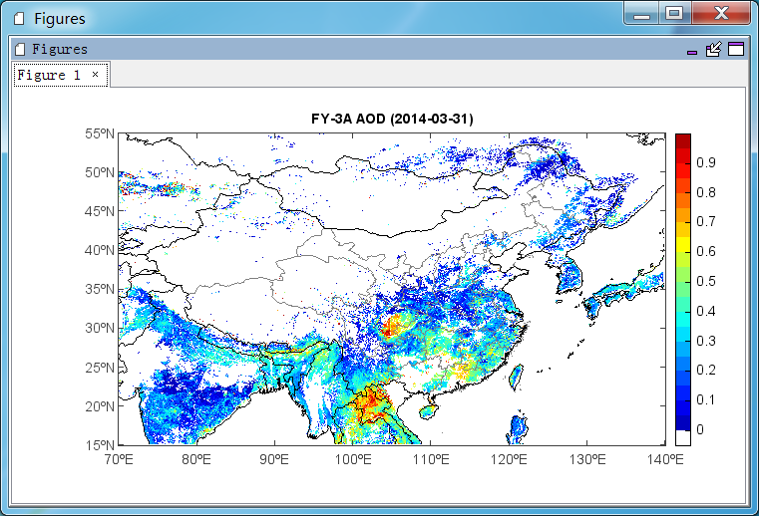
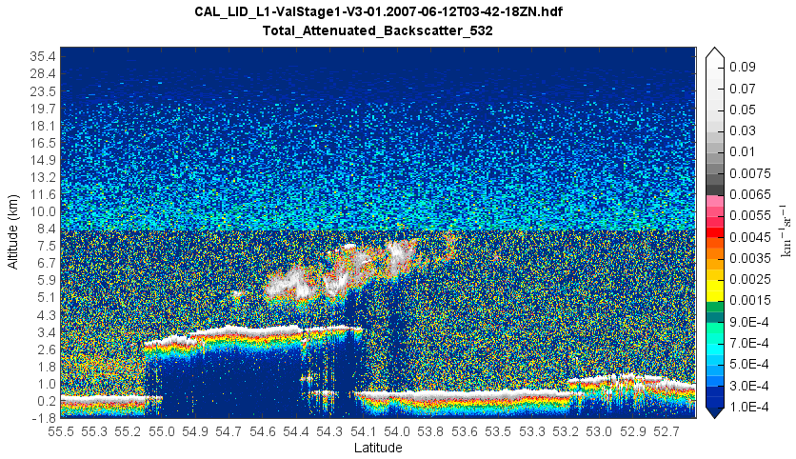
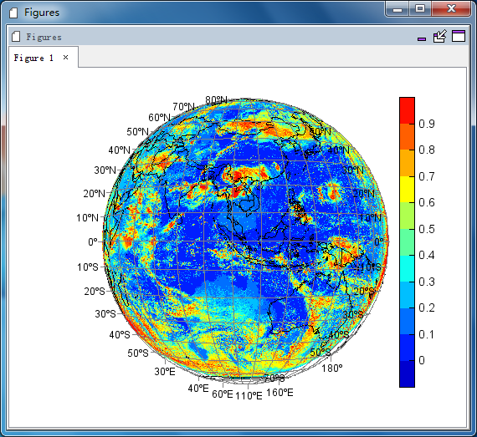
MeteoInfoLab – Satellite data analysis examples
Himawari-8

Slide 17
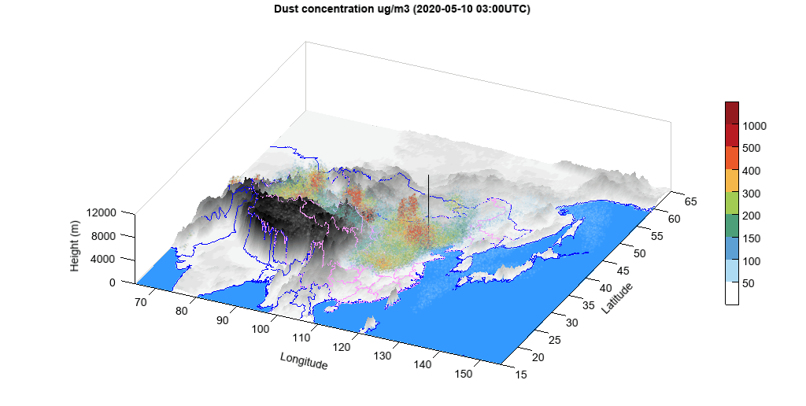
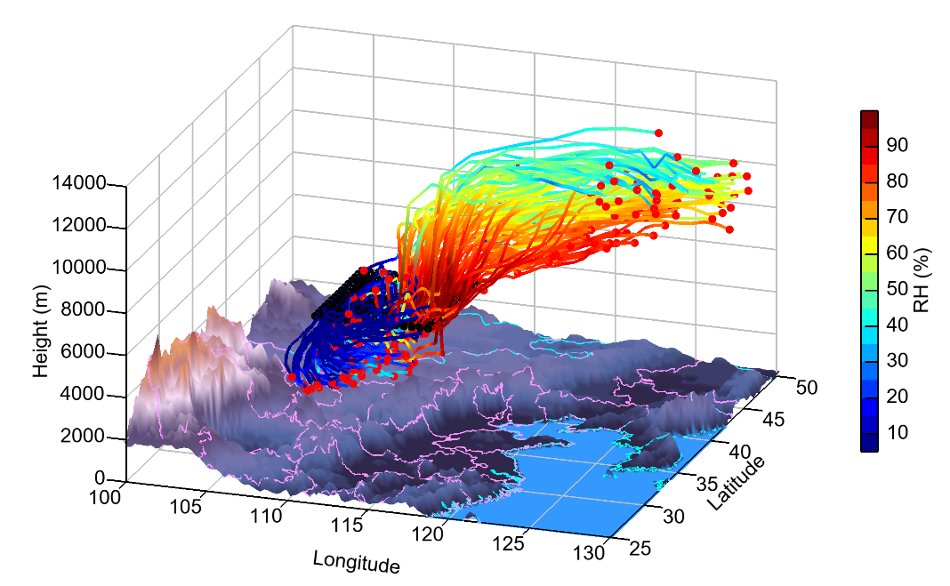
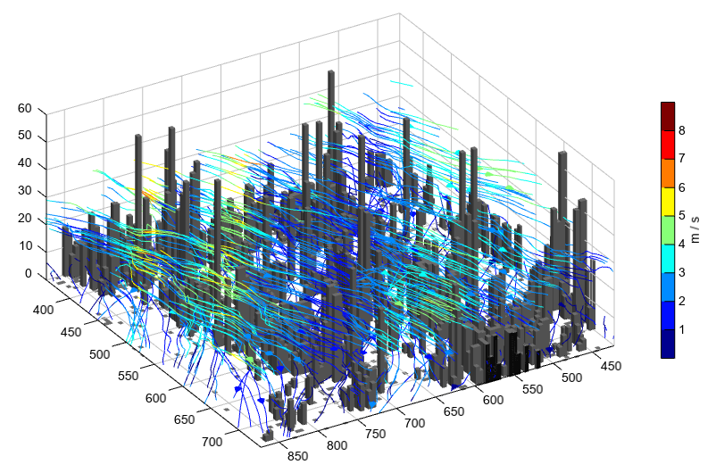
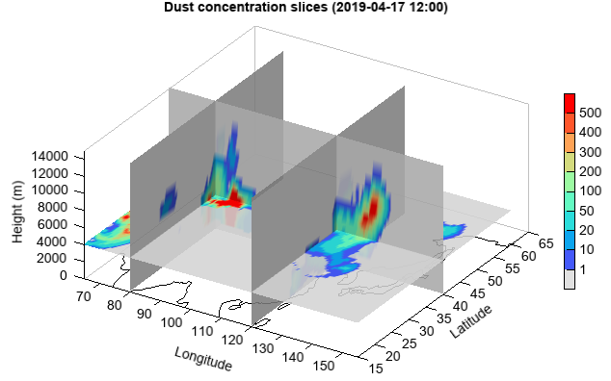
MeteoInfoLab – 3D plot examples

Slide 18
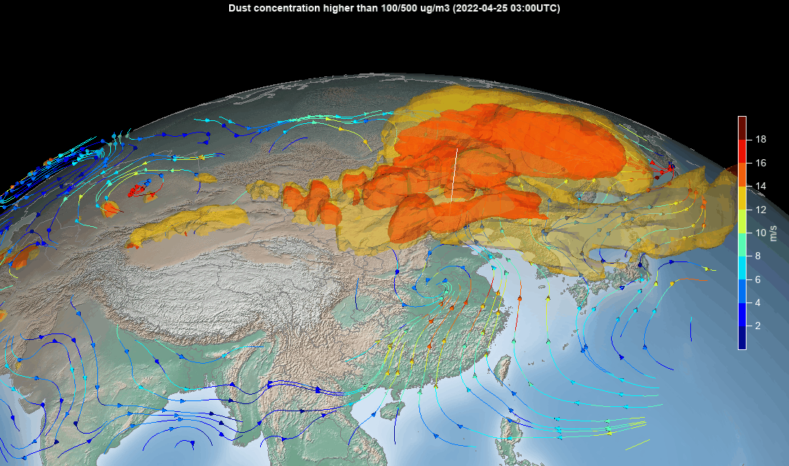
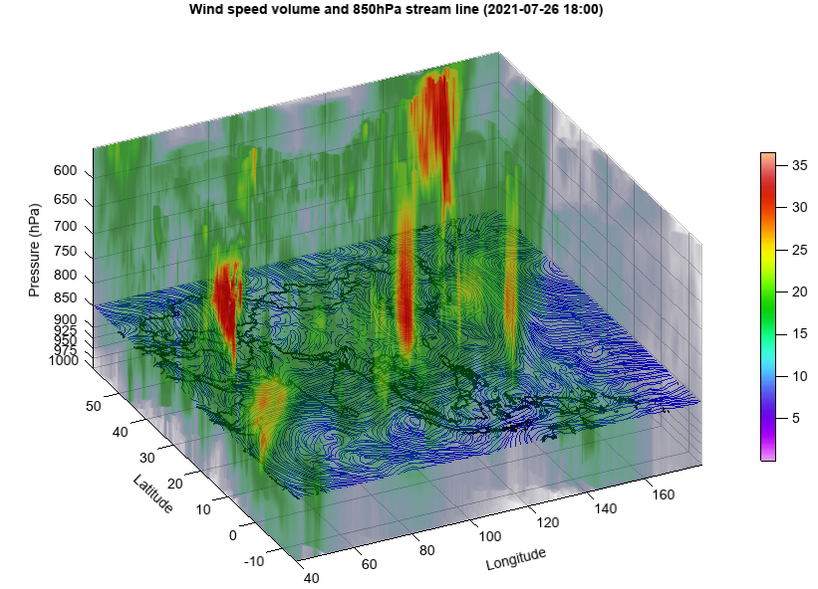
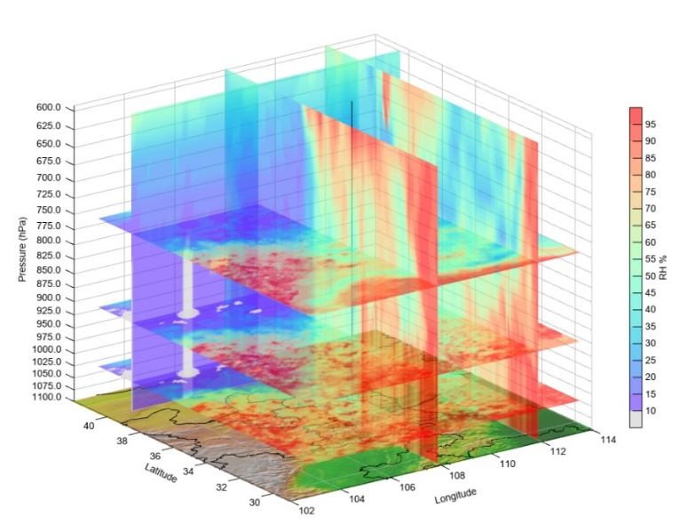
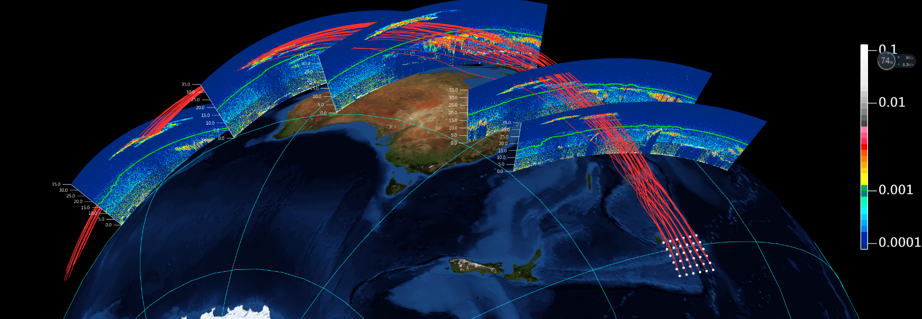
MeteoInfoLab – 3D plot examples

Slide 19
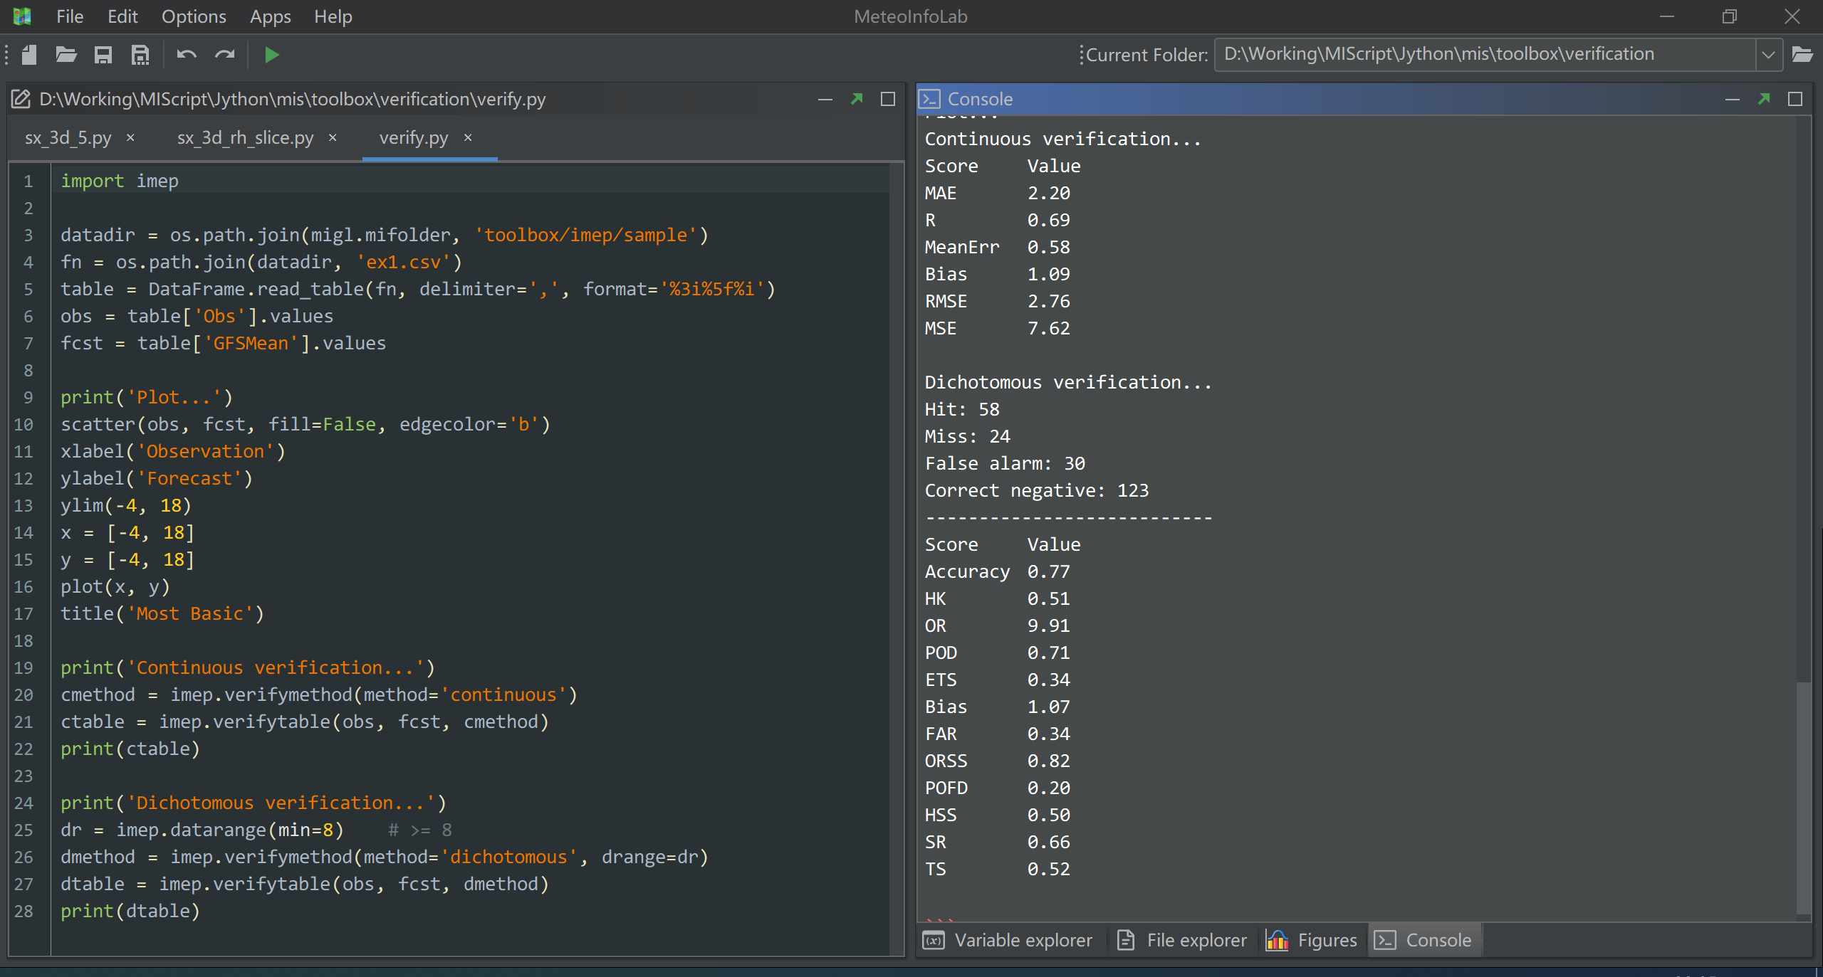
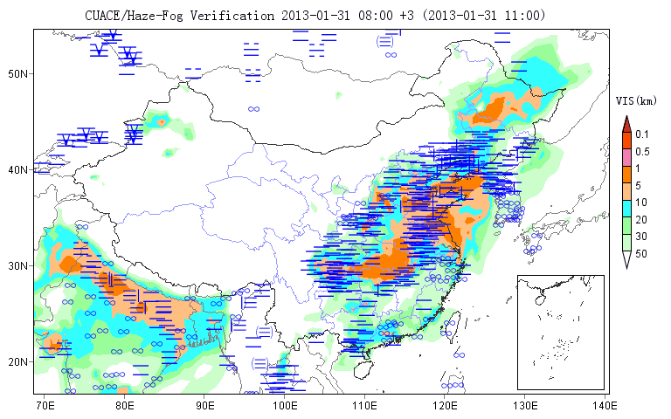
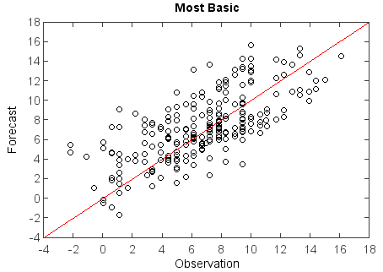
MeteoInfoLab toolbox – Model evaluation (IMEP)

Slide 20


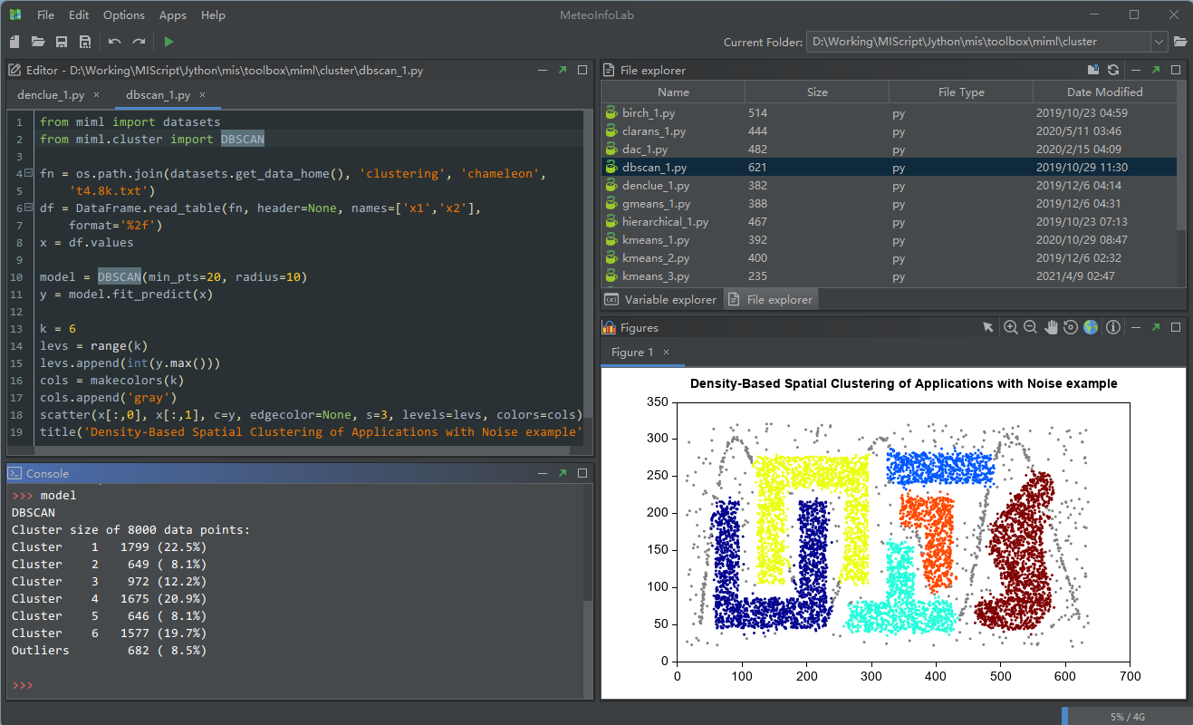

MIML – MeteoInfoLab Machine Learning Toolbox
Machine learning functions – Based on Smile
Deep learning functions – Based on Deeplearning4j
Combined with MeteoInfo computation and visualization platform making an powerful and easily used machine learning tool box.

Slide 21
Thanks for your attention!

