Slide 1


Variations of estuarine metabolic alkalinity loads:
Consequences for the biogeochemistry of a shelf sea (North Sea)
Johannes Pätsch^{1,2}, Helmuth Thomas^{1,3}, Mona Norbisrath^{1,3}
¹Institute of Carbon Cycles, Helmholtz-Zentrum Hereon, Geesthacht, Germany
² University Hamburg, Institute of Oceanography, Hamburg, Germany
³ Institute for Chemistry and Biology of the Marine Environment, Carl von Ossietzky University Oldenburg, Oldenburg, Germany
EGU22-3493

Slide 2
Content:
River Elbe: Variations of Total Nitrogen and Total Alkalinity loads
Consequences for the North Sea biogeochemistry
Decadal variations: Near coast increase of atmospheric CO₂ uptake
Conclusions
2

Slide 3
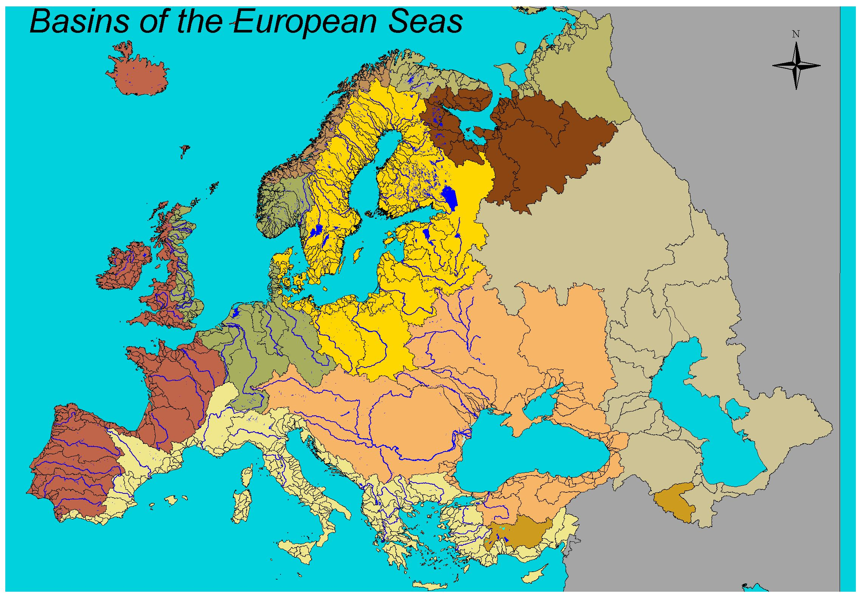
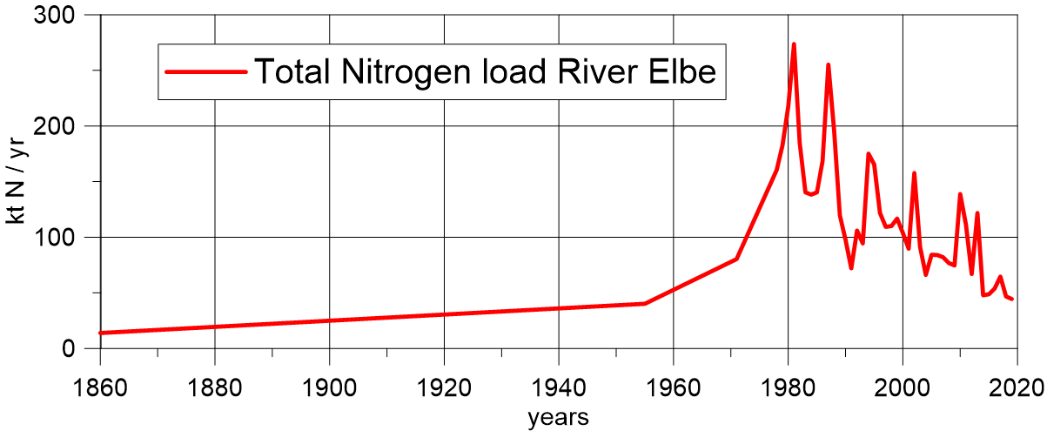
Total Nitrogen loads of River Elbe
River Elbe
estimate by Serna et al., 2010
observations
3

Slide 4
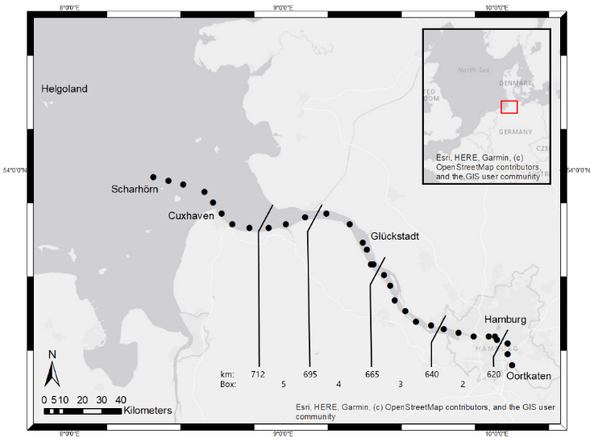
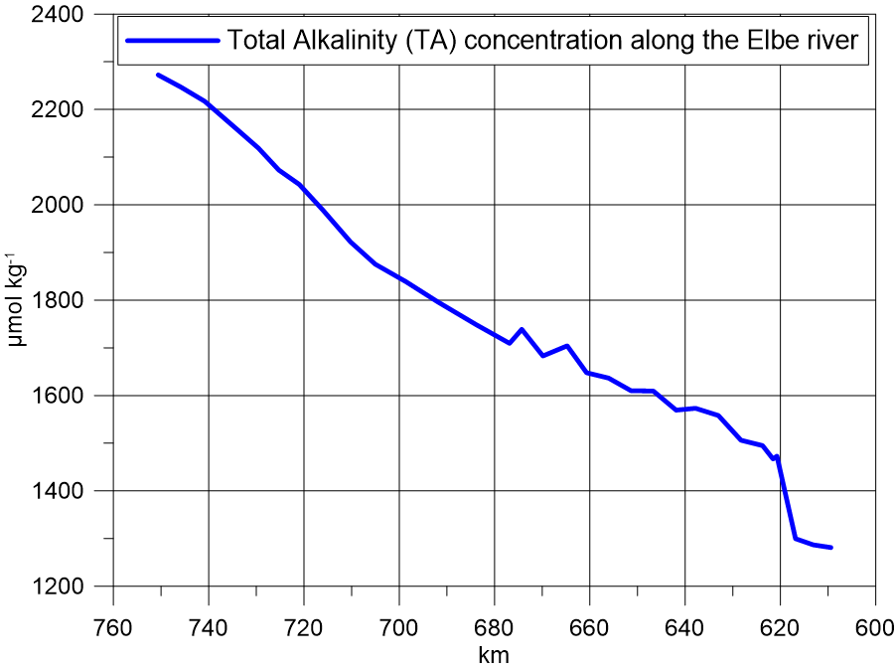

Observed Alkalinity concentrations along River Elbe in summer 2019
Δ TA = 333 µmol kg⁻¹
Δ TA = 333 µmol kg⁻¹
≈ 14 % of TA river load
model approach:
TA load reduction (86 %)
4

Slide 5
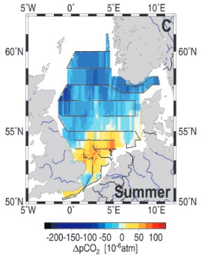
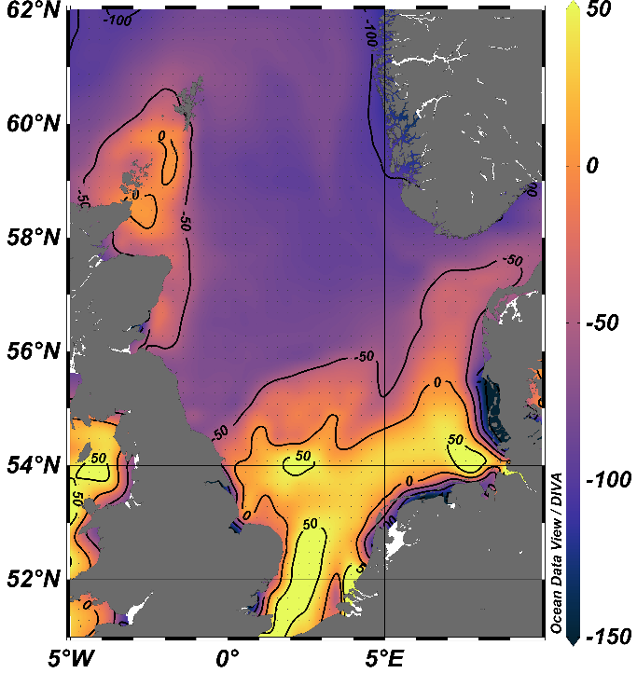
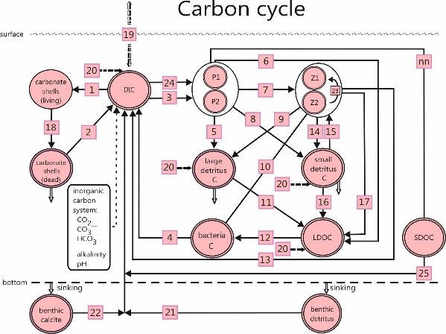
ΔpCO₂ in summer 2001
observations
model results
ECOHAM
under-saturation
Thomas et al. (2004)
over-saturation
5

Slide 6
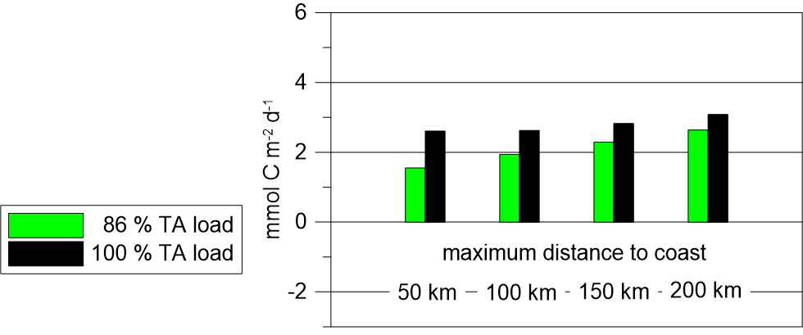
Simulated annual mean air to sea flux of CO₂ (distance to the coast)
2001
6

Slide 7
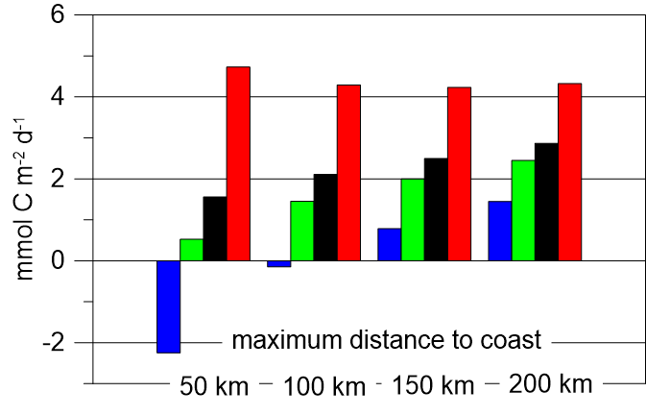
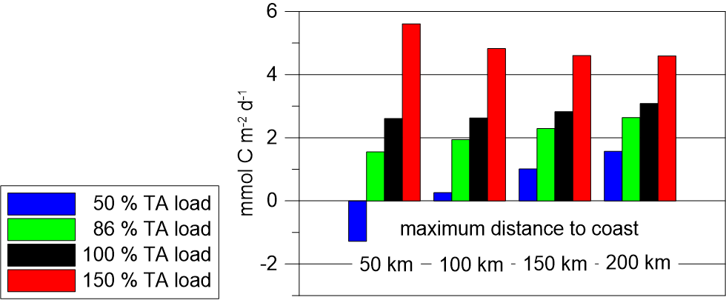
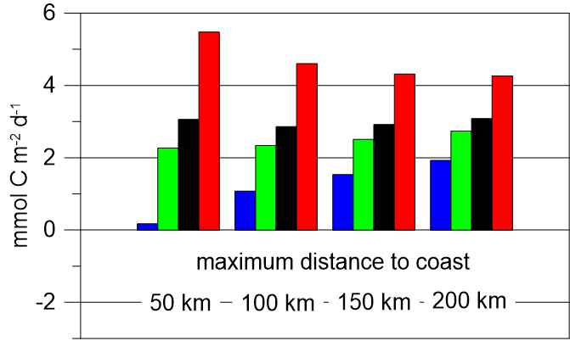
Simulated annual mean air to sea flux of CO₂ (distance to the coast)
CO₂ – uptake increased in near coast zones
over the years
1980
Why?
SST – increased -> opposite effect
pH – decreased -> opposite effect
2001
nitrate load
decreased
-> opposite effect
TN load
decreased
-> organic N decreased
-> NEP increased (?)
2014
-> CO₂ - uptake increased
6

Slide 8
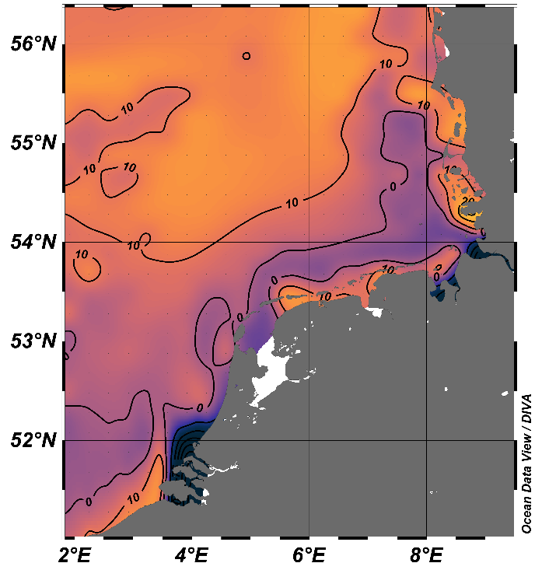
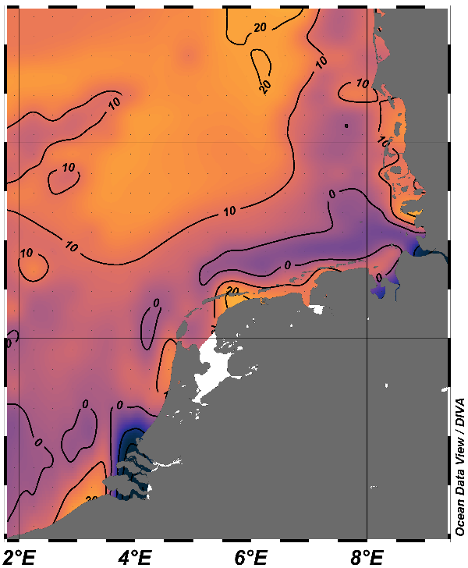
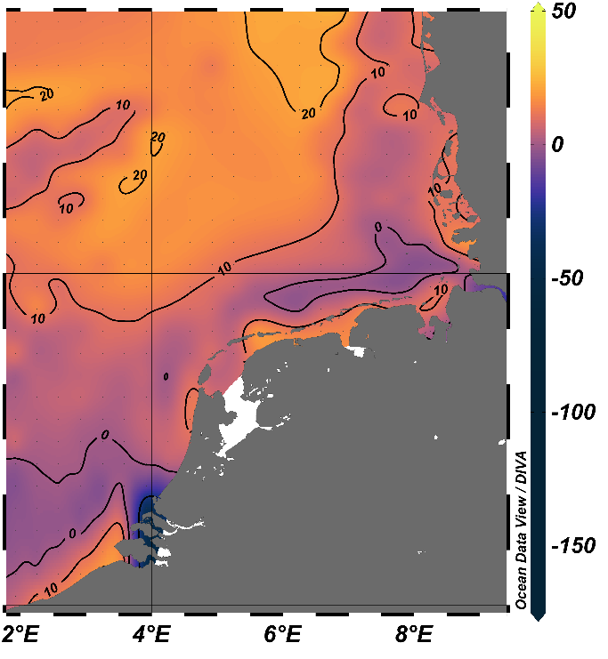
Simulated annual mean Net Ecosystem Production in the upper 30 m
1980
2001
2014
mmol C m⁻² d⁻¹
NEP increase near the coast
7

Slide 9
Conclusions
Anaerobic degradation in rivers entering the North Sea (River Elbe, near harbor) generates Alkalinity. These loads effect the biogeochemistry within the North Sea in a coastal strip of about 100 km. There atmospheric CO₂ uptake increases.
The inter annual variations of atmospheric CO₂ exchange within the near coast (~100 km) are mainly governed by organic river loads. Corresponding DIN loads are there not fully taken up due to light limitation in the coastal zone.
These findings partly cancel the contradiction between policy guidelines for reducing the eutrophication and oxygen deficiencies in coastal waters and those who claim massive bioenergy production, which in turn would increase nitrogen leaking into the sea.
8

Slide 10
Thanks for your attention

