Slide 1
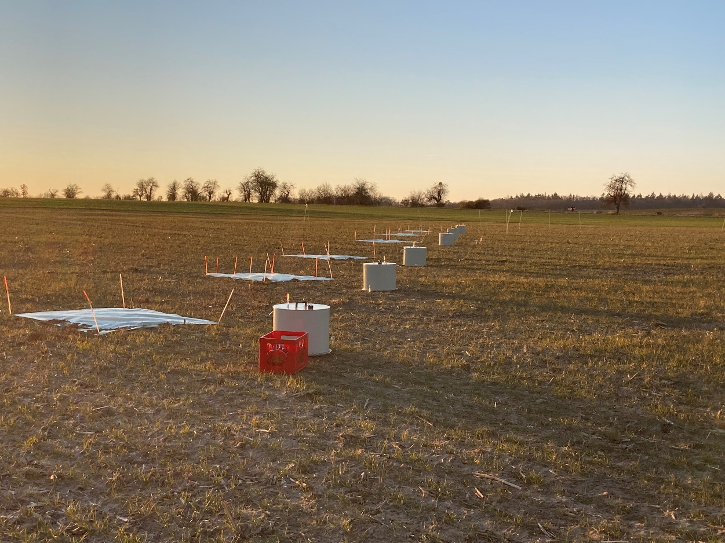

Leibniz Centre for Agricultural Landscape Research (ZALF) e.V.
EGU 2022: BG1.3: Nitrogen in the Anthropocene Session on Monday 23rd May
Does soil heterogeneity drive nitrogen transformation in agricultural landscapes?
Isabel Zentgraf
Dr. Mathias Hoffmann
Dr. Maire Holz
Date: 23.05.2022

Slide 2

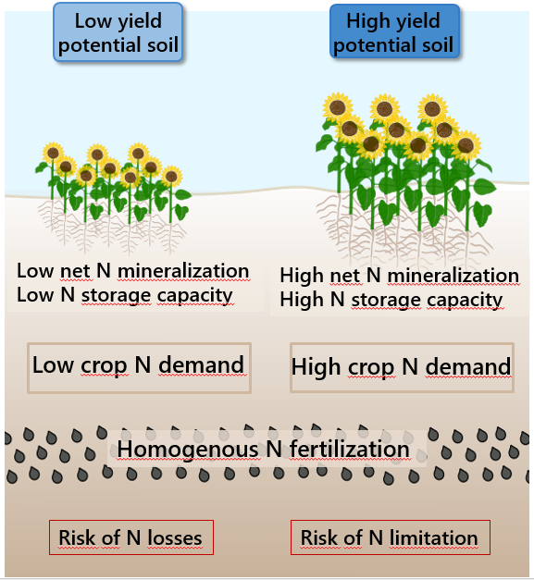
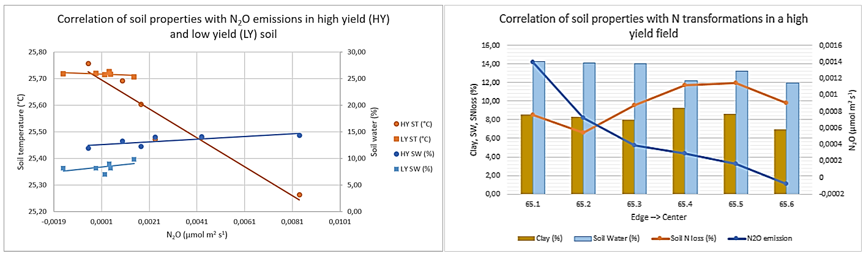
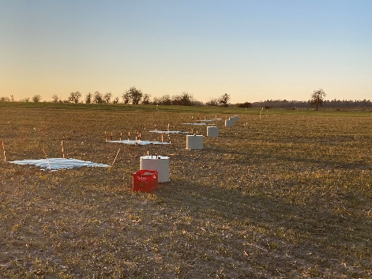
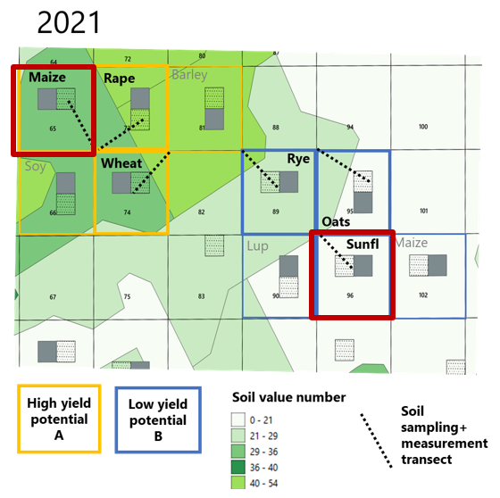
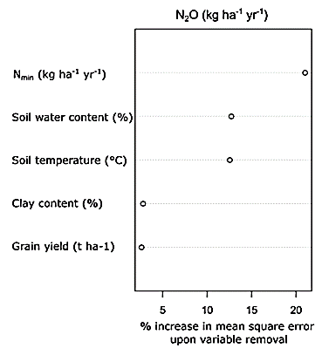
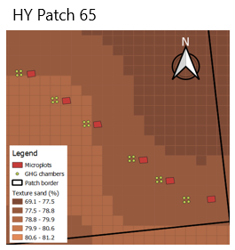
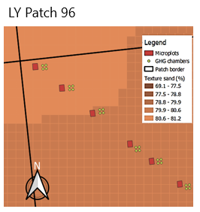
Does soil heterogeneity drive nitrogen transformation in agricultural landscapes?
Motivation
Differences between HY and LY potential zones & within a HY field
Is soil heterogeneity a driver of N transformation and N emission in agricultural landscapes?
N₂O Emissions in relationship
to soil and plant
parameters
Summary
Experimental area
Soil heterogeneity is a clear driver of N transformation and N emission in agricultural landscapes
Prominent difference in N emissions and N transformations between HY and LY soils
Strong variability of soil related parameters along the analysed transects
N₂O emissions are strongly related to soil parameters than plant parameters

Slide 3
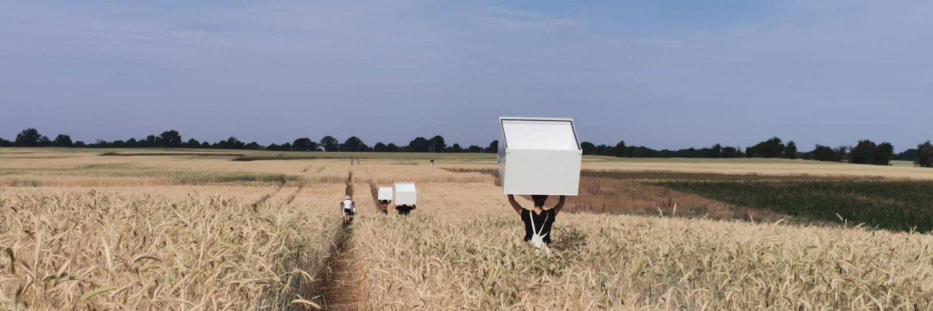
Thank you!

