Slide 1



Numerical Advances in Understanding the Behavior of Gravity Retaining Wall during Seismic Motions
European Geosciences Union General Assembly 2022
(EGU22)
Prerna Singh
Ph.D. Research Scholar
Department of Civil Engineering
Supervisors
Prof. Tanusree Chakraborty, Prof. Puneet Mahajan
Indian Institute of Technology Delhi
New Delhi, India

Slide 2

Framework
Literature Review
Research Objectives
Conclusions
Numerical Analysis
Motivation

Slide 3
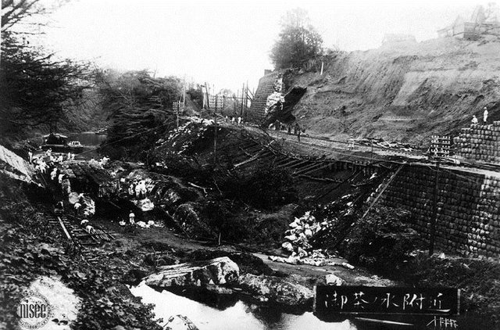
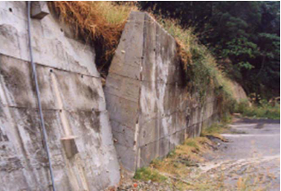
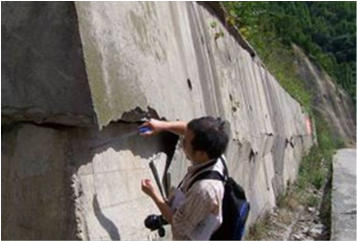

Motivation
Rotation of gravity wall due to slope failure during 1999 Chi-Chi earthquake.
Source: Sitar et al. (2012)
Retaining wall collapsed during 1923 Great Kanto earthquake, Japan.
Source: Sitar et al. (2012)
Earthquake damage of retaining wall 2008 Sichuan earthquake.
Source: Wu et al. (2012)
Mononobe-Okabe (MO) method
(Okabe (1926) and Mononobe and Matsuo (1929)
Response of dynamic loading in earthquake prone areas is crucial, and proper design is required for safety and serviceability.
Notes:
1. Earthquakes can create severe damage to the retaining structure, so their behavior becomes important.
2. Given attention after the great Kanto earthquake in 1923.
3. First pioneering and widely used method for evaluation of earth pressure of retaining walls.

Slide 4

Literature Review and Knowledge Gap
Reference | Problem studied | Limitation
Mononobe and Matsuo (1929), Okabe (1929) | Pseudo-static method for gravity retaining wall with cohesionless backfill | Neglected effect of time and phase difference, assumed uniform acceleration in the medium.
Steedman and Zeng (1990) | Pseudo dynamic approach for dynamic earth pressure | No effect of wall friction, wave amplification, V_{p}, V_{s} was considered.
Psarropoulos et al. (2004) | FE analysis of gravity and cantilever wall, harmonic excitation. | Complete bonding at wall-soil interface, harmonic excitation.
Choudhury and Nimbalkar (2006) | P_{ae} using pseudo dynamic method for vertical rigid retaining wall | Neglected non-uniformity in soil, sinusoidal wave is considered.
Al-Atik and Sitar (2010) | Experimental and FEM analysis for different types of retaining walls | Specific type of soil is considered, requires more experimental work.
Salem et al. (2020) | FE analysis for cantilever wall with dry cohesionless soil. | Wider range of ground motion data are needed
Knowledge Gap
Insufficient number of real-time ground motion records.
Lack of consideration of higher seismic loads.
Lack of consideration of proper soil-structure interaction.

Slide 5

Research Objectives
Construction of retaining wall soil model with proper interaction and boundary condition
Numerical analysis of model under wide range of real time dynamic loading
Quantitative response and comparison with MO method
Height (Anderson et al., 2008)
Relative density of soil (Al-Atik and Sitar, 2010)
Soil-structure interaction (Brinkgreve and Shen, 2011)

Slide 6

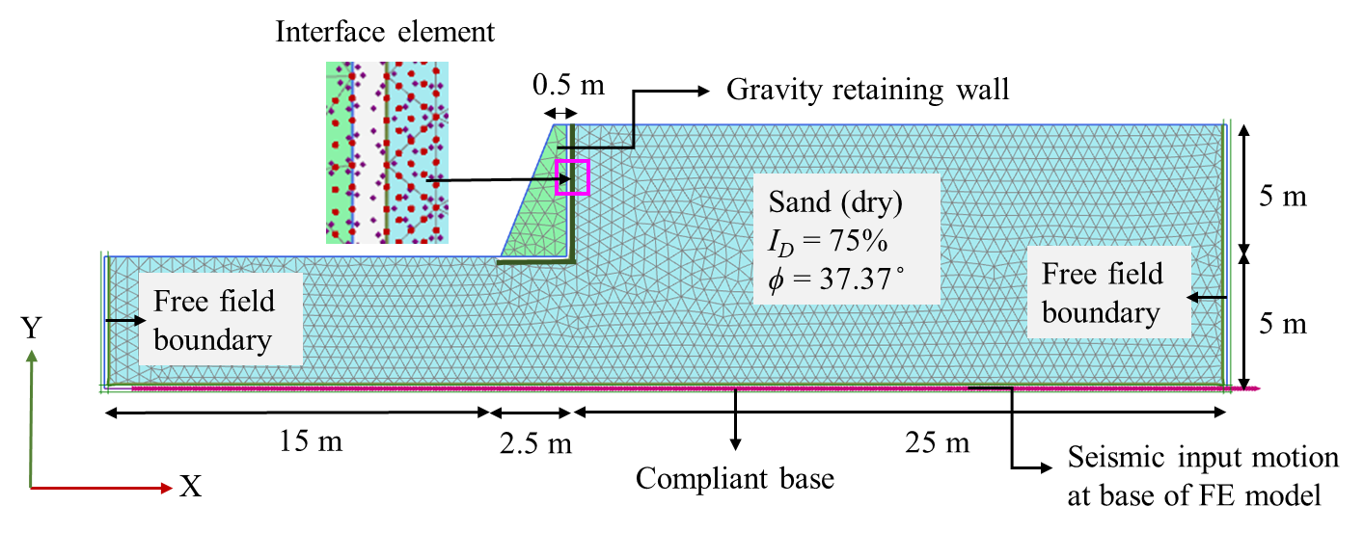
Methodology
1989 Loma Prieta earthquake
Earthquake: 1989 Loma Prieta
Retaining wall:
H = 5
Soil: Dry cohesionless, I_{D} = 75%,
Note: Scaled from a_{max} = 0.053 to 1.2g.
Numerical modelling (Plaxis software)
Acceleration
Response
Displacement
Earth pressure
Schematic representation of retaining wall soil system in Plaxis 2D.
Notes:
Earthquake (e.g., peak ground acceleration, frequency), Retaining wall parameters (e.g., height, Young’s modulus), Soil parameters (e.g., backfill and foundation soil properties)

Slide 7

Material properties
Elements
Parameters | Unit | Parameters based on I_{D}
Soil
Relative density (I_{D}) | % | 75
Unit Weight (γ_{s}) | kN/m³ | 18
Friction angle (ϕ) | ͦ | 37.37
Secant modulus (E₅₀^{ref}) | MPa | 45
Shear modulus (G_{o}^{ref}) | MPa | 111
Dilation angle (Ψ) | ͦ | 7.37
Constant for stress dependent stiffness (m) | - | 0.46
Shear strain at 70% of G_{o}^{ref} (y_{0.7}) | - | 1.25x10⁻⁴
Failure ratio (R_{f}) | - | 0.9
Retaining Wall
Young’s Modulus (E) | MPa | 35000
Poisson’s ratio (ν) | - | 0.15
Unit weight (γ_{w}) | kN/m³ | 24
CONCRETE
Elastic, isotropic
Constitutive model: Linear elastic
SOIL
Non-linear elasto-plastic
Constitutive model: HSsmall
EARTHQUAKE
Dynamic, Newmark’s implicit time integration
Note: Soil parameters for HSsmall model are obtained using equations from Brinkgreve et al. (2010).

Slide 8
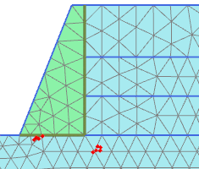
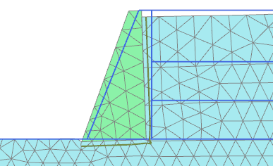
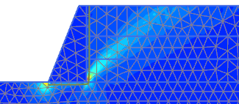
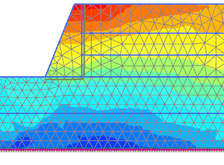



Results: Deformation and acceleration response
u_{r} = 0.08 m
Failure point
Deformed mesh
Generation of failure points
ε_{x}
Spectra acceleration response at wall top (SA_{wt}), wall base (SA_{wb}), soil top (SA_{st}), and base for a_{max} = 0.28g
Overturning mode
Non-linear and non-uniform distribution.
a_{wt} > a_{st} > a_{wb}.
Acceleration response at active state (t = 4.45 s)
Deviatoric strain
a_{max}= 0.28g

Slide 9

Results: Displacement, rotation and earth pressure response
Residual displacement at wall top (u_{wt}) and soil top (u_{st})
Comparison of P_{ae} from present study and MO method
Residual rotation of the wall.
With increase in a_{max}, u_{r} and θ increases
MO provides over-conservative P_{ae}
MO method gives P_{ae} until condition of shear fluidization is followed (Richards et al., 1990):
For present study, k_{h} < 0.55, Eq. (1) is satisfied .
(1)

Slide 10

Conclusions
The acceleration is not uniform and varies from base to top of ground surface. The amplification is maximum at wall top followed by soil top and wall base.
The formation of rupture surface started at around a_{max} = 0.5g and the dominant mode of failure for gravity retaining wall is overturning.
The translational displacement and rotation of the wall increased with increase of earthquake load.
The minimum active earth pressure force does not necessarily occur at the time of peak values as there is a time lag when waves travel from base to ground. The MO method provides highly overconservative results and the difference increases as seismic loading increases.

Slide 11


Thank You !!!

