Slide 1




Soil micro-food web adaptations to stoichiometric imbalance regulate soil multifunctionality
Reporter: Bing Li
Supervisor: Professor Qi Li
Soil Ecology Lab, Institute of Applied Ecology, Chinese Academy of Sciences

Slide 2
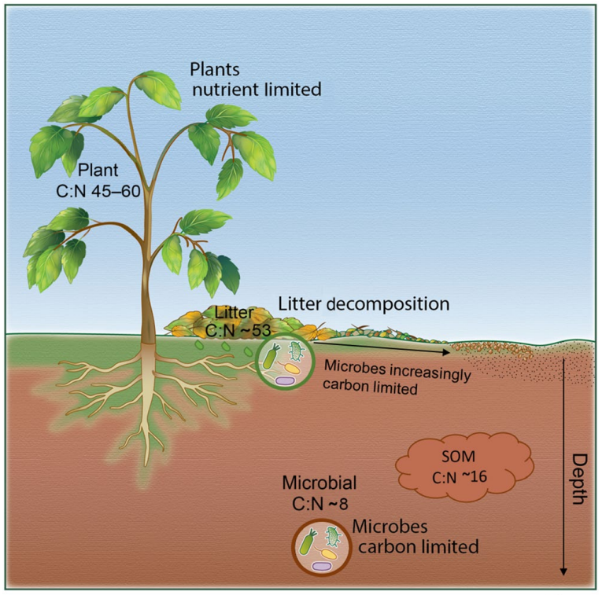
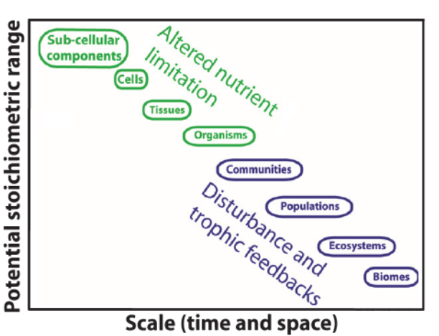
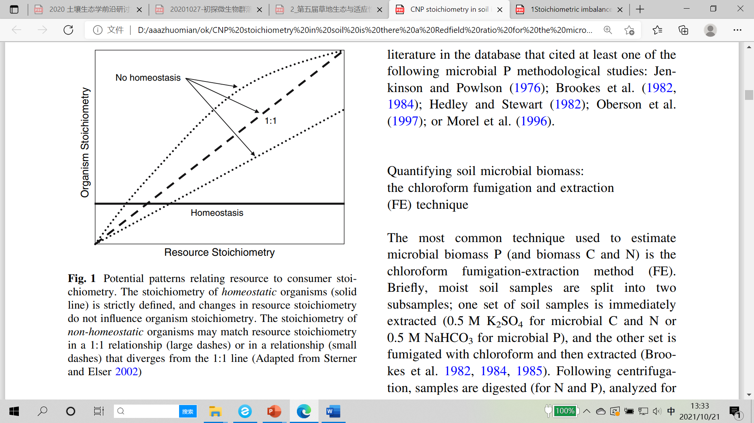
Background
Stoichiometry imbalance
Sistla and Schimel, 2012, New Phytologist; Soong et al., 2019, Global Change Biology

Slide 3
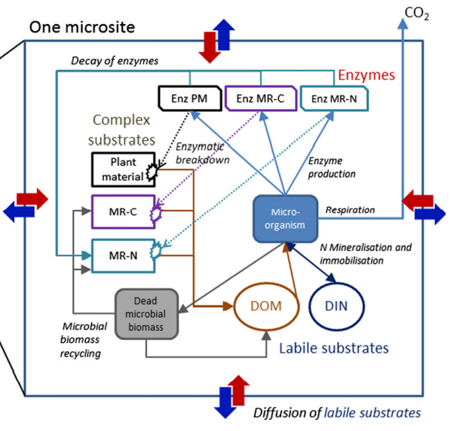
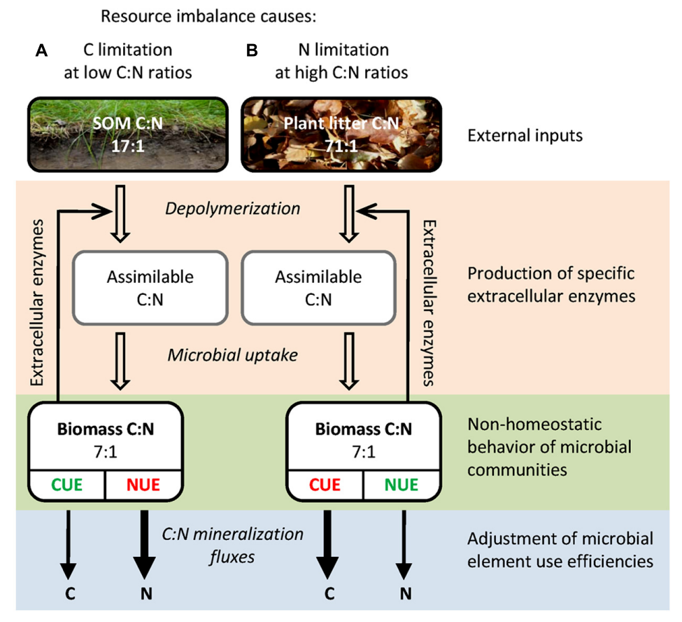
Background
Response mechanisms
Kaiser et al., 2014, Ecology Letters; Moorhead et al., 2014, Frontiers in Microbiology

Slide 4
Background
Soil micro-food web
Adapted from Orgiazzi et al., 2016, Global Soil Biodiversity Atlas
Notes:
vi

Slide 5

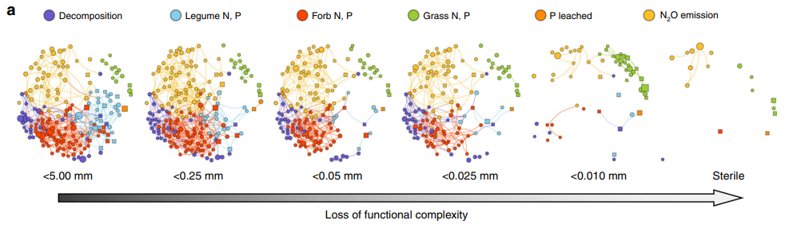
Background
Changes in network of soil micro-food web
Elemental limitation
Wagg et al., 2019, Nature Communications

Slide 6
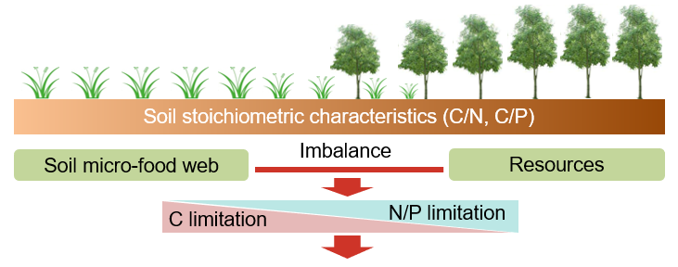
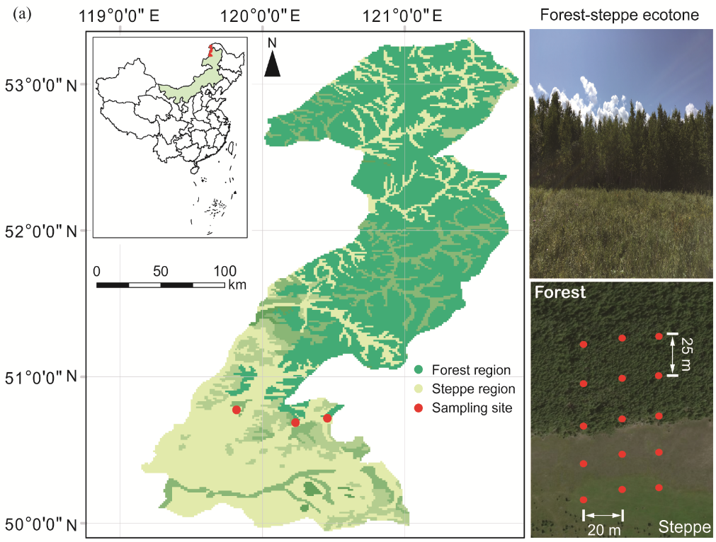
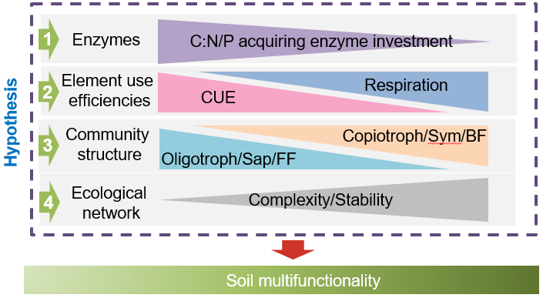
Experimental design and Hypothesis

Slide 7
Results
Stoichiometric imbalances and microbial homeostasis
C/N imbalances = (DOC/AN) / (MBC:MBN)
C/P imbalances = (DOC/AP) / (MBC/MBP)
N/P imbalances = (AN/AP) / (MBN:MBP)
Stoichiometric imbalances
Microbial homeostasis

Slide 8
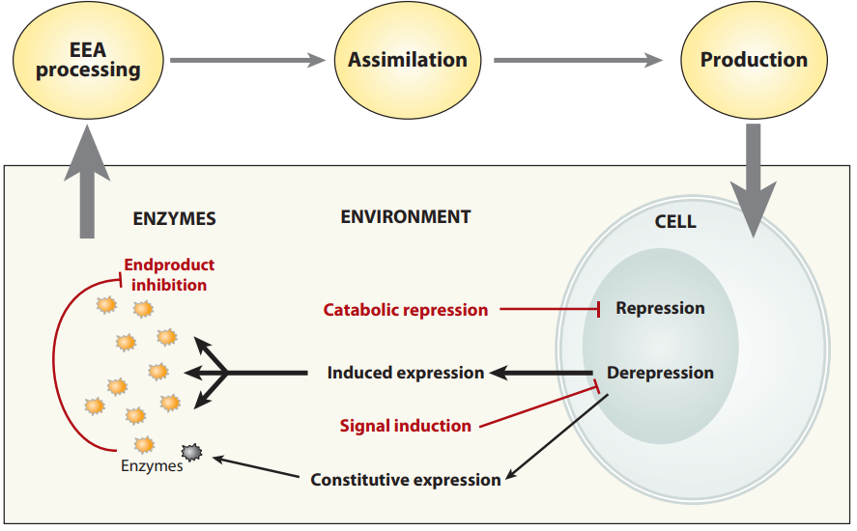
Results
Soil enzyme allocation
Most limiting resources

Slide 9
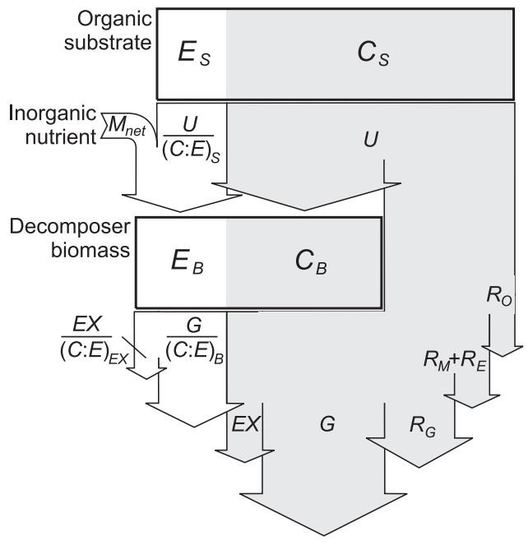
Results
Microbial carbon use efficiency and respiration
Excessive C could be consumed through overflow respiration as CO₂
Manzoni et al., 2012, New Phytologist

Slide 10
Results
Functional groups of soil micro-food web
The presence of bacterivores could also help to enhance microbial basal respiration and metabolic quotient

Slide 11
Results
Ecological networks of soil micro-food web
B-F
Complexity
Connections
B-N
Stability
N-F

Slide 12

Results
Soil ecosystem function
$$MNC=\frac{1}{N}\sum_{i}^{N}{S_{i}}$$
Soil ecosystem functions were evaluated by multi-nutrient cycling index (MNC). Nutrient variables include Carbon (TC, DOC, Litter-C, BG), Nitrogen (TN, NH₄⁺, NO₃⁻, Litter-N, NAG), Phosphorus (TP, AP, Litter-P, ACP) and Litter-biomass.

Slide 13
Conclusions
Soil microorganisms enhanced their C-acquiring enzyme allocation and CUE with decreasing soil C:N:P ratios along the forest-steppe ecotone
The community composition of soil micro-food web changed with an increase in oligotrophic bacteria, saprotrophic fungi and fungivorous nematodes in steppe with lower soil C:N:P ratios.
The decreasing soil C:N:P ratios induces a more simplified and unstable soil network.
Multiple adaptation pathways jointly influence soil ecosystem function, among which the community structure plays an important role.

Slide 14
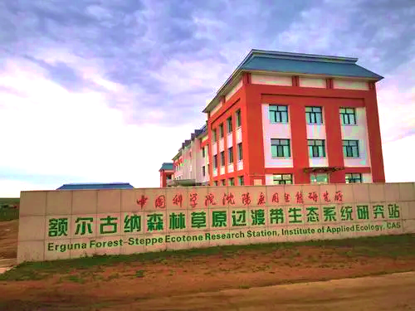
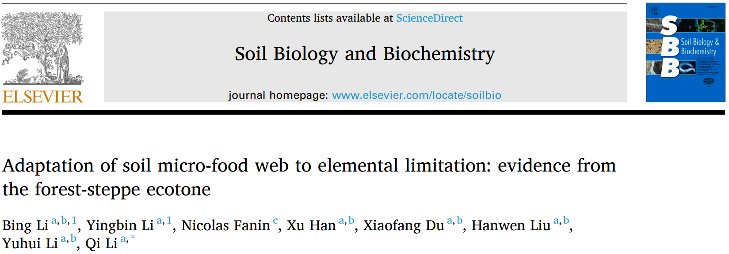
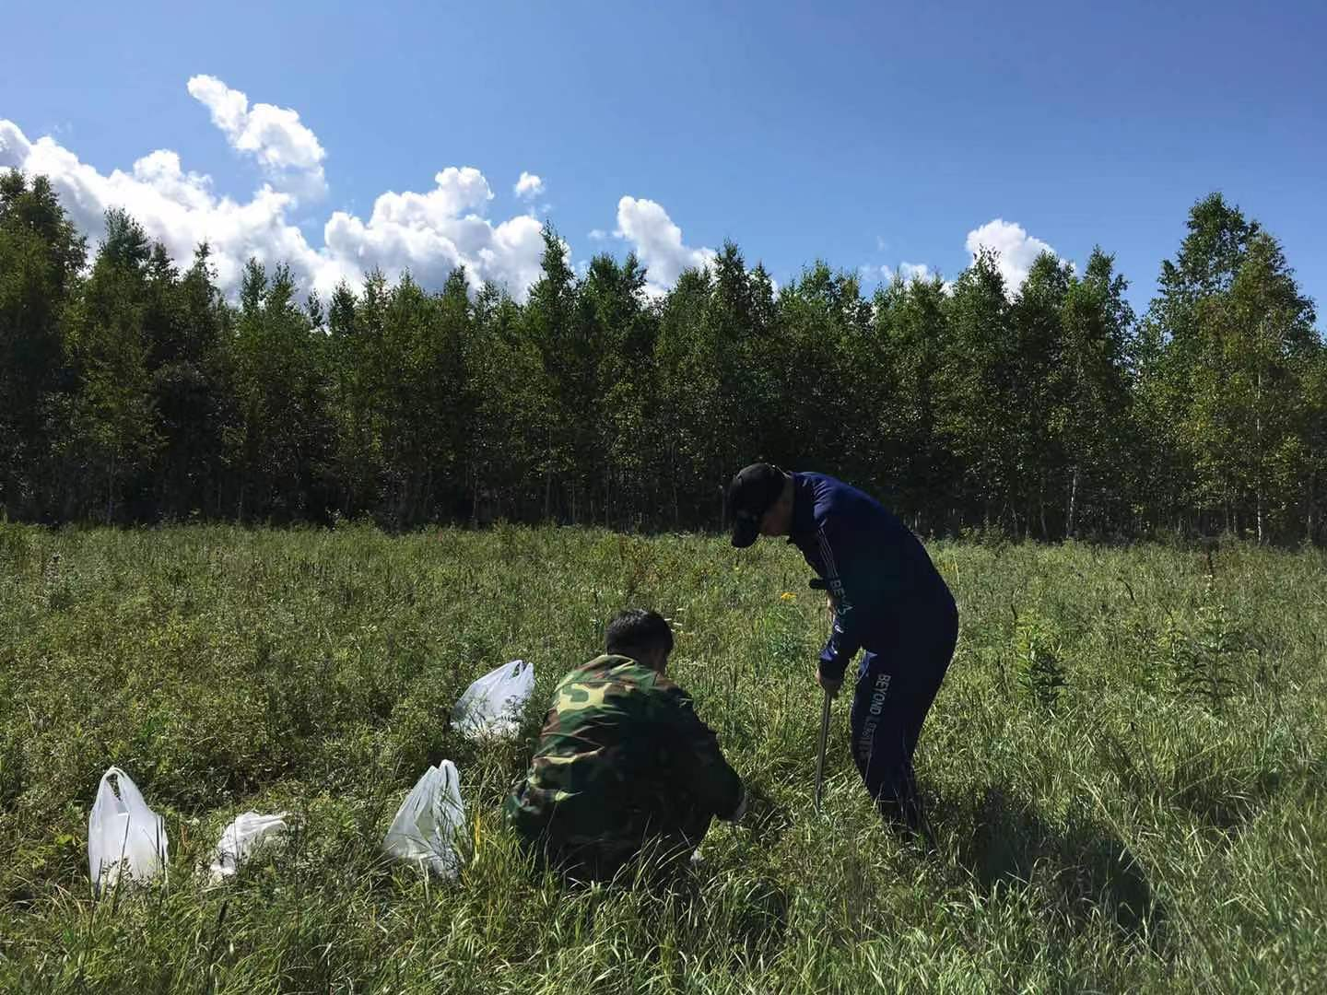

Acknowledgments

Slide 15
Thank you for your attention !

