Slide 1
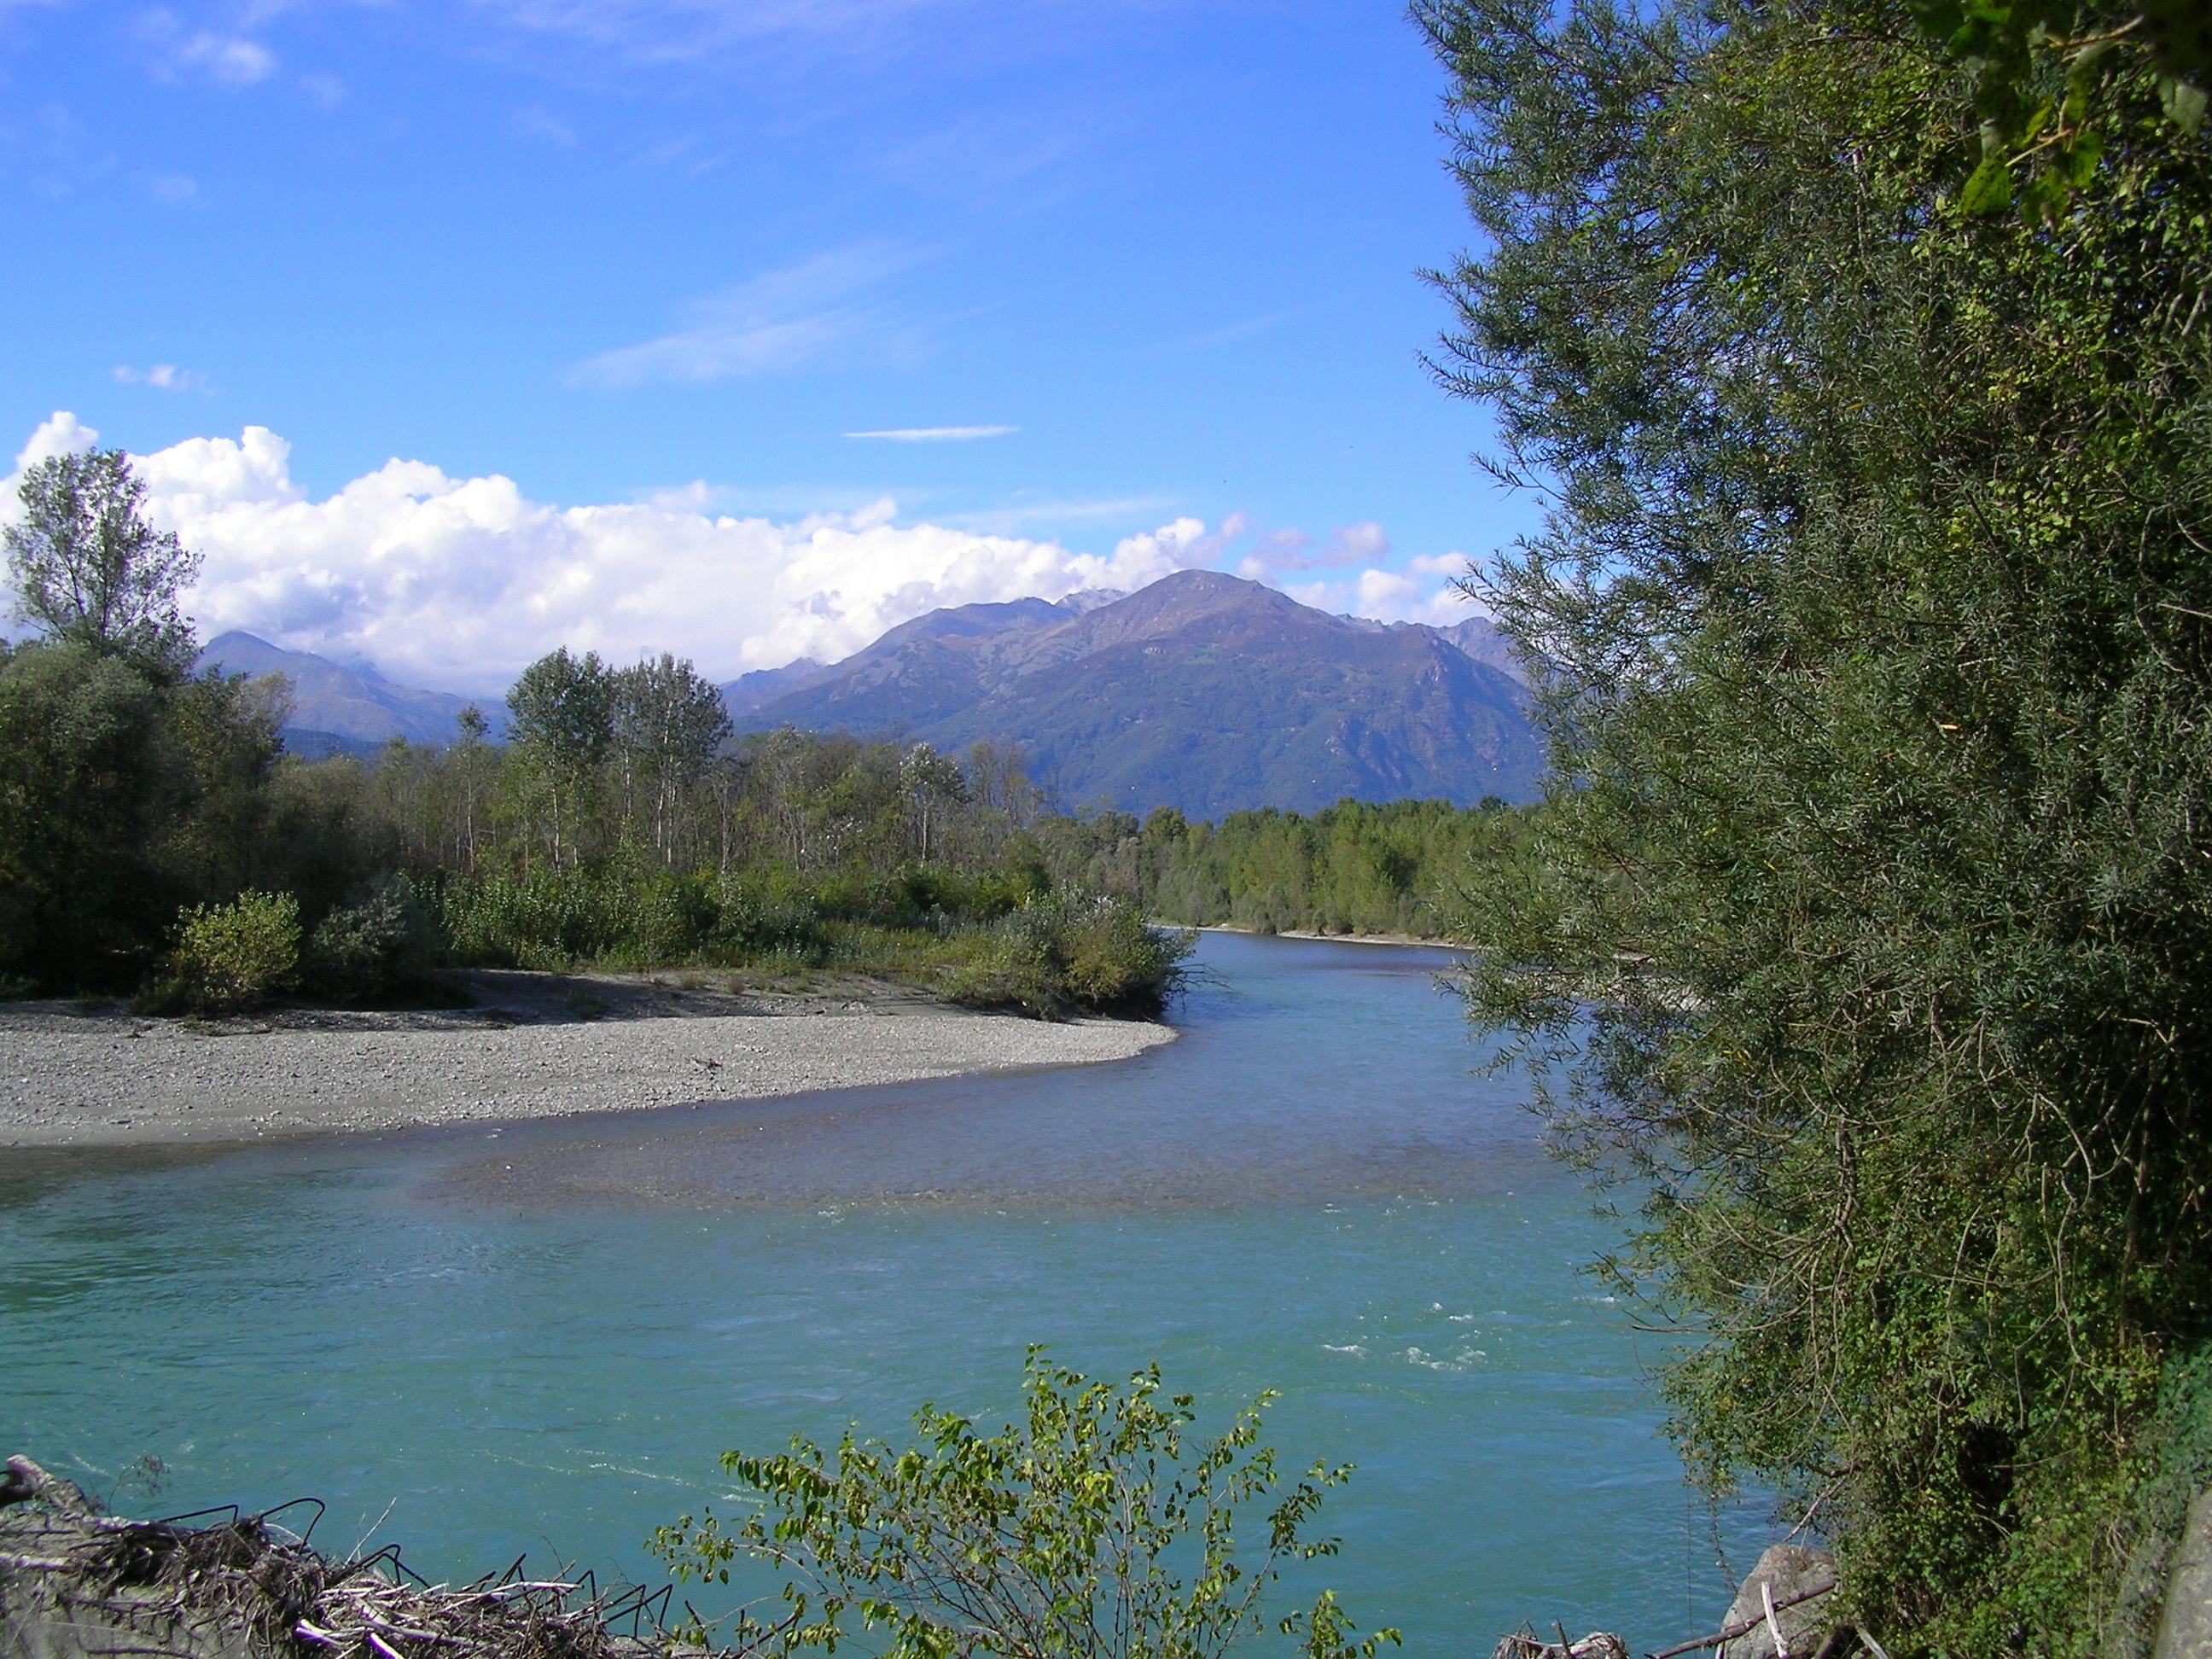






${\text{Paolo} \text{Filippucci}}^{ 1}$, ${\text{Luca} \text{Brocca}}^{ 1}$, ${\text{Stefania} \text{Bonafoni}}^{ 1}$, and ${\text{Angelica} \text{Tarpanelli}}^{ 1}$
1. National Research Council, Research Institute for Geo-Hydrological Protection, Perugia, Italy (paolo.filippucci@irpi.cnr.it)
2. Università degli Studi di Perugia, Department of Engineering, Perugia, Italy
River Discharge estimation from optical satellite data: latest advances using NIR sensors

Slide 2
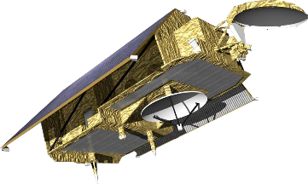
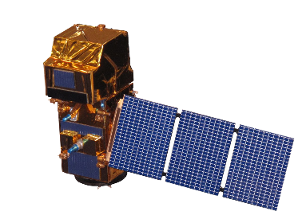
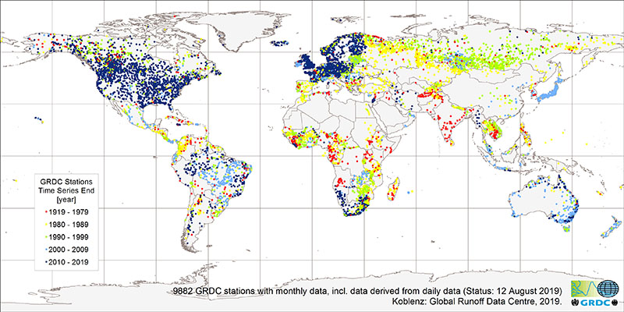
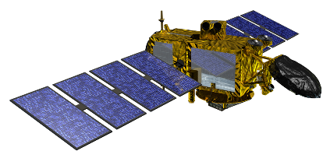
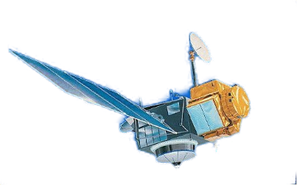
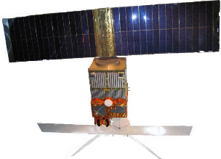
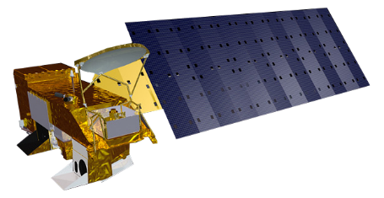
Methodology concept
Sentinel-3
Sentinel-2
JASON-3
TOPEX
ERS 1
AQUA

Slide 3
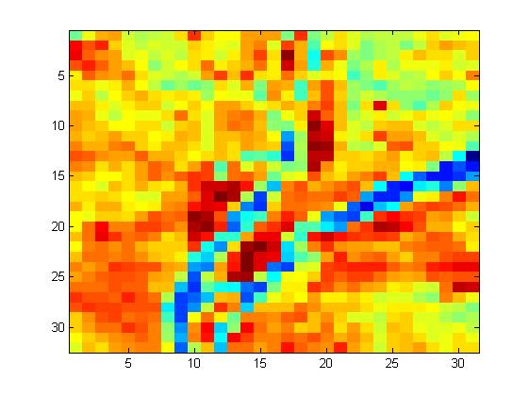
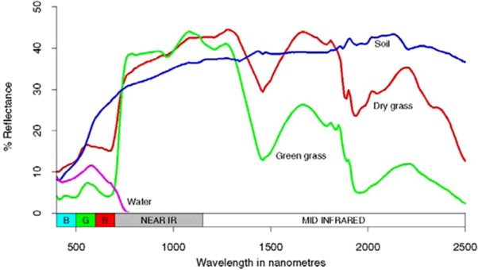

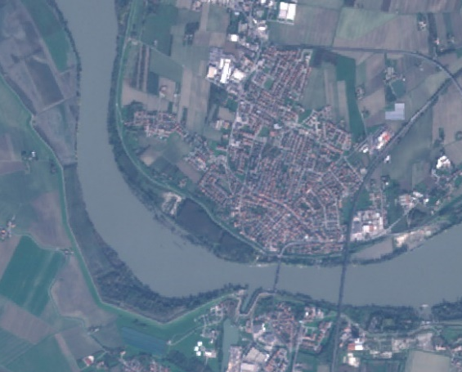
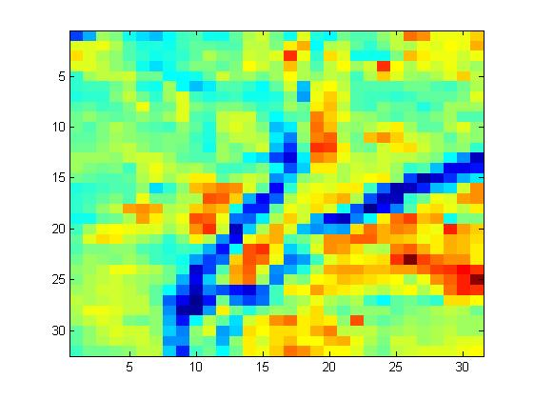
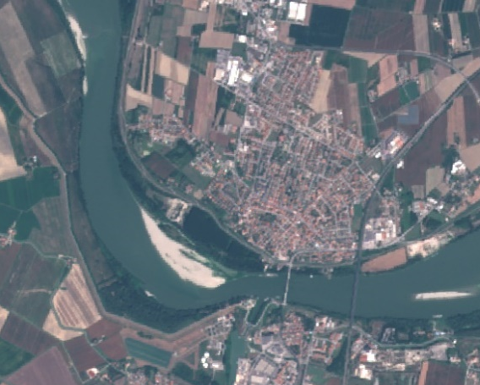
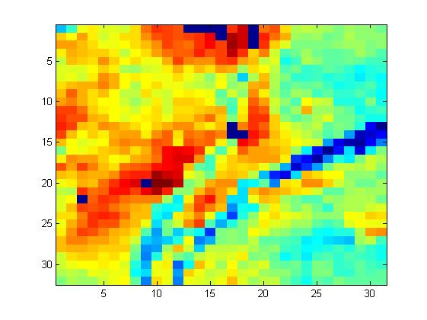
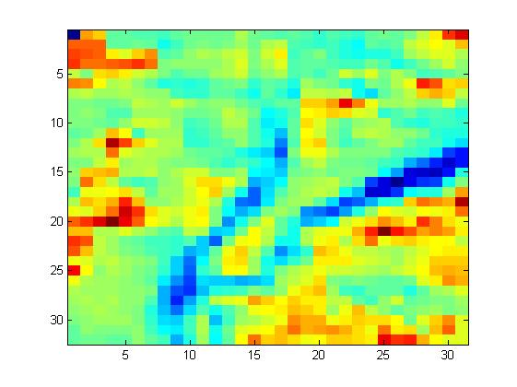

Methodology concept
Mohamed et al., 2018, EJRSSS
C
M
C
SOME LITERATURE STUDIES
Tarpanelli et al., 2020, RS
Sahoo et al., 2020, RSE
Shi et al., 2020 RS
Li et al., 2019, WRR
Tarpanelli et al., 2013, RSE
M
S2-1c 2018-08-17
$$CM∝Q$$

Slide 4
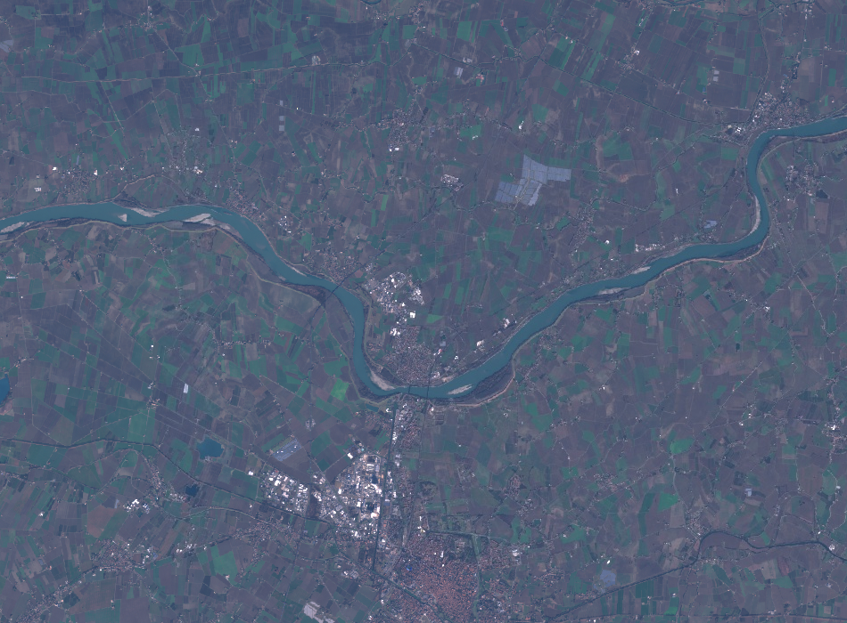
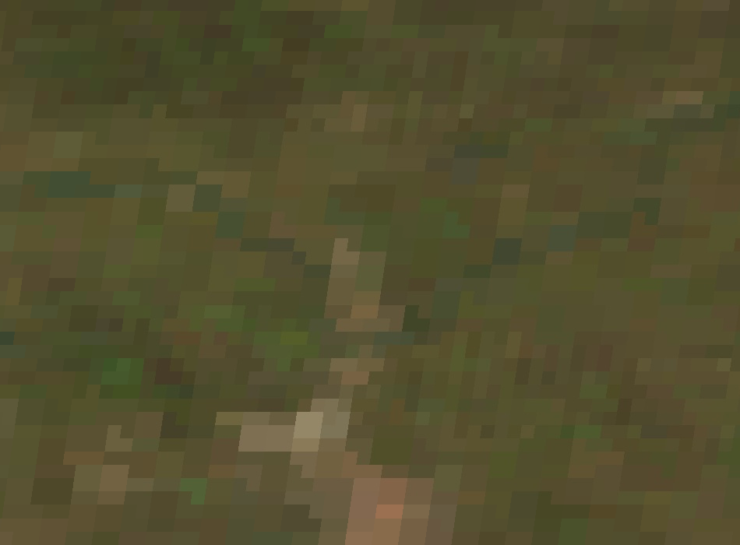
What is new?
[S2-1c 29-01-2019 Po River]
[MOD09GA 29-01-2019 Po River]
High spatial resolution benefits:
Medium narrow river analysis
Increased accuracy in distinguish the different geographical features of the river area
Increased capacity in distinguish river features and patterns

Slide 5
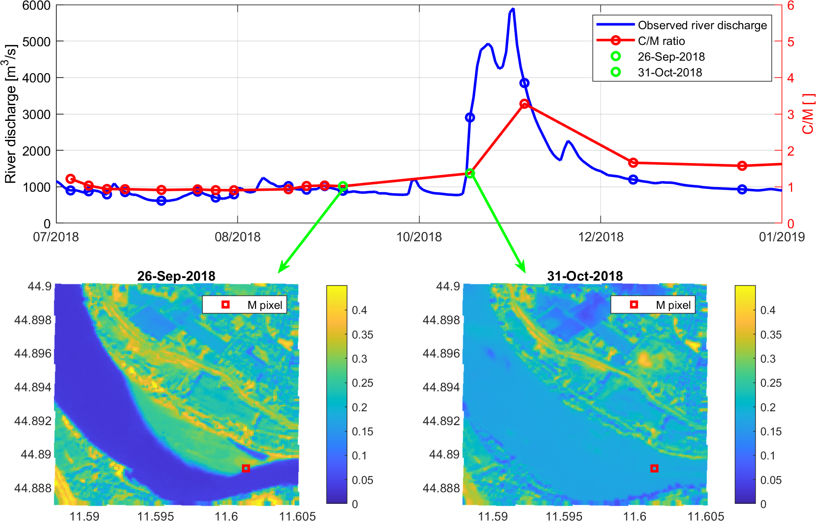
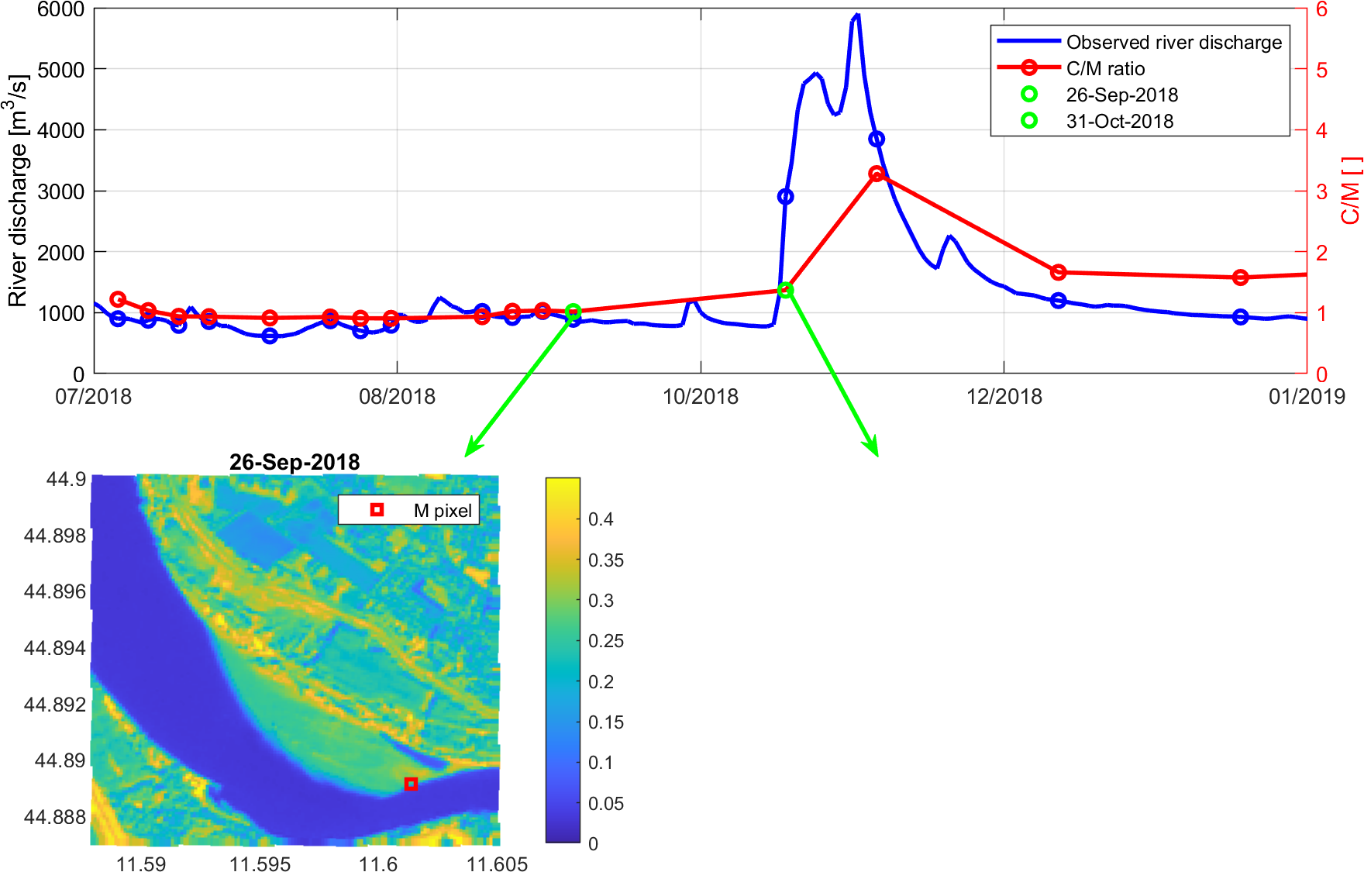
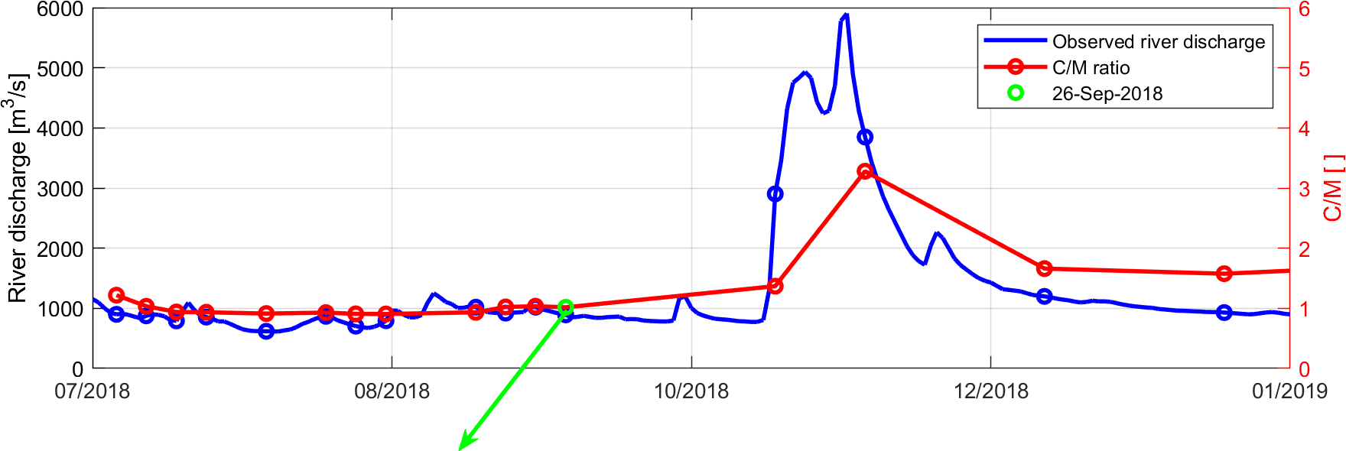
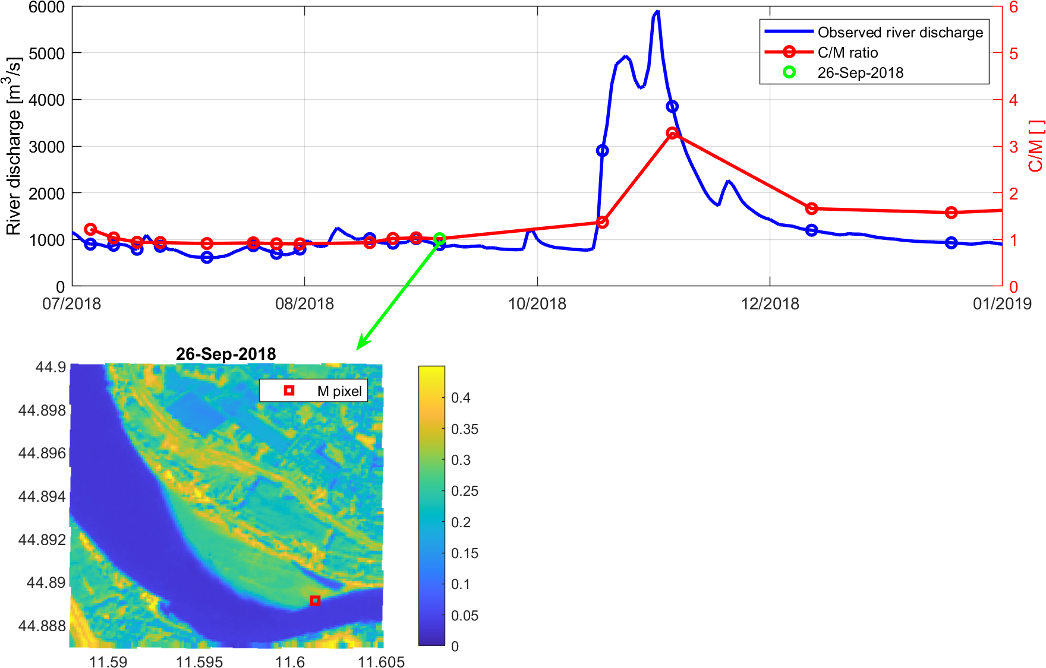
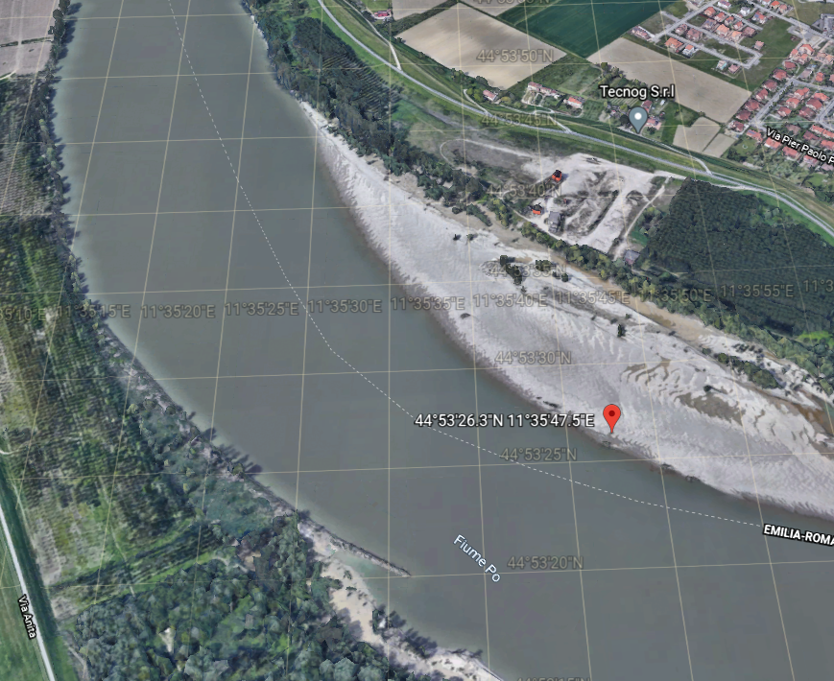
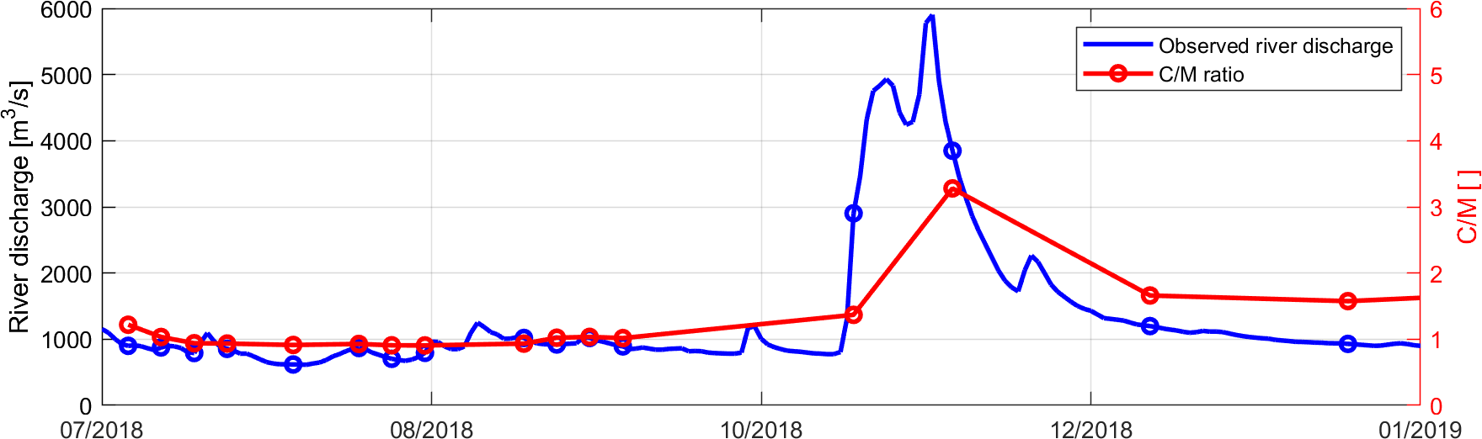
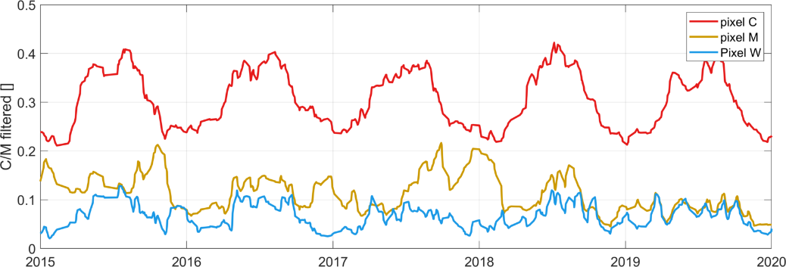
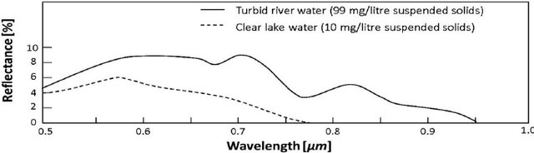




From CM to CMW approach
$$C$$
$$W$$
$$M$$
C
$$CMW∝Q$$
M
W

Slide 6
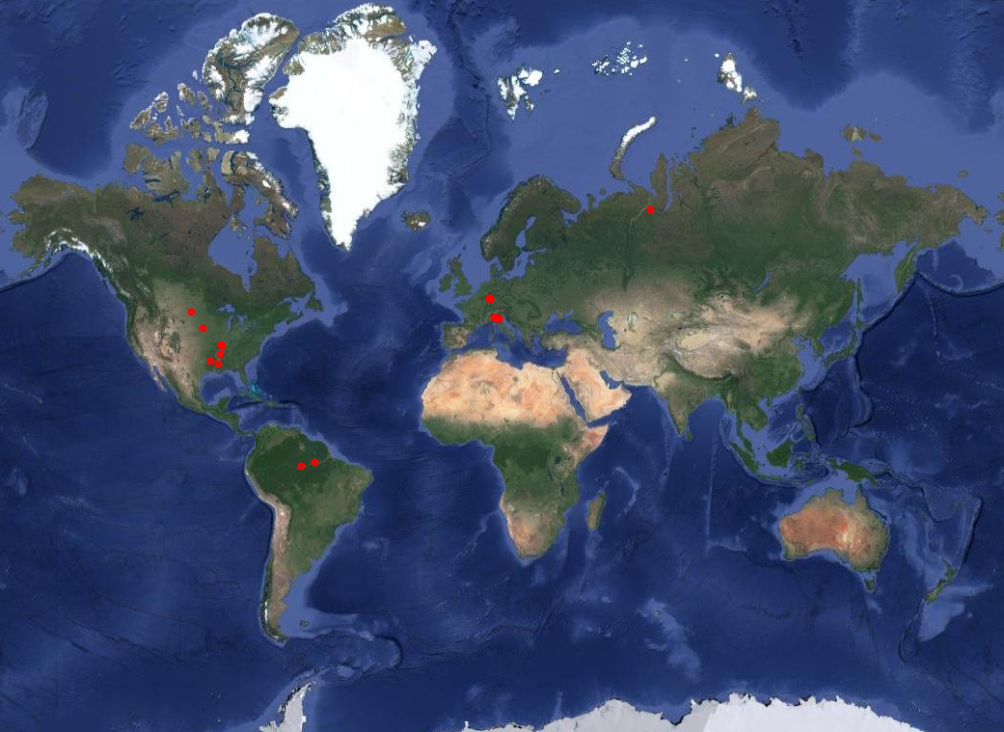
Application of the procedure
Po (Italy): 5 stations
Rhein (Germany): 3 stations
Mississippi (US): 4 stations
Missouri (US): 2 stations
Amazon (Brazil): 2 stations
Red (US): 1 station
Ob (Russia): 1 station

Slide 7
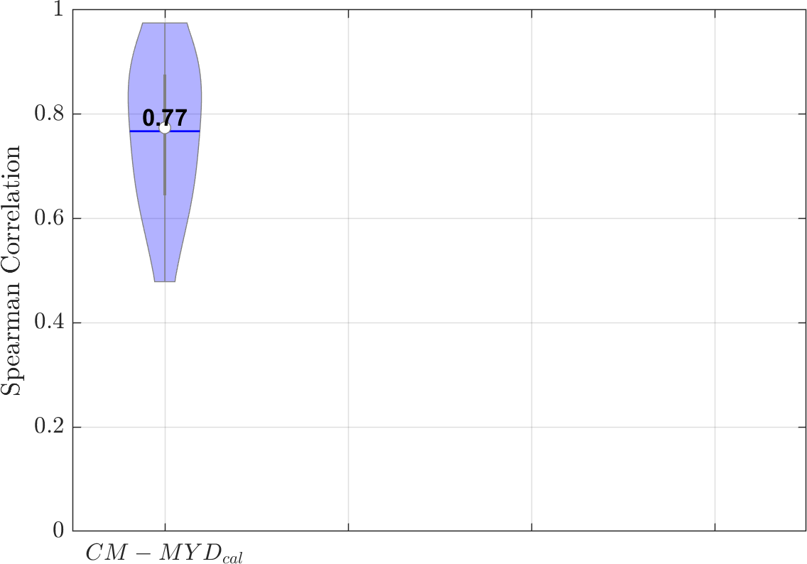
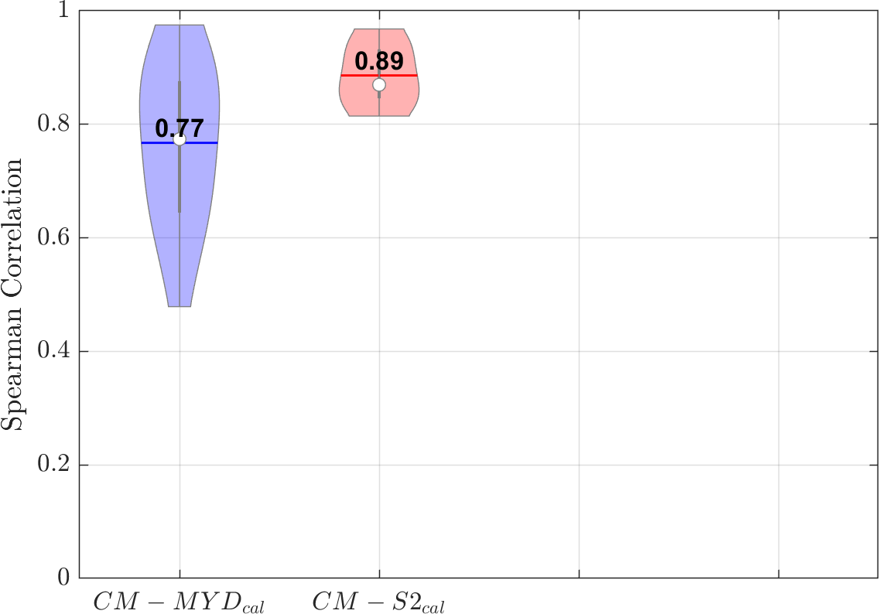
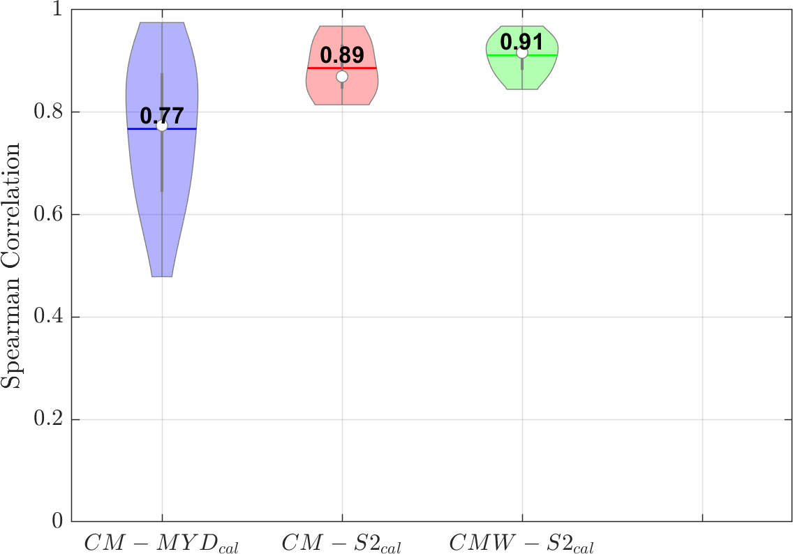
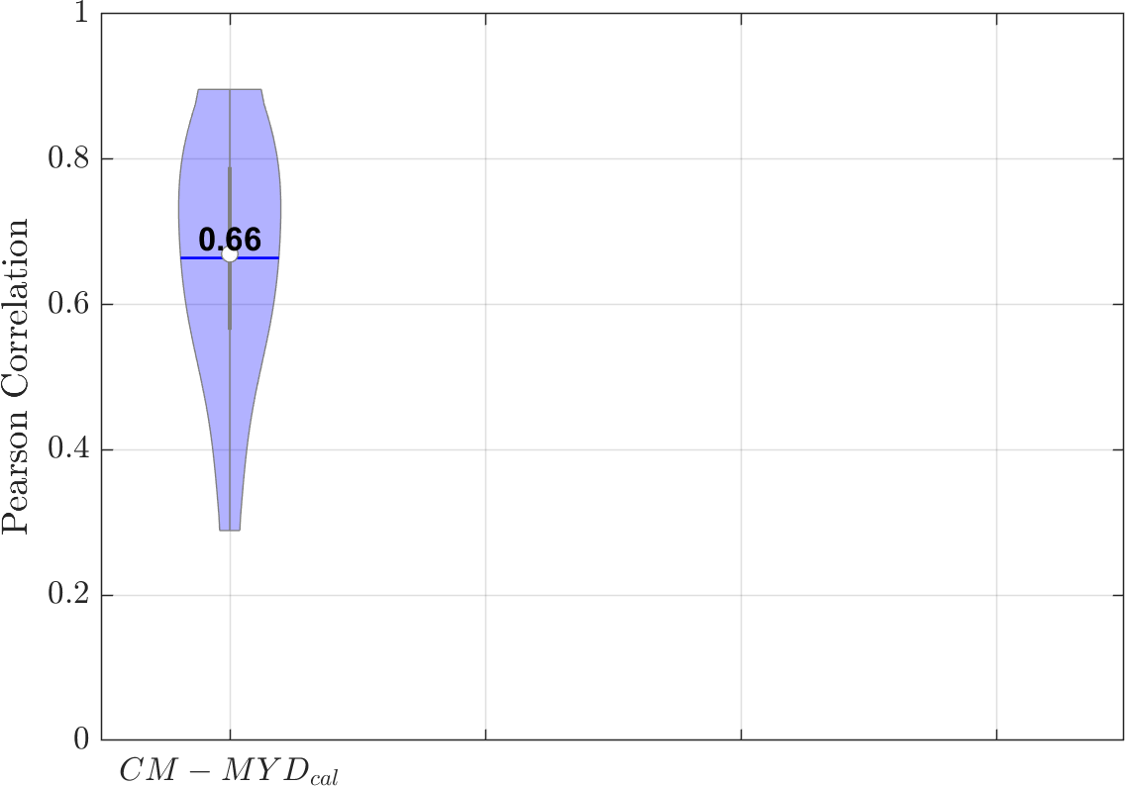
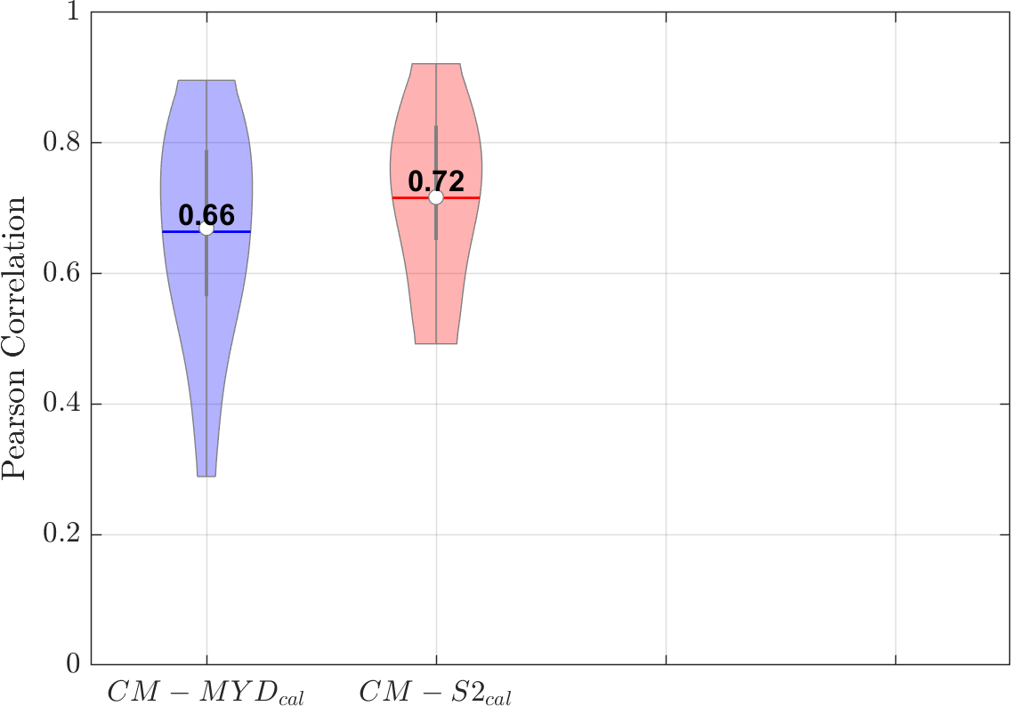
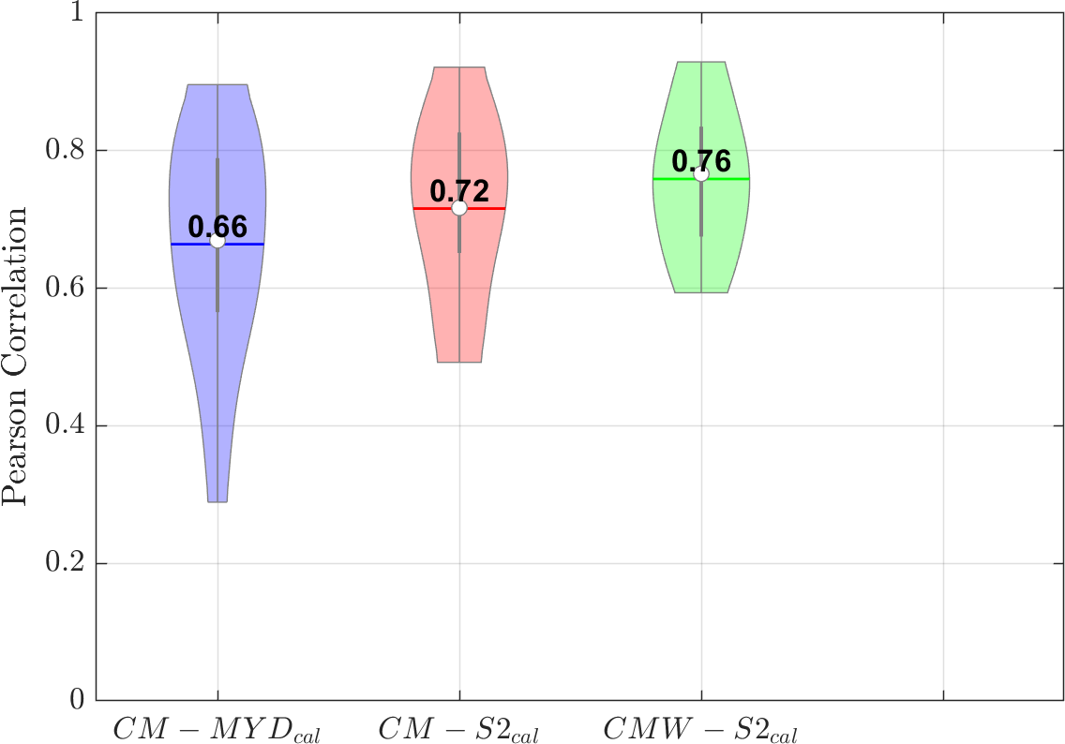
Application of the procedure
CM/CWM vs River discharge
2016-2019

Slide 8
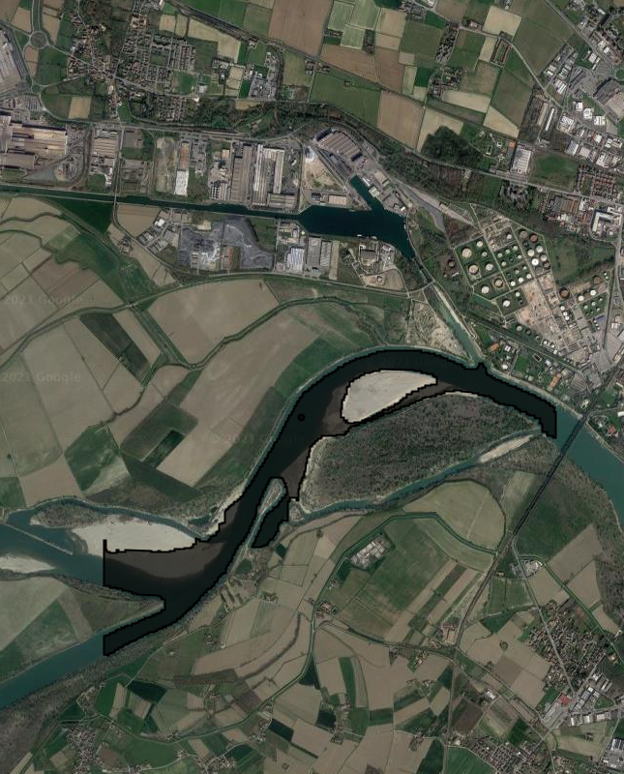
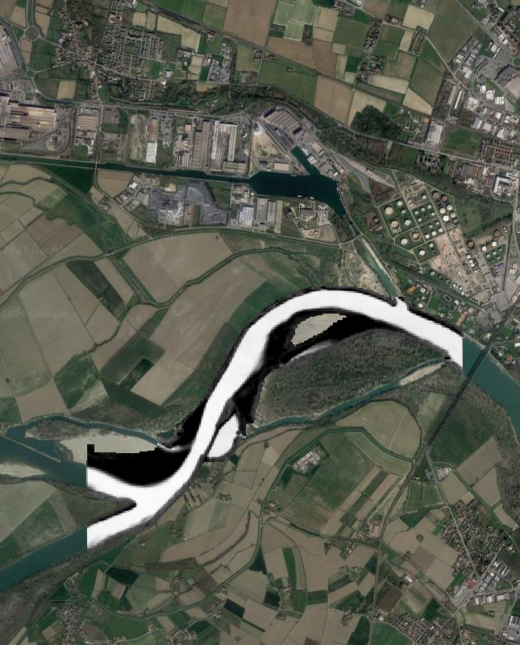
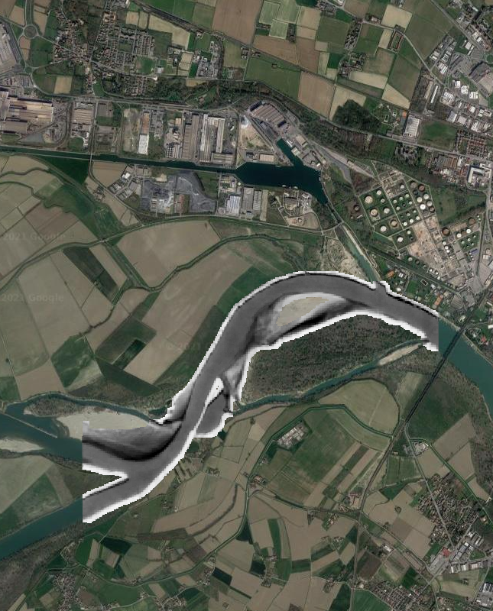
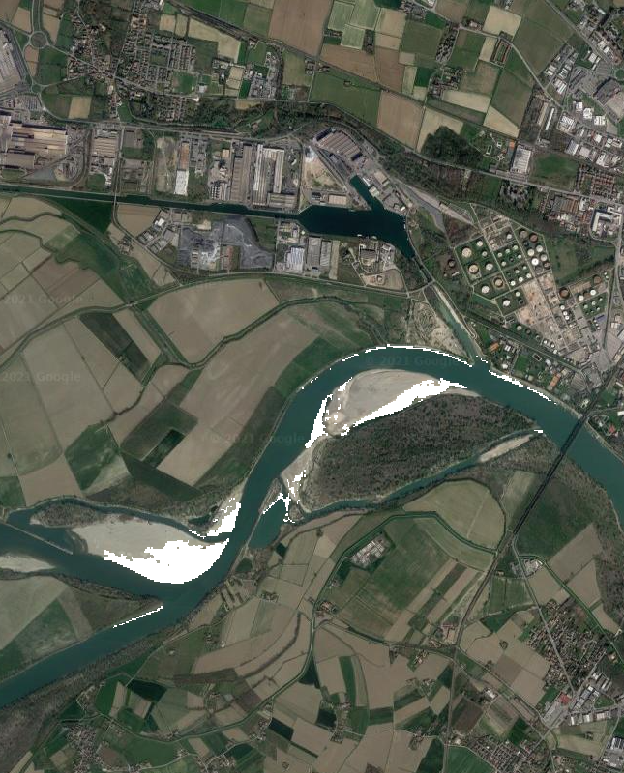
Uncalibrated CMW
River area correlation with W
River area correlation with C and V
Uncalibrated M position
+
=

Slide 9
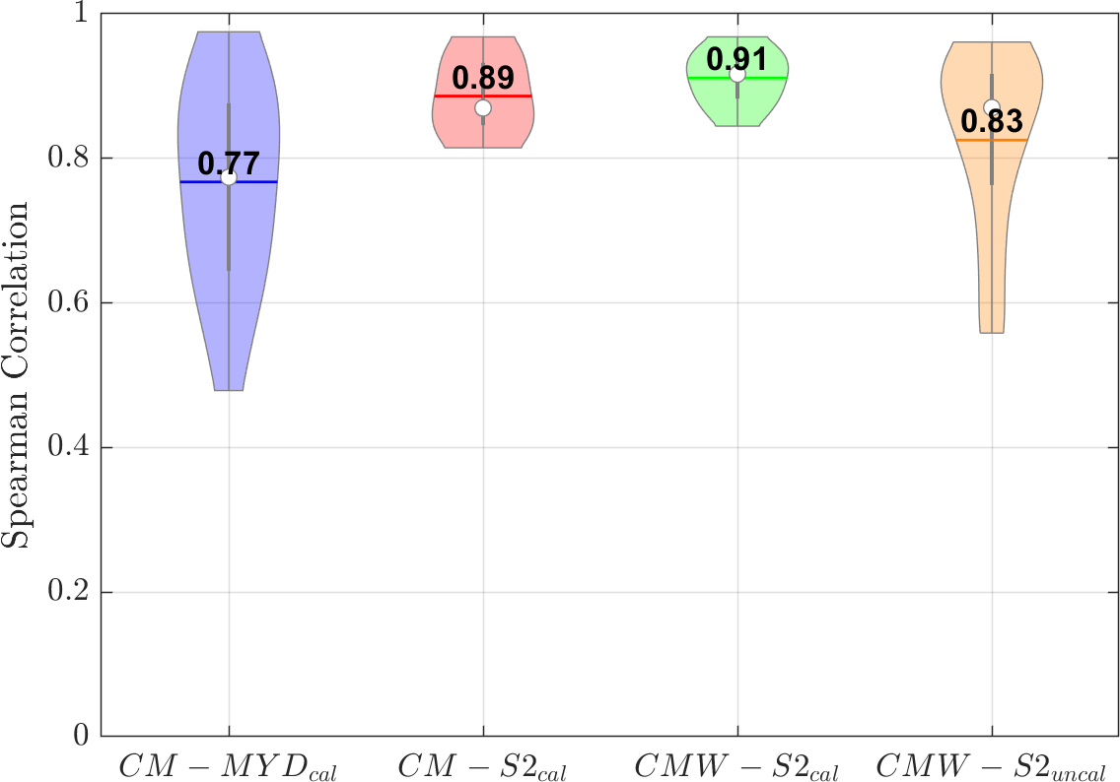
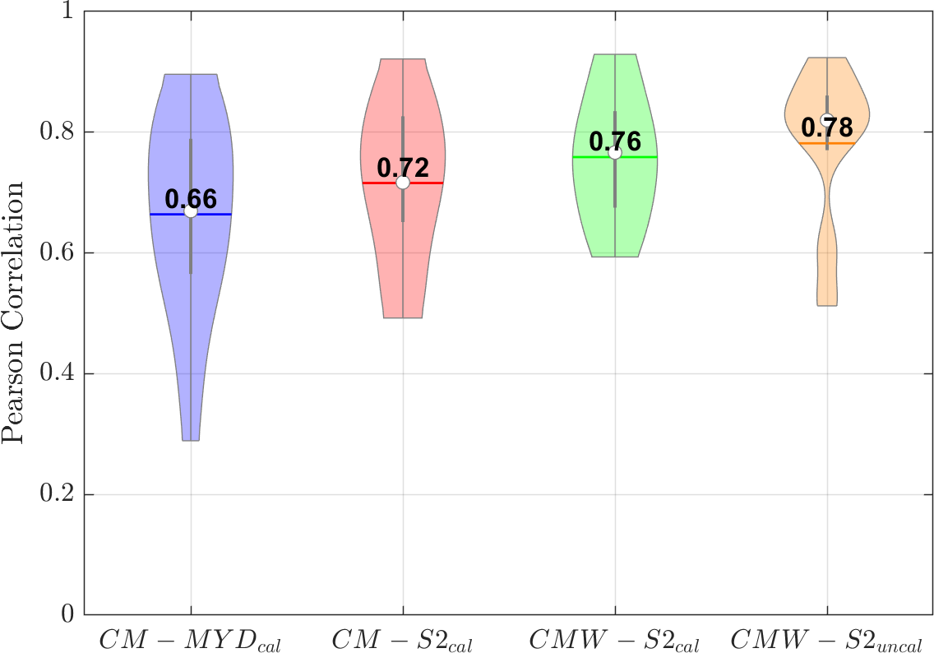
Application of the procedure
CM/CWM vs River discharge
2016-2019

Slide 10
Conclusions and Next Steps
Sentinel 2 high spatial resolution allows to improve our capacity of estimating river discharge from remote sensing;
The CM approach has been developed in order to include the contribution of the river sediment load to its reflectance signal;
An uncalibrated procedure for the selection of M pixels has been developed, making the first step toward the application over ungauged rivers.
Residual sources of noise
Unmasked clouds, cloud shadow and snow cover;
Transferability of the uncalibrated procedure;
Issues related to the quality of S2 data (e.g. registration)

Slide 11
Thank you for your attention!
Contact info: paolo.filippucci@irpi.cnr.it

