Slide 1



Nighttime temperature and optimal photosynthetic capacity over the past fortnight jointly control the acclimation of leaf respiration
Yanghang Ren, Han Wang, Sandy P. Harrison, I. Colin Prentice and other contributors
25th May 2022

Slide 2
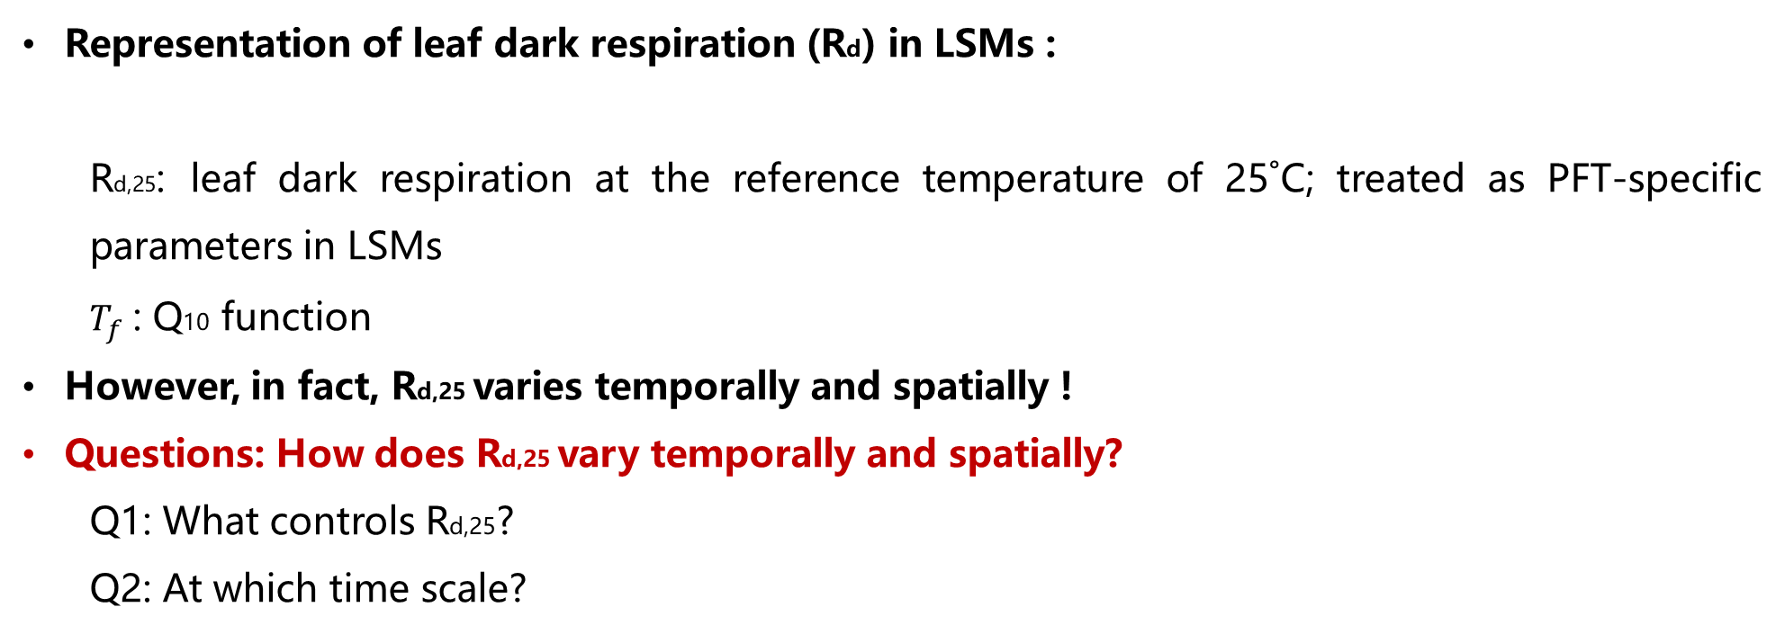

Introduction
Representation of leaf dark respiration (Rd) in LSMs :
Rd,25: leaf dark respiration at the reference temperature of 25˚C; treated as PFT-specific parameters in LSMs
$T_{f}$: Q10 function
However, in fact, Rd,25 varies temporally and spatially !
Questions: How does Rd,25 vary temporally and spatially?
Q1: What controls Rd,25?
Q2: At which time scale?
$$R_{d}={Rd}_{25}∗T_{f}$$

Slide 3
Hypotheses
Hypotheses | Equations | Factors Controlling R_{d,25} | Acclimation Time scale | Refs.
Huntingford | R_{d,25}=r₀+r₁n_{1,a}-r₂T_{daily} | daily temperature, leaf nitrogen concentration | 10-day | (Huntingford et al. 2017)
Wang | R_{d,25}=b₂₅V_{cmax,25} | optimal carboxylation capacity at 25°C | 15-day | (Wang et al. 2020)
Reich | R_{d,25}=R_{fix}/Hr(T_{night}) | night-time temperature | Not yet unified | (Reich et al. 2021)
Ren | R_{d,25}=b H(T_{midday}) /Hr(T_{night})V_{cmax,25} | optimal carboxylation capacity, night-time temperature | To be specified | This study

Slide 4
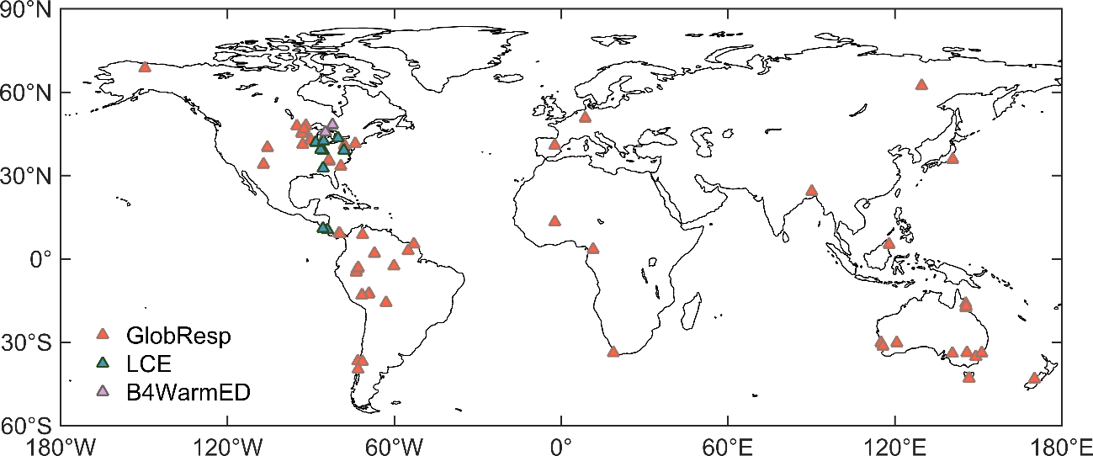
Datasets to test Hypotheses
1. B4WarmED dataset (temporally)
Warming experiments
1620 measurements: Rd, canopy temperature
10 species
From 2 boreal forest sites (from 2009 to 2014)
2. LCE dataset (spatially)
598 samples
From 12 sites
3. GlobResp dataset (spatially)
1469 samples
From 39 sites

Slide 5
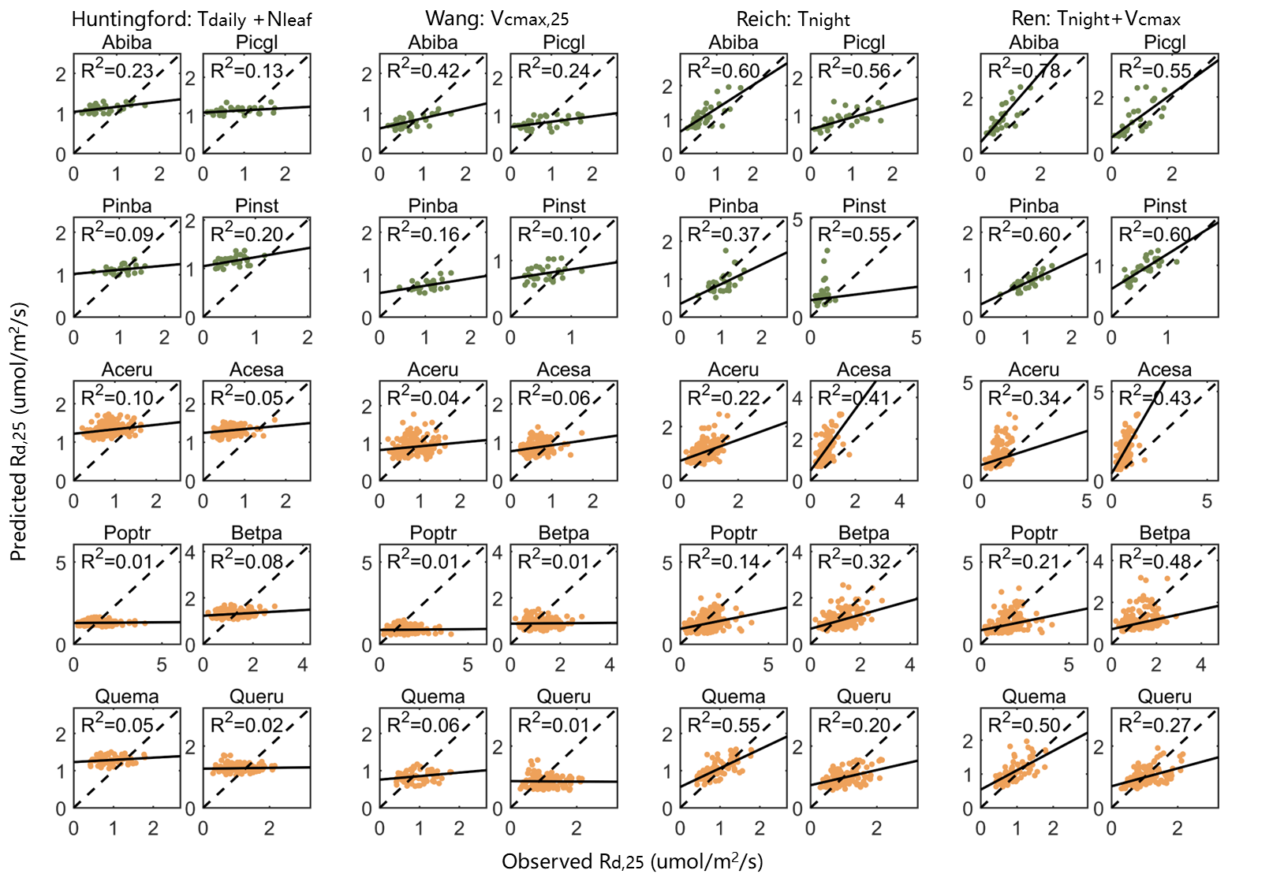
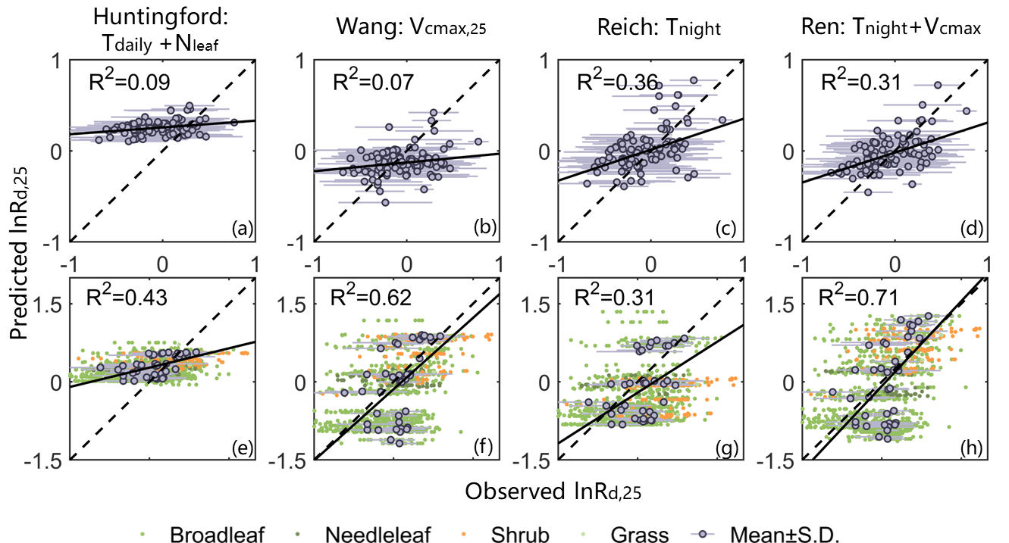
Results1：
Rd,25 is jointly controlled by Vcmax and Tnight.
Community level
Species level
Fig. Scatter plots of natural-log transformed R_{d,25} between observation and prediction at their highest R² by four hypotheses

Slide 6
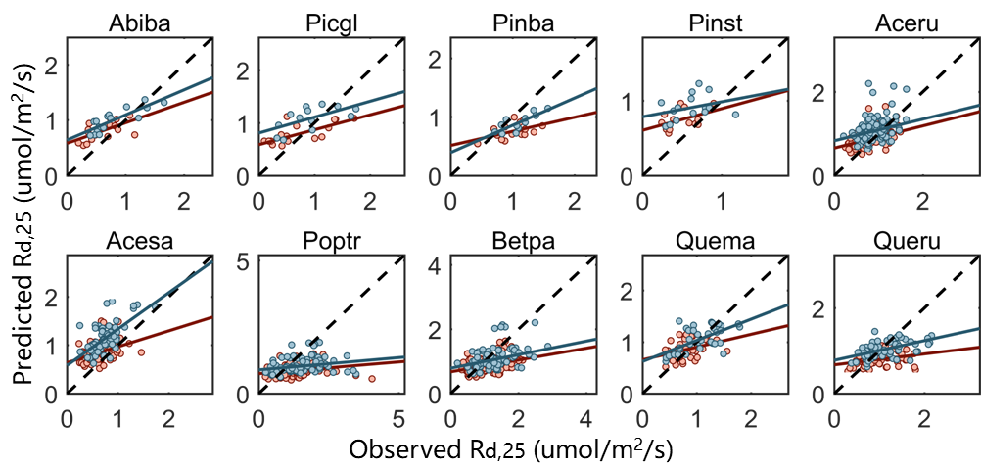
Results2：
The acclimation time scale of Rd,25 is 15 days.
Robustness of our Hypothesis in the Future Warming World
Fig. The relationship (R² and RMSE) of observed R_{d,25} to predicted R_{d,25} for differing numbers of prior days
Fig. Scatter plots of observed and predicted R_{d,25} for the ambient (blue points) and warming (red points) samplings

Slide 7
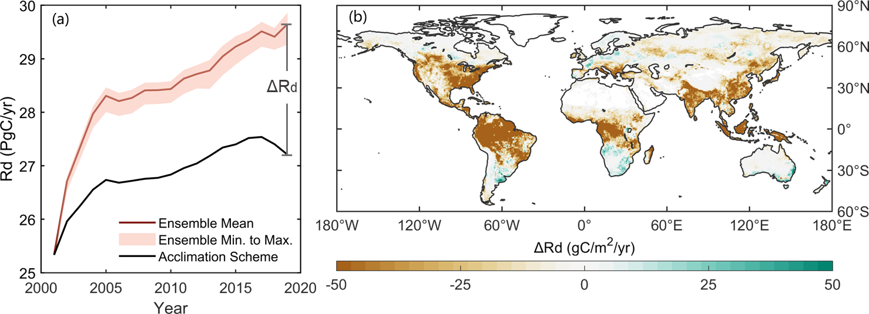
Results3：
The impacts of acclimation on global leaf respiration
The new R_{d,25} scheme dampens the R_{d}-warming feedback derived from multiple land surface models.
Fig. The changes in global annual leaf respiration from 2001 to 2019

Slide 8
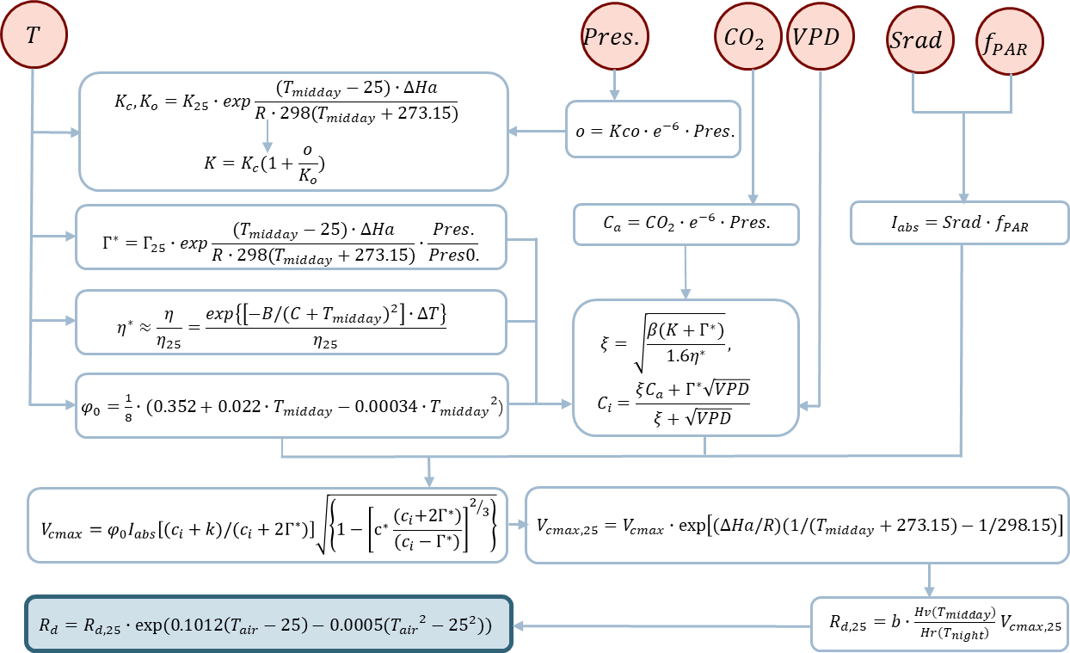
Take home messages:
Rd,25 is jointly controlled by Vcmax and Tnight.
The acclimation time scale of Rd,25 is 15 days.
The new R_{d,25} scheme dampens the R_{d}-warming feedback derived from multiple land surface models.
Fig. The flowchart of leaf dark respiration (R_{d}) adjusting to the optimal carboxylation capacity and the past night-time temperature.

Slide 9


Thanks for your attention!
ryh21@mails.tsinghua.edu.cn

