Slide 1
A combined seismic phase classification and back-azimuth regression neural network for array processing pipelines
EGU 2022 - International Monitoring System and On-site Verification for the CTBT, disaster risk reduction and Earth sciences
Andreas Köhler & Erik Myklebust
andreas.kohler@norsar.no

Slide 2



Introduction
Basic automatic seismic event detection pipeline (e.g., at IDC and NDCs)
000000
000000
P
S
S
N
P
S
Phase classification and back-azimuth measurement
Event association and location
Phase detection
Seismic arrays are very beneficial for detection, classification and baz measurement
Machine learning can improve existing algorithms: Learn from decades-long reviewed data sets

Slide 3
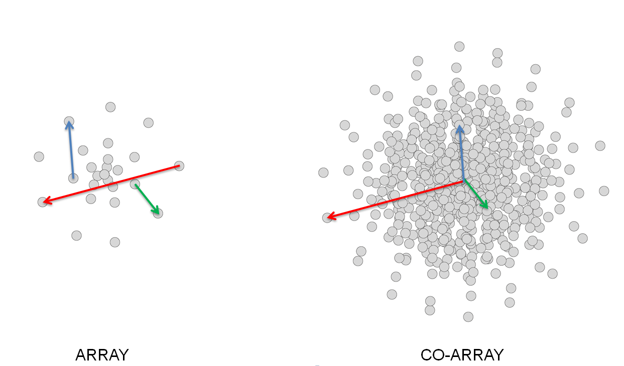
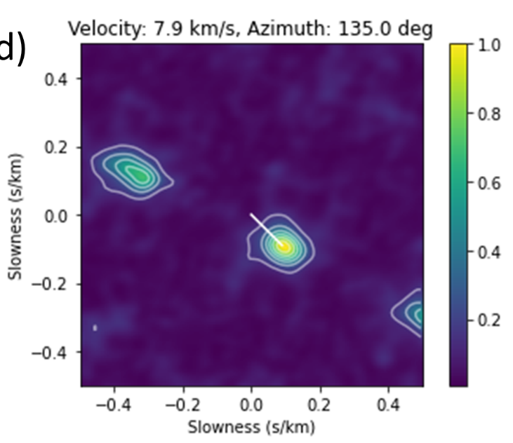
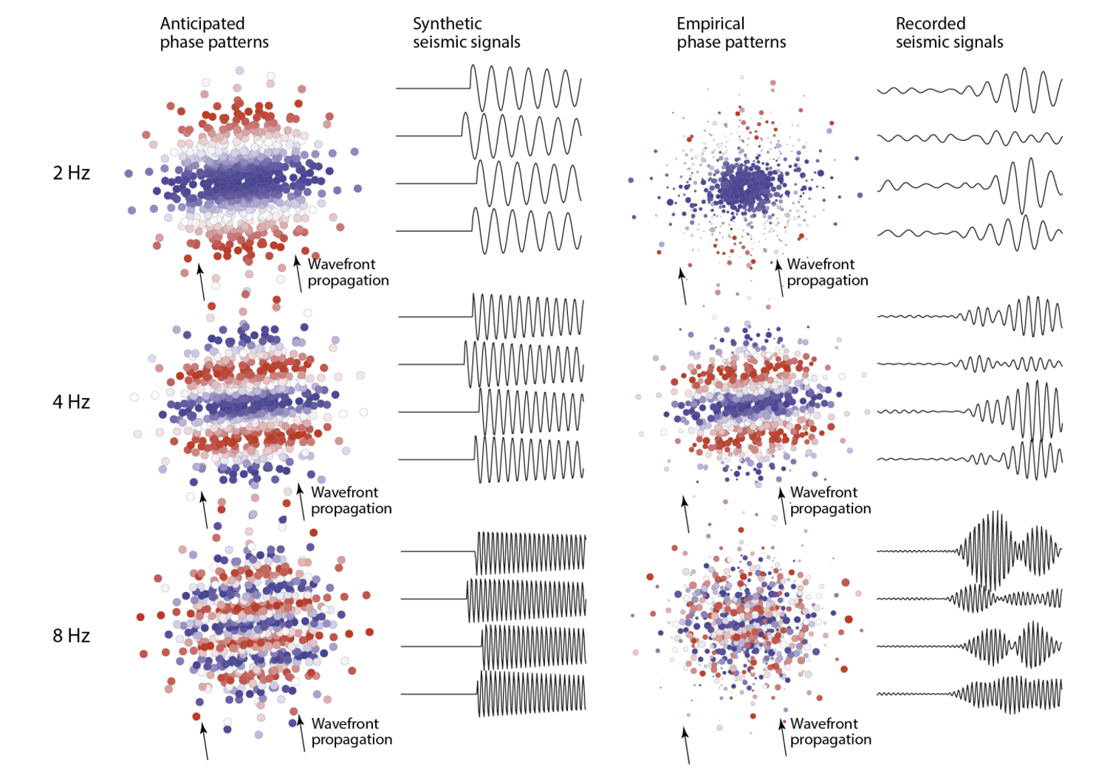
Seismic phase classification with arrays
Classic approach:
Assume plane wave and back-azimuth at array identical to source direction: anticipated time / phase differences on co-array
Find slowness of best fitting plane wave through grid search (FK analysis) or other methods (e.g., PMCC)
Use apparent velocity thresholds to classify regional and teleseismic arrivals

Slide 4
Limitations of classic approach
Deviation from plane wave due to local inhomogeneities below array
Travel path / back-azimuth deviations due to geology between source and array
Lack of waveform coherency
(Average) local velocity thresholds for seismic phases differs from site to site and must be defined manually
Solution:
Empirical slowness corrections
Empirical matched field processing (single target source)
Machine learning?

Slide 5
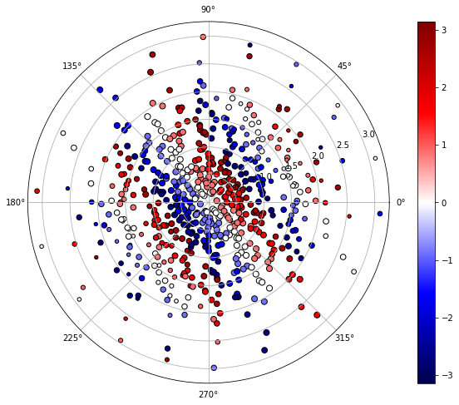
Machine learning for seismic phase classification
    For each seismic detection compute phase difference on co-array (cross-spectral matrix of array data) = phase pattern
    Do that in different narrow frequency bands
    Use a neural network to map phase pattern to seismic phase type (=classification) and back-azimuth (=regression)
    Train NN with labeled seismic arrivals (phase type and back-azimuth) using reviewed events observed on a given array
    Potential benefit of this approach compared to FK:
      Does not depend on plane wave assumption
      Correct for discrepancies between observed and origin back-azimuth
      No manually defined, hard velocity limit to classify P and S wave (or other phases)
      Is computationally faster once NN is trained (no grid search needed)

Slide 6
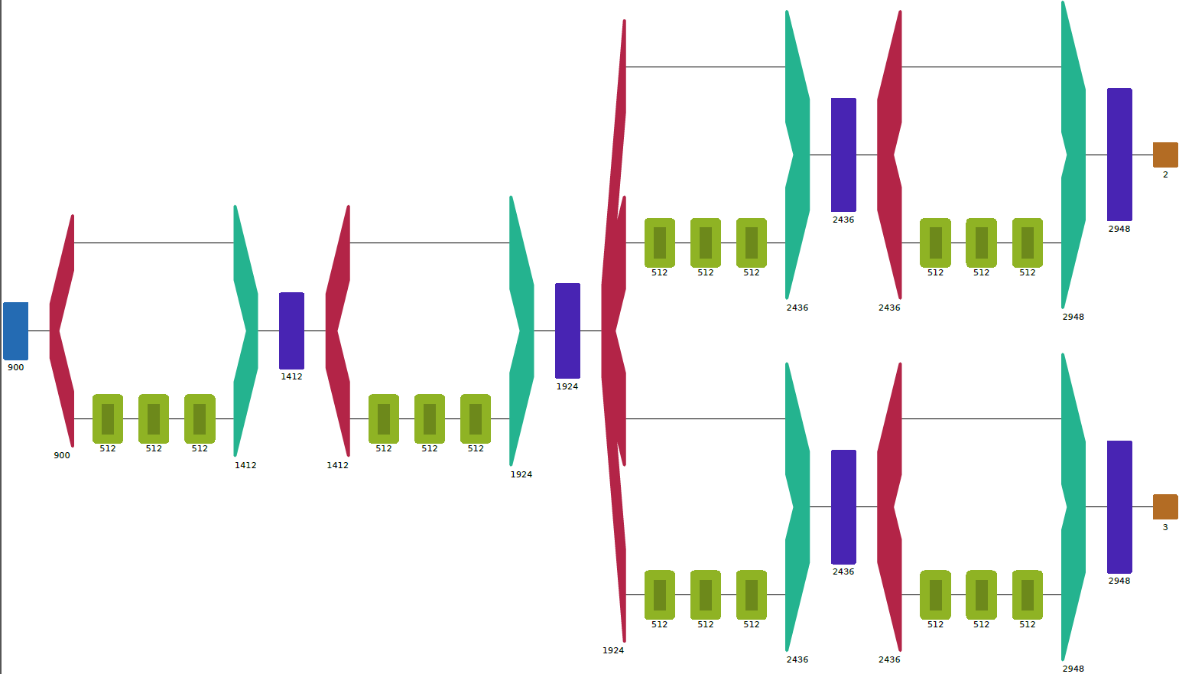
Machine learning for seismic phase classification
    Regression NN
    Input:
    Co-array phase pattern in different frequency bands (number of nodes depends on array)
    Output:
      Back-azimuth (in x-y coordinates = two nodes)
      Phase type label: P, S or Noise
    Classification NN

Slide 7
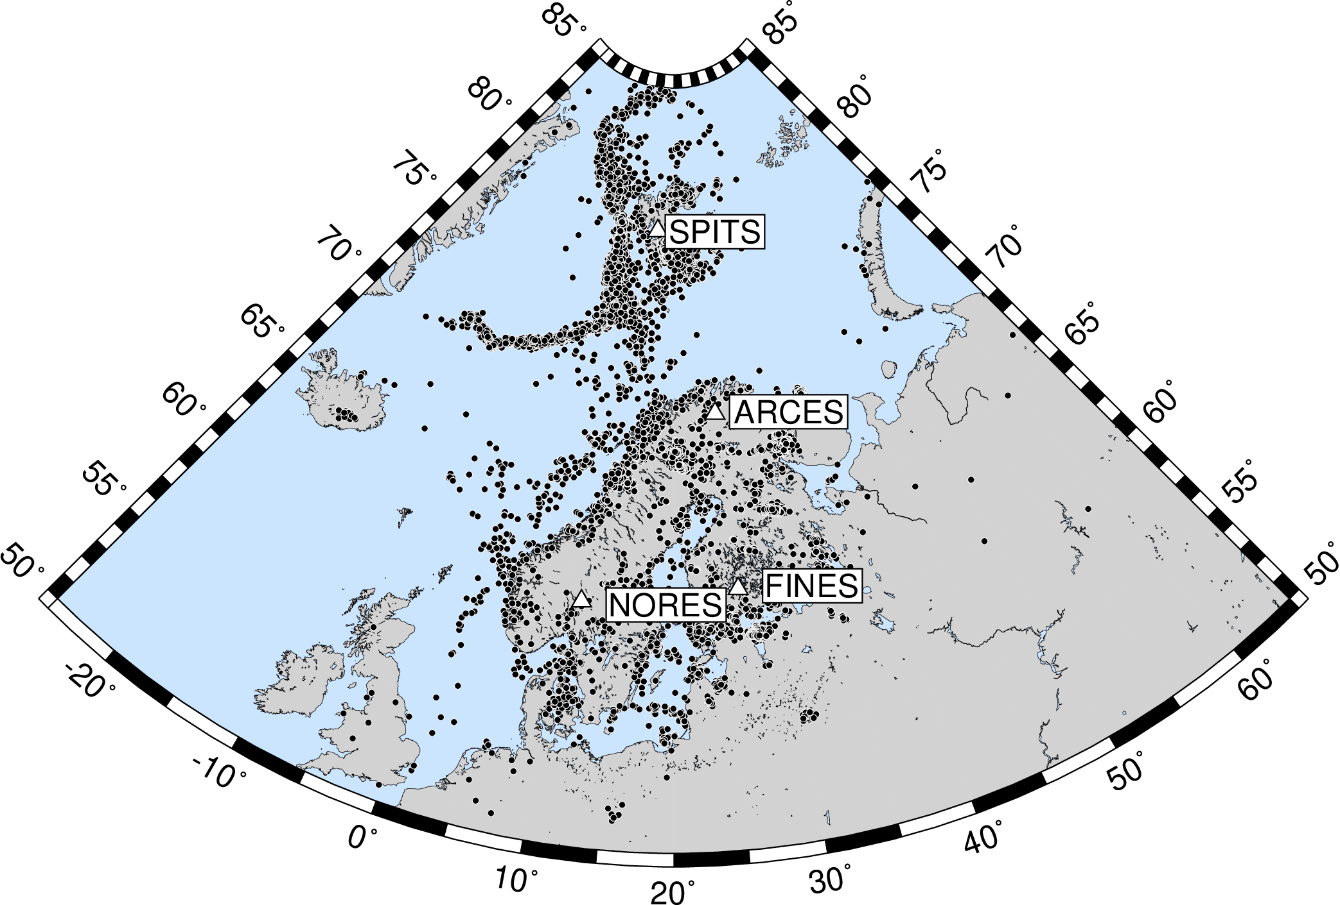
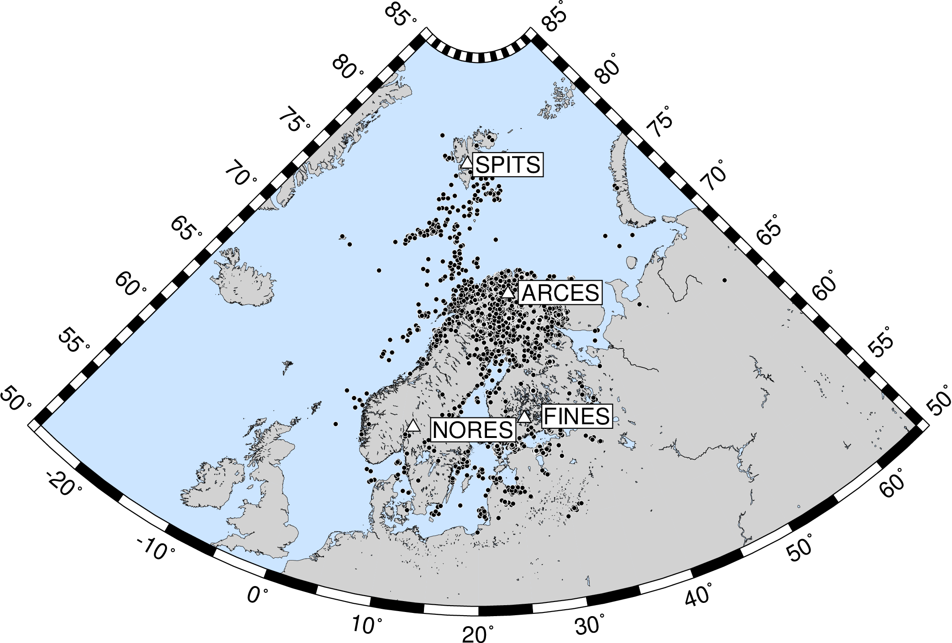
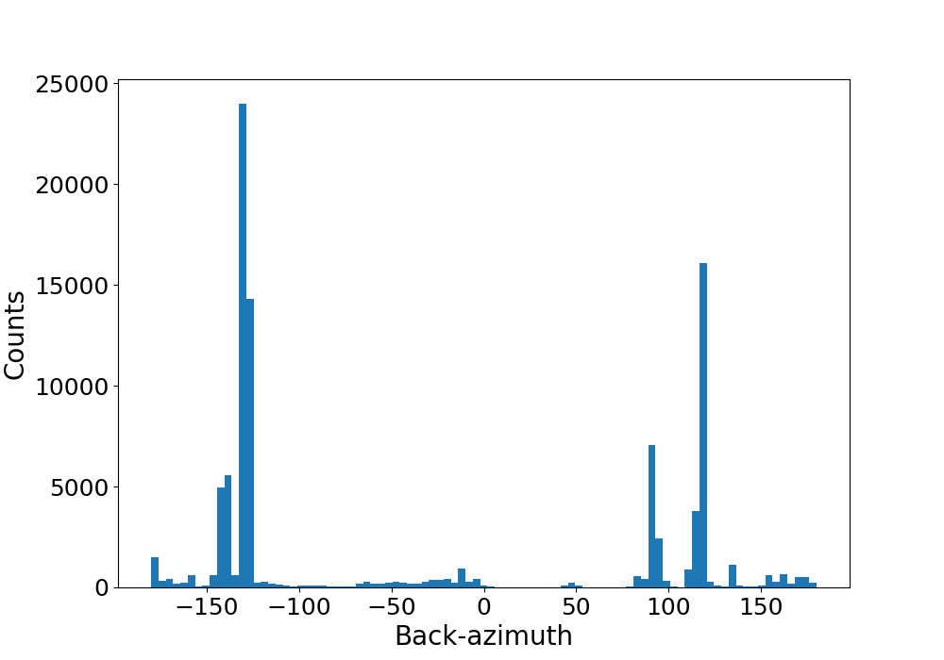
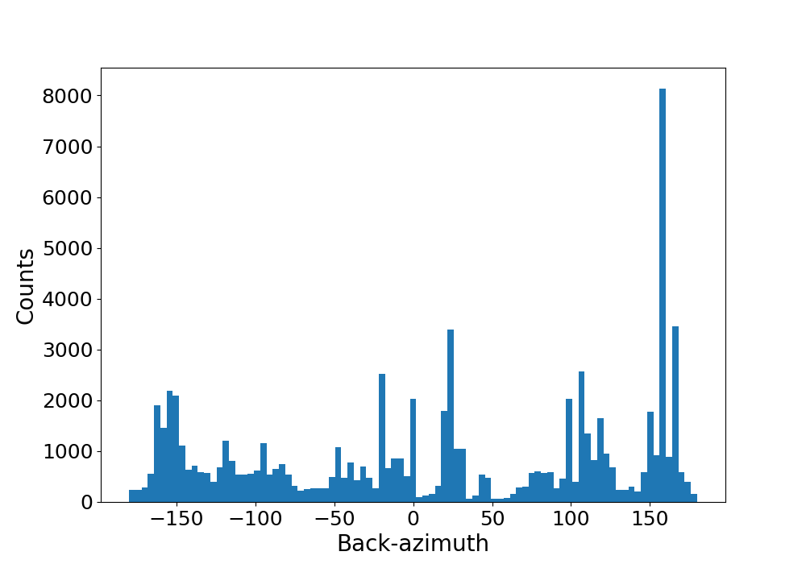
Training data
    ~100,000 P and S wave arrivals from merged Scandinavian regional reviewed event bulletins of 25 years (NORSAR and University of Helsinki)
    Tested on 4 arrays: ARCES, FINES, NORES, SPITS
    Co-array pattern of three frequency bands combined: 2.5 Hz, 4.0 Hz, 5.5 Hz
    Dominating back-azimuths (mostly mines)
    NORSAR catalog
    ARCES
    FINES
    Helsinki catalog

Slide 8
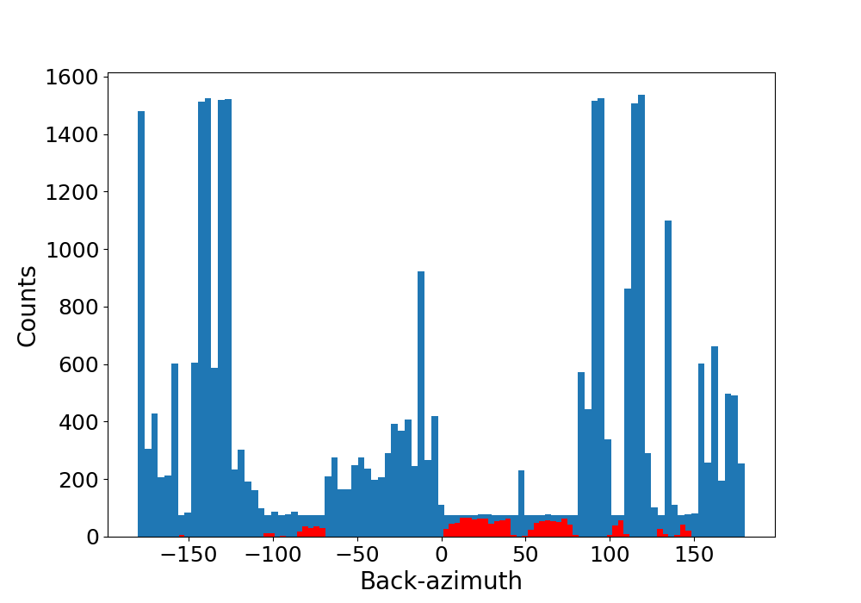
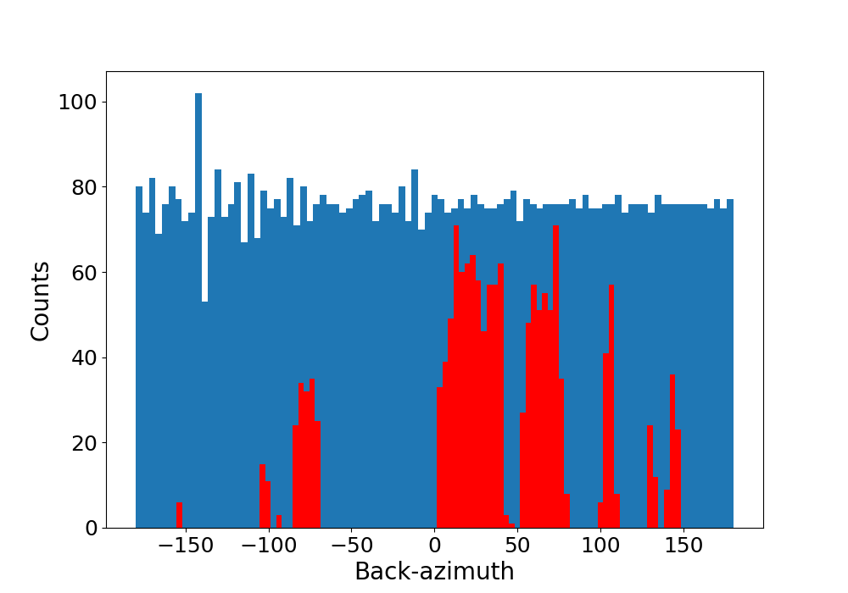
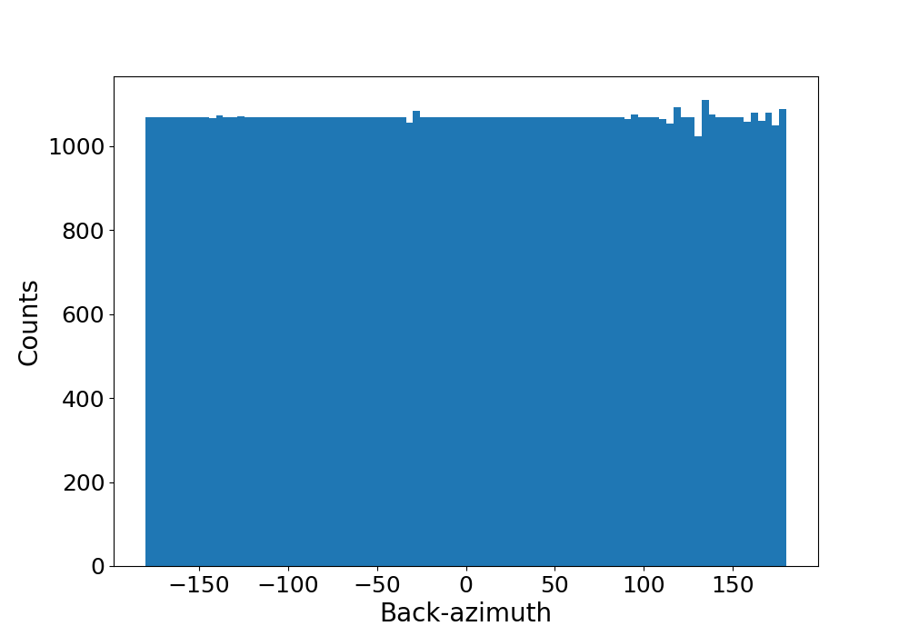
Training data preparation and augmentation
    Coherency threshold to sort out too noisy arrivals (not necessarily required)
    Adding noise class: time window before P arrival
    Weighting sampled by back-azimuth distribution: tested - no effect
    Balancing by sub-sampling overrepresented back-azimuth bins
    Augmentation of underrepresented directions with synthetic plane wave phase pattern (using only those would be like classic approach with FK and fixed velocity thresholds)
    Upsampling of underrepresented directions
    ARCES
    Moderately balanced
    Perfectly balanced

Slide 9
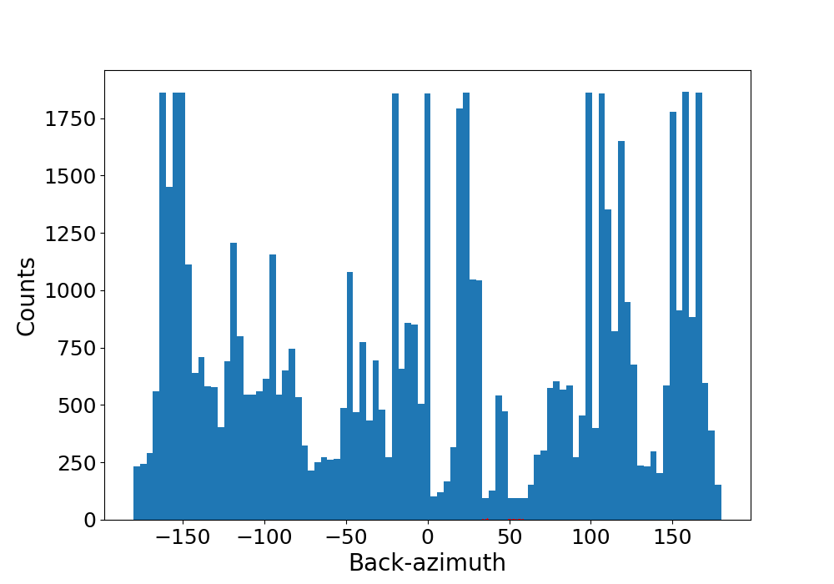
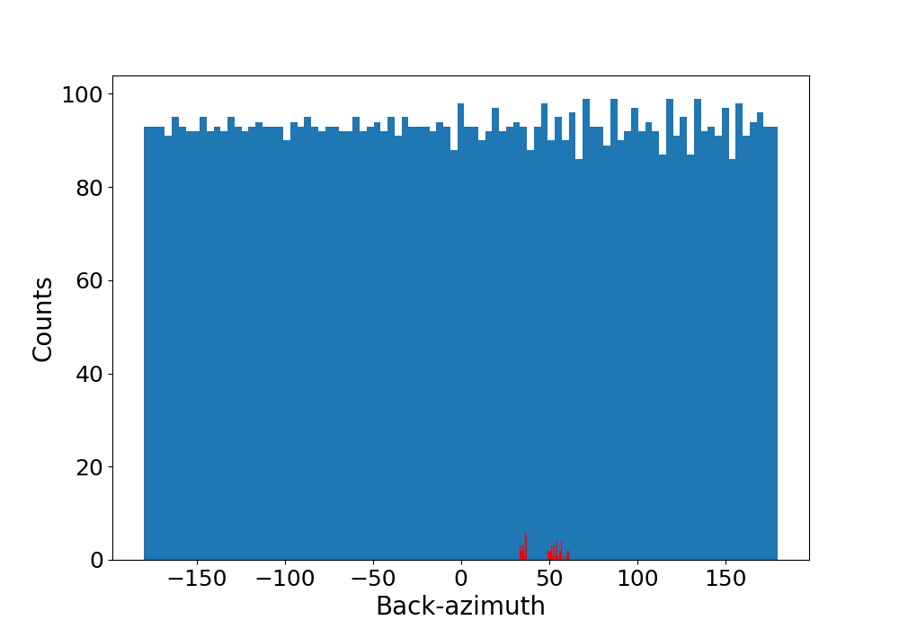
Training data preparation and augmentation
    Coherency threshold to sort out too noisy arrivals (not necessarily required)
    Adding noise class: time window before P arrival
    Weighting sampled by back-azimuth distribution: tested - no effect
    Balancing by sub-sampling overrepresented back-azimuth bins
    Augmentation of underrepresented directions with synthetic plane wave phase pattern (using only those would be like classic approach with FK and fixed velocity thresholds)
    Upsampling of underrepresented directions
    FINES
    Moderately balanced
    FINES
    Perfectly balanced

Slide 10
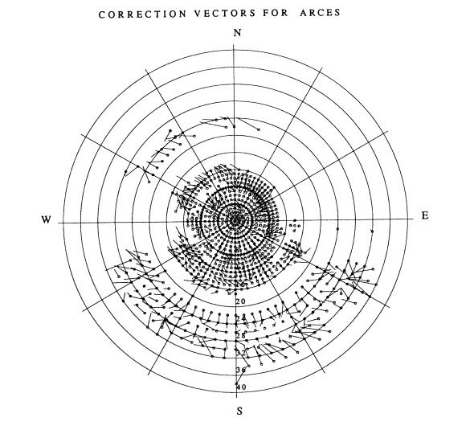
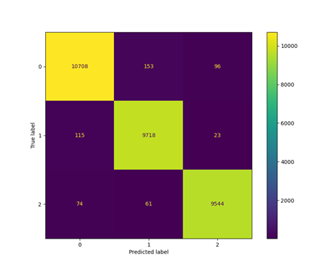
Evaluation
    With test data not used for training
    With phase labels and FK back-azimuth from classic automatic processing pipeline (NORSAR FKX)
    With previously obtained empirical slowness corrections for ARCES, FINES and NORES (Schweitzer, 2001: Slowness Corrections — One Way to Improve IDC Products)
    On the following slides ‘ML’ stands to our new method and ‘FKX’ for FK-based processing
      Seismic phase classification evaluated by accuracy (correct vs. all predictions) and confusion matrix
      Back-azimuth regression evaluated by showing fit and distribution of residuals with respect to true source back-azimuth

Slide 11
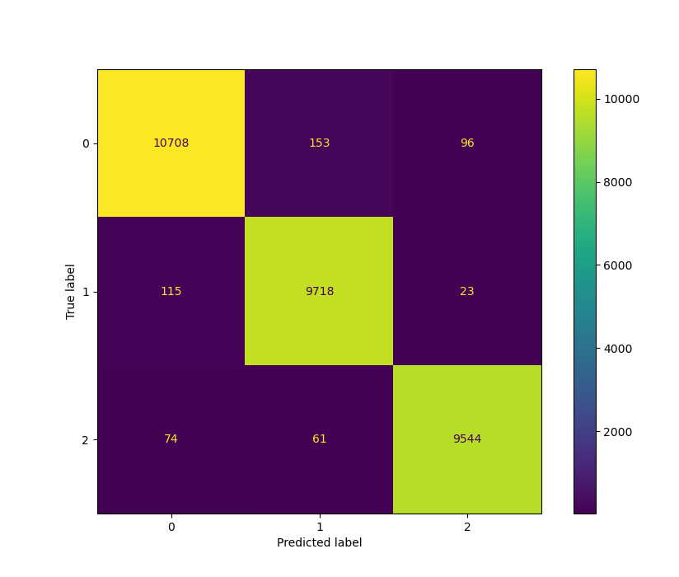
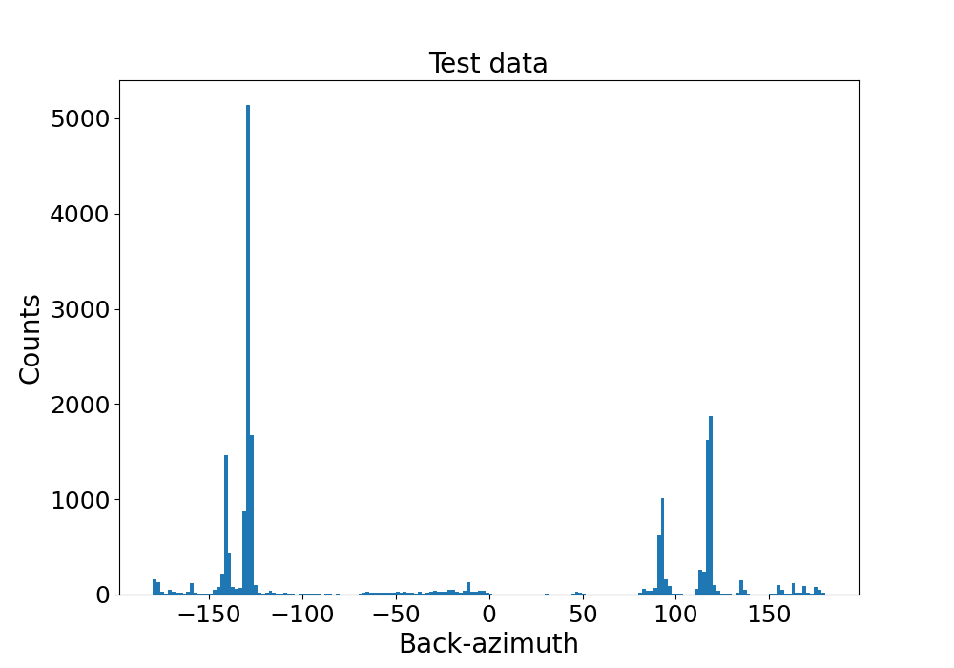
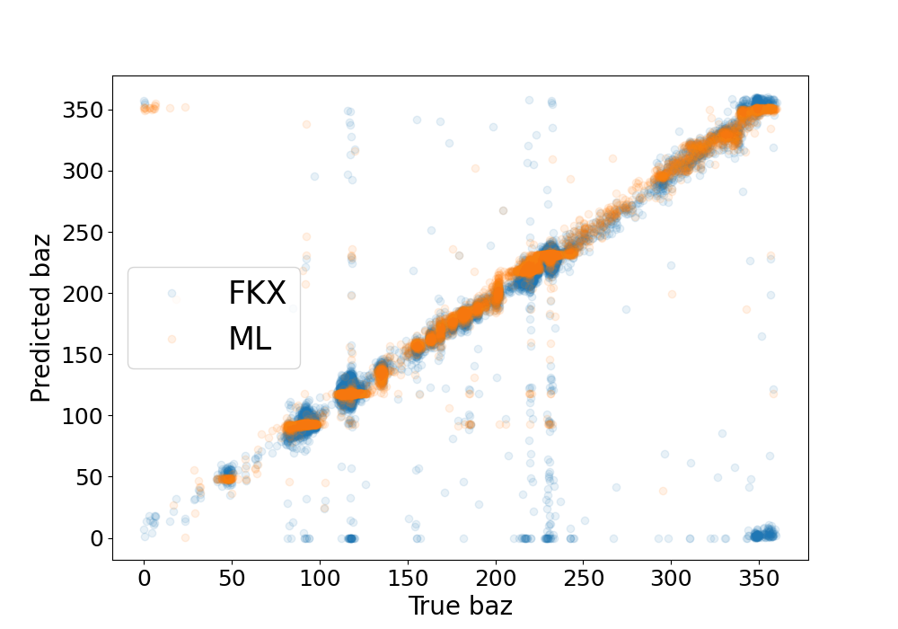
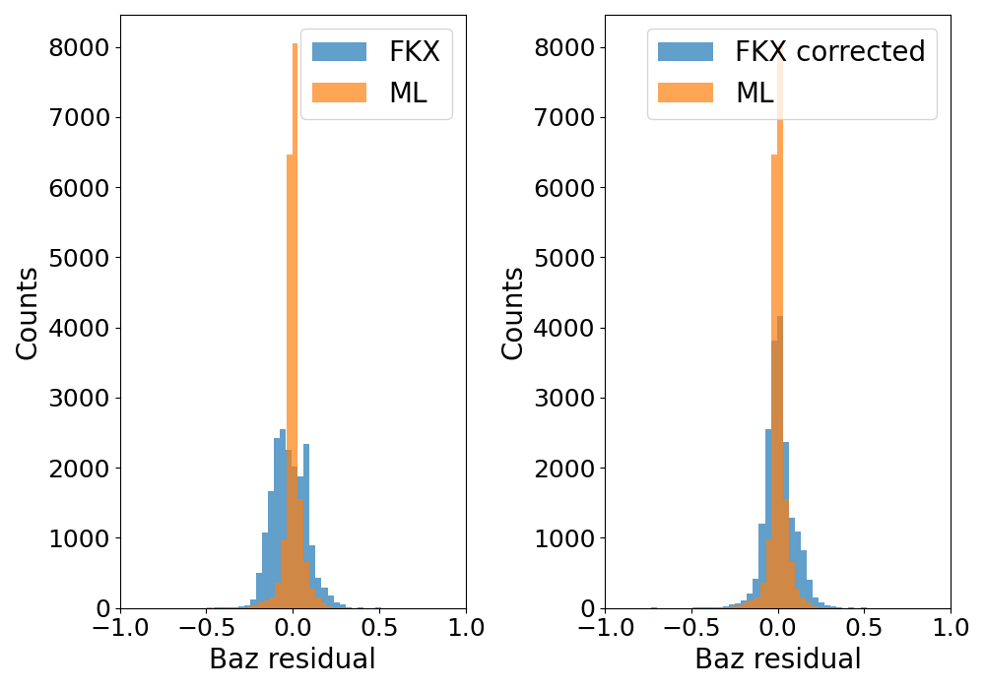
Noise P S
Results
Seismic phase classification
Noise
P
S
ARCES
no augmentation
no back-azimuth balancing
Accuracy
True vs ML: 0.99
True vs FKX: 0.99
Back-azimuth regression
FKX with empirical slowness corrections
-60 -30 0 30 60
Baz residual
-60 -30 0 30 60
Baz residual

Slide 12
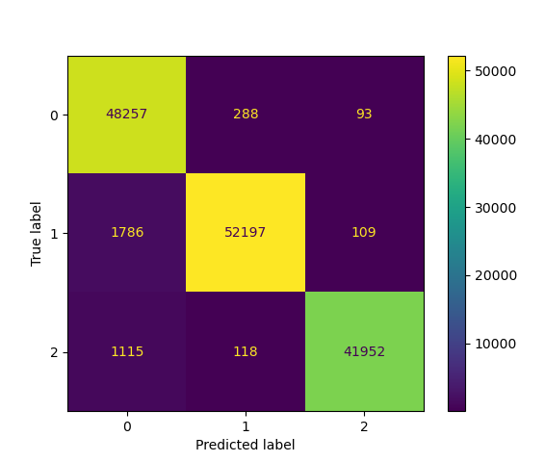
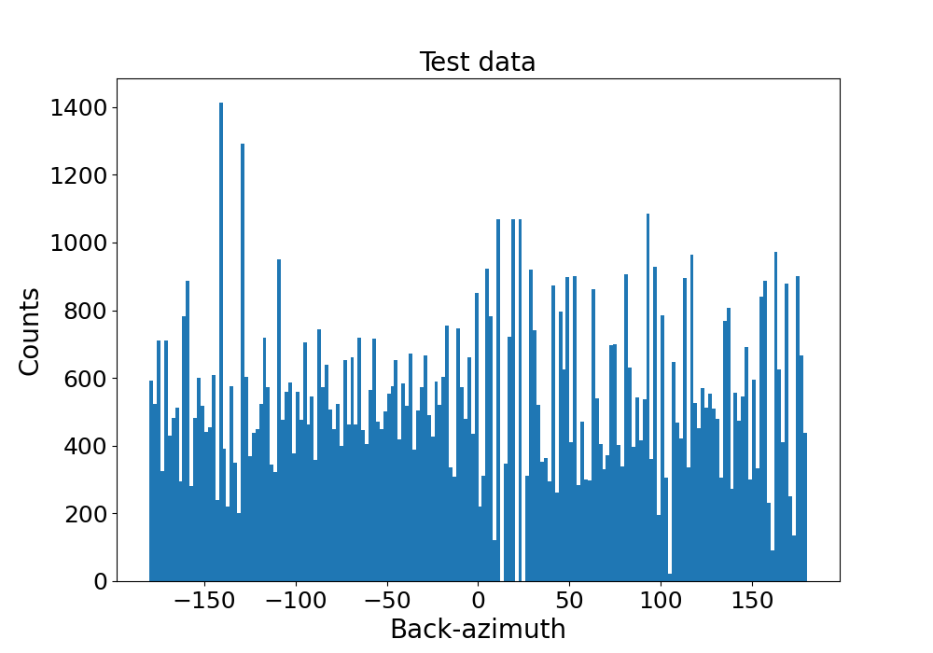
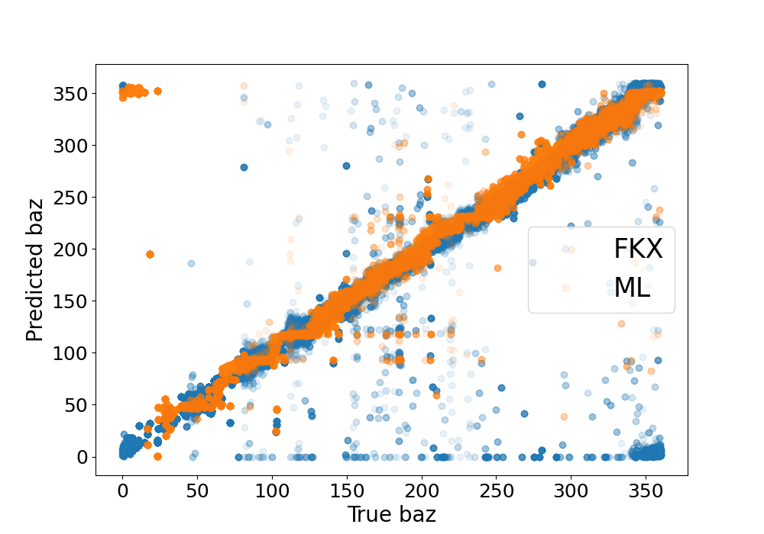
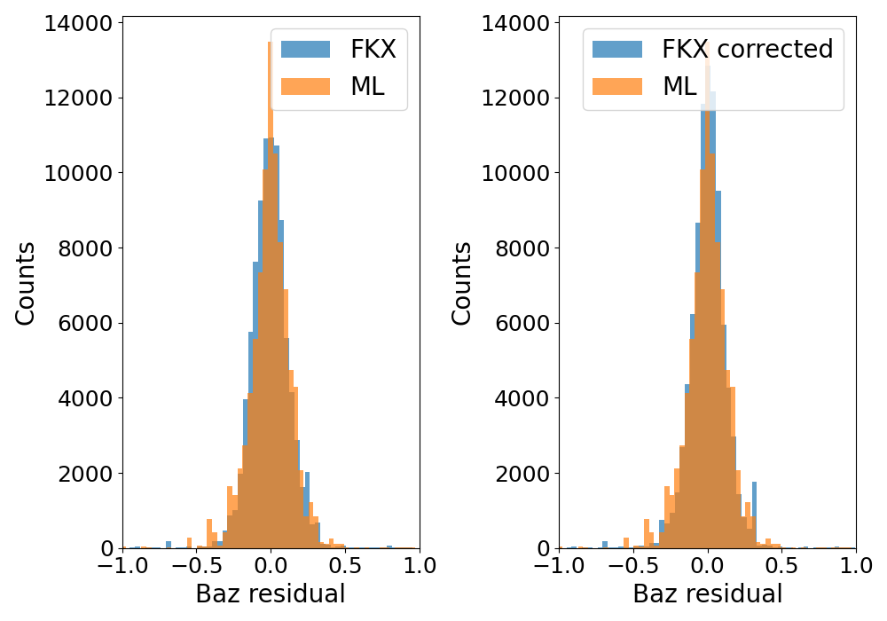
Noise P S
Results
Seismic phase classification
Noise
P
S
ARCES
no augmentation
no back-azimuth balancing
testing with upsampled data
Accuracy
True vs ML: 0.97
True vs FKX: 0.97
Back-azimuth regression
-60 -30 0 30 60
Baz residual
-60 -30 0 30 60
Baz residual

Slide 13
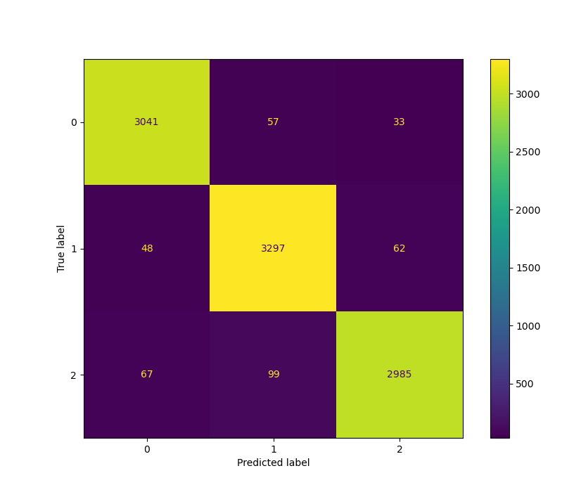
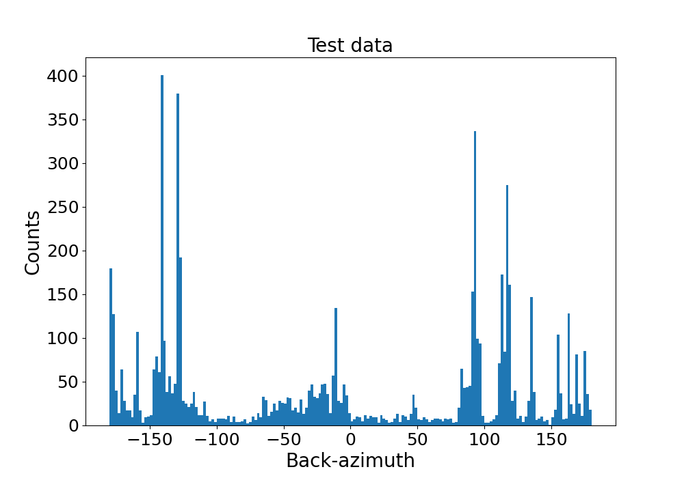

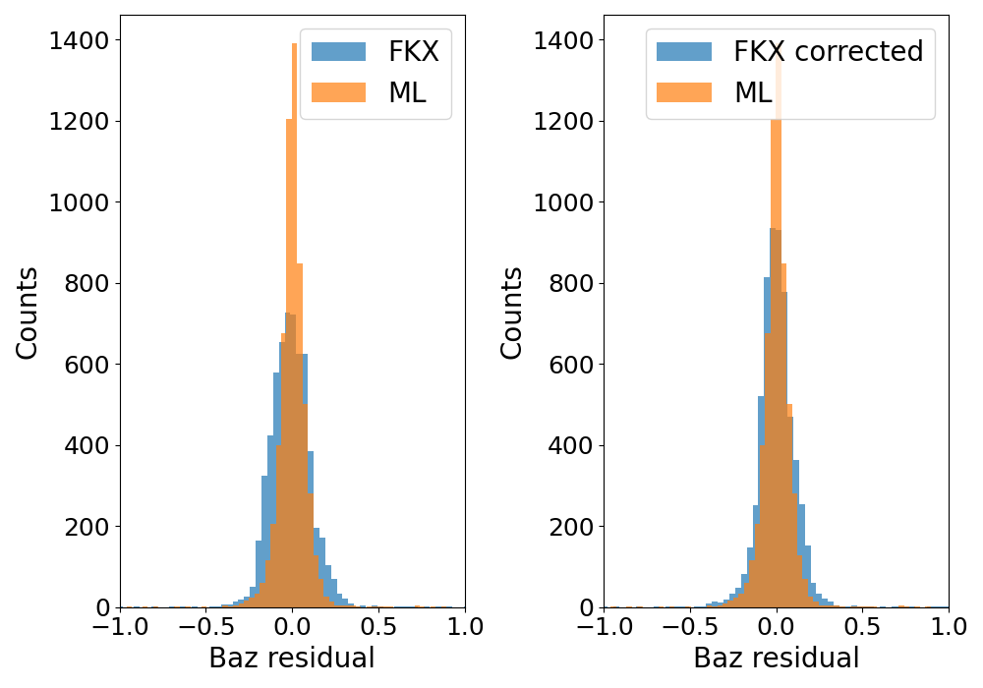
Noise P S
Results
Seismic phase classification
Noise
P
S
ARCES
augmentation
moderate back-azimuth balancing
Accuracy
True vs ML: 0.98
True vs FKX: 0.98
Back-azimuth regression
-60 -30 0 30 60
Baz residual
-60 -30 0 30 60
Baz residual

Slide 14
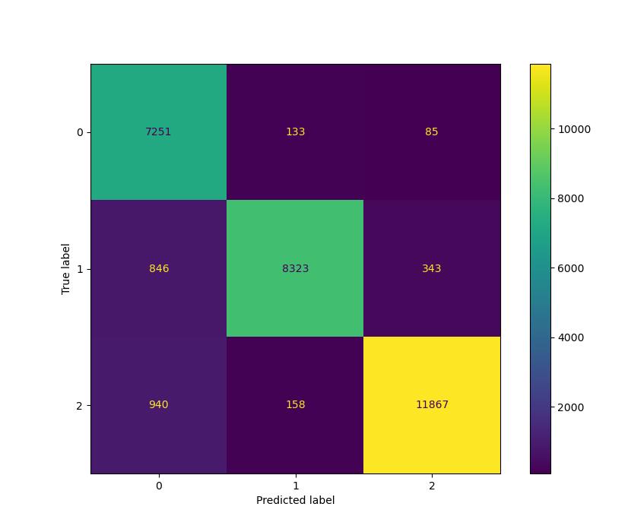

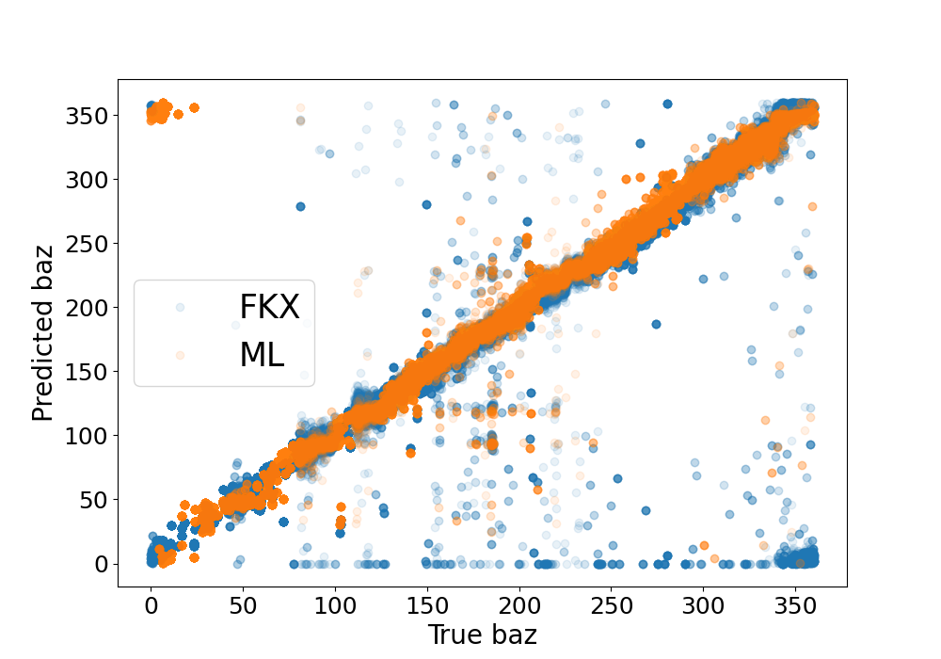
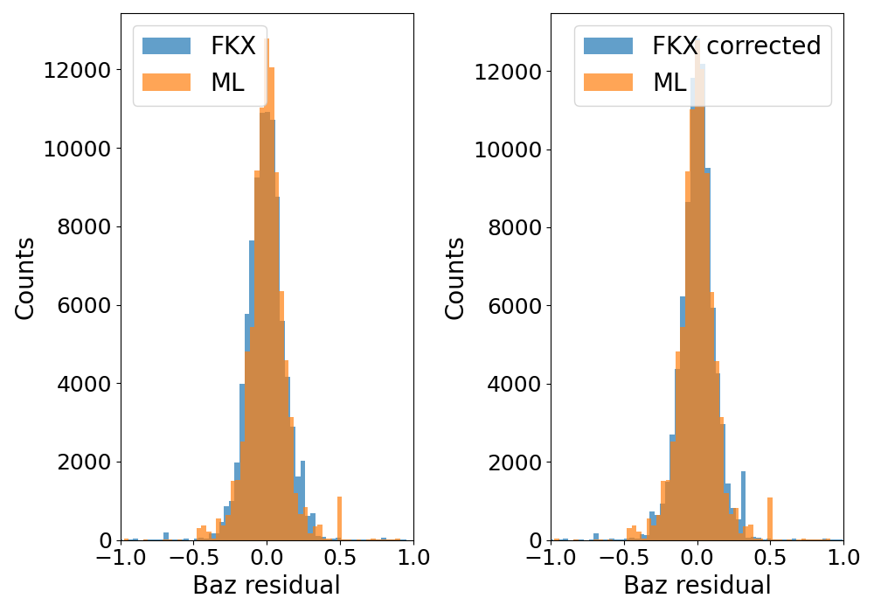
Noise P S
Results
Seismic phase classification
Noise
P
S
ARCES
augmentation
moderate back-azimuth balancing
Testing with upsampled data
Accuracy
True vs ML: 0.99
True vs FKX: 0.98
Back-azimuth regression
-60 -30 0 30 60
Baz residual
-60 -30 0 30 60
Baz residual

Slide 15
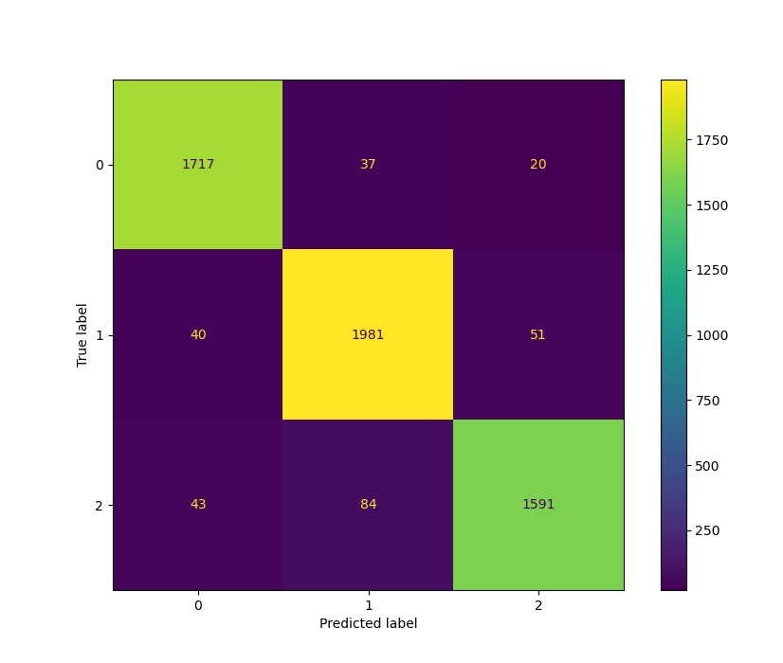
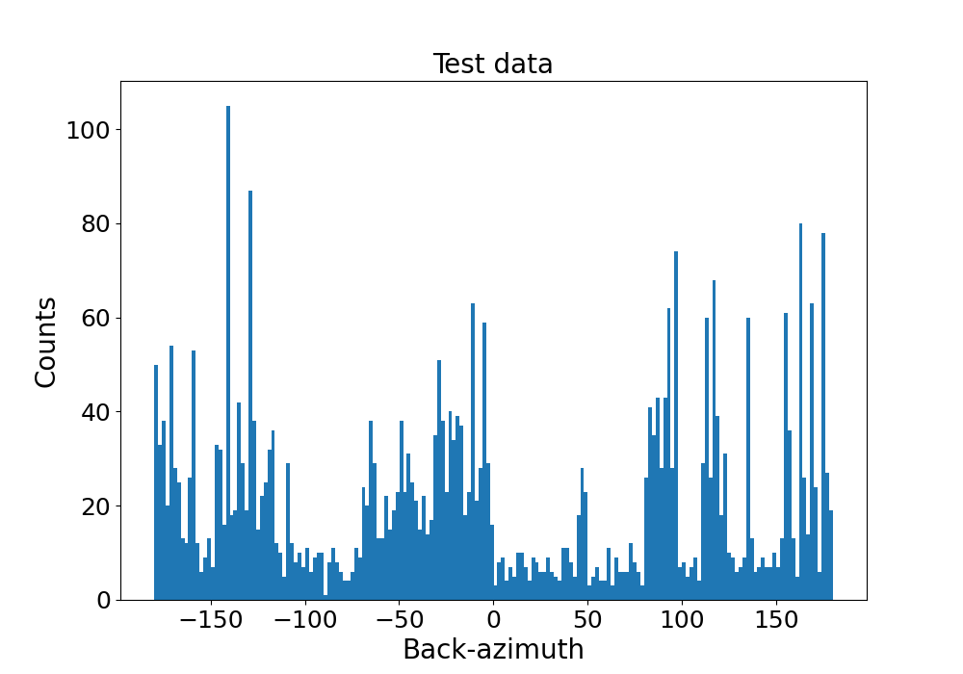

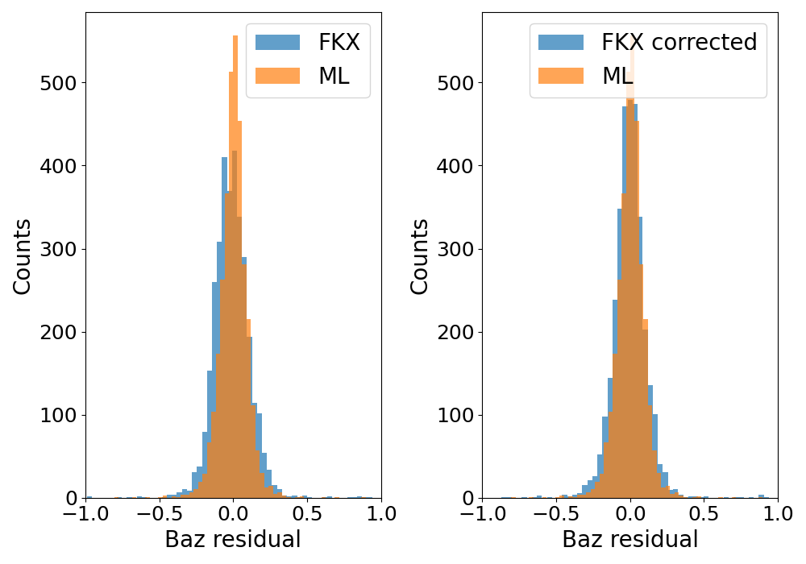
Noise P S
Results
Seismic phase classification
Noise
P
S
ARCES
augmentation
better back-azimuth balancing
Accuracy
True vs ML: 0.98
True vs FKX: 0.97
Back-azimuth regression
-60 -30 0 30 60
Baz residual
-60 -30 0 30 60
Baz residual

Slide 16

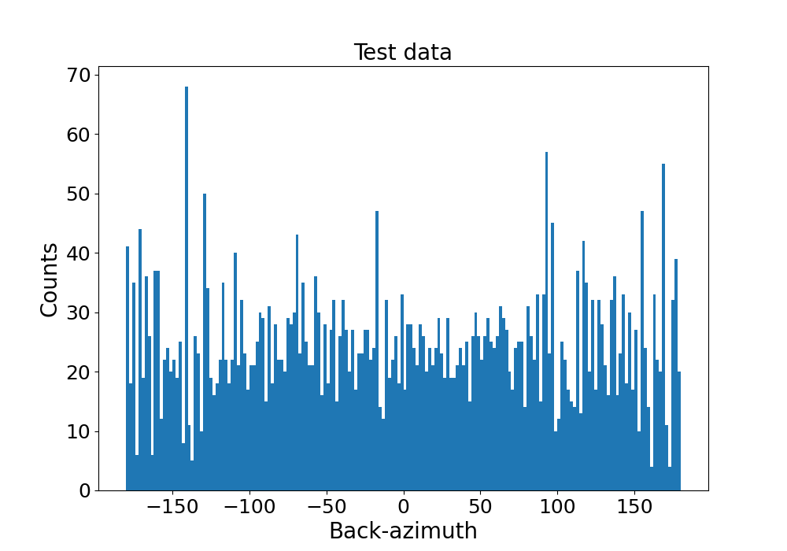
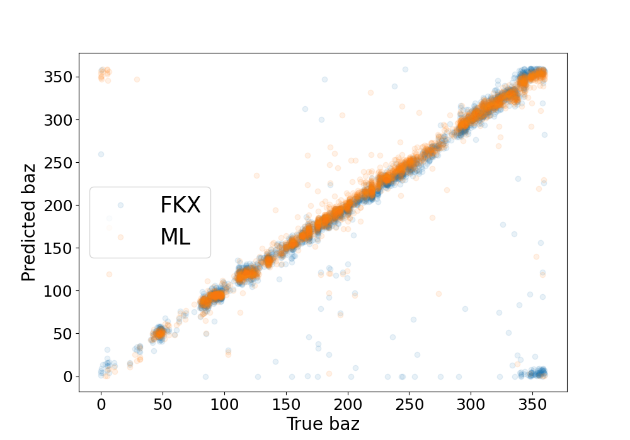
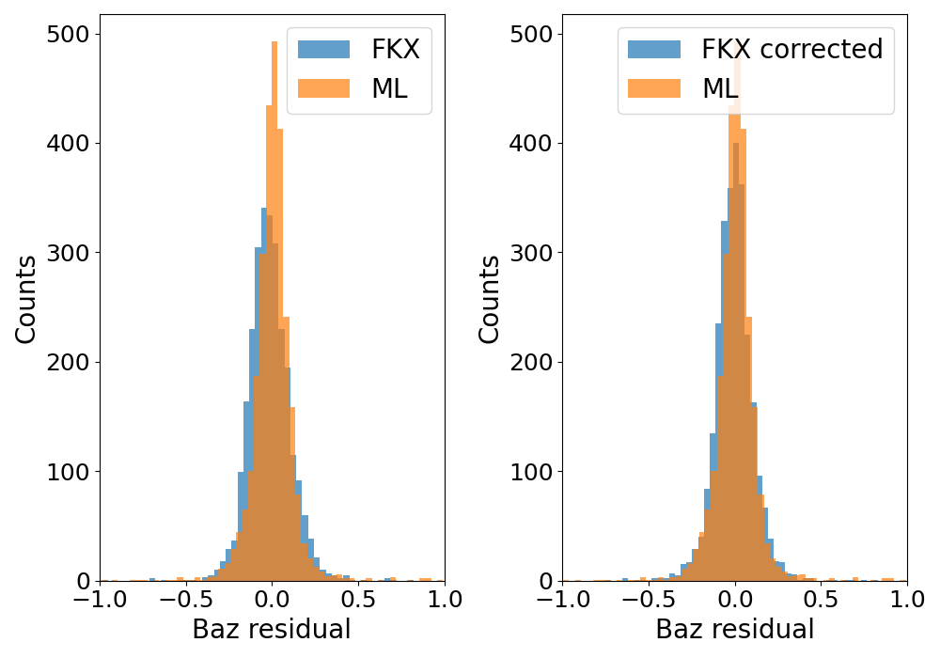
Noise P S
Results
Seismic phase classification
Noise
P
S
ARCES
augmentation
optimal back-azimuth balancing (but not enough training data …)
Accuracy
True vs ML: 0.93
True vs FKX: 0.97
Back-azimuth regression
-60 -30 0 30 60
Baz residual
-60 -30 0 30 60
Baz residual

Slide 17
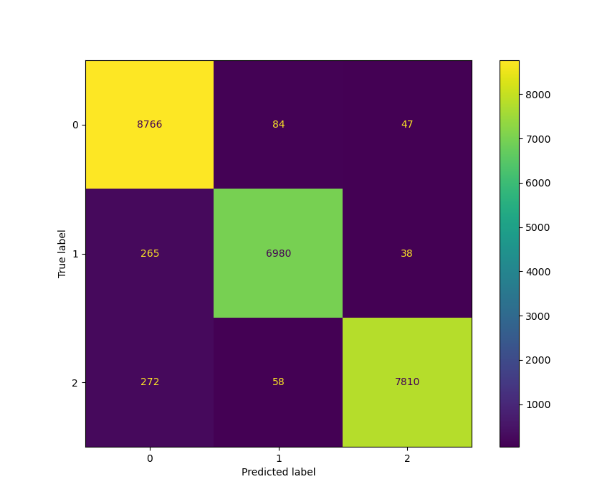
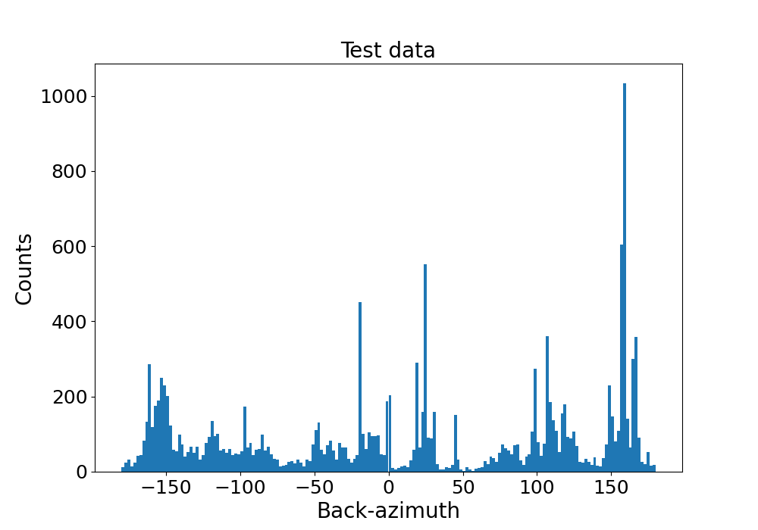
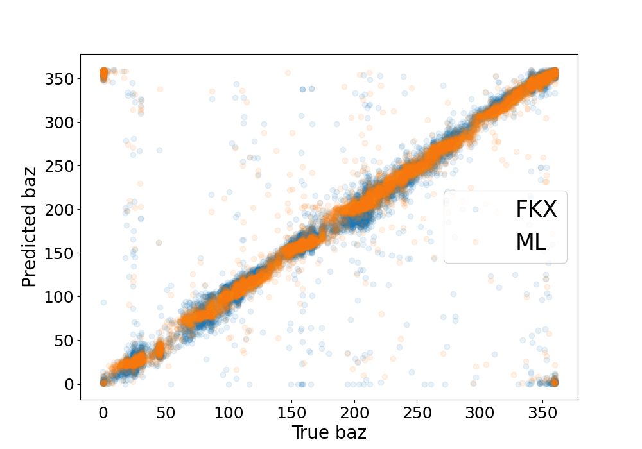
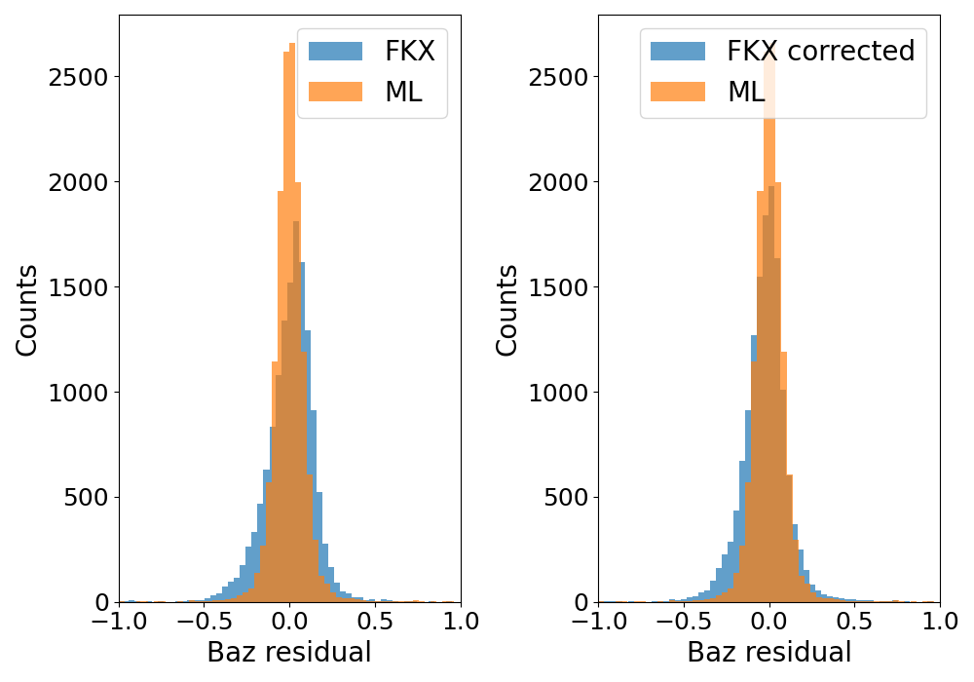
Noise P S
Results
Seismic phase classification
Noise
P
S
FINES
no augmentation
no back-azimuth balancing
Accuracy
True vs ML: 0.97
True vs FKX: 0.98
Back-azimuth regression
-60 -30 0 30 60
Baz residual
-60 -30 0 30 60
Baz residual

Slide 18
Conclusions
Successful proof-of-concept for combined back-azimuth regression and seismic phase classification neural network for ARCES and FINES array data:
Source back-azimuth prediction improved compared to classic FK
Indirect slowness corrections consistent with previous found values
About 10 time faster than FK once trained:
  FK: cross-spectral matrix + grid search in slowness place
  NN: cross-spectral matrix + prediction (multiplication with NN weights)
Similar performance for P and S wave classification as classic FK-based approach (if enough training data)
Where classic approach is still more flexible: New method …
… requires large training data set
… must be trained for each array individually
… is trained for a fixed frequently band

Slide 19
Next steps
    Train and test on more IMS arrays
    Train with regional seismic phase (Pn, Pg, Sn, Sg, Lg, Rg …). So far Pn/Sn and Pg/Sg are both labeled as P/S. Lg is labeled as S.
    Use other catalogues for training (LEB,…)
    Train with teleseismic arrivals
    Compare with all associated arrivals in automatic bulletins (not just reviewed arrivals)
    Include more frequency bands
    Include a new class of arrivals from close to or inside the array which may cause problems for event associating: a potential method to sort those out

