Slide 1



AMUSED
A MUltidisciplinary Study of past global climatE changes from continental and marine archives in the MeDiterranean region
The Castiglione maar drilling (central Italy)
Macrì P., Caricchi C., D’Ajello Caracciolo F., Di Roberto A., Giaccio B., Minelli L., Nicolosi I., Scateni B., Siravo G., Smedile A.

Slide 2

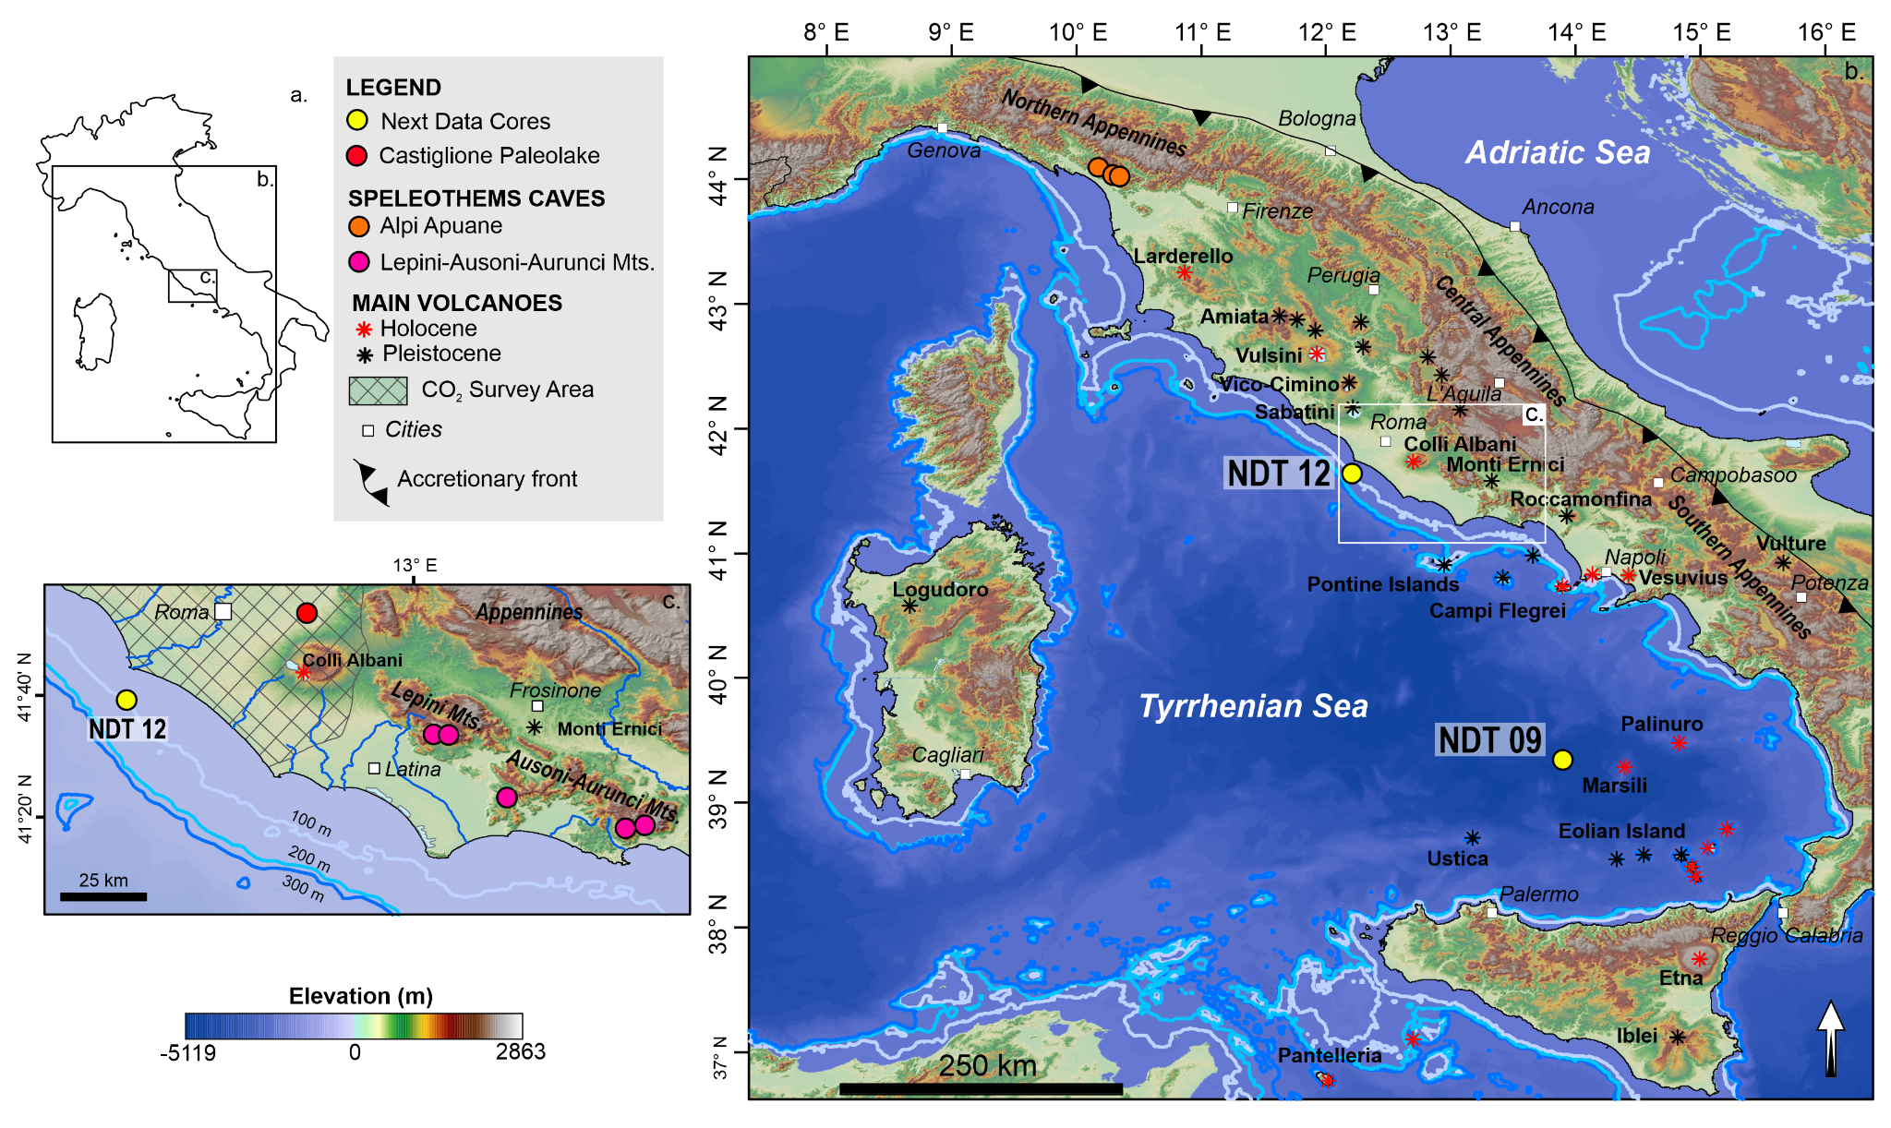
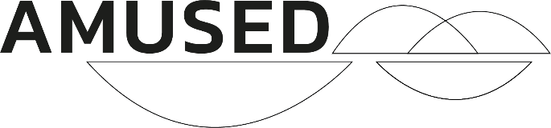
Amused Project Overview
Castiglione paleolake
EGU – Vienna, Austria & Online | 23–27 May 2022
Notes:
The main goal of this project is to reconstruct the climatic variability in the central Mediterranean region during the middle-late Quaternary, with a focus on the Holocene, by integrating paleoclimate multi-
proxies data acquired from different paleoenvironmental settings.
Specifically, we propose to investigate lacustrine, speleothem and marine successions aiming at comparing, within a narrow geographical range, the expressions of the climate variability in three different sub-systems at different temporal scales and resolution (i.e., from orbital to sub-millennial scale).
We selected: 1) the Castiglione maar in central Italy,, where two 116/126 m and a 10 m long cores were drilled, spanning last ~280 kyr and ~12 kyr respectively,
2) Speleothems that will be acquired from selected caves of the central and noth Italy and
3) two marine cores the 5.7 m and the 3.8 m long (NDT09 and NDT12 spanning last 50 kyr and 5 kyr respectively) recovered in the Tyrrhenian Sea during the NextData Project cruise.

Slide 3
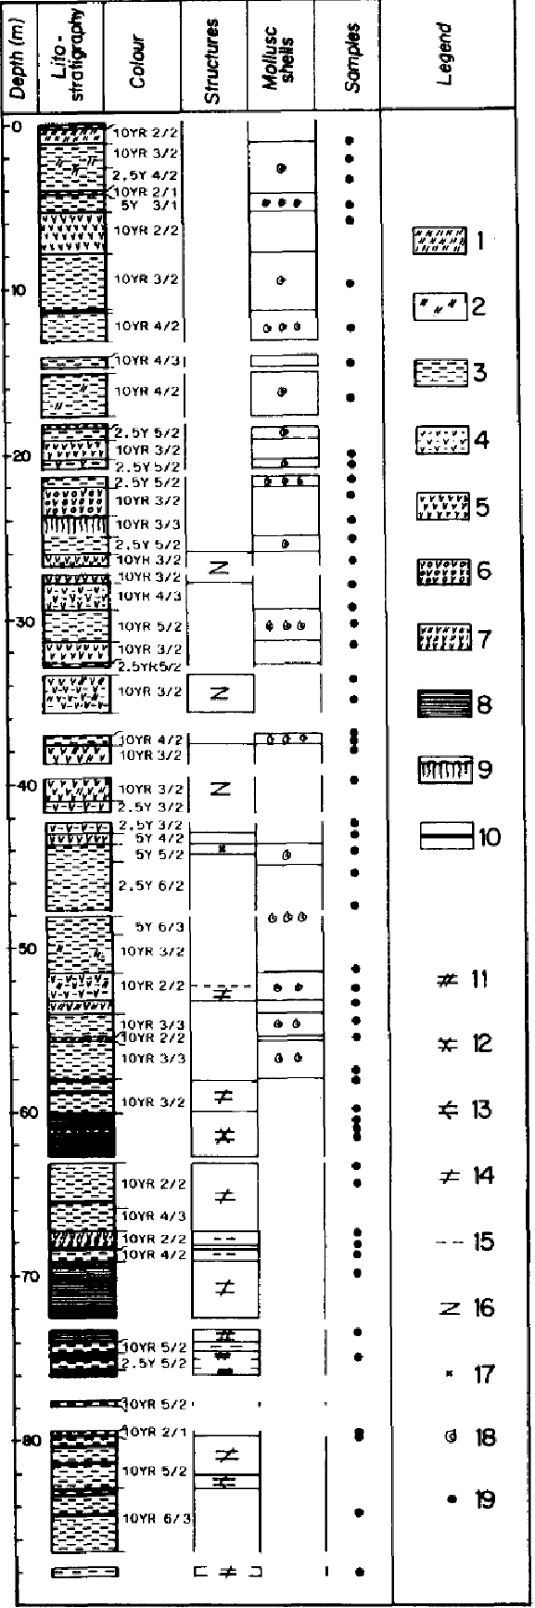
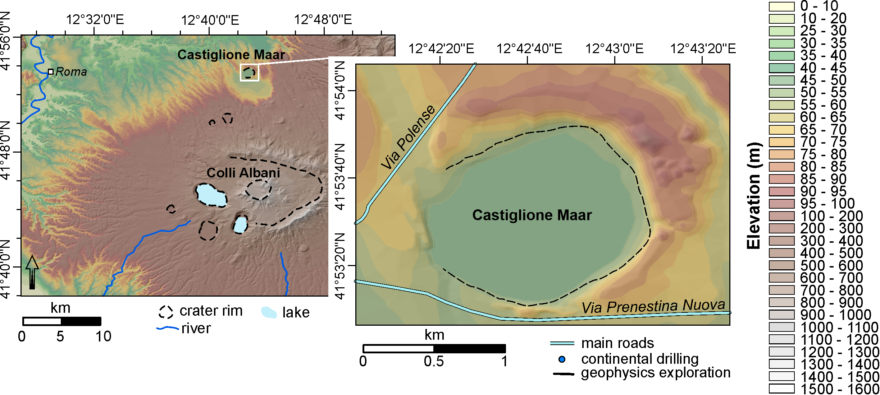
Castiglione maar
Narcisi et al., 1992
EGU – Vienna, Austria & Online | 23–27 May 2022
EGU – Vienna, Austria & Online | 23–27 May 2022
Notes:
Previous low-resolution and chronologically poorly constrained investigations, indicate that the Castiglione maar hosts an at least 90 m-long lacustrine succession, spanning the last ~250 kyr (Narcisi
et al., 1992). We are thus confident about the potentiality of this site in providing a continuous succession suitable for high-resolution paleoclimatic investigations.

Slide 4

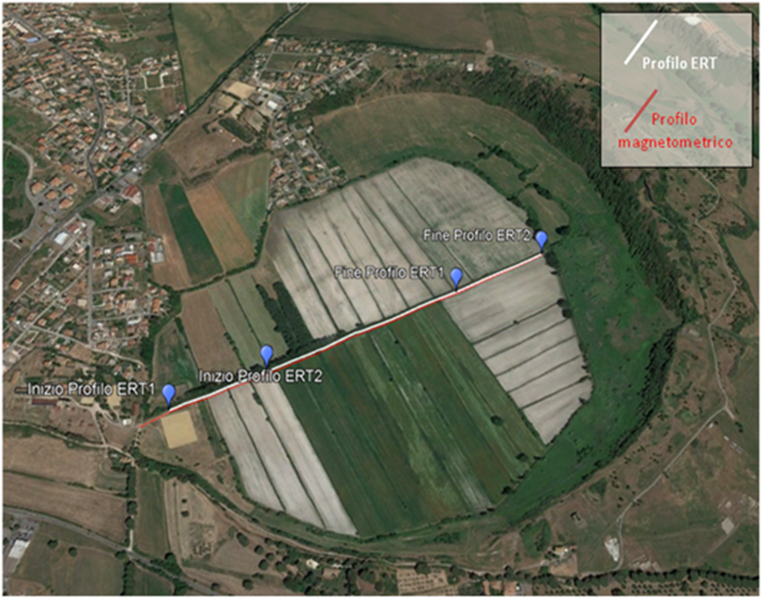
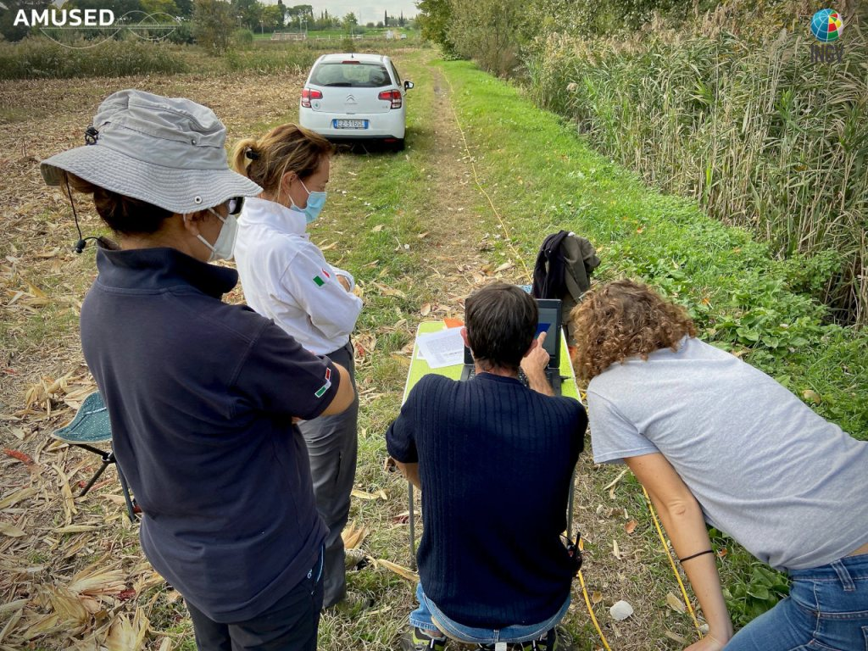
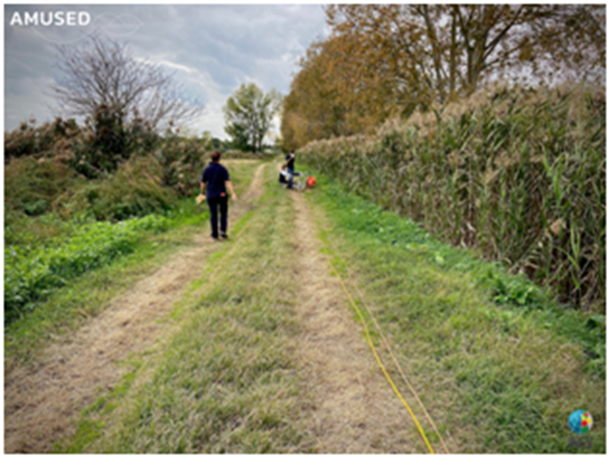
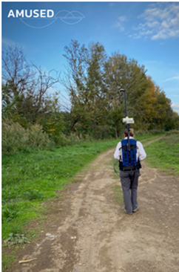
Geophysical exploration
Tecnica roll-along
ERT 2
ERT 1
EGU – Vienna, Austria & Online | 23–27 May 2022
Notes:
However first of all we run a geopysical exploration in order to identify the best drilling site.

Slide 5
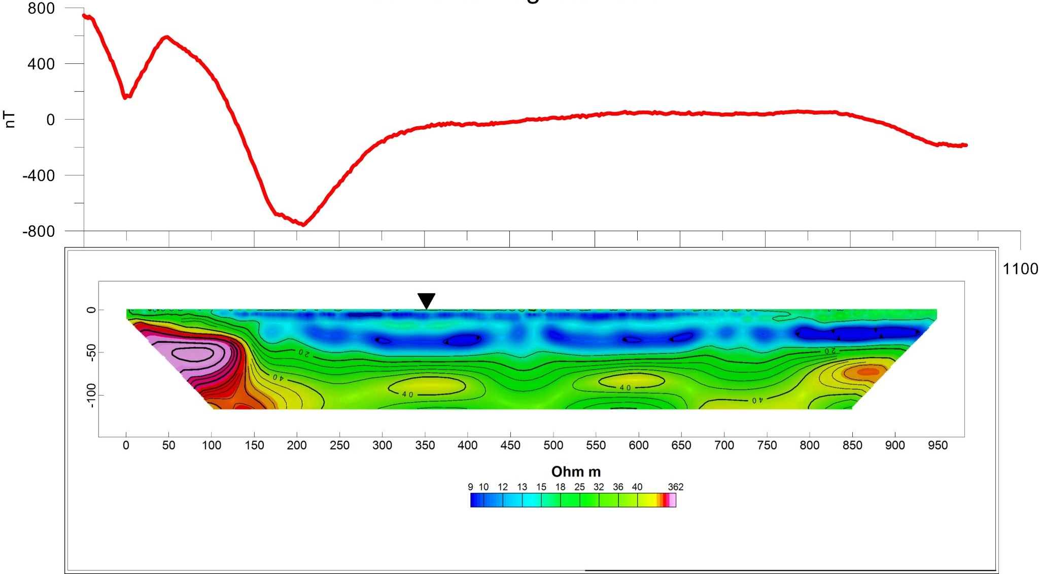
Geophysical exploration
Ground magnetic vs ERT (electrical resistivity tomography) profiles
SW
NE
C1 – C2 – C3
EGU – Vienna, Austria & Online | 23–27 May 2022
Notes:
Il profilo geoelettrico mostra la forma del cratere: il lato SX mostra, con dei colori violetti, il bordo quasi affiorante del substrato vulcanico, la parte DX del profilo non arriva al margine del cratere.

Slide 6
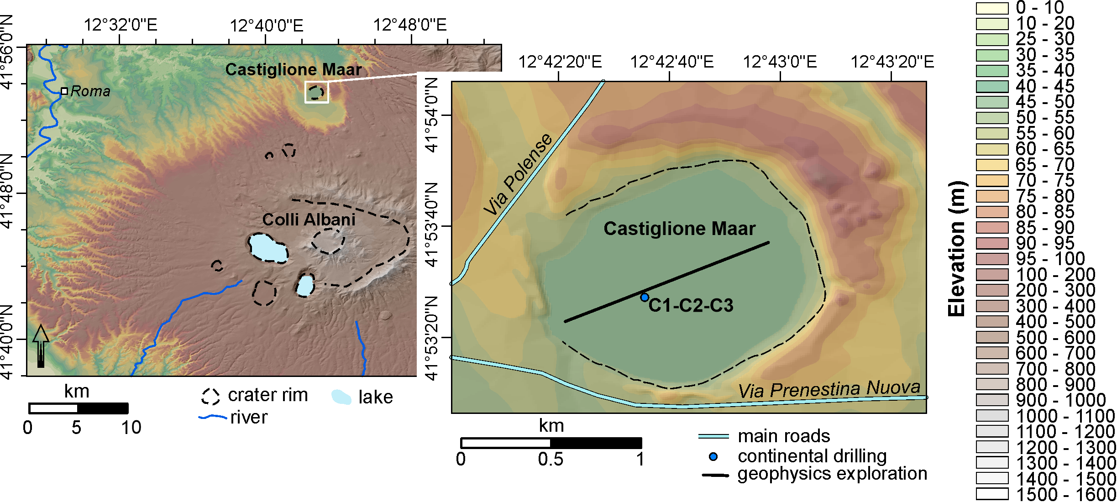
Castiglione maar
Narcisi et al., 1992
EGU – Vienna, Austria & Online | 23–27 May 2022
EGU – Vienna, Austria & Online | 23–27 May 2022
Notes:
Previous low-resolution and chronologically poorly constrained investigations, indicate that the Castiglione maar hosts an at least 90 m-long lacustrine succession, spanning the last ~250 kyr (Narcisi
et al., 1992). We are thus confident about the potentiality of this site in providing a continuous succession suitable for high-resolution paleoclimatic investigations.

Slide 7
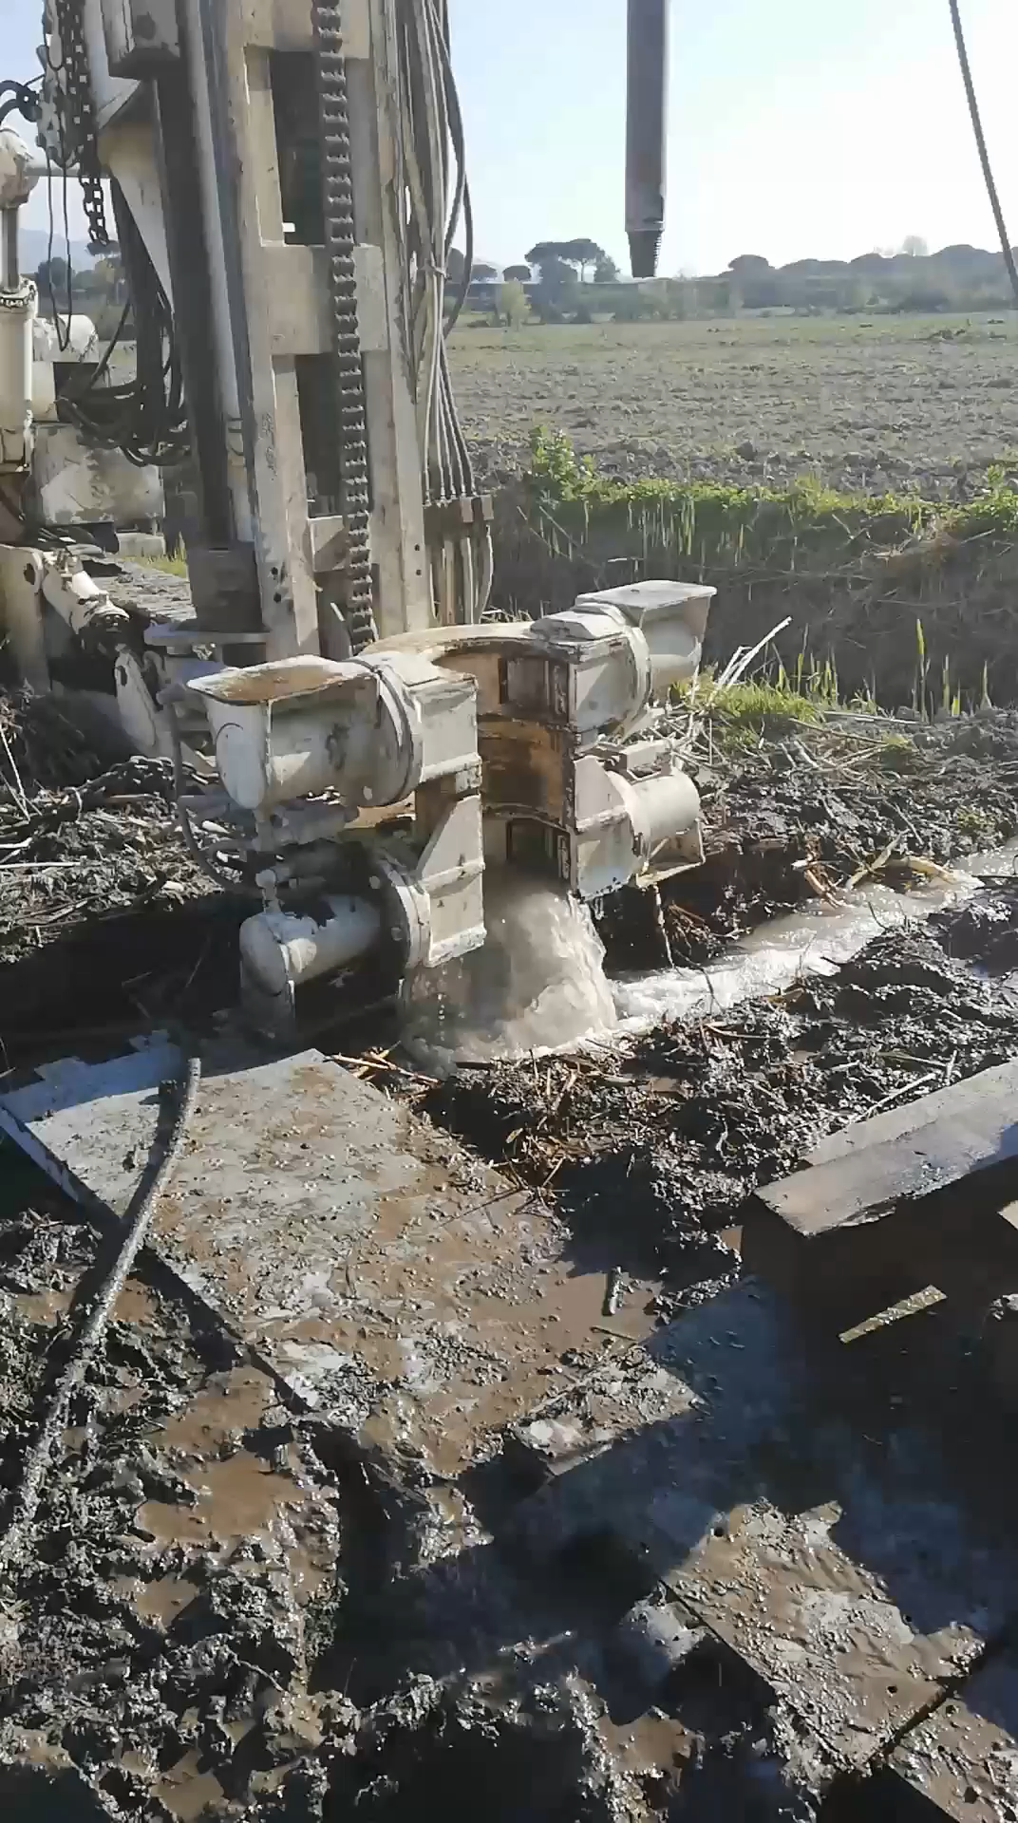
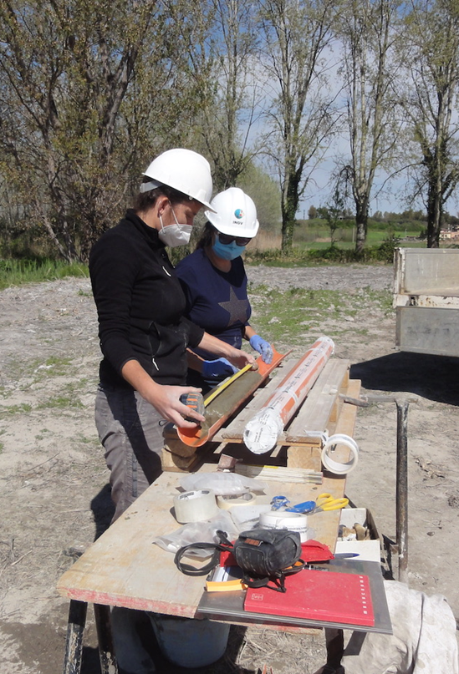
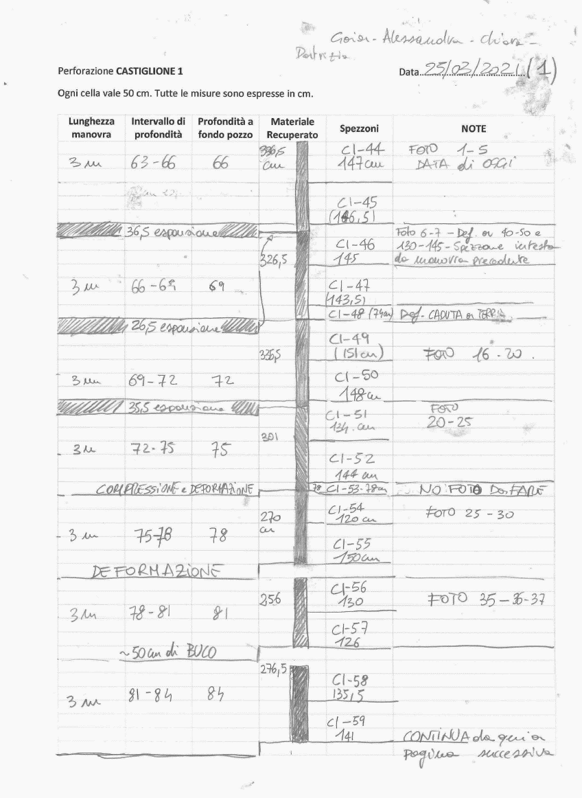
Castiglione maar drilling
EGU – Vienna, Austria & Online | 23–27 May 2022
Notes:
Drilling operations
Artesian water table
Storing

Slide 8
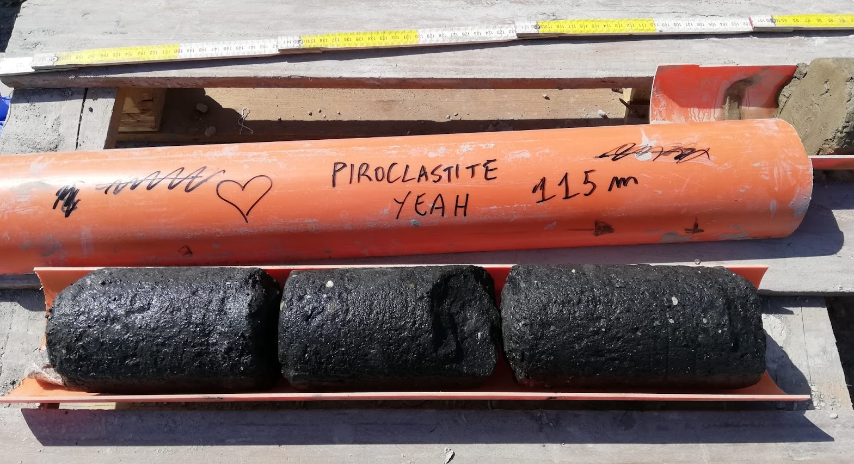
Castiglione Maar drilling
EGU – Vienna, Austria & Online | 23–27 May 2022
Notes:
Finally the bottom.

Slide 9
Castiglione maar drilling
CORE | C1 | C2 | C3
Lenght (m) | 116 | 126.5 | 15
Recovered (m) | 94.54 | 107.5 | 11.92
Lost (m) | 21.46 | 19 | 3.0 8
Recovered (%) | 81.4% | 85.0% | 79 %
n. sections (1.5 m) | 71 | 82 | 9
EGU – Vienna, Austria & Online | 23–27 May 2022

Slide 10
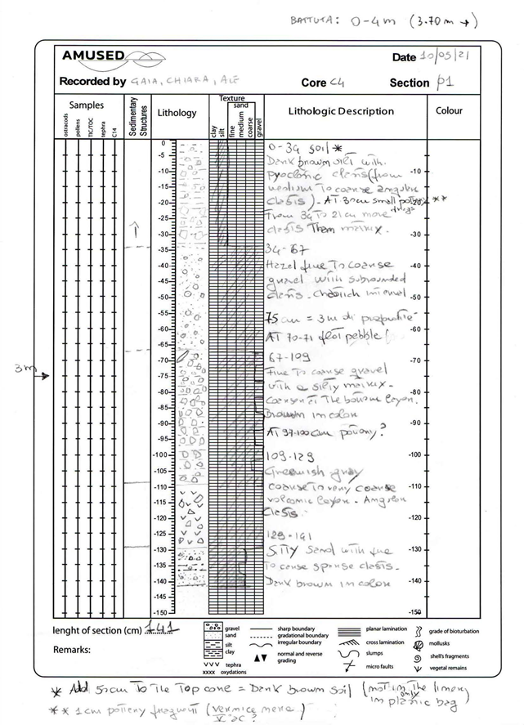
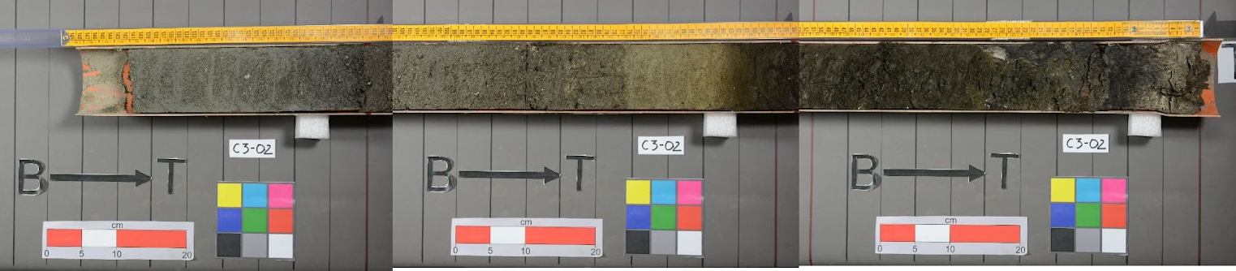
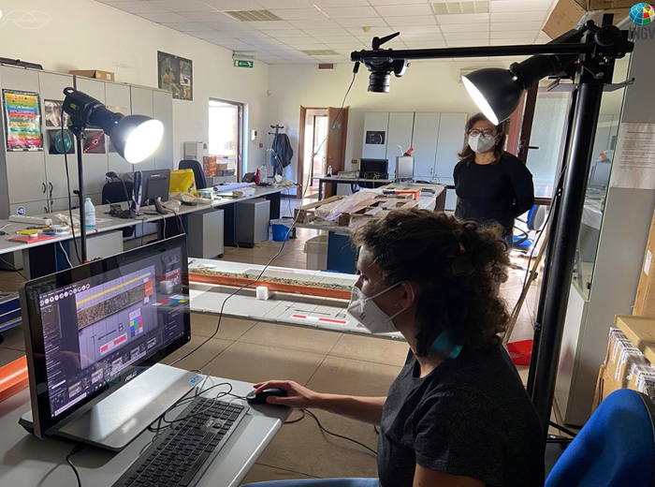
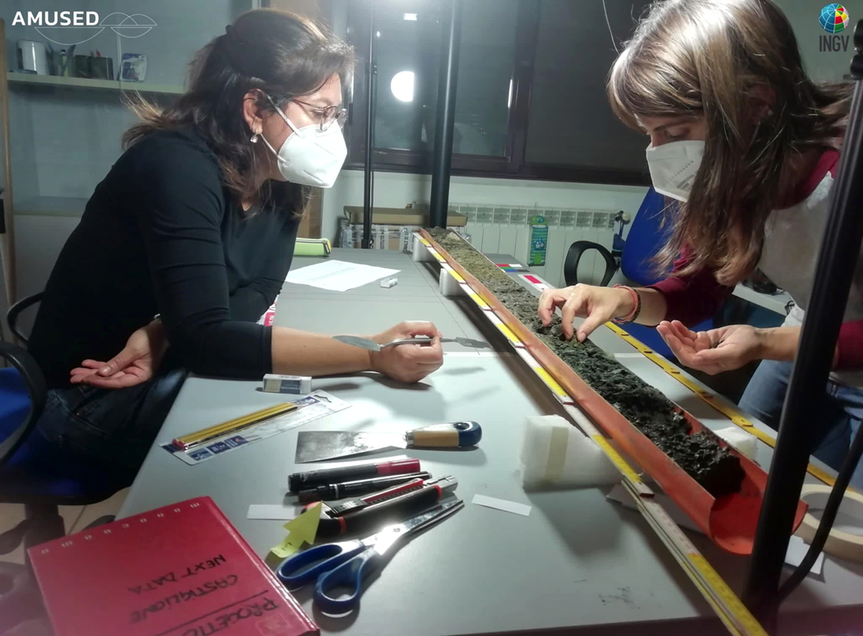
Core sections opening
Lithostratigraphic description and sections shooting
EGU – Vienna, Austria & Online | 23–27 May 2022

Slide 11
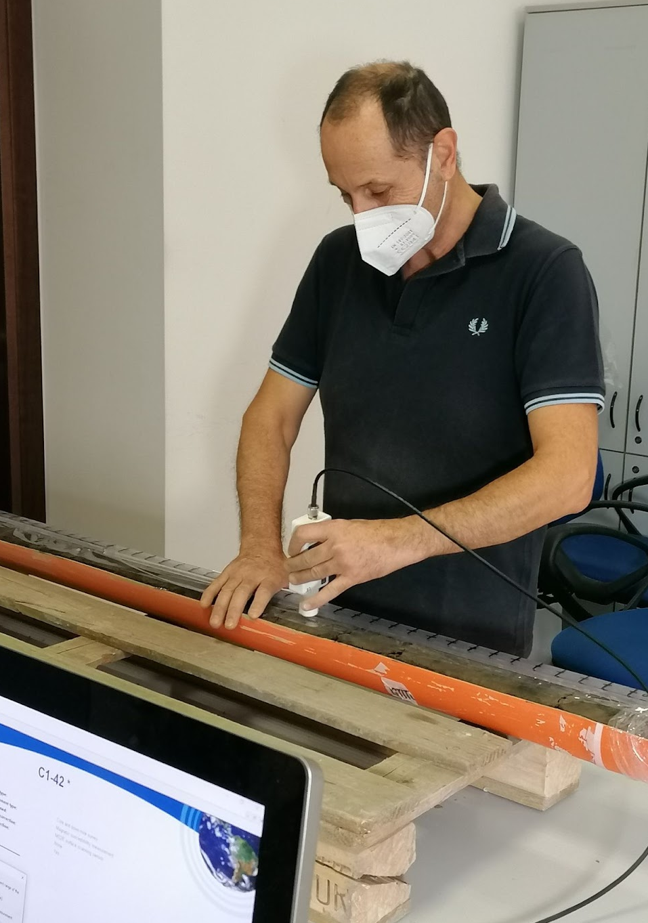
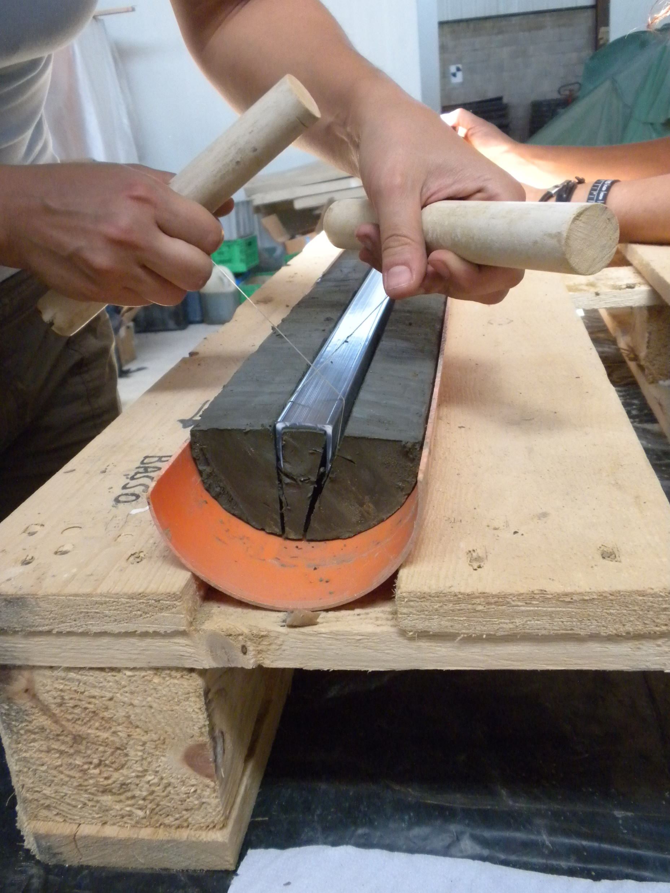
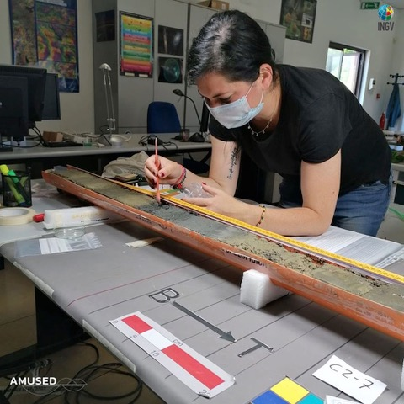
Core sections opening
Anisotropy of Magnetic
Susceptibility (AMS)
U-channel sampling
Tephra sampling
EGU – Vienna, Austria & Online | 23–27 May 2022

Slide 12
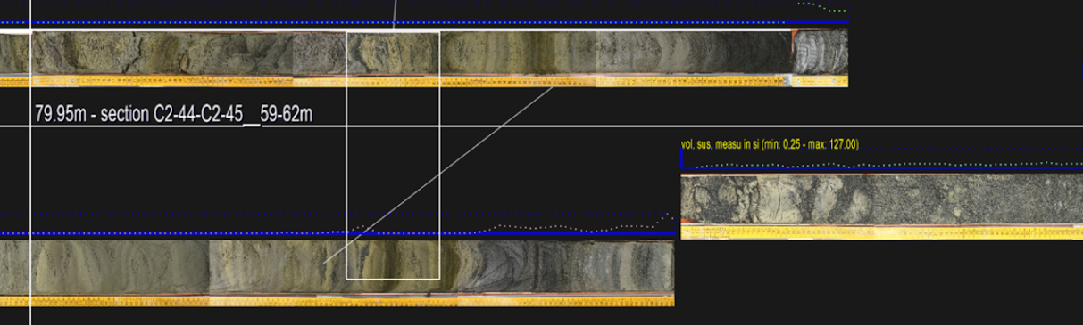
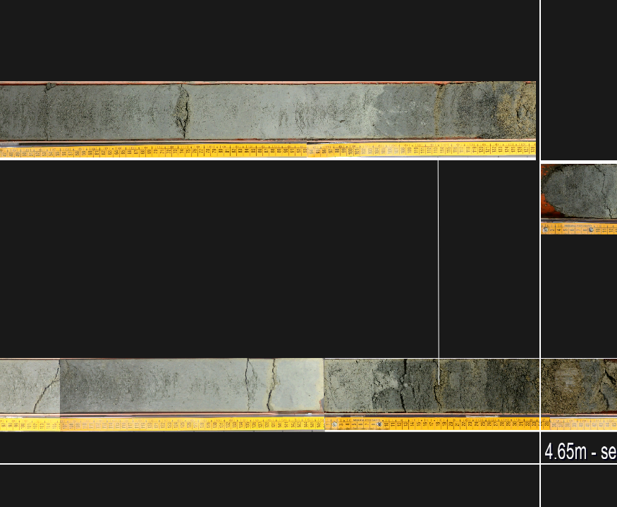
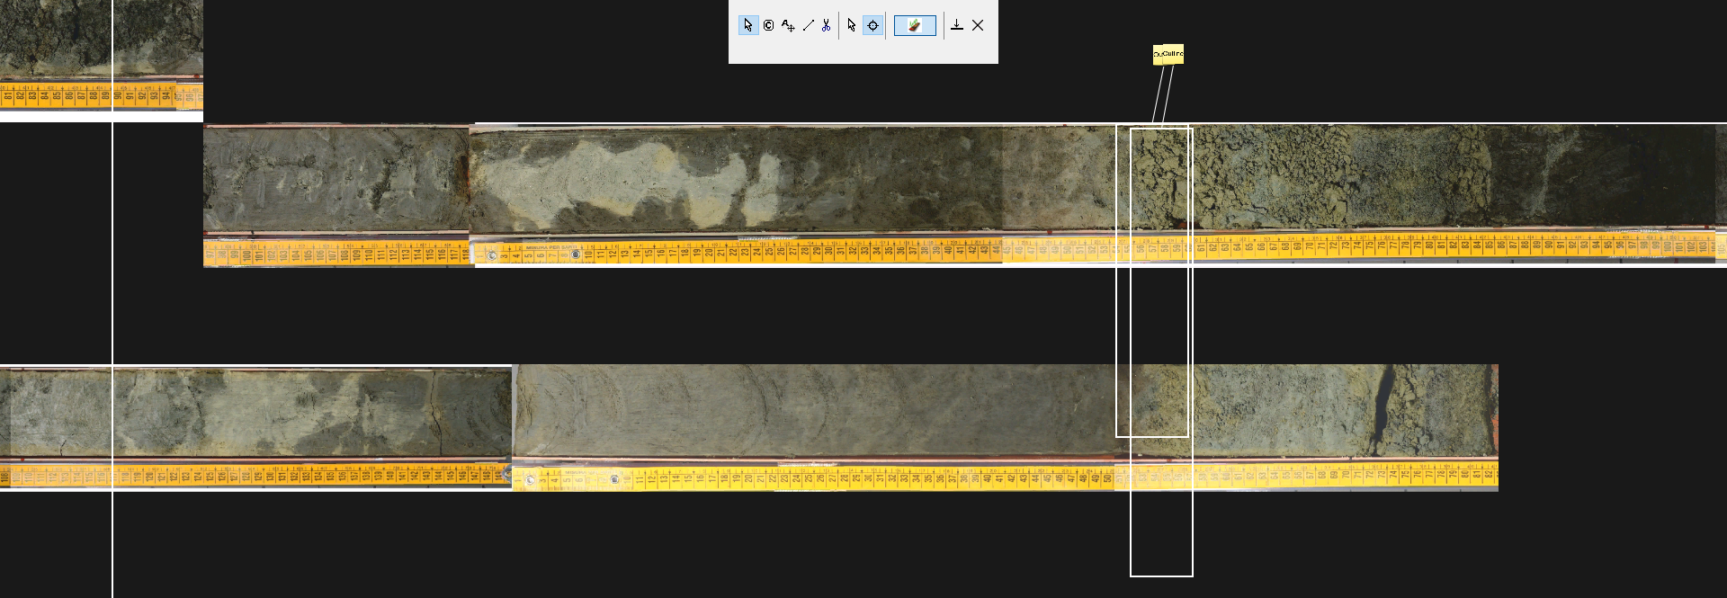
Building of the “Castiglione composite stratigraphic section”
Corelyzer Software https://cse.umn.edu/csd/corelyzer
Disturbed material to be avoided
EGU – Vienna, Austria & Online | 23–27 May 2022

Slide 13
Castiglione maar drilling
CORE | C1 | C2 | C3 | COMPOSITE
Lenght (m) | 116 | 126.5 | 15 | 131.37
Recovered (m) | 94.54 | 107.5 | 11.92 | 114.31
Lost (m) | 21.46 | 19 | 3.0 8 | 17.06
Recovered (%) | 81.4% | 85.0% | 79 % | 87.0%
n. sections (1.5 m) | 71 | 82 | 9
EGU – Vienna, Austria & Online | 23–27 May 2022

Slide 14
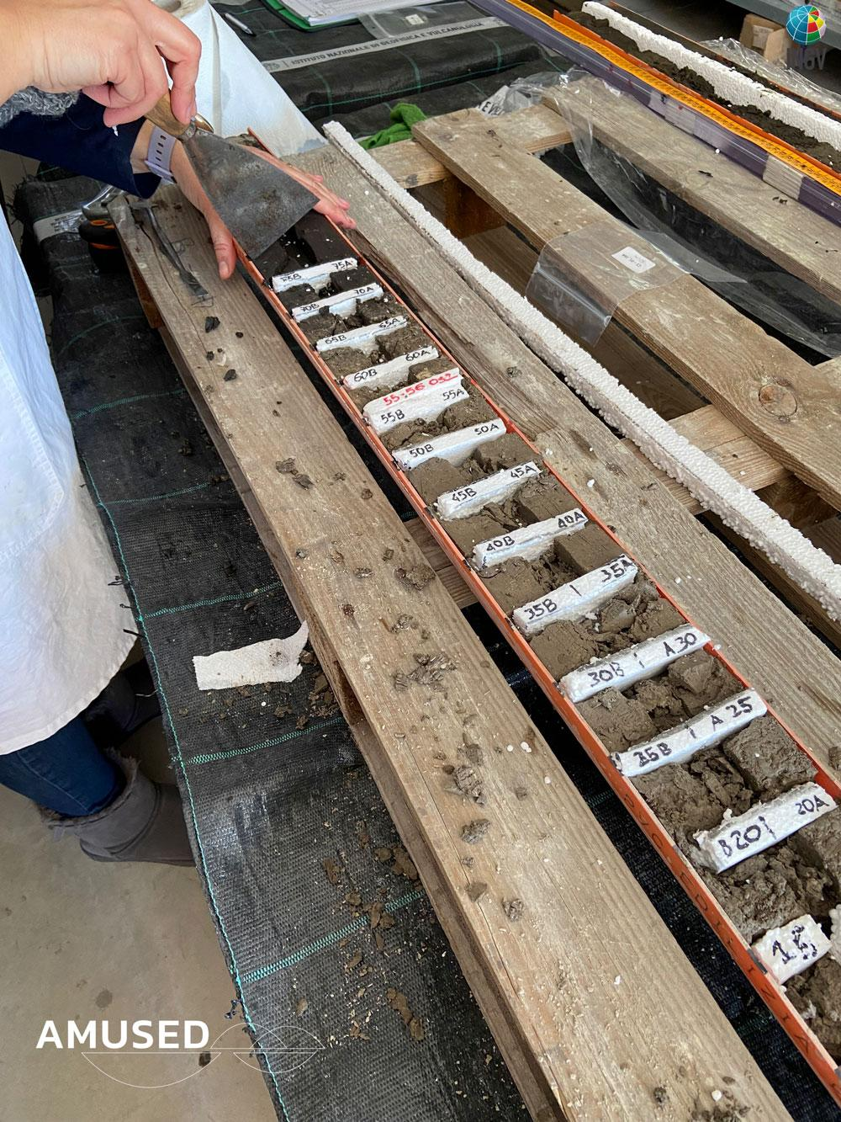
Cores sampling (5 or 25 cm spacing)
Paleomagnetic measurements (1-cm spacing)
TC/TIC/TOC (every 25 cm, 450 samples)
δ¹⁸O and δ¹³C (ca. 250 samples)
Ostracods (every 25 or 50 cm, 280 samples)
Palinology from MIS 5e (every 3 cm, 475 samples)
X-ray fluorescence scanning (each 0.5 mm)
EGU – Vienna, Austria & Online | 23–27 May 2022

Slide 15
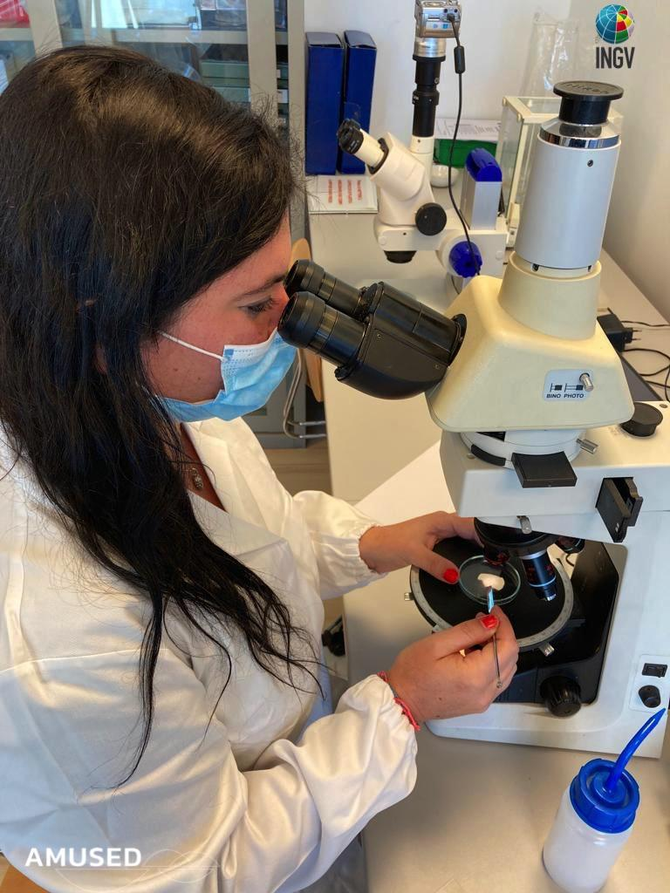
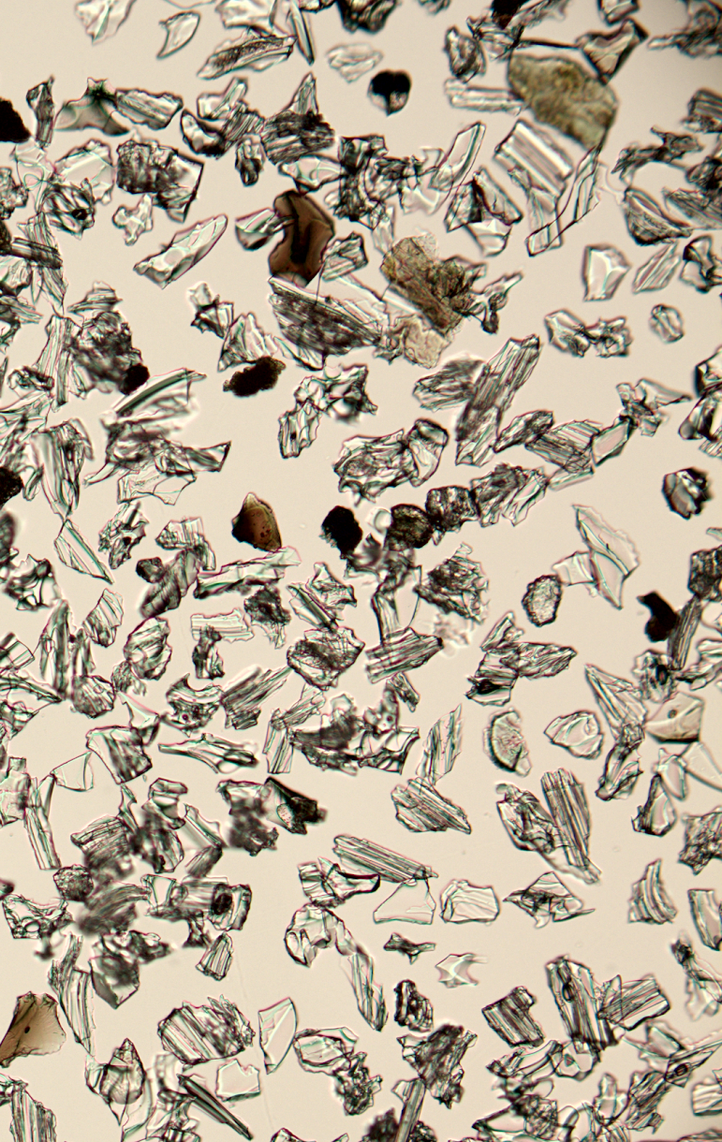
Preliminary tephra analysis
Tephracronology (150 samples, 78 selected)
SEM + EPMA analyses (50 samples)
Trace elements (50 samples)
Isotopic analyses ⁸⁷Sr/⁸⁶Sr, ¹⁴³Nd/¹⁴⁴Nd (50 samples)
Absolute radiometric dating ⁴⁰Ar-³⁹Ar (12 samples)
EGU – Vienna, Austria & Online | 23–27 May 2022

Slide 16
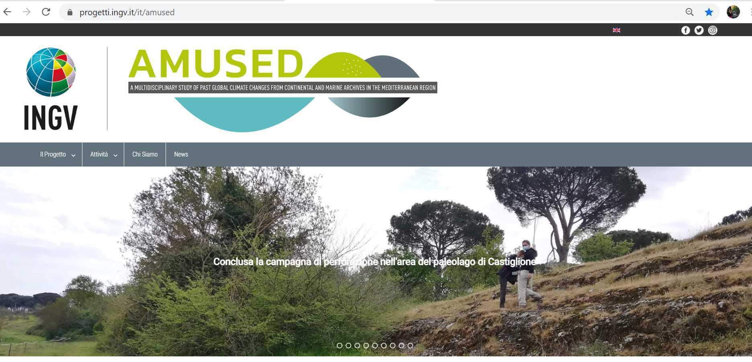
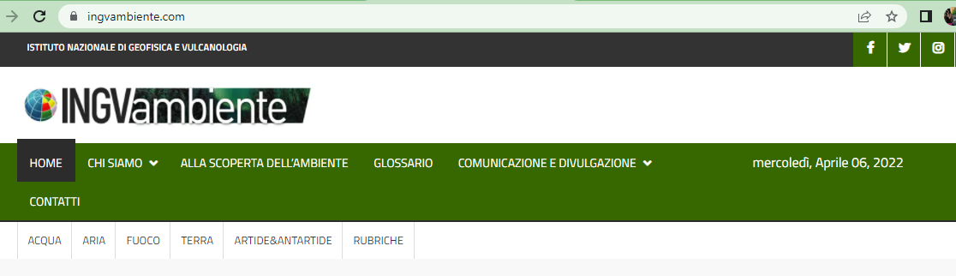

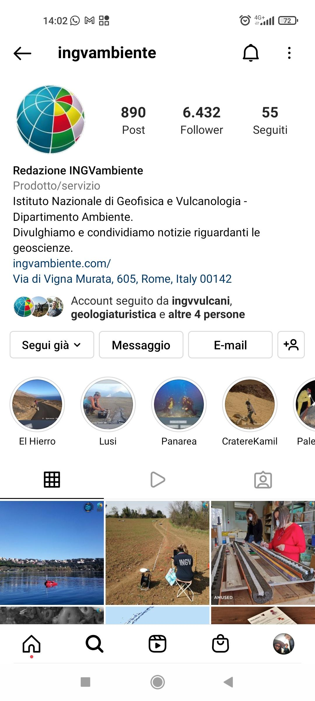
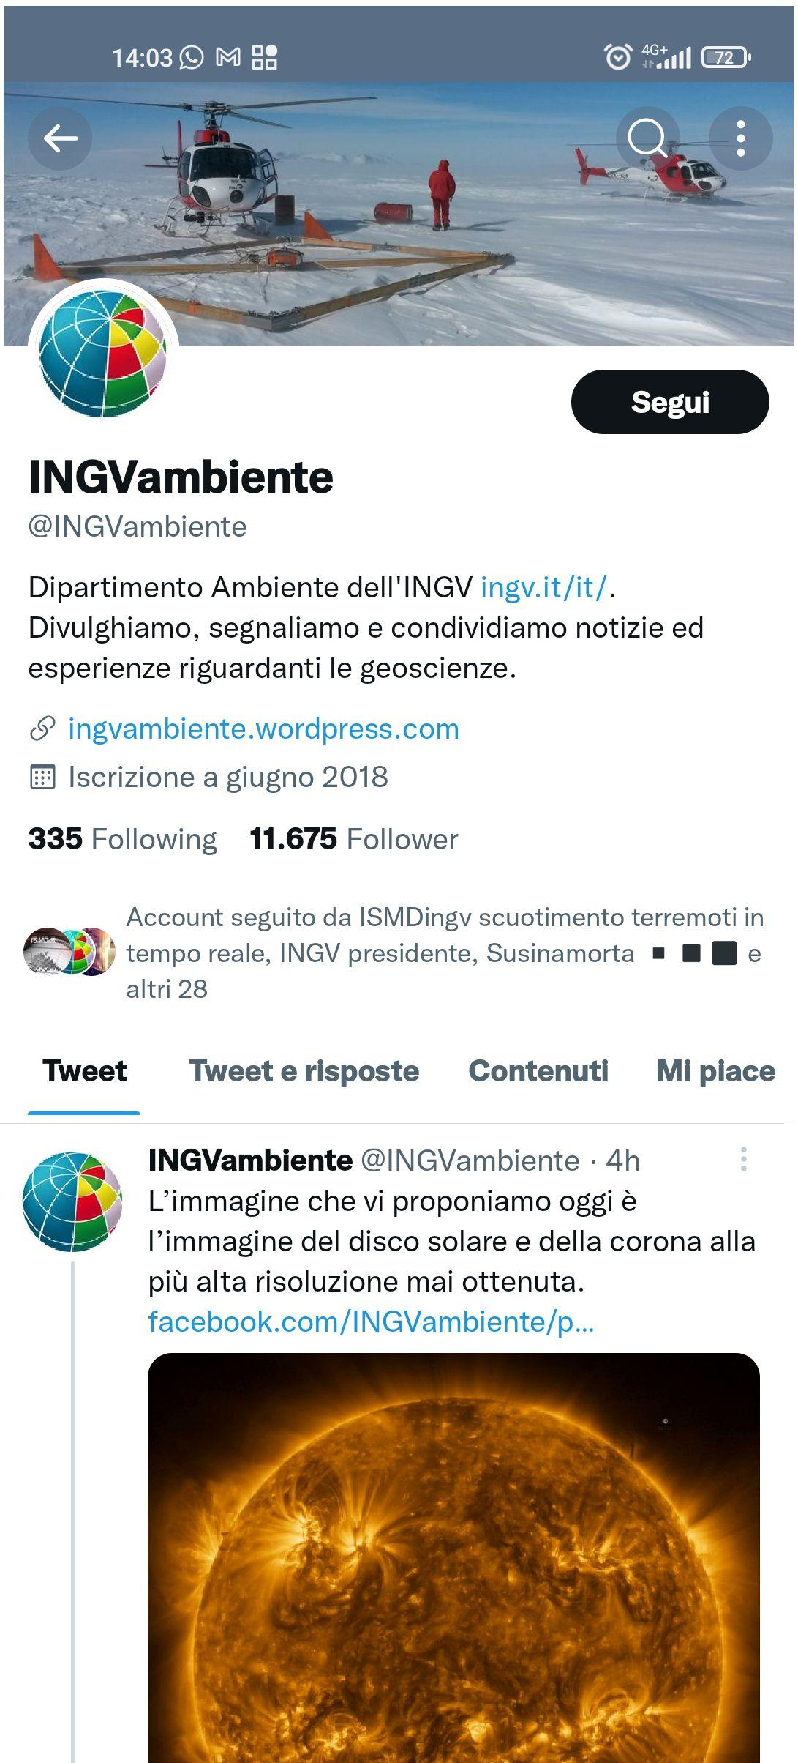


https://progetti.ingv.it/it/amused
Follow us on the AMUSED web site and INGV social!
https://ingvambiente.com/
CONTACTS
patrizia.macri@ingv.it
gaia.siravo@ingv.it
EGU – Vienna, Austria & Online | 23–27 May 2022

Slide 17
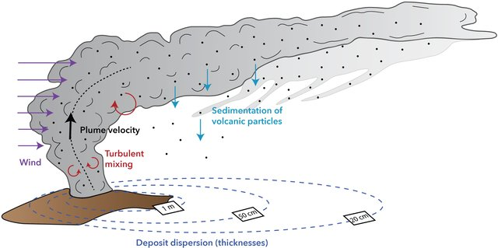
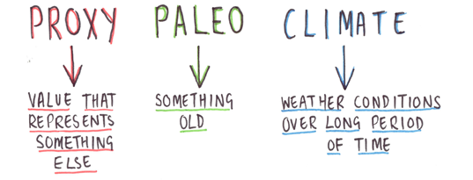
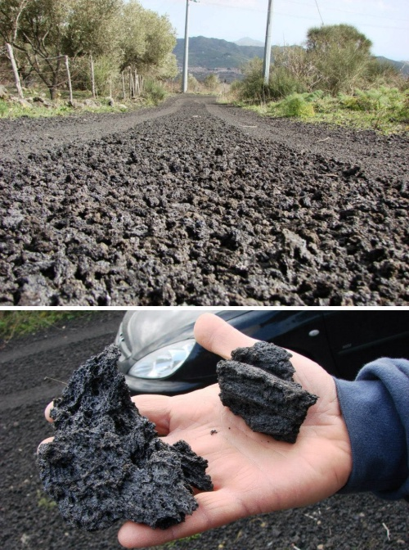
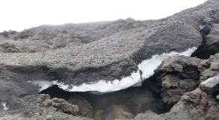
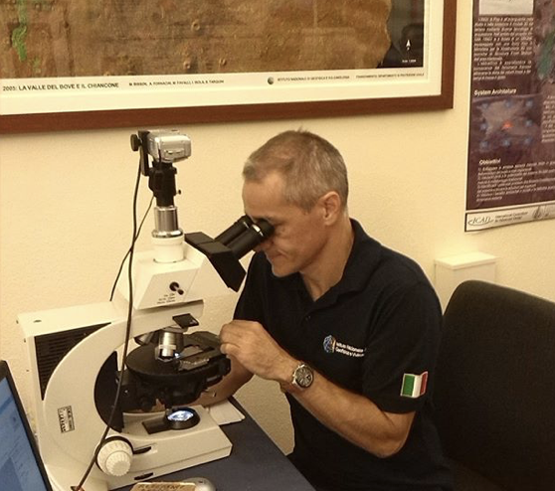
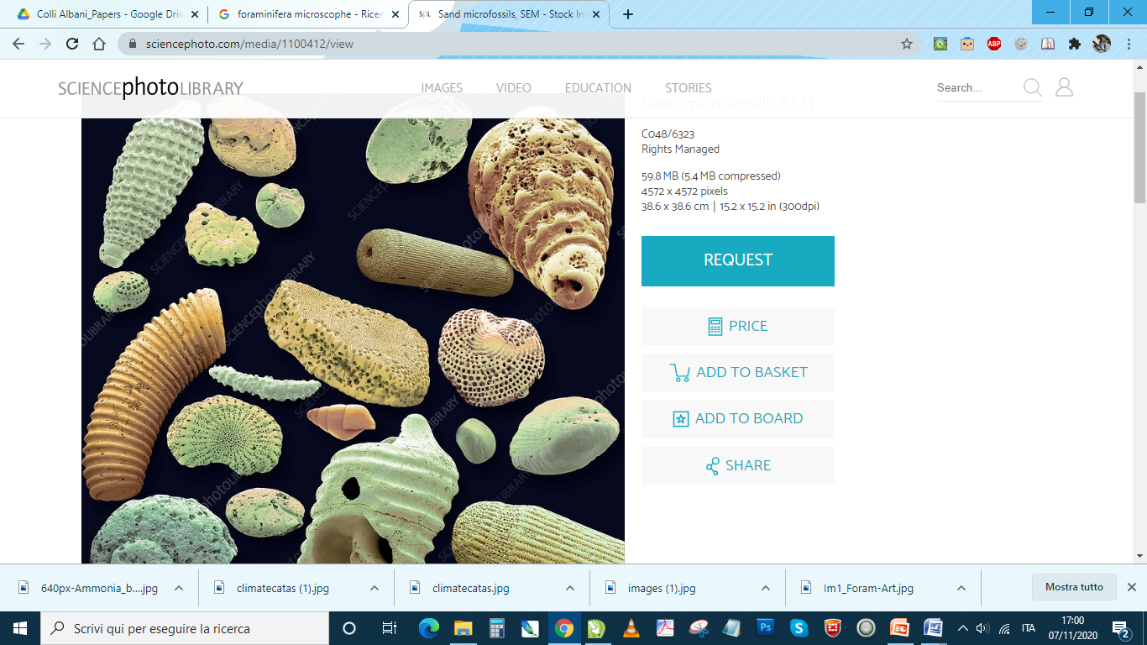
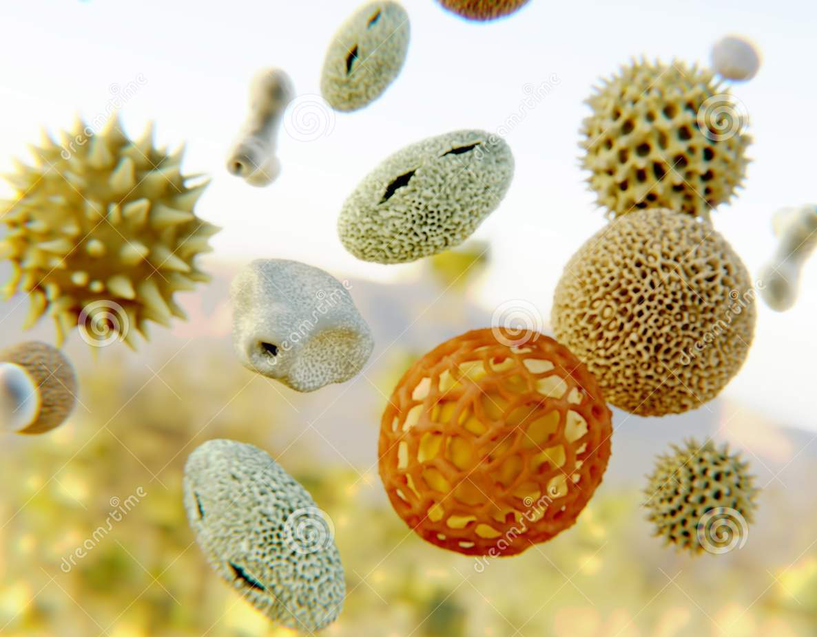
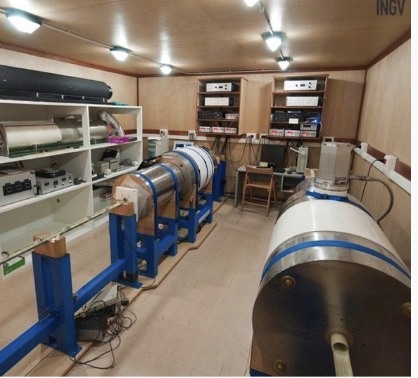
Multidisciplinary analyses on Castiglione cores
X-ray fluorescence scanning (each 0.5 mm)
Paleomagnetism and rock magnetism
Micropaleontology (ostracods)
Carbon content (TC/TIC/TOC)
Isotopic curves from sediments (δ¹⁸O, δ¹³C)
Palinology
Tephracronology and SEM analyses
Trace elements (Mg, Ba, Sr, P)
Isotopic analyses on tephra (⁸⁷Sr/⁸⁶Sr, ¹⁴³Nd/¹⁴⁴Nd)
Absolute radiometric dating (¹⁴C, ⁴⁰Ar-³⁹Ar)
EGU – Vienna, Austria & Online | 23–27 May 2022

