Slide 1
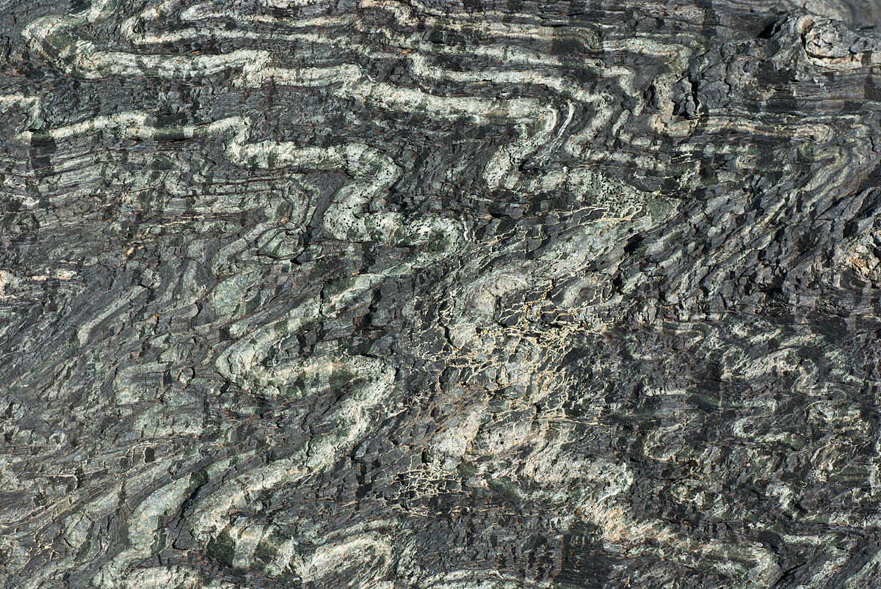



Evolution of P-wave velocities during antigorite dehydration at pressures up to 2.5 GPa
Arefeh Moarefvand¹, Julien Gasc¹, Damien Deldicque ¹, Loic Labrousse², Alexandre Schubnel¹
1) Laboratoire de Géologie, Ecole Normale Supérieure, PSL Resarch University, Paris France
2) ISTEP, Sorbonne Université, Paris France

Slide 2
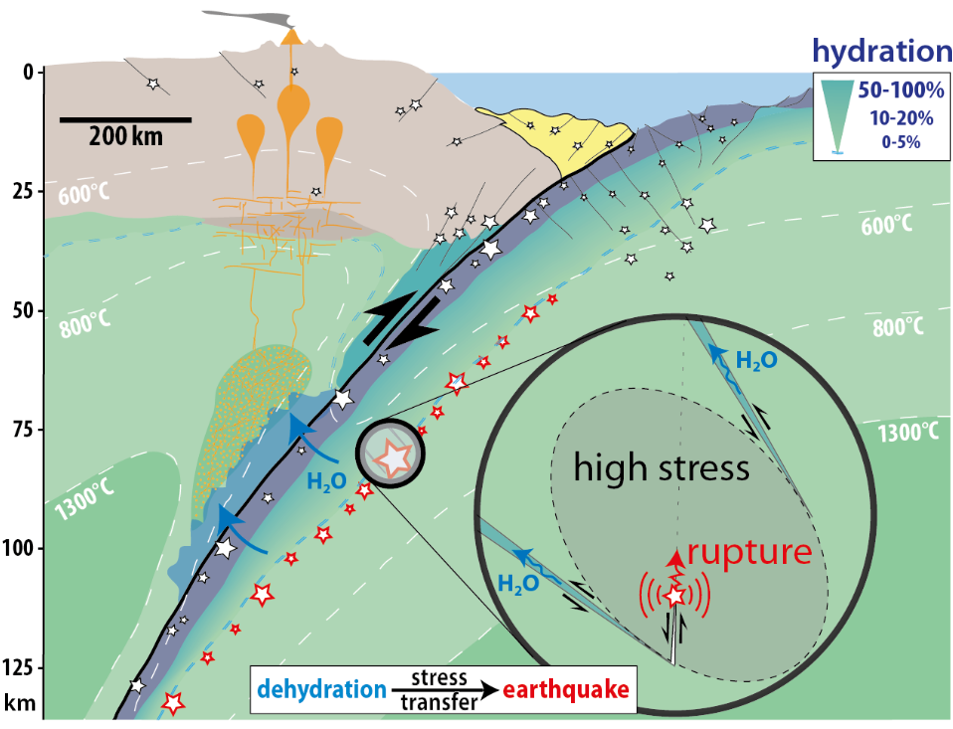
Introduction | Methods | Experiments | Results | Conclusions
Intermediate and deep seismicity has been observed along subducting plates at depths down to 700 km under pressure conditions where plastic deformation is expected.
The main mechanisms proposed for earthquake generation in deep subduction zones are dehydration embrittlement and plastic shear instability, which may result in intermediate-depth earthquakes, whereas transformation-induced faulting is also commonly invoked to explain deep earthquakes.
Some researchers also consider dehydration embrittlement as a potential seismogenic mechanism of deep earthquakes.
[Ferrand et al. (2017)]

Slide 3
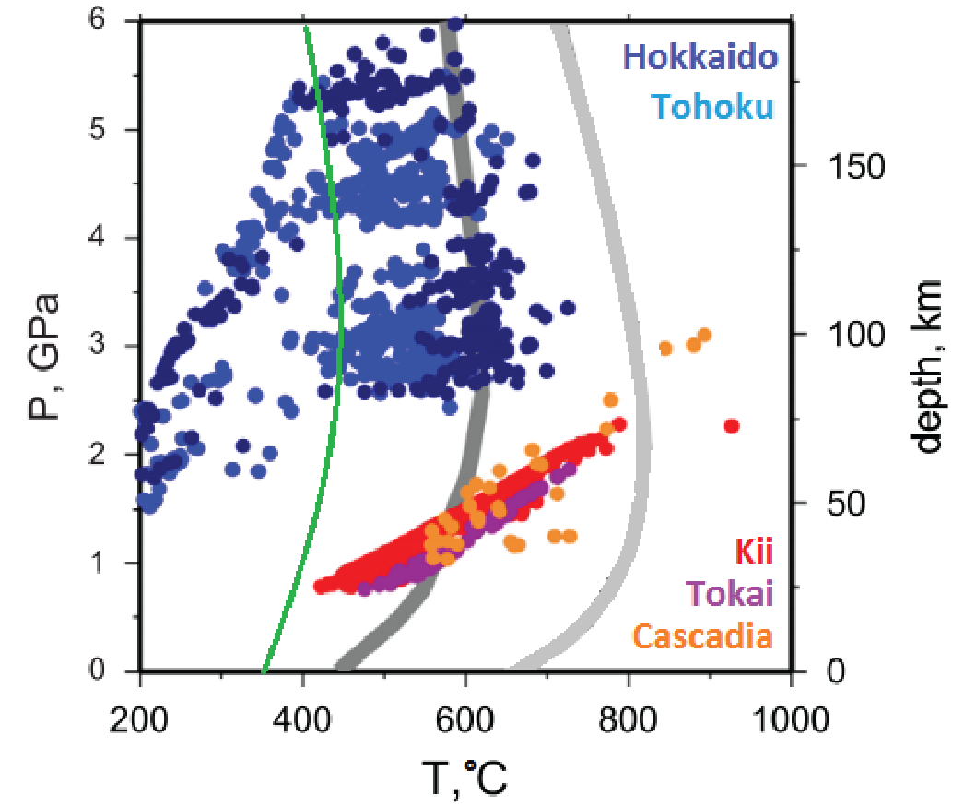
Introduction | Methods | Experiments | Results | Conclusions
[Hacker et al. (2003), Schwartz et al. (2013)]
[Ferrand et al. (2017)]
Pressure and temperature (P-T) stability field of serpentine minerals coincides with the PT conditions of intermediate-depth seismicity in subduction zones.

Slide 4
Active acoustic monitoring since 1993 until 2019 :
Introduction | Methods | Experiments | Results | Conclusions
200 MPa
[Popp & Kern. (1993)]

Slide 5
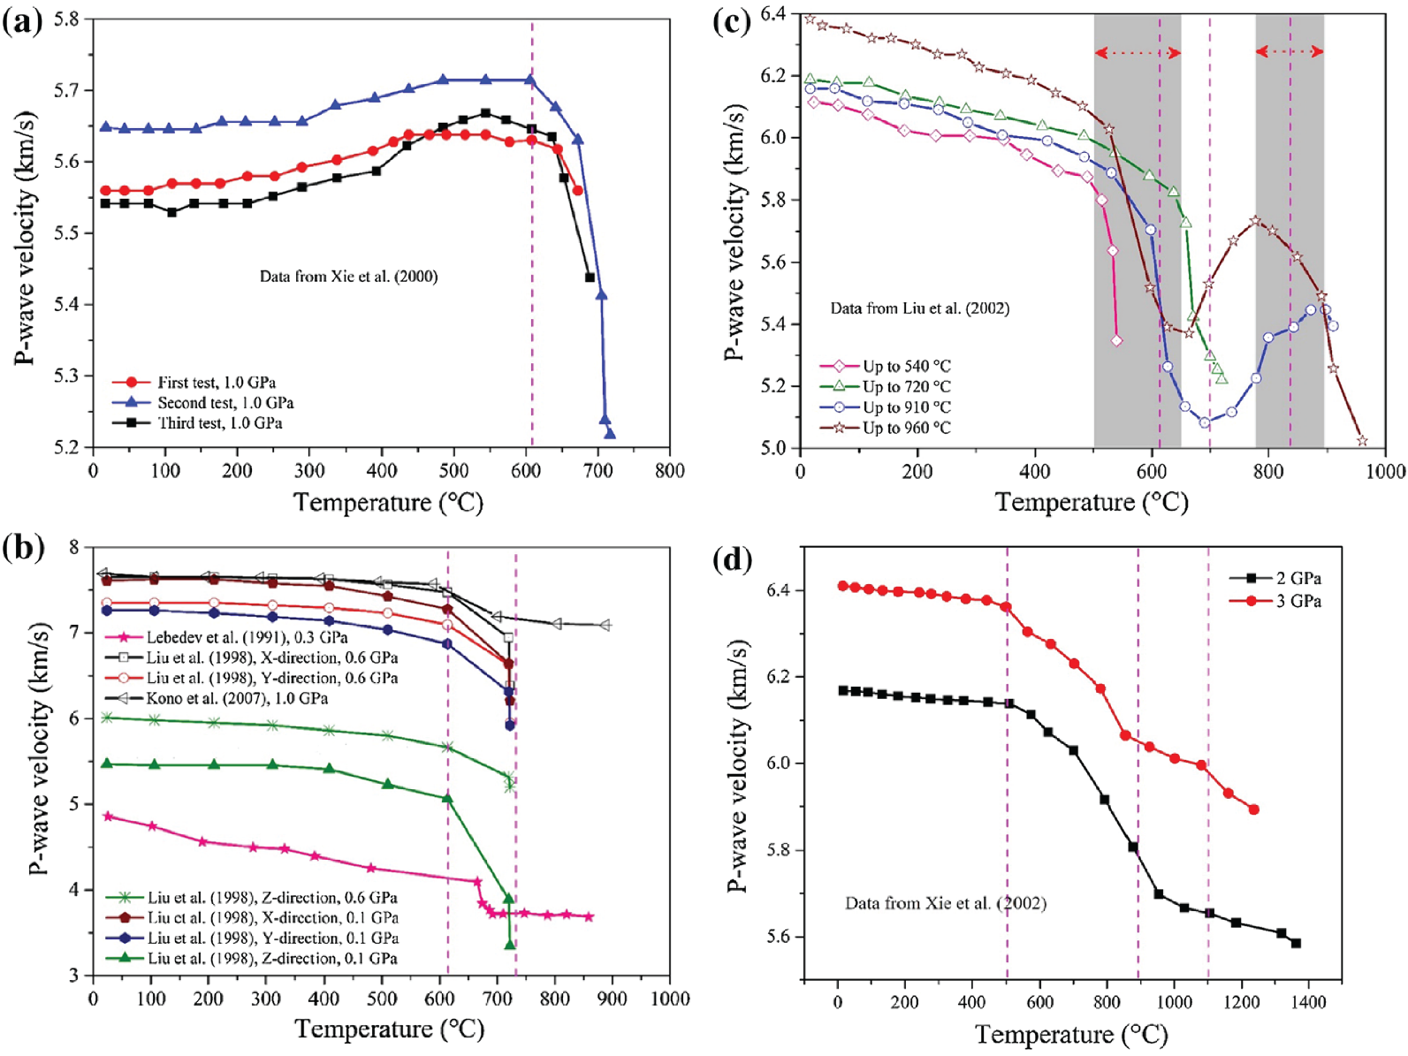
Active acoustic monitoring since 1993 until 2019 :
Introduction | Methods | Experiments | Results | Conclusions
Up to 3 GPa
200 MPa
[Popp & Kern. (1993)]
[Sun et al. (2019)]

Slide 6
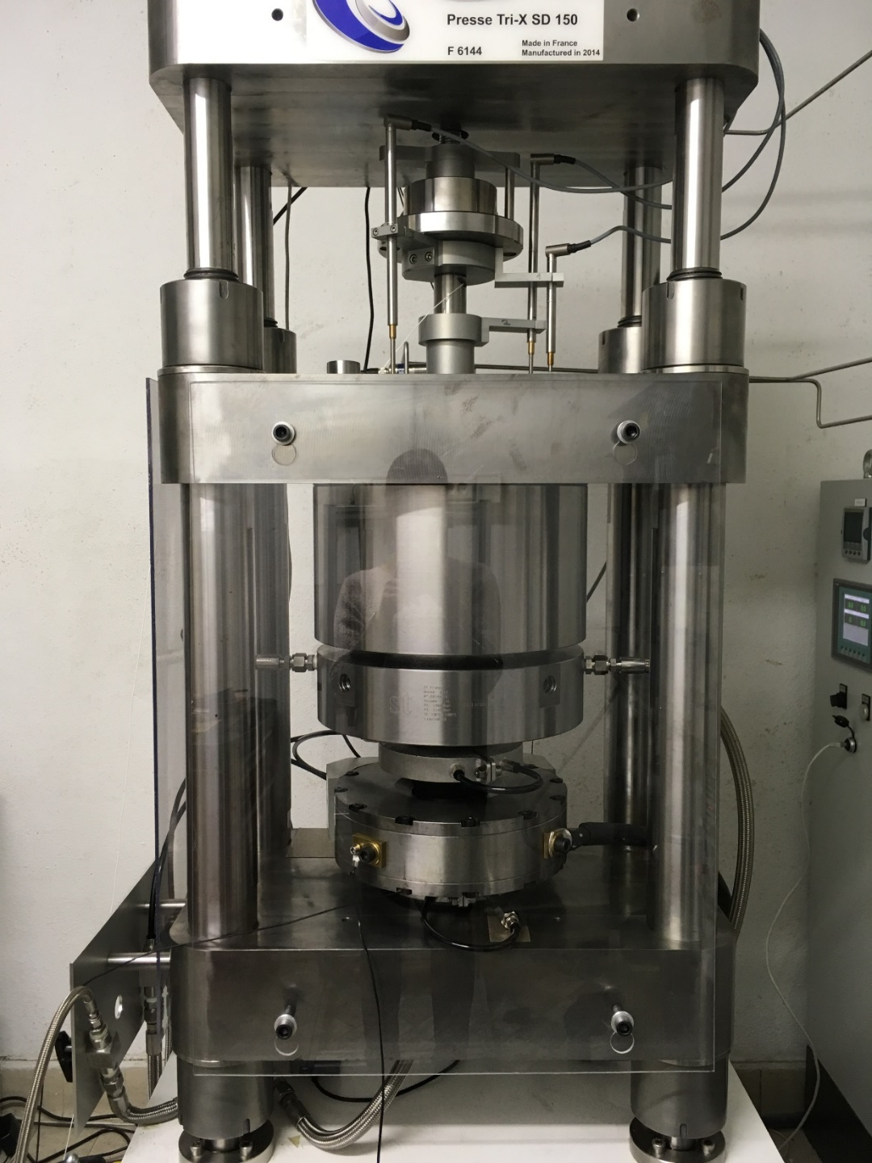
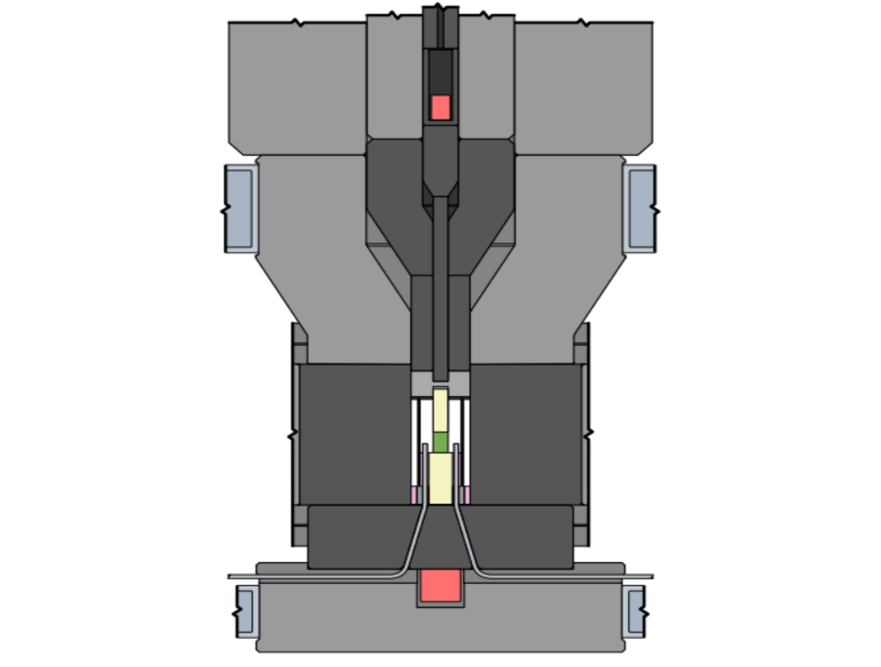
Our apparatus :
Introduction | Methods | Experiments | Results | Conclusions
Top
ultrasonic
transducer
Deformation
piston
Confining
piston
Sample
Assembly
Bottom
ultrasonic
transducer
Griggs apparatus at ENS witch is equipped by 2 ultrasonic transducers (shown in red).
With this apparatus we can go up to 5 GPa and 1000 °C which allows us to carry out experiments under realistic subduction zone conditions.
Notes:
Une photo

Slide 7
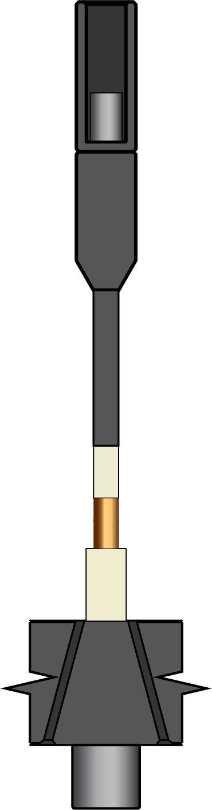
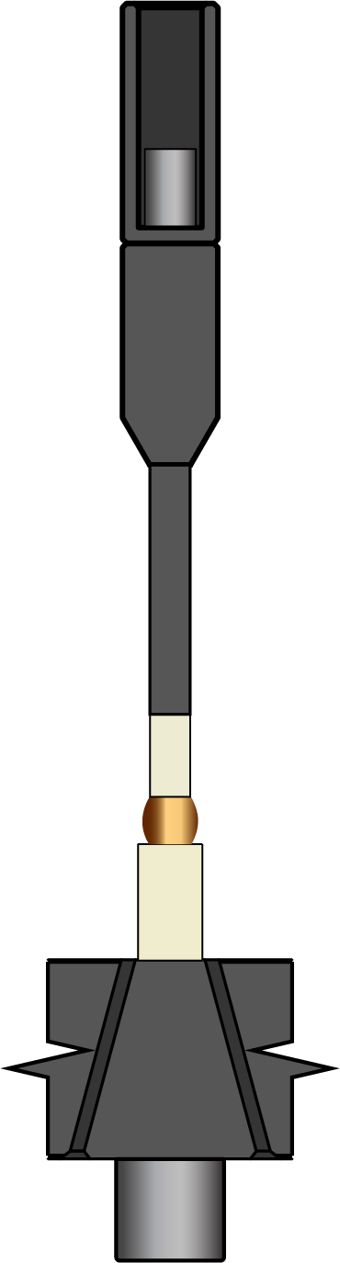
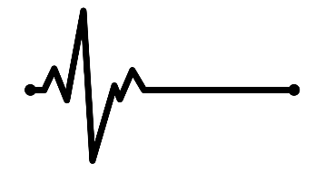
Our apparatus :
Introduction | Methods | Experiments | Results | Conclusions
Top
ultrasonic
transducer
Deformation
piston
Confining
piston
Sample
Assembly
Bottom
ultrasonic
transducer
Griggs apparatus at ENS witch is equipped by 2 ultrasonic transducers (shown in red).
With this apparatus we can go up to 5 GPa and 1000 °C which allows us to carry out experiments under realistic subduction zone conditions.
Notes:
Une photo

Slide 8


Our apparatus :
Introduction | Methods | Experiments | Results | Conclusions
Top
ultrasonic
transducer
Deformation
piston
Confining
piston
Sample
Assembly
$$∆t$$
Bottom
ultrasonic
transducer
$$∆L$$
Griggs apparatus at ENS witch is equipped by 2 ultrasonic transducers (shown in red).
With this apparatus we can go up to 5 GPa and 1000 °C which allows us to carry out experiments under realistic subduction zone conditions.
Notes:
Une photo

Slide 9
Our apparatus :
Introduction | Methods | Experiments | Results | Conclusions
Top
ultrasonic
transducer
Deformation
piston
Confining
piston
Sample
Assembly
$$∆t$$
Bottom
ultrasonic
transducer
$$∆L$$
Griggs apparatus at ENS witch is equipped by 2 ultrasonic transducers (shown in red).
With this apparatus we can go up to 5 GPa and 1000 °C which allows us to carry out experiments under realistic subduction zone conditions.
[Moarefvand et al. (2021)]
Notes:
Une photo

Slide 10
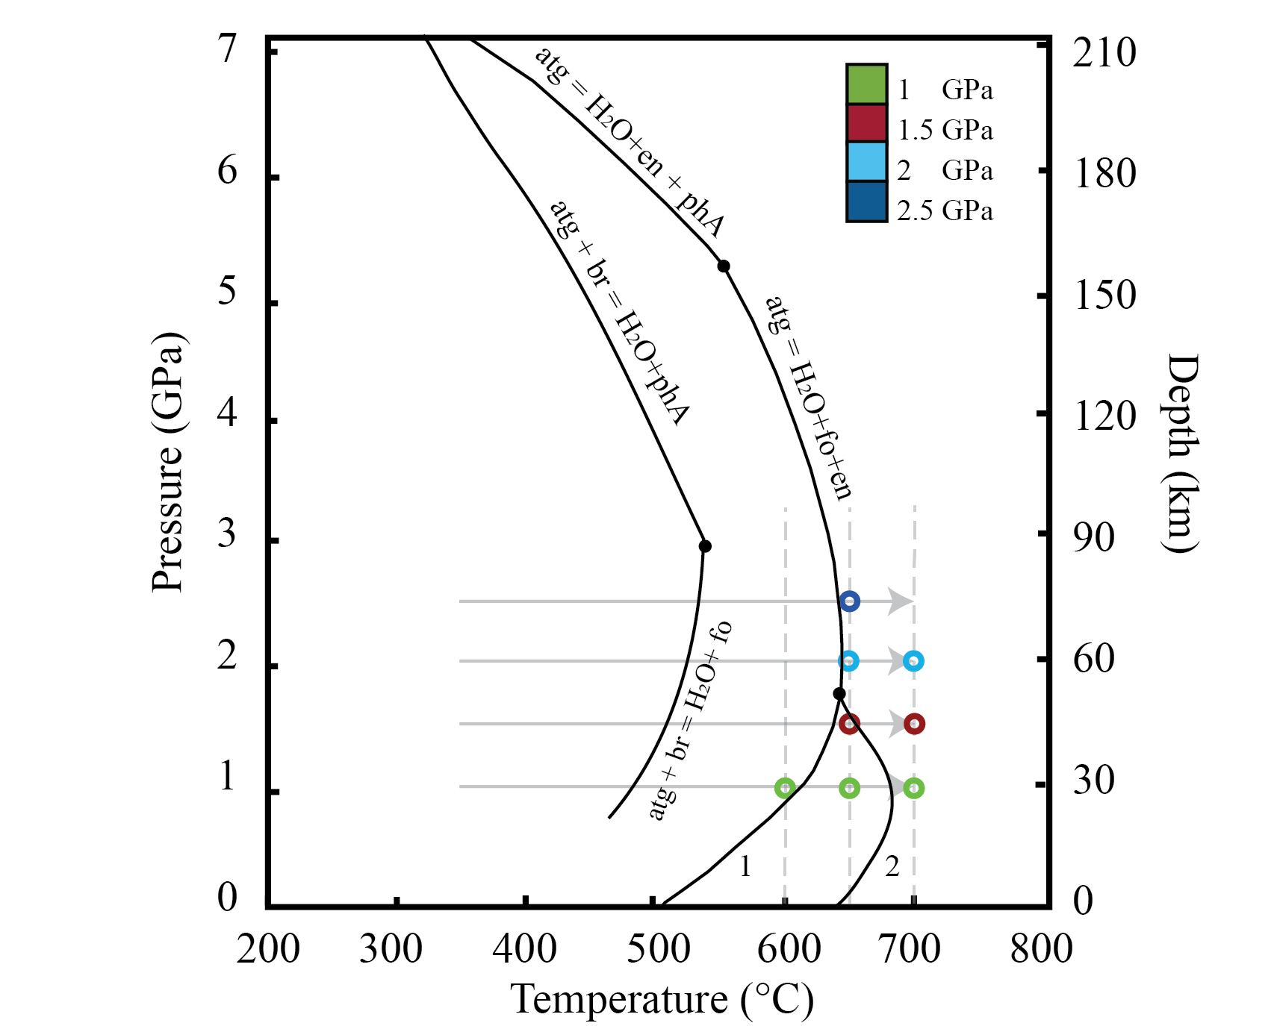
Experimental conditions:
Introduction | Methods | Experiments | Results | Conclusions

Slide 11
Experimental conditions:
Introduction | Methods | Experiments | Results | Conclusions
1 GPa | 600 – 650 – 700 °C
1.5 GPa | 650 – 700
2 GPa | 650 – 700
2.5 GPa | 650

Slide 12
Experiment conditions:
Introduction | Methods | Experiments | Results | Conclusions
1 GPa | 600 – 650 – 700 °C
1.5 GPa | 650 – 700
2 GPa | 650 – 700
2.5 GPa | 650
T = target temperature
P = constant
10 °C/min
T = 300 °C
P = constant

Slide 13
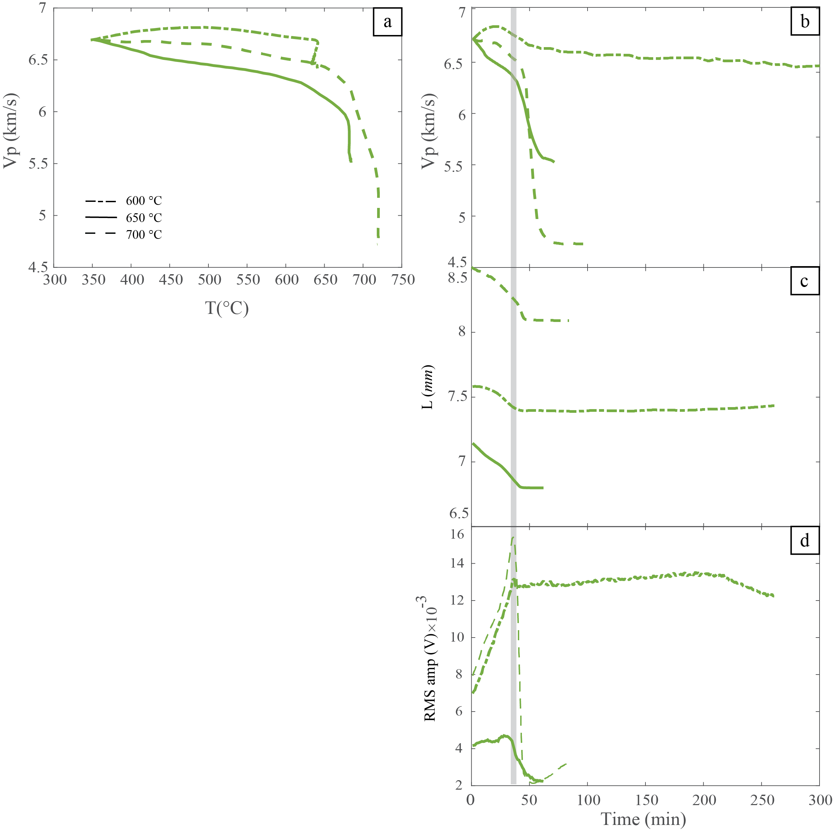
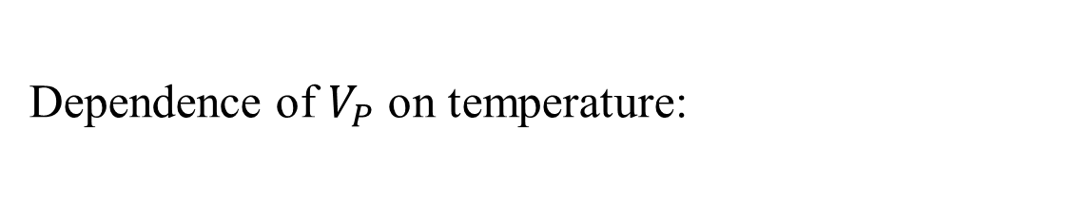
Dependence of $V_{P}$ on temperature:
Introduction | Methods | Experiments | Results | Conclusions
Notes:
The velocity drop varies from 0.25 km/s (1 GPa, 600 ◦C) to 1.96 km/s (1 GPa, 700 ◦C) and the duration of velocity varies from 261 min (1 GPa, 600 ◦C) for the slowest to 60 min (1 GPa, 650 ◦C) for the fastest

Slide 14
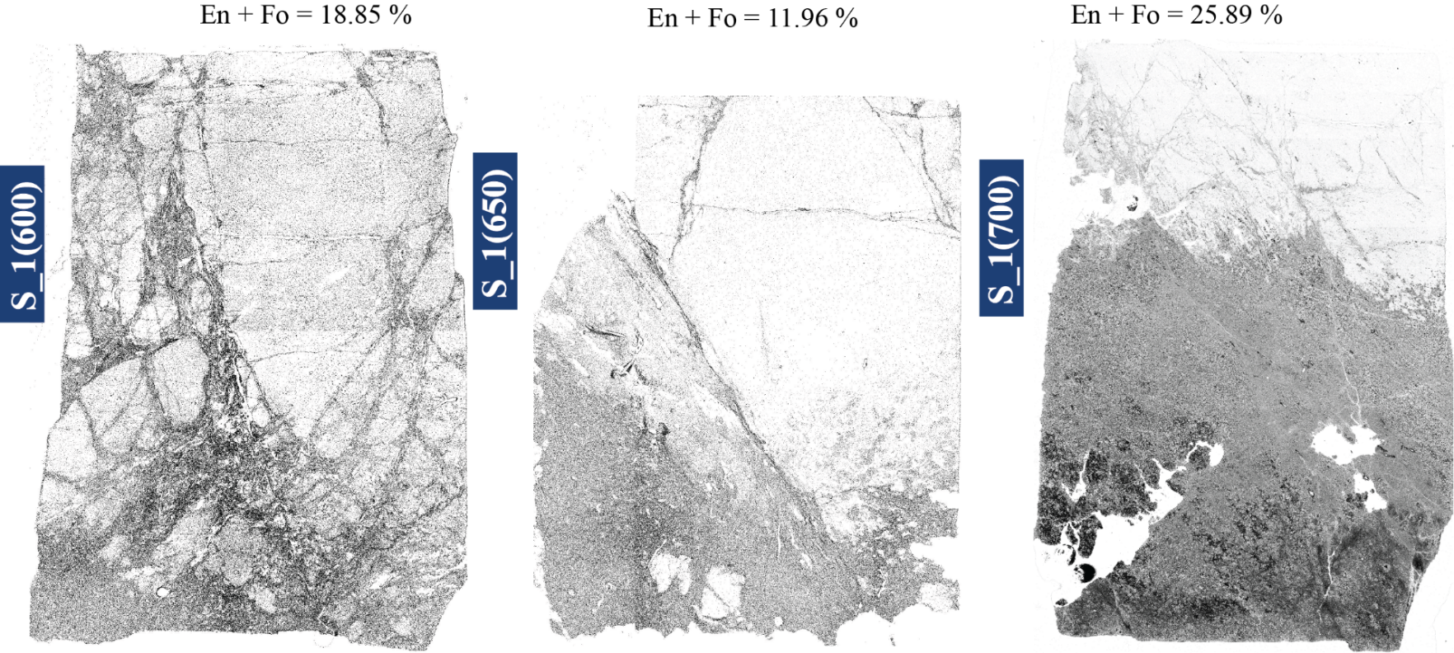
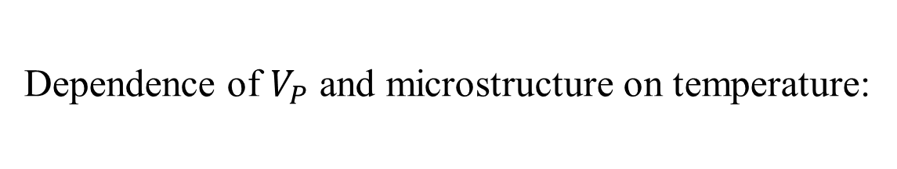
Introduction | Methods | Experiments | Results | Conclusions
Dependence of $V_{P}$ and microstructure on temperature:

Slide 15

Dependence of $V_{P}$ and microstructure on temperature:
Introduction | Methods | Experiments | Results | Conclusions

Slide 16
Introduction | Methods | Experiments | Results | Conclusions
Dependence of $V_{P}$ and microstructure on temperature:
Samples were reacted mostly at the lower part of the sample because of the (small) temperature gradient inside the sample assembly.
The samples were reacted along fractures, which evidences relations between dehydration and strain localization.
At 1 GPa and 600°C, the sample is more damaged than at 650 and 700°C.

Slide 17
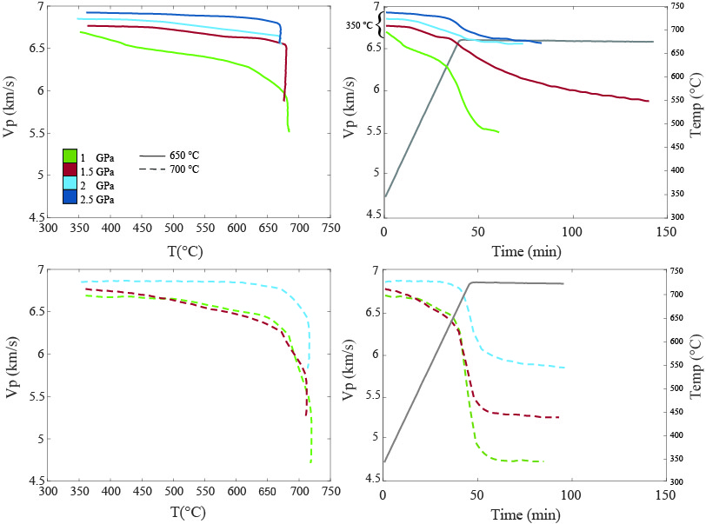
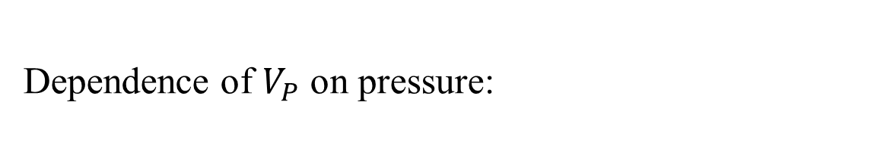
Dependence of $V_{P}$ on pressure:
Introduction | Methods | Experiments | Results | Conclusions
The velocity drop and the duration of dehydration vary depending on confining pressure and maximum temperature.

Slide 18
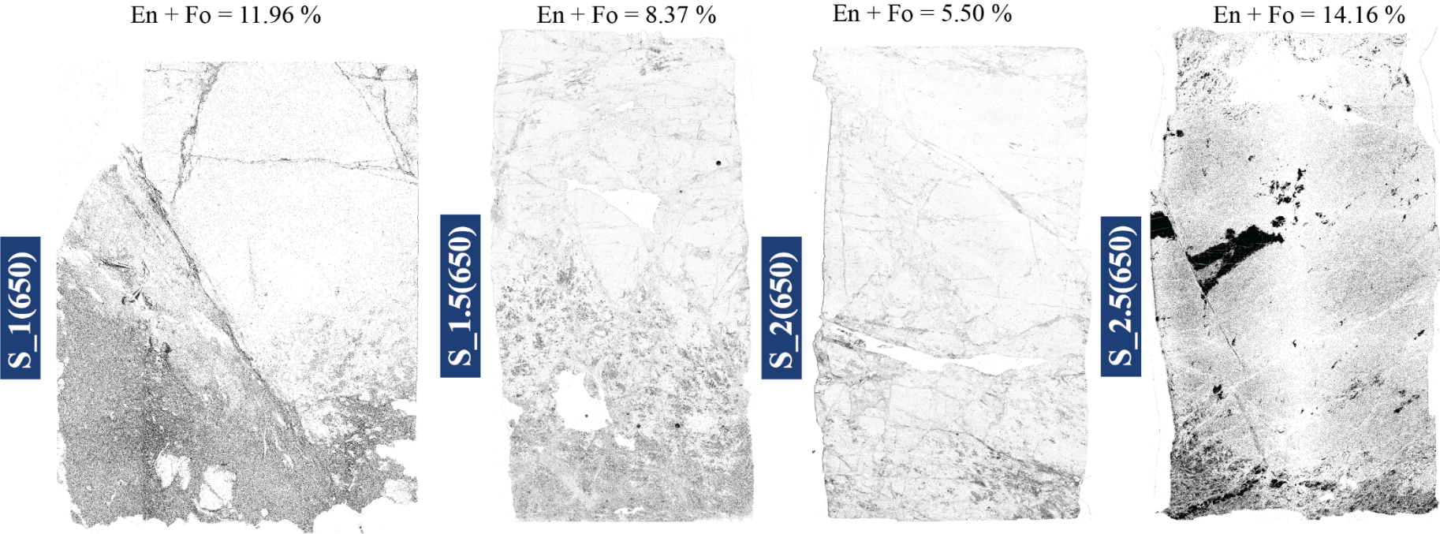
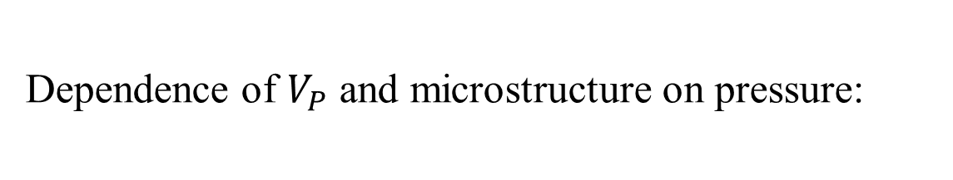
Dependence of $V_{P}$ and microstructure on pressure:
Introduction | Methods | Experiments | Results | Conclusions

Slide 19
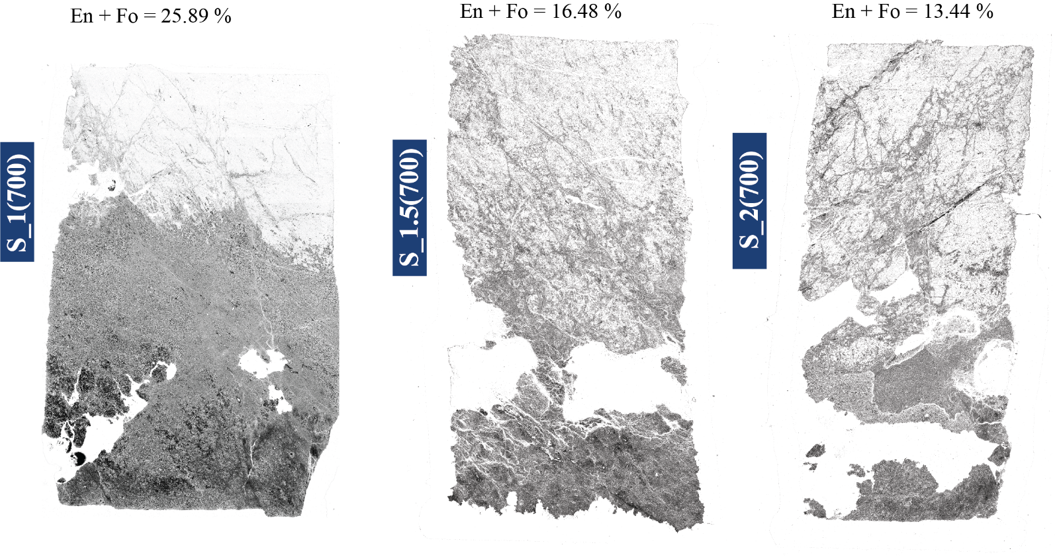
Dependence of $V_{P}$ and microstructure on pressure:
Introduction | Methods | Experiments | Results | Conclusions

Slide 20
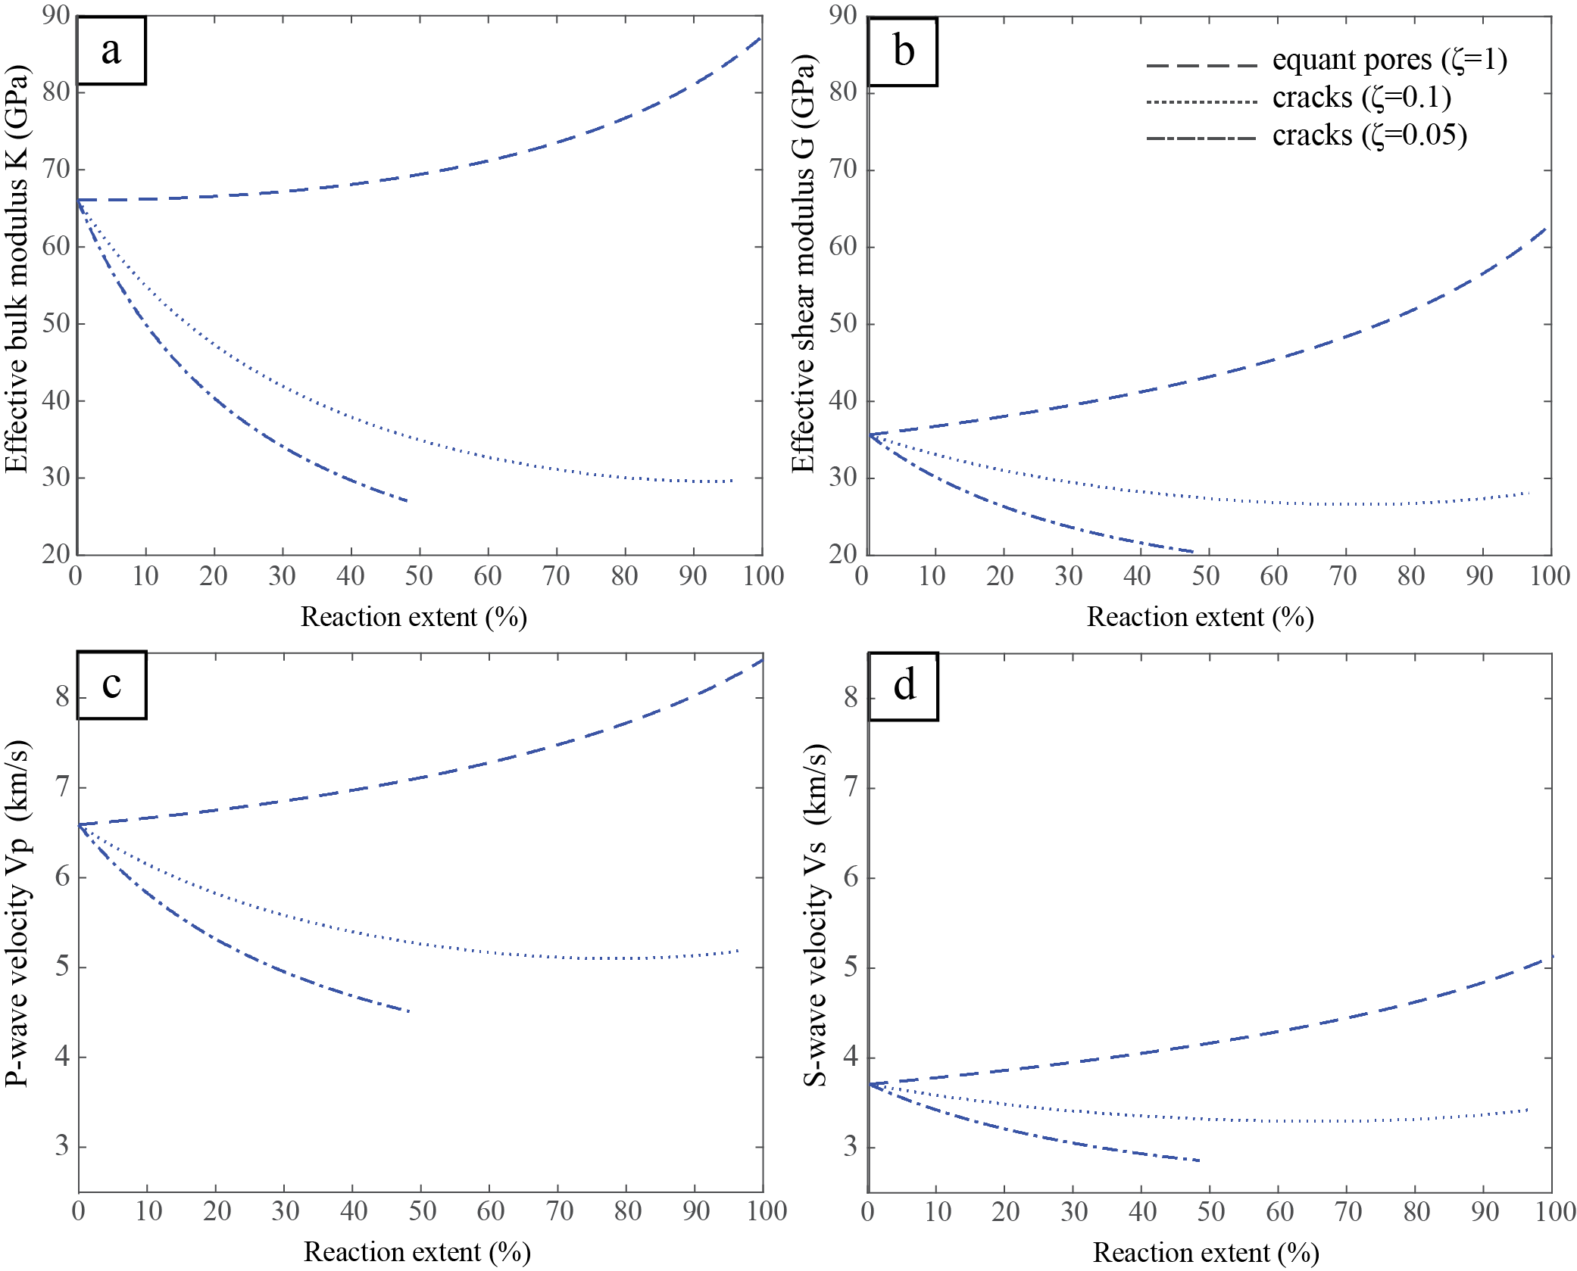
Effective medium modelling of the relationship between elastic moduli and reaction extent :
Introduction | Methods | Experiments | Results | Conclusions
For equant pores (aspect ratio of ζ = 1), because of the hardening of the solid fraction, effective moduli (and consequently velocities) increase with reaction extent.
When cracks are considered (ζ = 0.1 and ζ = 0.05), effective moduli and seismic waves decrease with increasing reaction extent.
The effect of cracking increases with decreasing aspect ratio and is more significant on the effective bulk modulus and therefore on P-wave velocities.

Slide 21
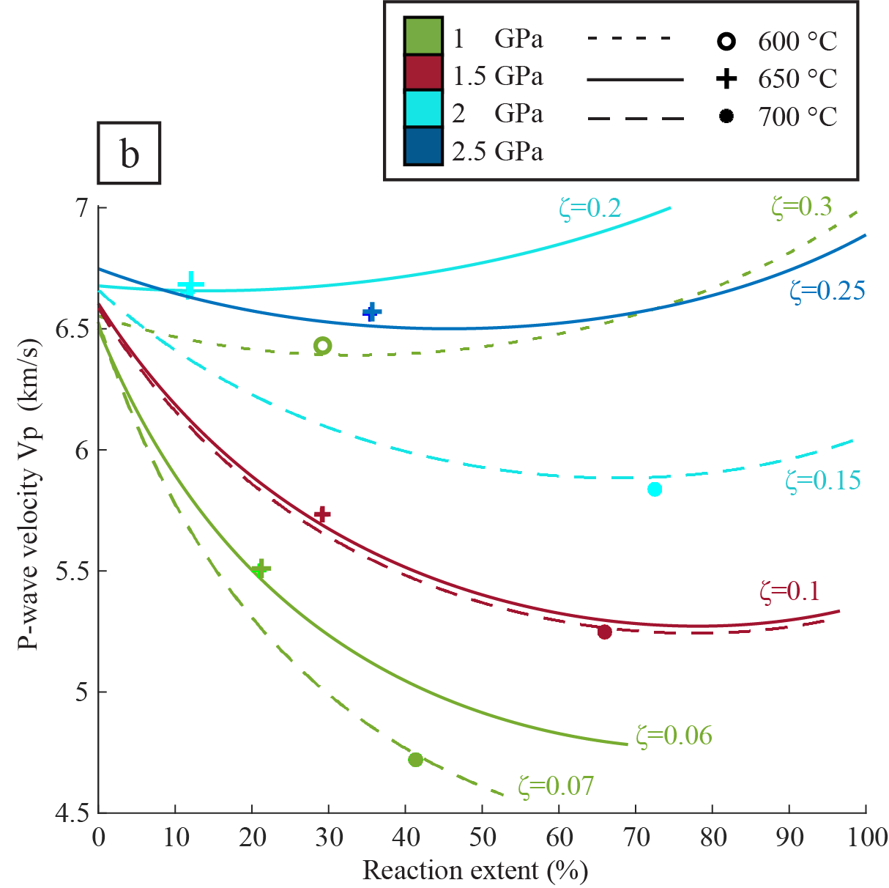
Introduction | Methods | Experiments | Results | Conclusions
Effective medium modelling of the relationship between elastic moduli and reaction extent :
Experiments at 650-700°C and 1-1.5 GPa with an important velocity drop are well fitted with aspect ratios lower than 0.1 which represents significantly elongated cracks.
The experiment at 700°C and 2GPa suggests a higher shape factor of 0.15
Experiments with small velocity changes are in agreement with a shape factor range of 0.25-0.35, i.e. ellipsoidal fluid inclusions.

Slide 22
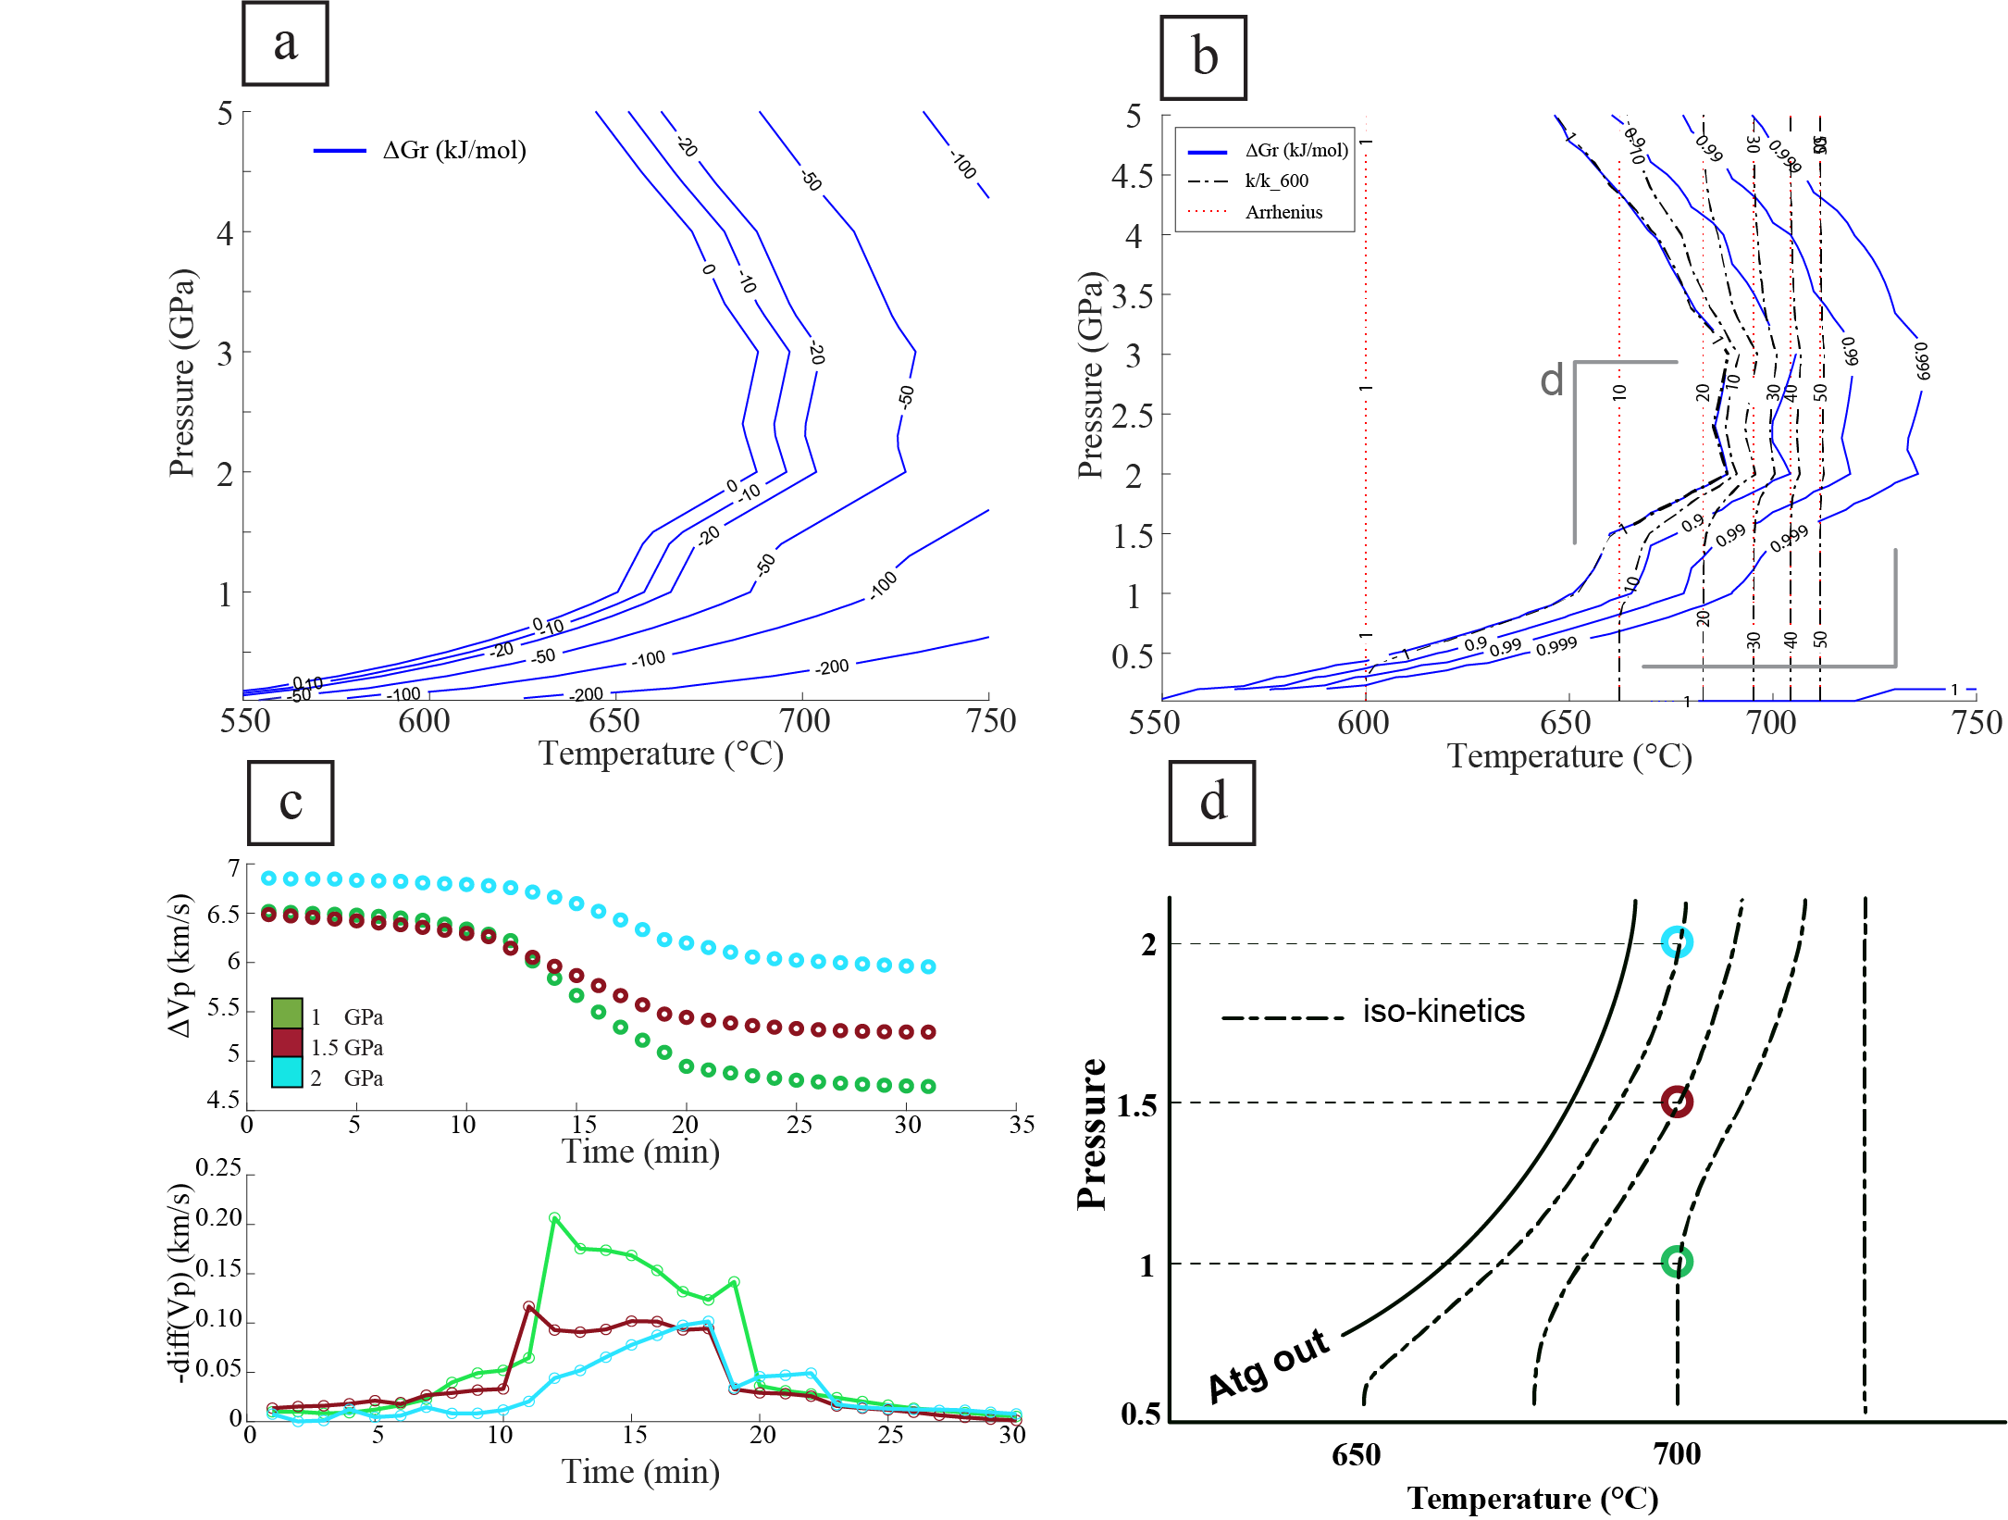
Kinetics and P-wave velocity change:
Introduction | Methods | Experiments | Results | Conclusions
The rate and the duration of the reaction depend strongly on the temperature and the distance to the reaction (ΔGr).

Slide 23
Introduction | Methods | Experiments | Results | Conclusions
All experiments show a decrease of P-wave velocity induced by antigorite dehydration.
The present study suggests that serpentine dehydration is a possible explanation for the low-wave-velocity/high-electrical- conductivity layer.
All the recovered sample have been damaged in their reacted domains. This could be explained by the "Dehydration-Driven Stress Transfer“ model proposed by Ferrand et al. (2017).
This study suggests that different regimes of cracking exist depending on reaction P-T conditions, using the effective moduli model.
The present study also highlights the effect of equilibrium overstep on the dehydration kinetics.

Slide 24

Thank you for attention !

