Slide 1


Comparison of measured and satellite-derived ASCAT surface soil moisture data in a small mountain catchment
Patrik Sleziak, Michal Danko, Martin Jančo, Ladislav Holko, Juraj Parajka
EGU, Vienna, Austria & Online | 25 May 2022

Slide 2
Introduction
Soil water plays an important role in affecting hydrological response of alpine catchments.
The representativeness of satellite soil moisture in mountains is still not well understood.
Objective
To analyse and compare satellite-derived ASCAT soil moisture data and in situ soil moisture measurements in a small experimental mountain catchment.

Slide 3
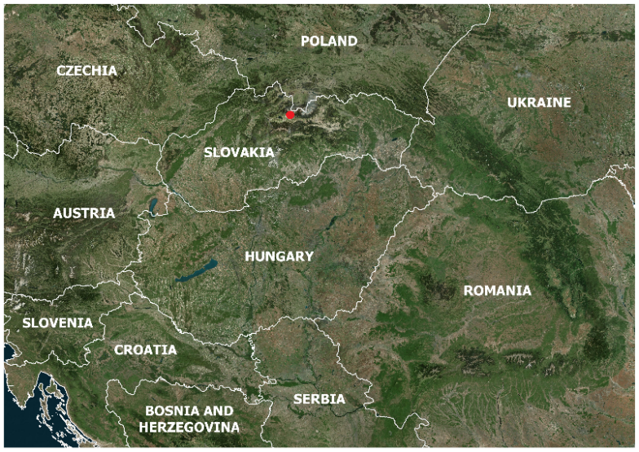
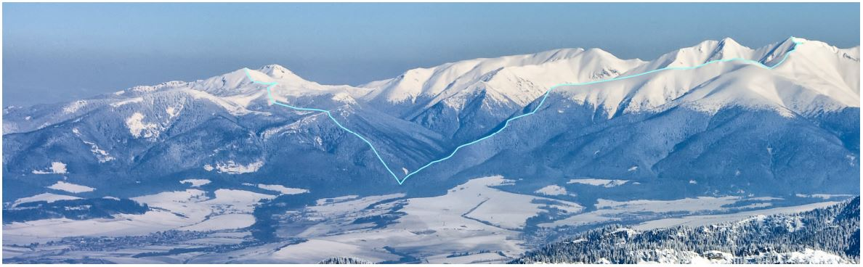
Jalovecký Creek catchment
Representative for the hydrological cycle of the highest part of the Western Carpathians.
Hydrological monitoring and research are conducted here since 1986 (soil moisture measurements from 2012).

Slide 4
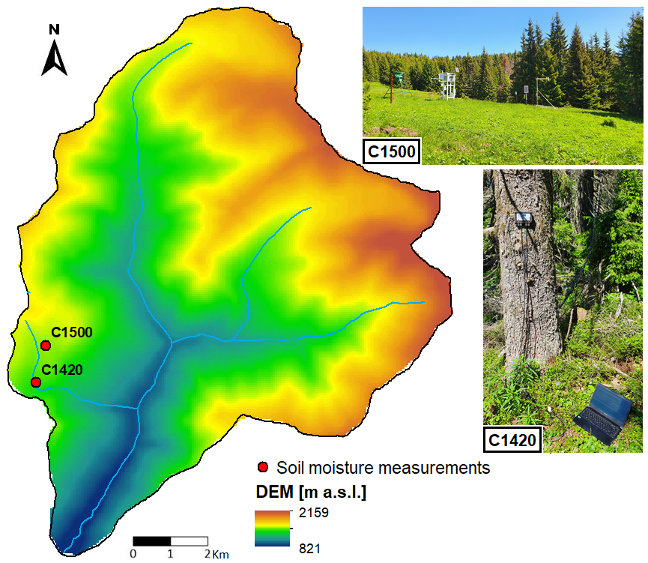
Soil moisture measurements

Slide 5
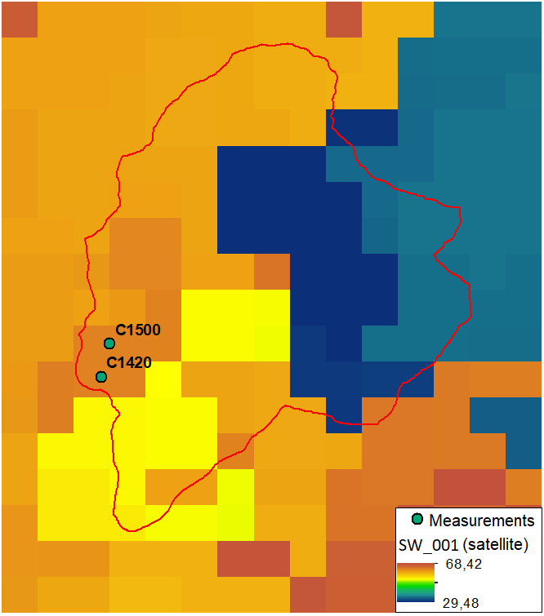
S1 ASCAT satellite soil moisture product
Experimental product created by combining ASCAT and Sentinel-1 data.
The new version of the ASCAT product provides data with higher spatial and temporal resolutions and improved soil moisture mapping under vegetation.
Satellite-derived soil moisture data represented by the Soil Water Index are determined by an exponential filter with characteristic time delays (T in days = reduction of the infiltration of the soil moisture dynamics).

Slide 6
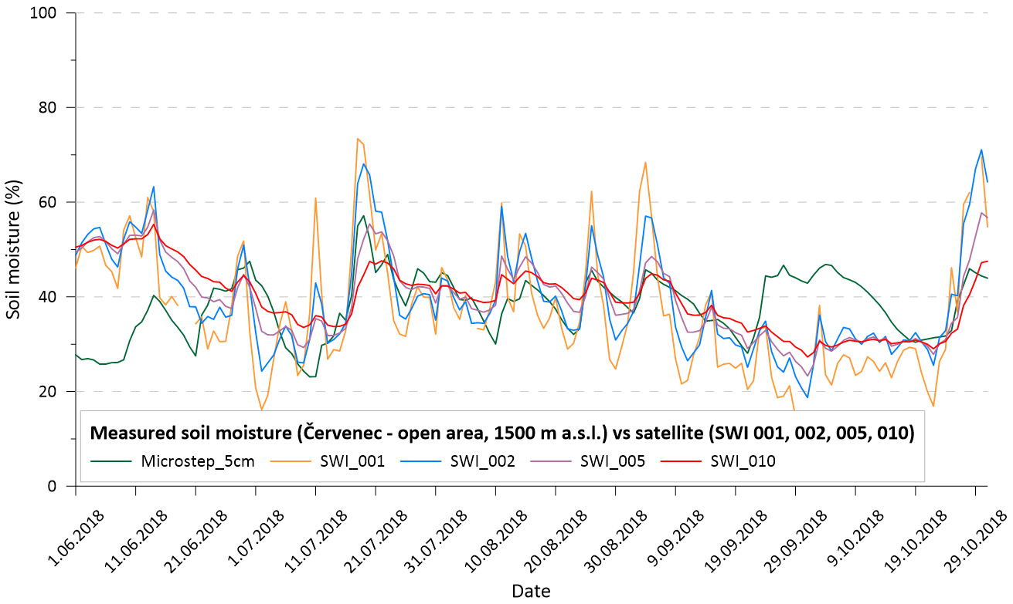
Results
The impact of the SWI exponential filter (T = 1, 2, 5, 10 vs in situ measurements at 5 cm depth)
Visually good match, higher T values = greater smoothing
2018 (only summer)

Slide 7
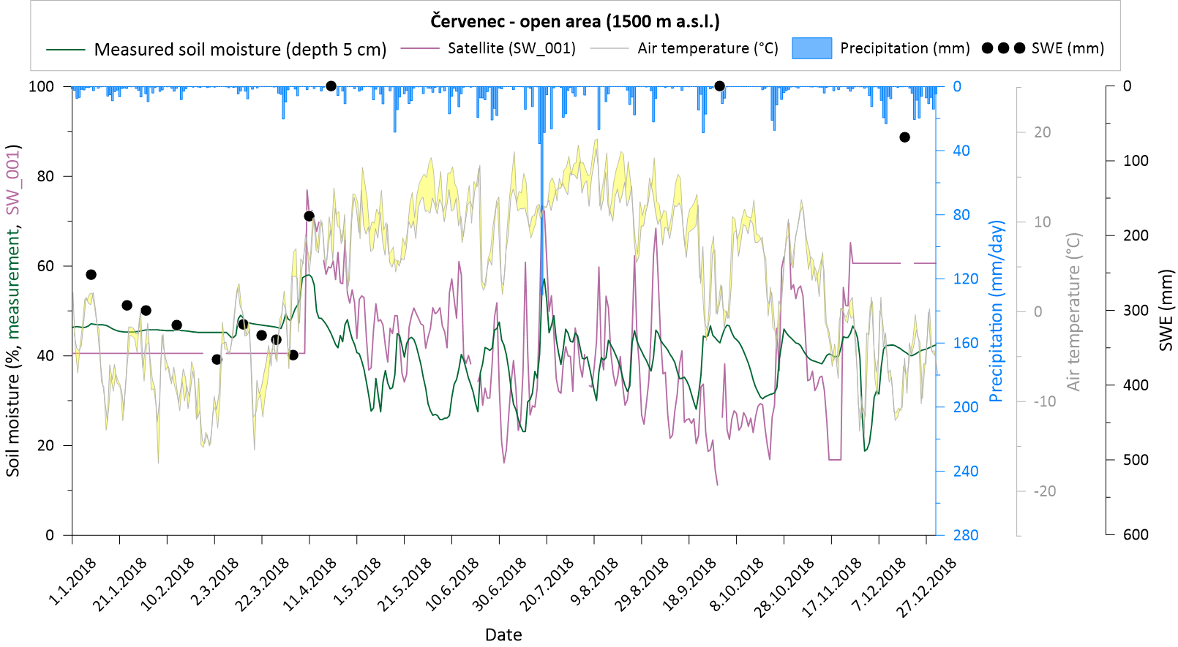
Measured soil moisture at open area (5 cm depth) vs satellite (SWI 001)
2018 (summer + winter)

Slide 8
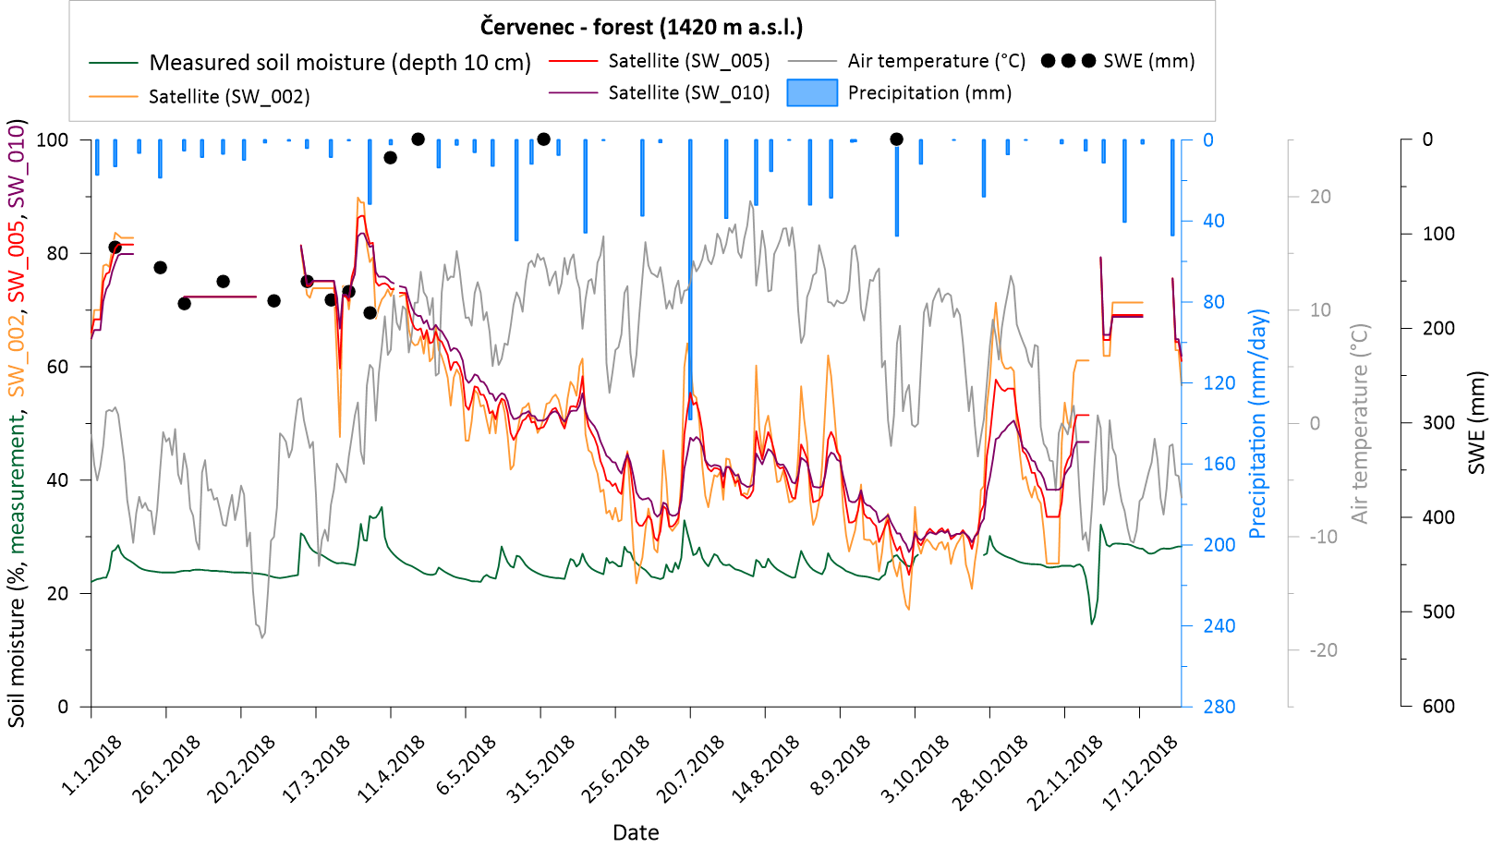
Measured soil moisture at forest (10 cm depth) vs satellite (SWI 002, SWI 005, SWI 010)
2018 (summer + winter)

Slide 9
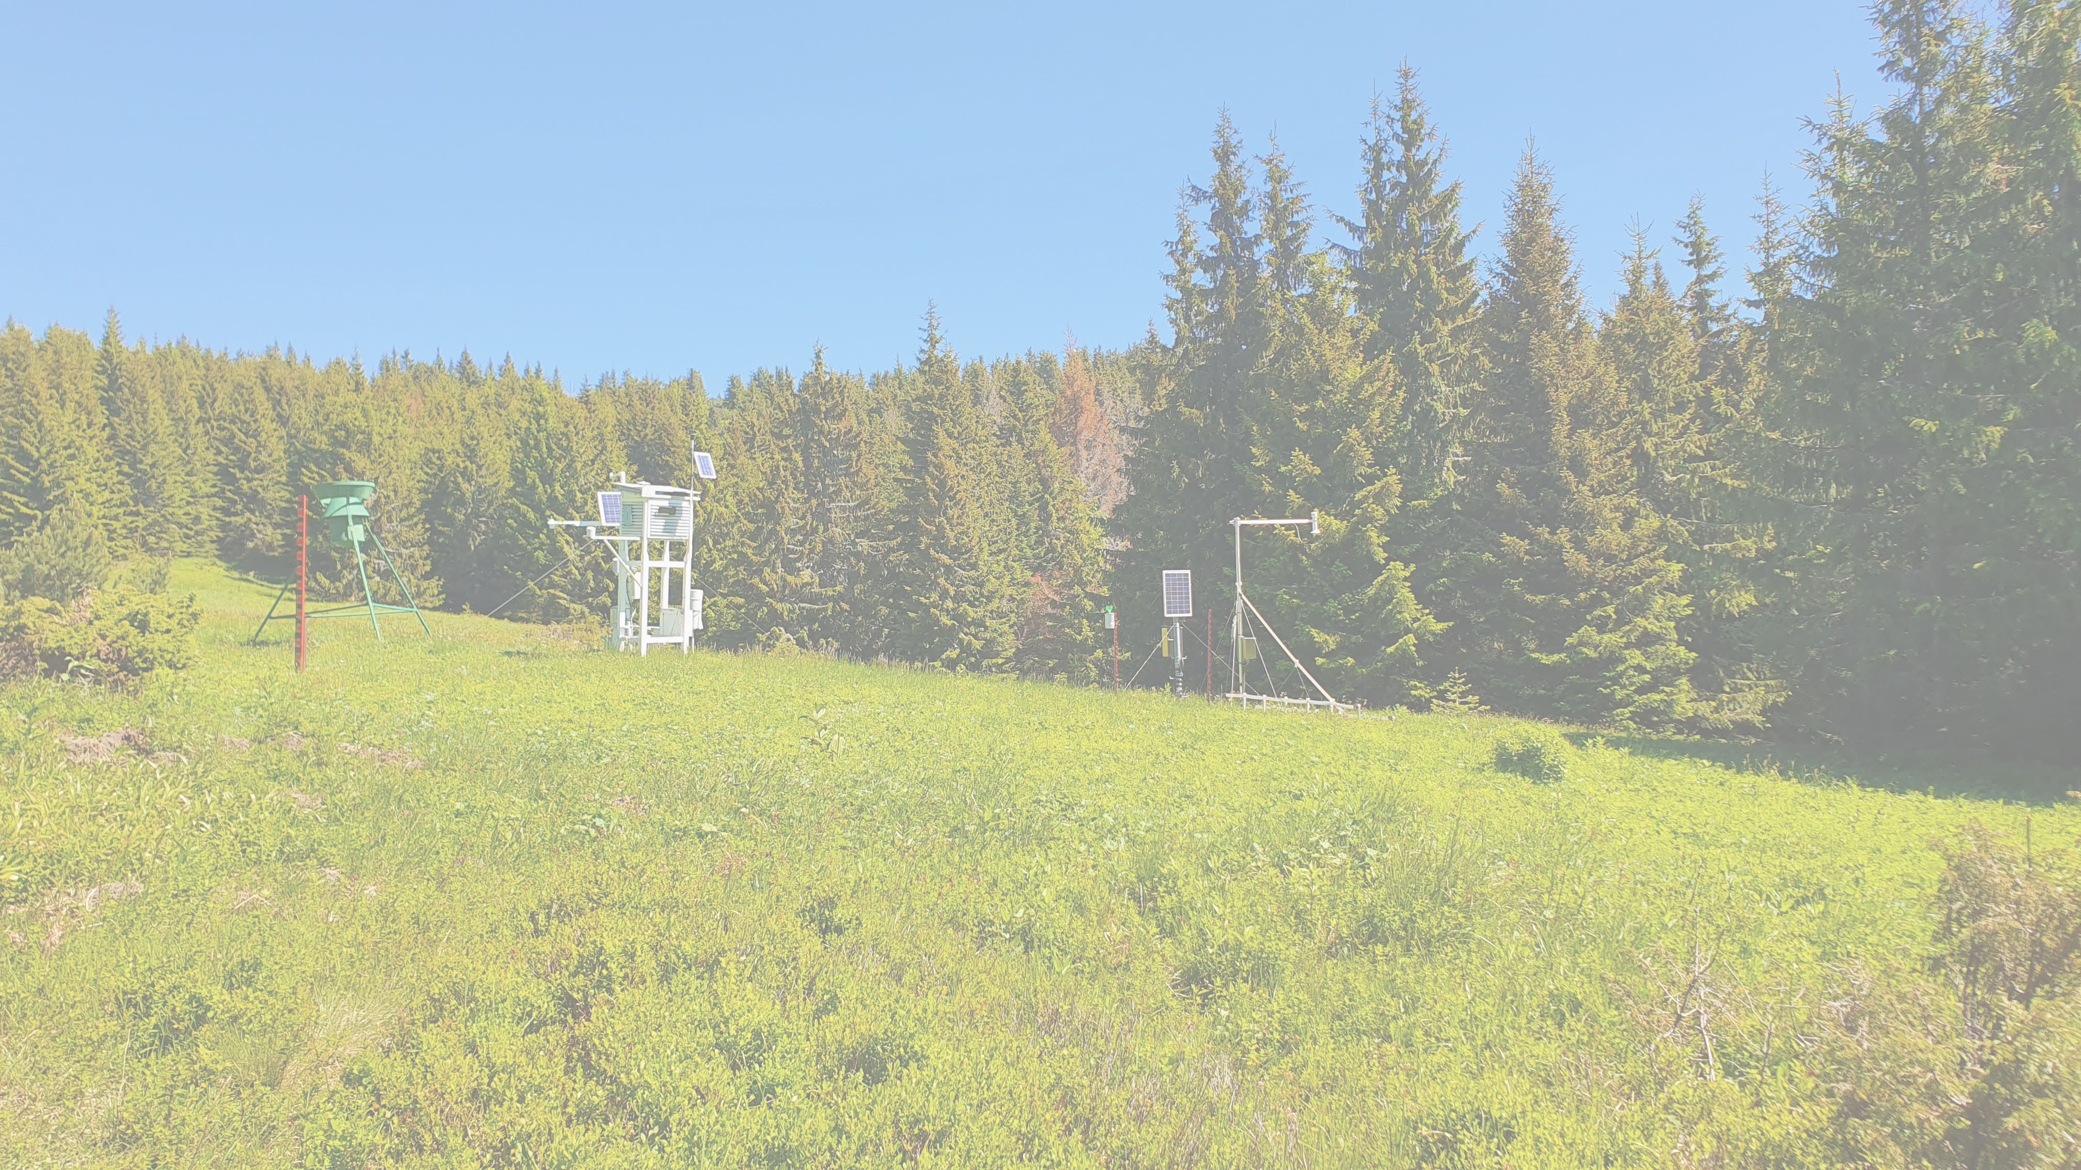
Conclusions
T-values 1-10 led to good correlations in the shallow subsurface (0–10 cm) for summer/winter.
Need to better mask snow and frozen ground.
Verify the value of the satellite product in hydrological modelling.
Based on the ASCAT data try to detect the snow melting time.

