Slide 1


Variations and Significance of Mg/Sr and ⁸⁷Sr/⁸⁶Sr of drip water and active speleothem in Furong Cave, Southwest China
Jun-Yun Li, Ting-Yong Li, Chuan-Chou Shen, Tsai-Luen Yu, Tao-Tao Zhang, Yao Wu, Jing-Li Zhou, Chao-Jun Chen, Jian Zhang
Southwest University, Chongqing, China
E-mail: jxljy@swu.edu.cn

Slide 2
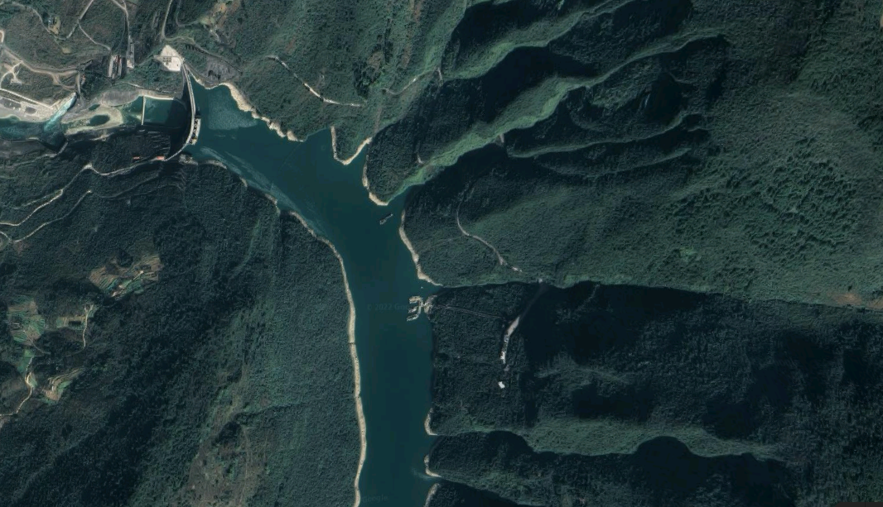
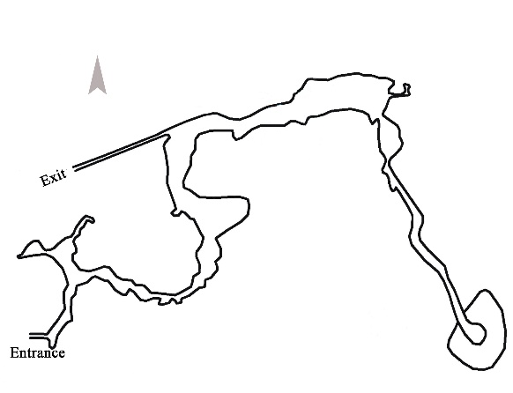
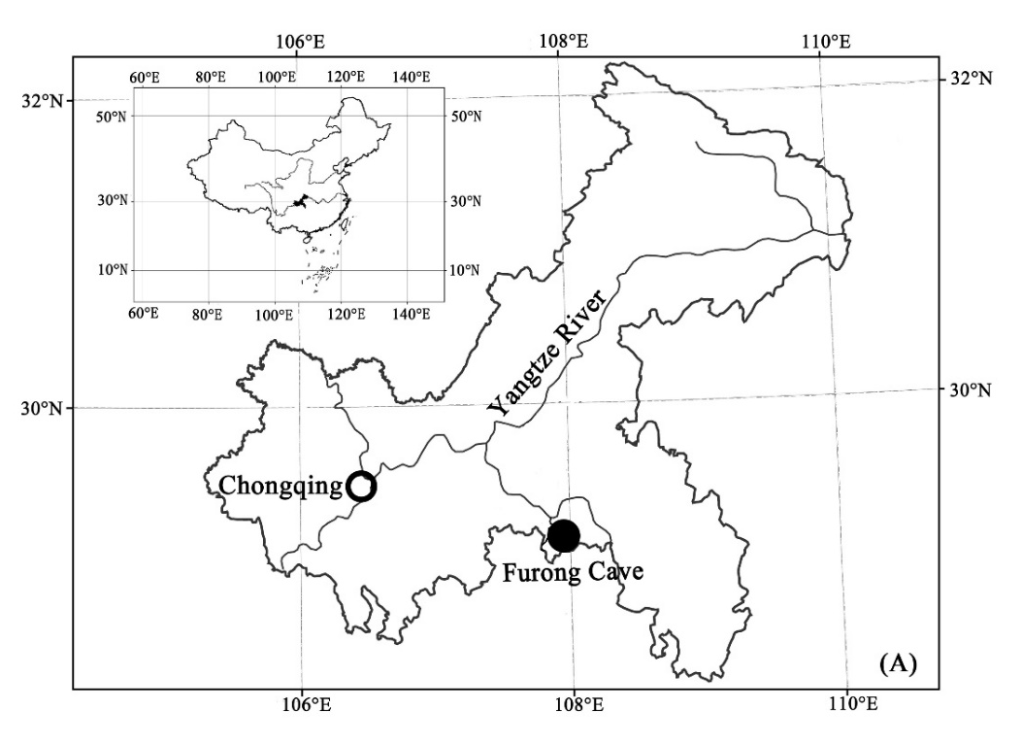
1. Furong Cave
Furong Cave
Furong River

Slide 3
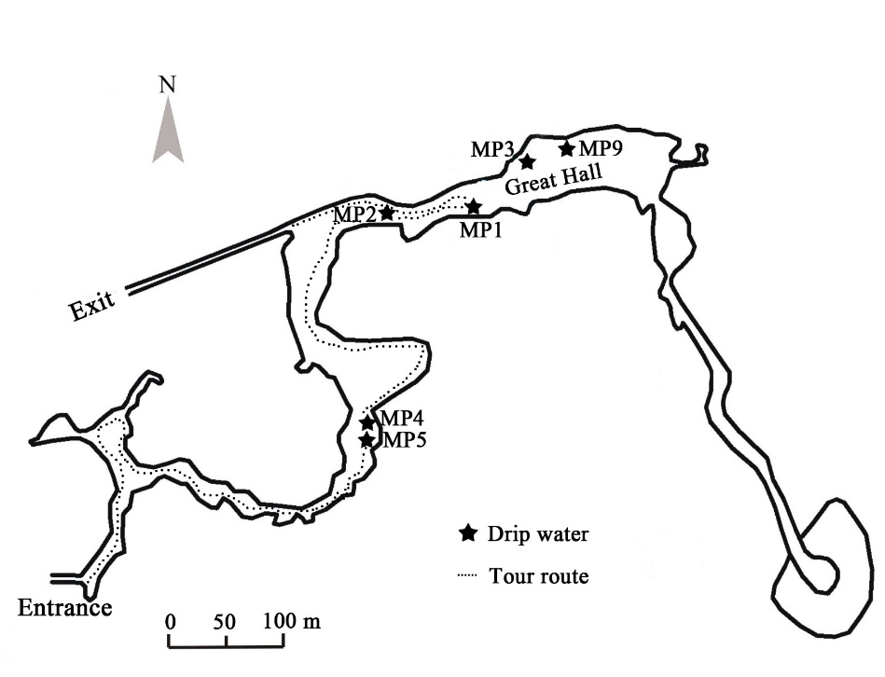
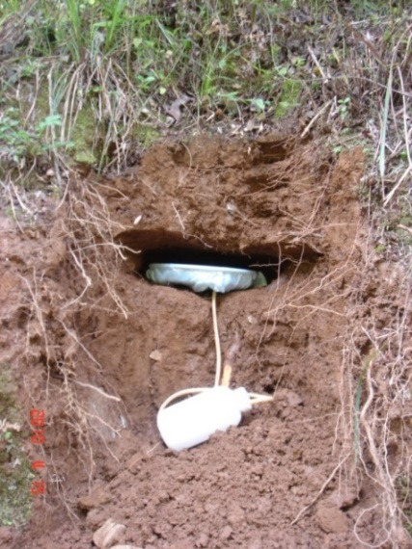

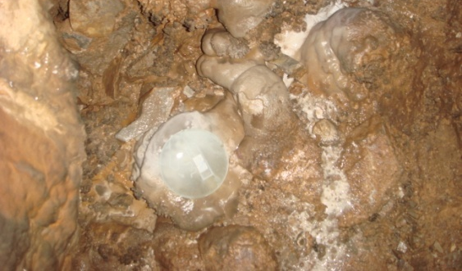
2. Sampling
Soil water
Active speleothem

Slide 4
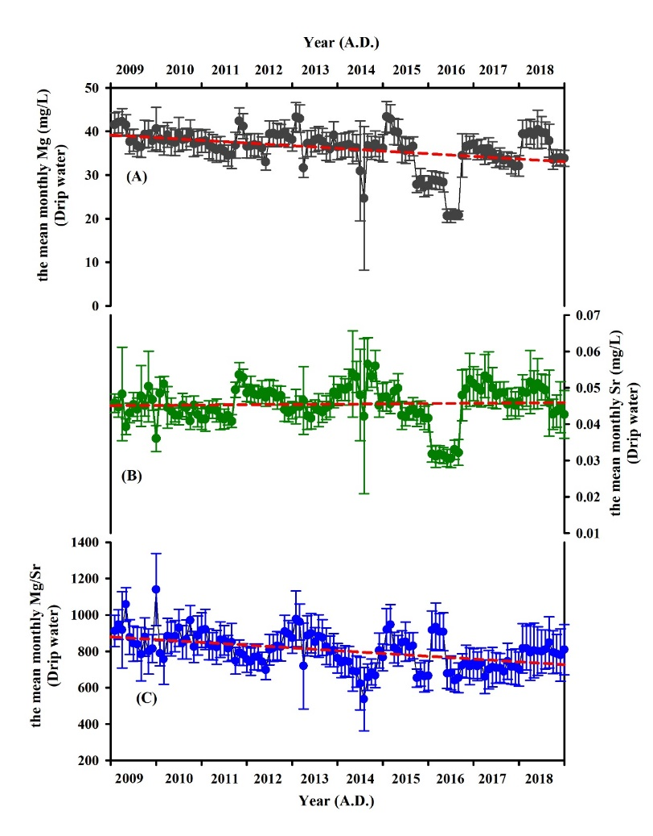
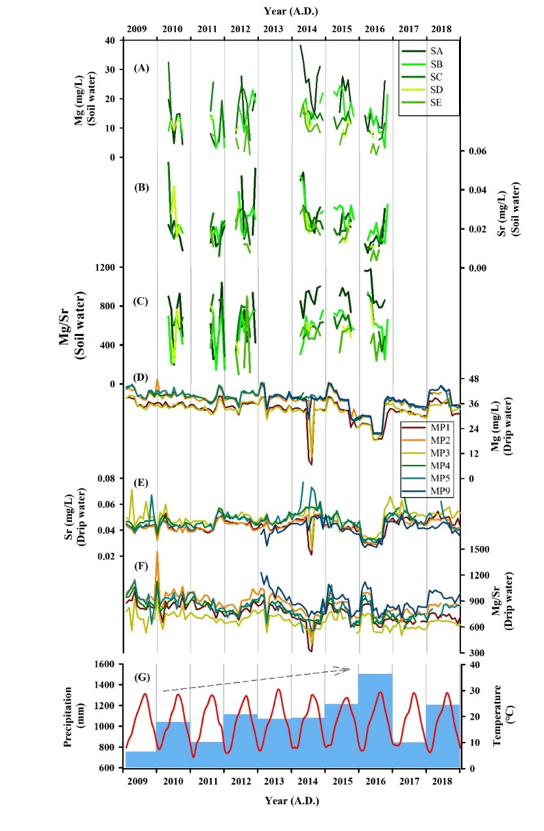
3. Results
3.1 Mg, Sr, and Mg/Sr in soil water and drip water
There are no seasonal variations of Mg and Sr in soil water and drip water as well as Mg/Sr ratios.
It is showed that the decreasing trend of the monthly average Mg contents and Mg/Sr ratios of the drip water with the increasing rainfall during 2009 to 2018, but the contents of Sr have no obvious change.

Slide 5
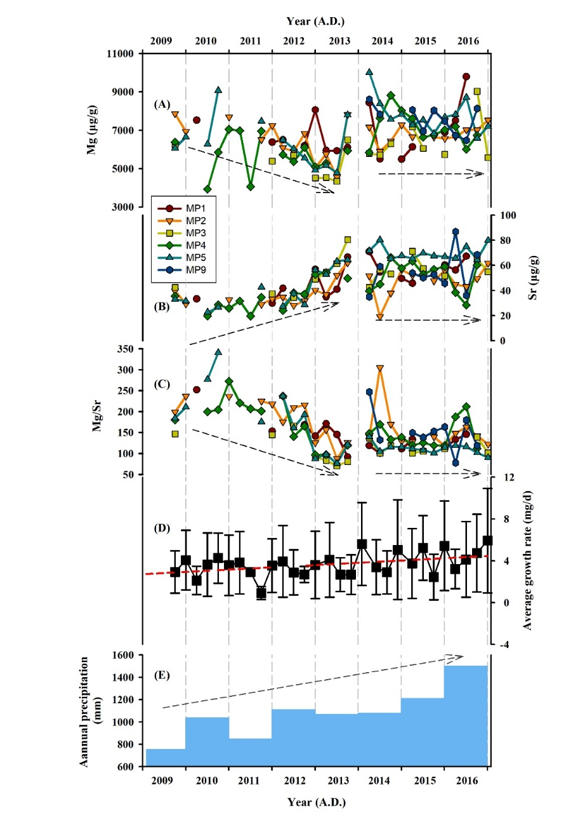
3.2 Mg, Sr, and Mg/Sr in active speleothem
The reduction of Mg in active speleothem might be affected by the content of Mg in drip water.
Sr contents in active speleothem is influenced by the growth rate.
With the increase of growth rate, more Sr and less Mg may enter into the calcium carbonate crystals, which resulted in the decrease of Mg/Sr ratios in active speleothem.

Slide 6
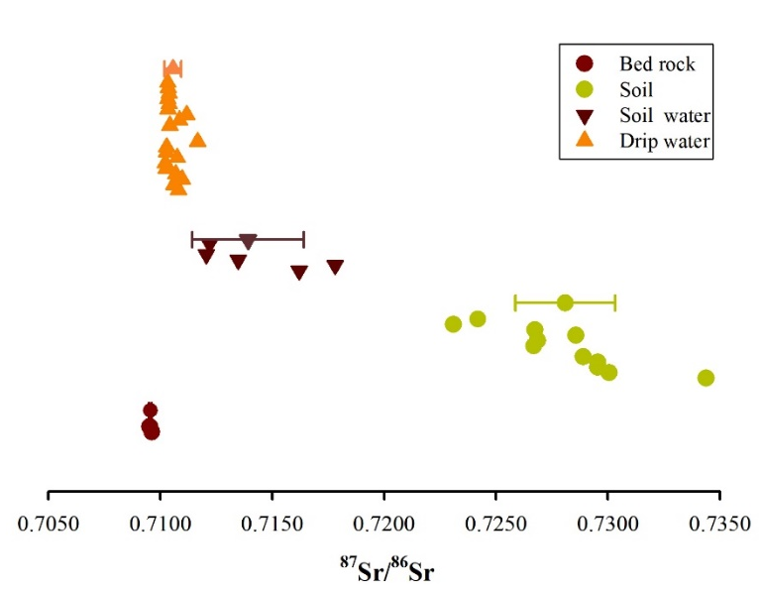
3.3 ⁸⁷Sr/⁸⁶Sr
The ⁸⁷Sr/⁸⁶Sr values of soil are higher than that of limestone because of the chemical weathering.
The ⁸⁷Sr/⁸⁶Sr values of all of the soil water and drip water fell between those of the soil and the bedrock. It indicates that soil and bedrock are the main source of Sr.
The ⁸⁷Sr/⁸⁶Sr values of drip water are closer to bedrocks than soil water. It suggests that the bedrock controls Sr contents in drip water.

Slide 7
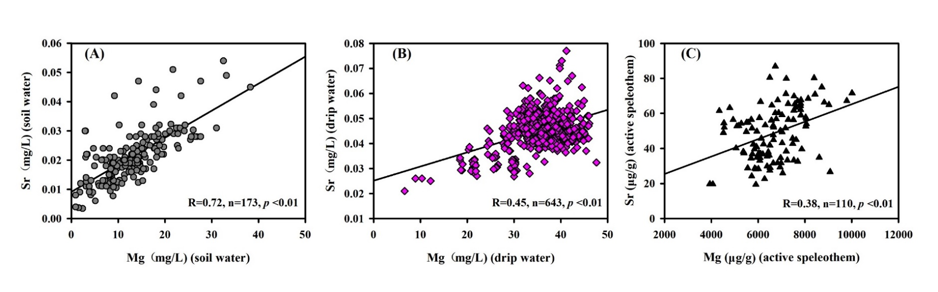
3.4 The influence factors of Mg and Sr
PCA analysis results on Mg and Sr data of soil water, drip water and AS (active speleothem)
 | Soil water (n=173) |  | Drip water (n=643) |  | AS (n=110)
 | *Comp.1 | Comp.2 | Comp.1 | Comp.2 | Comp.1 | Comp.2
Standard deviation | 1.311 | 0.528 | 1.202 | 0.743 | 1.174 | 0.788
Proportion of Variance | 0.860 | 0.140 | 0.723 | 0.277 | 0.689 | 0.311
Cumulative Proportion | 0.860 | 1.00 | 0.723 | 1.00 | 0.689 | 1.00

Slide 8
4. Conclusions
The trace element composition of the cave drip water mainly originates from the bedrock.
There were no seasonal variations of the Mg and Sr contents and Mg/Sr ratios in drip water and active speleothem according to the complex Karst system in the bedrock with hundreds of meters’ thickness.
Mg contents and Mg/Sr ratios responded to the change of regional rainfall on the multi-year timescale.
The residence time of fissure water in the bedrock is the main factor affecting the trace element composition of the drip water.

Slide 9


