Slide 1

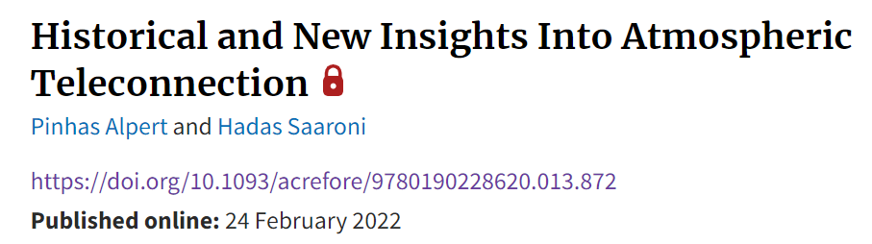
Historical and New Insights into Atmospheric Teleconnection
Pinhas Alpert
The Porter School of Environment and Earth Sciences, Tel-Aviv University, Israel
With contributions by: H. Saaroni, C. Shafir, E. Elhacham, S. Krichak, Late R. Samuels and others
EGU, 26 May 2022

Slide 2
Teleconnection definitions
Go along with:
Large scales, great distances or widely separated regions
Webster Dictionary (1958)
Meteorological Glossary (1991)
Glossary of Weather and Climate (Geer, 1996),
However, the term Teleconnection does not appear in the Glossary of Meteorology AMS, 1959 (Ed. R.E. Huschke)

Slide 3
Historical Perspective of the Term Teleconnection
Annual number of references including the term teleconnection (continuous line) and the term synoptic meteorology (dashed line) in manuscripts and books related to climate from 1960 to 2020, based on a Google Scholar search

Slide 4
Why is the “Teleconnection” term defined primarily for widely separated points?
Potential Answer suggestions:
Because a simple physical process (material advection,
same synoptic system, etc.) cannot immediately explain
such distant, and complex, atmospheric relations.
Also, models more often fail in predicting these patterns,
particularly regional models (hurricane examples).

Slide 5
A Contradicting Teleconnection Example From 1,800 Years Ago
The Talmud in Shabbat Tractate (p. 65), the great Jewish Rabbi named Rav made, in Aramaic, the following statement : “Rain in the West (Israel region) is strongly testified by the Euphrates” (Freedman, 1972).
Alpert, P., & Neumann, J. (1989). An Ancient "Correlation" between Streamflow and Distant Rainfall in the near East. Journal of Near Eastern Studies, 48(4), 313-314. https://doi.org/10.1086/373411
The correlation (R = +0.46) between observed precipitation (JFM) in Har Kenaan station, north Israel, and the Euphrates runoff (MAM), 1939–1972

Slide 6
Teleconnections in Mediterranean Studies
Tropical teleconnections with the Mediterranean climate and weather
Alpert, P., et al. (2005). Tropical tele-connections to the Mediterranean climate and weather. Advances in Geosciences, 2, 157-160. https://doi.org/10.5194/adgeo-2-157-2005

Slide 7
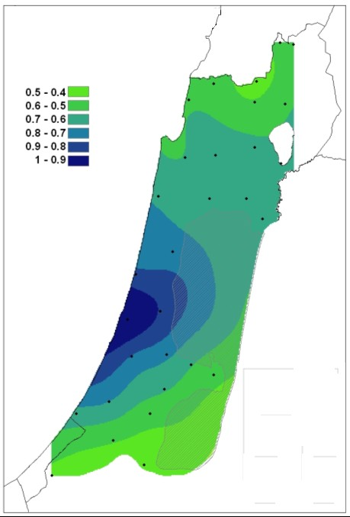
Teleconnections at Subsynoptic Scales
Aerosol–rainfall interaction or in a megacity’s potential effects on precipitation
Such connections are often not understood, especially when the physical mechanisms involved are complex

Slide 8
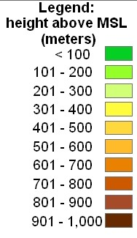
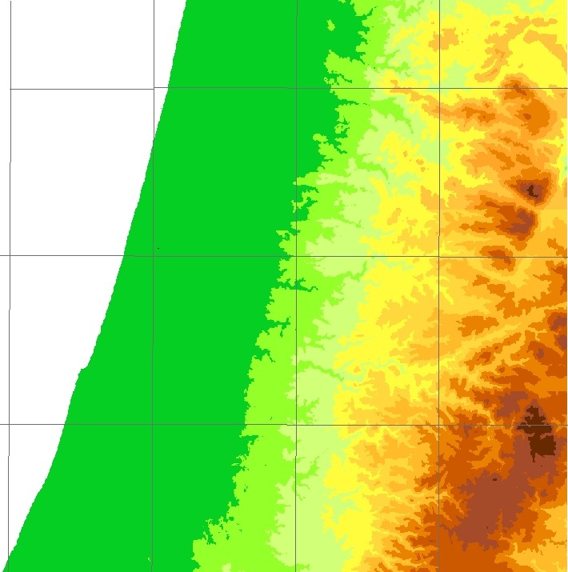
32’20
Wind direction
32’10
Mediterranean sea
Greater Tel Aviv
urban area
32N
Wind direction
34’40
34’50
35E
35’10

Slide 9
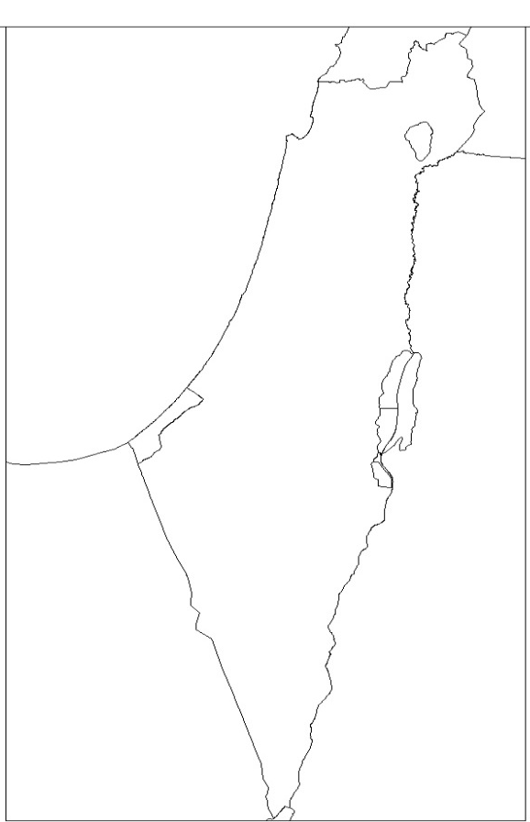
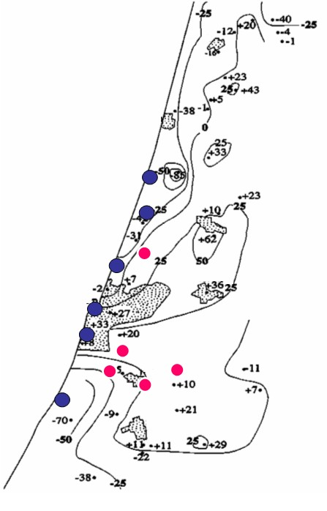
Rainfall Residual map:
Measured mean annual precipitation minus expected from multi-regression
Haifa
Netanya
Legend : (mm)
Tel Aviv
Netanya
75
Jerusalem
50
25
Be’er Sheva
0
-25
-50
-75
Eilat
Tel Aviv
Alpert, P., Halfon, N., & Levin, Z. (2008). Does air pollution really suppress precipitation in Israel? Journal of Applied Meteorology and Climatology, 47(4), 933-943. https://doi.org/10.1175/2007JAMC1803.1
Rehovot

Slide 10
The real problems in Global Modelling
my personal perspective
Aerosol-rainfall interactions:
P. Alpert, Shafir, H., and Elhacham, E. (2021). An unknown maximum lag-correlation between rainfall and aerosols at 140–160 minutes. Geophysical Research Letters, 48, e2020GL089334.
CO2-H2O synergy in climate models:
P. Alpert, D. Niyogi, R.A. Pielke,Sr., J. L. Eastman, Y.K. Xue, and S. Raman, "Evidence for carbon dioxide and moisture interactions from the leaf cell up to global scales: Perspective on human-caused climate change", Global Planetary Change (LCLUC Special Issue), 54, 202-208, 2006.

Slide 11
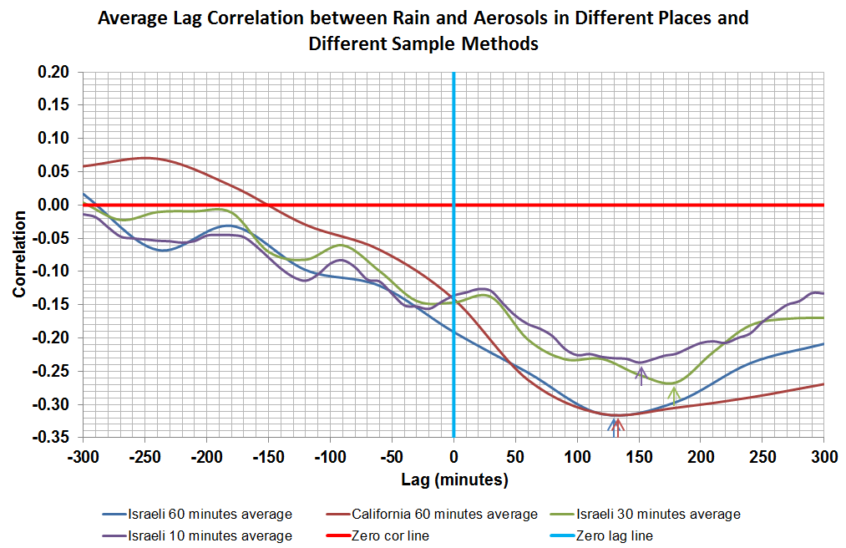
High time resolution (10-60 minutes) lag-correlations
Alpert et al (GRL, 2021)

Slide 12
Key points
The highest negative correlations were consistently at a positive lag of about 140-160 minutes where a positive lag means that the aerosol time-series follows that of the rain.
Suggested to be the probable outcome of scavenging along with the rise in aerosol concentration after rain depending on aerosol sources, hygroscopic growth and transport.
This lag correlation missed in climate models.
Consistent lack of significant correlation at negative lags, may suggest the existence of a weak aerosol effect on precipitation.

Slide 13
Summary
Tropical “remote” areas seem to play a major role in Mediterranean climate
An ancient teleconnection was pointed out already in the Talmud as far back as approximately 1,800 years ago
Physical mechanisms for the teleconnections e.g., El-Nino, Indian Monsoon, Hurricanes, should be further investigated
The highest negative correlations were consistently at a positive lag of about 140-160 minutes where a positive lag means that the aerosol time-series follows that of the rain.
Climate changes in aerosol forcing in the models probably play a significant role that should be explored by a more realistic inclusion of aerosols in our climate models

Slide 14
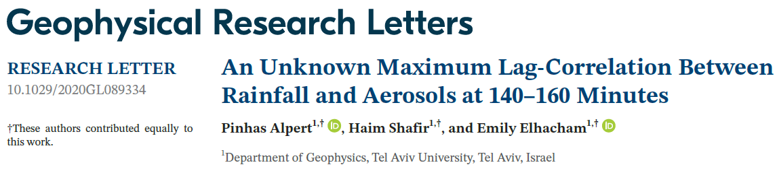
Reference:
Alpert, P., Shafir, H., & Elhacham, E. (2021). An unknown maximum lag-correlation between rainfall and aerosols at 140–160 minutes. Geophysical Research Letters, 48, e2020GL089334. https://doi.org/10.1029/2020GL089334

Slide 15

More details
To download my Publications go to : http://www.tau.ac.il/~pinhas/publications.htm
Thank you for listening!

Slide 16

THANK YOU FOR YOUR ATTENTION

