Slide 1



Photocold
Improving photosynthesis estimation in northern temperate and boreal forest ecosystem
Yunpeng Luo^{1,2}, Arthur Gessler², Koen Hufkens^{1,2}, Petra D’Odorico², Benjamin Stocker^{1,2}
¹ ETH Zurich, Department of Environmental System Science, Zurich, Switzerland
² Swiss Federal Institute for Forest, Snow and Landscape Research WSL, Birmensdorf, Switzerland
³ Department of Environmental Systems Science, Institute of Terrestrial Ecosystems, ETH Zurich, Zurich, Switzerland

Slide 2
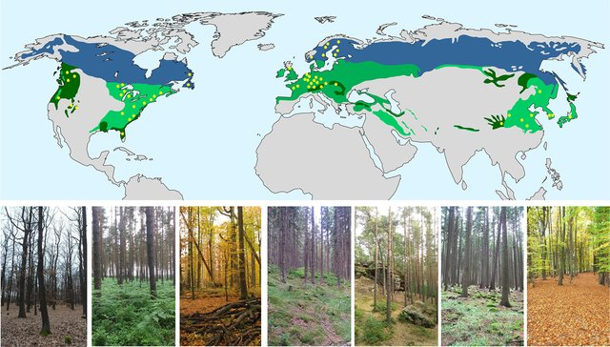
Background: why we focus on this topic?
Large area
Lladó et al., 2017
Boreal and temperate Forests are important to regulate global carbon dynamics
These forests are projected to increase C uptake with global warming

Slide 3
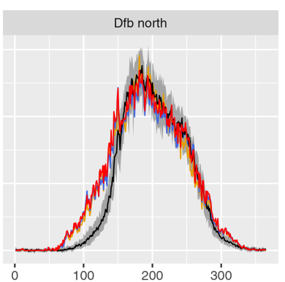

Background: why we focus on this topic?
Large area
Lladó et al., 2017
Boreal and temperate Forests are important to regulate global carbon dynamics
H0: Lack considering of delay effects of Tempature (Makela et al., 2004)
Key challenges in simulation of CO₂ assimilation, especially in early spring
H0: Related to physiological processes, e.g. photoprotection?
Stocker et al., 2020
DOY

Slide 4
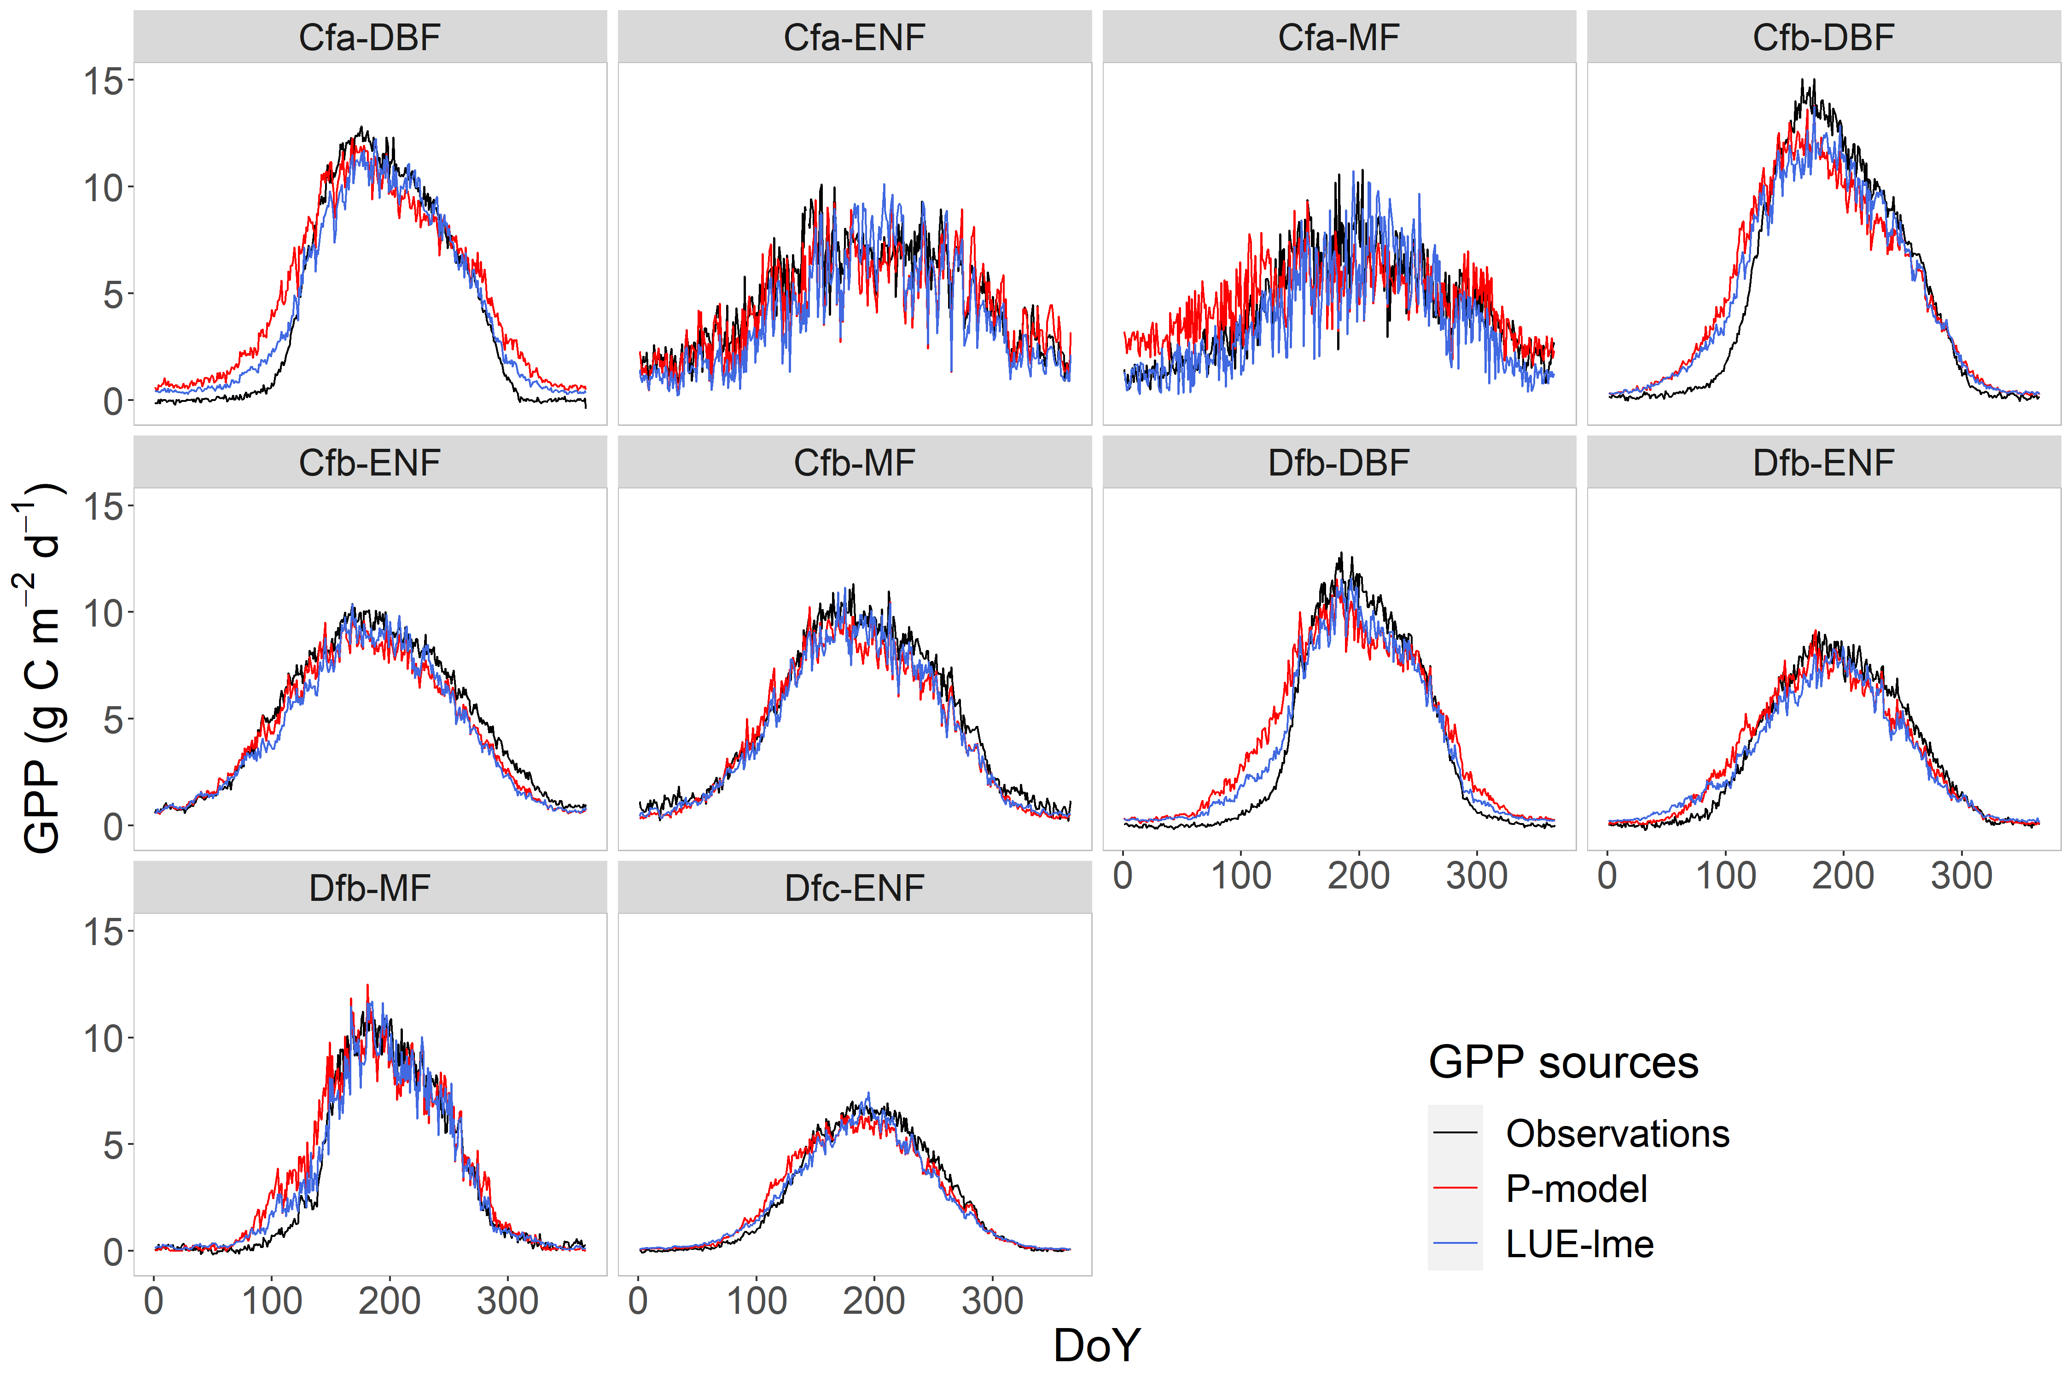
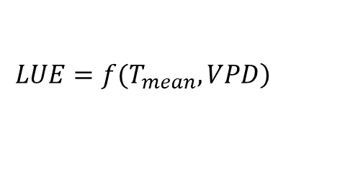

Main Results and Discussion
Reason of GPP overestimation?
$$GPP=LUE×fAPAR×APAR$$
LUE
LUE-lme
$$\left.LUE=f(T_{mean}, VPD\right)$$
P-model:
LUE considers the effect of
instaneous temperature
Luo et al., in prep.

Slide 5
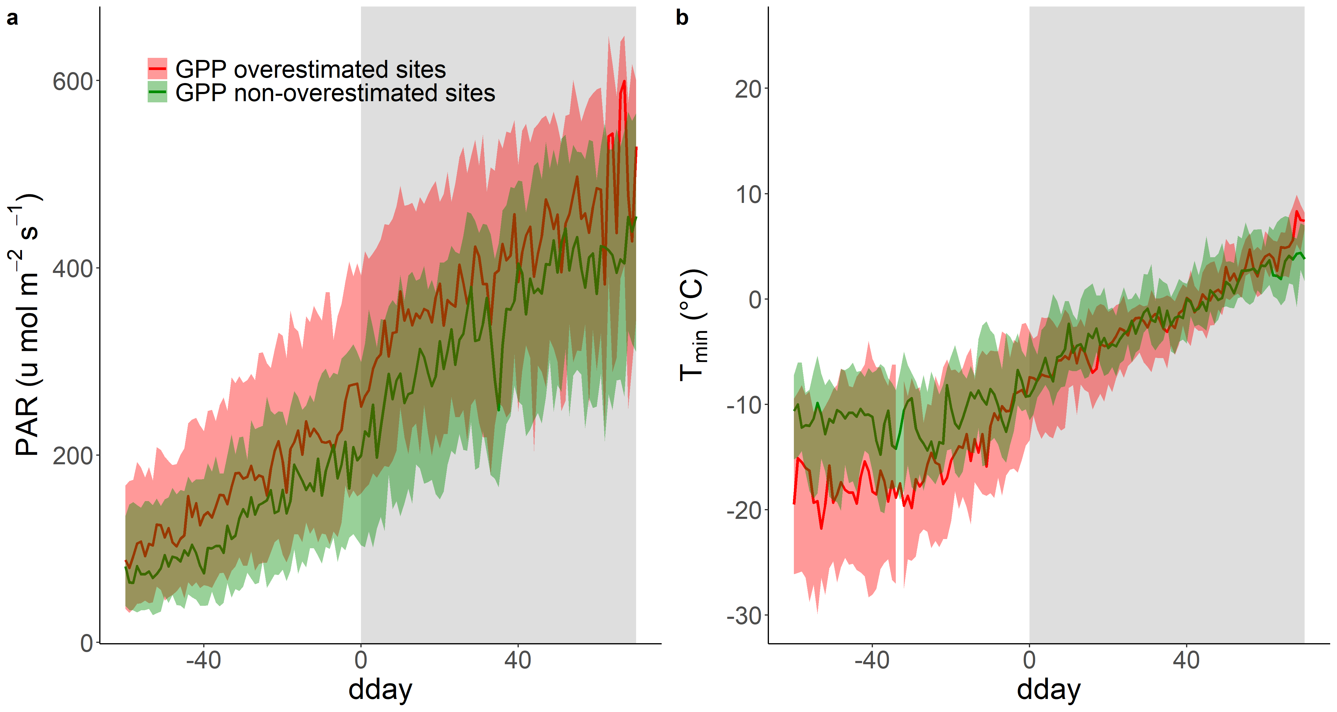
Main Results and Discussion
Data from Fluxnet 2015
GPP overestimated period
Difference in PAR and T_{min} (antecedent)
Luo et al., in prep.

Slide 6
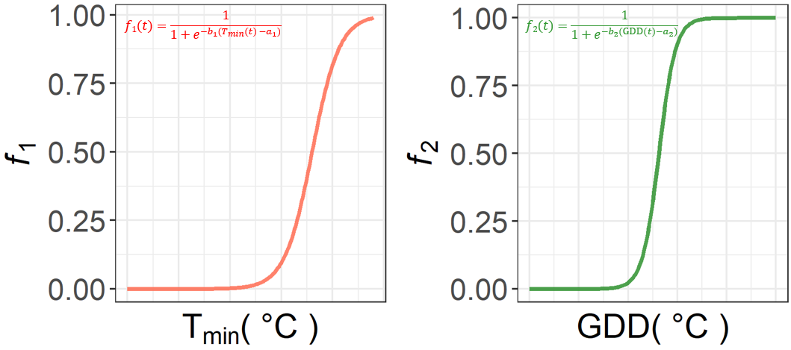
Main Results and Discussion
Data from Fluxnet 2015
Low temperature adjustment
Dehardening
Difference in PAR and Tmin (antecedent)
Embedding empirical correction factors
Luo et al., in prep.

Slide 7
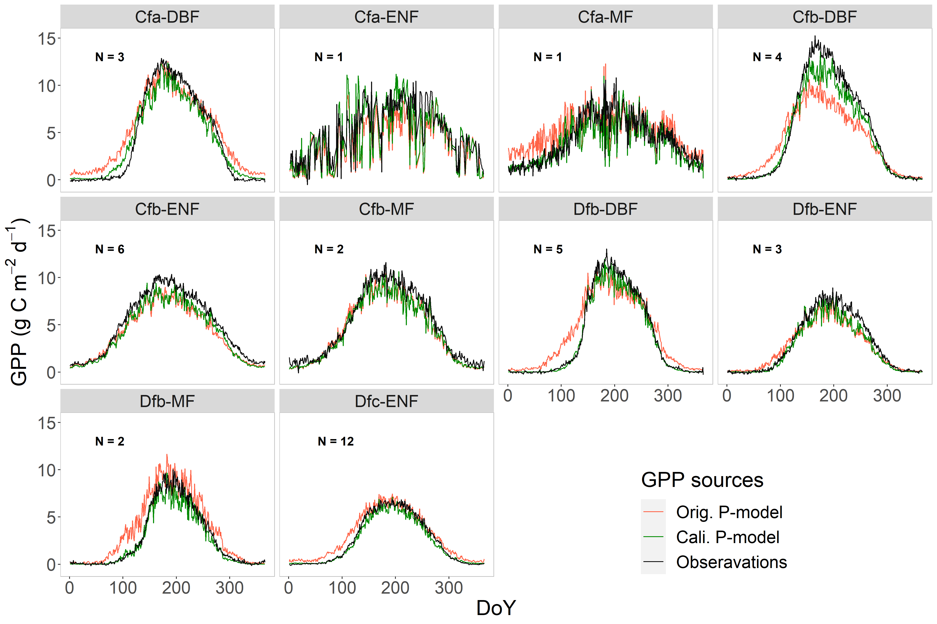
Main Results and Discussion
Model improving with embedding correction factor
Luo et al., in prep.

Slide 8


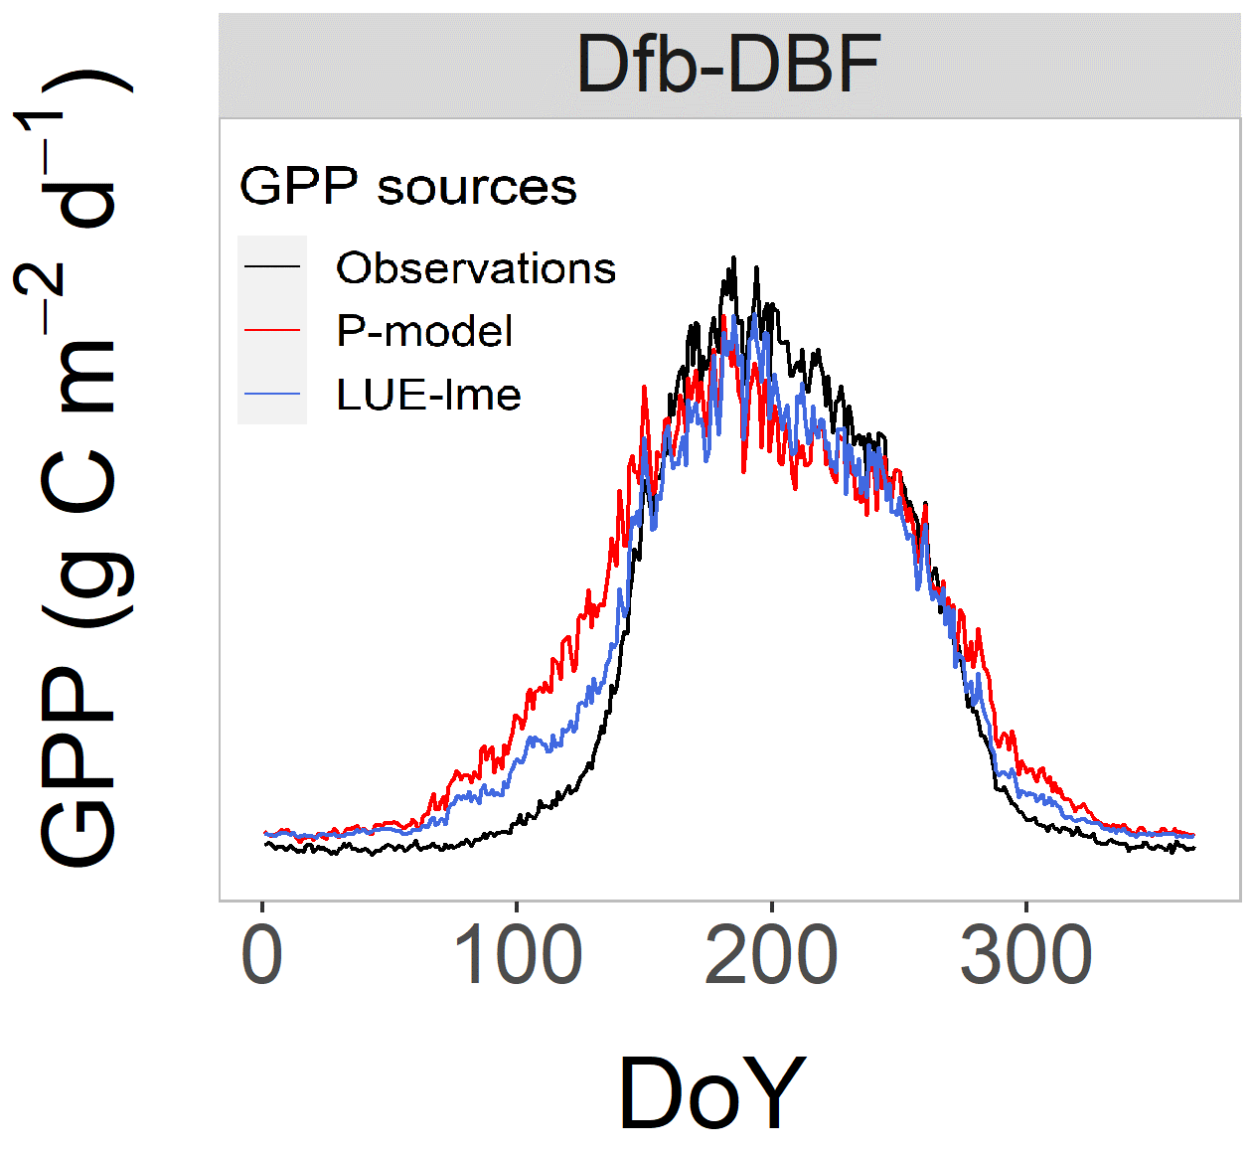
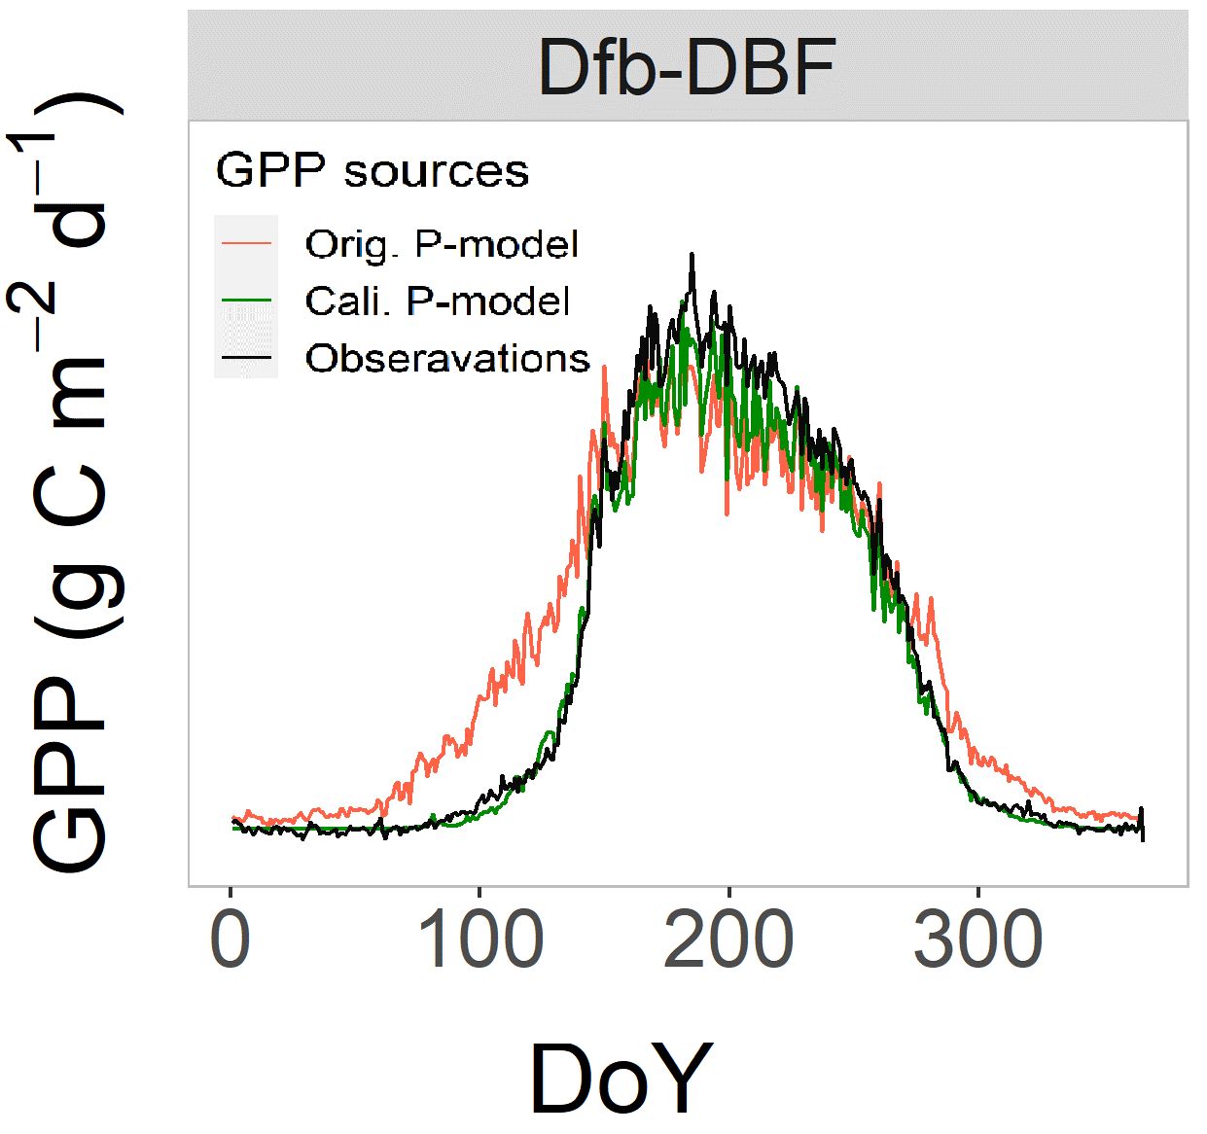

Summary
GPP overestimation particularly related to low T and high radiation
QR for Abstract
- Lack of considering of the lagged effects of temperature on GPP results in GPP overestimation
- Improving the GPP representation by embedding the correction factor

Slide 9
Backup slides

Slide 10
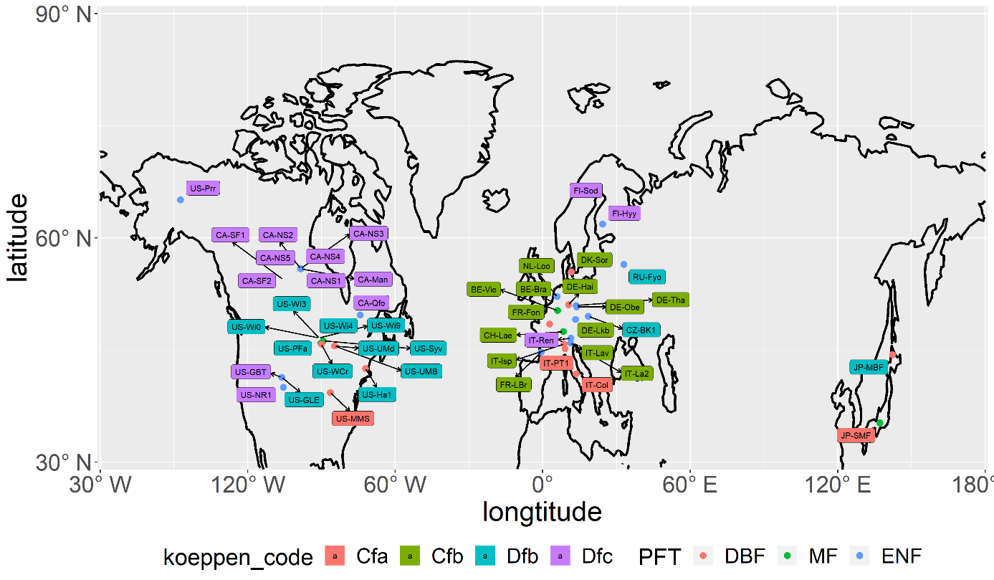
Used datasets and Methods
Final selected forest sites:
39 sites, 322 site years
Observations: daily GPP based from EC (fluxnet 2015)
GPP
DBF
MF
ENF
Modelled daily GPP: from P-model
Meteos (Fluxnet2015)
Radiation (SW_{IN}); Ta (T_{min}, T_{max}, T_{mean});
Soil T (T_{soil}); SWC…
Notes:
Removed this slide

