Slide 1

Seasonality of debris-flow events in the mining area of Calimani Mountains (Eastern Carpathians, Romania) inferred from tree rings
EGU 2022 General Assembly
Vienna, Austria
June 23-27, 2022
Olimpiu Pop, Andrei RUSU, Csaba Horváth
Laboratory of Dendrochronology, Faculty of Geography, Babeş-Bolyai University,
Cluj-Napoca, Romania
olimpiu.pop@ubbcluj.ro

Slide 2
During the second half of 20th century, in the central part of the Călimani Mountains (Eastern Carpathians, Romania), the mining activities for sulfur-rich ore extraction and processing resulted in significant morphological changes.
Hydrogeomorphic processes, i.e., debris flows originating in the spoil heap area produced in the last decades an increasing volume of sediments transferred along the stream channels.
In this mining area, very limited information exist about the frequency and spatial extent of debris flow activity.

Slide 3
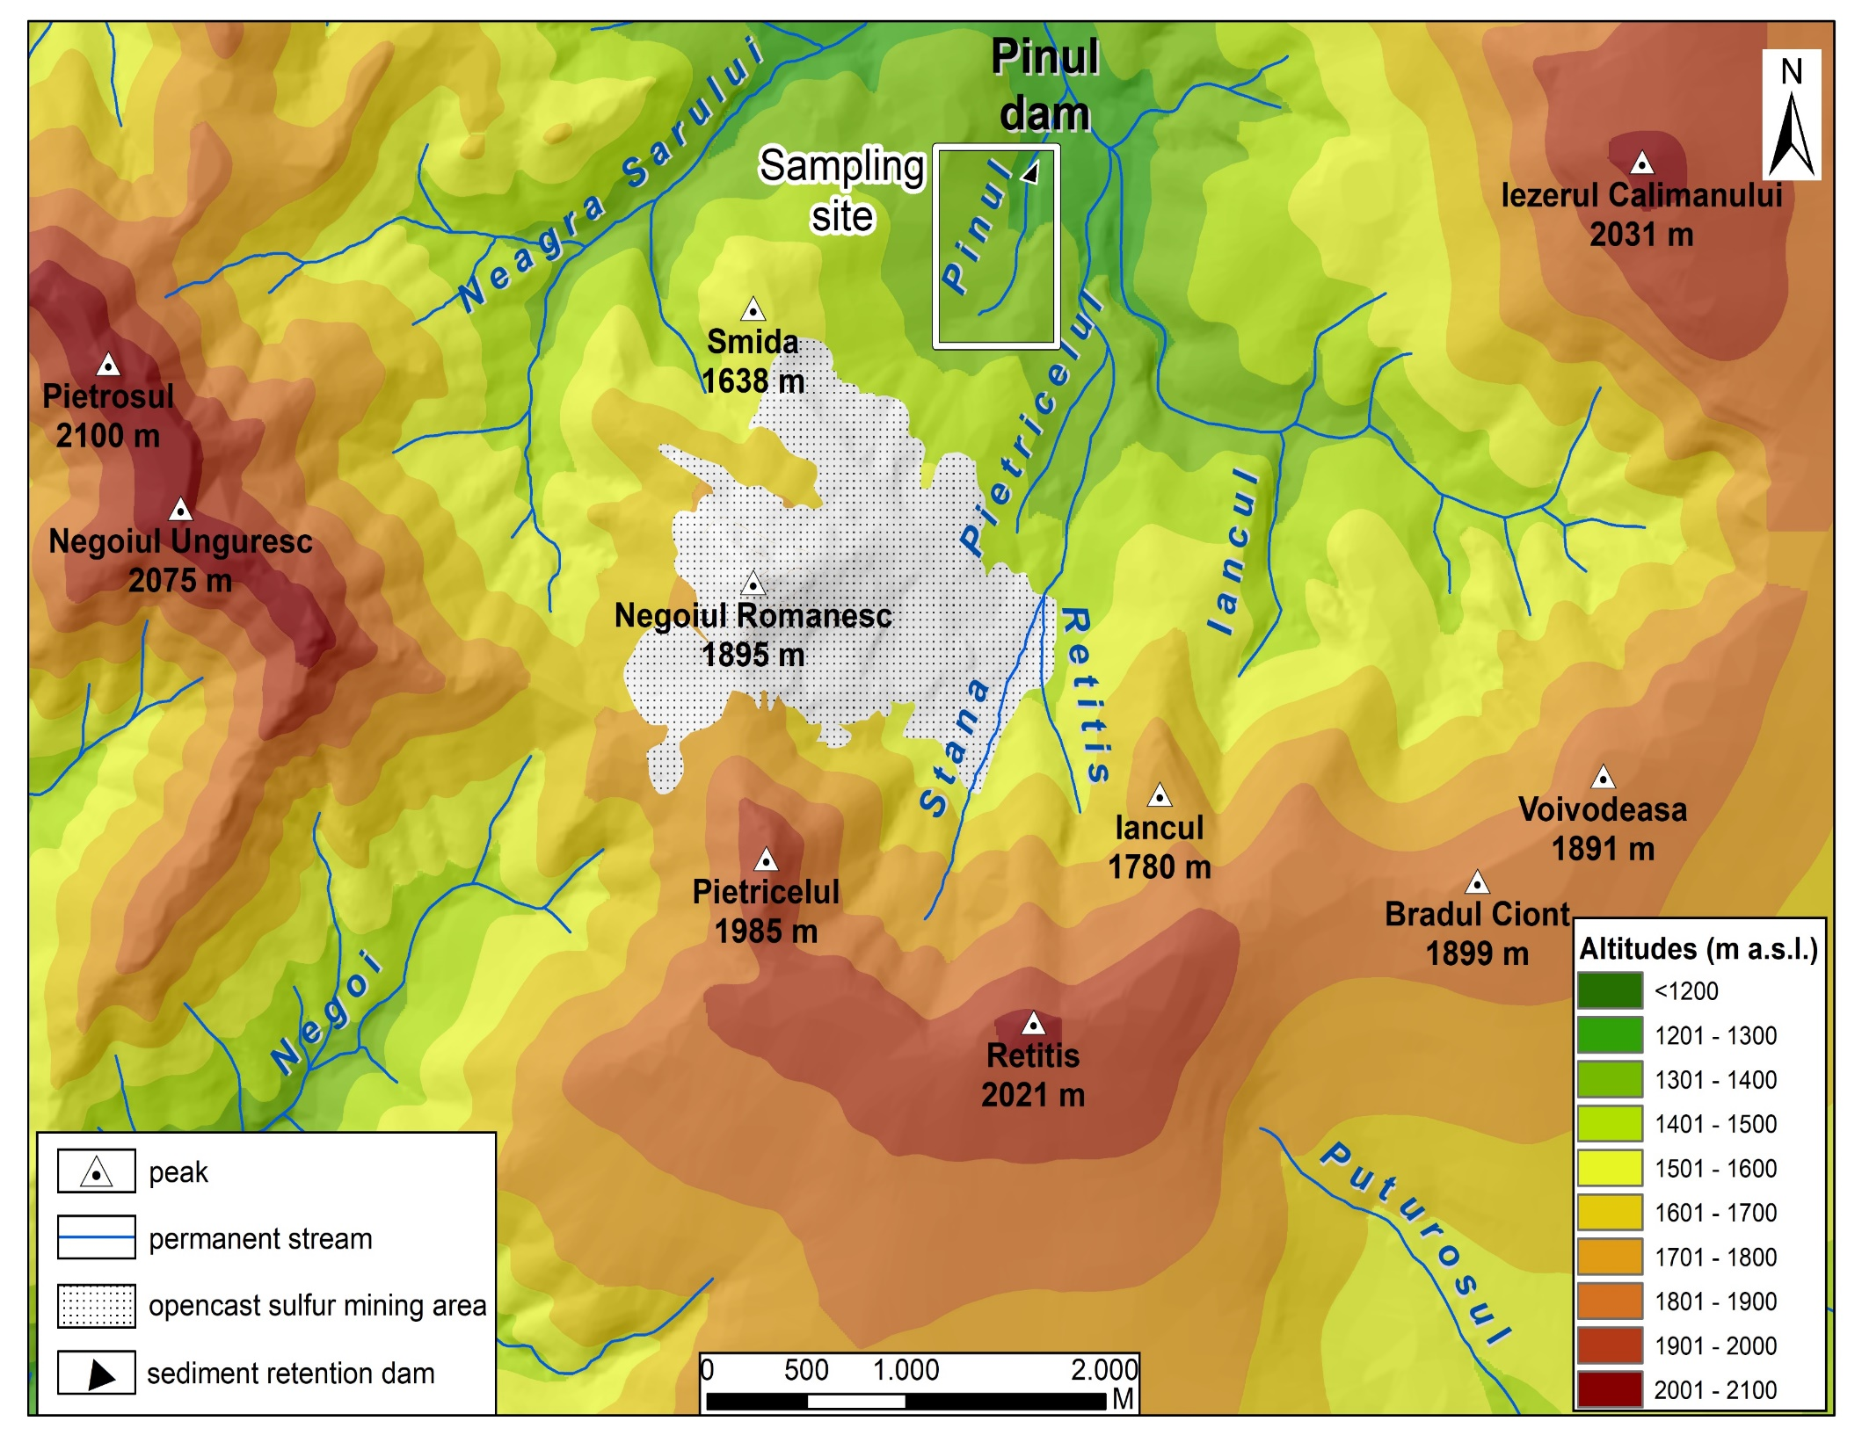
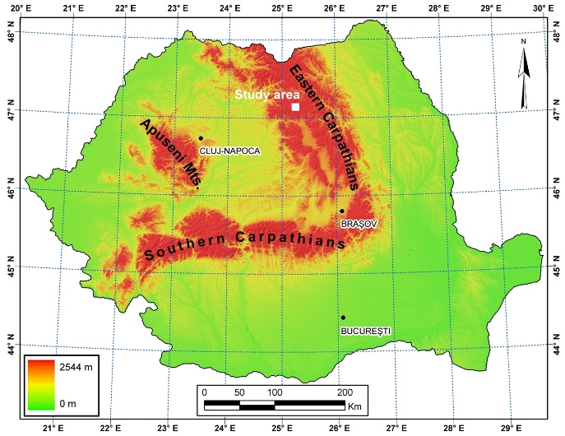

Slide 4
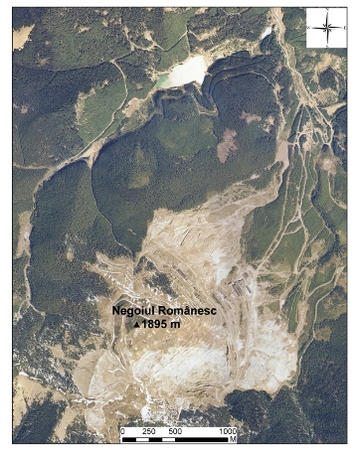
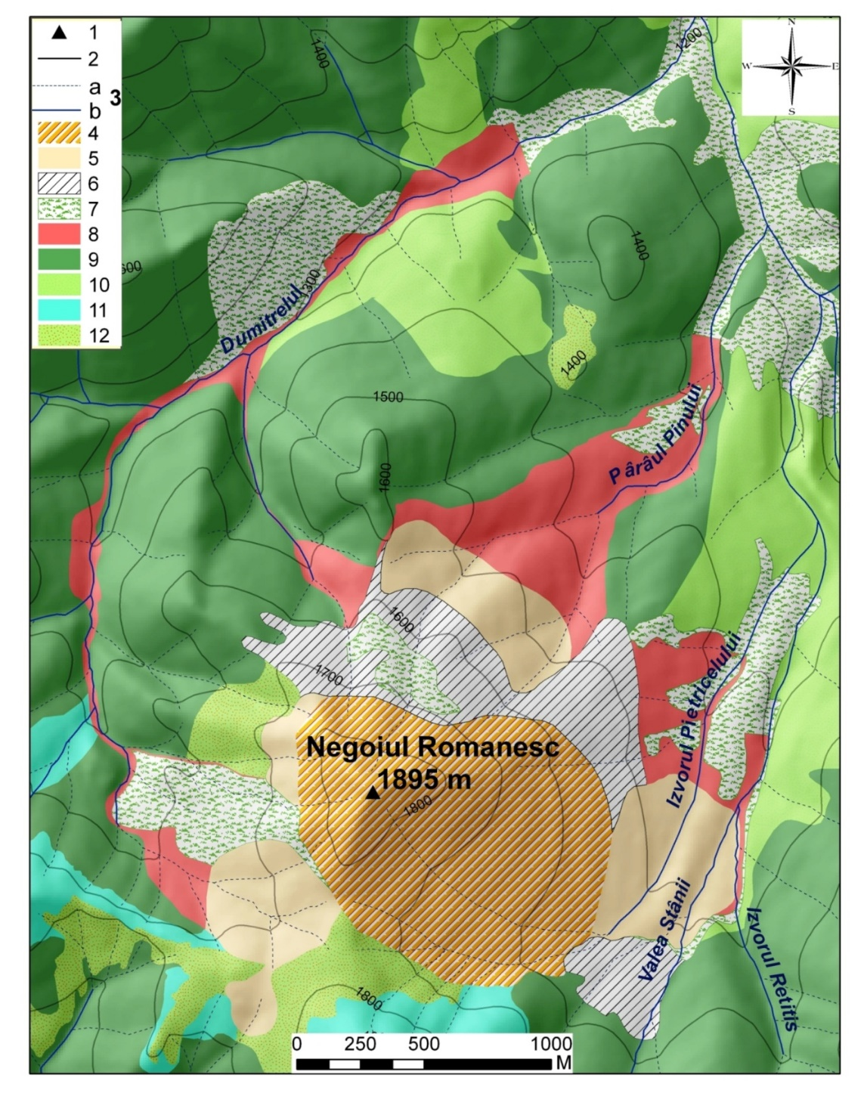
1 - peak; 2 - permanent stream; 3 - contour line; 4 - opencast sulfur mine; 5 - spoil heap talus; 6 - spoil heap platform; 7 - disturbed forest; 8 - DF affected areas; 9 – old-growth forest stand; 10 – young forest stand; 11 - subalpine shrubs; 12 - alpine meadow.

Slide 5
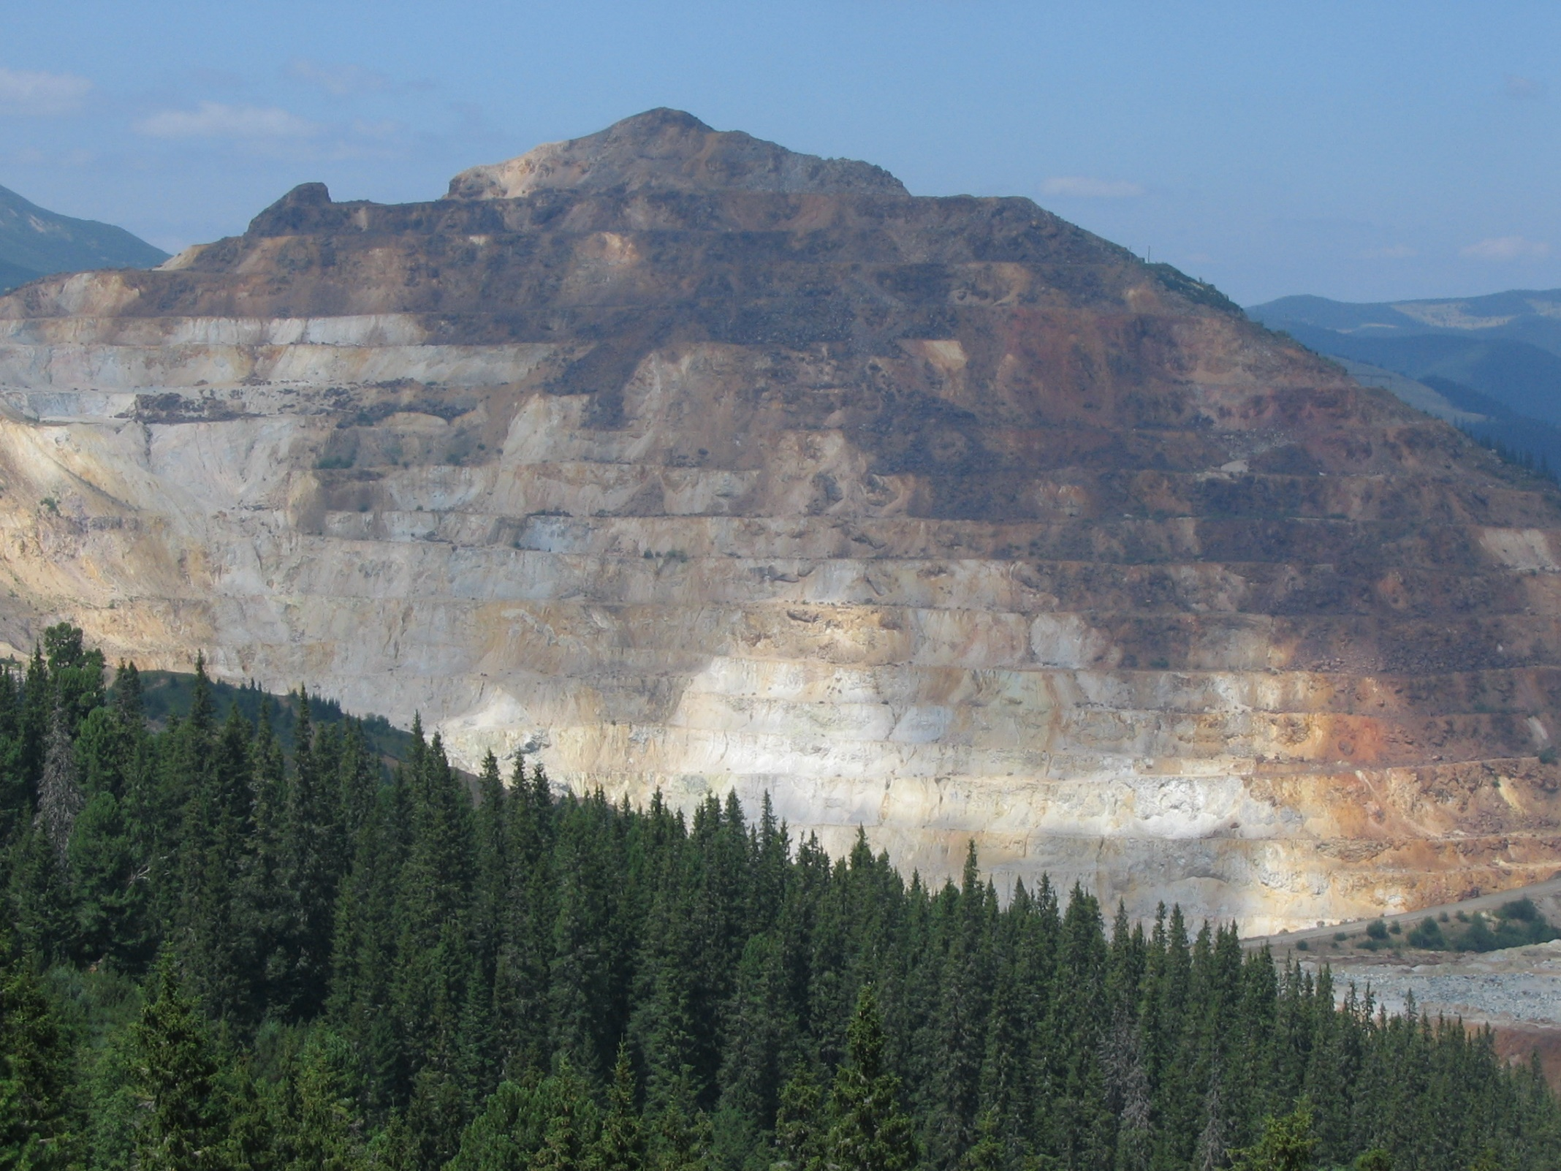
Negoiul Românesc peak (1895 m)
Open-pit quarry

Slide 6
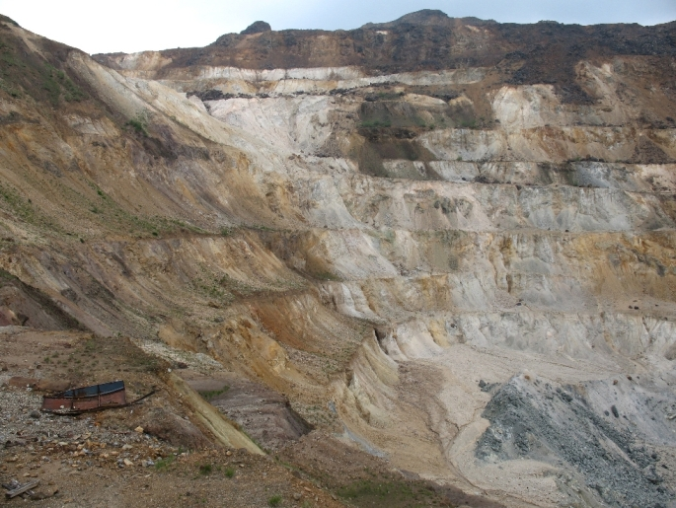
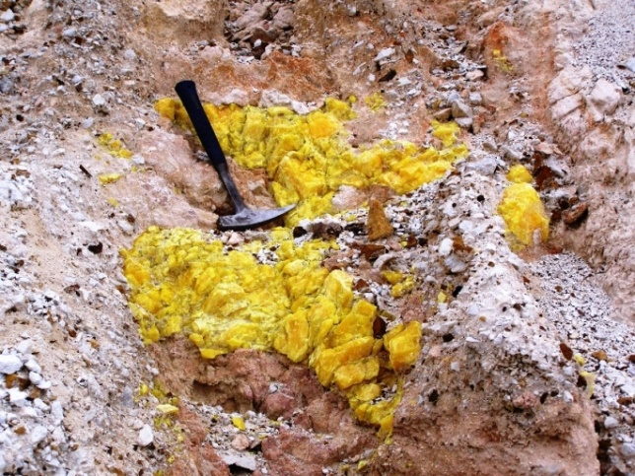
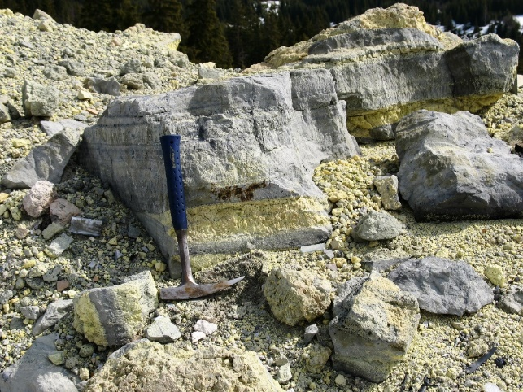
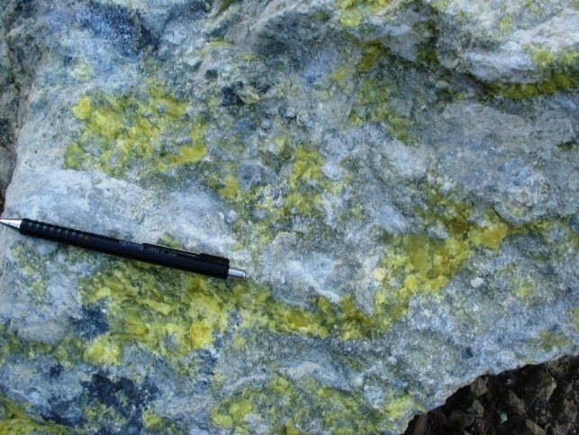
Negoiul Românesc open-pit quarry

Slide 7
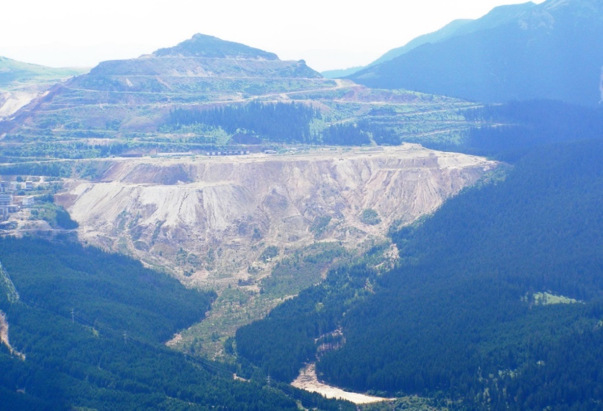
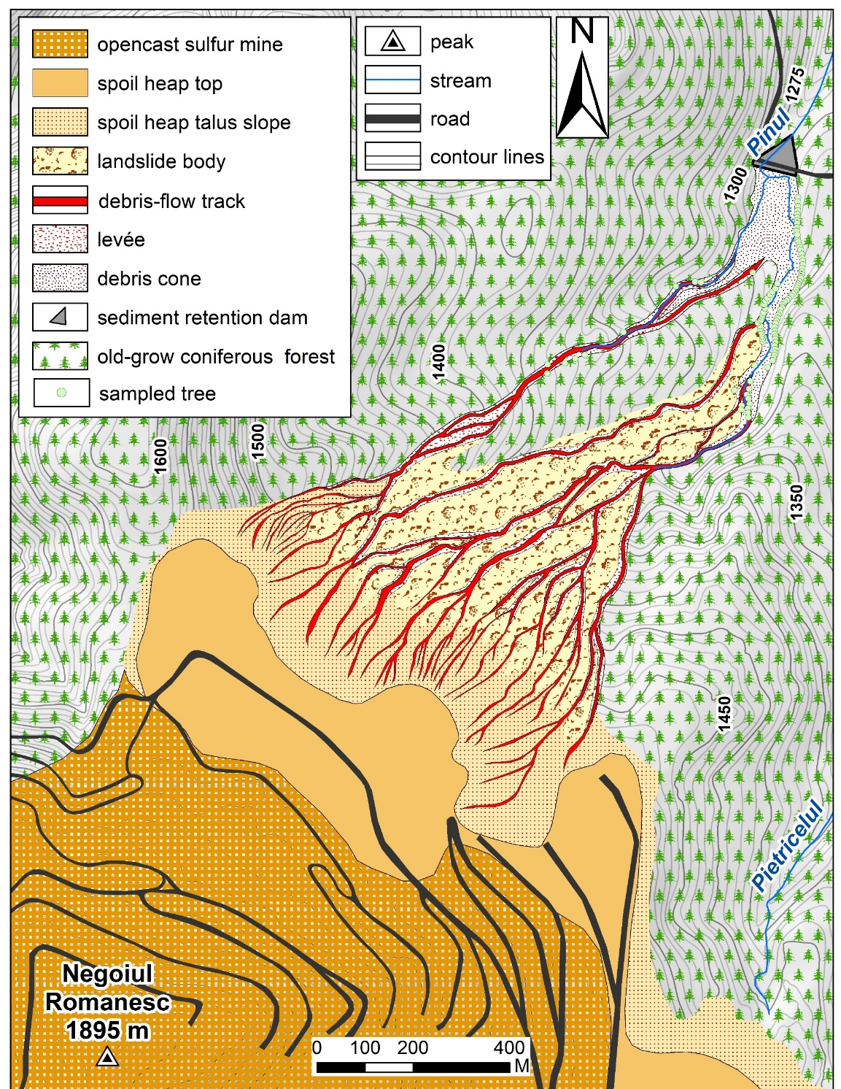
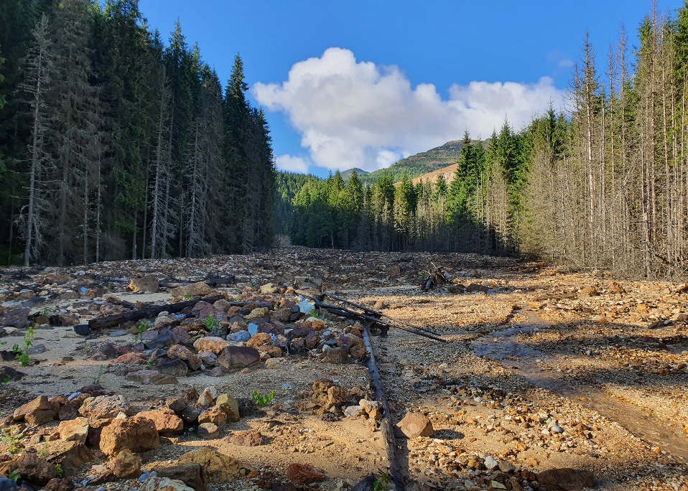
Pinul
spoil heap
Pinul
sediment retention basin
2021

Slide 8
Objective
The main aim of this study is to reconstruct the spatio-temporal DF activity in the mining area and analyze the growth reactions (scars) of disturbed trees in order to identify the seasonal occurrence of debris-flows.
Dendrogeomorphic reconstruction
Identification and mapping of the landforms along the DF channel (orthophotoplans, topographical maps 1/5000, GPS devices, tape, clinometer and compass);
Tree-sampling: 78 trees sampled at the level of the visible disturbances (scars) on stems:
  Location of sampled trees (GPS);
  Sample collection: stem discs
Local reference chronology: 25 undisturbed trees living outside the DF path;
  Sample preparation for analyses: air-drying, sanding, tree-age determination;
Tree-ring width measurements: digital LINTAB positioning table connected to a Leica stereomicroscope + TSAP-WinTM Scientific;
Identification of growth disturbances (GDs) related to mechanical impact: scars;
DF activity index:
I_{t} = (∑_{i}^{n}₌ ₁R_{t} / ∑_{i}^{n}₌ ₁A_{t}) ×100% (Shroder, 1978)
(R) - the number of trees showing growth disturbances in the event year (t);
(t) - the event year;
(A) - the total number of sampled trees alive in the year (t).
Event year definition: ≥ 7 trees with scars + It ≥ 10%.
Shroder, J. F., 1978. Dendrogeomorphological analysis of mass movement, Table Cliff Plateau, Utah. Quaternary Research 9, 168-185.

Slide 9
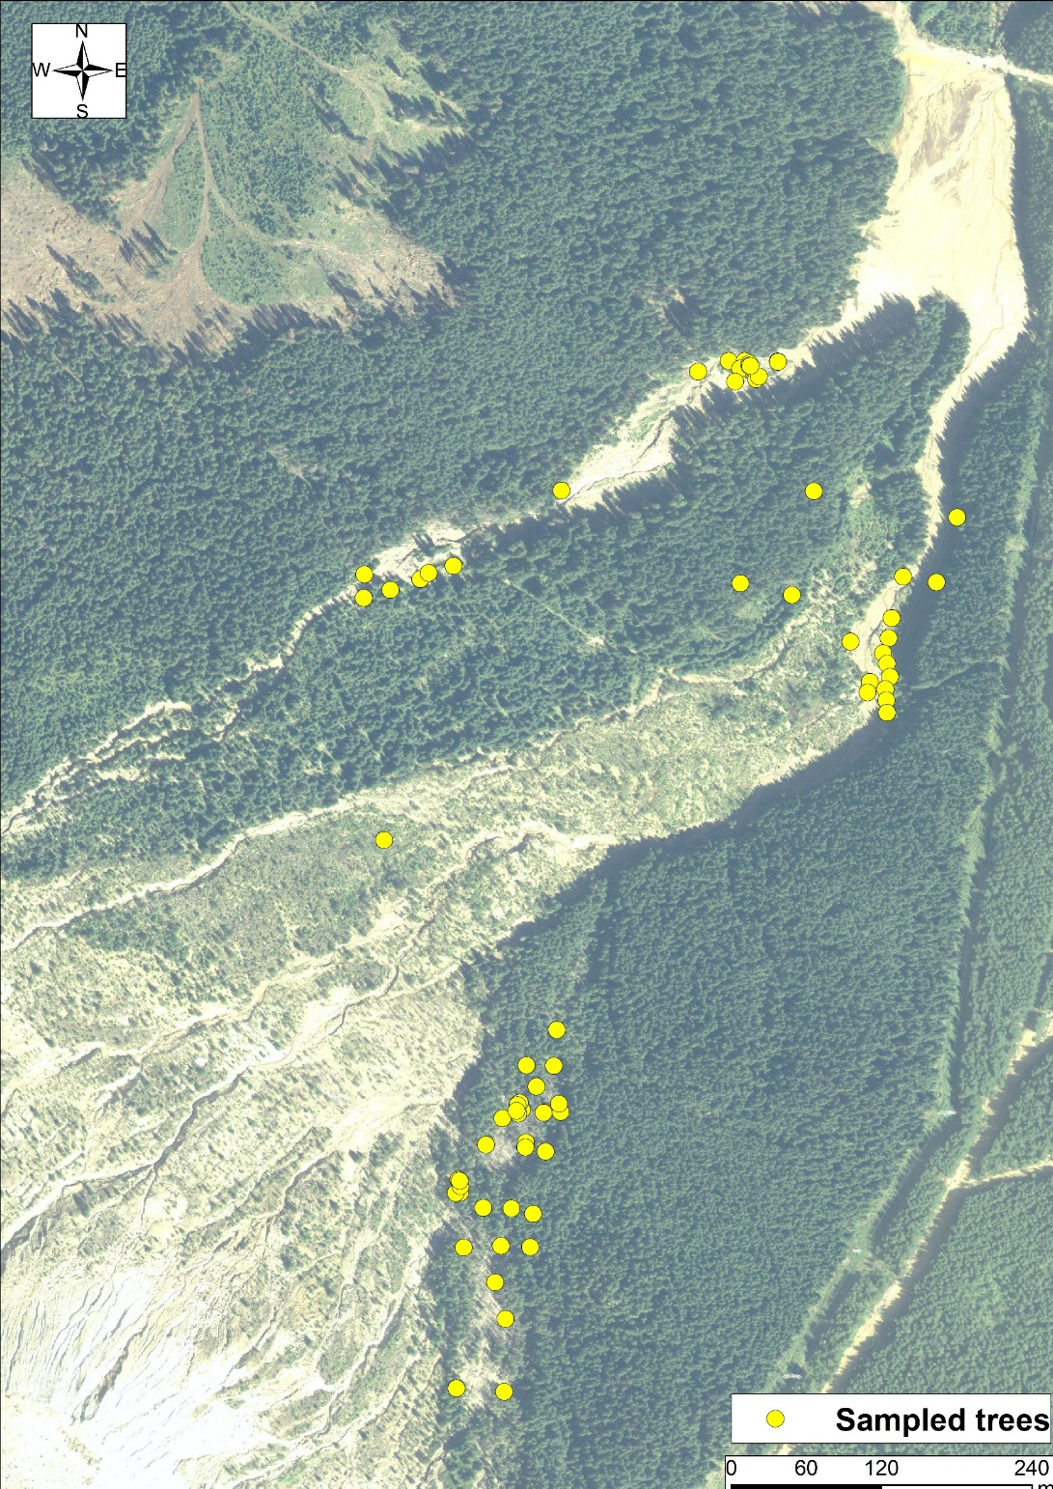
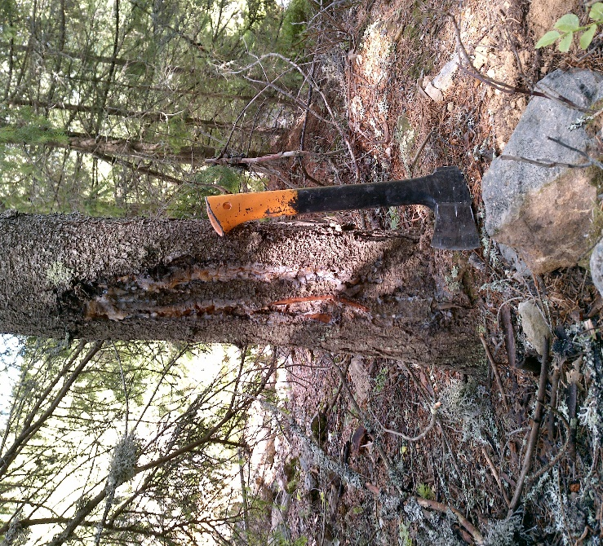
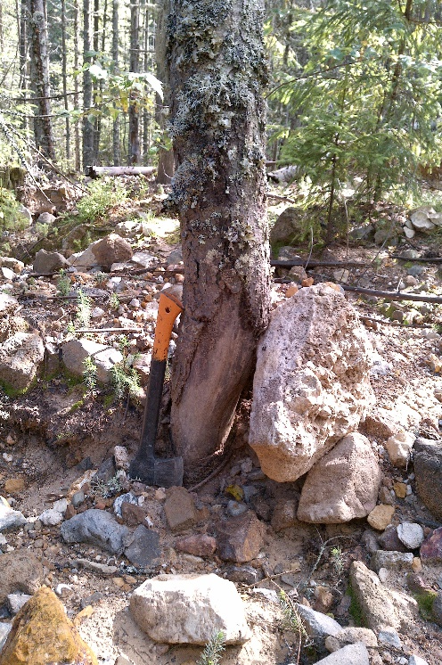
Sampling site
Pinul sediment retention basin
Examples of wouded trees sampled
Reference trees site
Pinul spoil heap

Slide 11
DF occurrence along Pinul stream
certain DF event
possible DF event
DF return period = 3 years

Slide 12

Growing season in Calimani Mts. = May to September
Latewood
LW = July to September
Annual
growth
ring
Earlywood
EW = May to June
Picea abies (L.) Karst.
Schweingruber F.H., Börner A., Schulze E.D., 2006. Atlas of woody plant stem. Springer-Verlach, Berlin, 229 p.

Slide 14
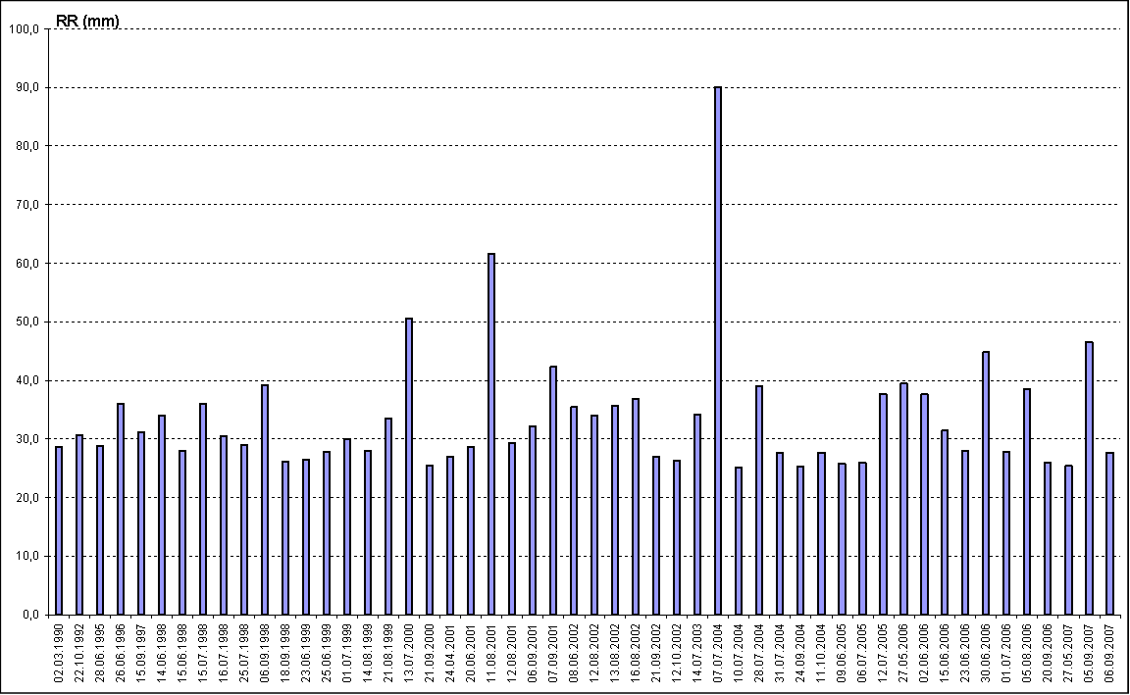
07.07. 2004

Slide 15
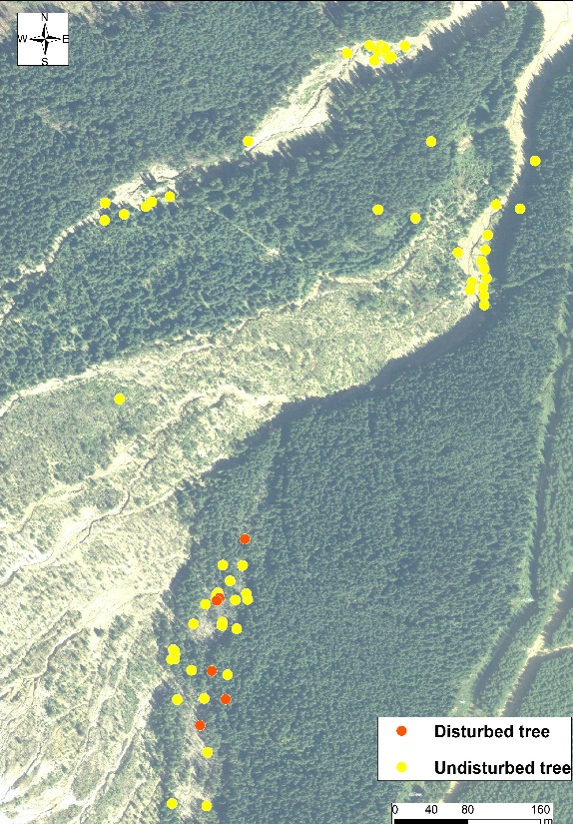




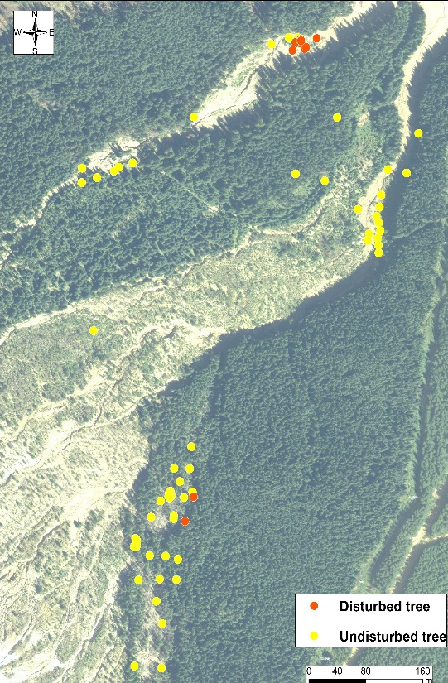
1994
2004
2007
2012
2016
2020

Slide 16
CONCLUDING REMARKS
Between the 1970s - 2021, the mining activity created specific landforms (opencast mine, spoil heaps, dams, tailing ponds etc.) in the central part of the Calimani Mountains (Eastern Carpathians, Romania). The spoil heaps are still intensely affected by hydrogeomorphic processes.
Along the Pinul stream, 9 certain DF events have been reconstructed, spanning the period 1994 – 2021, with an average return period of 3 years.
A higher sample depth could allow to confirm other DF events and to determine smaller values of DF return periods.
Dendrogeomorphic approach can provide valuable information on both reconstruction and monitoring of DF activity in anthropogenically-disturbed areas.

Slide 17
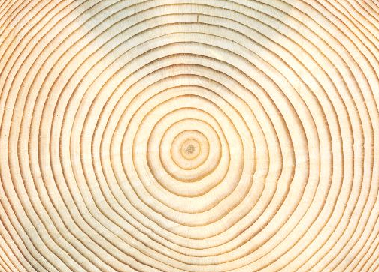
Thank You for your attention!

