Slide 1
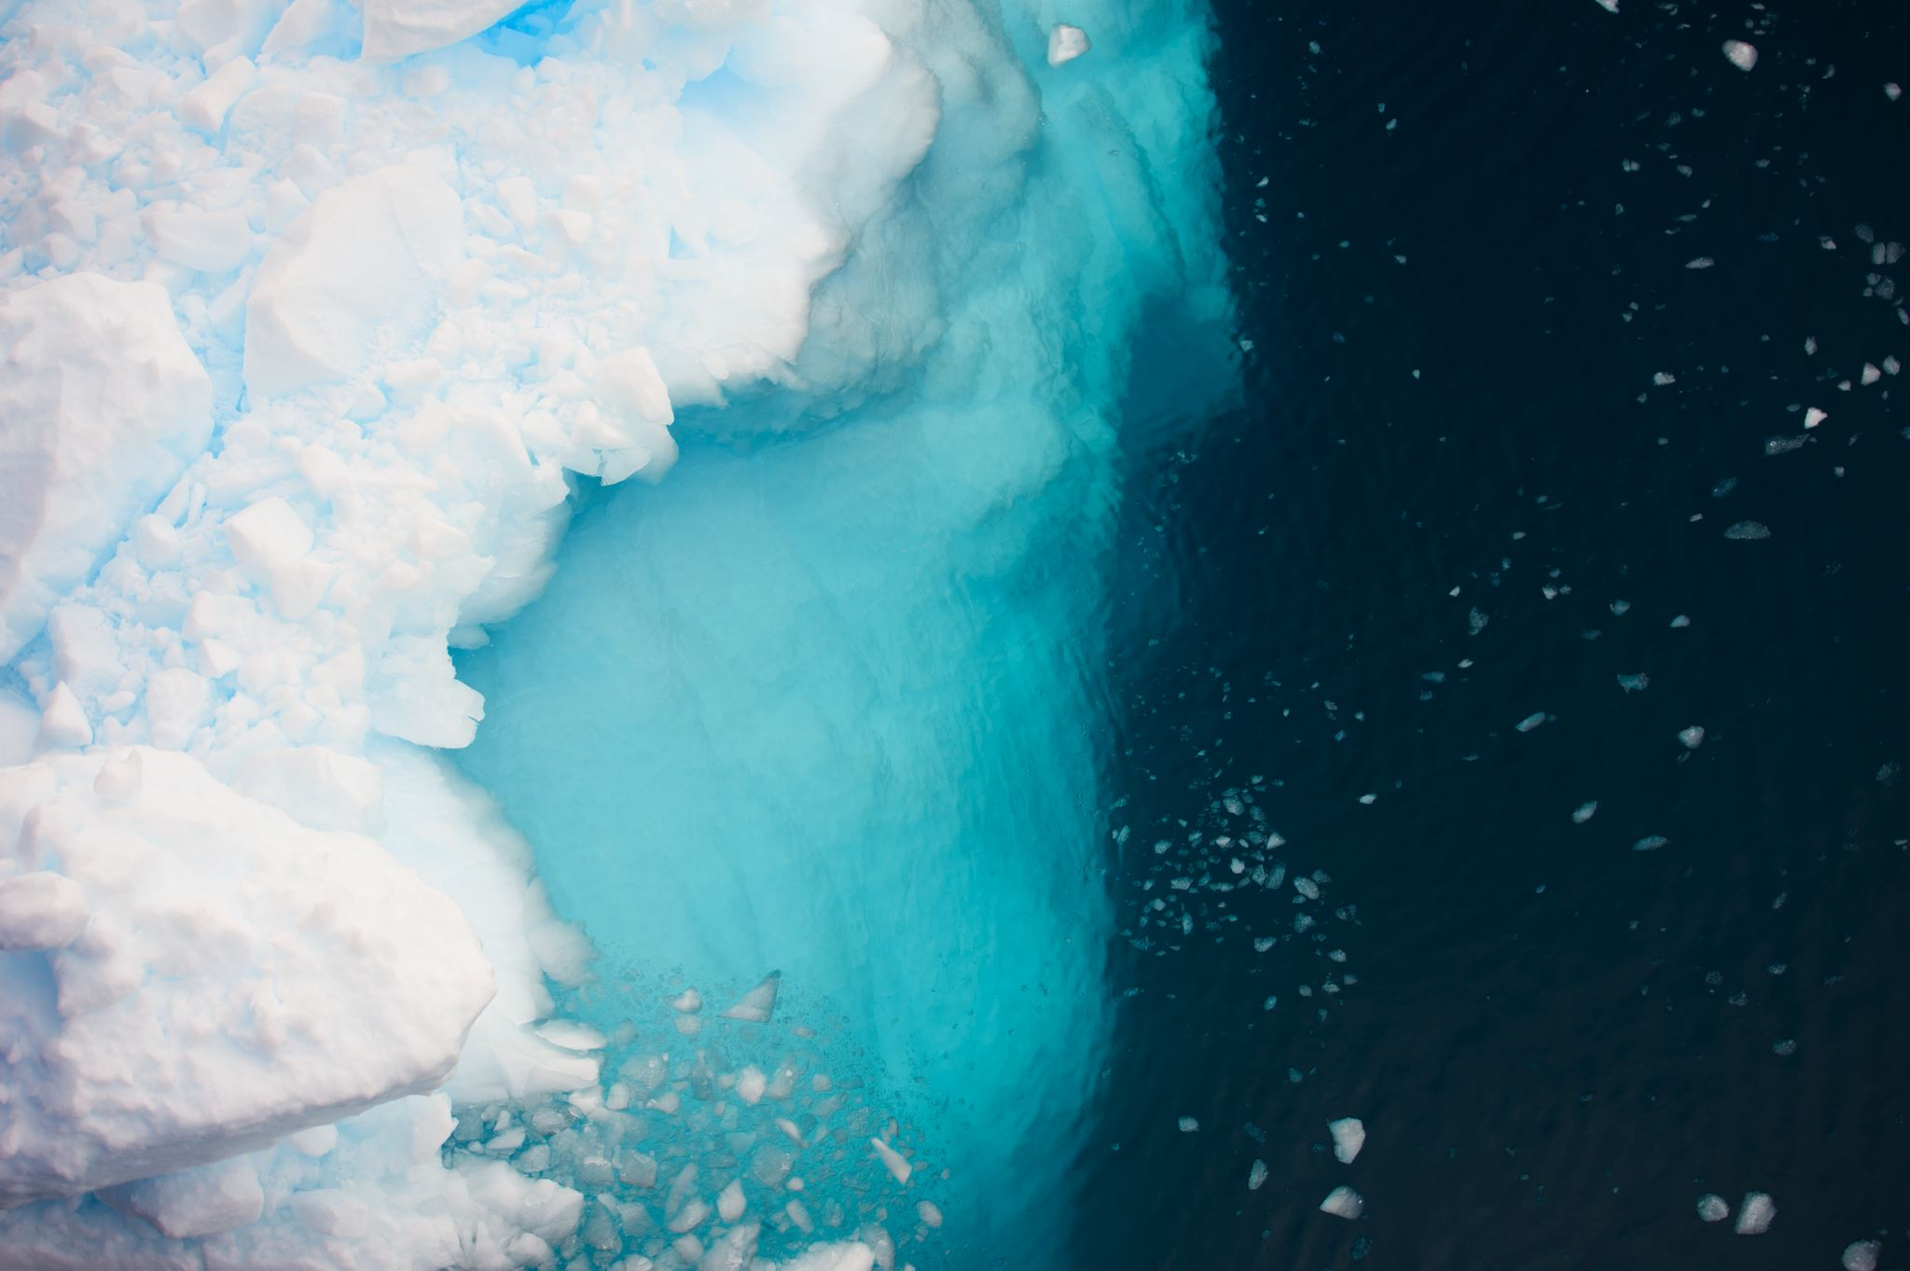



Southern Ocean CO₂ draw down and release on glacial-interglacial timescales
Maddie Shankle¹, Molly Trudgill¹, Romain Euverte², Elisabeth Michel², William Gray², James Rae¹
¹
²
Notes:
Ok thanks very much – so today (SWITCH SLIDES), I’ll be talking about …

Slide 2
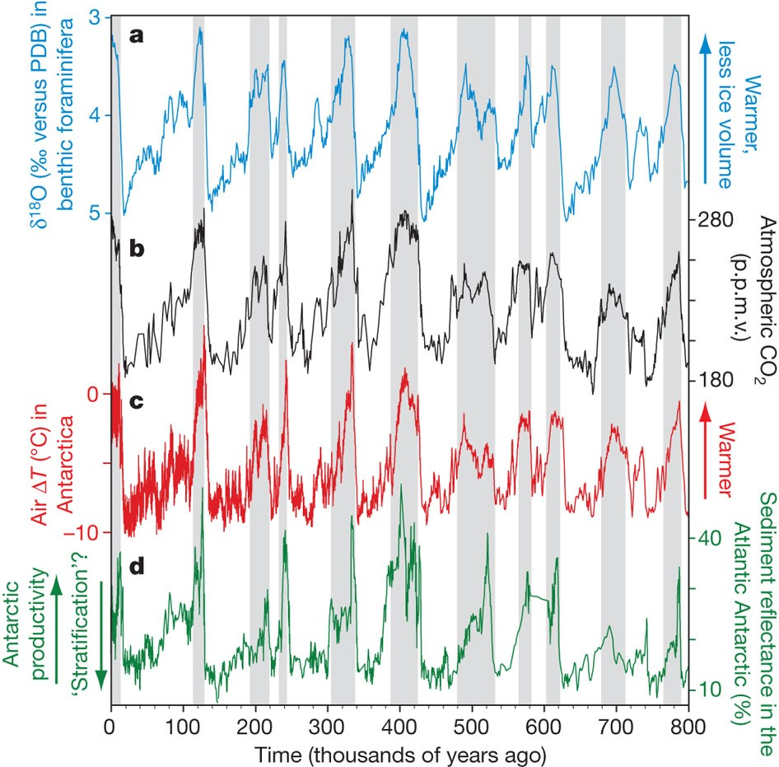


Southern Ocean key to glacial-interglacial climate change
Ice Core Records of Atmospheric CO₂ & Antarctic Temperature
Maddie Shankle @MaddieShankle
mgs23@st-andrews.ac.uk
Modified from Sigman et al., 2010
Notes:
Ok thanks very much – so today (SWITCH SLIDES), I’ll be talking about how the Southern Ocean drove glacial-interglacial CO2 changes, which is a relationship documented beautifully here by the ice core record. What we’re lacking, however, is much direct evidence of the processes that were at play to drive this relationship. So we know generally, the Southern Ocean’s control over atmospheric CO2 comes from it being a conduit (SWITCH SLIDES) for transferring carbon between the… vast reservoir that is the deep ocean and, surface waters and the atmosphere.

Slide 3
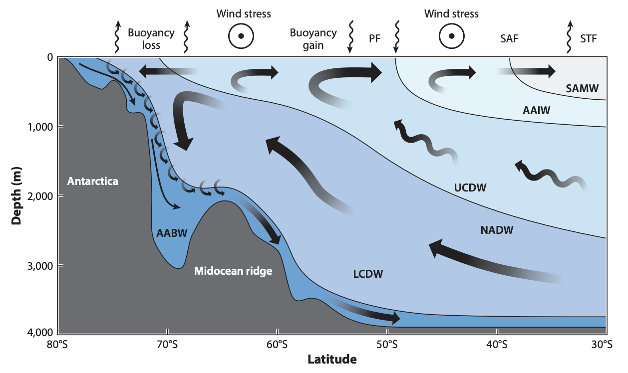
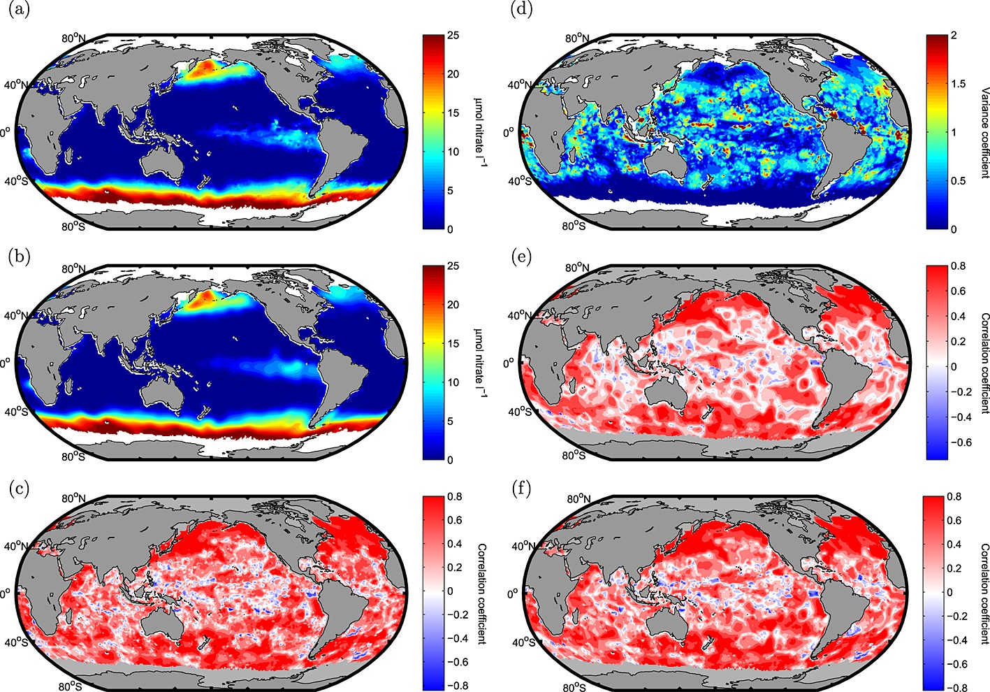
Southern Ocean and Carbon: a conduit between surface and deep
Circulation and mixing pathways connect surface and abyssal waters, bringing carbon-rich deep waters up to surface
Gent, 2016
Modern surface nitrate concentrations
Inefficient biological pump limited by trace nutrients: nutrients brought up with carbon not be fully used, resulting in carbon outgassing
Maddie Shankle @MaddieShankle
mgs23@st-andrews.ac.uk
Arteaga et al, 2015
Elevated nitrate concentrations indicate iron limitation (and light limitation)
Notes:
… for transferring carbon between the vast reservoir that is the deep ocean and, surface waters and the atmosphere. So there are two aspects to this:
First, we have this vigorous circulation in the Southern Ocean that brings deep, carbon-rich water up to the surface. And second, once that water reaches the surface, we have a very inefficient biological pump which cannot fully utilize the major nutrients brought up with the carbon, and so CO2 outgasses to the atmosphere as a result.
So for this reason, the main hypotheses for how to draw ~down atmospheric CO2 during the ice ages have focused on both of these mechanisms – essentially requiring some change to circulation or biological productivity – or both – that would have had the net result of taking this carbon out of surface waters and instead storing it more down at depth.
So, what I’m showing today are new records that excitingly directly record certain physical and biogeochemical changes occurring over the course of the Last Glacial Period.

Slide 4
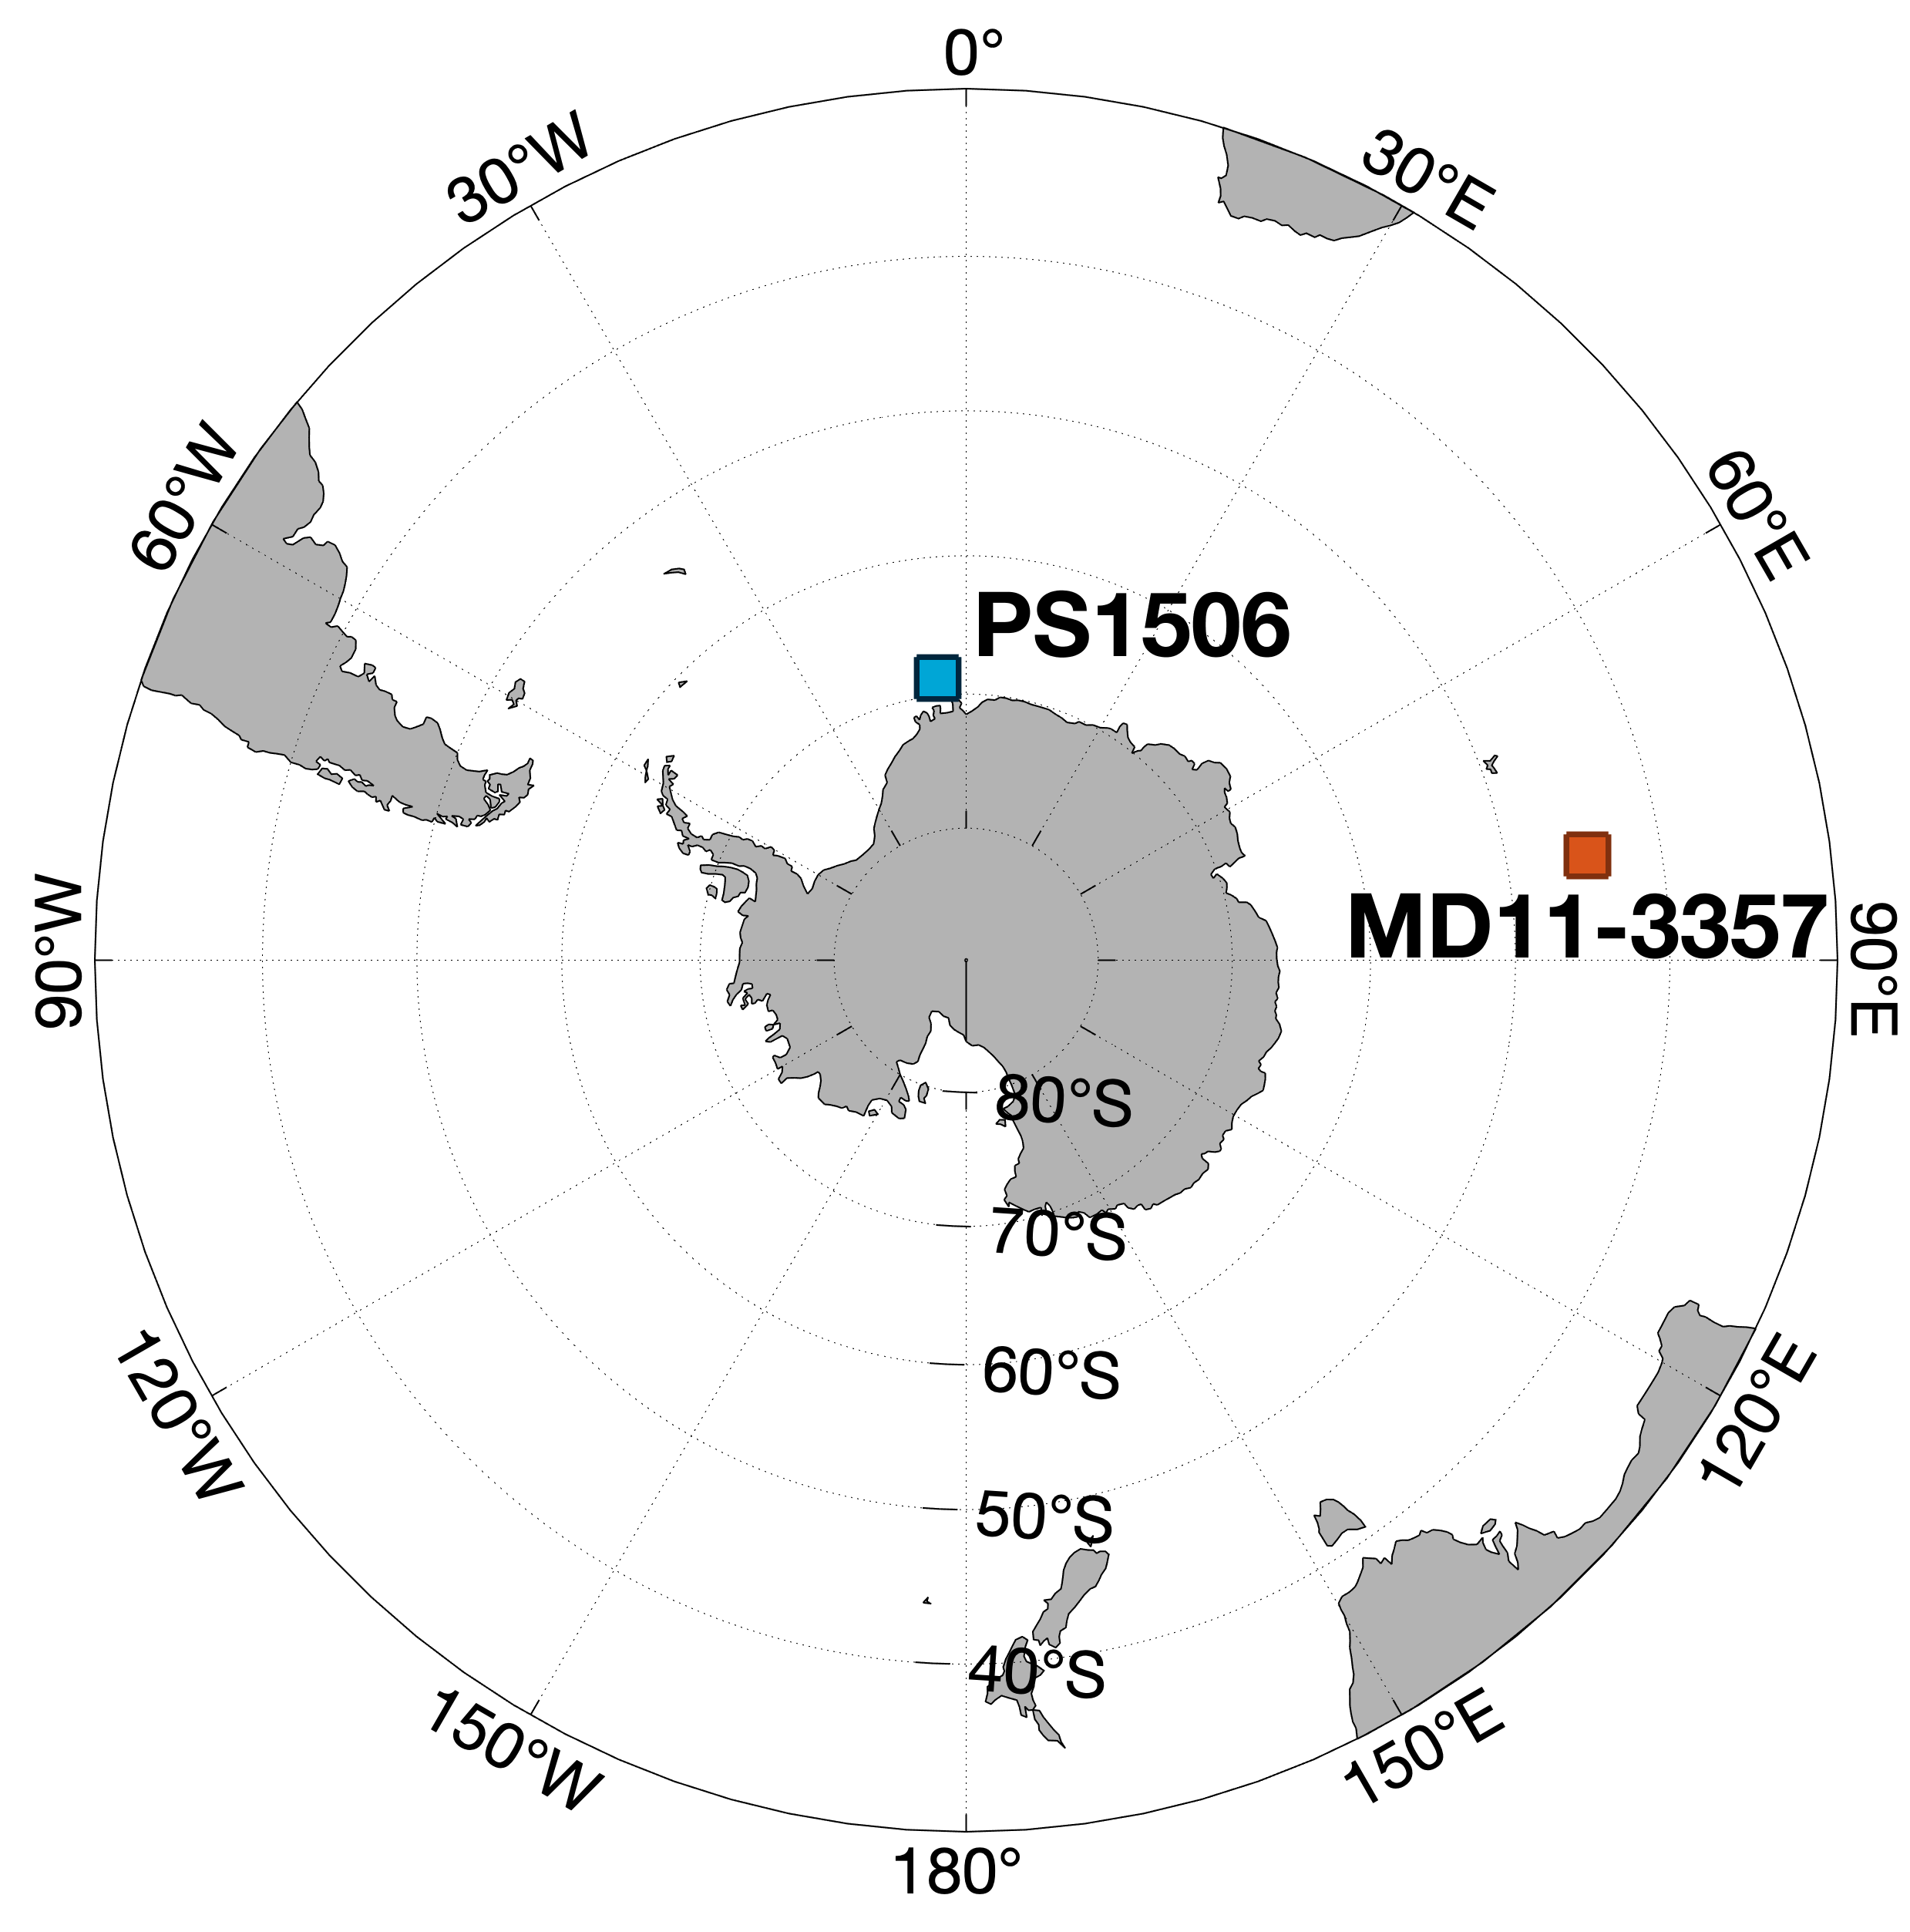
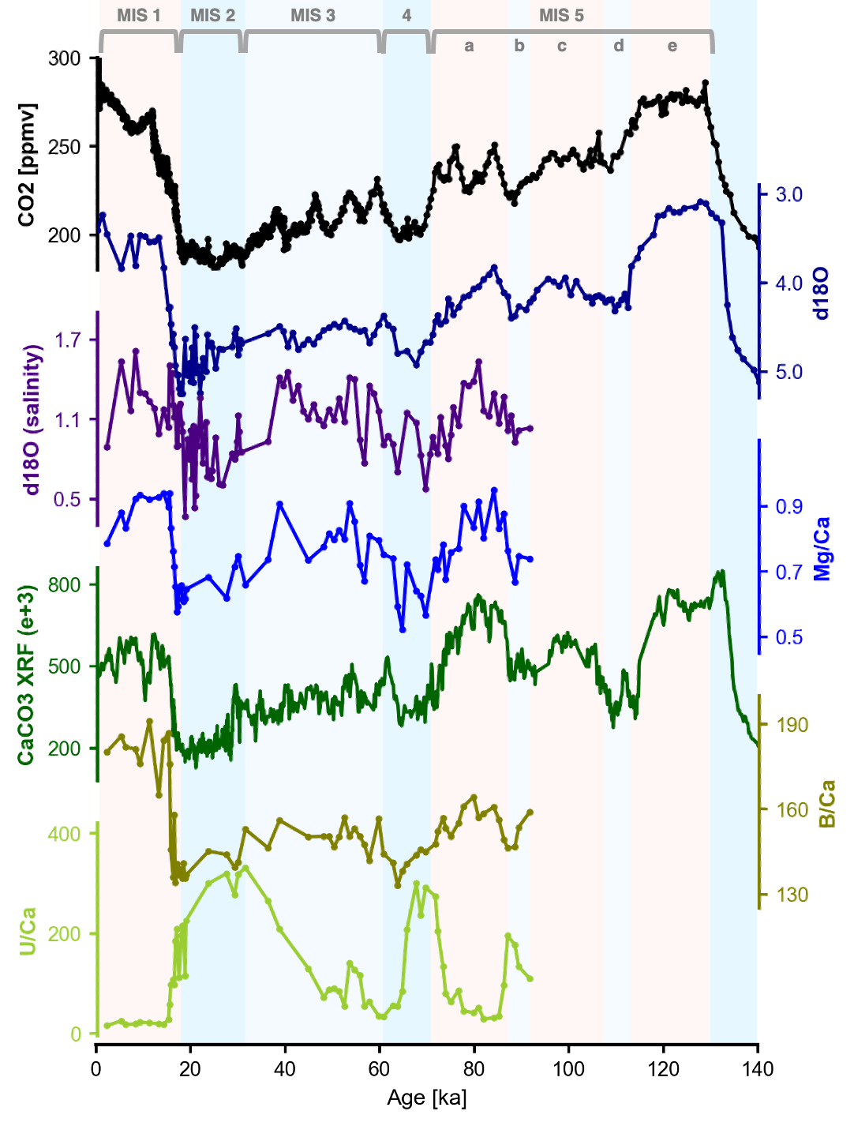
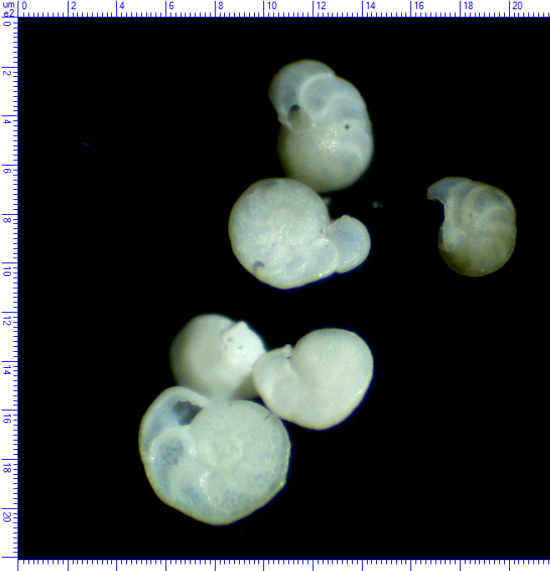
New records reflect physical, biogeochemical processes at play in deep-sea, ice age CO₂ storage
Maddie Shankle @MaddieShankle
mgs23@st-andrews.ac.uk
Cibicidoides wullerstorfi (M. Shankle)
Notes:
And these data come from a site in the Indian Ocean sector of the Southern Ocean and were measured on benthic foraminifera, so these records are reflecting changing bottom water or specifically Antarctic Bottom Water conditions at this site.

Slide 5

During periods of CO₂ decline, we record signals of…
Maddie Shankle @MaddieShankle
mgs23@st-andrews.ac.uk
[Data back to 140ka in progress]
Notes:
And interestingly, we see many of the same features of the CO2 record, recorded in these various geochemical proxies. So if we focus on dips in the CO2 specifically, which I’ve colored here in blue bars, we see firstly very excitingly…

Slide 6
During periods of CO₂ decline, we record signals of…
… accumulation of carbon in deep waters
Maddie Shankle @MaddieShankle
mgs23@st-andrews.ac.uk
[Data back to 140ka in progress]
Notes:
… evidence for that enhanced carbon content in these deep waters. So here we have the B/Ca ratio of these forams tests, and where it declines, this indicates decreasing (NEXT SLIDE) saturation state of the carbonate ion

Slide 7
During periods of CO₂ decline, we record signals of…
… accumulation of carbon in deep waters
Dips in Ca, B/Ca
= increased carbon storage
(decreased [CO₃²⁻] saturation state)
Maddie Shankle @MaddieShankle
mgs23@st-andrews.ac.uk
[Data back to 140ka in progress]
Notes:
… saturation state of the carbonate ion, or in other words more acidic conditions, and more carbon at depth. And we see this not only generally decreasing down into the LGM, but we also see dips even during smaller, shorter-lived periods of CO2 decline such as MIS4 and MIS 2.
Now to complement this, we also have the CaCO3 record showing very similar structure, likely reflecting changes in carbonate preservation at this site as a function of bottom water carbonate ion saturation … so this record also
suggests we could see similar structure in the B/Ca record, beyond where we currently have data.
But, besides this carbon storage, we also record notable changes in the physical properties of the water, (NEXT SLIDE) so if we look at the Mg/Ca and oxygen isotope records…

Slide 8
During periods of CO₂ decline, we record signals of…
… deep-water cooling
Maddie Shankle @MaddieShankle
mgs23@st-andrews.ac.uk
[Data back to 140ka in progress]
Notes:
… so if we look at the Mg/Ca and oxygen isotope records of this site, we see signals of deep-water cooling – again, decreasing from MIS5e into the LGM (NEXT SLIDE), but also with dips occurring conspicuously …

Slide 9
During periods of CO₂ decline, we record signals of…
warmer
… deep-water cooling
colder
brine
warmer
colder
Maddie Shankle @MaddieShankle
mgs23@st-andrews.ac.uk
[Data back to 140ka in progress]
Notes:
dips occurring conspicuously occurring during periods of CO2 decline such as MIS4 and MIS2 (particularly in the Mg/Ca record).
Now, if we then correct the d18O record for sea level change and temperature, as is done here (point to purple line), what remains will be the salinity signal, and these similar dips that we get during periods of low CO2 (point MIS 4, 2) we interpret to be the light-d18O signal of brine rejection.
So, we can see that there’s this general correspondence of the carbon storage (point to B/Ca, CaXRF) with bottom water temperature and salinity, suggesting the importance of physical processes, but we can also see that there’s clear evidence (NEXT SLIDE) of respired carbon storage at depth...

Slide 10
During periods of CO₂ decline, we record signals of…
… respired carbon storage at depth
Maddie Shankle @MaddieShankle
mgs23@st-andrews.ac.uk
[Data back to 140ka in progress]
Notes:
…of respired carbon storage at depth, from lowered bottom water oxygen. And this is reflected in these peaks in U/Ca (NEXT SLIDE), which reflect events of oxygen depletion…

Slide 11
During periods of CO₂ decline, we record signals of…
… respired carbon storage at depth
Anoxic/O₂ depletion
(O₂ taken up by respiration of organic matter)
Maddie Shankle @MaddieShankle
mgs23@st-andrews.ac.uk
oxic
[Data back to 140ka in progress]
Notes:
…, which reflect events of oxygen depletion, which would have come about from the respiration of organic matter sent down by the biological pump.

Slide 12
During periods of CO₂ decline, we record signals of…
… deep-water cooling
… accumulation of carbon in deep waters
… respired carbon storage at depth
Maddie Shankle @MaddieShankle
mgs23@st-andrews.ac.uk
[Data back to 140ka in progress]
Notes:
So it seems like together, these two sets of processes – both physical and biogeochemical – conspire to store CO2 in the deep Southern Ocean during the glacial period(s).
And I would also like to point out, if we zoom-in on these records, we see the ~same sense of change even on millennial time-scales (NEXT SLIDE) – so where we on the previous slide saw cooling, the influence of brine rejection, and increased carbon storage…

Slide 13
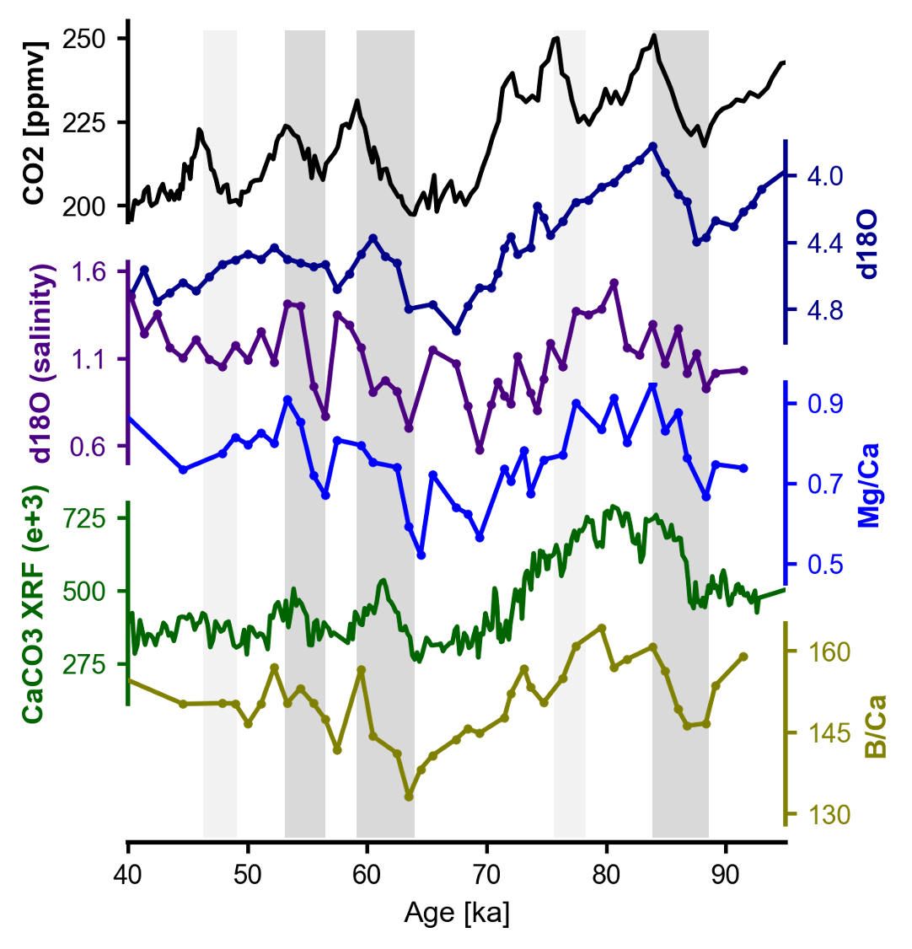
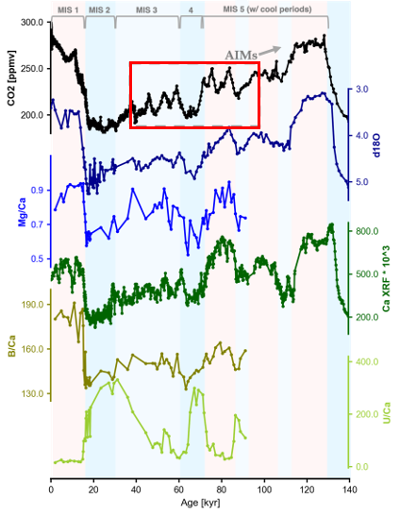
Same sense of change in millennial-scale variations
Maddie Shankle @MaddieShankle
mgs23@st-andrews.ac.uk
Notes:
so where we on the previous slide saw cooling, the influence of brine rejection, and increased carbon storage during periods of declining CO2, when we look instead at periods of rising CO2, here in the gray bars, we see the inverse – we see warming (next slide) – so increases in…

Slide 14
Same sense of change in millennial-scale variations
Maddie Shankle @MaddieShankle
mgs23@st-andrews.ac.uk
Notes:
– so increases in… both the dark and light blue lines – and also heavier, increasing signals in the “salinity” curve (next slilde)…, so less of that lightening-influence of brine rejection.

Slide 15
Same sense of change in millennial-scale variations
Maddie Shankle @MaddieShankle
mgs23@st-andrews.ac.uk
Notes:
increasing signals in the “salinity” curve (next slilde), so less of that lightening-influence of brine rejection we saw before.

Slide 16
Same sense of change in millennial-scale variations
Maddie Shankle @MaddieShankle
mgs23@st-andrews.ac.uk
Notes:
And finally instead of enhanced carbon storage at depth, we see less carbon storage (so increases in the two green curves) during these intervals of increasing CO2.
So it’s fascinating that we see the same sense of change on both orbital ~and millenial timescales. And finally, …

Slide 17
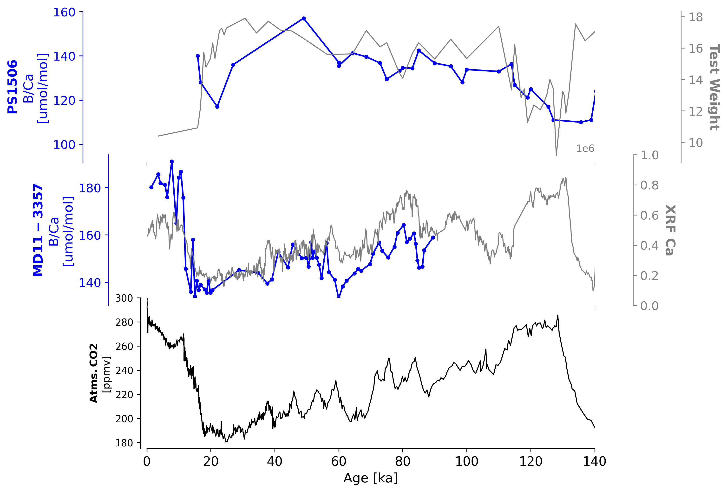
Export of carbon surface > deep at site PS1506
Maddie Shankle @MaddieShankle
mgs23@st-andrews.ac.uk
Notes:
… I’d just like to wrap up by quickly comparing this core’s record of carbon storage to that of another core, PS1506. (click click) And being..

Slide 18
Export of carbon surface > deep at site PS1506
Main site (reflecting deep water conditions)
Maddie Shankle @MaddieShankle
mgs23@st-andrews.ac.uk

Slide 19
Export of carbon surface > deep at site PS1506
Weddell Sea (deep-water formation site, feeling the surface water signal)
Main site (reflecting deep water conditions)
Maddie Shankle @MaddieShankle
mgs23@st-andrews.ac.uk
Notes:
.. And being located in the region of deep-water formation, ~this core is being bathed by those waters coming down from the surface, so it actually reflects surface conditions even despite being a benthic record.

Slide 20
Export of carbon surface > deep at site PS1506
Weddell Sea (deep-water formation site, feeling the surface water signal)
Accumulating carbon at depth
Main site (reflecting deep water conditions)
Maddie Shankle @MaddieShankle
mgs23@st-andrews.ac.uk

Slide 21
Export of carbon surface > deep at site PS1506
Weddell Sea (deep-water formation site, feeling the surface water signal)
Losing carbon at the surface
Accumulating carbon at depth
Main site (reflecting deep water conditions)
Maddie Shankle @MaddieShankle
mgs23@st-andrews.ac.uk
Notes:
So where we see decreasing B/Ca in the MD11 record, PS1506 is actually recording an increase, and a loss of carbon from these surface waters as we dip down into the LGM. So we take the divergence of these two records as further evidence of the systematic export of carbon out of surface waters, and down into deep waters, away from the atmosphere.

Slide 22
During periods of CO₂ decline, we record signals of…
… deep-water cooling
… accumulation of carbon in deep waters
… respired carbon storage at depth
Maddie Shankle @MaddieShankle
mgs23@st-andrews.ac.uk
[Data back to 140ka in progress]
Notes:
So in summary, we have evidence of both the physical and the biogeochemical conspiring together to give enhanced carbon storage at depth over the Last Glacial Period. So thanks very much, and I’d be happy to take any questions.

