Slide 1

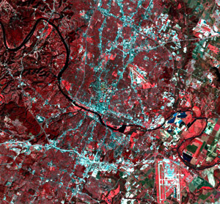



Do Landsat satellite estimates of canopy disturbance reproduce tree mortality rates observed from forest inventories across Spain?
Daniel Nadal-Sala (d.nadal@kit.edu)
Cornelius Senf, Thomas Pugh, Nadine Ruehr, Julen Astigarraga, Paloma Ruiz-Benito, Miguel A. Zabala, Adriane Esquivel-Muelbert
EGU meeting, Vienna, May 2022

Slide 2
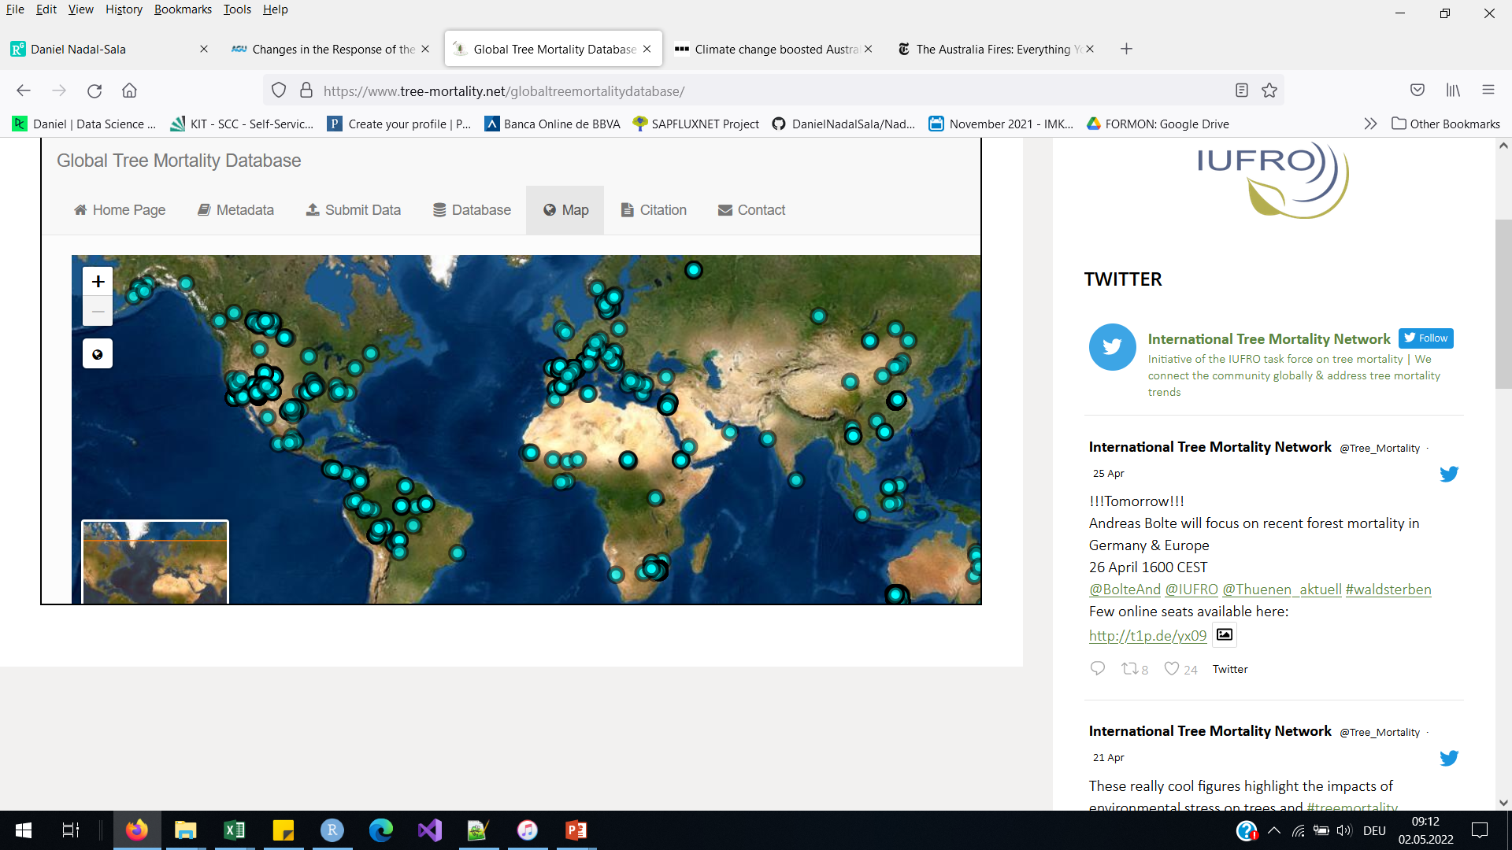
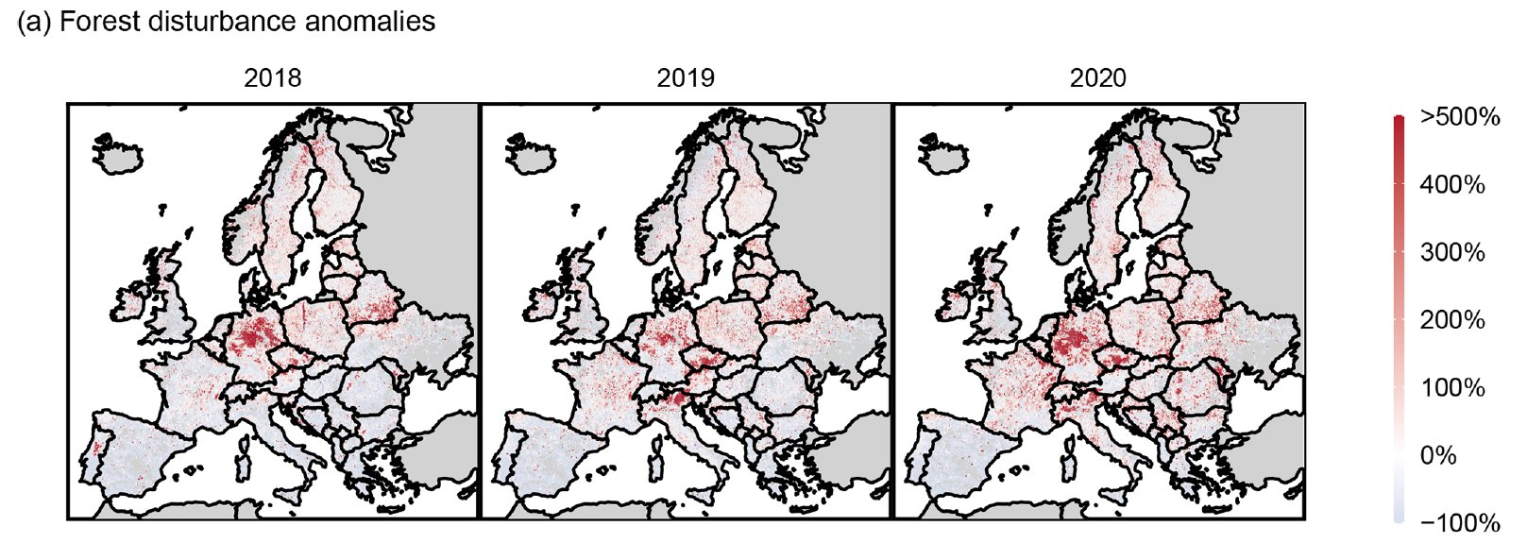
Widespread (and increasing) tree mortality
Source: International Tree Mortality Network (www.tree-mortality.net)
Senf and Seidl, 2018 (Biogeosciences)

Slide 3
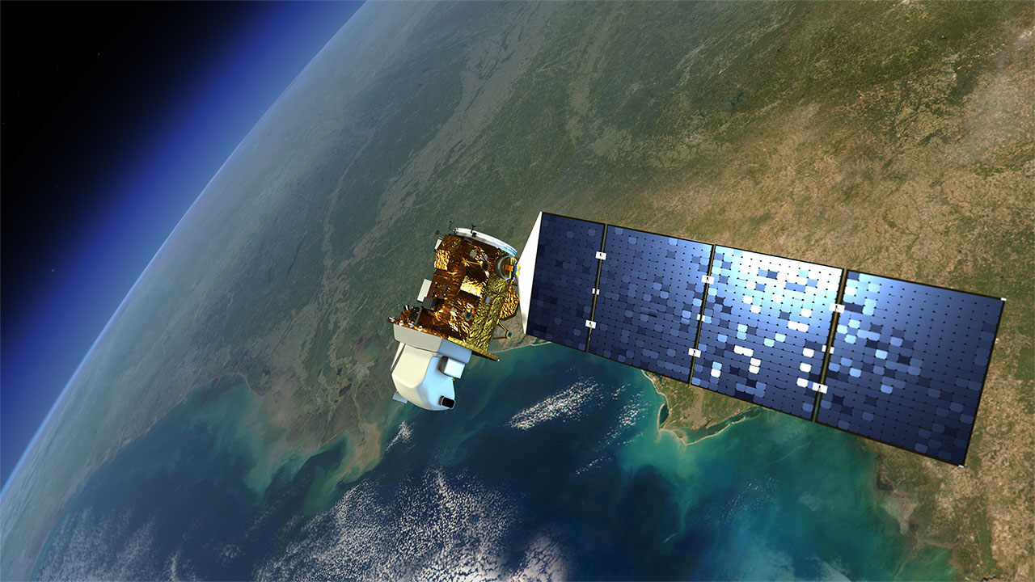
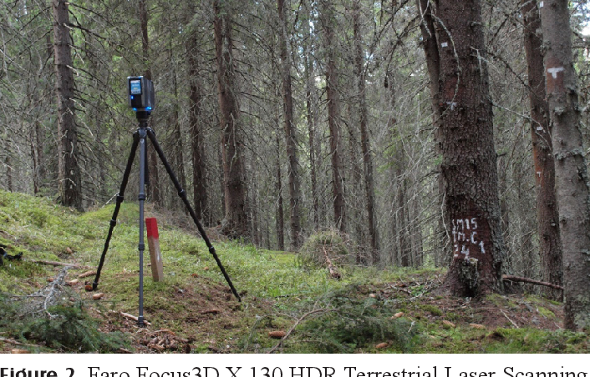
Objectives: Landsat observations validation with NFIs
Source: NASA
Source: Apostol et al., 2018 (Annals of Forest Research)

Slide 4
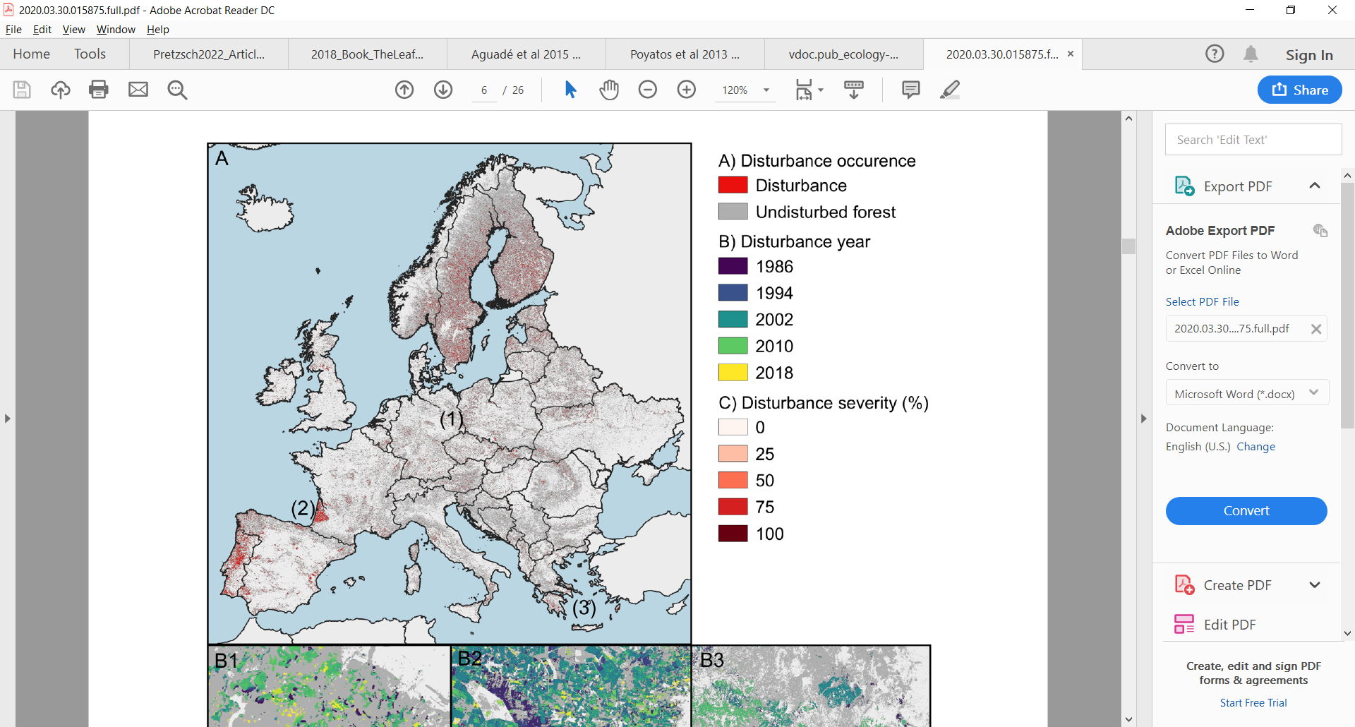
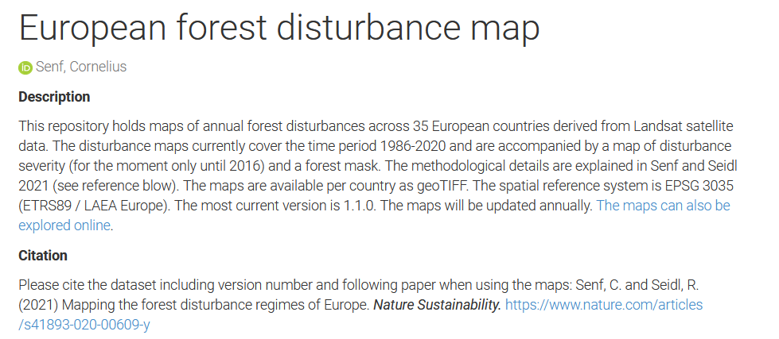
Disturbance map for European forests
Period covered: 1984-2016
Annual registers of canopy disturbance:
Calculated from Landsat satellite images
30 m resolution
Recorded as the year of last disturbance
Data available in Senf and Seidl, 2020 (Nature Sustainability) https://zenodo.org/record/4570157#.YoNqH1RBxEZ
Senf and Seidl, 2020 (Nature Sustainability)

Slide 5
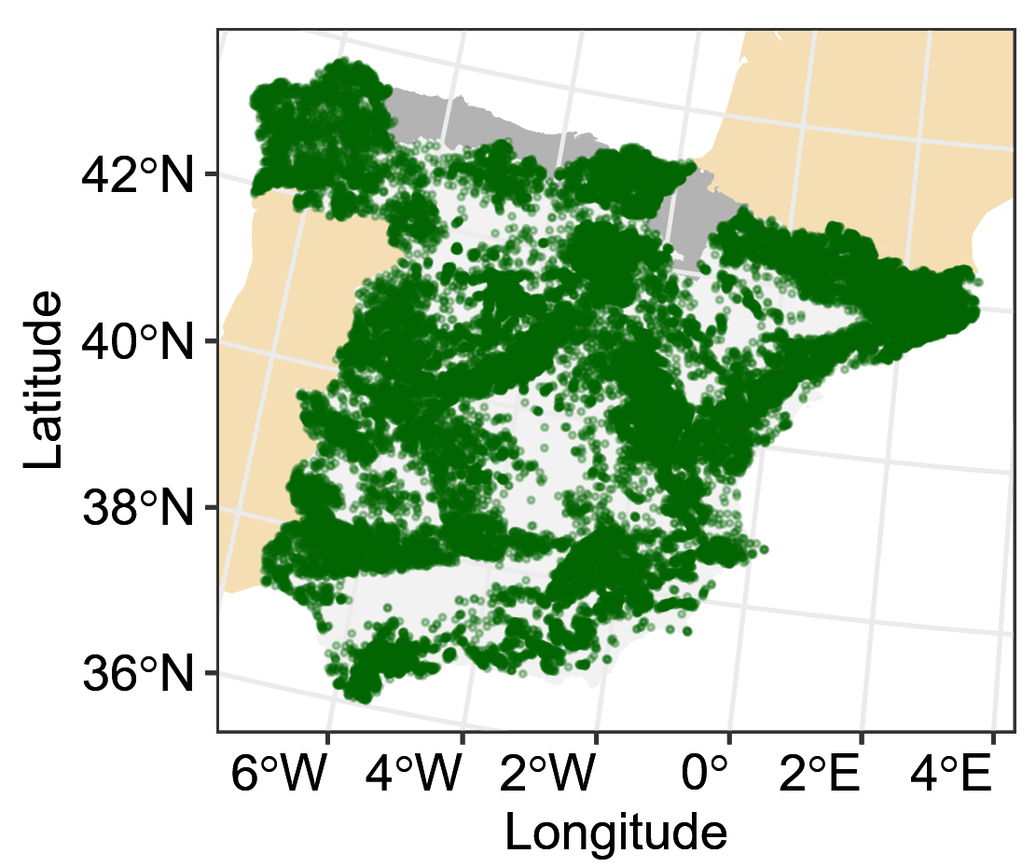


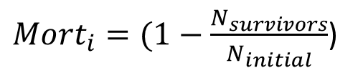
Mortality calculation from Spanish National Forest Inventories
${Mort}_{i}=(1−\frac{N_{survivors}}{N_{initial}}$)
$$p({Mort}_{i})={\left(1−{(1−Mort}_{i}\right)}^{\left(1/t\right)})$$
Kohyama et al., 2018 (Methods Ecol. Evol.)
NFI2-3 Stands
(n = 45564)
~ 10 years
Initial population
(no recruitment)
Forest National Inventory 2
Forest National Inventory 3

Slide 6
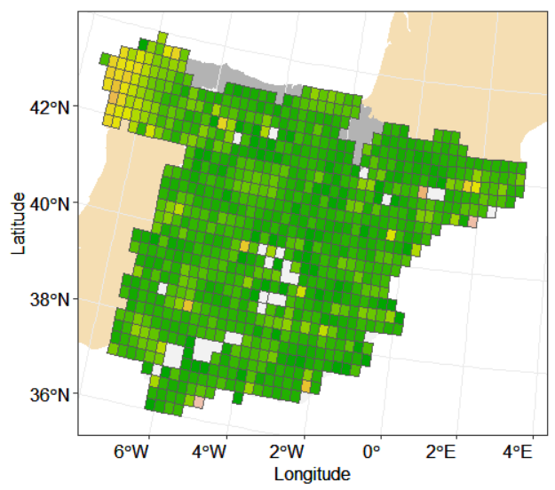
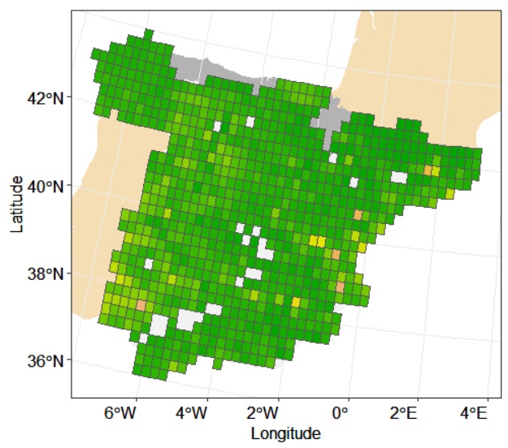
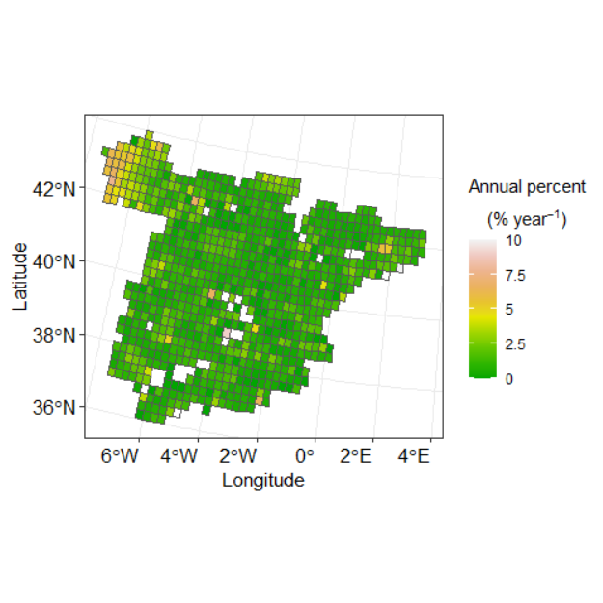
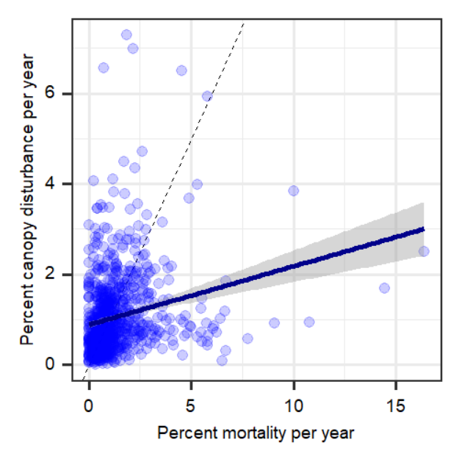
Results: Landsat vs NFI (0.25° x 0.25°)
Annual mortality from NFI 2-3
Canopy disturbance from Landsat
p < 0.01
r = 0.22
Underestimation by canopy disturbance

Slide 7
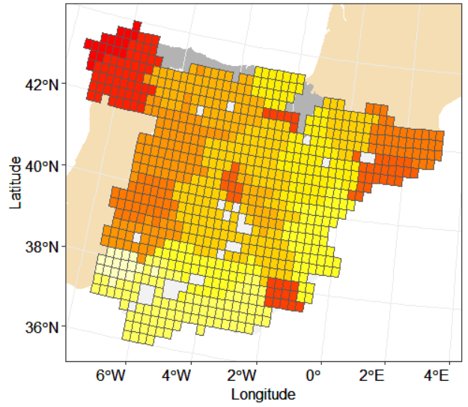
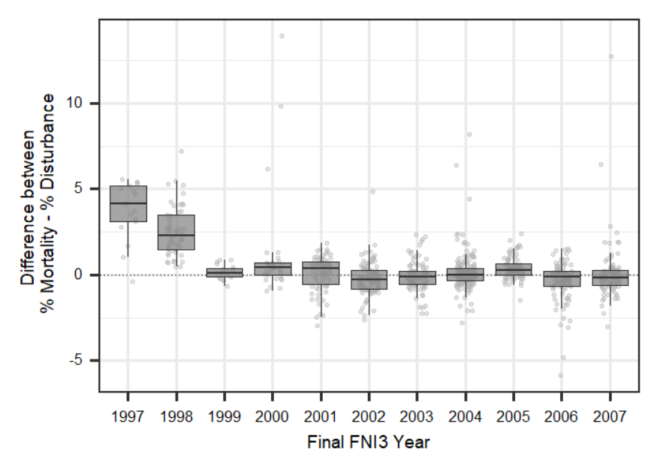
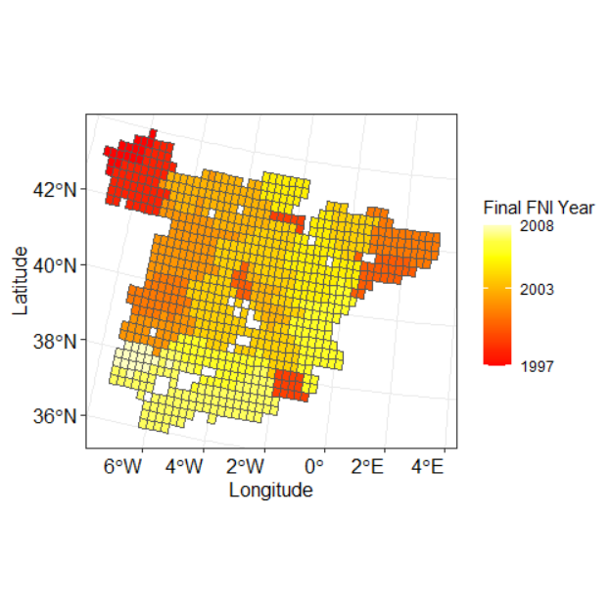
Temporal bias in in the Landsat data before 1999
FNI mortality – Landsat disturbance
Landsat underestimates
Landsat overestimates
Landsat 7 satellite launched at 1999

Slide 8
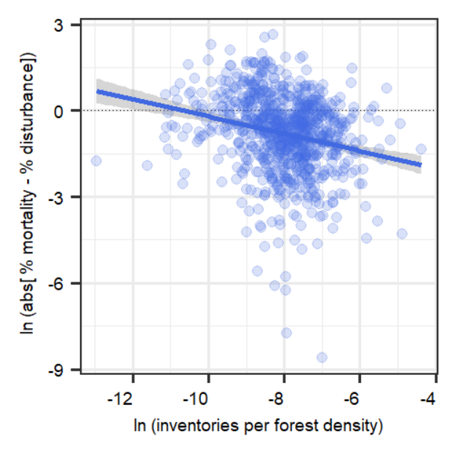
Density of the NFI’s matters!
+ inventories per forested area per pixel
=
- Difference from satellite observations
Absolute difference
Representativity NFI

Slide 9
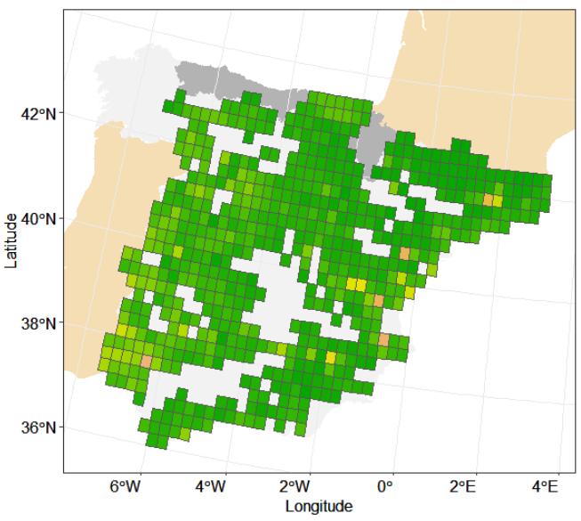
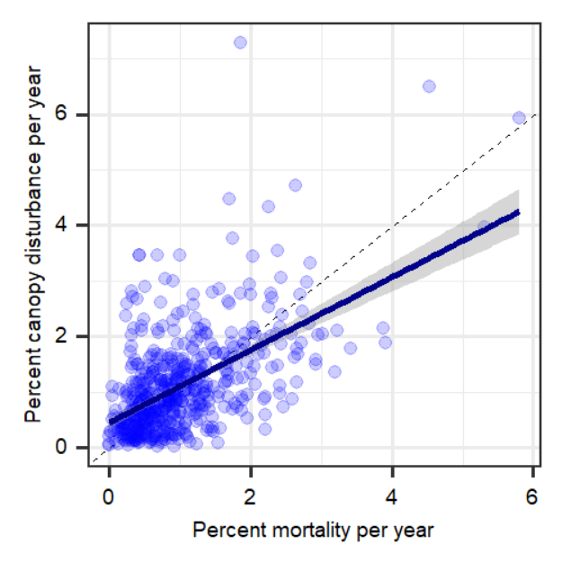
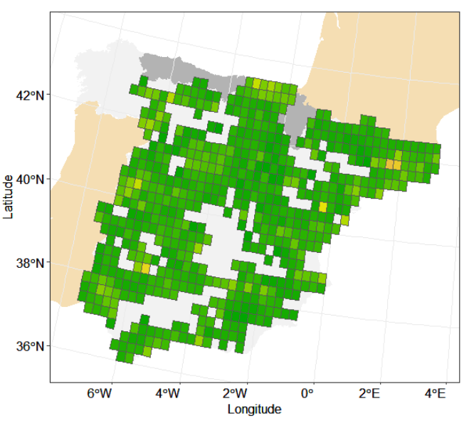
Tree mortality vs Landsat canopy disturbance rates
Landsat
Correlation between Landsat and FNI after controlling by NFI density and finishing year
p < 0.01
r = 0.55
NFI tree mort.

Slide 10
Conclusions and lessons learned
Good correlation with NFI’s mortality, with some uncertainties
Sources of uncertainty:
Changes in satellite calibrations (Landsat)
Low density of NFI’s per pixel (NFI)
These results open the door to implement the analysis at broader regional level.

Slide 11

Thank you for your attention
Gràcies per la seva atenció
Gracias por su atención

