Slide 1
Surface water quality under the Sustainable Development Agenda
Edward R. Jones¹, Marc F.P Bierkens^{1,2}, Niko Wanders¹, Edwin Sutanudjaja¹, Ludovicus P.H van Beek¹, Michelle T.H. van Vliet¹
¹Department of Physical Geography, Faculty of Geosciences, Utrecht University, NL
²Deltares, Unit Soil and Groundwater Systems, Utrecht, NL
Edward Jones
email: e.r.jones@uu.nl

Slide 2
Water quality and the SDGs
Humans depend on adequate water quality, yet are also responsible for degradation.
Observational water quality data lacking at the global scale (Damania et al., 2019)
Competition for (increasingly) scarce and polluted water resources is increasing water scarcity across the global (van Vliet et al., 2021), prohibiting achievement of SDG 6.
SDG 6.3 targets halving the proportion of untreated wastewater entering the environment by 2030.

Slide 3
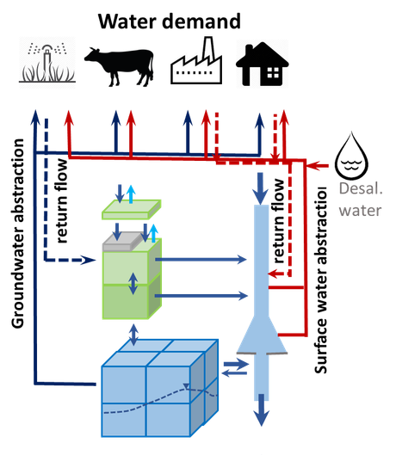
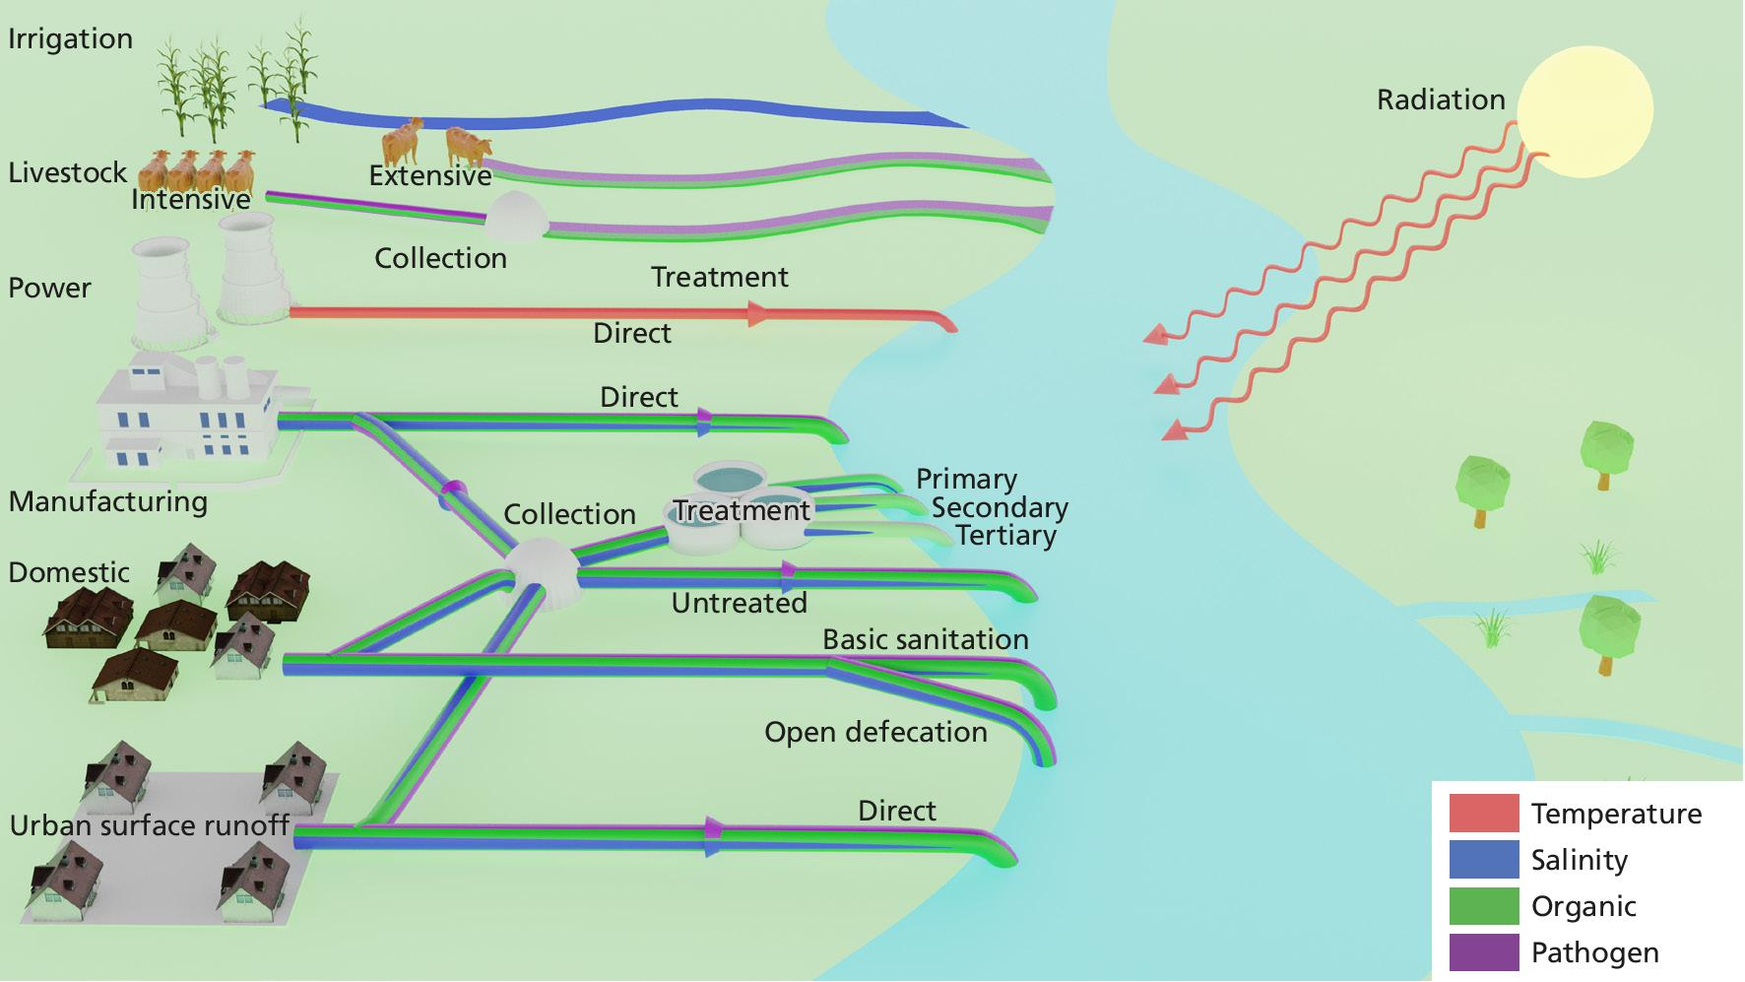
Global water quality modelling (DynQual)
PCR-GLOBWB2: a global hydrological model (5 arc-min; daily)
Approach: 1) quantify pollutant loadings; 2) route loadings through the stream network, accounting for in-stream decay processes; 3) compute in-stream concentrations.
Sutanudjaja et al., (2018)
Jones et al., (2021)

Slide 4
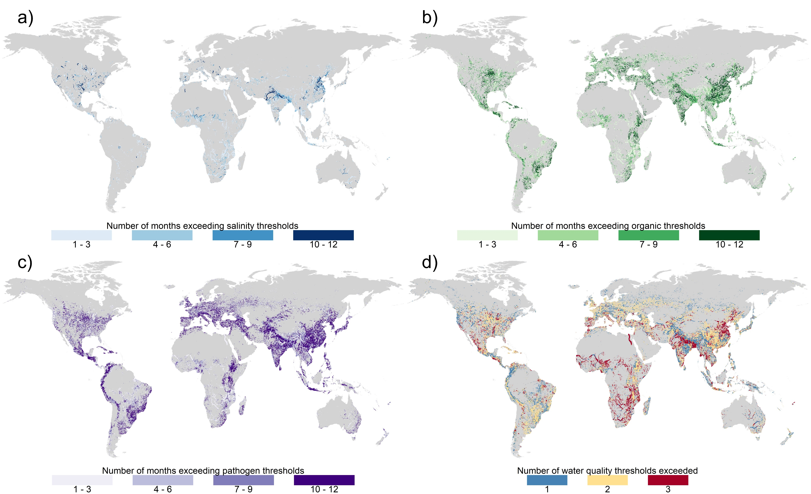

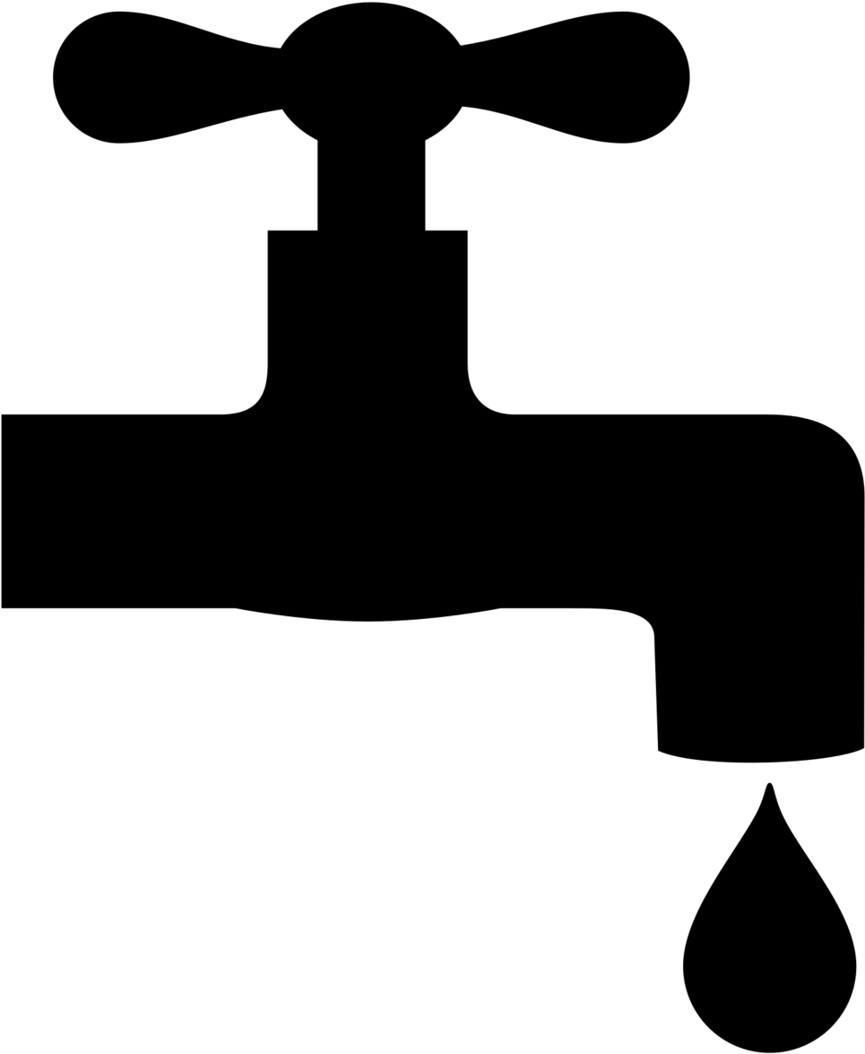
Exceedance of water quality thresholds
TDS: >2,100 mg l⁻¹
BOD: >8 mg l⁻¹
FC: >1,000 cfu 100ml⁻¹
Jones et al., in review

Slide 5
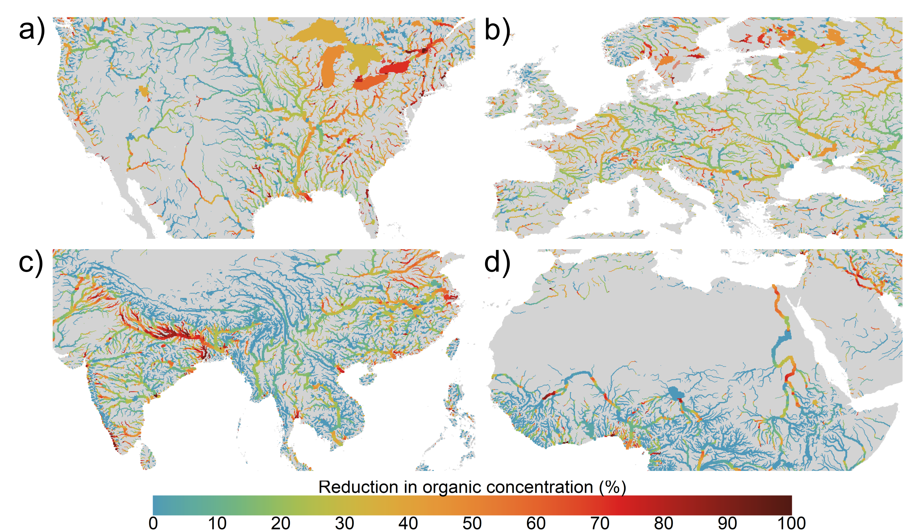
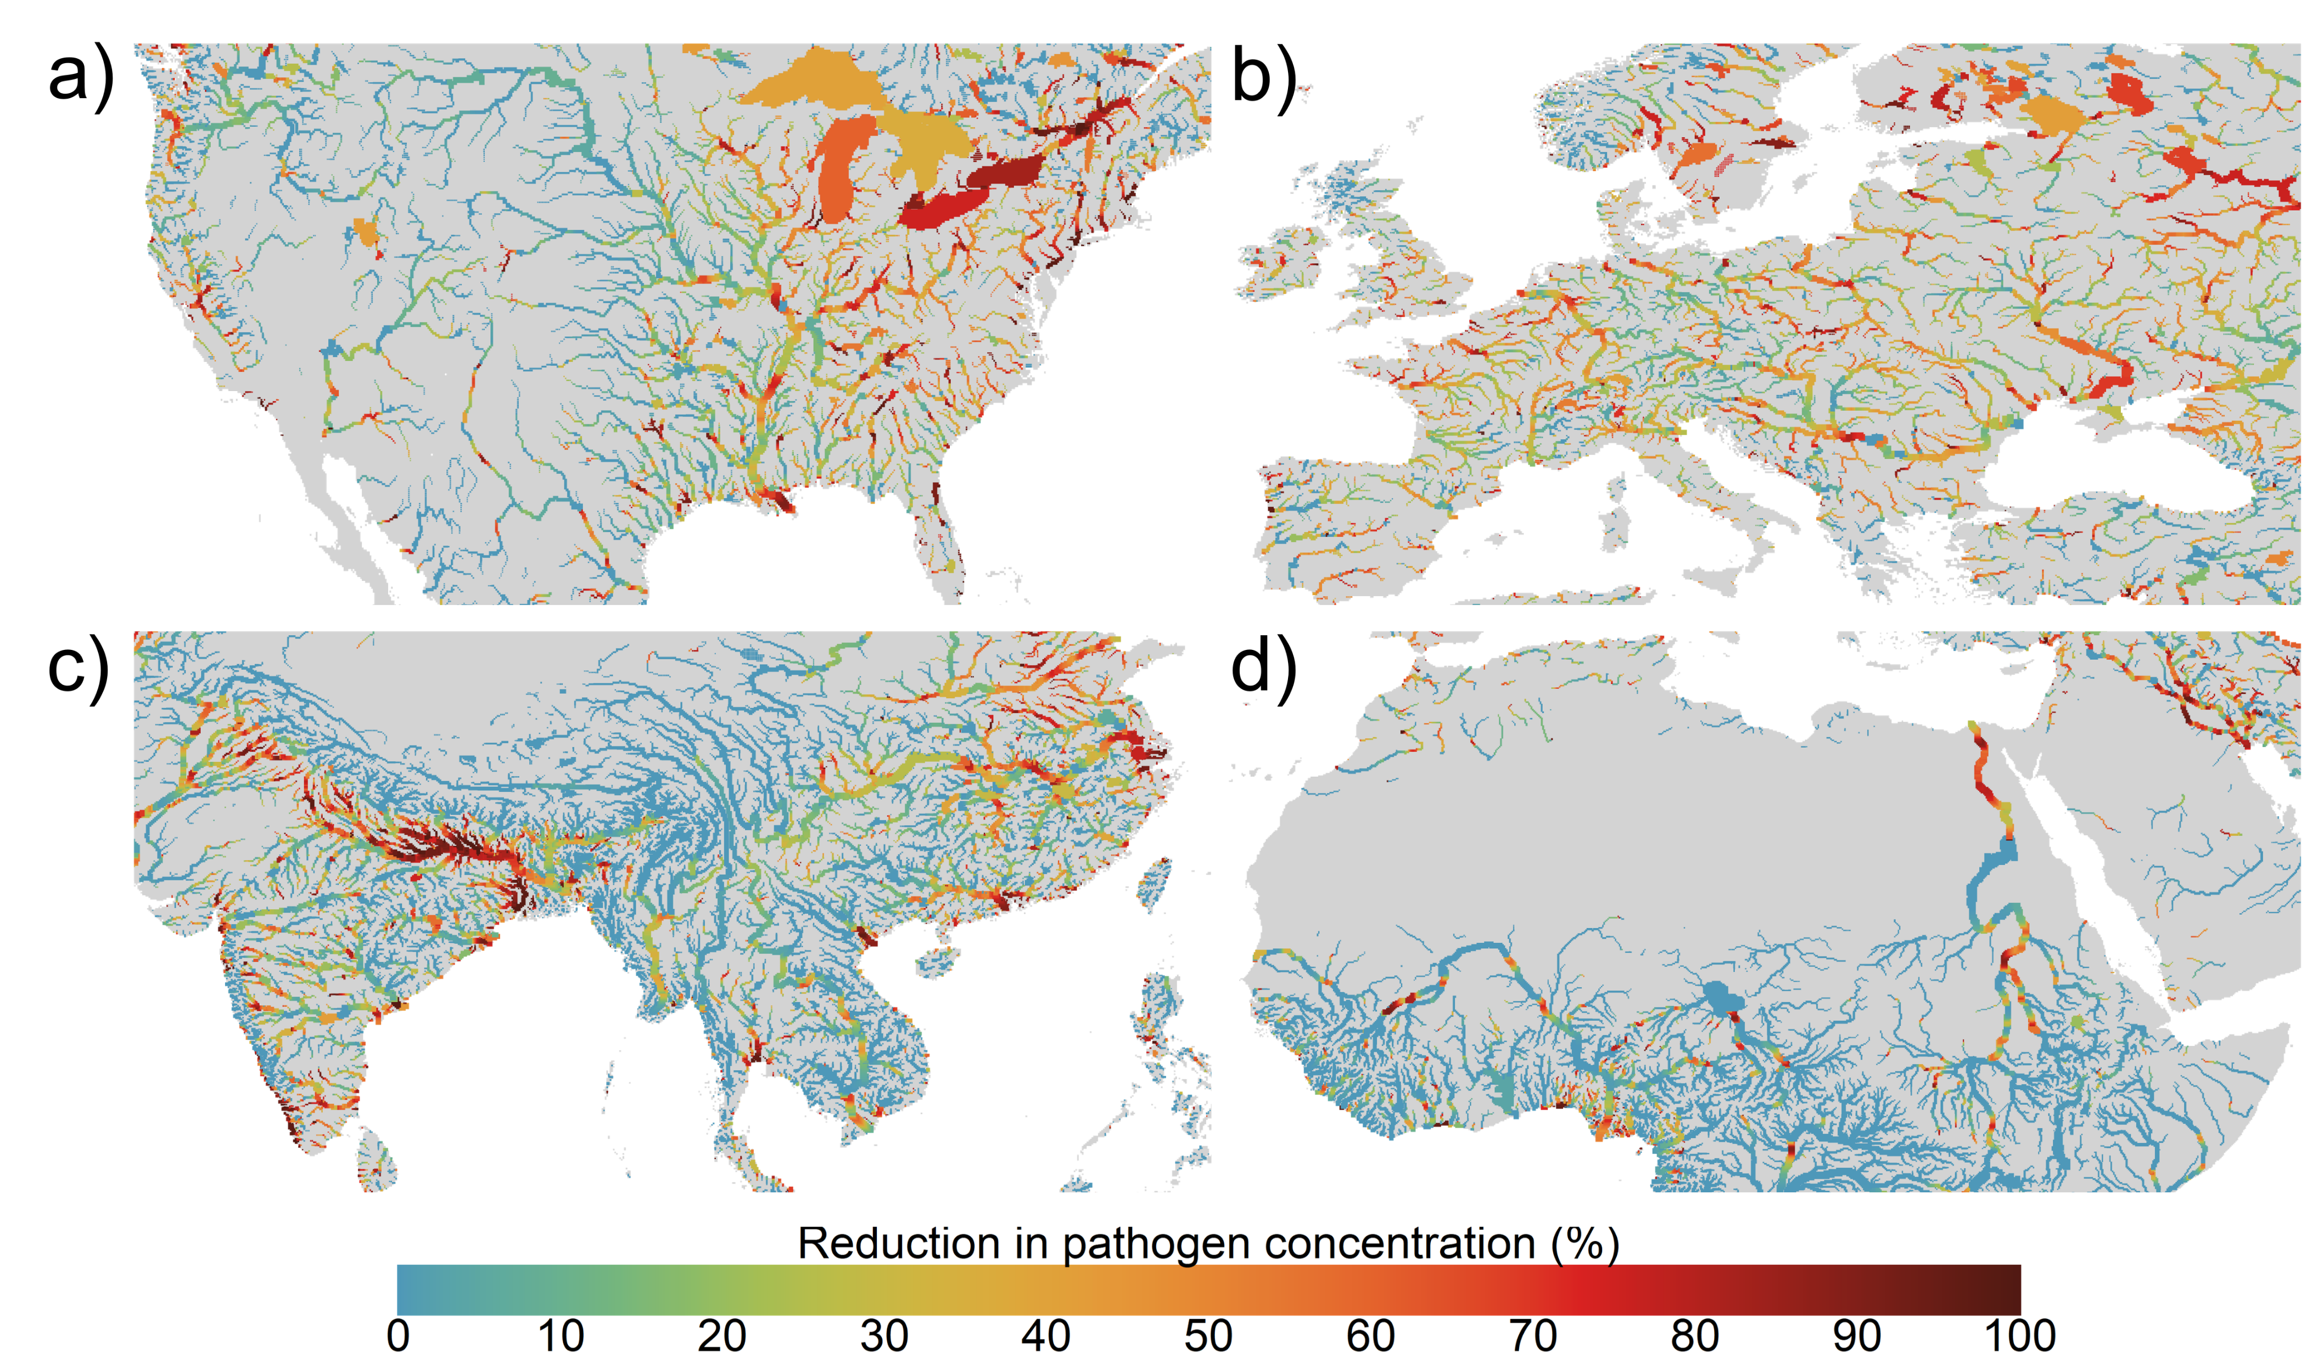
Halving the proportion of untreated wastewater (SDG 6.3)
Jones et al., in review

Slide 6
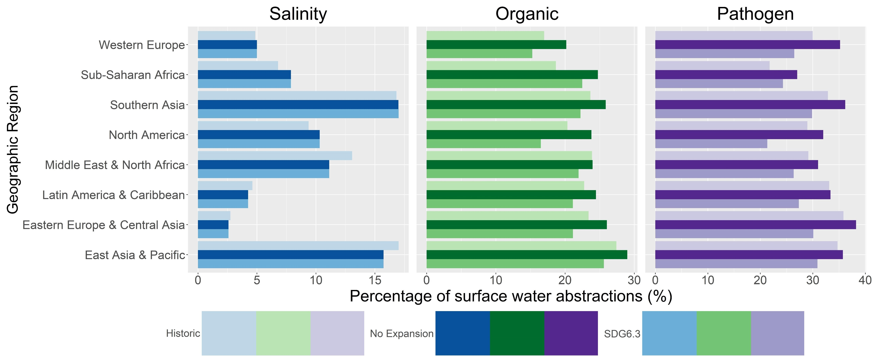
Halving the proportion of untreated wastewater (SDG6.3)
Jones et al., in review

Slide 7


Key messages & outlook
Water quality modelling (DynQual) to ‘fill-the-gaps’ in observational data record.
Exceedances of water quality thresholds across all world regions, albeit with different frequencies and magnitudes.
SDG 6.3 substantially improves water quality worldwide.
Yet, improvements are still insufficient in many world regions for safe human use and protecting aquatic ecosystem health.
Future work:
Water quality under (uncertain) climate and socio-economic change.
Water scarcity alleviation through water quality improvements.
References
Sutanudjaja, E. et al. (2018) PCR-GLOBWB 2: A 5 arcmin global hydrological and water resources model, Geoscientific Model Development, 11, 2429-2453
van Vliet, M. T. H. et al. (2021) Global water scarcity including surface water quality and expansions of clean water technologies, Environmental Research Letters, 16, 024020
Jones, E. R., et al. (2021) Country-level and gridded estimates of wastewater production, collection, treatment and reuse, Earth Syst. Sci. Data, 13, 237-254.
Edward Jones
email: e.r.jones@uu.nl
Questions..?

